Slide 1



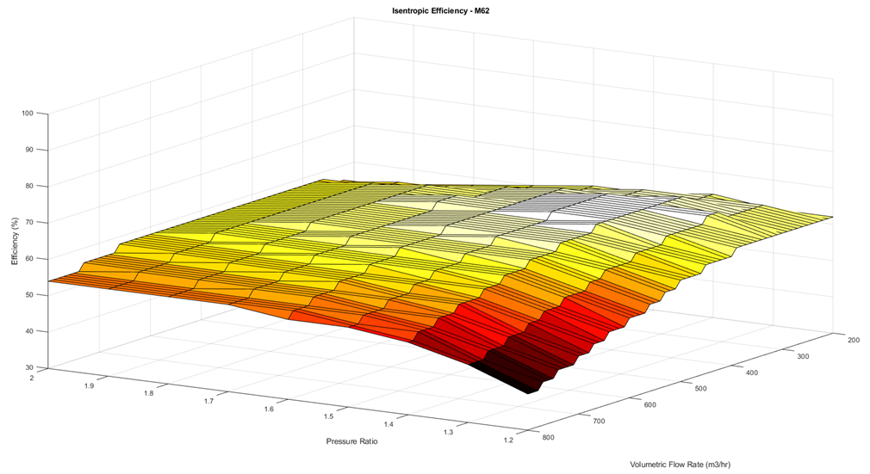
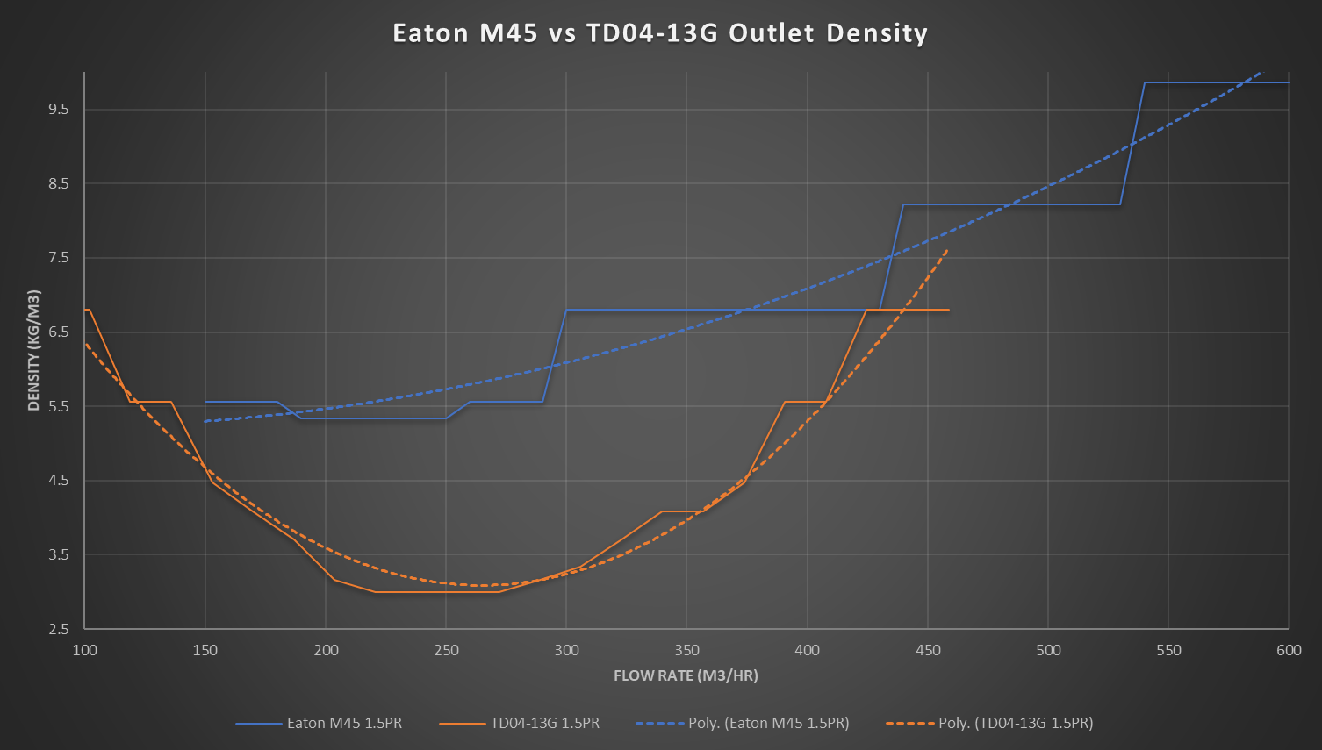
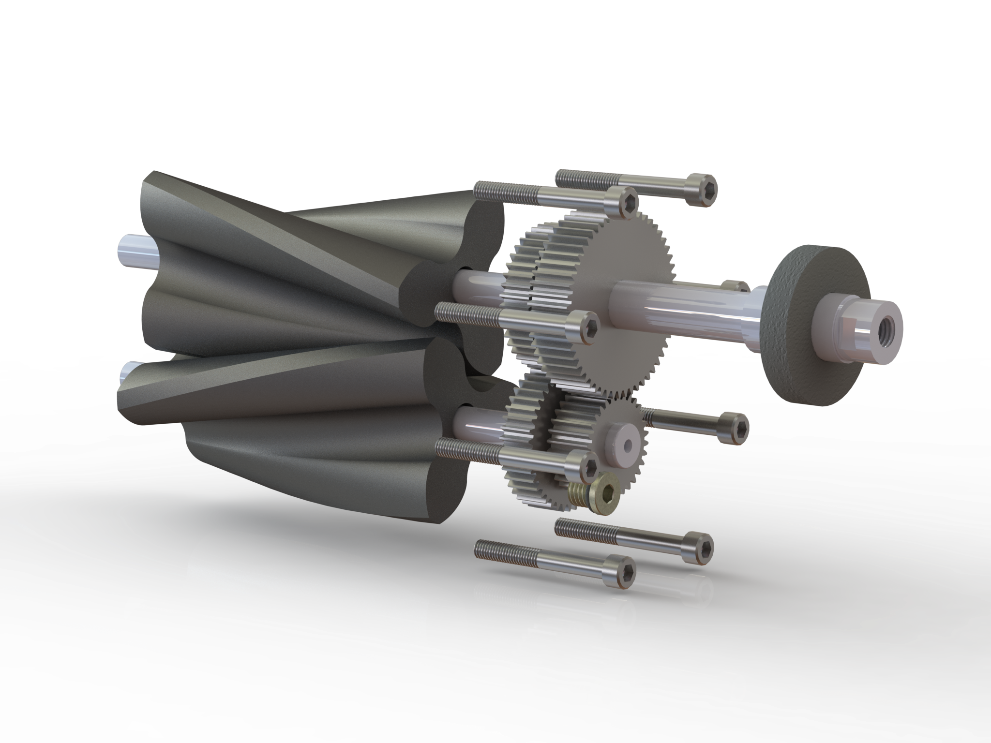
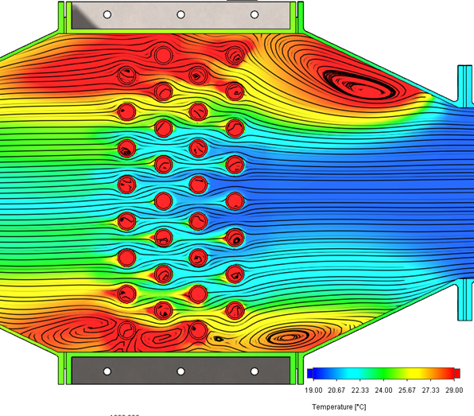
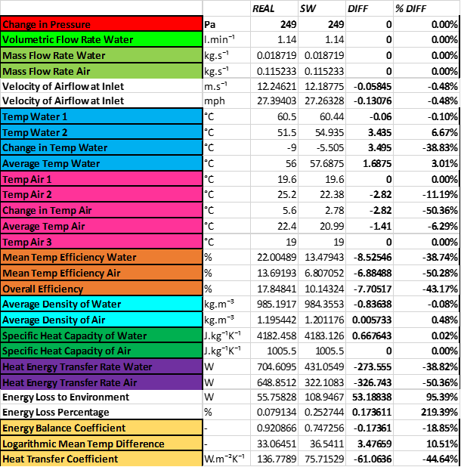
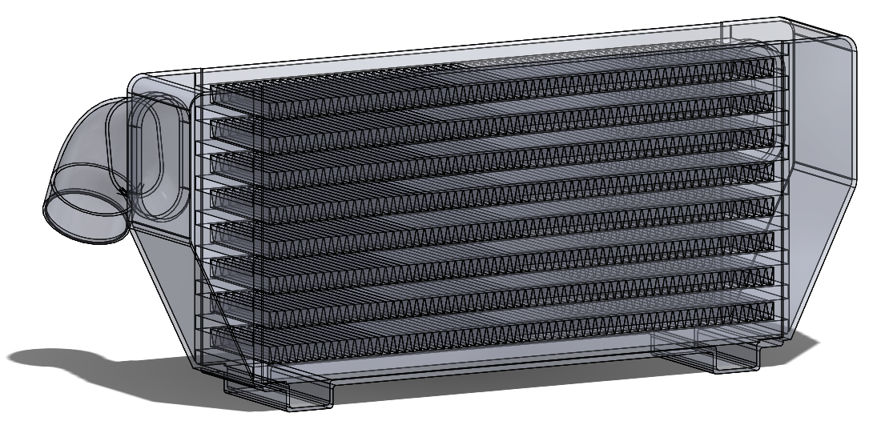
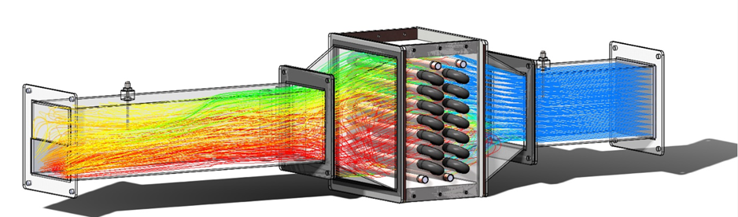



Thermodynamic Analysis of the Modern Positive Displacement Supercharger and
Associated Charge-Air-Cooling Systems in Automotive Applications using
Computer-Aided Methods
Owen Lyndon Lord – BEng Motorcycle Engineering
Malcolm McDonald/Owen Williams
School of Engineering
Introduction
This project conducted a brief investigation into forced induction techniques, comprised of two distinct parts:
The thermodynamic analysis of traditional, “Roots”, positive displacement style supercharging in comparison to the, currently popular, turbo-supercharging method of forced induction using the Ideal Gas Law relationships.
And the development of a validated experimental method to carry out thermodynamic analysis on heat exchanger systems associated with automotive forced induction using Solidworks Flow Simulation and a real-world heat exchanger experiment.
Figure 1:Example of Isentropic Compressor Efficiency vs Volumetric Flow Rate for Roots-style superchargers at Pressure Ratios ranging from 1.2-2.0Π
Results
Supercharger Trends and Results:
Figure 1 displays clearly the phenomena of “efficiency islands” seen during analysis of supercharging devices, the lighter the colour the greater the efficiency of compression, meaning the white area is a “sweet-spot” of operation to gain the best performance from the system.
As can be seen in Figure 2, a key trend observed was the difference in air density seen at the outlet between the “Roots” and “Turbo” systems due to the increase in temperature seen during compressive work.
Heat Exchanger Trends and Results:
One key trend observed of boundary layer separation driving increased heat exchanger outlet temperature through eddy propagation reducing flow velocity through the exchanger element allowing greater time of heat transfer. As can be observed in Figure 3.
Another was the drastic effect humidity has on the uptake of heat energy into the air during forced convective heat transfer. The reason for the disparity in values between the Real-world and SolidWorks results, seen in Table 1.
Methodology
Supercharger Analysis:
Interpret and Analyse performance maps of Compressor Efficiency and Flow Rate against Pressure Ratio.
Collate the data and create a usable spreadsheet database.
From the database carryout a series of calculations based on the Ideal Gas Law among other common thermodynamic relationships.
Compare and contrast trends seen in both Roots-style and Turbo-style supercharging techniques.
Heat Exchanger Analysis:
Set up and run a real-world heat exchanger experiment to collect data for use in validation.
Draft CAD models to be used in CFD based thermal analysis.
Construct a CFD model using CAD geometry applying input and atmospheric data from the real-world experiment.
Calculate, solve and analyse the CFD model to validate with results seen in the real-world experiment.
Figure 2: Example of Outlet “Density Losses” against Volumetric Flow Rate comparing a Roots-style supercharger (Blue) and Turbo-supercharger (orange) at a Pressure Ratio of 1.5Π
Table 1: Example of the results and calculations seen during the corroboration of the real-world heat exchanger experiment and the CFD model developed in SolidWorks Flow Simulation.
Figure 3: Temperature Colour Plot displaying the combination Convective/Conductive Heat Transfer CFD methodology developed using Solidworks Flow Simulation to mimic the real-world experiment.
Figure 4:Flow trajectories coloured by temperature seen through the CFD model of the TD1007 Heat Exchanger Experiment at a flow velocity of 3.9ms⁻¹
References
Hiereth, H. & Prenninger, P., 2003. Charging the Internal Combustion Engine. Vienna: Springer-Verlag.
McDonald, M., 2019. Discussions on Thermodynamics of Real-World Compressive Work [Interview] (1-31 October 2019).
Heisler, H., 1995. Advanced Engine Technology. 1st ed. London: Elsevier Ltd..
School of Engineering

