Slide 1
Human Factors in High Hazard Environments
Level 4
ACDA 4020
Factors Affecting Performance in the Working Environment

Slide 2
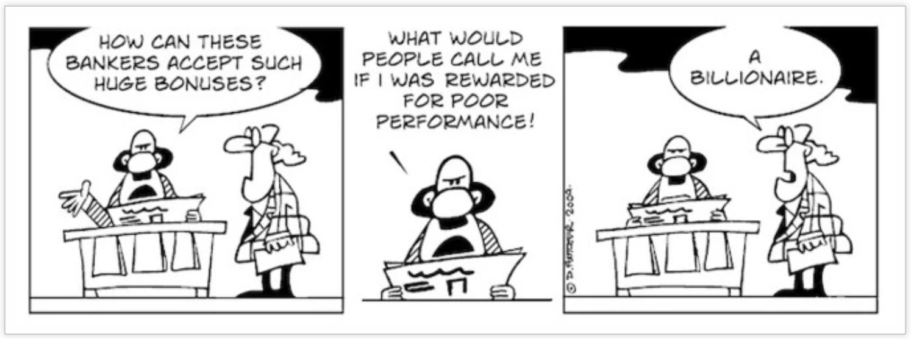
This presentation discusses factors that affect performance including
fitness, health, stress, time pressures, workload, fatigue, medication,
alcohol and drugs

Slide 3
Fitness and Health
Pre-employment disposition.
  Medical examination (may also be pension and insurance related)
  Freedom of movement, impaired vision etc
  Offer or alternative employment within the industry
Day-to-day wellbeing
  Illness (physical or mental)
  Injury
  Where does RESPONSIBILITY fall in OME if you do not declare a disposition (the Equality Act).

Slide 4
Conditions that lead to impairment in OME
Minor physical illness such as colds/flu,
Major illnesses (malaria, cholera, dysentery),
Mental illness (depression and anxiety),
Minor injury (broken finger),
Major injury (frozen shoulder etc)
Physical deterioration (eyesight, hearing)
Affects of toxins (CO gas, alcohol, drugs - illicit or prescription)
There is no hard and fast rule, but your medical records are requested if you are involved in an incident for litigation purposes

Slide 5

What positive measures can you take?
Do not hide injury or ailment
Do not skip meals
Take regular exercise
Stop smoking and vaping
Sensible alcohol intake

Slide 6
Stress: Domestic and Work Related
Is anyone here not stressed?

Slide 7
Causes and Symptoms
One-off or ongoing factors
Acute stress (short duration)
Chronic Stress (recurs frequently or ongoing)
Stressors:
  Physical (the conditions of the environment we work in)
  Psychological - emotional upset (bereavement, domestic etc), real or imagined problems (financial, ill health, phobias)
  Reactive – events occurring in every day life (time pressure, the unknown)
Manifests as physiological symptoms, health effects, behavioural changes, cognitive effects

Slide 8
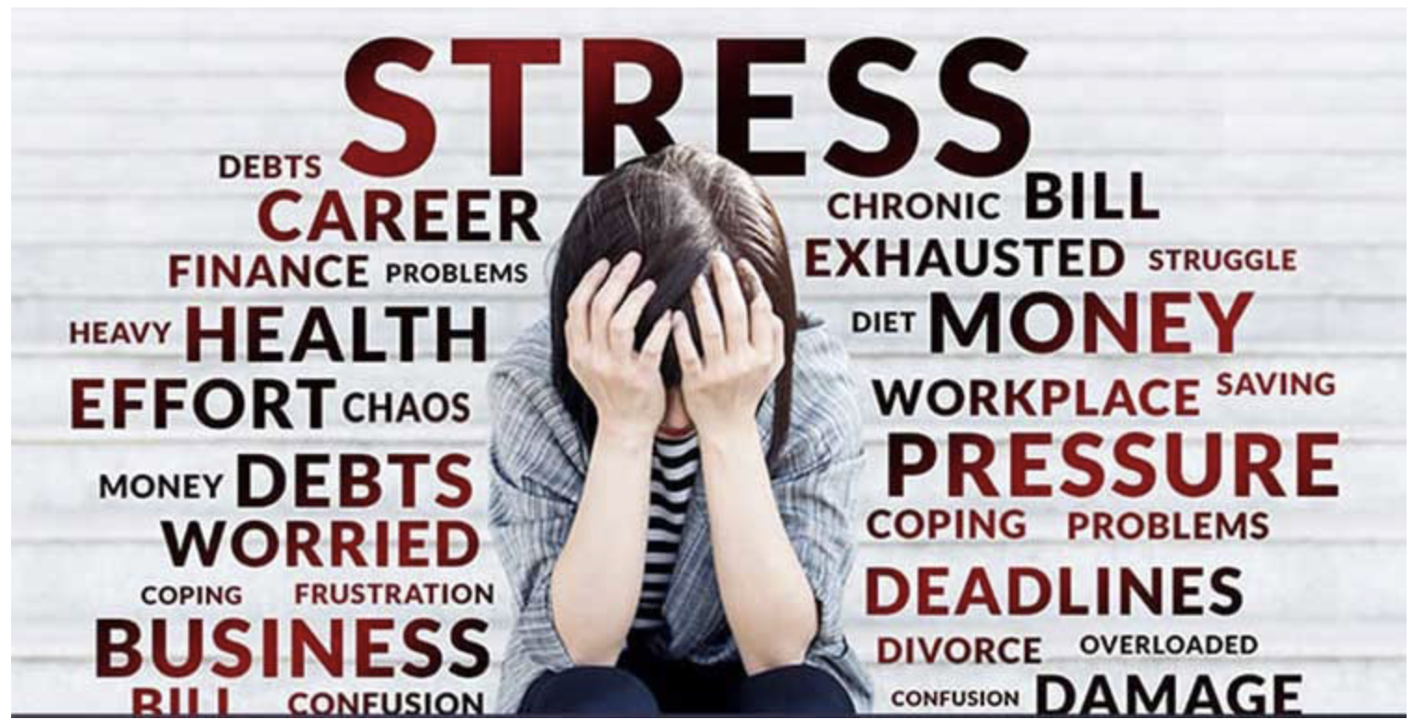
Stress Management
Be aware of self and others
Defend to alleviate symptoms (medication/alcohol, blame, deny)
Cope to deal with source (delegate, prioritise, sort, adjust)

Slide 9
Time Pressure and Deadlines
Actual
Perceived
Self-imposed
In OME:
  The deadline handed down to you
  Your responsibility to carry out the job safely
  = CONFLICT

Slide 10
Those responsible for setting deadlines should:
Prioritise work-load
Consider the time for briefing and delegation (one-third, two-third rule)
Consider the time to do the work, which should include breaks and shift changes
Allow contingency for illness (20%)
Select those with the correct skillset/pathway to conduct the work
Consider the availability of resources external to the human (supply chain risk)

Slide 11
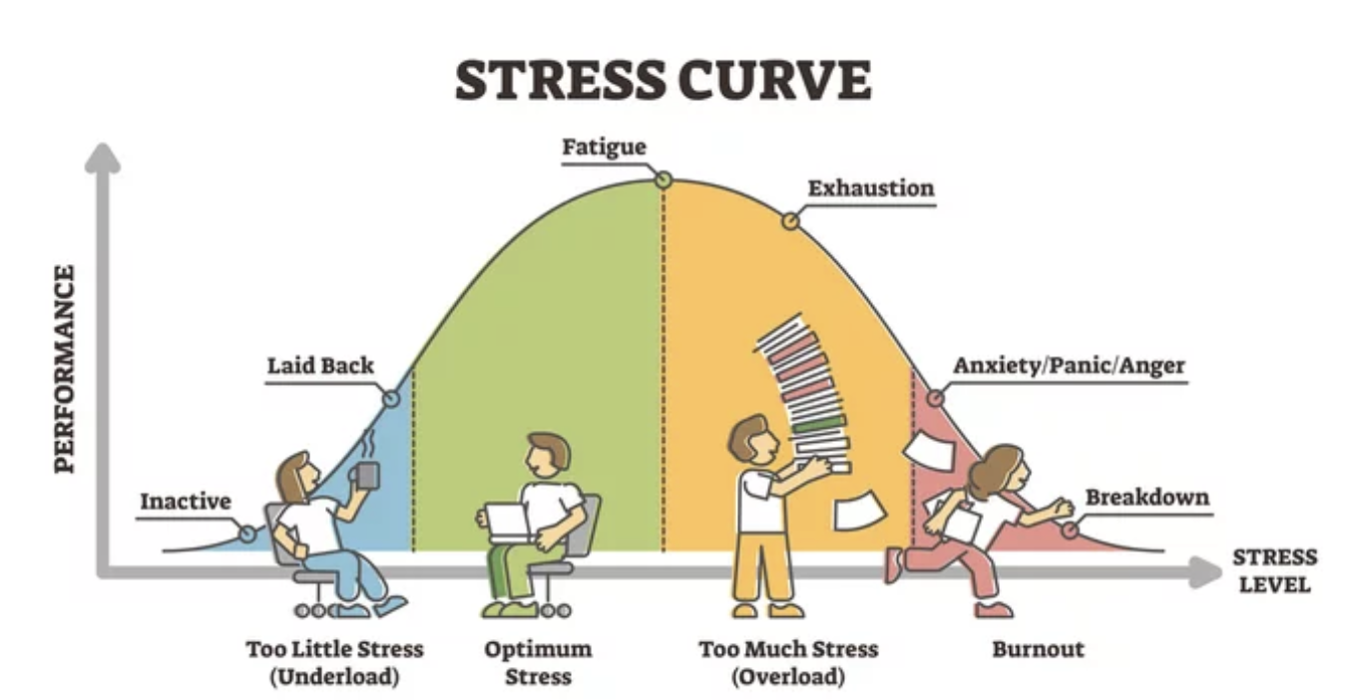

Slide 12

Workload Management in OME
Ensure staff are SQEP
Ensure staff have tools and equipment
Allocate tasks to teams and individuals that can be accomplished w/o cutting corners
Provide human factors training to planners so they can identify performance limitations
Encourage staff to identify and report when overload is building up – THE ACCIDENT PRECURSOR

Slide 13
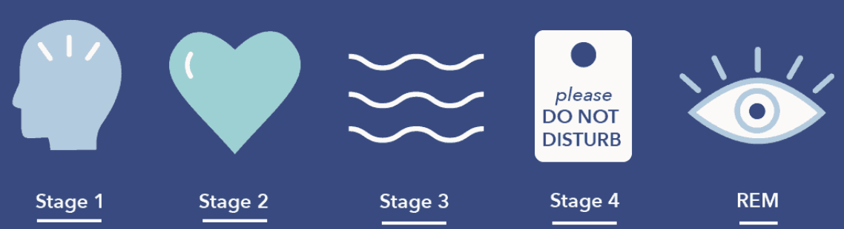
Sleep and Fatigue
Sleep can be resisted for a short time.
There are 5 stages of sleep (my humble view):
  Stage 1 – The transitional phase (between worlds)
  Stage 2 – Deeper level of sleep
  Stage 3 – Deep sleep – quite unresponsive to external stimuli
  Stage 4 – Deepest sleep. Very difficult to awaken
  Stage 5 – REM sleep. The dreaming state. Most difficult from which to awaken.

Slide 14
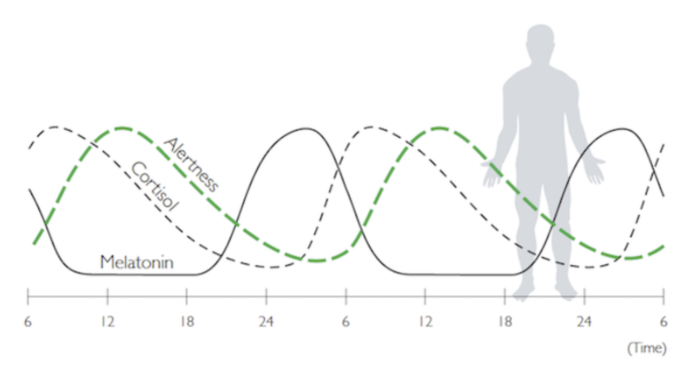
Circadian Rhythms

Slide 15
Cortisol
Cortisol has many important functions, acting on many different parts of your body. It can help:
  your body respond to stress or danger
  increase your body’s metabolism of glucose
  control your blood pressure
  reduce inflammation
Cortisol is also needed for the ‘fight or flight’ response, which is your healthy, natural response to perceived threats. The amount of cortisol produced is controlled by your body to ensure the balance is correct.

Slide 16
Melatonin
Melatonin is a hormone that your brain produces in response to darkness. It helps with the timing of your circadian rhythms (24-hour internal clock) and with sleep.
Being exposed to light at night can block melatonin production.

Slide 17
Fatigue
Diminished perception
Diminished motor skills
Short-term memory loss
Tunnel vision – fail to see bigger picture
Distracted by trivia
Poor judgement and decision making
Abnormal moods
Reduction in quality of work

Slide 18
Drugs, Alcohol and Medication
Affect Central Nervous System
Decision making
Side effects – analgesics, antibiotics, antihistamines, cough mixtures, decongestants
Pep pills, sleeping tablests (affect circadian rhythm)

Slide 19
Summary
Human physiology is complex and wonderful. The human body is capable of amazing levels of effort and can recover quickly from over stress.
However the body is a limited machine and constant abuse will cause degraded performance and even irreparable damage.
By understanding the bodies limitations and the effect of the physical world on human physiology we can work hard and limit any adverse effects.

Slide 20
The OME working environment
Social
Individual and team responsibilities,
motivation, culture, management, supervision, leadership
Working Environment
Tasks
Physical Environment
Social Enviromnent
Tasks
Physical work, repetitive tasks, stress, fatigue, time, sleep, day, night
Physical
Noise, illumination,OME physical properties, (toxicity, sensitivity), climate, weight, temperature, motion, phobias, layout, tools, cleanliness, PPE.

Slide 21
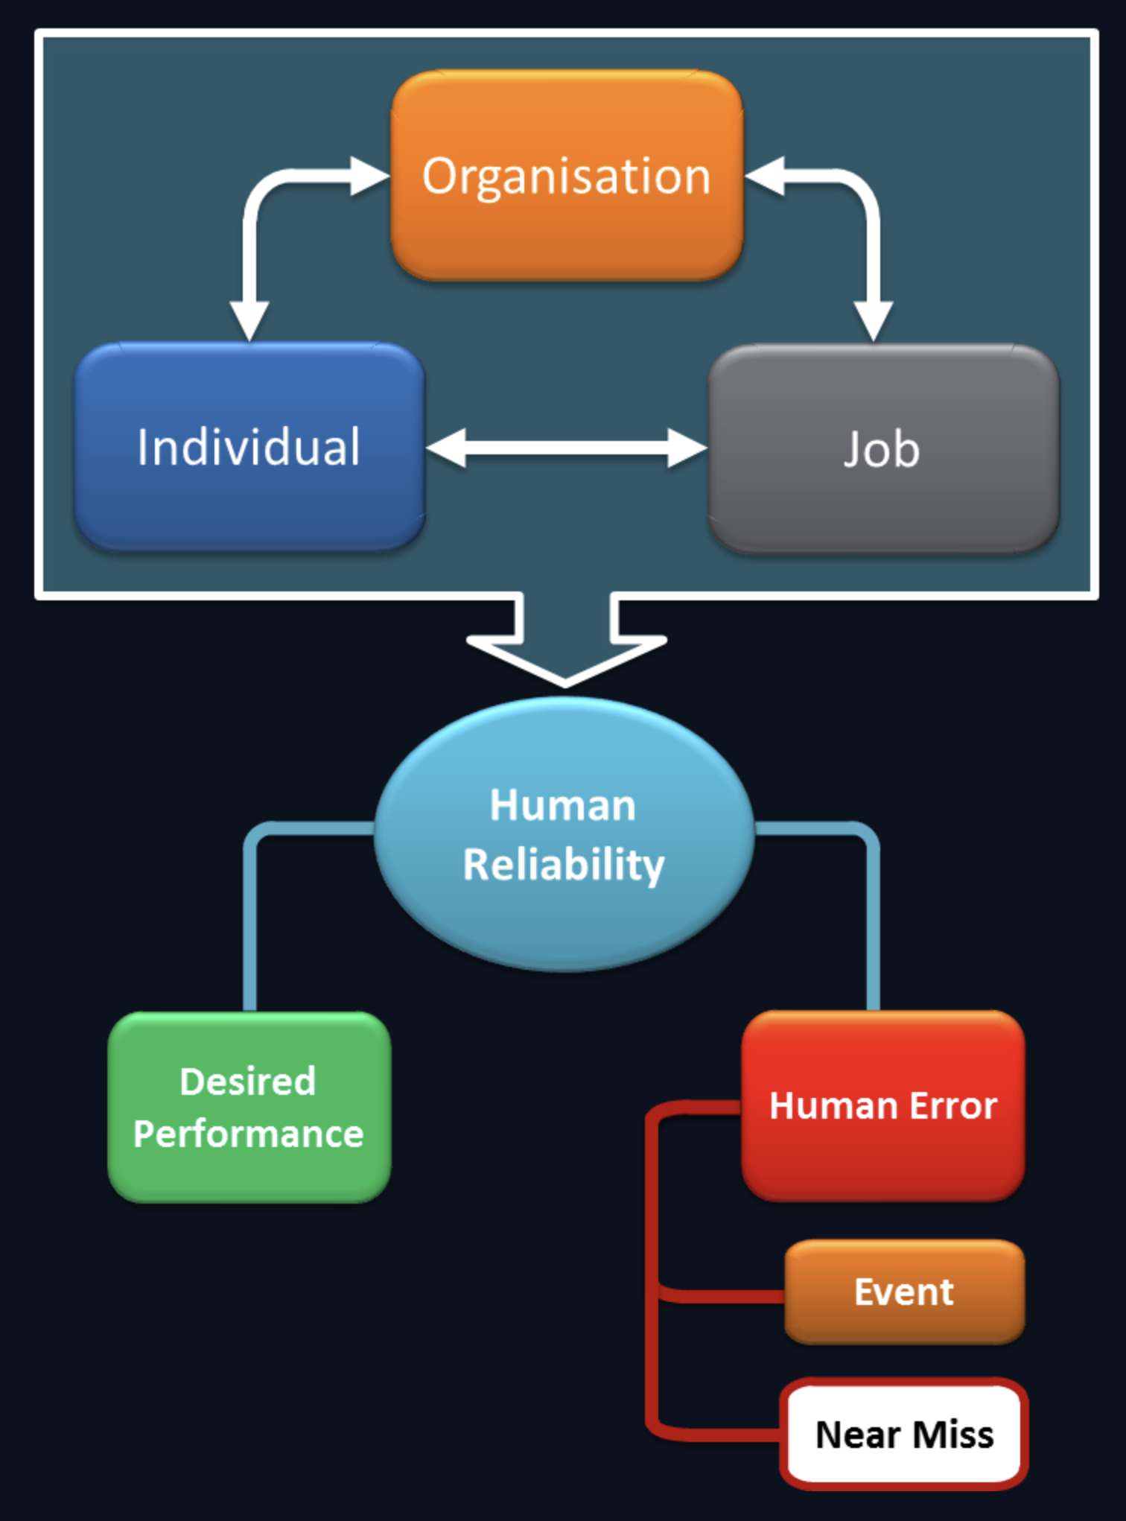

Slide 22
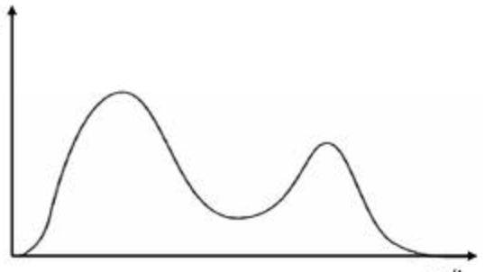
Fatalities during operational tours - discuss
One month
6 month
Fatalities
Time

Slide 23
Summary
Understanding the physical environment and its effects allows us to control our exposure to risk and limit or eliminate any detrimental effects on the body.

