Slide 1
Distributed & Cluster Computing- “Introduction”
Dr Tim Bashford

Slide 2
This semester
The second portion of this module is about making code fast.
Sort of the opposite end from real-time systems – given very powerful hardware (e.g. supercomputers), how do we take advantage of the available resources?
Studying three parallelism methods:
  Threading (already covered in concept – we’ll just take another look at this using C++11).
  Message Passing Interface (MPI)
  GPGPU (CUDA)
  Hopefully these all sound familiar!

Slide 3
Module plan
Date | Topic
03/02/2017 | Introduction, threading in C++
10/02/2017 | Introduction to clustering/Message Passing Interface (MPI)
17/02/2017 | Point-to-point MPI
24/02/2017 | Aggregating MPI
03/03/2017 | GPGPU principles
10/03/2017 | Introduction to CUDA
17/03/2017 | CUDA shared memory model
24/03/2017 | Accelerated WCF (C#) - part 1
31/03/2017 | Accelerated WCF (C#) - part 2
07/04/2017 | No lecture - Easter break
14/04/2017 | No lecture - Easter break
21/04/2017 | No lecture - Easter break
28/04/2017 | Final session (optional) - assignment support
05/05/2017 | (Vivas)

Slide 4
Assignment
You’ve already completed one, which I’ve marked – feedback for that coming.
Second assessment revolves around making code fast. I’m going to give you some scientific code, including some input files, and the expected output. Your only job is to make it run as quickly as possible.
  You’ll need to use the three parallelism methods we’re going to study.
  I have some additional, “hidden” input files which I’ll use for marking – so you can’t cheat ☺.
  You’ll ultimately write-up the process you went through to improve the code.
Hand-out:

Slide 5
Assignment 1 feedback
A few things people did wrong…

Slide 6
Today
Threading recap for C++.
  Based on the assessment hand-ins, threading you’ve done previously in C++ has used the pthread library?
Today, we’re going to use a different threading library, introduced in C++0x, originally taken from Boost::thread.
Things have moved on a little since pthread.
  Good and bad news – less annoying, yet somehow more difficult.
To do this, we’ll need to get familiar with Lambda expressions.

Slide 7
Lambda expressions
A way of creating an “anonymous” function which is written in-line in your code.
C++ has really gone to town on Lambdas in recent versions – you’ll find them everywhere!
Syntax:
[ capture-list ] ( params ) -> ret { body }
[ capture-list ] ( params ) { body }
[ capture-list ] { body }
Coming soon:
[ capture-list ] ( params ) mutable(optional) constexpr(optional)(c++17) exception attribute -> ret { body }

Slide 8
Lambda expressions
This sounds complicated…
  Well, yes.
So, why has C++11, and especially 14/17 gone down this route?
  Exceptionally flexible and extensible – you can now write enormous amounts of internal logic using a single prototype.
  As lots of languages get more beginner friendly, but more cluttered in doing so, C++ has largely gone the other way.
  Lots of methods which previously had a non-lambda prototype now expect one, such as vector find_if.

Slide 9
Lambda expressions
The [ capture-list ] defines things we take into the Lambda expression. Important to note that a Lambda function will not otherwise be able to access local parameters. Examples:
[a, b] – take in the variables a and b.
[a, &b] – take a by value, b by reference.
[this] – pointer to current object.
[*this] – copy of current object.
[&] – by reference default.
[=] – by value default.
[this, *this] – error, doesn’t make sense.

Slide 10
Lambda expressions
( params ) – nothing new about this, parameter list in the form:
(p1type p1name, p2type, p2name…)
e.g. (int p1, int p2)
You can also define a return type of a Lambda if you like, using the pointer dereference arrow (->) though most Lambdas return auto.
Let’s see an (admittedly slightly pointless) example…

Slide 11
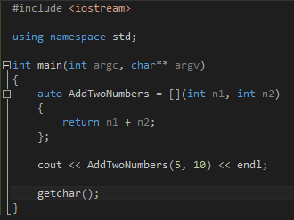
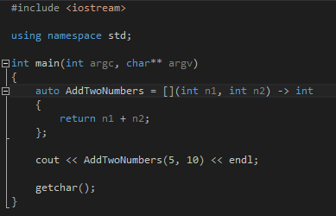
Lambda expressions

Slide 12
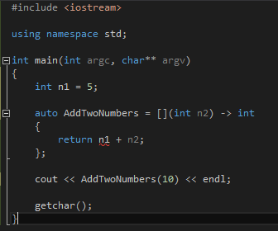
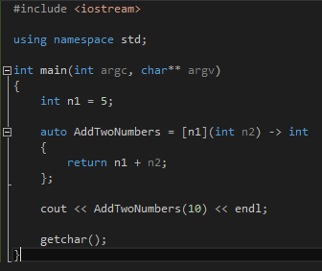
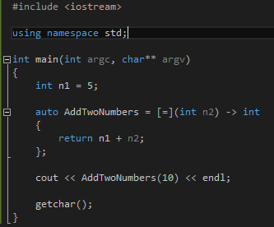
Lambda expressions
What if we want to take a parameter from outside the expression?

Slide 13
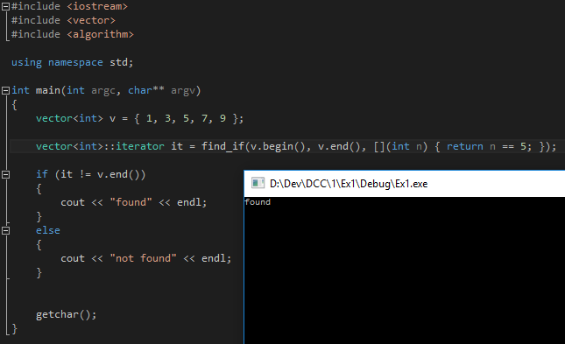
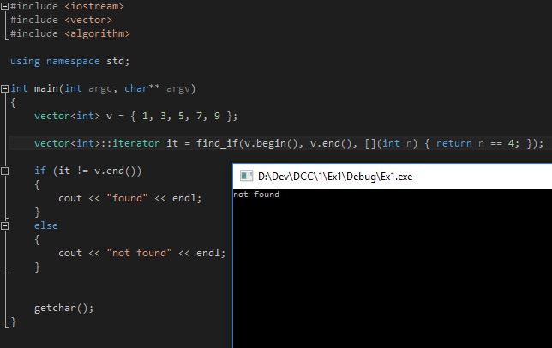
Lambda expressions
Let’s see a more usable example, integrated into the C++ libraries.

Slide 14
Application to threading
It’s now the accepted standard that threads are launched using a Lambda.
  Good news – it’s easy.
  Previous (interim) method used std::bind, and was a tad fiddly. Still better than pthread!
  No longer have to create some horrendous wrapper object, because we can just pass parameters through the Lambda.

Slide 15
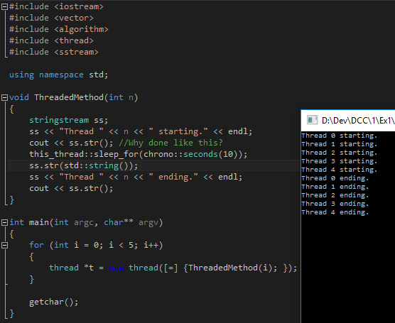
Example

Slide 16
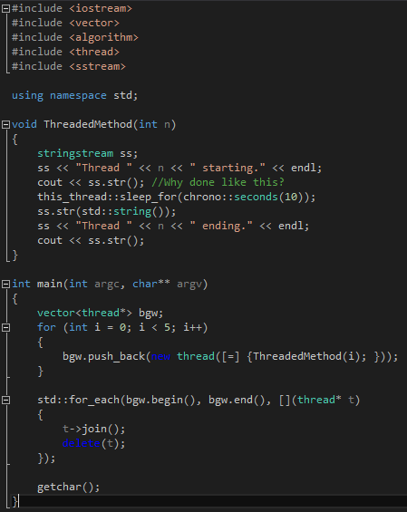
Of course, this is a memory leak…

Slide 17
Synchronisation?
C++11 introduced std::mutex. http://en.cppreference.com/w/cpp/thread/mutex
  I’ll leave you do a little independent reading on this one – it’s not really different to the C# implementation we’ve studied.
You can make your own thread barrier (or there’s one in Boost). Ditto ThreadPool.

Slide 18
Exercise
I’m setting an exercise you’ve done previously, to be completed in C++.
  This should be a recap/getting back into C++, more than anything new!
See the Tutorial worksheet.

