Slide 1
ECEY4008C Datblygu Sgiliau Astudio Effeithiol
ECEY4008
Developing Effective Study Skills

Slide 2
ECEY4008C Datblygu Sgiliau Astudio Effeithiol
ECEY4008 Developing Effective Study Skills
Sgiliau Ymchwilio
Meddwl yn Feirniadol
Researching Skills
Critical Thinking

Slide 3
Cynnwys Contents
Beth yw ‘ymchwil?’
Sut i ymchwilio
Ffynonellau
Meddwl yn feirniadol
What is ‘research?’
How to research
Sources
Critical thinking

Slide 4
Sgiliau Skills
Sgiliau Cyflogadwyedd/Trosglwyddadwy
Trefniadaeth
Cynllunio
Rheoli amser
Employability/Transferable Skills
Organisation
Planning
Time management
Notes:
Notes for Module Team:
Draw students’ attention to the types of skills they can acquire from the lecture – these are skills that potential employers are looking for and should be included in job applications.

Slide 5
Adnoddau Resources
Ymchwil
Gwefannau
Erthyglau
Clip fideo
Gweithgareddau
Research
Websites
Articles
Video clip
Activities

Slide 6
Rhaglen Ymarferydd Blynyddoedd Cynnar
Meini prawf y NOS a gyflawnwyd yn y ddarlith hon:
Craidd – K27
0401 – K60; P9, P11
0409 – K70, K71, K72

Slide 7
Early Years Practitioner programme
The NOS criteria met in this lecture:
Core – K27
0401 – K60; P9, P11
0409 – K70, K71, K72

Slide 8
Beth yw ymchwil?
What is research?

Slide 9
Beth yw ‘ymchwil?’
What is ‘research?’
Darganfod gwybodaeth
Darllen
Gwneud nodiadau
Darllen gwerthusol
Adfyfyrio beirniadol
Ffynonellau
Finding information
Reading
Note taking
Evaluative reading
Critical reflection
Sources

Slide 10
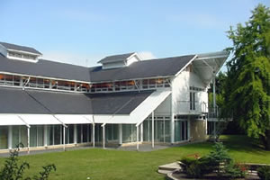
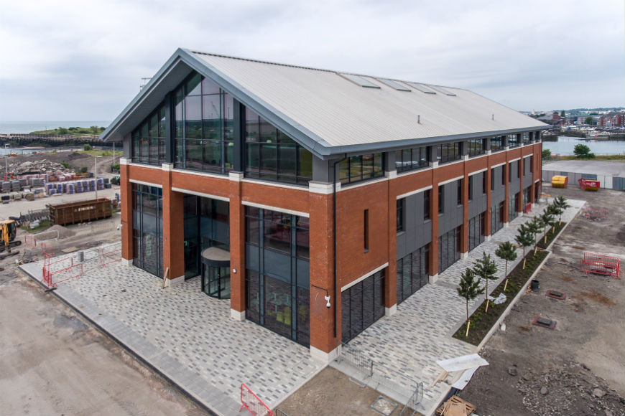
Darganfod gwybodaeth
Finding information
Ble mae dechrau?
Where to start?
Syniadau?
Ideas?

Slide 11
Sgiliau darllen lefel uwch
Higher level reading skills
Cip-ddarllen
Bras-ddarllen
Darllen yn fanwl
Darllen yn feddylgar
Scanning
Skimming
Detailed reading
Intelligent reading

Slide 12
Sgiliau darllen lefel uwch
Higher level reading skills
Critical reading
Reading with an understanding of the author’s viewpoints and bias
Choosing suitable books and articles
Darllen yn feirniadol
Darllen gydag ymwybyddiaeth o farn yr awdur
Dewis llyfrau ac erthyglau addas

Slide 13
Gwneud nodiadau
Making notes
Gwneud llungopïau o rhai erthyglau pwysig / defnyddiol
Uwch oleuo neu tanlinellu pwyntiau o bwys
Gwneud nodiadau o’r prif bwyntiau
Cadw ffeil trefnus o’ch nodiadau
Make photocopies of some important / useful articles
Highlight or underline important points
Make notes on the main points
Keep an organised file of your notes and articles

Slide 14
Gwneud nodiadau
Making notes
Useful to note:
Date of notes
Provide full reference details for the book, article or website related to your notes
Gwerth nodi:
Dyddiad y nodiadau
Manylion llawn y llyfr, bennod, erthygl neu wefan perthnasol i’r nodiadau

Slide 15
Ffynonellau
Resources
Ffynonellau addas?
Llyfrau
Erthyglau
Cyfnodolion
Teledu/radio
Y We
Arall?
Appropriate sources?
Books
Articles
Journals
Television/radio
The Internet
Other?

Slide 16

Y We
The Internet
.ac.uk
.gov.uk
Gwefannau nodwyd gan ddarlithwyr
Google scholar
.ac.uk
.gov.uk
Websites noted by lecturers
Google scholar

Slide 17

DIM Wikipedia
Dolen i Wefan Wikipedia
NO Wikipedia
Link to Wikipedia Website

Slide 18
Gwefannau addas?
Appropriate websites?
Kidshealth
Link to http://kidshealth.org/
Mumsnet
Link to http://www.mumsnet.com/
Simply Psychology
Link to http://www.simplypsychology.org/

Slide 19
Gwefannau addas?
Appropriate websites?
Early Education
Link to https://www.early-education.org.uk/
Joseph Rowntree Foundation
Link to https://www.jrf.org.uk/?gclid=CNuml-2Y-8cCFRFmGwodQggCcw
The Guardian – Education
Link to http://www.theguardian.com/education
Times Education Supplement (TES)
Link to www.tes.com

Slide 20
Ac eraill And others
National Autistic Society
Mencap
NHS
NICE
Barnadoes
NSPCC

Slide 21
Meddwl yn Feirniadol
Critical Thinking
Beth yw ‘meddwl yn feirniadol?’
What is ‘critical thinking?’

Slide 22
Meddwl yn Feirniadol
Critical Thinking
“..setting out actively to understand what is really going on by using reasoning, evaluating evidence and thinking carefully about the process of thinking itself.”
(Chatfield, 2017: 6).

Slide 23
Adfyfyrio Amheus
Sceptical Reflection
Gwerth wrth amau darn o wybodaeth
Cwestiynu rhagdybiaethau a wnaed
Codi ymwybyddiaeth o wrthddywediadau ac anghysondebau
Value in doubting piece of information
Questions assumptions made
Raises awareness of contradictions and inconsistencies

Slide 24
Gwrthrychedd
Objectivity
Deall rhywbeth o safbwynt niwtral
Dim yn dibynnu ar farn/cred un person
Dim yn dibynnu ar y darn cyntaf o wybodaeth a dderbyniwyd
Understanding something from a neutral perspective
Not relying on one person’s opinion/belief
Not relying on first piece of information received

Slide 25
Gofynnwch eich hunan...
Ask yourself…
Pam ddylwn i ymddiried yn y wybodaeth yma?
Pam mae'r awdur/ cyflwynydd yn credu'r wybodaeth yma?
Pa wybodaeth arall sydd yno?
A ydw i'n gwybod digon i ateb y cwestiynau hyn?
Why should I trust this information?
Why does the author/presenter believe this information?
What other information is there?
Do I know enough to answer these questions?

Slide 26
Goddrychedd a Rhagfarn
Subjectivity or Bias
Barn bersonol
Barn unochrog
Cyffredinoliadau
Dylid Osgoi’r rhain mewn academia
Personal opinion
One-sided opinion
Generalizations
Should be avoided in academia

Slide 27
Chwilfrydedd Deallusol
Intellectual Curiosity
Yn y Brifysgol, cewch gyfleoedd i:
Dadlau
Darganfod atebion dros eich hunan
Meddwl mewn ffyrdd mwy creadigol
Bod yn agored i wahanol safbwyntiau
At University, you will have opportunities to:
Debate
Find out answers for yourself
Think in more creative ways
Be open to different perspectives

Slide 28
Gwyliwch / Watch
Five simple strategies to sharpen your critical thinking | BBC Ideas - YouTube

Slide 29
Meddwl beirniadol / Critical thinking
Byddwch yn amheugar
Byddwch yn chwilfrydig a chwestiynwch syniadau
Peidiwch â chredu popeth rydych chi'n ei ddarllen
Osgoi seilio eich dadleuon ar ychydig o ffynonellau yn unig
Gwiriwch ffeithiau ac ystyriwch gogwydd neu agenda'r awdur
Ychydig iawn o faterion ie / na / cywir / anghywir - dathlu cymhlethdod
Be sceptical
Be curious and question ideas
Do not believe everything you read
Avoid basing your arguments on only a few sources
Fact check and consider the authors bias or agenda
Very few yes / no / right / wrong issues- celebrate complexity

Slide 30
Darllen / Reading
Critical Thinking | SkillsYouNeed
Critical Thinking and Fake News | SkillsYouNeed

Slide 31
Darllen Beiriniadol / Critical Reading see also (Cottrell, 2013: 188)
Beth yw prif bwynt yr hyn yr ydych yn ei ddarllen?
Pwy a'i hysgrifennodd?
Pam y cafodd ei ysgrifennu? Pa bryd y cafodd ei ysgrifennu?
Ydy syniadau neu gyd-destun wedi newid ers iddo gael ei ysgrifennu?
A yw'r dystiolaeth a gyflwynir yn gadarn ac yn gredadwy?
Sut daeth yr awduron i’w casgliadau?
A ydych yn cytuno â'r casgliadau?
Beth mae hyn yn ei ychwanegu at ein gwybodaeth? Pam ei fod yn ddefnyddiol?
What is the main point of what you are reading?
Who wrote it?
Why was it written?
When was it written?
Have ideas or context changed since it was written?
Is the evidence presented robust and credible?
How did the authors come to their conclusions?
Do you agree with the conclusions?
What does this add to our knowledge?
Why is it useful?

Slide 32
Gweithgaredd
Activity
Gyda'r rhestr wirio a ddarperir, dadansoddwch yr erthygl ganlynol:
With the checklist provided, analyse the following article:

Slide 33
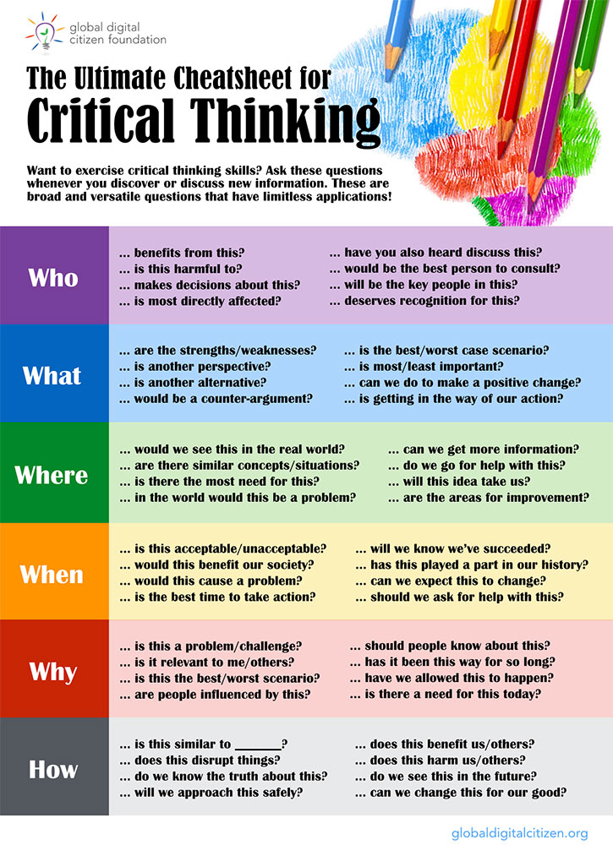

Slide 34
Cyfeiriadau
References
Chatfield, T. (2017) Critical Thinking. London: SAGE Publications Ltd.
Cottrell, S. (2013) The study skills handbook (4th ed). Hampshire: Palgrave Macmillan.
Educational Technology and Mobile Learning (2017) ‘48 Questions to Help Students Develop Critical Thinking Skills, https://www.educatorstechnology.com/2017/01/48-questions-to-help-students-develop.html [Accessed: August 13 2018].

