Slide 1
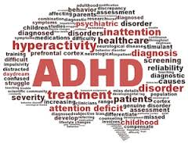
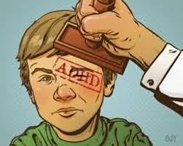
ADHD
Lecture 6
Dr Charlotte Greenway

Slide 2
Today….
What is ADHD?
Characteristics/Symptoms
Classification/Diagnosis
Prevalence
Aetiology – Genetics and Environmental risks
Executive functions and ADHD
Impact on Life and Schooling

Slide 3
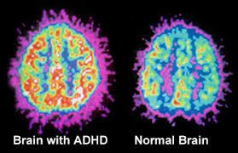
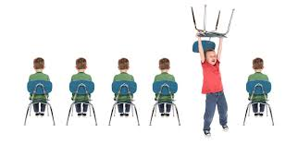
What is ADHD?
It is a neurological problem!
It’s a problem in the area of the brain that allows us to tune out of what we shouldn’t be focussing on.
It’s also the part of the brain that controls our impulses and social behaviour
In many children with ADHD this part of the brain has not fully developed.

Slide 4
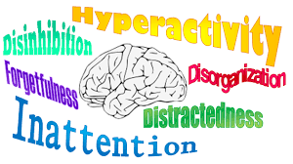
  Attention-deficit/hyperactivity disorder involves…
ADHD is characterized by a pattern of behaviour, present in multiple settings (e.g., school and home), that can result in performance issues in social, home, or educational settings.
Two categories …
inattention and hyperactivity and impulsivity that include behaviours like failure to pay close attention to details, difficulty organizing tasks and activities, excessive talking, fidgeting, or an inability to remain seated in appropriate situations.
DSM-V, APA (2013)

Slide 5
ADHD Classification
International Classification of Mental and Behavioural Disorders 10th revision (ICD-10)
Attention-deficit hyperactivity disorder, unspecified type
…originating in childhood in which the essential features are signs of developmentally inappropriate inattention, impulsivity, and hyperactivity. At least some of the symptoms must be present before the age of 7 years.
Diagnostic and Statistical Manual of Mental Disorders – 5th Edition (DSM-5)
attention-deficit hyperactivity disorder (ADHD)
"a persistent pattern of inattention and/or hyperactivity-impulsivity that interferes with functioning or development"
http://www.adhd-institute.com/assessment-diagnosis/diagnosis/#sthash.tCbZmDnY.dpuf

Slide 6
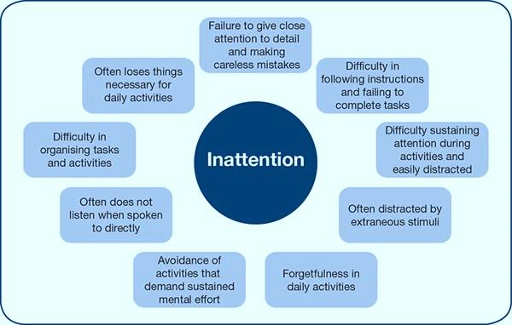
Figure created from information in the DSM-5TM and ICD-10 classifications

Slide 7
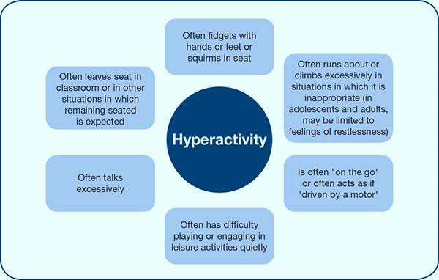

Impulsivity
Often blurts out answers before questions have been completed
Often has difficulty awaiting turn
Often interrupts or intrudes on others
Figure created from information in the DSM-5TM and ICD-10 classifications

Slide 8

Presentation of ADHD
Combined | Inattentive | Hyperactive/impulsive
All three core features are present and ADHD is diagnosed when ≥6 symptoms of hyperactivity/impulsivity and ≥6 symptoms of inattention have been observed for ≥6 months | Diagnosed if ≥6 symptoms of inattention (but <6 symptoms of hyperactivity/impulsivity) have persisted for ≥6 months | Diagnosed if ≥6 symptoms of hyperactivity/impulsivity (but <6 symptoms of inattention) have been present for ≥6 months
Current severity of ADHD
Mild | Moderate | Severe
Few, if any, symptoms in excess of those required to make the diagnosis are present, and symptoms result in no more than minor impairments in social or educational functioning | Symptoms or functional impairment between “mild” and “severe” are present | Many symptoms in excess of those required to make the diagnosis, or several symptoms that are particularly severe, are present; or the symptoms result in marked impairment in social or educational functioning

Slide 9

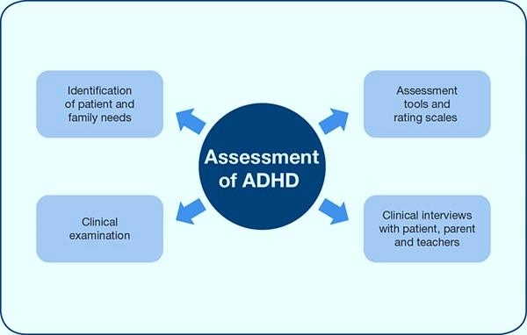
There is currently no single available tool for the diagnosis
http://www.adhd-institute.com/assessment-diagnosis/rating-scales/
Formal diagnosis is made using evidence accumulated from the initial clinical assessment and medical classification systems

Slide 10
ADHD: Prevalence and Demographics - UK
Between the ages of 5 and 15 years - 3.62% of boys and 0.85% of girls had ADHD. (Ford et al., 2003)
The wide variation - the lack of a strict definition, lack of precise and objective methods for assessment, geographic differences.
Sex ratios vary widely - referral bias. Males are more likely to have behaviour and conduct problems and thus more likely to be referred for psychiatric follow-up (Barkley, 1988)
- same definitions of ADHD for both boys and girls, and usually find more boys than girls with ADHD (a ratio of about 3 to 1).
Children and Families Bill, 2013
Notes:
The wide variation in prevalence can be explained by the lack of a strict definition for the disorder, lack of precise and objective methods for assessment, geographic differences, and low awareness of the disorder.
Sex ratios also vary widely and may, in part, be explained by referral bias. Males are more likely than females to have behaviour and conduct problems and thus more likely to be referred for psychiatric follow-up¹.
ADHD persists in some patients into adolescence and adulthood, however the core symptoms change. With increasing age the core symptoms of hyperactivity/impulsivity tend to decrease, although inattention persists.
1. Barkley RA. Attention-Deficit Hyperactivity Disorder. A Handbook for Diagnosis and Treatment. New York: Guilford Press, 1988.

Slide 11
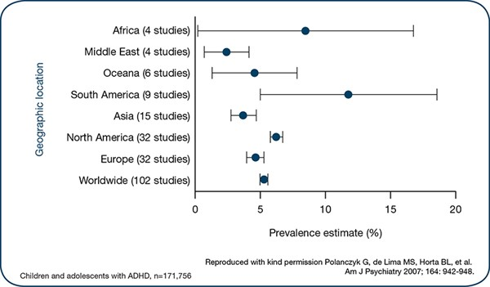
Geographical location
DSM-V suggests that cultural attitudes towards the interpretation of behaviour may contribute to differences in prevalence estimates across studies
Meta-analysis of studies (n=102) -aged ≤18 years varied.
Prevalence for Europe was just under 5%
More recently - Worldwide prevalence of ADHD is estimated at between 5.29%3 and 7.1% (Willcutt, 2012)

Slide 12


A large percentage will have a comorbid learning disorder, another mental health disorder, or a neuro-developmental disorder.
This creates the chicken or egg conundrum.
Which came first: the ADHD or the supposed comorbidity?
The presence of comorbidity conditions makes the diagnosis of ADHD more difficult.
Comorbidity
Learning disorders (46% vs 5%)
Conduct disorder (27% vs 2%)
Anxiety (18% vs 2%)
Depression (14% vs 1%)
Speech problems 12% vs3%)
Autism spectrum Disorder (6% vs 0.6%)
Epilepsy/Seizures (2.6% vs0.6%)
33% had one comorbidity disorder, 16% had two, and 18% had three or more.
60,000, children, 6-17 years including over 5,000 with ADHD.
Overall, 67% of ADHD children had at least one other mental health or neuro-developmental disorder compared to 11% of children without ADHD.

Slide 13
Aetiology
Causes still largely unknown
What we do know…
  the occurrence of ADHD is closely tied with biological factors
    Size and density of various brain structures
    The way chemical reactions take place within the brain
Interplay between multiple genetic (Gizer, Ficks and Waldman, 2009; Larsson, et al. 2013) and environmental risk factors (Grizenko, et al. 2012)
Risk factors that affect the neurobiological basis of the disorder (Cortese, et al. 2012)
Notes:
Junk food
Bad parenting
Watching too much TV
Lack of discipline
Chaotic home life

Slide 14
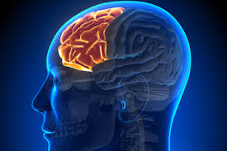
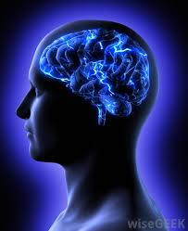
Brain structure differences
Smaller cortex in ADHD – thoughts and actions
  Diminished size usually occurs in the Frontal lobe
  – impulse control
  – socialisation
  – reason
  – judgement
Not fully developed – neurons in this part of the brain are needed for focussing, paying attention.

Slide 15
Chemical differences
Neurons communicate with one another using neurotransmitters – Dopamine and Serotonin
Neurotransmitter – chemical messengers that carry information to and from nerve cells
ADHD - Dopamine and Serotonin deficiency – Why?
To produce D and S– we need vitamin B6 and B9 (Folate)
MTHFR
GENETIC DEFECT
(Methylenetetrahydrofolate)
We need to activate them
When we eat/ supplement – they are in an inactivated form
So – defect does not allow activation
Curatolo, P., D’Agati, E., & Moavero, R. (2010).
Notes:
Dopamine is a neurotransmitter that helps control the brain's reward and pleasure centres. Dopamine also helps regulate movement and emotional responses, and it enables us not only to see rewards, but to take action to move toward them.
Serotonin - This includes brain cells related to mood, sexual desire and function, appetite, sleep, memory and learning, temperature regulation, and some social behaviours.
As a stress hormone, norepinephrine affects parts of the brain where attention and responding actions are controlled. (fight or flight)

Slide 16
Genetics
    DRD4 Dopamine receptor gene
      DAT1 Dopamine transporter gene
All chemical process in the body are under the control of genes.
Dopamine – no exception
There are 100s of dopamine genes
A number of defective variants have been found
So – ADHD is not caused by one faulty gene – but is ‘polygenetic’ disorder
A small number of these genes are not usually sufficient to cause significant disruption to dopamine transmission – other processes will compensate for small defects.
It’s only when there are multiple defects that overwhelm the compensatory mechanisms
Curatolo, P., D’Agati, E., & Moavero, R. (2010).
Notes:
Dopamine is manufactured in one cell. When an electric impulse reaches the end of the nerve cell, the dopamine enters the synapse before transferring to the next verve cell – it does so by attaching itself to a receptor gene on the next cell = causing it to fire into action or onto another cell.
There needs to be a recycling process – the original nerve cell that manufactured the dopamine needs to re-obsorb some of the dopamine so that it can be reused (re-up-take) – the DAT1 – transporter gene does this.

Slide 17
Genetics
Twin studies - heritability estimated to be 76% in the population
(Farone , Perlis, Doyle, et al. 2005).
Swedish twin registry (n=21,000 children twin pairs, and n=37,714 adult twin pairs) - the genetic contribution to ADHD was 88% across child/adolescent twins; and 72% in adult twins (Larsson H, Chang Z, D’Onofrio BM, et al. 2013)
http://ac.els-cdn.com/S0165178114003746/1-s2.0-S0165178114003746-main.pdf?_tid=27823106-de18-11e5-9190-00000aab0f02&acdnat=1456663282_c5d6a0399db243ede83a88b7d1b85617

Slide 18
Genetics
Adoption studies in children and adolescents have also indicated that rates of ADHD are significantly higher between biological relatives (parent-child or sibling) compared with adoptive relatives (Sprich, Biederman, Crawford, et al. 2000)
In addition, results from a genome-wide association study of pooled DNA from adults with ADHD suggested that a genetic component was likely to contribute to the persistence of ADHD from childhood into adulthood (Lesch , Timmesfeld, Renner, et al. 2008)
Notes:
A genome-wide association study is an approach that involves rapidly scanning markers across the complete sets of DNA, or genomes, of many people to find genetic variations associated with a particular disease.

Slide 19
Non-genetic causes
Severe head trauma
Brain haemorrhage
Lead poisoning
Brain infection
Brain tumours
Leukaemia
hydrocephalus
Any condition that causes sufficient damage to the frontal lobes can cause ADHD
Some environmental conditions interact with a genetic susceptibility to ADHD
Low birth weight
Smoking during pregnancy
Alcohol abuse during pregnancy

Slide 20
Impact of ADHD on the life of a child
European Lifetime Impairment Survey
Assessed the impairment and symptoms of ADHD in children and adolescents from six European countries (France, Germany, Italy, Spain, the Netherlands and the UK).
Parents/caregivers of children and adolescents with ADHD (n=535) and without ADHD (n=424) participated in the online survey
Caci H, Doepfner M, Asherson P, et al (2013)

Slide 21
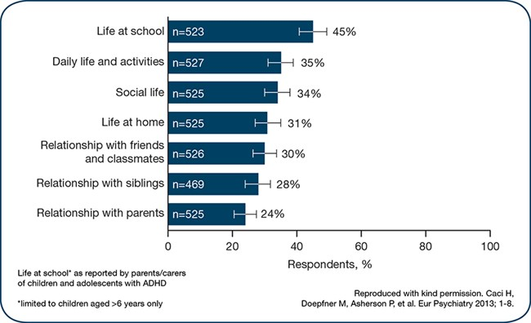
Parents/caregivers reported a perceived negative impact on various aspects of their child’s life, including life at school (45%), daily life and activities (35%) and social life (34%)

Slide 22
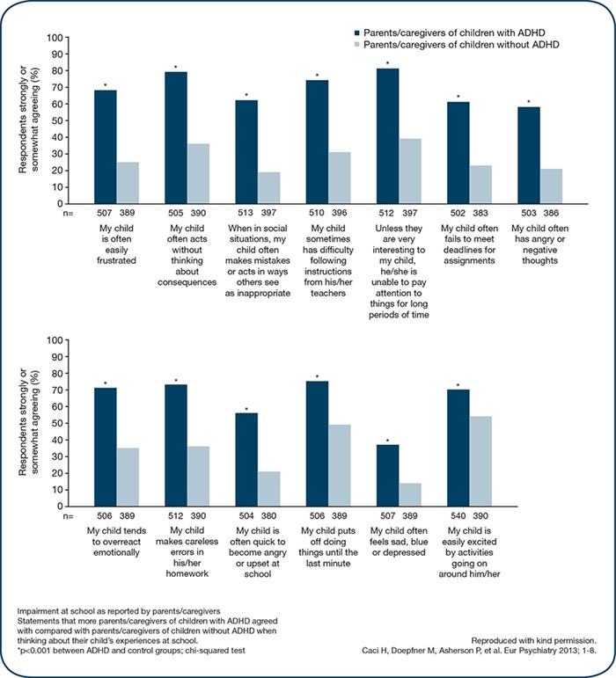
Figure developed from Adamou et al. 2013

Slide 23
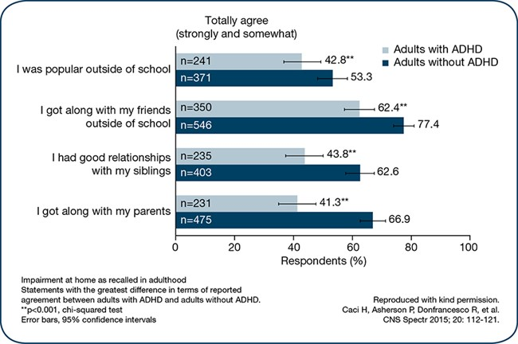
European Lifetime Impairment Survey
(Caci, Asherson, Donfrancesco et al. 2015)
Impact as recalled by adults with ADHD (n=588) compared with adults without ADHD (n=736).
Adults with ADHD recalled similar impact from their childhood, as indicated by a lower degree of agreement with positive statements related to daily life and relationships compared with adults without ADHD

Slide 24
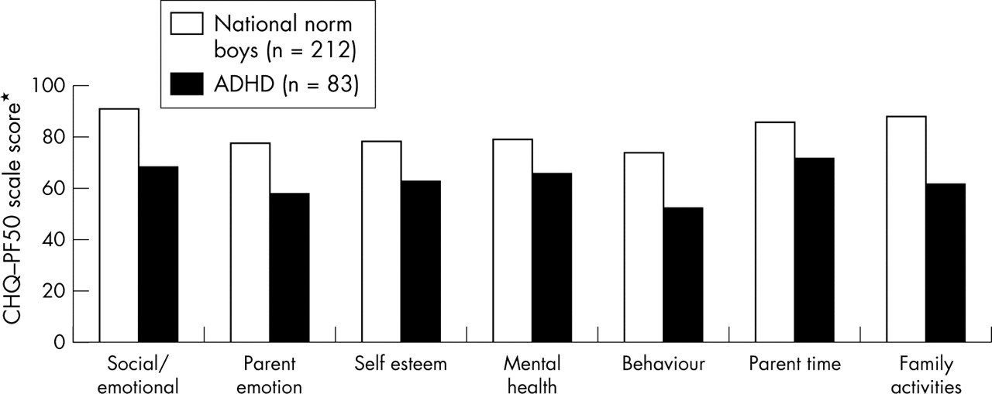
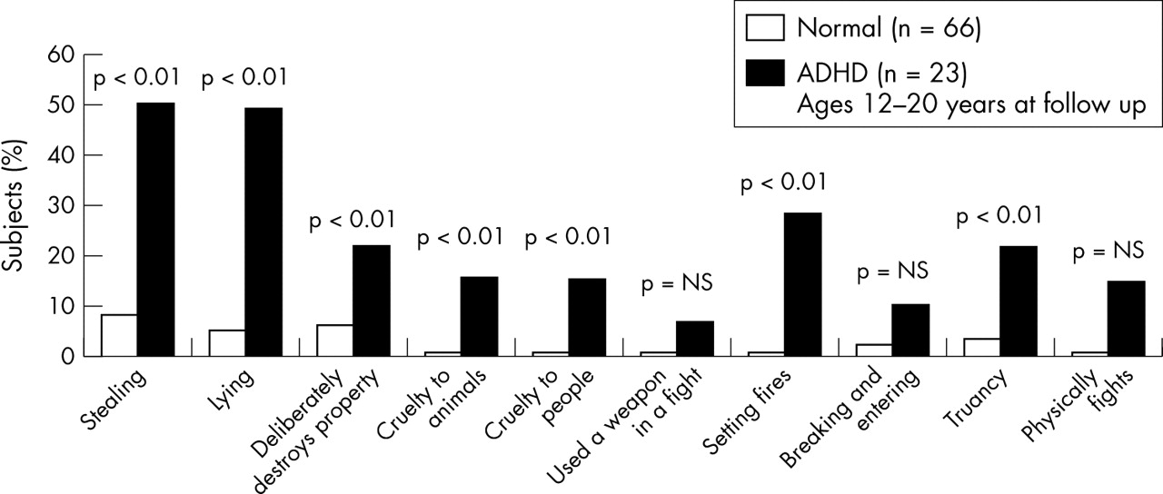
Emotional and family functioning in children with ADHD compared with controls. *Higher scores indicative of greater functioning.
V A Harpin Arch Dis Child 2005;90:i2-i7
Antisocial behaviour in adolescents with ADHD. Data primarily represents outcomes in those with conduct disorder as teenagers.
Notes:
Emotional and family functioning in children with ADHD compared with controls.13 *Higher scores indicative of greater functioning. CHQ, Child Health Questionnaire.13
Antisocial behaviour in adolescents with ADHD.26 Data primarily represents outcomes in those with conduct disorder as teenagers.

Slide 25
Impact of ADHD on School Performance
Poor classroom behaviour
Poor academic achievement
Special education requirements (tutoring and special educational programmes)
Association between symptoms of inattentiveness (as measured by the Conners 10-item scale) in children aged 7 and 10 years and academic underachievement at age 16 years (APA, 2013)
Adolescents and adults with ADHD have been found to be less likely to have achieved a further education degree (Davis, Claudius, Palinkas, et al. 2012)
School exclusion
Repetition of grades
Failure to gain external qualifications
Low self-esteem
Social clumsiness
Inflexibility
Defiant behaviour
Notes:
This slide outlines examples of how ADHD affects school performance.
Poor performance in school is believed to result from inattentive, impulsive and restless behaviour in the classroom.
School performance may also be reduced due to a higher incidence of learning difficulties (both due to symptoms impairing the ability to learn and due to comorbid learning difficulties in some patients), delayed intellectual development and delays in language development.

Slide 26

Executive dysfunction
This stems from an inability to inhibit present behaviour so that demands for the future can be met (Barkley, 2000)
Executive functions
Snake bite – no plan…
Stepped on = bite back
Frontal and pre-frontal lobes play a large role in this self control and planning.
Where we came from, where we want to go, and how to flexibly control ourselves in order to actually execute the plan = EF
Humans fortunately have the option to modulate behaviour
Notes:
In other words, people with ADHD are so drawn to the present that the future does not even “show up on their radar
Screen.” There is no future or past; only “NOW.”
When you step on a snake, it bites. No verbal discussion occurs within the snake’s brain.
No recall of whether striking back worked in the past. No thought as to where this action
will lead to in the future. No inhibition. Stepped on. Bite back. Humans, fortunately, have
the option to modulate their behavior.

Slide 27
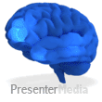
Executive dysfunction
Inhibition - putting brakes on your behaviour – to plan involves putting on the brakes on distracting activities – allows us to stop and think to consider our actions before we act.
Without these brakes – unable to inhibit distractions (inattentive), unable to inhibit instant reactions (impulsive), or unable to inhibit physically acting upon these stimuli (hyperactive).
Foresight (predicting and planning for the future
Organisation
Initiation – getting started
Emotional regulation
Hindsight (remembering past experience)
Working memory
Shifting agenda
Flexibility
Self- talk
Sense of time
Barkley, (2000)
Notes:
Most importantly, the ability to inhibit (“putting on the brakes”) is central to effective executive function. Successful execution of a plan largely involves putting brakes on distracting activities. These brakes--courtesy of our pre-frontal inhibitory centers--allow us the luxury of time during which we can consider our options before reacting. This lack of inhibition is a double problem for people with ADHD. First, without these brakes, they will be viewed as unable to adequately inhibit distractions, inhibit impulsive reactions, or inhibit physically acting upon these stimuli (hyperactivity). Second, patients with ADHD do not inhibit their behavior long enough for the other executive functions below to adequately develop either.
Executive functions identified by Barkley include:
Self-talk refers to the ability to talk to ourselves--a mechanism by which we work through our choices using words. Toddlers can be heard using self-talk out loud. Eventually, this ability becomes internalized and automatic. However, ADHD patients have not inhibited their reactions long enough for this skill to fully develop. Working memory refers to those ideas that we can keep active in our minds at a given moment. For example, in order to learn from mistakes, you have to be able to juggle not just the present situation, but also keep in mind past times when certain strategies did or did not work.
Working memory hopefully also includes keeping future goals in mind (such as remembering that we want to get into a good college, not just do the most intriguing activity currently available). Without the ability to inhibit, people with ADHD never get to develop good function of their working memory. Foresight (predicting and planning for the future) will be deficient when inadequate working memory teams up with a poor ability to inhibit the present distractions. People with ADHD cannot keep the future in mind. They are prisoners of the present; the future catches them off guard. In fact, surprisingly poor foresight is perhaps the greatest difficulty in their lives. Sense of time is an executive function that is usually extremely poor in ADHD.
Shifting from Agenda A to Agenda B is a difficult task requiring good executive function. Pulling yourself out of one activity and switching to another--transitioning--is innately difficult, and requires effort and control.
Separating emotion from fact requires time to reflect. Each event has an objective reality, and an additional “emotional tag” which we attach to it. For example, a traffic jam may occur, causing us to be late for work. That is the objective fact. How we react, though, is up to the emotional tag of significance that we place on it. Do we stay calm, and make plans to finish up a little later. Or, do our emotions cause us to see the traffic as a personal, unfair attack--causing us to seethe and curse.
Without the gift of time, we never get to separate emotion from fact. This leads to poor ability to judge the significance of what is happening to us.
In short, then, the ability to modulate behavior comes largely from our pre-frontal lobes, which function primarily as inhibitory centers. Without the luxury of inhibitory brakes, ADHD patients do not get to fully utilize any of their frontal lobe “executive functions.”

Slide 28
Associated Problems
Peer problems
Inattentive symptoms → ignored
Hyperactive/impulsive symptoms → actively rejected
Not deficient in social reasoning/understanding, but rather the execution of appropriate social behaviour
Family dysfunction/parental issues
No clear causal relationship between family problems and ADHD
Family problems can impact the severity and developmental course/outcomes of ADHD
Self-esteem
Inflated: Positive illusory bias (Hoza)
Low self esteem associated with comorbid depression
Notes:
There are some other problems that are associated with (but not caused by ADHD). Also, every child with ADHD is different and may have any combination of these difficulties or none of them. As I just mentioned, they may have difficulties making and keeping friends. This is particularly important as peer relationships are an important predictor of relationships with adults. Children with poor peer relationships are more likely to have poor relationships as adults. Children with ADHD often come from families where there is more stress or parents may have ADHD themselves. Due to the impairment caused by their symptoms, children with ADHD often don’t feel very good about themselves. I work part-time at Children’s National Medical Center and just last week I heard a child being tested in the room next door to where I was testing a child. This child was yelling, “I can’t do it. I always fail.” These thoughts are not uncommon in children with ADHD. Fifty percent of children with ADHD also have oppositional or aggressive difficulties. They may be arguing with adults often or misinterpreting something a peer does as hostile and impulsively hitting them when they feel threatened.

Slide 29
Summary
ADHD is a neurological disorder
Causes
  Genetic and environmental
5% of school aged children in the UK
Complex – co-morbidity
Impact
  Executive functions
  Classroom behaviour
  Academic achievement

Slide 30


Slide 31
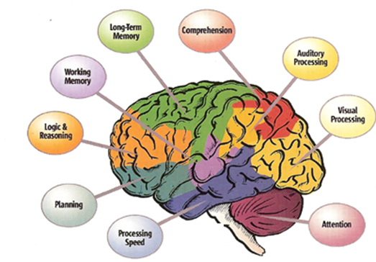
Create a toolkit for the classroom for those with ADHD
Attention
Impulsivity
Hyperactivity
3 groups
Things to think of…
Improving Social Skills
Improving Consistency of Performance
Increasing Compliance in the Classroom
Increasing Time On Task
Organizing Your ADHD Students
Presenting Lessons to ADHD Students
Room Set Up and ADHD Students
Dealing with Impulsive Behaviours

Slide 32
EF- Attention deficit
Poor concentration
  Inefficient attentional mechanisms
  Difficulty concentrating on tedious tasks
  Careless errors, lack of precision and attention to detail
  More difficulty with listening than looking – learning style
  Attentional mechanisms tire more quickly
Task Impersisitence
  Failure to complete tasks
Disorganisation
  Difficulty following sequences with supervision
Forgetfulness
  LTM better than STM
  Difficulty following instructions

Slide 33
EF- Impulsivity
Stop and think
  Difficulty with this before they act
  Often say the first thing that comes to mind
  Blurt out answers
  Tactless
  Risk taking
  Can’t wait their turn
Do not learn from mistakes
The problem isn’t that they don’t know the correct thing to do or tat they don’t want to do the right thing!
It’s their lack of SELF CONTROL

Slide 34
Why? Impulsivity deficit
The mechanisms that control behaviour in the brain seem unreliable
ADHD is a problem of performance, not of knowledge.
Russell Barkley PhD. – it’s not a matter of not knowing what to do, but of not being able to do what you know.
Difficult delaying gratification
  LT goals difficult
  Reward driven – immediate
So teaching a child to consider the consequences of their actions does not solve impulsivity.
  They lack the reflective and behavioural inhibition mechanisms needed to apply this to their everyday lives.
Act without thinking
  Risk taking
  Accident prone
Difficulty sharing and cooperating - groups

Slide 35
EF- Hyperactivity
On the go
  Restless
  Overactive
  Fidgeting
Difficulty remaining seated
  Walk about the classroom
Running and climbing
  Slips and trips
  Injuries
Boisterous and loud
  Difficulty engaging in quiet activities
Talk excessively
  Disruptive
Repetitive sounds
  Disruptive

Slide 36
Therapy Options
Behavioural treatment
Medication management
Combining medication/behavioural treatment
Educating parents/patient about ADHD
Educational support services
Notes:
A treatment plan should contain:
Patient and parent education.
Behavioural and/or medication management.
Educational support services.
Follow-up is necessary for:
Evaluation of home/school reports.
- Parent/school feedback.
Dose adjustment.
Re-evaluation of treatment plan and evaluation of other treatments.

Slide 37
Well-Established ADHD Treatments
Stimulant Medications
Behavioural Interventions
  Behavioural parent training
  Behavioural classroom management
  Intensive summer treatment programs
Pelham & Fabiano, 2008

Slide 38
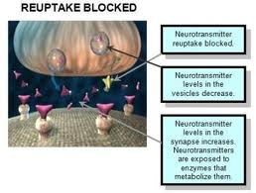
Medication: Stimulants
Most well-researched, effective, and commonly used medication treatment for ADHD.
  Methylphenidate (Ritalin, Concerta, and Metadate)
  Dextroamphetamine (Adderall)
These medications
reduce ADHD symptoms by:
  Blocking the reuptake of
  norepinephrine (NOR) and
  dopamine (DOP) and facilitating
  their release
  → Enhances NOR and DOP
  availability in in certain brain
  regions: PFC and basal ganglia
Notes:
Stimulants work by increasing norepinephrine and dopamine actions by blocking their reuptake and facilitating their release.
This leads to enhancement of norepinephrine and dopamine in certain brain regions including the prefrontal cortex and basal ganglia.

Slide 39
Stimulant Medications
Research has shown that stimulants:
  Are highly effective in reducing ADHD symptoms in the short term
  Decrease disruption in the classroom
  Increase academic productivity and on-task behaviour
  Improve teacher ratings of behaviour
Different formulations work best for different children
Common side effects: insomnia, decreased appetite
Strattera (atomoxetine)
  A non-stimulant alternative that works well for some children
  Has not been studied as long or as intensively as the stimulants
  Smaller effect size relative to the stimulants

Slide 40
Limitations of Stimulant Treatment
Individual differences in response
  Not all children respond (approximately 80%)
Limited impact on domains of functional impairment
  Primary reason for treatment seeking
Does not normalize behaviour
Family problems beyond the scope of medication
No long-term effects established
Long-term use rare
Limited parent/teacher satisfaction
Some families are not willing to try medication

Slide 41
Behavioral Treatment Components
Psychoeducation about ADHD
Structure/routines
Clear rules/expectations
Attending/rewards
Planned ignoring
Effective commands
Time out/loss of privileges
Point/token systems
Daily school-home report card
Intensive summer treatment programs

Slide 42
Behavioral Treatment Considerations
Need to address cross-situational impairments
  Poor generalization from treatment setting to real-world
  Implement treatments in all settings in which child shows impairment
School behaviour
  504 Plan/Individualized Education Plan (IEP)
  Academic interventions needed in addition to behavioural interventions (Raggi & Chronis, 2006)
Environmental contingencies must be delivered consistently, which is difficult to maintain
  Parental psychopathology can interfere with implementation

Slide 43
References
American Psychiatric Association (2013) Diagnostic and Statistical Manual of Mental Disorders. Fifth edition. Washington, DC: American Psychiatric Association.
Cortese S, Kelly C, Chabernaud C, et al. (2012) Toward systems neuroscience of ADHD: a meta-analysis of 55 fMRI studies. Am J Psychiatry; 169: 1038-1055.
World Health Organization. The ICD-10 Classification of Mental and Behavioural Disorders. Available at: www.who.int/entity/classifications/icd/en/bluebook.pdf. - See more at: http://www.adhd-institute.com/assessment-diagnosis/#sthash.iophPmFE.dpuf
Farone SV, Perlis RH, Doyle AE, et al. (2005) Molecular genetics of attention-deficit/hyperactivity disorder. Biol Psychiatry; 57: 1313-1323.
Larsson H, Asherson P, Chang Z, et al (2013) Genetic and environmental influences on adult attention deficit hyperactivity disorder symptoms: a large Swedish population-based study of twins. Psychol Med; 43: 197-207.
Gizer IR, Ficks C, Waldman ID (2009) Candidate gene studies of ADHD: a meta-analytic review. Hum Genet; 126: 51-90.
Grizenko N, Fortier ME, Zadorozny C, et al. (2012) Maternal Stress during Pregnancy, ADHD Symptomatology in Children and Genotype: Gene-Environment Interaction. J Can Acad Child Adolesc Psychiatry; 21: 9-15.
National Institute for Clinical Excellence. Full Guidance - Attention deficit hyperactivity disorder: Diagnosis and management of ADHD in children, young people and adults, March 2009.
http://www.adhd-institute.com/burden-of-adhd/impact-of-adhd/#relatedmedia

