Slide 1
Module Code : ACCA5036 – Scripting and Programming Concept
BSc (Hons) Cloud Computing
Week 09 – Error Handling & Program Testing
Dr Mobolanle Bello

Slide 2
Lesson Objectives
Error Handling
Common Python Errors
Basic Error Handling
Debugging Technique
Program Testing

Slide 3
ERROR HANDLING
The process of anticipating, detecting, and resolving programming, application, or communication errors.
Prevents the program from crashing by gracefully handling runtime errors.

Slide 4
Types of Errors
Common Types of Errors in Python
Syntax Errors
Runtime Errors
Logical Errors

Slide 5
SYNTAX ERRORS
A syntax error in Python occurs when the interpreter encounters code that doesn't conform to the language's syntax rules.
These errors prevent the code from being executed and must be corrected before the program can run.

Slide 6
Syntax Errors
Common Causes of Syntax Errors
Here are some common causes of syntax errors in Python:
Missing or Misplaced Punctuation
Incorrect Indentation
Mismatched Parentheses or Brackets
Invalid Variable Names
Incorrect Use of Keywords

Slide 7
Syntax Errors
1) Missing or Misplaced Punctuation: Forgetting to include colons, commas, or parentheses.
Python Example
if x > 10 # Missing colon
print("x is greater than 10")

Slide 8
Syntax Errors
2) Incorrect Indentation: Python relies on indentation to define code blocks.
Python Example
def greet(name):
print(f"Hello, {name}!") # Incorrect indentation

Slide 9
Syntax Errors
3) Mismatched Parentheses or Brackets:
Not closing parentheses, brackets, or braces.
Python Example
print("Hello, World!" # Missing closing parenthesis

Slide 10
Syntax Errors
4) Invalid Variable Names:
Using reserved keywords or invalid characters in variable names.
Python Example
1st_name = "Alice" # Variable name cannot start with a number

Slide 11
Syntax Errors
5) Incorrect Use of Keywords:
Misusing Python keywords or functions.
Python Example
for i in range(5)
print(i) # Missing colon

Slide 12
Identifying Syntax Errors
When a syntax error occurs, Python provides an error message that includes the type of error and the line number where it was detected. This helps in identifying and fixing the issue.
Python Example:
print("Hello, World!" # SyntaxError: unexpected EOF while parsing

Slide 13
Fixing Syntax Errors
To fix syntax errors, carefully read the error message and review the code around the indicated line. Here are some steps to follow:
- Check for Typos: Look for any typos or missing punctuation.
- Verify Indentation: Ensure that all code blocks are properly indented.
- Match Parentheses and Brackets: Make sure all opening parentheses, brackets, and braces have corresponding closing ones.
- Use Valid Variable Names: Ensure variable names follow Python's naming conventions.
- Correct Keyword Usage: Verify that all keywords and functions are used correctly.

Slide 14
LOGICAL ERRORS
A logical error in programming occurs when the code runs without crashing but produces incorrect or unintended results.
These errors are often more challenging to detect and fix because the program doesn't provide explicit error messages.

Slide 15
Common Causes of Logical Errors
Logical errors can arise from various sources, including:
1) Incorrect Algorithm: Using the wrong algorithm or an incorrect implementation of an algorithm.
Python Example
# Incorrect algorithm for finding the maximum value
def find_max(numbers):
max_value = 0
for num in numbers:
if num > max_value:
max_value = num
return max_value
print(find_max([1, 2, 3, 4, 5])) # Incorrect result: 5 (correct), but fails for negative numbers

Slide 16
Common Causes of Logical Errors
2) Faulty Logic: Errors in the logical flow of the program, such as incorrect conditions in `if` statements or loops.
Python Example
# Incorrect condition in an if statement
def is_even(number):
if number % 2 = 0: # Should be '=='
return True
else:
return False
print(is_even(4)) # SyntaxError, but if it were '==', it would be correct

Slide 17
Common Causes of Logical Errors
3) Incorrect Use of Operators: Using the wrong operators or incorrect precedence of operators.
Python Example
# Incorrect use of operators
def calculate_area(length, width):
return length + width * 2 # Should be (length + width) * 2
print(calculate_area(5, 3)) # Incorrect result: 11 (should be 16)

Slide 18
Common Causes of Logical Errors
4) Off-by-One Errors: Errors that occur when a loop iterates one time too many or too few.
Python Example
# Off-by-one error in a loop
def sum_numbers(n):
total = 0
for i in range(1, n): # Should be range(1, n+1)
total += i
return total
print(sum_numbers(5)) # Incorrect result: 10 (should be 15)

Slide 19
Common Logical Errors
Zero Division Error
Index Error

Slide 20

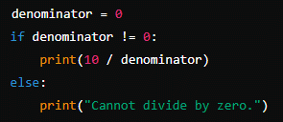
Logical Error
Zero Division Error
Dividing a number by zero, which is mathematically undefined and not allowed in programming.
Correct code

Slide 21


Logical Error
Index Error
Attempting to access an index that is out of range (index 3 where the last index is 2 in a list of three elements)
Correct code

Slide 22
Identifying Logical Errors
Logical errors can be identified through careful testing and debugging. Here are some techniques:
1) Print Statements: Insert print statements to check the values of variables at different points in the code.
Python Example
def find_max(numbers):
max_value = 0
for num in numbers:
print(f"Checking number: {num}, current max: {max_value}")
if num > max_value:
max_value = num
return max_value
print(find_max([1, 2, 3, 4, 5]))

Slide 23
Identifying Logical Errors
2) Unit Testing: Write unit tests to verify that individual parts of the code work as expected.
Python Example
import unittest
def add(a, b):
return a + b
class TestMathFunctions(unittest.TestCase):
def test_add(self):
self.assertEqual(add(2, 3), 5)
self.assertEqual(add(-1, 1), 0)
if __name__ == "__main__":
unittest.main()

Slide 24
Identifying Logical Errors
3) Debugging Tools: Use debugging tools available in IDEs to step through the code and inspect variable values.
Python Example
# Example using a debugger in an IDE like PyCharm or VSCode
def calculate_area(length, width):
area = (length + width) * 2
return area
print(calculate_area(5, 3))

Slide 25
Fixing Logical Errors
To fix logical errors, follow these steps:
Understand the Problem: Clearly understand the expected behaviour and the actual behaviour of the code.
Isolate the Error: Narrow down the part of the code where the error occurs.
Analyse the Logic: Review the logic and ensure it aligns with the intended algorithm or process.
Test Thoroughly: After making changes, test the code thoroughly to ensure the error is fixed and no new errors are introduced.

Slide 26
Run Time Error
A run-time error in Python occurs while the program is running, causing it to terminate unexpectedly.
These errors are different from syntax errors, which are detected before the program runs, and logical errors, which produce incorrect results without stopping the program.

Slide 27
Common Causes of Run-Time Errors
Here are some common causes of run-time errors in Python:
Division by Zero
Invalid Operations
Accessing Non-Existent Elements
File Not Found
Out of Memory

Slide 28
Common Causes of Run-Time Errors
1) Division by Zero: Attempting to divide a number by zero.
Python Example
x = 10 / 0 # ZeroDivisionError: division by zero

Slide 29
Common Causes of Run-Time Errors
2) Invalid Operations: Performing operations on incompatible types.
Python Example
result = "hello" + 5 # TypeError: can only concatenate str (not "int") to str

Slide 30
Common Causes of Run-Time Errors
3) Accessing Non-Existent Elements: Trying to access elements in a list or dictionary that don't exist.
Python Example
my_list = [1, 2, 3]
print(my_list[5]) # IndexError: list index out of range

Slide 31
Common Causes of Run-Time Errors
4) File Not Found: Attempting to open a file that doesn't exist.
Python Example
with open("non_existent_file.txt", "r") as file:
content = file.read() # FileNotFoundError: [Errno 2] No such file or directory: 'non_existent_file.txt'

Slide 32
Common Causes of Run-Time Errors
5) Out of Memory: Running out of memory due to excessive resource usage.
Python Example
large_list = [0] * (10**10) # MemoryError

Slide 33
Handling Run-Time Error with Exceptions
Python provides a way to handle run-time errors using exceptions. By using `try` and `except` blocks, you can catch and handle exceptions gracefully, preventing the program from crashing.
Python Example
try:
x = 10 / 0
except ZeroDivisionError:
print("Cannot divide by zero!")
try:
result = "hello" + 5
except TypeError:
print("Cannot concatenate a string and an integer!")
try:
my_list = [1, 2, 3]
print(my_list[5])
except IndexError:
print("List index out of range!")
try:
with open("non_existent_file.txt", "r") as file:
content = file.read()
except FileNotFoundError:
print("File not found!")

Slide 34
Handling Run-Time Error with Exceptions
Using Multiple Except Blocks
You can handle different types of exceptions separately by using multiple `except` blocks.
Python Example:
try:
# Some code that may raise multiple exceptions
x = 10 / 0
result = "hello" + 5
except ZeroDivisionError:
print("Cannot divide by zero!")
except TypeError:
print("Cannot concatenate a string and an integer!")

Slide 35
Handling Run-Time Error using Else and Finally Clauses
The `else` clause can be used to specify code that should run if no exceptions are raised. The `finally` clause can be used to specify code that should run regardless of whether an exception is raised or not.
Python Example:
try:
x = 10 / 2
except ZeroDivisionError:
print("Cannot divide by zero!")
else:
print("Division successful!")
finally:
print("This will always be executed.")

Slide 36
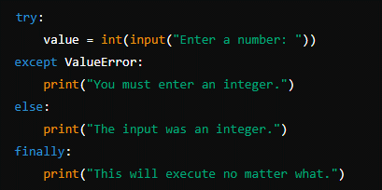
else and finally
else Block: Runs if the try block does not raise an exception.
finally Block: Executes after all other blocks, always runs, used for clean-up activities.
Example

Slide 37
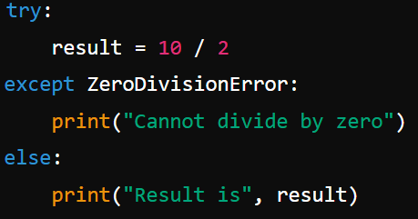
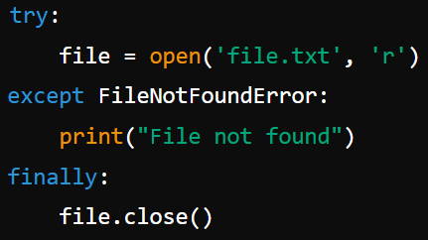
Else and Finally Blocks
Else and Finally Blocks
Notes:
Else and Finally
Else and Finally Blocks
Else Block:
pythonCopy code
try: result = 10 / 2
except ZeroDivisionError: print("Cannot divide by zero")
else: print("Result is", result)
Finally Block:
pythonCopy code
try: file = open('file.txt', 'r') except FileNotFoundError: print("File not found") finally: file.close()

Slide 38
Handling Run-Time Error
6) Raising Exceptions
You can also raise exceptions manually using the `raise` statement. This is useful for enforcing certain conditions in your code.
Python Example:
def check_positive(number):
if number < 0:
raise ValueError("Number must be positive!")
return number
try:
check_positive(-5)
except ValueError as e:
print(e)

Slide 39

Raising Exceptions
Deliberately trigger an exception when a certain condition is met.
Syntax: raise ExceptionType("Message")
Example
Notes:
if x < 0: raise ValueError("Negative values are not allowed")

Slide 40

Raising Exceptions
You can trigger an Exceptions
Notes:
if x < 0: raise ValueError("Negative values are not allowed")

Slide 41
DEBUGGING TECHNIQUES AND TOOLS
Debugging is a crucial part of the software development process, helping developers identify and fix errors in their code.

Slide 42
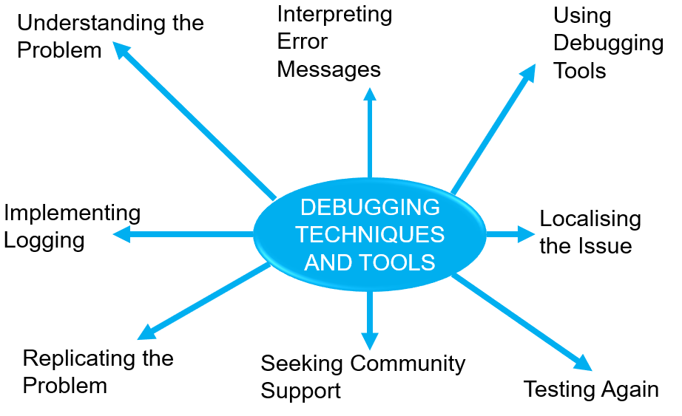

Slide 43
Debugging Techniques and Tools
1)Understanding the Problem
Before diving into debugging, it's essential to understand the problem.
Identifying symptoms of an issue, such as crashes or unexpected behaviour, and gathering relevant information like error messages, logs, and context is crucial for resolving the problem.

Slide 44
Debugging Techniques and Tools
2) Interpreting Error Messages
Error messages and stack traces provide valuable clues about the source of the problem.
Key steps include analysing error messages carefully to understand the issue and following the stack trace to pinpoint the code location where the error occurred.

Slide 45
Debugging Techniques and Tools
3) Using Debugging Tools
Debugging tools are essential for inspecting and controlling the execution of your code. Common tools and techniques include:
Setting Breakpoints: Pause the execution of your program at specific points to inspect the state of variables and the flow of execution.
Stepping Through Code: Execute your code line by line to observe its behaviour and identify where things go wrong.
Analysing Program Flow: Use the debugger to follow the program's flow and understand how data is being manipulated.

Slide 46
Debugging Techniques and Tools
4) Implementing Logging
Logging is a powerful technique for tracking the execution of your code and identifying issues. Key practices include:
Inserting Log Statements: Add log statements at critical points in your code to record the state of variables and the flow of execution.
Analysing Logs: Review log files to identify patterns and anomalies that may indicate the source of the problem.

Slide 47
Debugging Techniques and Tools
5) Localising the Issue
Narrowing down the scope of the problem helps in isolating the root cause. Techniques include:
Isolating Components: Focus on specific modules or components that are likely to be causing the issue.
Binary Search: Use a divide-and-conquer approach to systematically narrow down the location of the problem.

Slide 48
Debugging Techniques and Tools
6) Replicating the Problem
Reproducing the issue consistently is crucial for effective debugging.
Steps include identifying the problem's trigger conditions and creating test cases to consistently reproduce the issue are crucial steps in problem-solving.

Slide 49
Debugging Techniques and Tools
7) Seeking Community Support
Sometimes, seeking help from the community can provide valuable insights. This involves:
Using Online Forums: Post questions on forums like Stack Overflow to get help from other developers.
Collaborating with Peers: Discuss the problem with colleagues or peers who might have encountered similar issues.

Slide 50
Debugging Techniques and Tools
8) Testing Again
After making changes to fix the issue, it's important to test thoroughly to ensure the problem is resolved and no new issues are introduced. This includes:
Regression Testing: Run tests to ensure that recent changes haven't broken existing functionality.
Continuous Testing: Integrate automated tests into your development workflow to catch issues early.

Slide 51
Popular Python Debugging Tools
Python has several great debugging tools that help developers identify and fix issues efficiently.

Slide 52
Popular Debugging Tools for Python
pdb (Python Debugger) – Python's built-in debugging tool that allows step-by-step execution, breakpoints, and variable inspection.
faulthandler – Helps debug crashes by displaying a traceback of where the error occurred.
PyCharm Debugger – Comes with PyCharm, providing an intuitive interface for breakpoints, stepping, and variable evaluation.
Visual Studio Code Debugger – Integrated debugger in VS Code, supporting breakpoints and step execution.
pyrasite – Injects debugging code into running Python processes, useful for debugging live applications.
PySnooper – An easy-to-use debugging tool that logs variable changes and execution flow automatically.

Slide 53
WHY TEST YOUR CODE?
The Importance of Testing
Catch Bugs Early: Prevent errors from going live.
Save Time: Reduces debugging and maintenance time.
Improve Code Quality: Ensures each part of your code does what it should.
Enhance Readability: Tests serve as documentation of intended behaviour.

Slide 54
PROGRAM TESTING
Program testing is a critical process in software development that ensures the code behaves as expected and meets the requirements.

Slide 55
TYPES OF TESTING
Unit Testing: Testing individual components or functions of the program in isolation.
Integration Testing: Testing how different components interact with each other.
Functional Testing: Ensuring that the program functions according to specified requirements.
Regression Testing: Verifying that new changes haven’t adversely affected existing functionalities.
System Testing: Testing the entire system as a whole.

Slide 56
Unit Tests vs. Integration Tests
Unit Testing
Tests individual functions or methods in isolation.
Verifies that each piece of the code works independently.
Integration Testing
Tests multiple components working together.
Ensures that individual units interact correctly within the system.
Use Cases
Unit Tests: Ideal for validating specific functions.
Integration Tests: Useful for ensuring components work together

Slide 57
THE TEST PLANNING PROCESS
The test planning process is a crucial phase in software testing that involves defining the scope, approach, resources, and schedule of testing activities.
It ensures that testing is well-organized and effective.

Slide 58
The Test Planning Process
The test planning process is essential for ensuring that testing is well-organised, efficient, and effective.
By defining the scope, objectives, approach, resources, schedule, and deliverables, you can ensure that testing activities are aligned with project goals and requirements.

Slide 59
The Test Planning Process
The test planning process is essential for ensuring that testing is well-organised, efficient, and effective.
By defining the scope, objectives, approach, resources, schedule, and deliverables, you can ensure that testing activities are aligned with project goals and requirements.

Slide 60
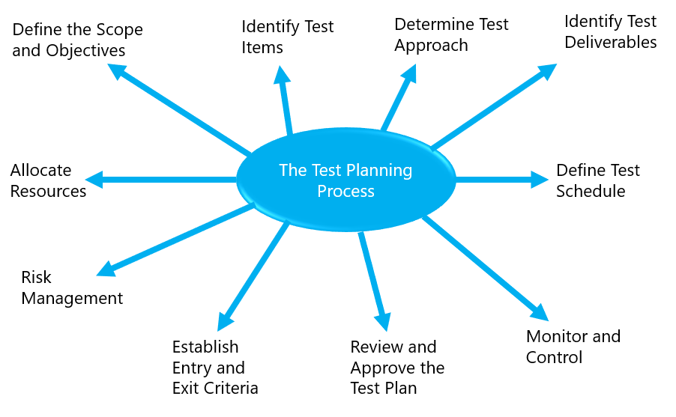

Slide 61
The Test Planning Process
1) Define the Scope and Objectives
Scope: Determine what will be tested and what will not be tested. This includes identifying the features, functionalities, and components to be tested.
Objectives: Define the goals of testing, such as finding defects, ensuring quality, and verifying that the software meets requirements.

Slide 62
The Test Planning Process
2) Identify Test Items
Test Items: List the items to be tested, including software modules, interfaces, and data flows.
Dependencies: Identify any dependencies between test items and other components or systems.

Slide 63
The Test Planning Process
3) Determine Test Approach
Testing Levels: Decide on the levels of testing to be performed, such as unit testing, integration testing, system testing, and acceptance testing.
Testing Types: Choose the types of testing to be conducted, such as functional testing, performance testing, security testing, and usability testing.
Testing Techniques: Select the testing techniques to be used, such as black-box testing, white-box testing, and exploratory testing.

Slide 64
The Test Planning Process
4) Identify Test Deliverables
Test Plan: A document outlining the test strategy, objectives, scope, resources, schedule, and deliverables.
Test Cases: Detailed test cases that specify the inputs, actions, and expected results for each test.
Test Scripts: Automated test scripts for executing tests.
Test Data: Data required for executing test cases.
Test Reports: Reports summarising the test results, defects found, and overall quality of the software.

Slide 65
The Test Planning Process
5) Allocate Resources
Test Team: Identify the team members responsible for testing, including their roles and responsibilities.
Tools and Environment: Determine the tools and environment needed for testing, such as test management tools, automation tools, and test environments.

Slide 66
The Test Planning Process
6) Define Test Schedule
Timeline: Create a timeline for testing activities, including start and end dates for each phase of testing.
Milestones: Identify key milestones and deliverables, such as the completion of test case design, test execution, and test reporting.

Slide 67
The Test Planning Process
7) Risk Management
Identify Risks: Identify potential risks that could impact testing, such as resource constraints, technical challenges, and schedule delays.
Mitigation Strategies: Develop strategies to mitigate identified risks, such as contingency plans and risk-based testing approaches.

Slide 68
The Test Planning Process
8) Establish Entry and Exit Criteria
Entry Criteria: Define the conditions that must be met before testing can begin, such as the availability of test environments and test data.
Exit Criteria: Define the conditions that must be met before testing can be considered complete, such as the completion of all test cases and the resolution of critical defects.

Slide 69
The Test Planning Process
9) Review and Approve the Test Plan
Review: Conduct a review of the test plan with stakeholders, including project managers, developers, and business analysts.
Approval: Obtain approval for the test plan from relevant stakeholders to ensure alignment and commitment.

Slide 70
The Test Planning Process
10) Monitor and Control
Progress Tracking: Monitor the progress of testing activities against the test plan.
Adjustments: Make adjustments to the test plan as needed based on changes in scope, schedule, or resources.

Slide 71
TEST CASE DEVELOPMENT
Test case development is a crucial part of the software testing process.
It involves creating detailed test cases that specify the inputs, actions, and expected results for each test.

Slide 72
Test Case Development
Test case development is a systematic process that involves understanding requirements, defining test objectives, designing detailed test cases, creating test data, and reviewing and maintaining the test cases.
Well-developed test cases ensure thorough testing and help in identifying defects early in the development process.

Slide 73
Test Case Development
Test case development is a systematic process that involves understanding requirements, defining test objectives, designing detailed test cases, creating test data, and reviewing and maintaining the test cases.
Well-developed test cases ensure thorough testing and help in identifying defects early in the development process.

Slide 74
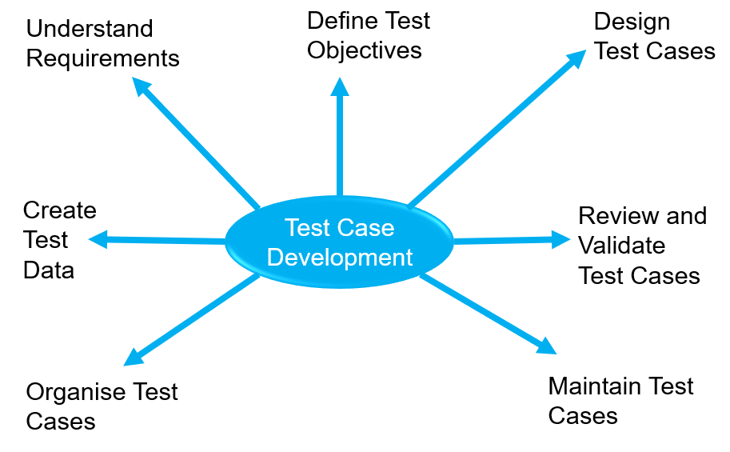

Slide 75
Test Case Development
1) Understand Requirements
Gather Requirements: Review the software requirements specification (SRS) and other relevant documents to understand the functionality and behaviour of the system.
Identify Test Scenarios: Identify high-level test scenarios that cover the different functionalities and use cases of the system.

Slide 76
Test Case Development
2) Define Test Objectives
Purpose: Determine the purpose of each test case, such as verifying a specific functionality, validating a business rule, or checking for boundary conditions.
Scope: Define the scope of the test case, including what will be tested and what will not be tested.

Slide 77
Test Case Development
3) Design Test Cases
Test Case ID: Assign a unique identifier to each test case for easy reference.
Test Case Description: Provide a brief description of the test case, including its purpose and scope.
Preconditions: Specify any preconditions that must be met before executing the test case, such as the state of the system or the availability of test data.
Test Steps: List the detailed steps to be followed during the test, including the inputs to be provided and the actions to be performed.
Expected Results: Define the expected results for each step, including the expected output, system behaviour, and any changes to the system state.
Postconditions: Specify any postconditions that should be verified after executing the test case, such as the state of the system or the availability of test data.

Slide 78
Test Case Development
4) Create Test Data
Identify Test Data: Identify the data required for executing the test cases, including input values, expected output values, and any other relevant data.
Prepare Test Data: Prepare the test data, ensuring it covers different scenarios, including valid, invalid, boundary, and edge cases.

Slide 79
Test Case Development
5) Review and Validate Test Cases
Peer Review: Conduct a peer review of the test cases to ensure they are complete, accurate, and clear.
Validation: Validate the test cases against the requirements to ensure they cover all the necessary scenarios and meet the test objectives.

Slide 80
Test Case Development
6) Organise Test Cases
Test Case Repository: Organise the test cases in a test case repository, such as a test management tool or a spreadsheet, for easy access and management.
Categorisation: Categorise the test cases based on different criteria, such as functionality, module, or priority, to facilitate test execution and reporting.

Slide 81
Test Case Development
7) Maintain Test Cases
Update Test Cases: Update the test cases as needed to reflect changes in the requirements, design, or implementation of the system.
Version Control: Use version control to manage changes to the test cases and maintain a history of revisions.

Slide 82
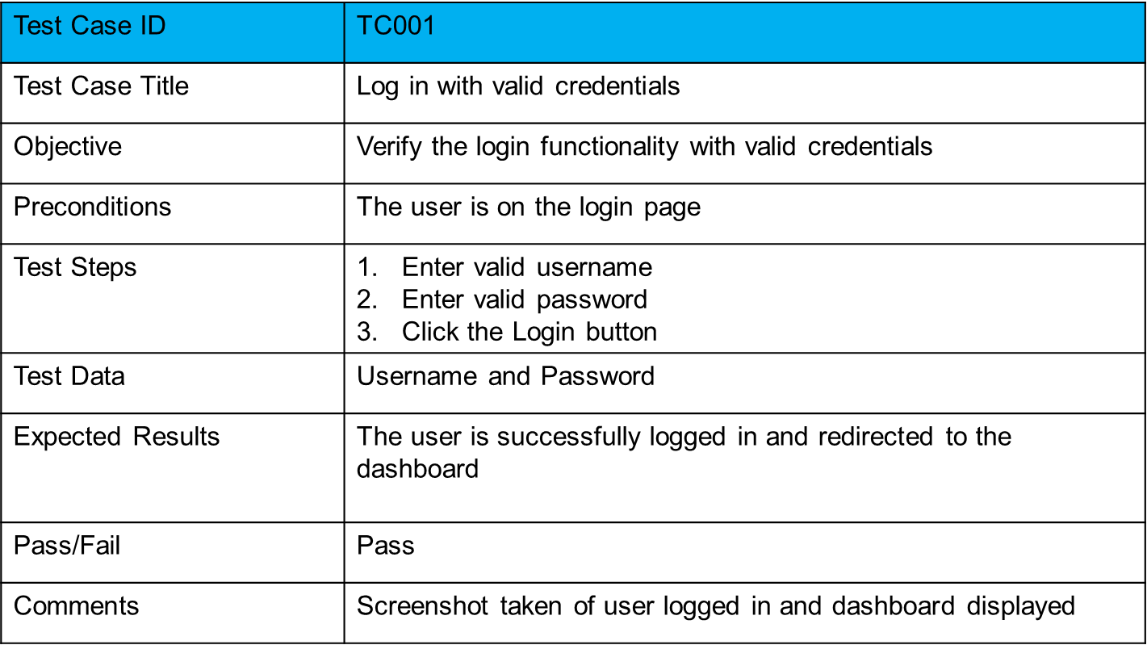
Test Case Development
Example of a Test Case Template

Slide 83
Exercise
Do the following quiz on Moodle: Quiz - Error Handling
Do the following quiz on Moodle: Quiz - Error Handling II

Slide 84
Questions and Answers

