Slide 1
This academic presentation summarises a hackathon concept for a smart nutrition platform that automates weekly meal planning, grocery preparation, meal alarms and feedback-driven adjustment for users with different goals, diet types and health conditions. The design frames NutriFlow as a practical decision-support system that reduces decision fatigue while staying aligned with healthy-diet and behaviour-change guidance [1]-[5].
NutriFlow: An Intelligent Meal-Planning Platform for Healthier Living
Module: ACCB6019 Emerging Trends
Assessment: Hackathon 2026 Team Presentation
Team: Uri Neto, Kelvin Tavares, Ima David, Malinson Gonzalez
Notes:
[Sources]
- User-provided report and embedded interface images from NutriFlow_report_optionA_sourcesbacked.docx. Claims summarised from report sections 1, 3, and references [1]-[5].
[/Sources]

Slide 2
Presentation roadmap
The presentation covers six linked areas: the nutrition-planning problem and the proposed solution; research on existing digital nutrition systems and the gap NutriFlow addresses; the platform's core features and expert-system logic; system architecture, process flow and interface prototype; team planning and development phasing; and a final evaluation discussing benefits, limitations, ethics and future improvements.
1. Problem statement and proposed solution
2. Research, existing solutions and market gap
3. Core features and intelligent decision logic
4. Architecture, process design and user interface
5. Team-working, scope control and timeline
6. Evaluation, ethics, conclusion and references
2
Notes:
[Sources]
- Structure derived from report contents page and main sections in the uploaded document.
[/Sources]

Slide 3
Problem statement and proposed solution
Healthy eating is not only a knowledge problem; it is also a planning and routine problem.
Maintaining a healthy lifestyle is difficult because balanced eating requires time, planning, shopping discipline and routine adherence. Users often know they should eat better, but busy schedules, irregular grocery habits and dependence on processed food make healthy choices hard to sustain [1], [2].
Current daily food choices involve repeated micro-decisions about calories, meal timing, portion suitability, dietary restrictions and what ingredients are available at home. This creates decision fatigue and often pushes users toward convenience rather than nutrition quality.
NutriFlow responds by shifting support earlier in the process: it collects user profile data, estimates calorie needs, generates a weekly meal plan, creates a shopping list, supports ordering, sets meal alarms and adapts future recommendations from feedback.
The concept therefore positions the platform as a digital planning assistant rather than a simple tracking diary. Its value proposition is reduced effort, stronger personalisation and better practical follow-through.
3
Notes:
[Sources]
- Summarised from report section 1 and section 3.5. In-text citations [1] and [2] retained from the report. Images are embedded prototype screens from the uploaded report.
[/Sources]

Slide 4
Research and gap in existing nutrition applications
The literature supports mobile nutrition tools, but it also reveals a gap between tracking and proactive planning.
What existing apps do well
What still remains missing
Applications such as MyFitnessPal, Lifesum and Yazio are widely used for food logging, calorie monitoring and weight management. Studies cited in the report show that digital nutrition tools can support healthier behaviour and improved management of obesity or diabetes when users engage with them consistently [6]-[8]. Recent AI-assisted diet systems also suggest that users value greater personalisation and more adaptive support [6], [7].
However, the dominant model still depends heavily on manual input. Most systems ask users to record what they have already eaten, interpret calories themselves and organise shopping separately. NutriFlow addresses four linked gaps: weak meal-decision automation, incomplete personalisation, poor grocery integration and limited adherence support. By combining calorie estimation, meal generation, shopping preparation and reminders in one workflow, the concept aims to move from passive monitoring to active decision support.
Notes:
[Sources]
- Based on report section 2 and references [6]-[8].
[/Sources]

Slide 5
System features and functionality
NutriFlow integrates multiple user-facing functions into a single weekly planning workflow.
User profile capture records age, height, current weight, target weight, diet type, selected health condition and preferred number of meals per day. This allows the system to distinguish between users who want three large meals and users who prefer smaller meals with snacks.
Calorie logic estimates a daily target from the relationship between current weight, target weight and goal category. Maintenance, weight-loss and weight-gain profiles therefore receive different targets rather than a generic recommendation.
Weekly meal generation combines diet type, health-condition rules and meal frequency. A vegetarian user with four meals per day and a carnivore user with three meals per day can therefore receive different plan structures, not just different recipes.
The shopping module aggregates ingredients across the week into one grocery list and prepares them for preferred-store ordering. Meal alarms support adherence, while feedback on hunger, satisfaction or fullness enables later adjustment [5], [9], [10].
Notes:
[Sources]
- Derived from report section 3 and references [5], [9], [10]. Prototype images taken from uploaded report.
[/Sources]

Slide 6
Intelligent decision-making and expert system logic
The system uses rule-based inference rather than black-box machine learning.
NutriFlow is described in the report as a basic AI-style decision process, but technically it is closer to a lightweight expert system. In a classical expert system, a knowledge base is combined with inference rules to reach decisions. NutriFlow follows the same pattern in simplified form: user inputs are compared against diet definitions, nutrition values, allergy constraints, health-condition rules and calorie formulas so that the meal engine selects only options that fit the profile [6]-[8].
Knowledge base: meals, ingredient values, diet definitions, health rules
Inference rules: filter, calculate, match, replace, aggregate
This means the platform does not randomly guess meals. It first captures inputs such as age, weight, goal, activity level, allergies, diet type and restrictions, then calculates calorie and protein targets. After that, the decision layer filters the meal database, matches suitable meals and supports controlled replacements when the user swaps or regenerates items. The result is a structured planning workflow that is explainable, auditable and easier to justify academically than an opaque recommendation model.
Interface actions: generate, swap, remove, regenerate, feedback
Outputs: meal plan, shopping list, reminders, later plan adjustment
Notes:
[Sources]
- Based on report section 4 and references [6]-[8].
[/Sources]

Slide 7
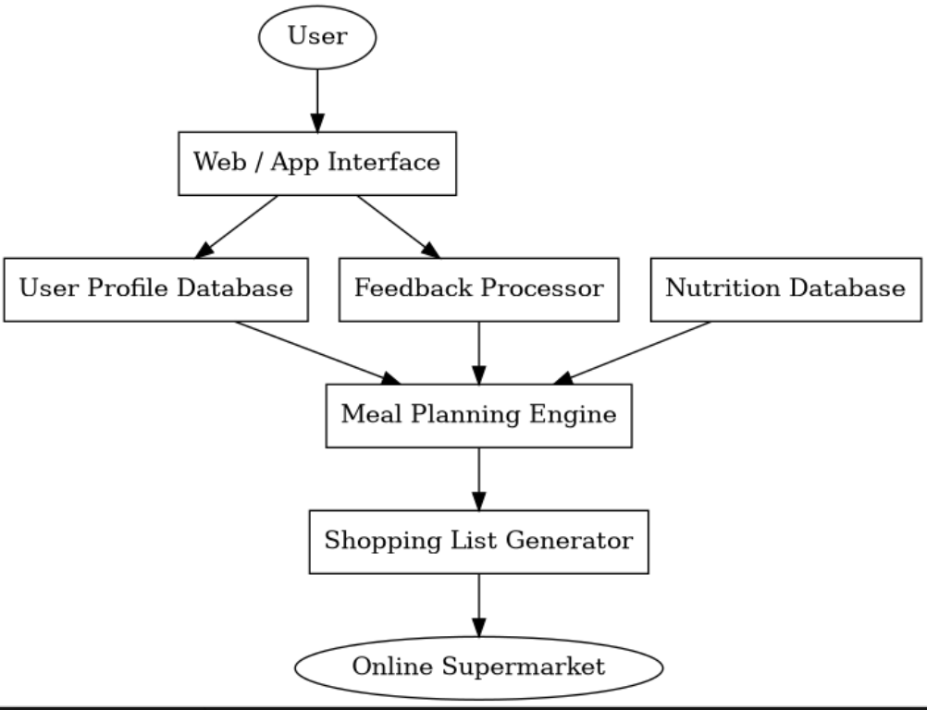
System architecture
The proposed platform is modular so that each service can be explained, prototyped and extended independently.
The architecture begins with the user-facing web interface, which sends profile and preference data to the profile module. The meal-planning engine then calculates nutrition targets and applies diet and health-condition rules using its internal database. Output is passed to three connected services: a shopping module that aggregates ingredients, a reminder scheduler that prepares meal alarms and a feedback processor that stores user responses for future adjustment. This modularity is academically important because it shows separation of concerns and makes the concept scalable for later integration with retailer APIs, secure user accounts or wearable-device data.
Figure 1. NutriFlow system architecture.
Notes:
[Sources]
- Content based on report section 5. Architecture figure extracted from uploaded report.
[/Sources]

Slide 8
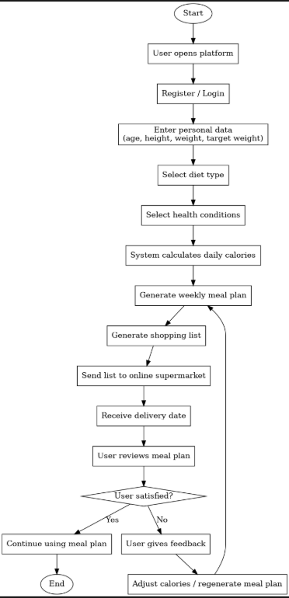
Process design and feedback loop
The process flow shows that NutriFlow is not a one-off planner but a cyclical support system.
The process starts with registration and profile entry, followed by diet selection, health-condition selection and preferred meal frequency. The system then calculates calorie needs, generates the weekly meal plan, schedules meal reminders and builds the shopping list. After the user follows the plan, feedback is collected on hunger, satisfaction or fullness. A decision node then checks whether the user response suggests the plan was appropriate. If the answer is no, the system adjusts targets or composition and regenerates the plan. This is important because it reframes nutrition support as an iterative behaviour process rather than a fixed recommendation produced once and never reviewed [9], [10].
Figure 2. NutriFlow process flow.
Notes:
[Sources]
- Based on report section 5 and references [9]-[10]. Process figure extracted from uploaded report.
[/Sources]

Slide 9
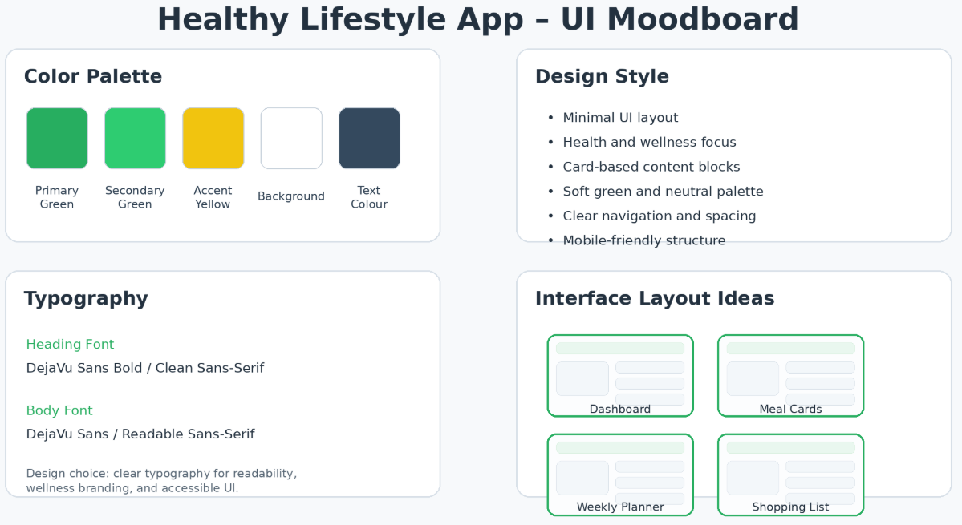
User interface design direction
The visual design aims to communicate health, clarity and routine support without appearing overly clinical.
The moodboard uses green as the primary accent colour because it is strongly associated with freshness, wellbeing and food. White and light neutral backgrounds keep the interface readable, while rounded cards and spacious layouts make the system feel calm rather than technical. Sans-serif typography supports legibility across dashboards and forms. This design choice matters because users interact with the logic through the interface layer. A strong interface does not merely look attractive; it reduces friction when users enter profile data, read meal plans, inspect shopping lists and respond to reminders or feedback prompts [10].
Figure 3. NutriFlow moodboard.
Notes:
[Sources]
- Based on report section 6.1 and reference [10]. Moodboard figure extracted from uploaded report.
[/Sources]

Slide 10
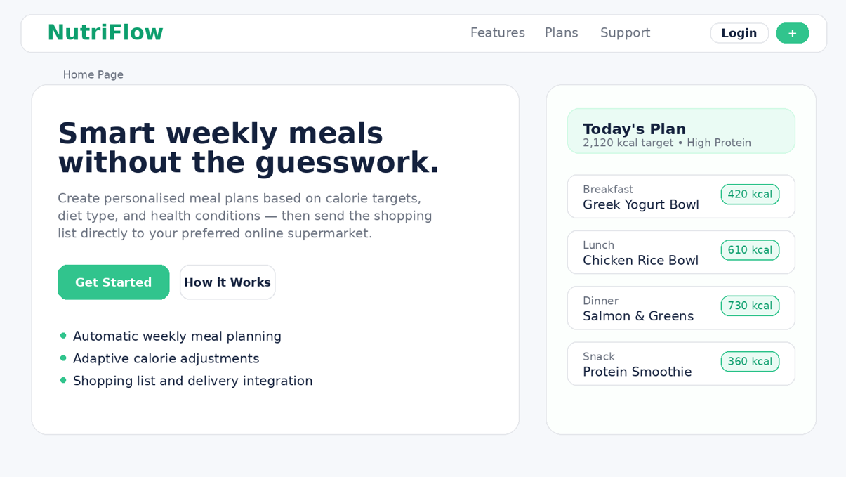
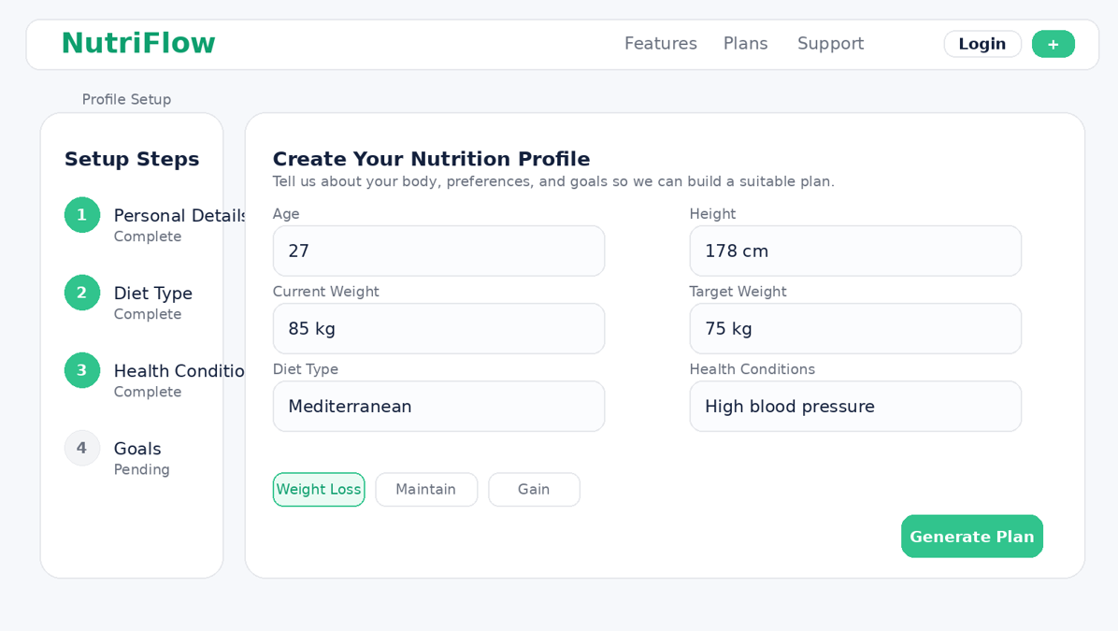
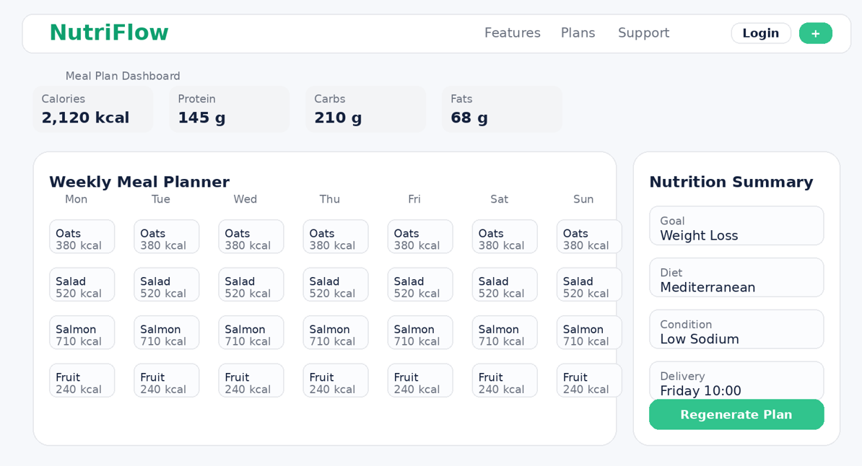
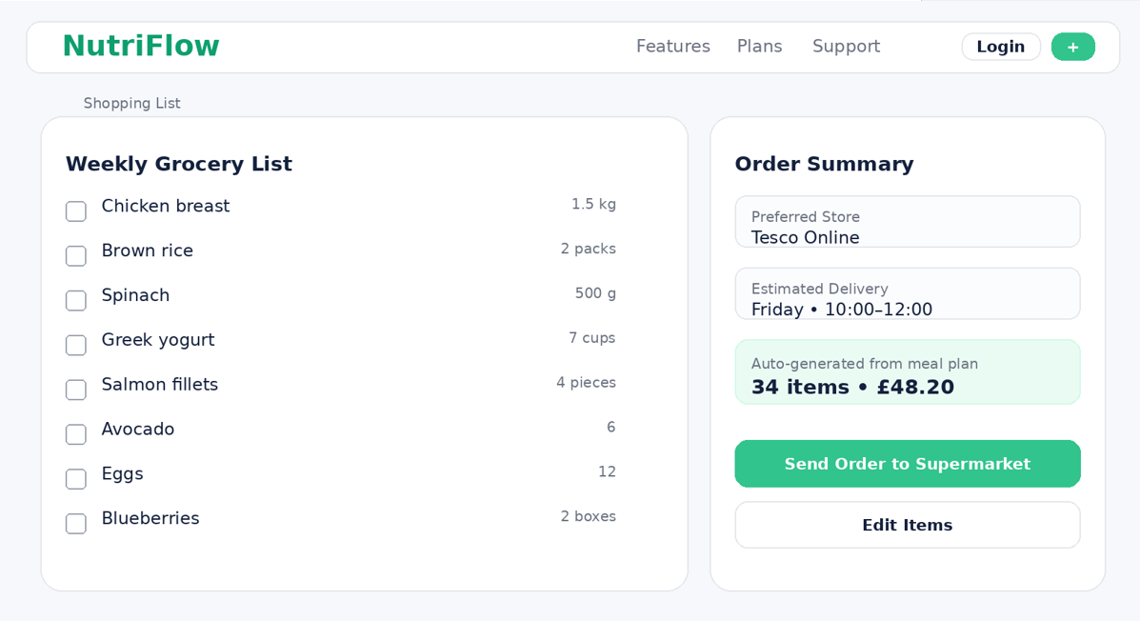
Prototype mockups and user journey
The prototype visualises how the concept translates from report logic into a usable browser-based workflow.
The home page introduces the service and highlights automated meal planning, adaptive calorie adjustment and shopping-list integration. The profile page captures planning variables such as age, height, weight, diet type and health condition. The dashboard then presents the weekly meal plan with calories and macro information, while the shopping page consolidates ingredients and delivery details. Together these screens demonstrate the transition from concept to interaction design. They also support the hackathon presentation because the prototype can be run locally in a browser without dependence on external systems.
Home page
Profile setup
Meal plan dashboard
Shopping list
Notes:
[Sources]
- Based on report section 6.2 and 6.3. All four mockup images extracted from uploaded report.
[/Sources]

Slide 11
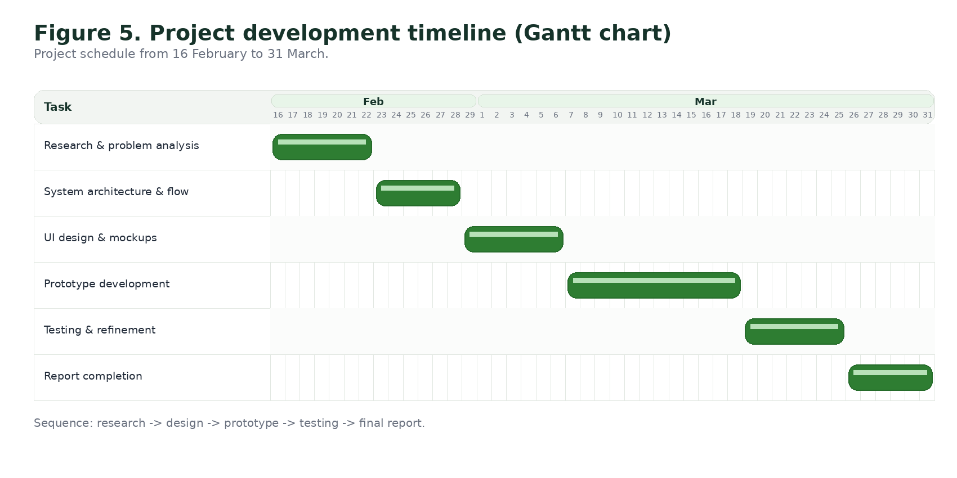
Team-working, scope control and project timeline
The project plan balances conceptual depth, visible output and feasibility within a hackathon context.
The team organised the project across research, planning, design and prototype preparation so that technical choices stayed aligned with the presentation and report. Scope control was essential. The team prioritised profile capture, calorie estimation, diet-aware meal generation, shopping-list creation, meal alarms and feedback-driven adjustment because these features best demonstrate innovation and user value within limited time. More complex elements such as real payment handling, retailer APIs and advanced machine learning were postponed as future development items.
The development phases run from requirements analysis and system design to prototype production, testing and final packaging. The Gantt chart shows the sequence from research and architecture design to interface work, prototype development, testing and report completion.
Figure 5. Project development timeline (Gantt chart).
Notes:
[Sources]
- Based on report section 7. Timeline figure extracted from uploaded report.
[/Sources]

Slide 12
Evaluation: benefits, feasibility and limitations
Evaluation considers practical usefulness as well as design and implementation constraints.
Benefits: NutriFlow reduces decision fatigue by automating weekly meal planning, improves convenience through shopping-list generation and delivery preparation, and offers broader personalisation than simple calorie trackers because it combines weight goals, diet type, health condition, meal frequency and feedback.
Feasibility: the prototype is cost-feasible because the concept can be demonstrated with common front-end tools and simulated data before expensive infrastructure is required. A staged rollout with a free core planner could reduce financial risk while proving user demand.
Limitations: recommendation quality depends on accurate user input, the rule base is simplified and does not replace a clinician or dietitian, and nutritional suitability does not guarantee the user will enjoy the food. Taste preference remains a significant barrier to adherence.
Overall, the concept is strongest as a decision-support tool that makes healthy eating more manageable, not as a medical diagnosis system or a fully autonomous nutrition advisor.
12
Notes:
[Sources]
- Based on report section 8.1-8.3.
[/Sources]

Slide 13
Ethical, privacy and future-development considerations
Because the platform handles diet and health-related data, governance matters as much as interface quality.
Ethics and privacy
Future improvements
NutriFlow would process sensitive data such as body weight, diet preferences and selected health conditions. Under UK GDPR, that means the platform would require strong safeguards including secure authentication, encrypted storage, access control and clear user consent [4]. The system should be framed as planning support rather than medical advice, and users should have practical options to edit, delete and minimise stored data.
Future versions could integrate wearable devices, broaden recipe diversity, add allergy-specific planning and include budget-aware grocery optimisation. A more advanced production system could also compare supermarket prices, check stock availability and use learning models to refine reminders around the user's routine. These additions would move NutriFlow from a strong prototype toward a scalable commercial service while keeping the core value proposition of personalised routine support.
Notes:
[Sources]
- Based on report section 8.4-8.5 and reference [4].
[/Sources]

Slide 14
Conclusion
NutriFlow is presented as a practical, research-informed and presentation-ready digital health concept.
In conclusion, NutriFlow addresses a genuine lifestyle problem by bringing automated meal planning, shopping-list generation, meal alarms, user-selected meal frequency and feedback-based adjustment into one workflow. The concept aligns well with the assignment brief because it combines research, system thinking, interface design and prototype demonstration. Its main academic strength is that it does not simply imitate an existing calorie tracker; it reframes digital nutrition support as an explainable decision-support process that helps users plan before they eat. Although the current build remains a prototype, it demonstrates how emerging digital tools can support more personalised and manageable health planning [1]-[10].
Automates weekly meal decisions
Integrates shopping and reminders
Uses rule-based, explainable logic
Supports feedback-driven adjustment
Suitable for academic prototype demonstration
Notes:
[Sources]
- Conclusion based on report section 9 and overall findings from the uploaded report.
[/Sources]

Slide 15
References
IEEE-style references retained from the report for consistency with the written submission.
[1] World Health Organization, "Healthy diet," Jan. 26, 2026. [Online]. Available: https://www.who.int/news-room/fact-sheets/detail/healthy-diet. [Accessed: Mar. 18, 2026].
[2] NHS, "The Eatwell Guide." [Online]. Available: https://www.nhs.uk/live-well/eat-well/food-guidelines-and-food-labels/the-eatwell-guide/. [Accessed: Mar. 18, 2026].
[3] National Institute for Health and Care Excellence, "Overweight and obesity management (NG246)," Jan. 14, 2025. [Online]. Available: https://www.nice.org.uk/guidance/ng246. [Accessed: Mar. 18, 2026].
[4] Information Commissioner's Office, "What is special category data?," Apr. 9, 2024. [Online]. Available: https://ico.org.uk/for-organisations/uk-gdpr-guidance-and-resources/lawful-basis/special-category-data/. [Accessed: Mar. 18, 2026].
[5] American Diabetes Association Professional Practice Committee, "5. Facilitating Positive Health Behaviors and Well-being to Improve Health Outcomes: Standards of Care in Diabetes-2025," Diabetes Care, vol. 48, suppl. 1, 2025.
[6] M. Amiri et al., "Personalized Flexible Meal Planning for Individuals With Diet-Related Health Concerns: System Design and Evaluation," JMIR Formative Research, vol. 7, 2023.
[7] H. S. J. Chew et al., "Effectiveness of an Artificial Intelligence-Assisted App for Improving Eating Behaviors in Adults With Overweight and Obesity," 2024. [Online]. Available: https://pubmed.ncbi.nlm.nih.gov/.
[8] Y. Wang et al., "Effectiveness of Mobile Health Interventions on Diabetes and Obesity Treatment and Management: Systematic Review of Systematic Reviews," JMIR mHealth and uHealth, vol. 8, no. 4, 2020.
[9] A. Andres et al., "Frequency of Meals and/or Snacking and Energy Intake: A Systematic Review," 2024. [Online]. Available: https://pubmed.ncbi.nlm.nih.gov/39812565/. [Accessed: Mar. 18, 2026].
[10] I. Maramba, A. Chatterjee, and C. Newman, "Methods of usability testing in the development of eHealth applications: A scoping review," Int. J. Med. Inform., vol. 126, pp. 95-104, 2019.
Notes:
[Sources]
- Reference list copied from the uploaded report.
[/Sources]

