Slide 1
BMSW5101 Developing workplace critical thinking
Week 3
Beliefs, Values and Attitudes

Slide 2
Today we would look at
Reading list
Recap of part A assessment
The relationship between beliefs, values and attitudes
30/09/2020
2

Slide 3
Beliefs, Values and attitudes

Slide 4
Take a minute and think
What are beliefs?
4

Slide 5
Beliefs
A belief is an internal feeling that something is true, even though that belief may be unproven or irrational. e.g. I believe that walking under a ladder brings bad luck, or I believe that there is life after death
(Anderson & De Silva, 2009).
Why do you (dis) agree with this definition?

Slide 6

Take a minute and think
What are values?
6

Slide 7
Values
A value is a measure of the worth or importance a person attaches to something; our values are often reflected in the way we live our lives e.g. I value freedom of speech, or I value my family, morals (Anderson & De Silva, 2009).
Why do you (dis) agree with this definition?

Slide 8
Sources of values
Values
Family
Social Influences (Peers)
Significant life / Historical events
The Workplace
Culture
Religion
Notes:
Family—caring for each other, family comes first
Social influences (peers)—importance of friendship, importance of doing things that peers approve of
The workplace—doing your job properly; approving/disapproving of ‘foreign orders’ (doing home-related activities in work time or using work resources for home related activities)
Significant / Historical life events—death of loved ones and the impact on what we value as being important; marriage and the importance and role of marriage and children; separation and divorce and the value change that may be associated with this (valuing of self or otherwise).
Major historical events—not wasting anything, saving for times of draught, valuing human life, patriotic values.
Religion—beliefs about ‘right and wrong’ and beliefs in gods
Culture—a cultural value such as the importance of individuality as opposed to conforming to groups

Slide 9
Discussion
Do you agree or disagree with these statements?
Shared Values are the basis of relationship
Values can motivate us –if we value something we will go after it.
Knowing our own values makes us more tolerant of others
They help to give lives meaningful significance

Slide 10
Take a minute and think
What do you consider to be attitudes?
10

Slide 11
Attitudes
An attitude is the way a person expresses or applies their beliefs and values, and is expressed through words and behaviour. eg I get really upset when I hear about cruelty to children and animals, or I hate school (Anderson & De Silva, 2009)
Why do you (dis) agree with this definition?
Notes:
Attitude describes what we think is the ‘proper’ way of doing something. Are derived from our values and beliefs. Sometimes our own attitudes can make us blind to other people’s values, opinions and needs. Attitudes will always have a positive and negative element and when we hold an attitude we will have a tendency to behave in a certain way toward people or objects. We will need to be aware of our own personal values, beliefs and attitudes and how they might impact on our work.

Slide 12
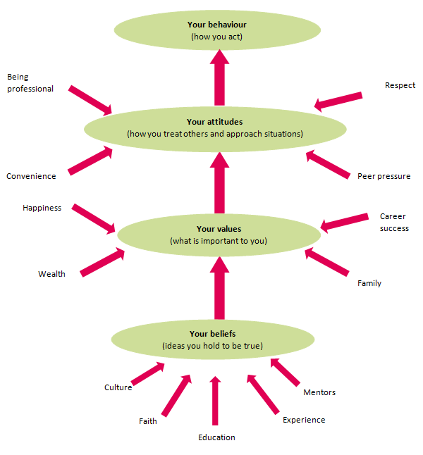
The relationship between beliefs, values and attitudes

Slide 13

Group activity
In your table group, identify two values, their sources and how these values can affect the behaviours of the individuals that hold them.
13

Slide 14

Individual activity (rank your values)
14
Notes:
It is important that you develop an awareness of what you value, as these values will be important in informing your relationships with clients, co–workers and employers.
You will be provided a list of dominant values for this activity to help you identify some of your values . Tick the values that apply to you and then select the ten most important values you ticked and rank them.
(1 = most important, 10 = least important).

Slide 15
The workplace context

Slide 16
The workplace Dilemma
To work effectively it is critical to understand your own values and beliefs.
In order to remain professional it is necessary to leave our personal values out of professional relationships.
One of the problems with our attitudes is we often ignore any information which is not consistent with them — we become selective in the way we perceive and respond to events and issues— and lose our ‘objectivity’.
We need to develop an insight about our attitudes in order to reduce the risk of making decisions at work based on our unconscious, pre-existing perceptions, allowing us work more professionally.
16

Slide 17
Respecting the beliefs, attitudes and values of others
Everyone is entitled to their own values, attitudes and beliefs. It is important to accept and respect that other people may well have different attitudes, values and beliefs than you.
We do not have the right to expect that others change their values, attitudes and beliefs just because they are different to ours.
It is quite possible that you may face situations at work that either challenge or compromise your own values, attitudes or beliefs when working.
Notes:
It is not always easy to avoid communicating your beliefs and values to clients, but it is something you need to be very aware of. It can be very easy to influence clients in subtle ways. Simple things like body language, gestures, the way you say something, or even actions, can give a client the impression you agree or disagree with their values or beliefs.

Slide 18

Shared values in the workplace
18
Notes:
If shared values are of the bases of relationships, what happens when values are not shared?

Slide 19
Scenario
Jane has been appointed as team lead in her workplace. Team bonding is one of her values which has made her successful as a team leader in the past. Jane has now proposed team bonding sessions in her new team but Barry would rather spend time alone reading a magazine during these sessions. Jane is very upset with Barry’s attitude.
What would you advise her to do?

Slide 20
Shared values in the workplace
Values can strongly influence employee conduct in the workplace.
  For example, If an employee values honesty, hard work, and discipline, for example, he will likely make an effort to exhibit those traits in the workplace. This person may therefore be a more efficient employee and a more positive role model to others than an employee with opposite values.
Shared values are often the bases of workplace relationships, so when values are not shared conflict may arise.
Notes:
Conflict may arise, however, if an employee realizes that her co-workers do not share her values. For example, an employee who values hard work may resent co-workers who are lazy or unproductive without being reprimanded. Even so, additional conflicts can result if the employee attempts to force her own values on her co-workers.

Slide 21

Your turn to be a manager
As a manager you understand the relationship between beliefs, values and attitudes. You are also aware of the impact of diverse attitudes on productivity and working relationships.
In what ways can you ensure that attitudes within the workplace are professional?

Slide 22
Organizational values and change

Slide 23
Developing organisational values
To bring about a change in an organisation - aligning the values of individuals within it along with the values of the organisation will bring about the most positive and successful change
If values are clear and widely accepted, employees know what they’re supposed to do and what’s expected of them, so they can act quickly to take care of problems.
23
Notes:
An organizational value is “any concept or idea that is held in high esteem by the members of an organization and that shapes the organization’s philosophy, processes and goals.” The values held by the members of an organization determine the organizational culture, which according to Simmerly (1987) is the most powerful internal force affecting any organization.

Slide 24
Organisational values
Identifying individuals and companies values can help to create “win – win” outcome as individuals find meaning to their work and organisations get a committed work force that functions well.
Value led organisations outperform others; growth in revenue, rate of job creation is higher, growth in stocks is higher, profit performance is higher and turn over is lower
Kotter and Heskett ( reported in Dearlove and Coomber,1999)
Being a value led organisation also leads to attracting people who have the same values and keep people who feel fully committed
Notes:
During the hiring process, values-based interview questions will help you understand:
Whether candidates’ priorities align with your goals
What candidates prioritize in the workplace
What drives their behaviours at work
Here are some examples of common corporate values at work:
Integrity: Acting with honesty and professionalism, and respecting company policies.
Collaboration: Working with colleagues and teams to meet joint goals.
Accountability: Taking responsibility for actions and decisions both in team and individual projects.
Social responsibility: Integrating social and environmental solutions to business operations.
Innovation: Implementing new ideas to improve the business.
Customer orientation: Maximizing and maintaining customer satisfaction.
Examples of value-based interview questions
Integrity
Have you ever faced an ethical dilemma at work? If so, what was the issue and what did you do?
What would you do if you saw a colleague stealing stationary from the company’s stock?
Collaboration
Describe a time your team failed to complete a project on time. What would you do differently, if you had the chance?
What would you do if you had to work with a person you didn’t get along with?
Accountability
Describe a successful team project you worked on so far. What was your contribution?
How would you react if your team received negative feedback about a part of the project that was entirely assigned to you?
Social responsibility
How do you keep a balance between performing thorough quality controls on products while keeping costs low?
What company policies would you suggest creating to make our operations more environmentally-friendly? How would you ensure employees understand and apply these guidelines?
Innovation
Describe a situation where you were facing a technical issue and your normal troubleshooting method wasn’t working. What did you do?
Can you give me an example of a well-designed product? What features make this product unique?
Customer orientation
Describe a time you managed to calm an irate customer. How did you manage to maintain your professionalism and address their complaint?
How would you reply to a customer who enters the store or calls just as your shift ends?

Slide 25
Organisation's values
Support the organisation
Values that are being lived already within the organisation
Tested and tried to build ownership / relationship
Staff engage with the organisations values (by discussing, challenging, influencing, fleshing it out)
25

Slide 26
While most organisations would explicitly state their core values, some values may not be written down. For instance, you won’t find the following values written down, but each comes from a real organization.
Look busy even if you’re not.
If you take risks and fail around here, you’ll pay dearly for it.
Before you make a decision, run it by your boss so that he or she is never surprised.
We make our product only as good as the competition forces us to.
What made us successful in the past will make us successful in the future.
If you want to get to the top here, you have to be a team player.
26

Slide 27
Conclusion
With diversity comes multiple personal values and attitudes that may bring unique challenges to an organisation.
It is important to separate our personal beliefs and attitudes from our professional lives.
Organisations can build values based on personal attitudes that have been tested to build relationships between employees..
27

Slide 28
ANY QUESTIONS?

Slide 29
Reference
Anderson, M. and De Silva, S., 2009. Beliefs, values and attitudes. Me-and-Us.

