Slide 1
Task 1 Group Presentation
Student Names and Numbers:
Hasina Ibrahim Sheikh (2122535)
Mina Khorshid (2122088)
Sadeka Gani Dhali (2122280)
BMSW4002_BIRM- Effective Team Working and Communication
Lecturers Name: Joanne Davies

Slide 2
Purpose
Presentation to critically analyse the communication methods, strategies and communication barriers between Bramley Court Care Home and its residence.
Bramley Court Care Home
Provided and run by: Bramley Court Care Homes Limited
Privately owned
Care home with nursing
Quality Care Quality Commission inspection ratings: Good
Conditions cared for: Older people generally / People with sensory impairments / People with dementia
Accommodates 76 residents

Slide 3
Types of Effective Communication
Verbal
Think before you speak
Non-Verbal
Body Language
Other form
Technical Aids
Clearly
Listen
Surroundings
Proximity
Language
Mediums e.g Boards
Use of terminology
Senses & Empathy
Slowly
Softly
Skillsforcare, (2018) & Croston, M. (2018)
Notes:
There are 3 parts to effective communication, according to a report by Skillsforce care on developing your workforce in Care.
1. Verbal, 2. Non-Verbal and 3. Other forms.

Slide 4
Benefit of Effective Communication
Feel valued, cared for and at ease.
Improves care services
Better working environment
&
increase job satisfaction
Empowered and Motivated.
Build trust
Enrich patient experience and reduces stress
Reduce misunderstandings &
complaints.
Odyssey Productions (2007) & Manchester University- Jack, Kirsten, Ridley, Caroline and Turner, Samuel (2019)
Notes:
There are 3 parts to effective communication, according to a report by Skillsforce care on developing your workforce in Care.
1. Verbal, 2. Non-Verbal and 3. Other forms.

Slide 5
Effective Communication at Bramley Court Care Home
The overall CQC rating was upgraded from OK to Good
Activity | Impact
Monthly newsletter | A positive way to share news, stories, and updates regarding people and the care homes.
Regular meetings | A platform for people to share their views and have changes made.
Approachable and felt listened | Families, residents and staff were positive, knowing they were heard by management
Key information shared | Patient care improved, as processes improved communication of residents health record and information between services.
Roles and performance | Staff were motivated and valued, understanding their roles, tasks and quality standards from the organisation
Care consent and the Law | Clear communication from the organization meant staff understand the law around patient care and consent.
Technology: Video Call | The use of technology has meant a more collaborative approach to great patient care.
Care Quality Commission Report, (2022)
Notes:
- Regular meetings were held with people living in the home giving people the opportunity to share their views. We saw several changes had been made following these meetings. For example, the menu had recently been changed to include specific meals.
The registered manager conducted regular team meetings where the views of the staff were sought. This meant staff were able to discuss their roles and had a forum to discuss particular subjects should they so wish.
People and their relatives told us they felt listened to
Managers and staff being clear about their roles, and understanding quality performance, risks and regulatory requirements
Staff were aware of their responsibilities to seek consent when caring for people
The care home had facilitated a video call with the GP, registered manager, a person living in the home and their relative to discuss treatment options.

Slide 6
How should the organization use the theories relating to models of communication?
Schramm Model Of Communication
Aristotle Model Of Communication
Shannon Weaver Model Of Communication
Berlo’s SMCR Model

Slide 7
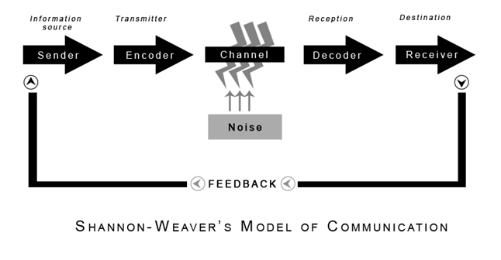
Shannon Weaver Model Of Communication
According to the Shannon Weaver Model of Communication, the six essential concepts are the sender, encoder, channel, noise, decoder, and receiver.
This is carried out in the nursing home utilising video conferencing tools like Microsoft Teams. This works well because it facilitates communication between the management team and stakeholders including shareholders, suppliers, and local government. (Gillespie and Schiffman, 2018)

Slide 8
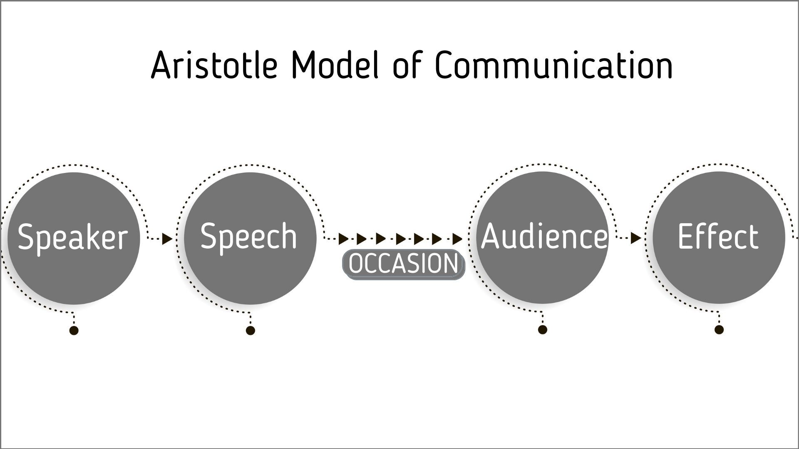
Aristotle Model Of Communication
The speaker and speech are at the centre of the Aristotle model. It can be broadly classified into five main categories. Speaker-speech-occasion-audience-effect is what we have.
This technique of communication may be applied while training workers using seminars. It can also be used to broadcast announcements to residents and workers. (Kasabova and Marinov, 2016)

Slide 9
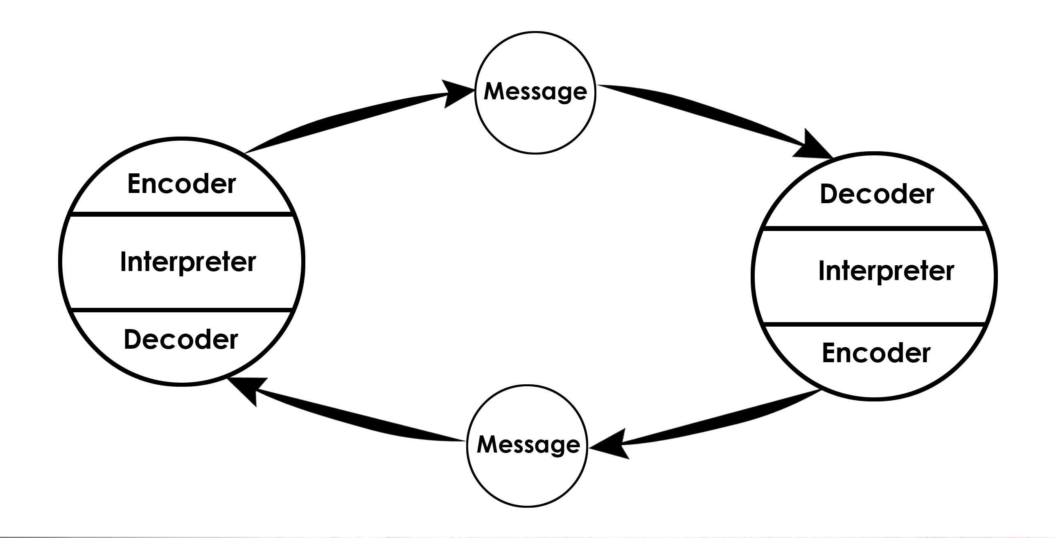
Schramm Model Of Communication
Schram’s model is a sender-message-receiver cycle . Schram's theory can be useful in a nursing home since it is an effective technique of interacting with everyone, regardless of the situation, indicating a high level of communication richness. (The Schramm Model of Communication, 2009).
Since it enables employees to communicate with management and vice versa as well as residents to communicate with staff (Sapienza, Iyer and Veenstra, 2015)

Slide 10
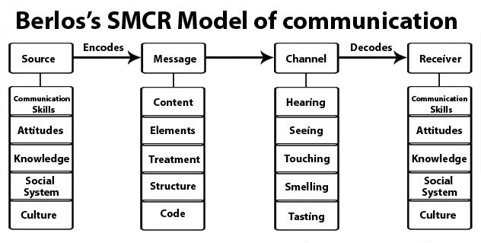
Berlo’s Model Of Communication
Berlo’s SMCR model of communication its simple form of sender, message, channel, receiver.

Slide 11
Barriers to Communication
Lunenburg, F.C (2010) tells us the main barriers are process, physical, semantic and psychosocial. Process ones exist when incorrectly sending and receiving feedback for information.
Physical ones being what physically gets in the way of talking (like a wall or call).
Semantic ones exist in the words we use, using the wrong words or difficult ones may send the wrong message.
Psychosocial ones exist in divides in cultures (which can make biases or change their views) or psychological signals (like spacing or emotion) which can change the message.

Slide 12
Channels of communication
One big channel of communication -as defined by Novak, M.C (2019)- is written communication. This can be in the form of e-mails, text messages, and letters.
This can deliver a message effectively, without the hassle of the other forms but it loses the personal connection other forms have too.
Speaking with (Bramley Care Home, 22/07/2022), the channels of communication they use is:
Video sharing | Emails | Telephone Calls | Formal channel | Informal channel
Digital communication | Face to Face | Physical
The organization can improve its channels of communication by:
Internal communication | Team collaboration

Slide 13
References
Bramley Care Home Manager (07/2022) personal communication ,telephone.
CareQualityCommission (2022) Bramley Court Care Home Inspection report. Available at: https://api.cqc.org.uk/public/v1/reports/19e94830-2fdf-40c2-b4ce-3fdf803d899e?20220707120000 (accessed at: 27/07/2022)
Croston, M. (2018) ‘Communication’ In Tetley, J., Cox, N., Jack, K. and Witham, G. (eds.) Nursing Older People at a Glance. Wiley-Blackwell: Oxford. pp. 6-7
Elleström, L., 2018. A medium-centered model of communication. Semiotica, [online] 2018(224), pp.269-293. Available at: <https://www.degruyter.com/document/doi/10.1515/sem-2016-0024/html> [Accessed 28 July 2022].
Gillespie, D. and Schiffman, R., 2018. A Critique of the Shannon-Weaver Theory of Communication and Its Implications for Nursing. Research and Theory for Nursing Practice, [online] 32(2), pp.216-225. Available at: <https://connect.springerpub.com/content/sgrrtnp/32/2/216.abstract> [Accessed 13 July 2022].
Kasabova, A. and Marinov, V., 2016. Aristotle on verbal communication: The first chapters of De Interpretatione. Empedocles: European Journal for the Philosophy of Communication, [online] 7(2), pp.239-253. Available at: <https://www.ingentaconnect.com/content/intellect/ejpc> [Accessed 28 July 2022].
Key Concepts in Marketing, 2009. The Schramm Model of Communication. pp.178-180.
Lunenburg, F.C (2010) Communication: The Process, Barriers, And Improving Effectiveness Texas: Sam Housten state university
Manchester University - Jack, Kirsten, Ridley, Caroline and Turner, Samuel (2019) Effective communication with older people. Nursing Older People, 31 (4). pp. 40-48. ISSN 1472-0795, Available at: https://doi.org/10.7748/nop.2019.e1126 (access at: 27/072022)
Novak, M.C (2019) The four types of communication (+tips for each one) Available at: https://learn.g2.com/types-of-communication#written-communication (accessed at: 27/06/22)
Odyssey Productions (2007). Professional Behavior In Healthcare Professions: Effective Communication With Patients. [Video/DVD] Alexander Street. Available at: https://video.alexanderstreet.com/watch/professional-behavior-in-healthcare-professions-effective-communication-with-patients
Sapienza, Z., Iyer, N. and Veenstra, A., 2015. Reading Lasswell's Model of Communication Backward: Three Scholarly Misconceptions. Mass Communication and Society, [online] 18(5), pp.599-622. Available at: <https://www.tandfonline.com/doi/full/10.1080/15205436.2015.1063666?casa_token=J3OJR126t2IAAAAA%3AhkE5Eud08ZAWZjfMCeK4_G0zKCSxSP3xQsricNvQbro94Iu0kePvE1au7nXLON_flFPPRrVi5FXP> [Accessed 28 July 2022].
Skillsforcare (2018) Communication skills in social care. Available at: https://www.skillsforcare.org.uk/resources/documents/Developing-your-workforce/Care-topics/Core-Skills/Communication-skills-in-social-care.pdf (accessed at: 26/07/2022)

Slide 14
Teamwork Evaluation | Team responses.
Who was in your team? | Hasina, Sadeka and Mina
What were the key strengths of your team? | Putting the presentation together, sharing thoughts and supporting each other.
What were the challenges that you overcame as a team? | Working together on the last point, which we had to share and each had their own thought on what to write. Making sure tasks are done in time.
What would you do differently if you worked as a team again? | Do a draft earlier on and get feedback to make sure we are going in the right direction. Use the same template and structure as it took time putting the slide in one format. Dedicate more time to communicate and practise.
How would you rate your team working? Out of 10? | 7

