Slide 1
E-Portfolio Evidence of Learning
Task 3 and 4
Student name: Kerris Adina Smith
Student ID: 1915100
Module: Changemakers: Creativity and Value Creation
Module code: BMHP5014_BIRM
Lecturer: Dr Azora Hurd

Slide 2
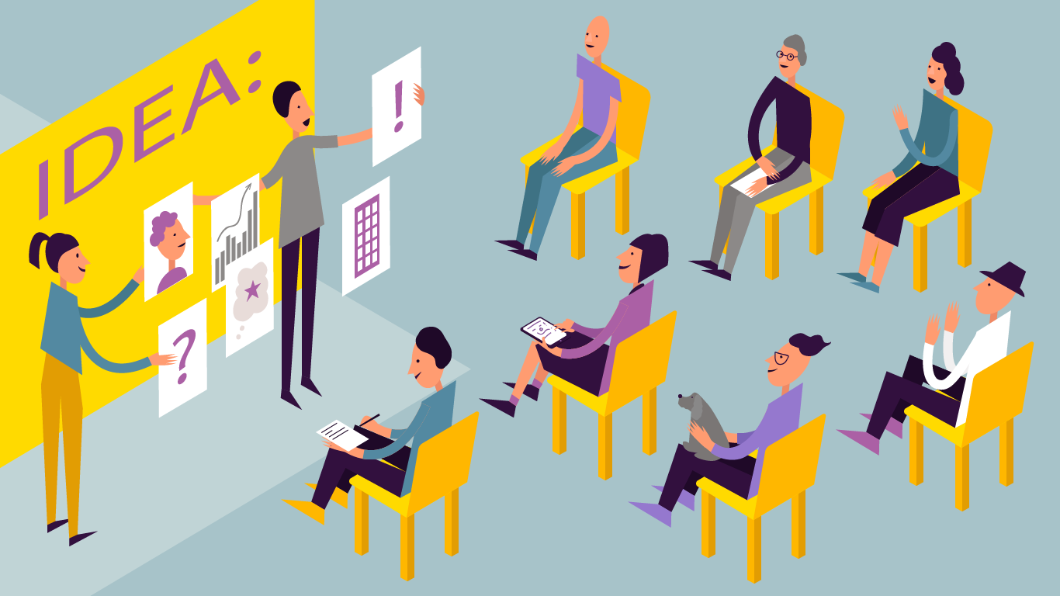
Content Page
Introduction
Pitch
Front side of flyer
Back of the flyer
Poster
Reference
Faselis, 2021

Slide 3
My Pitch
Task 3
Welcome All…
I have one goal and one passion and that is to help people in the community who are suffering with Mental Health. Covid 19 has been a very traumatic time for everyone and it has had a massive impact on people suffering with mental health. It is estimated that 75% of people in the UK cannot have access to treatment to help with their mental illness due to Covid 19 (Mental Health Foundation, 2021). This is very concerning and makes me wonder, ‘What exactly is going to happen to our communality mental state?’ This is why we need this this innovation for our community. My idea is to generate a app which is accessible to everyone via there smart phone, table or computer. The app I have generated, aim to help those at home trying to manage with this illness. The app aims to help with the following
Video calls with doctors and healthcare professionals - Due to covid 19 people care struggling to leave there home, being able to access doctors and healthcare professionals can help those who struggle leave there home due to there illness.
Therapeutic Music and virtual art – I has been proven that therapeutic Music and virtual art help manage mental illnesses (Guttman, 2021)
Exercises and Yoga – There are many benefits when exercising and doing yoga that helps with manage mental health. Exercises and Yoga helps with a good night sleep, reduces stress, helps control anxiety and depression and reduces post traumatic stress Connect and talk with others people in your community that suffer with mental illness (Kloppers, 2021).
Advise on how to have a good state of mind
Videos of coping mechanisms
Please see on the flyer if you would like to be apart of this amazing innovation or would like to make a donation.

Slide 4
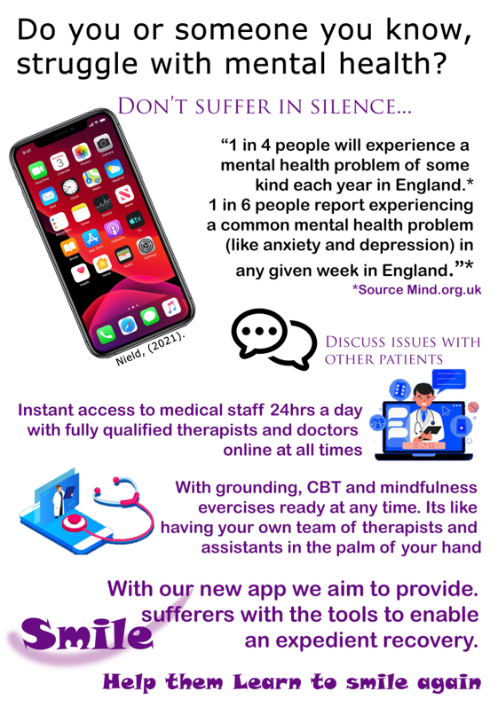
Task 3
Front of the flyer
Mind, (2021).
Raafiramadhan, (2021).

Slide 5
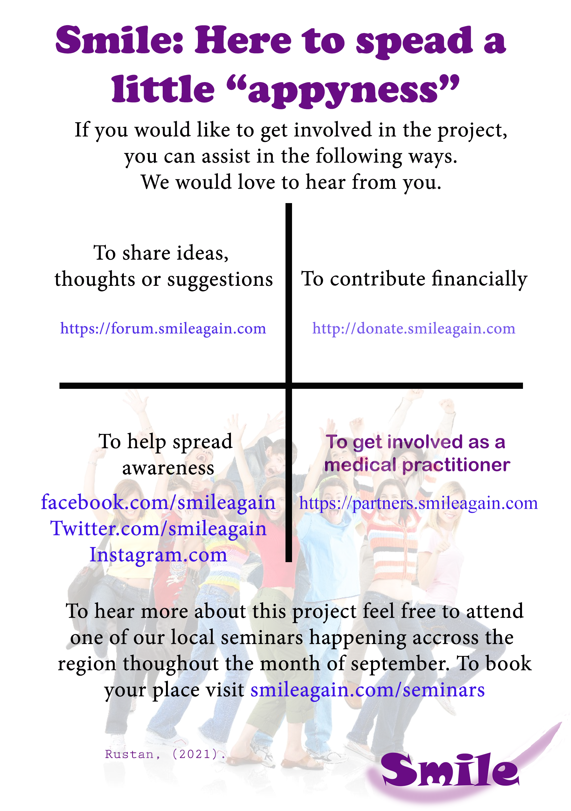
Task 3
Back of the flyer

Slide 6

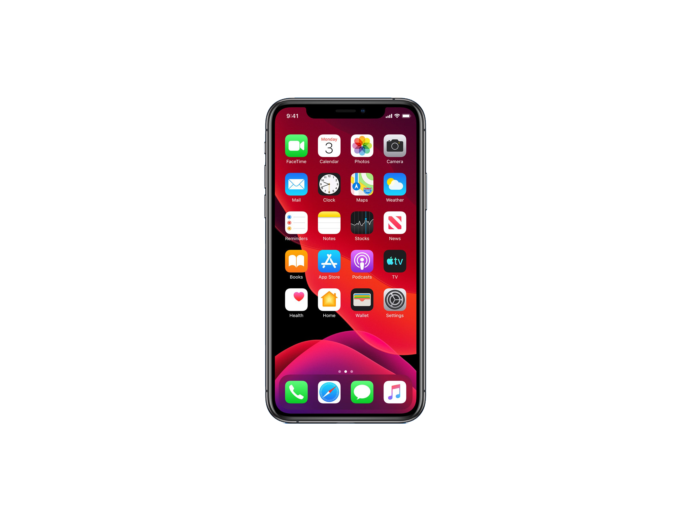

Smile Again
An App For Healing Minds
Having Mental health issues can put a strain on anyone's life. With Smile Again© we aim to make recovery easier.
In –app exercises to help patients keep on top of any mental practices – progress is checkable by your gp
Feeling Low? Licensed therapists are on hand 24 hours of the day
Get prescription refills through the app
See your progress at a glance
Download now @ Smileagain.com/app
Also available on the Apple Store and Play Store
Notes:
Task 4 Poster

Slide 7
Reference
Faselis, (2021|). How to Use Storytelling for a Successful Investor Pitch. Available at: <https://medium.com/the-faselis-blog/how-to-use-storytelling-for-a-successful-investor-pitch-c046c05873e9> (Accessed 23 March 2021).
Guttman, M., (2021). The Role of Art and Music Therapies in Mental Health and Beyond | Psychreg. Psychreg. Available at: <https://www.psychreg.org/art-music-therapies/> (Accessed 24 March 2021).
Kloppers, M., (2021). How Yoga Can Improve Your Mental Health. Thoughts on Life and Love. Available at: <https://www.thoughtsonlifeandlove.com/yoga-can-improve-your-mental-health/#:~:text=%20Benefits%20of%20Yoga%20Exercises%20to%20Your%20Mental,lack%20of%20adequate%20sleep.%20Insomnia%20contributes...%20More> (Accessed 24 March 2021).
Nield, D., (2021). How to Rid Your Phone of Those Default Apps You Never Use. Wired. Available at: <https://www.wired.com/story/remove-bloatware-phone/> (Accessed 11 March 2021).
Raafiramadhan, (2021). Stock Royalty-free - PNG - Download Free. Available at: <https://favpng.com/png_view/mattresse-stock-royalty-free-png/Fe99XJXC> [Accessed 25 March 2021]. Mind, (2021). How common are mental health problems?. Available at: <https://www.mind.org.uk/information-support/types-of-mental-health-problems/statistics-and-facts-about-mental-health/how-common-are-mental-health-problems/> (Accessed 25 March 2021).
Rustan, (2021). Happiness Royalty-free Stock Photography Smile - PNG - Download Free. FAVPNG.com. Available at: <https://favpng.com/png_view/happy-people-happiness-royalty-free-stock-photography-smile-png/QbfmwL5r#> (Accessed 11 March 2021).

