Slide 1
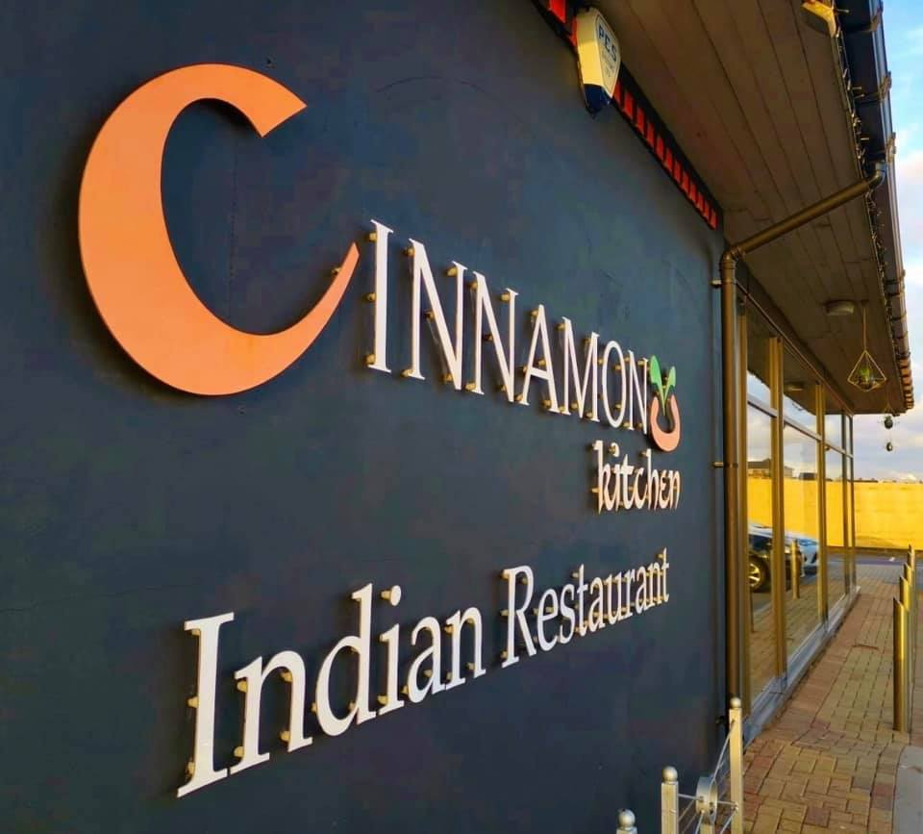
Placement Developing Restaurant Management (BMGM5004)
Individual Presentation
By
Amdadur Rashid Masum
Student ID: 2128870
Module Lead:Jemma Smith MA, PgCE
j.smith@uwtsd.ac.uk
Use of Generative AI in Assessment
For this assessment, you I have used ChatGPT to support my research, including searching for bibliography, using tools to summarise, compare and interrogate materials. Check text/creation for grammatical and syntactical mistakes, including rephrasing of my own work within specific standards.

Slide 2
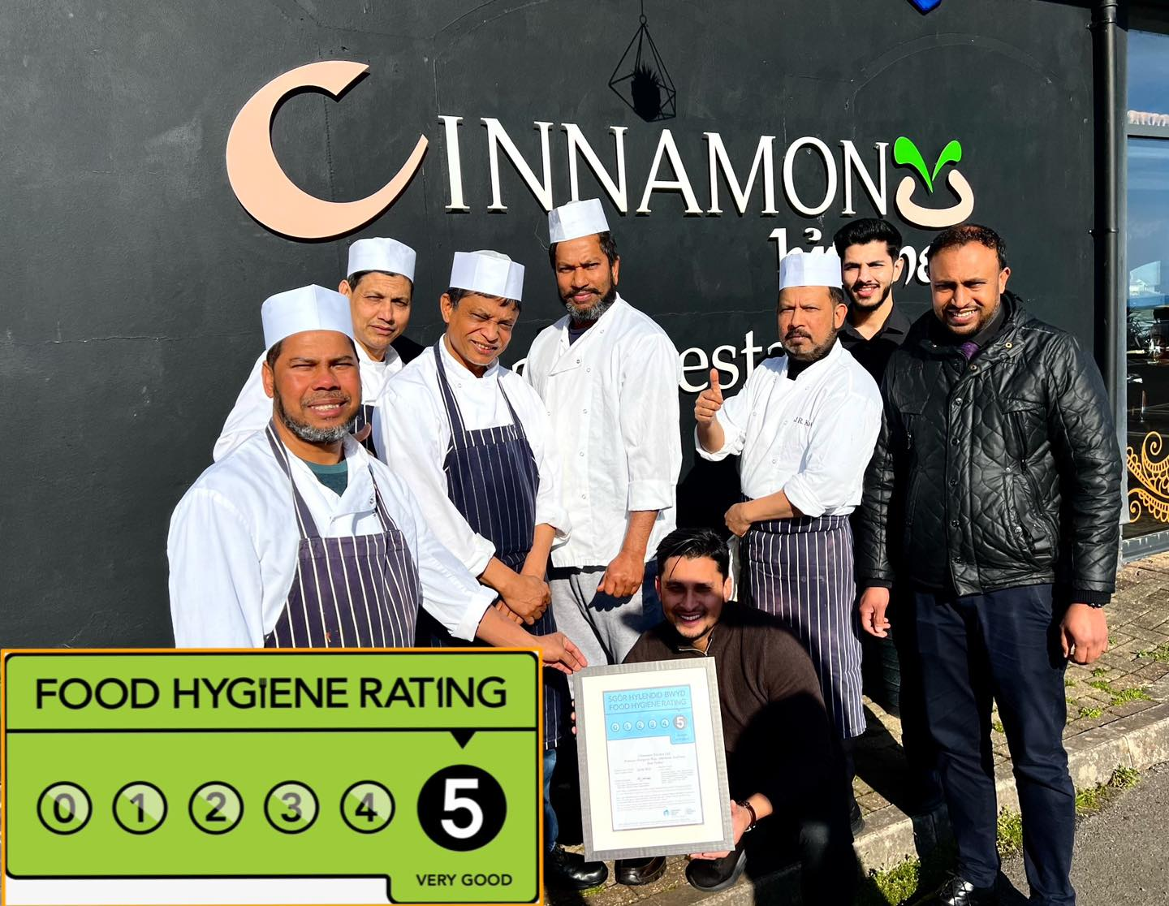
Introduction
This presentation reflects on my placement experience at Cinnamon Kitchen, a renowned modern Indian restaurant located in the heart of London. Known for its innovative cuisine and exceptional service, Cinnamon Kitchen combines traditional Indian flavours with contemporary techniques, offering a unique dining experience (Cinnamon Kitchen, 2023).
This presentation reflects on my placement experience, focusing on three key areas:
  Communication and team liaison.
  Troubleshooting and initiative.
  System management and data analysis.
The purpose is to critically evaluate my personal performance, key skills development, and the application of theory in practice (Lasch, 2021).
Self-reflection is essential for professional growth and continuous improvement (Brown, 2019).

Slide 3
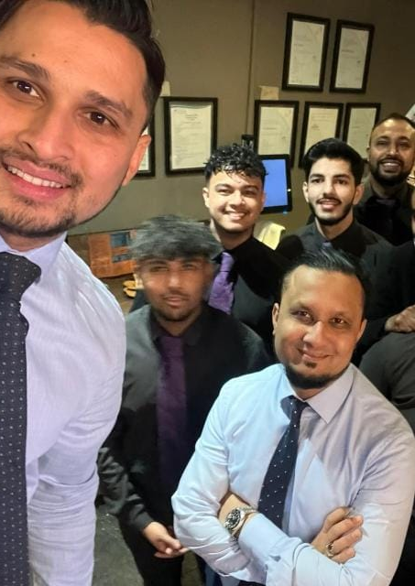
Communication and Team Liaison
Effective communication is critical in restaurant operations to ensure smooth workflows and team alignment (Johnston et al., 2012).
Example: Team Meetings/Briefings before each busy night where we can assign specific roles to each member of staff and mentally prepare for the night ahead.
Delegated tasks to each team members, ensuring timely preparation and service such as assignment of bar staff, floor staff, food staff and delivery drivers.
Communicated clearly with kitchen and front-of-house staff to avoid delays by notifying them of when the large bookings are scheduled to arrive so they are also able to make necessary preparations in their stock and prep. This allows for cohesion amongst all staff all to maximise efficiency.
Outcome: Enhanced operational efficiency and positive guest feedback (Heppell, 2015).
Reflection: This experience improved my leadership and task management skills, contributing to the business’s success.

Slide 4
Example and Outcomes
Specific Example: Cinnamon Kitchen operate a Sunday Buffet lunch service which is very popular in which 2 members of staff control the service. Those who work the lunch service must work together efficiently as a partnership to optimise the quality of service. One person controls the bar/drinks and the other overseas the food and both will work together to look after the floor and guests and effective communication is vital to this to ensure cohesion. Lunch staff are allocated based on waiters strength and usually two strong members are on the rota for these lunch periods.
Outcome:
Achieved a 95% guest satisfaction rate for lunch service.
Increased repeat business by 10% (Tesone, 2014).
Reflection: This experience highlighted the importance of clear communication and adaptability in high-pressure situations.

Slide 5
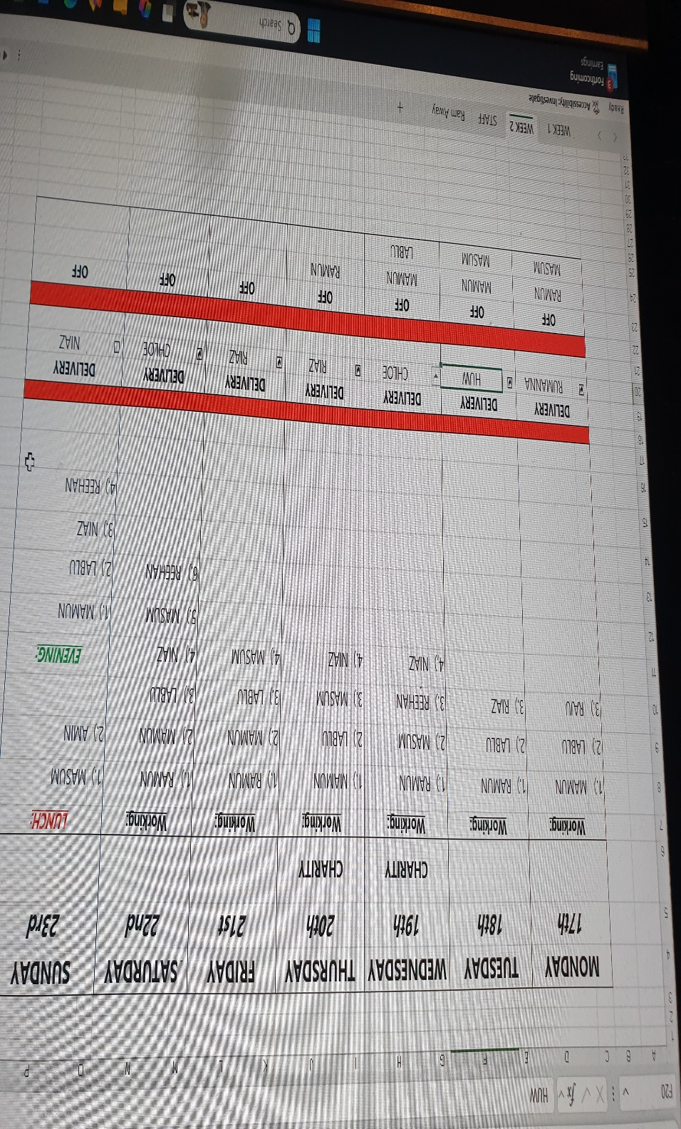
Element 2 – Troubleshooting Skills
Problem-solving is a key skill in restaurant management, especially during service disruptions (Management Today, 2023).
Example: Resolving a sudden staff shortage during a peak dinner service in a short period of time due to unforeseen circumstances. This is especially common in our delivery drivers due to unexpected weather or car conditions. In the instances we look to find cover and keep a list of back up drivers as a contingency to cause minimal disruption to service and delivery timings.
Reallocated team members to cover critical roles that will have a greater disruption to service. In instances where the takeaway packer is unavailable, a member of waitering staff will be reallocated in aiding the kitchen in packing takeaways as without, this will cause longer waiting times and a queue of customers therefore minimising disruption to service. Similarly with staff sickness and annual leave, work rota will be adjusted to ensure key workers are present on the busy periods to cover any shortfalls and skill gaps to ensure optimal service and productivity.
Adjusted workflows to maintain service standards such as prioritising more important tasks over menial tasks that can be done at quieter periods. For example, waiting for end of service/peak period to restock the bar/service area to prioritise service of dining in customers as the former can be done at a later time.
Outcome: Minimal disruption to service and positive feedback from guests (Johnston et al., 2012).
Reflection: This experience enhanced my ability to think critically and act decisively under pressure.

Slide 6
Element 2 – Example and Outcomes
Communicated any sudden changes clearly to the team beforehand to ensure they can adjust appropriately to any change in working patterns/roles to avoid confusion during service and positive coherence amongst all staff.
Overbooking or sudden influx of customers when there are limited tables available means that seating plans must be altered quickly and efficiently to ensure we are able to accommodate all guests even in instances where a table may not be available. Quick thinking and faster service means we can serve turn a table around more quickly and therefore seat more customers.
Maintained a 90% guest satisfaction rate despite the challenge.
Received commendation from management for effective problem-solving (Heppell, 2015).
Reflection: This experience reinforced the importance of adaptability and teamwork in resolving operational challenges.

Slide 7
Element 3 – Use of Systems
System Management and Data Analysis
Proficiency in restaurant systems is essential for operational efficiency and decision-making (Brown, 2019).
Example: Using point-of-sale (POS) and stock ordering systems to take all dining in, takeaway and drink orders. Cinnamon Kitchen initially took orders using pen and paper as well as recording bills and sales. Since 2019, an EPOS system was introduced to take orders and sales therefore saving time and optimising efficiency as order can be inputted and sent directly to the kitchen as well as being automatically calculated. All sales are also recorded at source reducing human error when it comes to calculation and saves time when tilling up at end of night (The Access Group 2023) .
Analysed sales data to identify popular menu items as the EPOS system categorises sales of menu items and gives us better insights into our consumer likes, trends and variations of menu items to allow us to adapt and also advertise these popular dishes.
Adjusted stock orders to reduce waste and improve cost control as our EPOS can also highlight items which do not sell or turnover in an efficient amount of time allowing us to consider and make necessary changes to our menu and analyse the position of those items on the menu. Cinnamon Kitchen has reduced many menu items over the years as a result of EPOS analysis.
Our EPOS system also allows Cinnamon Kitchen to generate sales reports to allow accurate forecasting for future sales and identify sales trends. For example, we can look at previous years sales to give indication as to periods when business maybe slow/quiet to adjust appropriately and prepare more efficiently (adjust staff rotas, reduce stock intake, reduce cost where appropriate) (The Caterer 2023).
Outcome:
Reduced food waste by 15%.
Improved profit margins by 10% (International Journal of Hospitality Management, 2023).
Reflection: This experience enhanced my analytical and technical skills, enabling data-driven decision-making.

Slide 8
Element 3 – Example and Outcomes
Example: Data-Driven Decision Making
Specific Example: Used end-of-day reconciliation reports to adjust stock orders.
Identified overstocked items and reduced future orders.
Highlighted underperforming menu items for review.
Outcome:
Achieved a 20% reduction in unnecessary stock.
Improved inventory turnover ratio (Tesone, 2014).
Reflection: This experience demonstrated the value of data analysis in enhancing operational efficiency.

Slide 9
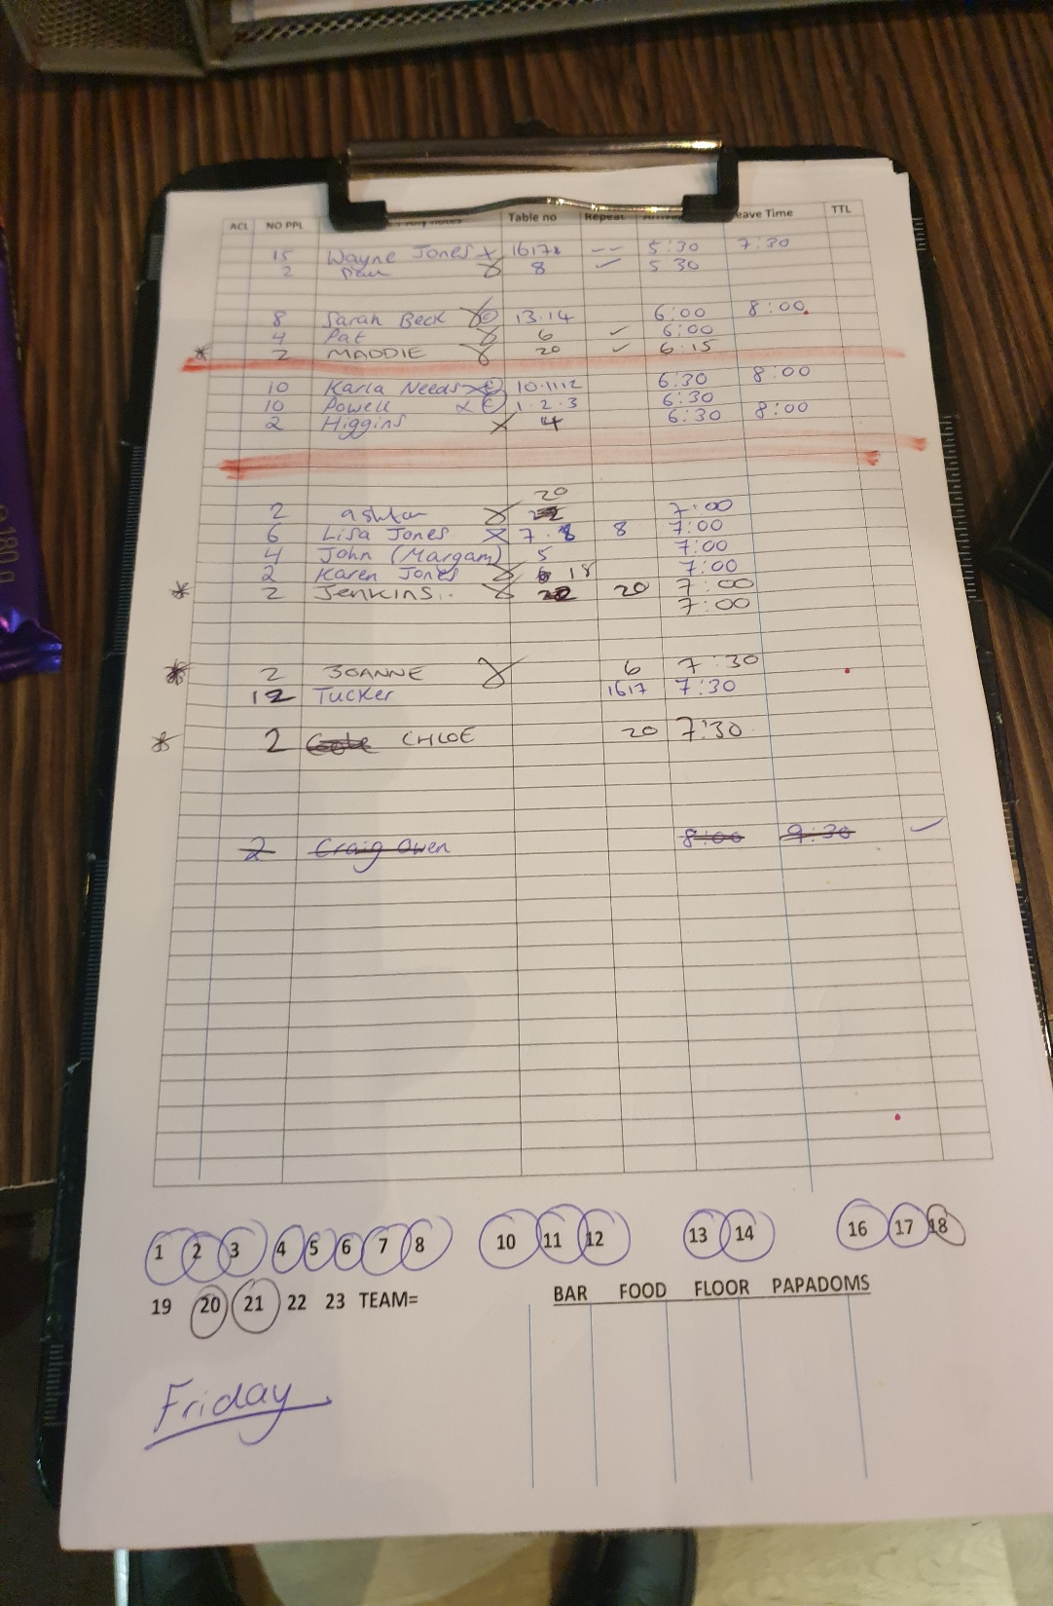
Reflection on Personal Development
Personal Development and Key Skills
Content:
Self-Management: Improved time management and organisational skills.
Task Management: Enhanced ability to prioritise and delegate tasks effectively.
Initiative: Developed confidence in making decisions and solving problems.
Communication: Strengthened interpersonal and team communication skills (Lasch, 2021).
Lost Opportunities: Recognised the need for further training in advanced data analysis tools.

Slide 10
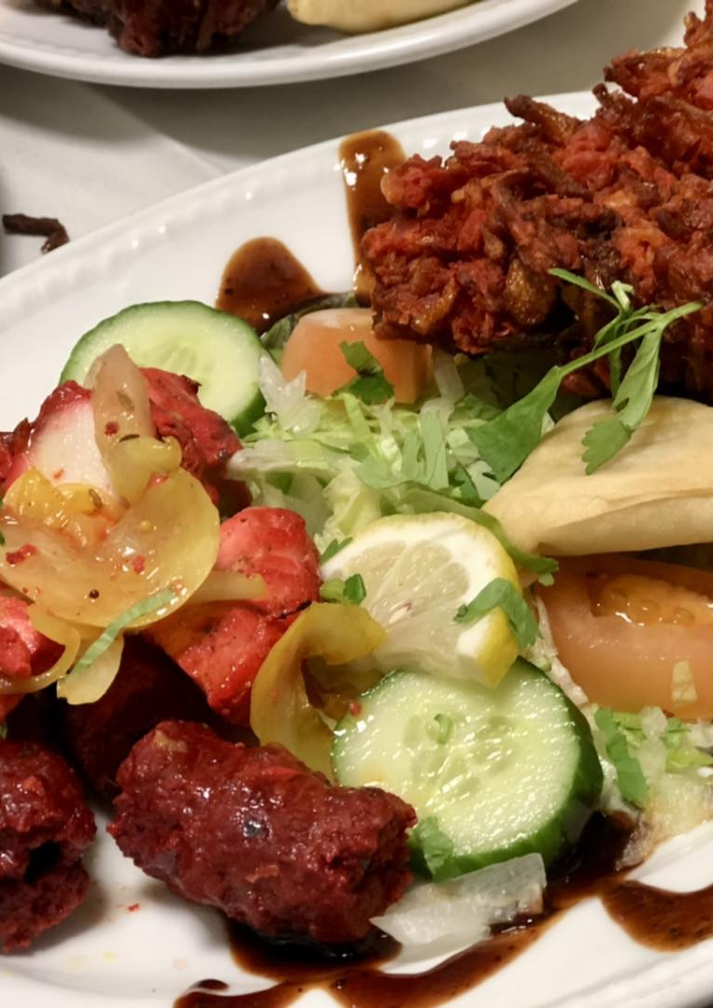
Future Career Development
Short-Term Goals: Pursue a management role in a high-end restaurant.
Long-Term Goals: Open my own restaurant, focusing on sustainability and exceptional service (Restaurant Magazine 2023) .
Areas for Development: Advanced data analysis, financial management, and staff training techniques (Heppell, 2015).
Reflection: This placement has provided a strong foundation for my future career in hospitality.

Slide 11
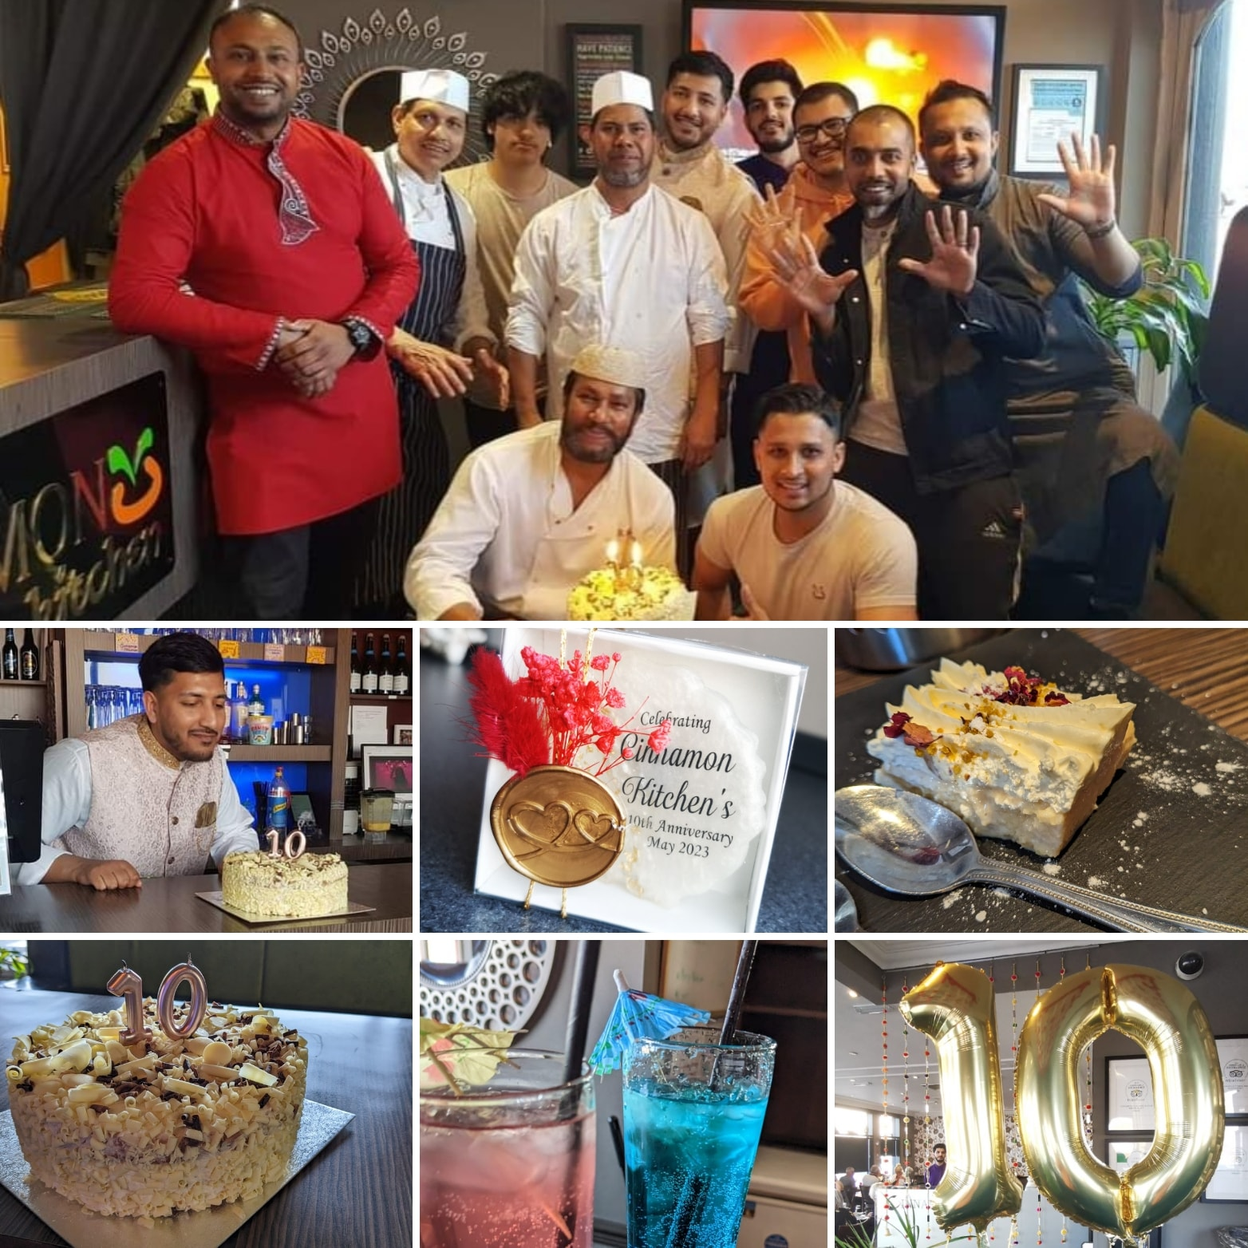
Conclusion
This presentation has highlighted my development in communication, troubleshooting, and system management.
These skills have not only enhanced my performance but also contributed to the success of the business.
Continuous improvement and self-reflection are key to achieving excellence in restaurant management (Brown, 2019).

Slide 12
References
Big Hospitality (2023) Available at: www.bighospitality.co.uk (Accessed: 03 March 2025).
Brown, D.R. (2019) The Restaurant Manager's Handbook: How to Set Up, Operate, and Manage a Financially Successful Food Service Operation. 5th edn. Florida: Atlantic Publishing Group Inc.
Businessballs (2023) Available at: www.businessballs.com (Accessed: 07 March 2025).
Cinnamon Kitchen (2023) Cinnamon Kitchen: Modern Indian Restaurant. Available at: https://cinnamonkitchenpt.co.uk/ (Accessed: 03 March 2025).
Cinnamon Kitchen (2023) Facebook. Available at: https://www.facebook.com/photo?fbid=956618053289849&set=a.418064817145178 (Accessed: 03 March 2025).
Cinnamon Kitchen (2023) TripAdvisor Reviews. Available at: https://www.tripadvisor.co.uk/Restaurant_Review-g681385-d4281703-Reviews-Cinnamon_Kitchen-Port_Talbot_Neath_Port_Talbot_South_Wales_Wales.html#/media/4281703/?albumid=101&type=ALL_INCLUDING_RESTRICTED&category=101 (Accessed: 03 March 2025).
Heppell, M. (2015) Five Star Service: How to Deliver Exceptional Customer Service. London: Pearson.
International Journal of Contemporary Hospitality Management (2023) Available at: www.emerald.com/insight/journal/ijchm (Accessed: 06 March 2025).
Johnston, R., Clark, G. and Shulver, M. (2012) Service Operations Management. London: Pearson.
Lasch, O. (2021) Principles of Management: Practising Ethics, Responsibility, Sustainability. London: Sage.
Restaurant Magazine (2023) Available at: www.restaurantmagazine.com (Accessed: 05 March 2025).
The Access Group (2023) Advantages and Disadvantages of EPOS Systems for Hospitality. Available at: https://www.theaccessgroup.com/en-gb/epos/sectors/hospitality/advantages-disadvantages/#:~:text=By%20streamlining%20services%2C%20reducing%20errors,help%20make%20your%20business%20successful (Accessed: 03 March 2025).
The Caterer (2023) Available at: www.thecaterer.com (Accessed: 01 March 2025).
Tesone, V. (2014) Principles of Management for the Hospitality Industry. Oxford: Butterworth-Heinemann.

