Slide 1

Student Name: Salam Al-Masoud
Student ID No.: 2235444
Lecturer Name: Charlotte Joyner
Date: 24/05/2023
The role and importance of quality service, hospitality, and guest services within the Double Tree by Hilton
Module name and code: Hospitality and Guest Service (BMIH4003)

Slide 2

Contents
Introduction
Target Consumers
Understanding the Guest Expectations
Nature & Scope of Guest Service
Role of Guest Services and Facilities
The Importance of Hospitality
Conclusion
References

Slide 3
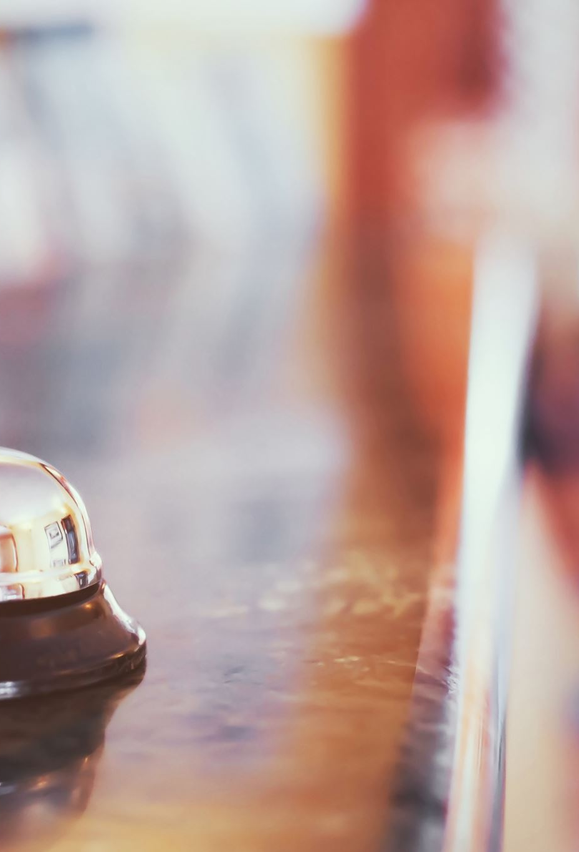
Introduction to DoubleTree by Hilton
A well-known hotel brand in the Hilton Worldwide family is DoubleTree by Hilton.
The company is renowned for its hospitable environment, which makes visitors feel at home as soon as they arrive.
At DoubleTree by Hilton, guests can expect first-rate service, luxury accommodations, and a focus on making their stay special.
DoubleTree by Hilton offers more than 580 hotels throughout the world and is dedicated to providing top-notch service at each of its properties.
The company is known for its distinctive chocolate chip cookies, which serve as a visual representation of the welcoming atmosphere visitors may expect while visiting (Hilton, 2023).
Notes:
Hilton Conrad Hotels and Resorts presentation. The presentation shows that Conrad is a luxury hotel brand known for its hospitality and modern elegance. Conrad hotels, located in some of the world's most desirable locations, offer unique experiences. This presentation will highlight Conrad's elegance, superb service, and unique options. Let's explore Hilton Conrad Hotels and Resorts' sophisticated luxury.

Slide 4

Target Consumers of DoubleTree by Hilton
Customers served by DoubleTree by Hilton include families, business travellers, vacationers, and people attending events.
Business travellers: DoubleTree by Hilton is sensitive to their demands and provides them with convenient locations, up-to-date services, and welcoming workspaces.
Leisure travellers: The brand appeals to tourists looking for a peaceful and comfortable stay. The on-site dining options, swimming pools, and fitness centres at DoubleTree by Hilton improve the whole guest experience.
Families are welcome at DoubleTree by Hilton, which also provides roomy lodgings, family-friendly features, and other services to make sure everyone has a happy visit.
Attendees: The DoubleTree by Hilton is a popular choice for conferences, weddings, and other social gatherings thanks to its extensive meeting and event facilities. The company offers flexible event venues and specialised event planning services (Burkard, 2013).
Notes:
DoubleTree by Hilton serves many markets. The hotel network offers business travellers accessible locations, modern amenities, and pleasant workspaces. DoubleTree by Hilton provides leisure guests a relaxing stay with pools, exercise centres, and on-site dining. DoubleTree by Hilton caters to families with spacious rooms and kid-friendly amenities. Finally, event attendees like DoubleTree by Hilton's flexible event spaces and event planning services. DoubleTree by Hilton targets these consumer segments to meet tourists' needs (Burkard, 2013).

Slide 5

Understanding Guest Expectations
By emphasising individualised care, close attention to detail, and the creation of enduring experiences, DoubleTree by Hilton aims to go above and beyond guests' expectations.
The company is aware that visitors anticipate first-rate hospitality, cosy lodgings, and first-rate amenities while they are with them.
The DoubleTree by Hilton values customer comments in order to enhance the overall visitor experience.
DoubleTree by Hilton seeks to establish enduring relationships with its clients through personalised communications and guest loyalty programmes (Tuan, 2021).
The company also stresses the value of treating each visitor as an individual and catering to their specific needs.
Notes:
DoubleTree by Hilton strives to exceed guests' expectations to create unforgettable stays. The brand strives to exceed expectations by providing personalised service, attention to detail, and an unforgettable experience. DoubleTree by Hilton guests expect superior service, pleasant accommodations, and top-notch amenities. Customer feedback helps the brand improve the customer experience. Personalised communications and loyalty programmes help DoubleTree by Hilton develop lasting relationships with guests. The company emphasises treating visitors as individuals and according to their interests and wants (Tuan, 2021).

Slide 6
Nature and Scope of Guest Services
DoubleTree by Hilton offers many guest services to enhance the guest experience.
Accommodations: The brand offers comfortable, functional guest rooms and suites. Expect comfortable bedding, Wi-Fi, and in-room entertainment.
Dining: DoubleTree by Hilton's restaurants, cafes, and bars serve a variety of foods and drinks.
Concierge Services: The brand's concierge services help customers book restaurants, transportation, and local attractions.
Fitness and Wellness: DoubleTree by Hilton offers fitness centres, pools, and spas to relax and rejuvenate guests.
Business Facilities: DoubleTree by Hilton has well-equipped business centres, meeting rooms, and conference and event spaces for business travellers (Litvin, Goldsmith and Pan, 2008).
Notes:
DoubleTree by Hilton prioritises guests. The brand offers effective, comfortable accommodations. Wi-Fi, luxury bedding, and in-room entertainment are offered. On-site restaurants, cafes, and bars serve various cuisines and drinks. The brand's concierge services book restaurants, transportation, and attractions. Fitness centres, pools, and spas at DoubleTree by Hilton let guests unwind. The brand offers business travellers well-equipped business centres, meeting rooms, and conference and meeting spaces (Litvin, Goldsmith and Pan, 2008).

Slide 7
Role of Guest Services and Facilities
Guest happiness requires excellent guest services and facilities. DoubleTree by Hilton strives to create enduring relationships with guests by exceeding expectations.
Brand Differentiation: DoubleTree by Hilton's guest services and facilities set it apart. The hotel brand differentiates apart with distinctive amenities and personalised experiences.
Return Business and Loyalty: Excellent guest services and facilities encourage return business. Satisfied guests are more likely to return and refer DoubleTree by Hilton.
Positive Reviews and Reputation: DoubleTree by Hilton attracts new guests and retains loyal customers by providing excellent guest services and facilities.
Notes:
DoubleTree by Hilton's guest services and amenities are crucial to its success. First, these services ensure consumer satisfaction. DoubleTree by Hilton provides top-notch services and amenities to exceed visitors' expectations. Thus, it can give guests exceptional stays and develop enduring relationships. Guest services and amenities further distinguish DoubleTree by Hilton from its competitors. The company's unique features and customised experiences set it apart in the competitive hospitality industry. High-quality amenities and services also boost customer loyalty and repeat business. Happy guests are more likely to return and recommend DoubleTree by Hilton. Positive reviews and a good reputation attract and retain customers (Jones and Jowett, 2010).

Slide 8

The Importance of Hospitality
Hospitality is vital to the hospitality sector and guest experience.
Hospitality creates a friendly atmosphere for guests. Hotels make guests feel welcome and valued from the time they arrive.
Personalized Service: Hospitality is about meeting guests' individual needs. Hotels strive to exceed guest expectations and offer memorable experiences.
Hospitality fosters long-term visitor relationships. Hotels may turn one-time visitors into regulars and promoters by building relationships.
Positive Word-of-Mouth: Hospitality is key to a hotel's success. Satisfied guests are more likely to recommend the hotel to friends, family, and internet platforms, attracting new guests and improving the hotel's reputation.
Notes:
Guest experience and hospitality depend on hospitality. It involves welcoming and appreciating guests. Hotels cater to guests' needs. Anticipating and exceeding guest expectations can impress hotels. Hospitality fosters client loyalty and advocacy. Hotel prosperity hinges on satisfied guests' word-of-mouth. Social media and other reviews improve the hotel's reputation and attract new clients.

Slide 9

Conclusion
DoubleTree by Hilton and the hotel business depend on quality service, hospitality, and guest services.
DoubleTree by Hilton targets business, leisure, family, and event travellers.
The brand offers luxurious lodgings, cuisine, concierge services, fitness and wellness features, and business facilities.
Guest services are essential for guest pleasure, memorable experiences, brand reputation, and loyalty.
Hotel creates a pleasant atmosphere, personalised service, relationships, and favourable word-of-mouth for the hotel business.
Hotels exceed guest expectations through anticipating needs, paying attention to detail, personalising, empowering personnel, and continuously improving.
Notes:
In conclusion, DoubleTree by Hilton and the hotel industry value hospitality, service, and guest services to create extraordinary visitor experiences. DoubleTree by Hilton targets their market and offers a variety of services and facilities to fulfil guest expectations. Hospitality fosters relationships, a welcoming environment, and positive word-of-mouth. These ideas assist DoubleTree by Hilton and other hotels attract guests, make a lasting impression, and compete in the hospitality industry (Ukhospitality, 2020).

Slide 10
References
Burkard, N. (2013). Market segmentation and branding in the hotel industry with special. Grin Verlag.
Hilton. (2023). DoubleTree by Hilton - Find Hotel Rooms. [online] Available at: https://www.hilton.com/en/brands/doubletree-by-hilton/.
Jones, C. and Jowett, V. (2010). Managing Facilities. Routledge.
Litvin, S.W., Goldsmith, R.E. and Pan, B. (2008). Electronic word-of-mouth in hospitality and tourism management. Tourism Management, 29(3), pp.458–468. doi:https://doi.org/10.1016/j.tourman.2007.05.011.
Tuan, N.M. (2021). Service Quality, Customer Experience and Commitment Affecting Customer Satisfaction in Vietnamese Hotel Industry. INTERNATIONAL JOURNAL OF MULTIDISCIPLINARY RESEARCH AND ANALYSIS, 04(01). doi:https://doi.org/10.47191/ijmra/v4-i1-11.
Hill Camp. (2015) What is Hospitality? Available at: https://www.youtube.com/watch?v=u0bqEeCVI_A (Accessed: 19th of May 2023).
Macdonald, S. (2021) 7 ways to create a great customer experience strategy [Blog]. Available at: https://www.superoffice.com/blog/customer-experience-strategy/ (Accessed: 19 th of May 2023).
Montgomery, D. (2016) ‘The Meanings of Destination: A Q Method Approach’, Journal of Travel Research, Vol. 56, No. 6, pp. 793-807.
Solomon, M. (2019) Heart of hospitality. New York: SELECT Books INC.
Ukhospitality. (2020) Reports. Available at: https://www.ukhospitality.org.uk/page/Reports (Accessed: 18th of May 2023).

