Slide 1
LCBB4013: Stakeholders Engagement
Tools and Platforms for Stakeholders Engagement
Week 5:Session 1

Slide 2

Last week we looked at:
Community engagement, discussed the importance of engaging the community and the value that brings.

Slide 3

Tools and Platforms for Community Engagement
Understand the different tools and platforms used to facilitate stakeholders' engagement.
To gain a deeper understanding on what, when and how to deploy the different tools and platforms.

Slide 4
Introduction
There are several innovative ways, tools, and platform to adopt for stakeholders' engagement. Adopting these tools enhance that a wider group stakeholders are reached, it also ensure swift responsiveness and there is something for everyone.
Some of the tools are interactive, practical, friendly, effective, fast, and cost-efficient.
    Creative arts, volunteering, music, social media platforms, interviews, open-space technology, citizens' panels, public meetings, community mapping, and forums.

Slide 5
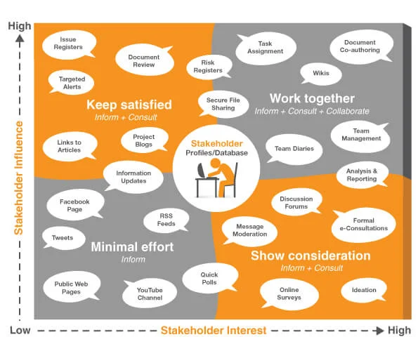

Slide 6
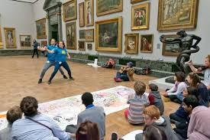



Creative Art
Creative arts is a language
Creative arts are appropriate measures used to engage participants in community projects.
Activities like dance, music poet and drama brings community together
Arts are used to express community challenges.
They are used to share stories that are difficult to capture in words
To collaborative understand the depth of resilient required.
Enables artistic and interactive learning.
Creative arts activities are used to reflect and unearth the vision of the future.

Slide 7
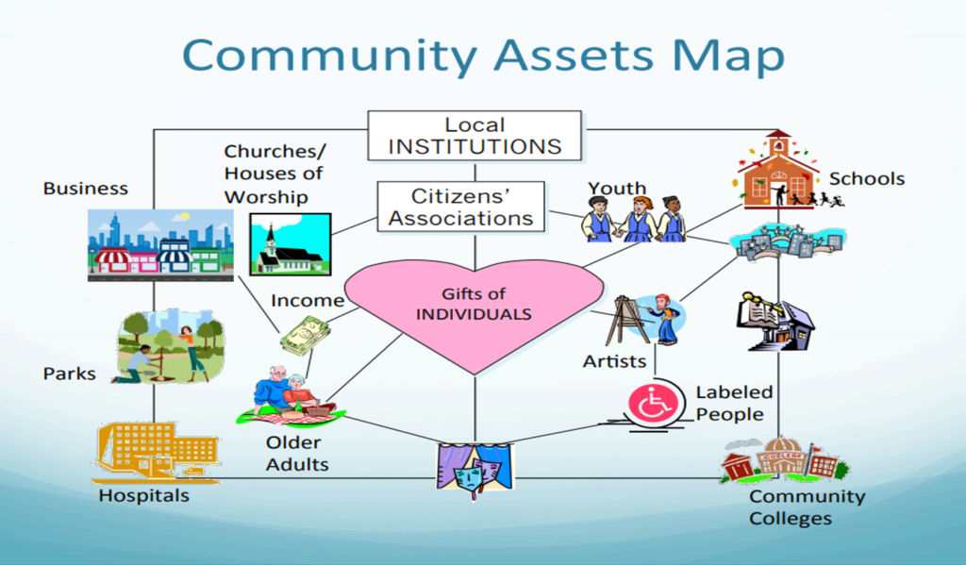
Community Mapping
Identify key points in the community; what assets they have and who are they?
Physical space, local economy, institution, associations and individual.
Recognise the group of people in each location.
Know the activities in each cluster that you want to explore.

Slide 8
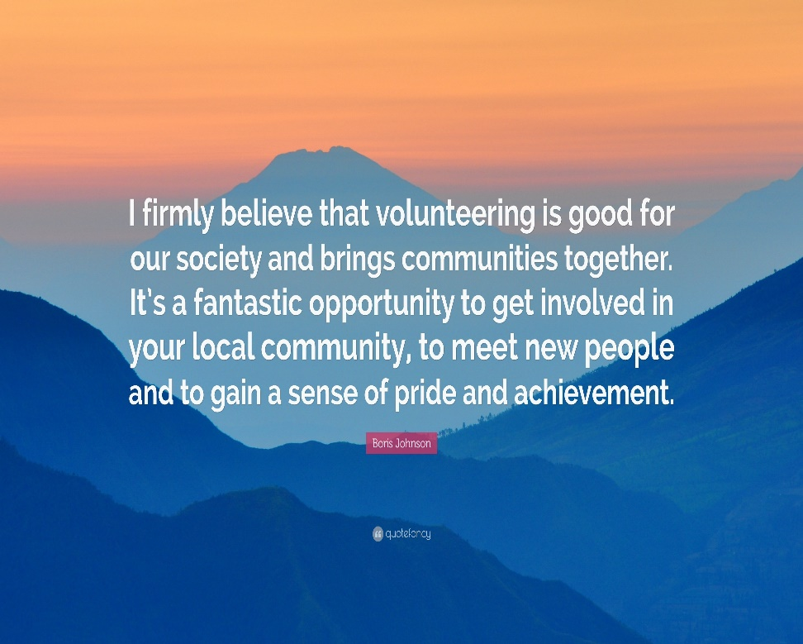
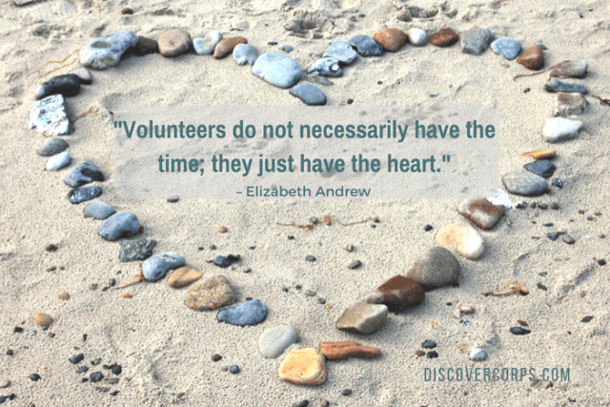
Volunteering

Slide 9
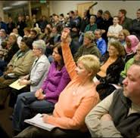
Public Meetings
Public meeting are open to all via open invitation.
Offers opportunity for people to raise issues and ask questions.
Good avenue to float ideas and to identify issues within a local area.
Accommodates a wide range of complex issues and themes.
A good way to build confidence for further involvement.

Slide 10
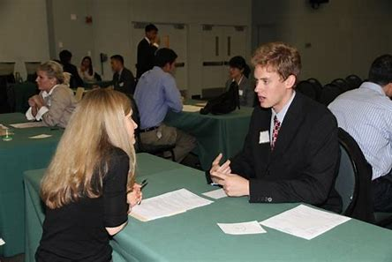
Interview
Interviews are used to gain deeper insight or experience of people.
It is subjective and promotes individualism.
It could be face-to-face, panel, situational, behavioural, competency-based and telephone interviews.

Slide 11

Workshops
Encourages people to work actively and collaboratively on issues.
Advocates inclusivity and involvement.
Creates an avenue for all participants to engage.

Slide 12

Focus Groups
Focus groups are qualitative processes, which are opinion seeking approaches.
6-12 people carefully selected to represent a designated part of the population.
It enables an in-depth understanding of issues.

Slide 13

Forums
Forum is a commonly used technique.
Creates opportunity for people to meet and share views on issues.
Usually guided by a facilitator or moderator.

Slide 14

Web-based Engagement
Web-based engagement is fast and effective.
Participants can engage from anywhere.
Cost effective
Interesting

Slide 15
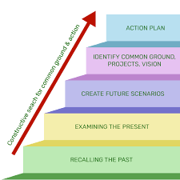
Future Search
Future search is a strategy used to determine the future stakeholders’ expectations.

Slide 16

Open Space Technology
Self-organised with themes.
Participants create an agenda, and facilitators create the space to harvest ideas and manage the time slots.
Simultaneous conversations are led by different conveyors.
Enhance learning, collaboration and creativity.

Slide 17

Social Media
The smart objective in social media engagement is to identify the target audience.
  Identify influencers; Identify hot conversations; Share weekly reports with others; Take action.
Social media make it easy for people to communicate.
Information gets to a wider spectrum of people.
Provides values, tell their story and make it fun.
Engage the community in their passion.

Slide 18

Citizens’ Panels
A collection of citizens randomly selected to form opinions.
Express in-depth views on particular issues.

Slide 19

Roundtable Discussions
Invite experts to share ideas.
Make it interactive.
Issues are discussed from different opinions.
Challenges are deliberated upon.
Be creative and deploy practical techniques.
Call for action

Slide 20
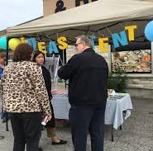
Street Stalls
Bring the issues to a common place.
Explore ideas in the market.
Create awareness through trade on the streets.

Slide 21

Community Surveys
Surveys are used to gather information.
Used to describe and examine characteristics of a population.
It is used to optimize questionnaires to deliver insights.
Helps in drawing up conclusions to aid decision making.

Slide 22
Conclusion
There are several innovative tools and techniques deployed in community engagement, nevertheless, social media has become the most popularly, fastest and cost-effective way to engage.

Slide 23


Slide 24
Reference
Blackadder, A. (n.d.). 7 creative ways to increase community engagement on social media. [online] www.hughesandco.ca. Available at: https://www.hughesandco.ca/blog/7-creative-ways-to-increase-community-engagement-on-social-media.

