Slide 1
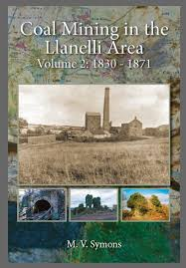
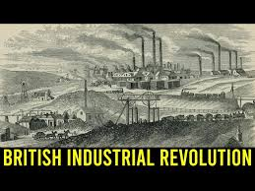
Llanelli’s Prosperity During the Industrial Revolution
Teodora Zenaida Goleanu

Slide 2
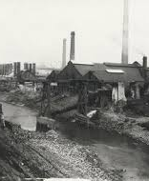
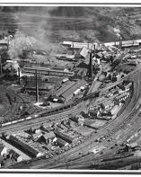
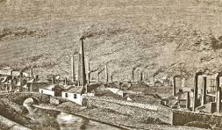
Introduction to Industrial Revolution
Llanelli's strategic location near Swansea Harbor and the Lower Swansea Valley facilitated access to coal and limestone resources, fostering industrial growth.
The town emerged as a center for tinplate manufacturing, shipbuilding, and metalworks, influenced by industrialists like Sir David Davies and companies like the South Wales Tinplate Works.
The industrial boom resulted in economic growth, increased employment opportunities, and a rising population as workers migrated to Llanelli.

Slide 3
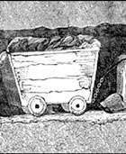
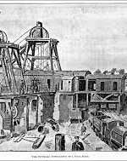
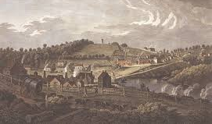
Llanelli's Growth Processes and Technologies
The adoption of steam power significantly improved production efficiency and transportation in Llanelli's factories and mines.
Innovative manufacturing techniques, like mechanized tinplate rolling, increased output and lowered costs, supported by intensive coal mining and limestone quarrying.
Technological advancements, including better ventilation in mines and expanded railways and steamships, enhanced distribution and sustained industrial growth.

Slide 4
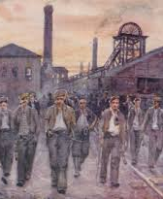

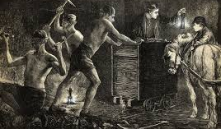
Llanelli's Social and Environmental Impact
Llanelli's growth was driven by a diverse workforce, including locals and immigrants, leading to the development of specialized trades and industries.
Urbanization resulted in crowded living conditions and the establishment of worker housing and community facilities.
Industrialization introduced social challenges, including labor disputes and workers' rights issues, as well as environmental impacts like pollution and landscape changes.

Slide 5
References
Fores, M. (1981). The myth of a British industrial revolution. History, 66, 181–198.
Gregory, D. (1988a). The production of regions in England's industrial revolution. Journal of Historical Geography, 14, 50–58.
Gregory, D. (1988b). Reply to ["The production of regions in England's industrial revolution: A response," by John Langton]. Journal of Historical Geography, 14, 174–176.
Hailey, C. K. (1982). British industrialization before 1841: Evidence of slower growth during the Industrial Revolution. Journal of Economic History, 42, 267–289.
Hartwell, R. M. (Ed.). (1970a). The industrial revolution. New York: Barnes & Noble/Oxford: Basil Blackwell.
Hartwell, R. M. (1970b). Nuffield Studies in Economic History (No. 1: The Industrial Revolution).
Hartwell, R. M. (1971). The industrial revolution and economic growth. London: Methuen.
Harvey, A. D. (1978). First public reactions to the Industrial Revolution. Études Anglaises, 31, 273–293.
Heim, C. E., & Mirowski, P. (1987). Interest rates and crowding-out during Britain's Industrial Revolution. Journal of Economic History, 47, 117–139.
Hills, R. L. (197?). Power in the Industrial Revolution. Manchester: Manchester University Press.
Trinder, B. (1982). The making of the industrial landscape. London: Dent.
https://www.econlib.org/library/Enc/IndustrialRevolutionandtheStandardofLiving.html

