Slide 1
Psychology in Health and Social Care
Applying Bowlby’s Attachment Theory to Early Childhood Development
Case Study: Shona, aged 3
Student Name: Bibi Tabasam
Student Number: 2519902
Module Code: LCHS4010
Module: Psychology in Health and Social Care
Lecturer: Neale Haddon
Assessment: Assignment 1 – Individual Presentation

Slide 2
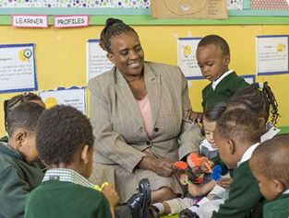
Shona’s Developmental Needs
Shona is a young three-year-old girl who has recently been admitted to a nursery school. Her presentation includes:
Separation anxiety from caregivers
Low verbal communication
Inability to participate in play activities with peers
Challenges adapting to a new environment
The need for support for her development socially, emotionally, cognitively and physically.
It is vital to refrain from diagnosing Shona with a developmental disorder due to her presentation, but rather look at her development individually.
Why attachment is relevant
A secure relationship makes it possible for the child to gain sufficient courage to cope with the situation (Bowlby, 1982; Ainsworth et al., 1978).
Central theme:
It may be possible that Shona has separation anxiety due to the difficulty that she faces in adjusting to the new nursery environment.For understanding behaviour attachment theory provides a useful framework.

Slide 3

Bowlby’s Attachment Theory
Key terms
Attachment: A continuous emotional bond between the child and their carer (Bowlby, 1982).
Attachment behavior: Children may cry, cling and seek proximity in order to stay near an adult who protects them.
Secure base: If there is a reliable carer who provides safety, it allows a child to explore their surroundings (Ainsworth et al., 1978).
Safe haven: The person to whom the attachment is formed provides consolation when a child feels upset.
Internal working models: Experiences early in life may influence the way one perceives oneself, other people and relationships.
Relationship to Shona
The new surroundings at nursery could make Shona seek comfort from familiar adults.

Slide 4

Applying Attachment Theory to Shona
Separation anxiety: Shona may have an attachment reaction because of separation from familiar carers, which results in anxiety and the need for more reassurance.
Inability to communicate verbally: Shona may not be able to express her feelings through verbal communication. In this case, practitioners have to consider other types of communications rather than assuming how she feels.
Difficulty with group play: Lack of confidence in Shona may be due to uncertainty in the new environment in which she finds herself.
Critical analysis: Attachment theory is just one of the ways to understand Shona's problems. It is not all.
Among some of the other factors that may affect her are:
Communication skills
Temperament
Experience
Developmental differences
Nursery environment (Madigan et al., 2023; Deneault et al, 2023)

Slide 5
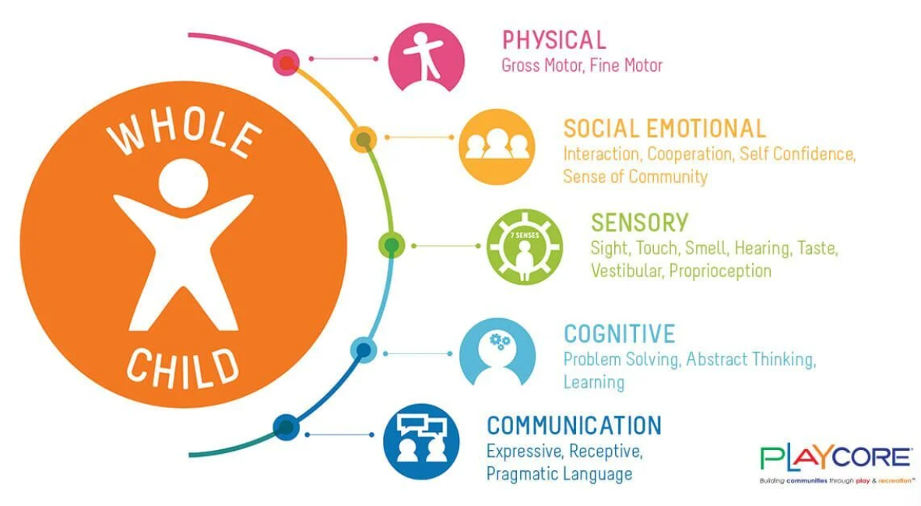
Attachment and Child Development
Language and cognitive development
There have been studies which demonstrate the connection between attachment security and language and cognitive development (Madigan et al., 2023).
Emotions development
Secure and sensitive interactions allow children to be able to:
Experience distress
Develop emotional security
Feel confident
Social skills development
Attachment security allows for:
Social competence
Pro-social behavior
Relationship confidence
(Deneault et al., 2023)
Key point
There are several other factors involved in development, apart from attachment. There is a correlation, but no causation.

Slide 6

Nature and Nurture
Interactionist Approach
Nature
Some biological factors may be as follows:
Temperament
Emotional reactivity
Genetics and neurology
Communicative characteristics
Nurture
Environmental factors may include:
Caregiver relationship
Previous separation history
Family environment
Nursery environment
Interaction with adults
Social communicative opportunities
Factor in the Case of Shona
The behavior of Shona can be understood through the interaction of nature vs. nurture. According to some researches, attachment is stable but also malleable during the period of childhood (Groh et al., 2020).

Slide 7
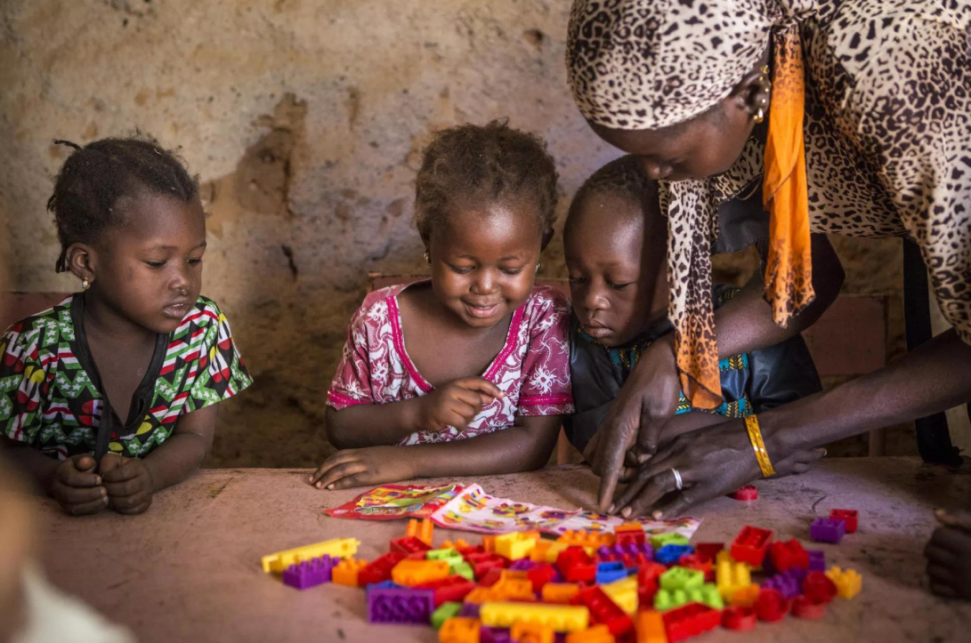
Supporting Shona in the Nursery
Relationship-Based Strategies
1. Reliable key person: The professional who makes Shona feel at ease can be used as the source of assurance.
2. Predictable routines: Employ predictable routines and visual cues that will make Shona able to anticipate what is going to happen next.
3. Transitions: Establish predictable and calming separation procedure with carers.
4. Emotional support: Acknowledge emotions of Shona and give a calm and consistent response.
5. Play: Begin with individual and then small group activity and slowly move onto large group participation.
6. Communication: Use plain language, gestures, and visual cues as appropriate. Intervention through relationships can be used for building attachment and adjustment (Cooper et al., 2017; García-Rodríguez et al., 2023).

Slide 8

Partnership Working and Early Identification
Parents/Carers
Share information about the schedule of Shona and her communication.
List factors which help her feel secure.
Try to provide consistency both at home and in the nursery, as far as possible.
Practitioners in the nursery
Conduct objective observations.
Monitor any change in her communication, behavior and participation.
Evaluate whether or not the strategies worked.
Other professionals
Further developmental assessments and monitoring should be conducted in case any concerns remain.
Key Point
Poor communication and group playing skills of Shona do not necessarily indicate that she has attachment difficulties.
The Reason for this being significant
A holistic approach is crucial in early years education (Tamblyn et al., 2023).

Slide 9
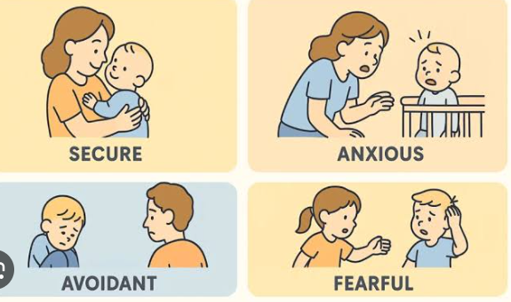
Critical Evaluation and Professional Judgement
Strengths of Bowlby’s Theory
Explains why children seek caregivers when stressed.
Places importance on the role of sensitivity in interaction.
Has the valuable notion of "secure base" that helps in the work with young children.
Existing studies show the correlation between attachment and development.
Weaknesses
Cannot explain all the behavior of Shona.
Development is not deterministic.
There are other environmental and developmental factors to consider.
Individual and cultural diversity have to be considered.
Professional practice
The practitioner has to:
Observe → Assess → Work with caregivers → Provide tailored interventions → Assess outcomes
General view
Although Bowlby's theory is very helpful in explaining relationships, it has to be complemented with other factors of development.

Slide 10
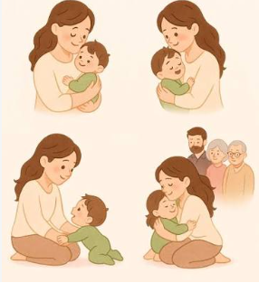
Conclusion
Bowlby's theory would be valuable in explaining the reasons for Shona's separation anxiety and her need for security.
It will be easy for a reliable practitioner to provide a secure base which will help with exploration and social confidence.
Development occurs as a consequence of the interaction between nature and nurture in Shona's case.
Attachment is one of the factors in development of emotions, social relations, language and cognition, although it cannot explain everything.
Principles of good practice include observations, partnership and personalization of services.
Final judgement
The best strategy would be to ensure a predictable and safe environment in the nursery, while also bearing in mind that Shona is an individual and there are many things that influence her development.

Slide 11
References
Ainsworth, M.D.S., Blehar, M.C., Waters, E. and Wall, S. (1978) Patterns of Attachment: A Psychological Study of the Strange Situation. 1st edn. Hillsdale, NJ: Erlbaum.
Bowlby, J. (1982) Attachment and Loss: Vol. 1. Attachment. 2nd edn. New York: Basic Books.
Deneault, A.-A., Hammond, S.I. and Madigan, S. (2023) ‘A meta-analysis of child-parent attachment in early childhood and prosociality’, Developmental Psychology, 59(2), pp. 236–255. doi: 10.1037/dev0001484.
Groh, A.M. et al. (2020) ‘Attachment in the Early Life Course: Meta-Analytic Evidence for Its Role in Socioemotional Development’, Child Development, 11(1). doi:10.1111/cdep.12213
Madigan, S. et al. (2023) ‘Does child-mother attachment predict and mediate language and cognitive outcomes?’, Developmental Review, 70, 101093. https://doi.org/10.1016/j.dr.2023.101093
Cooper, G., Hoffman, K. and Powell, B. (2017) The Circle of Security Intervention: Enhancing Attachment in early parent-child relationships: Order from Guilford Press. New York: Guilford Press. Available at: https://www.researchgate.net/publication/285137640_The_circle_of_security_intervention_Enhancing_Attachment_in_early_parent-child_relationships_Order_from_Guilford_Press (Accessed: 4 Oct 2026)
Tamblyn, A. et al. (2023) ‘How do physical or sensory early childhood education and care environment factors affect children's social and emotional development?’, Educational Review. 41(2), 100555. doi :10.1016/j.edurev.2023.100555

