Slide 1
Digital Scrapbook
Adele Rees
Student Number- 2501624
Module Code- ECEY4005
Word Count- 3,000

Slide 2
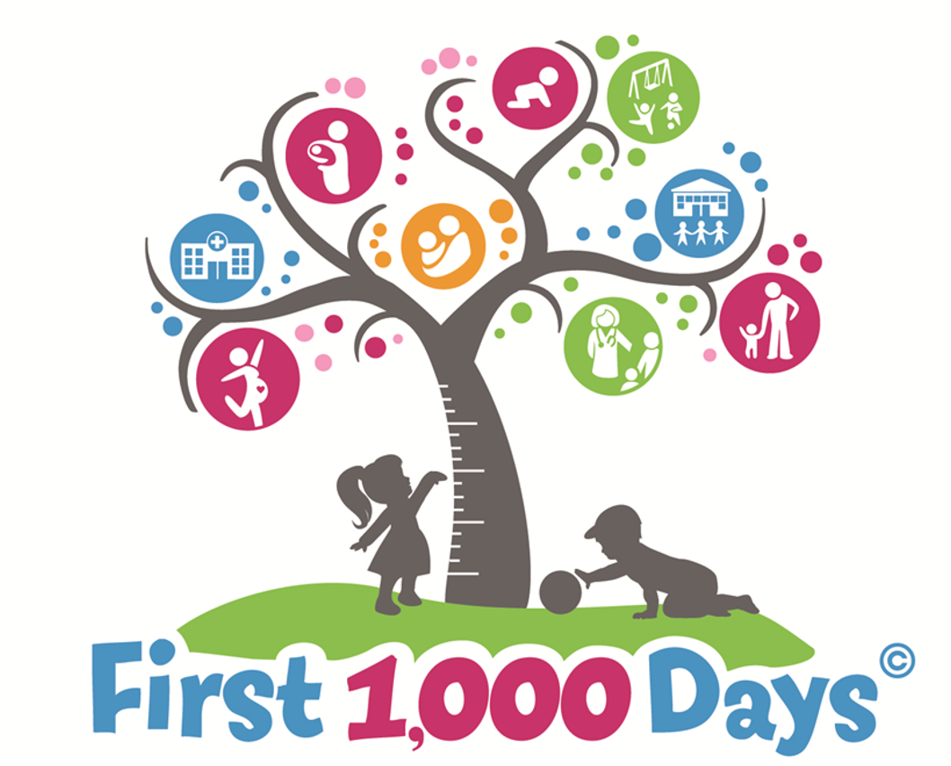
Introduction- The First 1,000 Days
'80% of the brain develops within the first 1,000 days' (Lawler, 2023).
'The first 1,000 days of life, from pregnancy to age two, are critical for an individual's cognitive, emotional and physical development' (NHS Confederation, 2025). During the first 1,000 days, sensory functions and core cognitive development begin to take shape (Lawler, 2023).
Early experiences play a key role in influencing children's self-perception and how they form relationships in the future (NHS Wales, 2024). 'In pregnancy, a mother's diet and pre-pregnancy stores are the sole source of nutrition for a growing foetus, highlighting the importance of eating well during this stage' (SR Nutrition, 2020). Therefore, 'investment in nutrition during this crucial period is shown to deliver significant returns, enhancing human capital, reducing healthcare costs, and supporting national development' (World Food Programme, 2024).
(Pauley, 2021).

Slide 3
Introduction- The First 1,000 Days
The NHS Confederation (2025) suggests that exposure to significant stress, combined with unsuitable caregiver attachment and adverse experiences in childhood, can have long-term impacts on a child's development and well-being.
Important interventions for child survival and development:
'Access to early antenatal care,
Increased skilled assistance with births,
Hospital deliveries,
Exclusive breastfeeding,
Immunization,
Proper weaning and support' (Onsomu and Ng'eno, 2025).

Slide 4
Introduction- The First 1,000 Days
Growth and health development during the first 1,000 days means that children are incredibly dependant on appropriate nutrition and healthcare (Suri, Verlato and Ray, 2025).
'In pregnancy, a mother's diet and pre-pregnancy stores are the sole source of nutrition for a growing foetus, highlighting the importance of eating well during this stage' (SR Nutrition, 2020). 'The development of healthy habits in young children is incredibly important for their development in the first 1,000 days. This includes the child's diet' (Early Years Wales, 2020).
'By investing in nutrition, healthcare, and supportive environments during this period, we can lay the foundation for healthier, more productive, and equitable societies' (Suri, Verlato and Ray, 2025).
'Cutting sugar in the first 1,000 days of a baby's life- from conception to the age of two- appears to reduce the risk of developing significant health issues in adult life' (Gallagher, 2024). Cutting sugar out of a child's diet could prevent future health conditions like obesity (Nutricia, 2025).

Slide 5

'Malnutrition effects on early development:
Impaired cognitive and motor functions,
Poor growth, including stunting and wasting,
Weakened immune system,
Financial burden of ongoing medical and health issues,
Complicates later development related to education, gender equality and poverty'
(Lawler, 2023).
(Coastal Kids, n.d).

Slide 6
Introduction- The First 1,000 Days
'Good nutrition, playing, talking and responding to babies builds their brains and bodies' (NHS Wales, 2024).
'Countries that fail to invest in the well-being of women and children in the first 1,000 days lose billions of dollars to lower economic productivity and higher health costs' (1,000 Days, 2024).
'Malnourished children in this window face higher risks of illness, death, and long-term developmental issues, perpetuating a cycle of poverty and poor health outcomes' (World Food Programme, 2024).
'Proper nutrition during this period is paramount' (Suri, Verlato and Ray, 2025).
'Low investment in a child's early days of life has been associated with stunting, becoming underweight, and wasting, which have long-term implications' (Onsomu and Ng'eno, 2025).

Slide 7
Caregiving
'Effective early years provision pays as much attention to children's care as it does to play and learning' (Birth to 5 Matters, 2021). NHS Wales (2011) believe that physical and emotional needs will be met more efficiently when their families are secure and caring. It gives them a better start at life.
'As practitioners, we must support children's PSED through ensuring that their hierarchy of needs are met to enable children to be ready to play and learn' (FamilyHub, 2023).
Maslow's Hierarchy of Needs:
'Physiological Needs: Basic needs for survival,
Safety Needs: Protection from harm, danger, and fear: stability and security,
Love and Belonging: Emotional needs for friendship, family and intimacy,
Esteem Needs: Needs for self-esteem, respect, recognition,
Self-Actualization Needs: The desire to achieve one's fullest potential' (CareRev, 2024).

Slide 8
Caregiving
Positive Relationships
The Department for Education (2022) states that it is essential that a child has a consistent key person. 'As a child's key person, you will provide a special relationship for the child and their parents or carers' (Department for Education, 2022).
NSPCC Learning (2021) believe that a positive relationship is one where a child can openly share their emotions, feel encouraged and appreciated. 'The ability to act kindly and compassionately is an important part of developing positive relationships' (Early Intervention Foundation & University of Cambridge, 2022). 'Knowing how to make and keep positive relationships allows children to form strong bonds with others' (Early Intervention Foundation & University of Cambridge, 2022).
'Through supported interaction with others, children learn how to make good friendships, co-operate and resolve conflicts peaceably' (Department for Education, 2022).

Slide 9

Caregiving
Key Attributes of Exceptional Care Work
'Empathy and kindness,
Patience and the ability to remain calm under pressure,
Passion,
Positivity,
Respect and good listening skills'
(Centre Point School, 2025).
(Fish Insurance, 2020).

Slide 10
Caregiving
Birth to 5 Matters (2021) believe that inclusive environments support and care for every child. 'Children thrive within environments that support their individual and diverse development needs' (Birth to 5 Matters, 2021). 'The environments in which babies and young children learn, play and socialise are a critical part of giving children the foundation they need to be successful learners for the rest of their lives' (Harrop, 2024).
Enabling Environments and Inclusive Practise
'Diverse forms of active play, both indoors and outdoors,
Experiencing the real physical and natural world, as well as the social world,
The space and time for children to fully discover, test and revisit their ideas and theories,
Cosy and quiet space for sleeping, resting, sitting quietly and sensory engagement,
Experiences in familiar and predictable spaces, and in those that are unfamiliar, complex and exciting'
(Birth to 5 Matters, 2021).

Slide 11
Caregiving
'John Bowlby's Attachment Theory emphasises the importance of early emotional bonds between a child and their caregiver' (McLeod, 2025).
McLeod (2025) believed that John Bowlby's theory states that young people are programmed from birth to create attachments. This is necessary from the moment they’re born, completely because the child will feel protected enough to navigate their environment confidently.
'Bronfenbrenner conceptualized that human development is shaped by complex relationships between individuals and their environments' (Lopez et al, 2021).
'Bronfenbrenner's model serves as a useful tool for exploring, categorizing, and interpreting different facets of children's environments and experiences' (Lopez et al, 2021).

Slide 12
Professional Partnership
'Collaborating in childcare is incredibly important because early years professionals can advocate for children, acting as their voice when others might not' (Connect Childcare, 2024).
'It promotes a more integrated family-focused approach to early help and child protection by encouraging multi-agency collaboration' (Wigan Safeguarding Children's Partnership, n.d).
'Building strong relationships with parents and caregivers in early years education is essential' (Connect Childcare, 2024).
'Working together ensures a good understanding of a child's needs, leading to appropriate provision within the setting and the possibility of supporting learning in the home' (Birth to 5 Matters, 2021).
'Parents must feel included, listened to and trusted within their own role supporting their child's wellbeing, development and learning' (Birth to 5 Matters, 2021).

Slide 13
Professional Partnership
Coram PACEY (2024) believes that it's important to include parents in their child's development. This can be done through regular communication, a learning journal, and clear boundaries.
'Professionals worldwide can share knowledge, experience and research and even build professional relationships and multi-agency collaboration' (Cushing, 2025).
Coram PACEY (2024) also states that it's important to keep parents involved, from the beginning. Parents should know who their child's key person is, and they should be updated on the progression that their child is making.
What Are the Impacts of Professional Partnership?
'Better outcomes for children and families through earlier, more effective support,
Stronger collaboration between agenies, leading to more coordinated care,
Reduced pressure on crisis services by preventing issues from escalating,
Empowered families who are actively involved in decision-making,
More efficient use of resources by streamlining services and targeting support' (Wigan Safeguarding Children's Partnership, n.d)

Slide 14
Professional Partnership
Microsystem
'Includes the child's most immediate relationships and environments. A child's parents, siblings, classmates, teachers, and neighbours would be a part of their microsystem' (Guy-Evans, 2024).
'Within the built environment, this could be the home, classroom, office of neighbourhood street' (Manolakelli, 2025).
An obvious link to immediate relationships is the child-teacher relationship. Building a firm relationship will encourage the child to learn (FutureLearn, n.d).
Bronfenbrenner
'The Bronfenbrenner ecological model explains how human development is influenced by the multiple environments we live in' (Cherry, 2025).
'It shows how individuals interact with different levels of influence, which include family, peers, schools, communities, and culture' (Cherry, 2025).
Cushing (2025) summarises that Bronfenbrenner's theory can interact and change with the child, depending on distinct social connections and their relations.
'Bronfenbrenner's theory is organised into a series of five nested systems or levels' (Cherry, 2025).

Slide 15
Professional Partnership
Mesosystem
'Where a person's individual microsystems do not function independently but are interconnected and assert influence upon one another' (Guy-Evans, 2024),
'This translates to the way different environments relate to each other' (Manolakelli, 2025),
'If a teacher and parent are in frequent communication, then they can make sure that good habits are practised at both home and school' (EBSCO, 2024).
Exosystem
' Incorporates other formal and informal social structure such as local governments, friends of the family, and mass media' (Guy-Evans, 2024).
'A child who has abusive parents might be removed from the family by protective services. The child did not cause the abuse, but the abuse has an impact on the child and the child's microsystem' (EBSCO, 2024).

Slide 16
Professional Partnership
Macrosystem
'Focuses on how cultural elements affect a child's development, consisting of cultural ideologies, attitudes, and social conditions that children are immersed in' (Guy-Evans, 2024).
The macrosystem changes over time, and the child might play a small part in those changes. These changes also affect the child's value and opportunities in life' (EBSCO, 2024).
Chronosystem
'Relates to shifts and transitions over the child's lifetime' (Guy-Evans, 2024).
'The types of friendships, responsibilites and conflicts that a toddler has are very different to those of a teenager' (EBSCO, 2024).
'A teenager's brain is better developed than a toddlers, and as such, a teenager is better able to solve complex problems' (ESBCO, 2024).

Slide 17
Professional Partnership
Maternal Factors
'Maternal health refers to the health of women during pregnancy, childbirth and the postnatal period' (World Health Organization, n.d).
'The orchestration of mutual communication between the mother and fetus is the driver of long-term health' (Muglia et al, 2022).
'It is shaped primarily by the maternal environment, with its genetic, physiologic, nutritional, inflammatory/infection and psychological components' (Muglia et al, 2022).
'During pregnancy, most women want to do 'the best for the baby' and this heightened motivation can provide leverage for tackling unhealthy lifestyle choices and promoting healthy ones' (Gray, 2012).

Slide 18
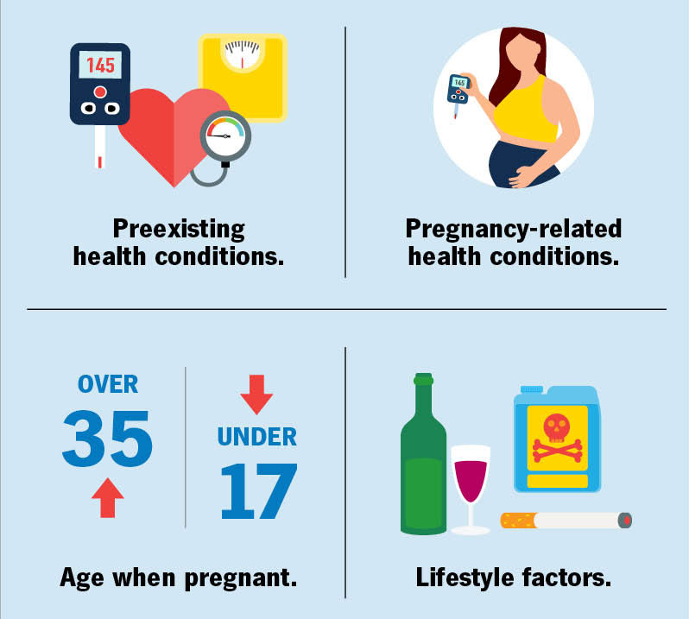
Professional Partnership
'Interventions For Modifiable Risk Factors:
Smoking cessation,
Interventions for reducing alcohol consumption in pregnant women,
Interventions to reduce gestational weight gain,
Improving maternal nutrition,
Managing the use of illicit drugs,
Perinatal mental illness and psychosocial stress,
Promoting breastfeeding' (Gray, 2012).
Risk Factors:
'Tobacco,
Alcohol,
Obesity,
Diet,
Illicit drugs,
Mental illness,
Low socio-economic status,
Psychosocial stress'
(Gray, 2012).
(Cleveland Clinic, 2024).

Slide 19
Challenges
'The early years sector is grappling with a significant workforce crisis, impacting the quality of care and education children receive' (Leatherbarrow, 2025).
'Some of the main workforce issues include low pay, challenging working conditions, lack of professional development, staff not having the right qualifications, poor leadership and low levels of staff well-being' (Owston et al, 2024).
Coram (2024) states that there are barriers within accessing early education, particularly for 'poorer White British households, children from ethnic minority backgrounds, families with English as an additional language and children with special educational needs and disabilties'.
'The proportion of unqualified staff has increased each year from 16% in 2018 to 22% in 2024' (CareTutor, n.d).
Leatherbarrow (2025) believes that challenges in providing care of a high standard lead to safeguarding issues, where children's safety and development is overlooked, disrupted and disturbed. This can disrupt the bond between a child and their key person, leading to future problems.

Slide 20
Challenges
Poverty
'Amongst the poorest fifth of parents with young children, only a third (36%) use formal childcare, compared to double that (73%) of the highest earning households' (Save the Children, 2024).
'High childcare costs are pushing more families into poverty and out of work' (Evans, 2025).
'Childcare costs in the UK are contributing to poverty and gender inequality' (Corfe, 2022).
Funding
'Despite its essential role, childcare policy has been plagued by underfunding, an unstable workforce and inequalities in access' (Talbot, 2025).
Business LDN (2024) summarise that improving costs, access and the quality of childcare would help greater workforce participation.
'As soaring price rises and cost of living pressure start to bite, the high cost of childcare has become unmanageable for families' (Jarvie et al, 2023).

Slide 21
Challenges
Resources
'NDNA discovered that 69.8% of the 714 providers who responded to its staffing sustainability survey did not have sufficient staff to operate at maximum capacity' (Argile, 2025).
'The Department for Education has estimated that 36,000 staff need to be recruited to create the 70,000 places needed' (Argile, 2025).
'78% of nurseries identified funding for resources as a significant challenge, underscoring the need for efficient resource management' (Galeon, n.d).
Funding
Jarvie et al (2023) states that families are left in an awkward situation. Employment becomes financially unviable due to childcare, however childcare then becomes impossible.
'The need for action to improve the childcare and early education system is urgent' (Jarvie et al, 2023).
'By planning effectively, sourcing quality materials, and adhering to best practises and regulatory requirements, settings can create safe, stimulating and supportive environments for young children' (Galeon, n.d).

Slide 22
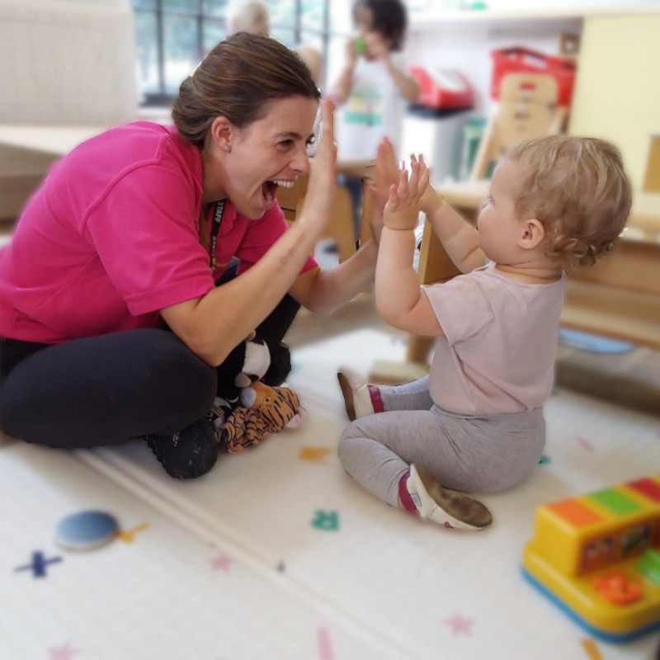
Challenges
Resources
'78% of nurseries identified funding for resources as a significant challenge, underscoring the need for efficient resource management' (Galeon, n.d).
'Top Reasons for Staff Leaving a Nursery:
Pay (50%),
Leaving for better conditions- such as better hours or less physical work (46%),
Personal reasons- such as family needs or relocation (37.8%),
Stress associated within the role or workload (35.1%).'
(Argile, 2025).
(Buttercups Day Nursery, 2021).

Slide 23
Activities
The National Literacy Trust (2024) state that activities are important, if not a major step in supporting a child's development.
'Play removes barriers, it is inclusive and accessible to all' (National Literacy Trust, 2024).
'Playing can be a great way for your child to exercise but playing also helps children learn' (NHS, 2023).
'Because play is open-ended and flexible, children can explore and experiment with confidence, take risks and challenge themselves at the limits of their capabilities, without fear of failure' (Birth to 5 Matters, 2021).
'Havigng freedom and time to play is an appropriately stimulating and resourced environment which is finely tuned for babies, toddlers and young children supports development and learning across all areas' (Birth to 5 Matters, 2021).

Slide 24
Activities
'Reggio Emilia Play Approach was created after WW2 in Reggio Emilia in northern Italy' (Worsley, 2023). 'It's founder Loris Malaguzzi, a teacher, believed that the community of Reggio Emilia needed a new and improved educational system for their children' (Worsley, 2023).
'The Reggio Emilia approach to early years education puts children in the driver's seat. It sees them as curious individuals with the power and potential to develop and learn' (Berg, 2025). 'The philosophy encourages children to express themselves and their knowledge. This is through painting, sculpting, dramatic play, dancing, writing, construction' (Berg, 2025).
'Allowing child-led expressive learning which encourages exploration and creativity will promote children's knowledge and inspire children to revisit activities' (Worsley, 2023).
Internationally
'Many countries have implemented measures to improve children's participation in early years provision' (Ofsted, 2023).
Internationally, there are lots of differences in children's development and activities. In other countries, the focus is on the child when they're older and about to begin school (Ofsted, 2023).
'In England, the early years curriculum framework starts from birth' (Ofsted, 2023).

Slide 25
Activities
Loose Parts
'Loose parts is a term coined by British architect Simon Nicholson, who carefully considered landscapes and environments that form connections' (PennState Extension, n.d)
'Loose parts are materials that are moved, carried, redesigned, lined up, taken apart, and put back together in multiple ways' (PennState Extension, n.d).
'There is no set of specific directions for materials considered loose parts. The child is the direction' (PennState Extension, n.d).
Montessori
'Montessori education builds a child's capacity to become a fulfilled and productive adult able to contribute to the world- at home, at work, and in their community' (Association Montessori Internationale, 2025).
Montessori believed in an educational approach that helped children become their best selves (Association Montessori Internationale, 2025).
'Montessori develops the whole child. Academics and knowledge-building are key qualities of Montessori, as is the ability to think creatively and understand the needs of others' (Association Montessori Internationale, 2025).

Slide 26
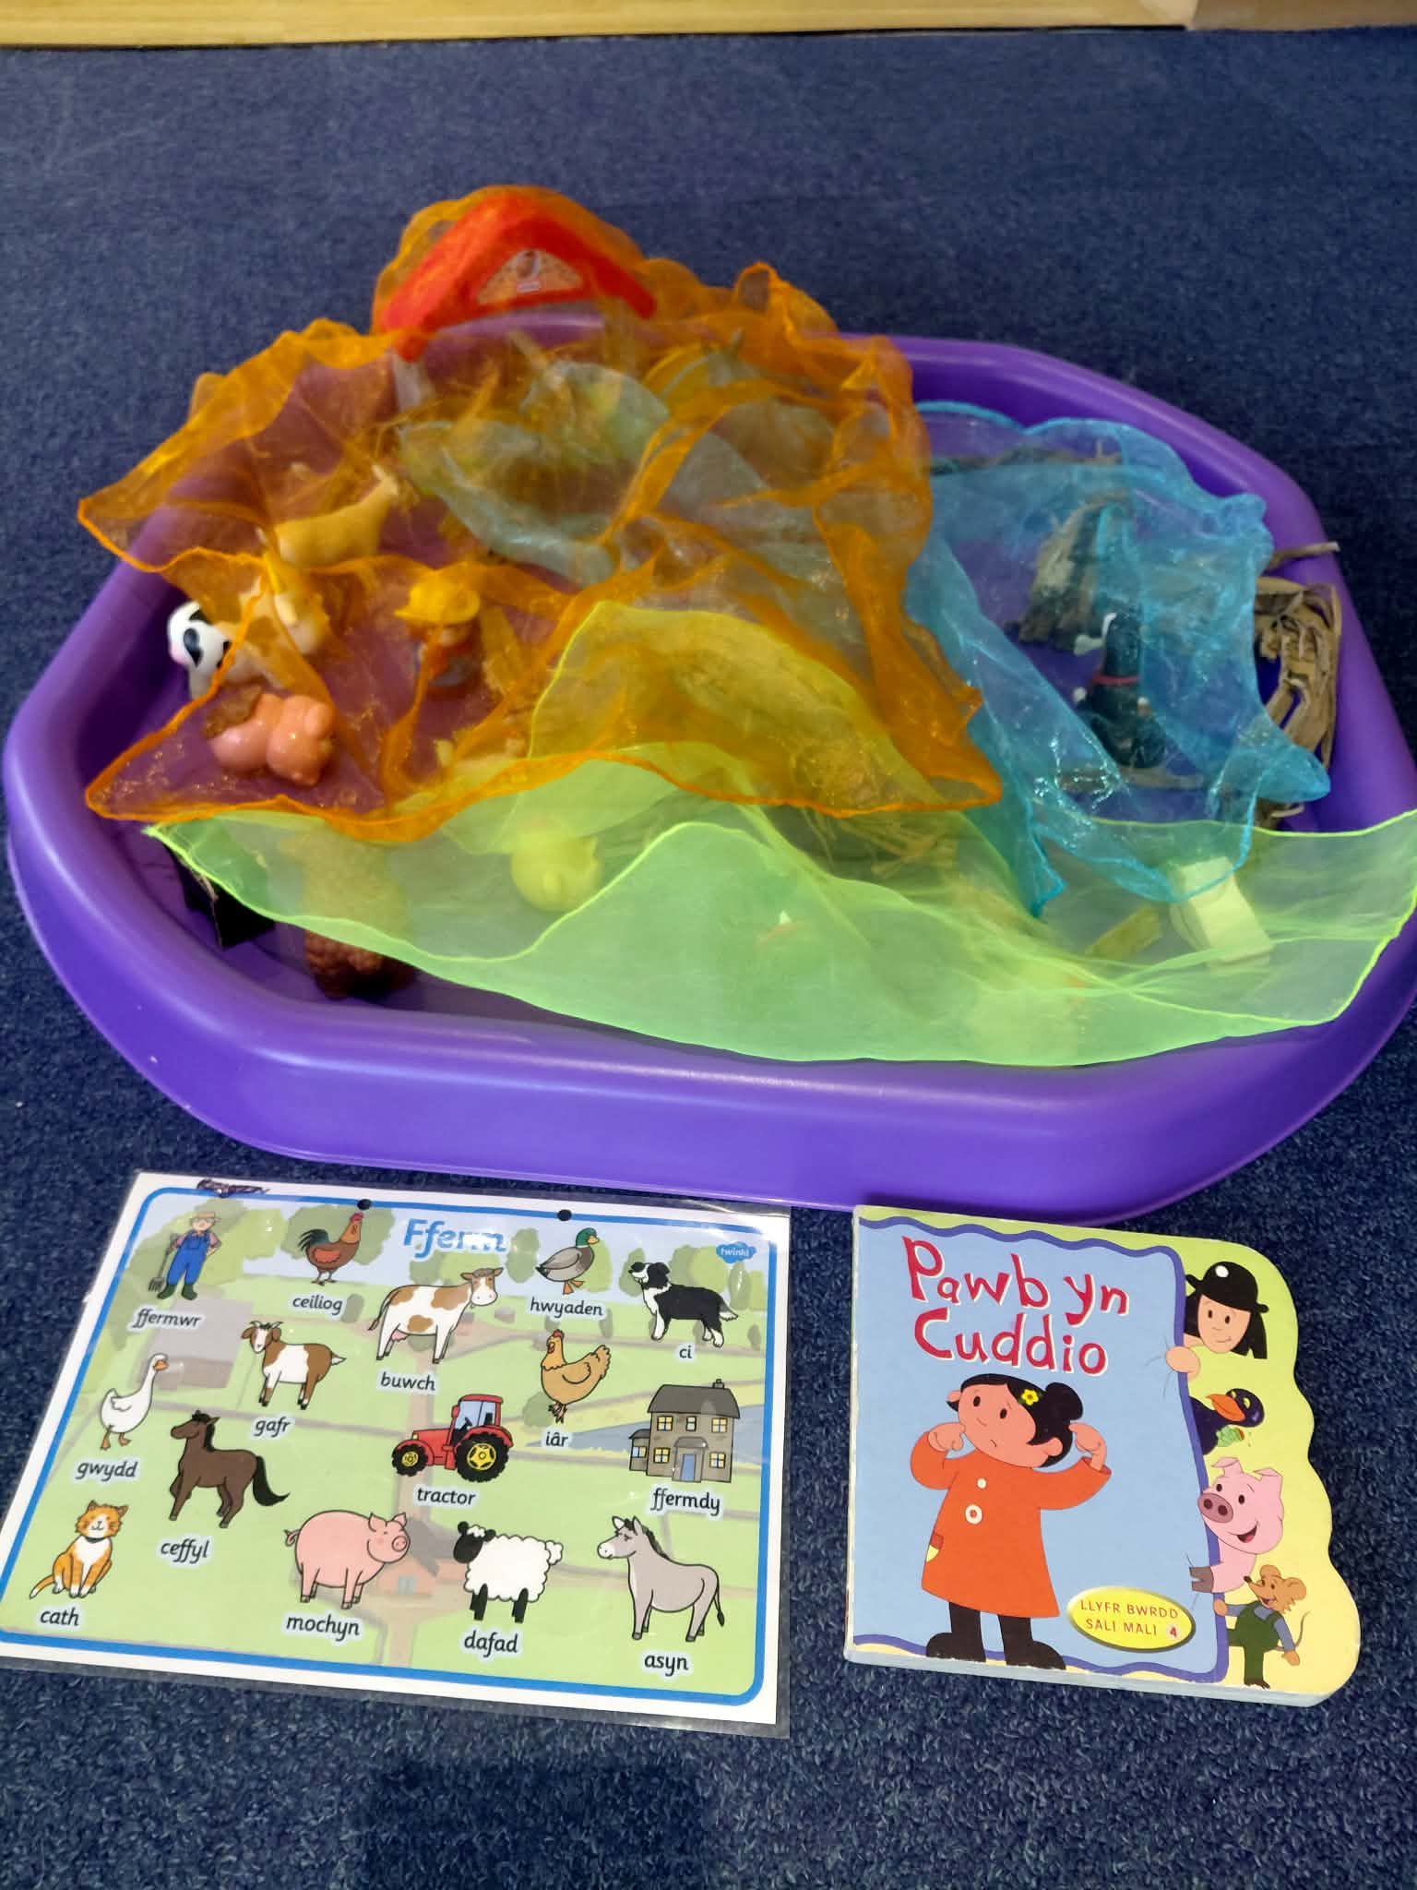
Activities
Here is an activity I did whilst working. The children developed fine motor skills through picking up the different farm animals. ‘Engaging in activities that require fine motor skills can improve focus, concentration and self-regulation' (Farringtons School, 2025).
Their fine motor skills were also improved by playing with the coloured scarves, as the texture forced them to use their senses (Yochimowitz, 2023).
The children were also developing their language as I helped them read the Welsh book, as well as teaching them different Welsh farm animals. ‘As speaking and listening develops, children build foundations for literacy, for making sense of visual and verbal signs and ultimately for reading and writing’ (Department for Education, 2022). It was clear that the children really enjoyed playing with the different farm animals, and it helped them develop cognitive thinking whilst also expanding on empathy and responsibility (JS Hubbuck, 2023).
Figure 1: Farm-themed activity (own image, 2026).​

Slide 27
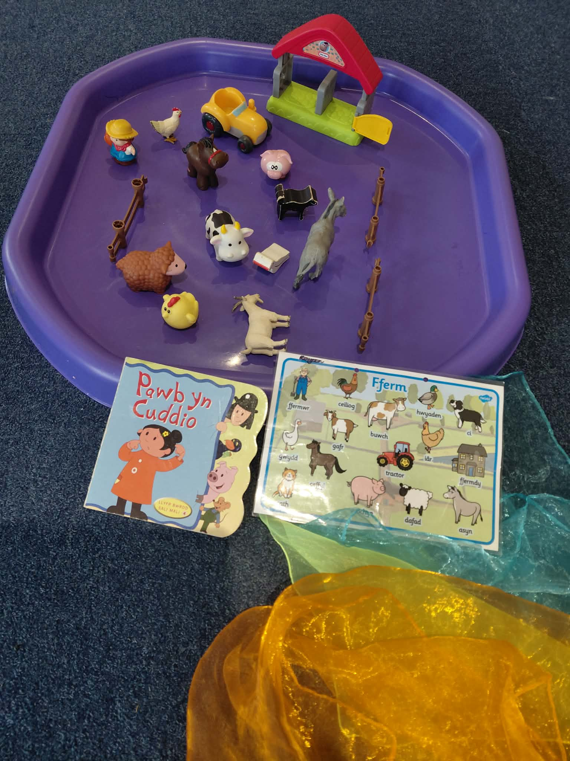
Activities
‘They’ll be given a sense of responsibility as a result of some added independence’ (Kumon, 2022). JS Hubbuck (2023) emphasised the importance of playing with the farm animals on vocabulary, ‘they can learn the names of animals, buildings, vehicles, and various other farming terms’. Playing with the toys also helped the children develop their pronunciation through making animal noises (Walsh, 2023). This is because ‘animal sounds use many of the common sounds from the English language, otherwise known as phonemes’ (Walsh, 2023). I ensured each child engaged in sharing and passing, to promote fairness and respect. ‘This development influences a child’s self-confidence, empathy, and the ability to develop meaningful and lasting friendships and partnerships’ (Help Me Grow, n.d).
Figure 2: Farm-themed activity (own image, 2026).

Slide 28
Reference List
1,000 Days. (2024) ‘Why 1,000 Days’. Available at: https://thousanddays.org/why-1000-days/ (Accessed: 14.01.2026).
Argile, A. (2025) ‘Early Years Workforce Crisis Demands Urgent Action Before Further Childcare Expansion’, NDNA, 6th June. Available at: https://ndna.org.uk/early-years-workforce-crisis-demands-urgent-action-before-further-childcare-expansion/ (Accessed: 17.01.2026).
Association Montessori Internationale. (2025). ‘The Montessori Difference’. Available at: https://montessori-ami.org/about-montessori (Accessed: 18.01.2026).
Berg, V. (2025) ‘The Reggio Emilia Approach to Early Years Education’, DayNurseries.co.uk, 6th August. Available at: https://www.daynurseries.co.uk/advice/the-reggio-emilia-approach-to-early-years-education (Accessed: 18.01.2026).
Birth to 5 Matters. (2021) ‘Care’. Available at: https://birthto5matters.org.uk/care/ (Accessed: 16.01.2026).
Birth to 5 Matters. (2021) ‘Learning Environments’. Available at: https://birthto5matters.org.uk/learning-environments/ (Accessed: 17.01.2026).
Birth to 5 Matters. (2021) ‘Parents as Partners’. Available at: https://birthto5matters.org.uk/parents-as-partners/ (Accessed: 18.01.2026).
Birth to 5 Matters. (2021) ‘Play’. Available at: https://birthto5matters.org.uk/play/ (Accessed: 18.01.2026).
Business LDN. (2024) ‘Fixing Britain’s Broken Childcare System Could Deliver £11BN Economic Boost’, 29th February. Available at: https://www.businessldn.co.uk/news-publications/news/fixing-britains-broken-childcare-system-could-deliver-ps11bn-economic-boost (Accessed: 17.01.2026).
Buttercups Day Nursery. (2021) ‘Welcome to Buttercups’. Available at: https://buttercups-nursery.co.uk/ (Accessed: 18.01.2026).

Slide 29
Reference List
CareRev. (2024) ‘How Maslow’s Hierarchy of Needs Applies to Nursing and Its Importance in Nursing Education’. Available at: https://www.carerev.com/blog/maslows-heirarchy-nursing-education (Accessed: 16.01.2026).
CareTutor. (N.D) ‘Tackling Early Years Workforce Challenges’. Available at: https://caretutor.org/tackling-early-years-workforce-challenges/ (Accessed: 17.01.2026).
Centre Point School. (2025) ‘The Importance of Teacher and Student Relationships’. Available at: https://centrepointschools.com/blogs/the-importance-of-teacher-and-student-relationships/ (Accessed: 18.01.2026).
Cherry, K. (2025) ‘The Bronfenbrenner Ecological Model and Its 5 Systems’, VeryWell Mind, 15th October. Available at: https://www.verywellmind.com/bronfenbrenner-ecological-model-7643403 (Accessed: 18.01.2026).
Cleveland Clinic. (2024) ‘High-Risk Pregnancy’. Available at: https://my.clevelandclinic.org/health/diseases/22190-high-risk-pregnancy (Accessed: 18.01.2026).
Coastal Kids. (n.d) ‘The Perfectly Proportioned Plate: Creating Healthy Eating Habits for Kids’. Available at: https://coastalkids.com/healthy-eating-habits-for-kids/ (Accessed: 18.01.2026).
Connect Childcare. (2024) ‘Building Strong Partnerships in Childcare’, 27th July. Available at: https://connectchildcare.com/blog/building-partnerships-in-childcare/ (Accessed: 18.01.2026).
Coram PACEY. (2024) ‘Working in Partnership with Parents’. Available at: https://www.corampacey.org.uk/working-in-partnership-with-parents/ (Accessed: 18.01.2026).
Coram. (2024) ‘Tackling Barriers to Access in Early Education’. Available at: https://www.coramfamilyandchildcare.org.uk/news/tackling-barriers-to-access-in-early-education/ (Accessed: 17.01.2026).

Slide 30
Reference List
Corfe, S. (2022) ‘Childcare Costs and Poverty’, Social Market Foundation, 21st July. Available at: https://www.smf.co.uk/publications/childcare-costs-and-poverty/ (Accessed: 17.01.2026).
Cushing, J. (2025) ‘Bronfenbrenner’s Ecological Systems Theory for a Modern Generation’, Social Pedagogy Professional Association, 20th October. Available at: https://sppa-uk.org/news/7865/ (Accessed: 18.01.2026).
Department for Education. (2022) ‘Exploring Language’. Available at: https://help-for-early-years-providers.education.gov.uk/areas-of-learning/communication-and-language/exploring-language (Accessed: 18.01.2026).
Department for Education. (2022) ‘Relationships’. Available at: https://help-for-early-years-providers.education.gov.uk/areas-of-learning/personal-social-and-emotional-development/relationships (Accessed: 17.01.2026).
Early Intervention Foundation & University of Cambridge. (2022) ‘Developing Positive Relationships’ Play in Education Development and Learning, pp.1-5. Available at: https://share.google/W7UpVKAr7STFVzSE1 (Accessed: 17.01.2026).
Early Years Wales. (2020) ‘First 1,000 Days’. Available at: https://www.earlyyears.wales/en/news/blog-first-1000-days (Accessed: 14.01.2026).
EBSCO. (2024) ‘Ecological Systems Theory’. Available at: https://www.ebsco.com/research-starters/psychology/ecological-systems-theory (Accessed; 18.01.2026).
Evans, L. (2025) ‘Families Pushed Out of Work Due to Childcare Costs’, BBC News, 5th August. Available at: https://www.bbc.co.uk/news/articles/c74dz9rgeglo (Accessed: 17.01.2026).
FamilyHub. (2023) ‘Maslow’s Hierarchy of Needs’. Available at: https://torbayfamilyhub.org.uk/topic/maslows-hierarchy-of-needs/ (Accessed: 17.01.2026).
Farringtons School. (2025) ‘Fine Motor Skills in Early Years’. Available at: https://www.farringtons.org.uk/2025/02/10/the-importance-of-fine-motor-skills/ (Accessed: 18.01.2026).
Fish Insurance. (2020) ‘5 Essential Attributes of Exceptional Care Work’. Available at: https://www.fishinsurance.co.uk/5-essential-attributes-of-exceptional-care-work/ (Accessed: 16.01.2026).

Slide 31
Reference List
Galeon, A. (n.d) ‘Managing Resources and Supplies in Early Years and Nurseries’ Mandatory Training Group. Available at: https://www.mandatorytraining.co.uk/blogs/early-years-chidlcare/managing-resources-and-supplies-in-early-years-and-nurseries?srsltid=AfmBOoraPQXMnwmMe-Lj4c5L_UROcvJvWfs1EsFYzlfEkLMCeSauW7pp (Accessed: 18.01.2026).
Gallagher, J. (2024) ‘Sugar in First 1,000 Days Linked to Poor Health Later’, BBC News, 31st October. Available at: https://www.bbc.co.uk/news/articles/c93qlyp42jyo (Accessed: 14.01.2026).
Gray, R. (2012) ‘Life Stage: Pre-Conception and Pregnancy’, Annual Report of the Chief Medical Officer 2012, Our Children Deserve Better: Prevention Pays, p.3-6. Available at: https://assets.publishing.service.gov.uk/media/5a7c632ce5274a7ee2567201/33571_2901304_CMO_Chapter_5.pdf (Accessed: 18.01.2026).
Guy-Evans, O. (2024) ‘Bronfenbrenner’s Ecological Systems Theory’, ResearchGate, January. Available at: https://www.researchgate.net/publication/383500583_Bronfenbrenner's_Ecological_Systems_Theory (Accessed: 18.01.2026).
Harrop, S. (2024) ‘The Importance of The Learning Environment to Young Children’, North Wales Management School, 19th March. Available at: https://online.wrexham.ac.uk/the-importance-of-the-learning-environment-to-young-children/ (Accessed: 17.01.2026).
Help Me Grow. (n.d) ‘What is Social and Emotional Development’. Available at: https://helpmegrowmn.org/HMG/HelpfulRes/Articles/WhatSocialDev/index.html (Accessed: 18.01.2026).
Jarvie, M., Shorto, S., Deer, L., and Goddard, E. (2023) ‘Childcare Survey’, Coram, pp.4-7. Available at: https://www.familyandchildcaretrust.org/sites/default/files/Resource%20Library/Childcare%20Survey%202023_Coram%20Family%20and%20Childcare.pdf (Accessed: 18.01.2026).
JS Hubbuck. (2023) ‘10 Incredible Benefits of Playing with Farm Toys’. Available at: https://hubbucks.co.uk/10-incredible-benefits-of-playing-with-farm-toys/ (Accessed: 18.01.2026).
Kumon. (2022) ‘How Can a Child Benefit from Taking Responsibility for Their Own Learning?’. Available at: https://www.kumon.co.uk/blog/benefits-of-children-taking-responsibility-for-their-own-learning (Accessed: 18.01.2026).

Slide 32
Reference List
Lawler, K. (2023) ‘What Are the First 1,000 Days? And Why Are They So Important?’, Concern Worldwide US, 29th August. Available at: https://concernusa.org/news/first-1000-days/ (Accessed: 14.01.2026).
Leatherbarrow, K. (2025) ‘Maintaining Quality Provision Amidst Workforce Challenges’, EDEN, 9th January. Available at: https://eden-ts.com/hot-topics/maintaining-quality-provision-amidst-workforce-challenges/ (Accessed: 17.01.2026).
Lopez, M., Ruiz M., Rovnaghi, C., Tam, G., Hiscox, J., Gotlib, I., Barr, D., Carrion, V., and Anand, K. (2021) ‘The Social Ecology of Childhood and Early Life Adversity’, National Library of Medicine, 18th July. Available at: https://pmc.ncbi.nlm.nih.gov/articles/PMC7897233/ (Accessed: 17.01.2026).
Manolakelli, A. (2025) ‘Architecture as a System: Applying Bronfenbrenner’s Ecological Systems Theory to the Built Environment’, ArchPsych, 28th August. Available at: https://www.archpsych.co.uk/post/bronfenbrenner-ecological-systems-theory-in-architecture (Accessed: 18.01.2026).
McLeod, S. (2025) ‘John Bowlby’s Attachment Theory’ SimplyPsychology, 20th April. Available at: https://www.simplypsychology.org/bowlby.html (Accessed: 17.01.2026).
Muglia, L., Benhalima, K., Tong, S., and Ozanne, S. (2022) ‘Maternal Factors During Pregnancy Influencing Maternal, Fetal, and Childhood Outcomes’, PubMed Central, 1st November. Available at: https://pmc.ncbi.nlm.nih.gov/articles/PMC9623926/ (Accessed: 18.01.2026).
National Literacy Trust. (2024) ‘10 Reasons Why Play is Important’. Available at: https://literacytrust.org.uk/resources/10-reasons-why-play-important/ (Accessed: 18.01.2026).
NHS Confederation. (2025) ‘First 1,000 Days of Life: A Renewed Focus- Evidence to the Health and Social Care Committee Inquiry’. Available at: https://www.nhsconfed.org/publications/first-1000-days-life-renewed-focus-evidence-health-and-social-care-committee-inquiry (Accessed: 14.01.2026).
NHS Wales. (2011) ‘The First 1,000 Days: Foundation for Life’. Available at: https://phw.nhs.wales/services-and-teams/local-public-health1/cwm-taf-morgannwg-public-health-team/cwm-taf-morgannwg-public-health-documents/cwm-taf-annual-report-of-the-director-of-public-health-2011-first-1000-days-foundations-for-life/ (Accessed: 16.01.2026).
NHS Wales. (2024) ‘The First 1,000 Days: A Golden Opportunity to Build a Fairer Future’. Available at: https://phw.nhs.wales/topics/the-first-1000-days-programme/resources/the-first-1000-days-a-golden-opportunity-to-build-a-fairer-future-infographic/ (Accessed: 14.01.2026).

Slide 33
Reference List
NHS. (2023) ‘The Importance of Play’. Available at: https://cambspborochildrenshealth.nhs.uk/speech-language-and-communication/the-importance-of-play/ (Accessed: 18.01.2026).
NSPCC Learning. (2021) ‘Healthy and Unhealthy Relationships’, 8th November. Available at: https://learning.nspcc.org.uk/safeguarding-child-protection/healthy-and-unhealthy-relationships#article-top (Accessed: 17.01.2026).
Nutricia. (2025) ‘First 1,000 Days’. Available at: https://www.nutricia.com/specialize/first-1000-days.html (Accessed: 14.01.2026).
Ofsted. (2023) ‘International Perspectives on Early Years’, GOV.UK, 20th June. Available at: https://www.gov.uk/government/publications/international-perspectives-on-early-years/international-perspectives-on-early-years (Accessed: 18.01.2026).
Onsomu, L.K., and Ng’eno, H. (2025) ‘The Importance of Investing in the First 1,000 Days of Life: Evidence and Policy Options’, MDPI, 8th April. Available at: https://www.mdpi.com/2227-7099/13/4/105 (Accessed: 14.01.2026).
Owston, L., Jones, A., and Stanley. Y. (2024) ‘Maintaining Quality Early Years Provision in the Face of Workforce Challenges’, GOV.UK, 13th May. Available at: https://earlyyears.blog.gov.uk/2024/05/13/maintaining-quality-early-years-provision-in-the-face-of-workforce-challenges/ (Accessed: 17.01.2026).
Pauley, E. (2021) ‘Time Well Spent: Doctors Collaborate with Community Partners in First Thousand Days’, The Boston Foundation, 4th November. Available at: https://www.tbf.org/blog/2021/november/first-1000-days-highlights-pauley-20211104 (Accessed: 18.01.2026).
PennState Extension. (n.d) ‘Loose Parts: What Does This Mean?’ Better Kid Care. Available at: https://extension.psu.edu/programs/betterkidcare/early-care/tip-pages/all/loose-parts-what-does-this-mean (Accessed: 18.01.2026).
SR Nutrition. (2020) ‘The Importance of Nutrition During the First 1,000 Days of Life’. Available at: https://www.srnutrition.co.uk/2020/12/the-importance-of-nutrition-during-the-first-1000-days-of-life/ (Accessed: 14.01.2026).
Suri, S., Verlato, G., and Ray, S. (2025) ‘Editorial: The First 1,000 Days: Window of Opportunity for Child Health and Development’, Frontiers in Nutrition, 18th August. Available at: https://pmc.ncbi.nlm.nih.gov/articles/PMC12400855/ (Accessed: 14.01.2026).

Slide 34
Reference List
Talbot, R. (2025) ‘Closing the Gaps: Funding, Inclusion and Quality in Childcare’, Save the Children, 13th June. Available at: https://www.savethechildren.org.uk/blogs/2025/closing-the-gaps-in-childcare (Accessed: 17.01.2026).
Walsh, L. (2023) ‘5 Reasons Why Farm Play is Important for Your Children’s Development’, HABA, 22nd September. Available at: https://www.habausa.com/blogs/blog-inspiration/on-the-farm-play?srsltid=AfmBOorrk9HyGYtbU83cWrFcLXW07Jg8Y2VLchQ4xf7F1eFQFDvY-gY1 (Accessed: 18.01.2026).
Wigan Safeguarding Children’s Partnership. (n.d) ‘Families First Partnership Programme’. Available at: https://wigansafeguardingchildren.co.uk/professional-zone/resources/families-first-partnership-programme (Accessed: 18.01.2026).
World Food Programme. (2024) ‘Nutrition Programming in the First 1,000 Days’. Available at: https://www.wfp.org/publications/nutrition-programming-first-1000-days (Accessed: 14.01.2026).
World Health Organization. (n.d) ‘Maternal Health’. Available at: https://www.who.int/health-topics/maternal-health#tab=tab_1 (Accessed: 18.01.2026).
Worsley, K. (2023) ‘What is the Reggio Emilia Approach, and How Does it Differ to the Montessori Approach?’, Pentagon for Learning and Play, 11th of October. Available at: https://www.pentagonplay.co.uk/news-and-info/reggio-emilio-learning?srsltid=AfmBOooJqZ2_0KDzT_ruhXnSn2rOjQCWA2UpQjH-K0umwRkJ90eYmFLb (Accessed: 18.01.2026).
Yochimowitz, L. (2023) ‘The Importance of Textures’, Paths to Literacy. Available at: https://www.pathstoliteracy.org/the-importance-of-textures/ (Accessed: 18.01.2026).

Slide 35
I confirm that I have not used any AI tools in the research and creation of this assignment. I confirm that I have not presented any AI generated materials as my own work. I confirm I have copies of my drafts, notes, and other resources I used, which I may be asked to provide in evidence.

