Slide 1
Module Name : Electronics I
Module Code : ACDB5002
Topic : LED
Lecture : 8
Lecture By,
Mrs. Jenifer Prince Devaraj,
Lecturer - Embedded Electronics,
Faculty of Applied Computing,
UWTSD
Email:j.prince-devaraj@uwtsd.ac.uk

Slide 2
Light Emitting Diodes (LED)
Light Emitting Diodes (LED)
Semiconductor diode which converts the electrical energy flowing through it into light energy.
LEDs emit either visible light or invisible infrared light when forward biased.
The LEDs which emits invisible infrared light are used for remote controls.
Works under the phenomenon of electroluminescence which is the process of emitting light in response to the strong electric field or flow of electric current.

Slide 3
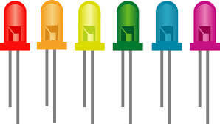
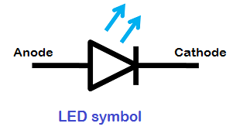
LED -Symbol
Light Emitting Diodes (LED)
Cathode
Anode

Slide 4
LED – Materials used
Light Emitting Diodes (LED)
  Gallium arsenide LEDs emit red and infrared light.
  Gallium nitride LEDs emit bright blue light.
  Yttrium aluminium garnet LEDs emit white light.
  Gallium phosphide LEDs emit red, yellow and green light.
  Aluminium gallium nitride LEDs emit ultraviolet light.
  Aluminum gallium phosphide LEDs emit green light.

Slide 5
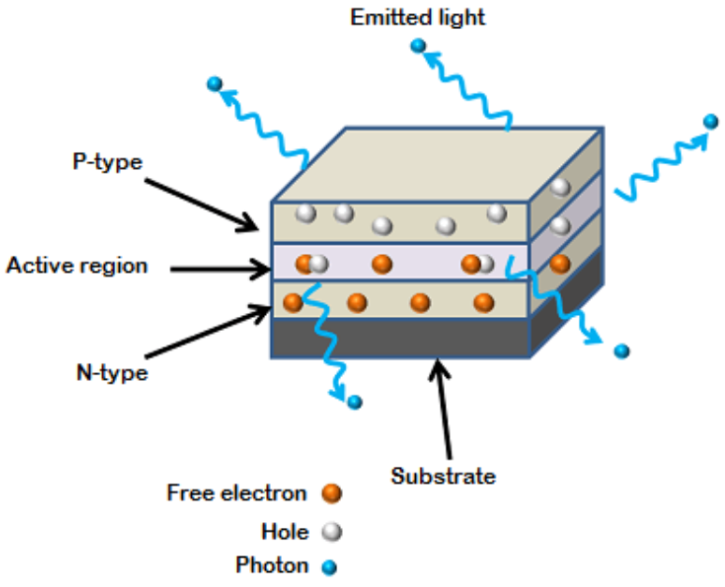
LED - Construction
Light Emitting Diodes (LED)
The active region emits light.
The active region is the region formed between the P region and N region, due to recombination.
The LED emits light all the way around the layered structures.
The basic layered structure is placed in a tiny reflective cap so that the light from the active layer will be reflected towards the desired exit direction.

Slide 6
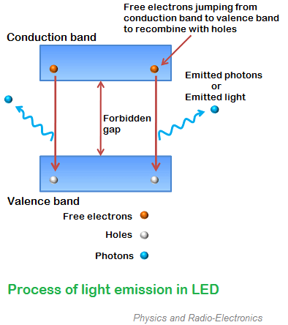
LED – Basic Theory
Light Emitting Diodes (LED)
The intensity of emitted light depends upon the forbidden gap or energy gap between conduction band and valence band.
The semiconductor device with large forbidden gap emits high intensity light (blue or ultraviolet light)
The semiconductor device with small forbidden gap emits low intensity light ( red or infrared light).

Slide 7
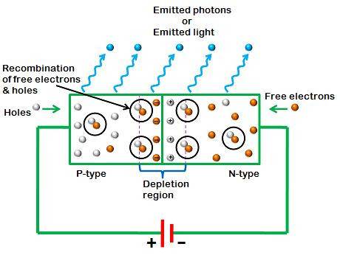
LED – Biasing
Light Emitting Diodes (LED)
Forward biased: connecting P-region to the positive terminal and N- region to the Negative. The free electron from the P-region recombine with the holes in the N-region. When they recombine, they emits light energy.
As the free electron are in the conduction band and the holes are in the valance band, the electron is at higher energy level and the holes are at the lower energy level.
When the electrons fall from the conduction band to the valance band, they emit energy (Light energy).

Slide 8
LED – Biasing
Light Emitting Diodes (LED)
Reverse biased:
When light emitting diode is reverse biased, the free electrons (majority carriers) from n-side and holes (majority carriers) from p-side moves away from the junction.
As a result, the width of depletion region increases, and no recombination of charge carriers occur. Thus, no light is produced.
If the reverse bias voltage applied to the LED is highly increased, the device may also be damaged.

Slide 9
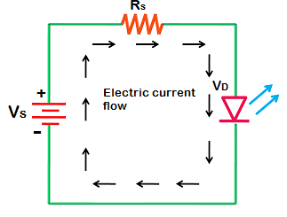
LED - Biasing of LED
Light Emitting Diodes (LED)
The safe forward voltage ratings of most LEDs is from 1V to 3 V and forward current ratings is from 200 mA to 100 mA.
If the voltage applied to LED is increased to a value greater than 3V. The depletion region in the LED breaks down and the electric current suddenly rises. This sudden rise in current may destroy the device.
To avoid this, we need to place a resistor (R_{s}) in series with the LED. The resistor (R_{s} ) must be placed in between voltage source (Vs) and LED.

Slide 10
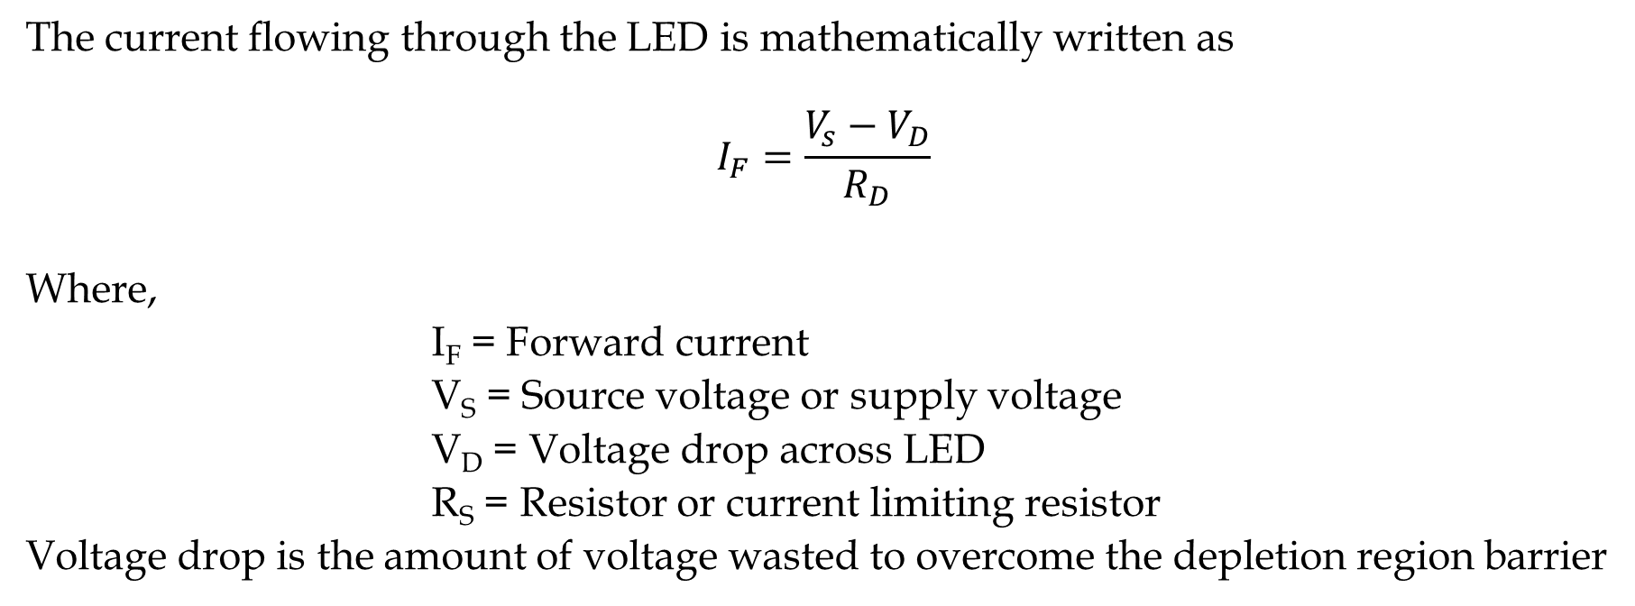
LED - Biasing of LED
Light Emitting Diodes (LED)
The current flowing through the LED is mathematically written as
$$I_{F}=\frac{V_{s}−V_{D}}{R_{D}}$$
Where,
I_{F} = Forward current
V_{S} = Source voltage or supply voltage
V_{D} = Voltage drop across LED
R_{S} = Resistor or current limiting resistor
Voltage drop is the amount of voltage wasted to overcome the depletion region barrier

Slide 11
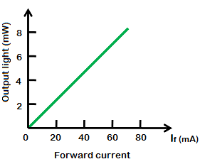
LED – output characteristics
Light Emitting Diodes (LED)
The amount of output light emitted by the LED is directly proportional to the amount of forward current flowing through the LED.
More the forward current, the greater is the emitted output light.

Slide 12
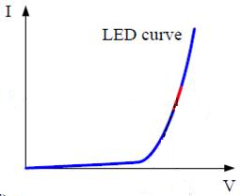
LED – VI characteristics
Light Emitting Diodes (LED)

Slide 13
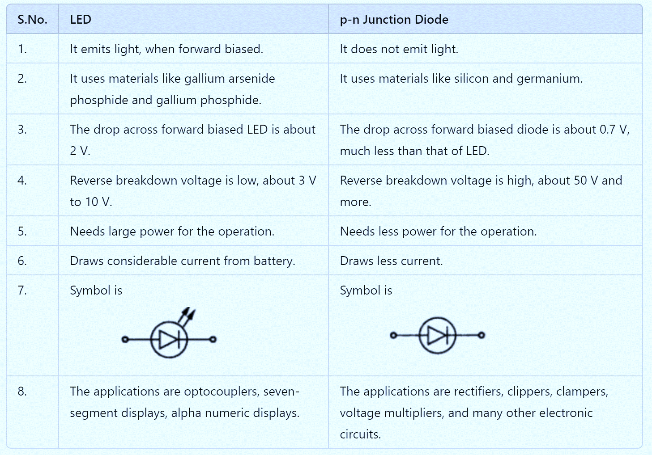
LED Vs PN junction diode
Light Emitting Diodes (LED)

Slide 14
Thank you

