Slide 1
Presentation- Green Haven Florists
Presented by Denisa Paraschiv

Slide 2
MODULE NAME- Problem solving and decision making
MODULE CODE – LCLM4004
STUDENT NAME – Denisa Paraschiv
STUDENT ID - 2517791
LECTURER- Toyin Adisa
Assignment 1: Presentation

Slide 3

introduction
Green haven florists is a small business that sells fresh flowers and floral arrangements for occasions such as weddings, birthdays, and anniversaries
Like many small businesses, it faces challenged such as competition, changing customer preferences, and managing costs.
Effective problem solving and decision making help improve customer satisfaction and business performance

Slide 4
Company background
Founded in 2016, in Norwich, Uk
Owned by: Liam and Priya Patel
The shop offers fresh flowers, bouquets, and customized floral arrangements for events such as weddings, birthdays, and anniversaries
Green Haven Florists has developed strong connections with the local community, creating loyal
This business focuses on quality flowers, creative design, and friendly customer service

Slide 5
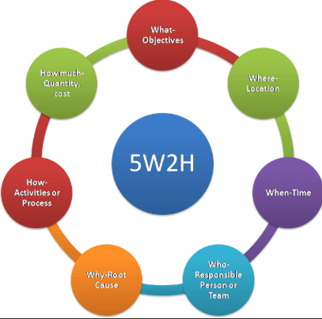
5W2H Method:
figure 1 & 2: : Berstene, T.G. (2018). https://sl.bing.net/Jtyf1afFam
WHAT- Green Haven Florists is experiencing declining profits and difficulty standing out from competitors
WHY- the managers did not keep up with the modern marketplace and did not promote the business effectively, especially on social media
WHERE- the problem occurs in the local flower retail market, where many competitors are actively advertising online
WHEN- the issue became noticeable as other businesses began using digital marketing and social media more effectively
WHO- the managers of Green Haven Florists are responsible for business decisions, while competitors are gaining an advantage through better promotion
HOW- competitors promote their products through social media and modern marketing strategies, attracting more customers and building stronger brand images
HOW MUCH- the business is losing potential customers and revenue, which affects its ability to maintain profits and compete in the market

Slide 6
Pestle analysis: Green Haven Florists
Figure 3: Bajcetic M (2008)
Political:
Government policies on importing flowers may increase costs if tariffs or trade restrictions change
Local government support for small businesses could help the florist expand
Economic:
1.During economic downturns, customers may spend less on luxury items like flowers
2.Inflation and rising supplier costs can increase the price of flowers and reduce profit margins.
Social:
Growing interest in celebrations and events (weddings, birthdays, valentine’s day) increases demand for flowers
More consumers prefer locally sourced and sustainable flowers, influencing what the shop should stock

Slide 7
Pestle analysis: Green Haven Florists
Figure 3: Bajcetic M (2008)
Technological:
1.Creating an online ordering website can help the business to reach more customers
2.Using social media marketing (e.g. Instagram or facebook) helps promote floral designs and special offers
Legal:
The florist must follow employment laws such as minimum wage and working hours
It must comply with health and safety regulations in the shop and workplace
environmental:
Climate change may affect flower supply and availability
Customers increasingly prefer eco-friendly packaging and reduced plastic use.

Slide 8
Fishbone diagram- Green Haven Florists
Figure 4: Dorri B et al (2007)
Marketing
Price
Product
-Limited promotion on social media
-No online advertising or website
-Prices higher than competitors
-Few promotions or discounts
-Limited variety or flower arrangements
-Flowers not always fresh
Low sales/ needs increasing in sales
-Shop not very visible
-Limited parking nearby
-Slow service during busy periods
-Staff not trained to upsell products
-Many other local florists nearby
-supermarkets selling cheaper flowers
Location
Customer service
competitIon

Slide 9

Conclusion: Green Haven Florists is facing difficulties because the managers failed to keep up with the changes in the modern marketplace. The business does not promote its products effectively, particularly on social media, while competitors actively advertise online and build stronger brand images. As a result, Green Haven Florists struggles to attract customers, maintain profits and differentiate itself from competing flower shop
Conclusion
Figure 5: Red Arrow Down Increasing Sales Vector Stock Vector - Illustration of marketplace, arrow: 308239874

Slide 10
References:
Figure 1 & 2: https://sl.bing.net/Jtyf1afFam
Berstene, T.G. (2018). The Root Cause Analysis Memory Jogger: A Process Based Approach to Root Cause Analysis.
Figure 3: Bajcetic M (2008) Water management economy in public—private partnership. Prometej, Novi Sad
Figure 4: Dorri B et al (2007) “Operations research”, 5th edition, SAMT Publications, Vol. (1)
Figure 5: Red Arrow Down Increasing Sales Vector Stock Vector - Illustration of marketplace, arrow: 308239874

Slide 11
Thank you!

