Slide 1

Customers and other Stakeholders

Slide 2


Customers
Why are customers important to marketeers?
Product innovation is based on customers ‘needs’ and ‘wants’
Evangelism is FREE marketing
Customer can sell your product or write your product off
Very important to keep the balance right!

Slide 3
Who are customers in social marketing terms?
Third Sector organisations – Both born independently and those born from government intervention
Charities
Local Authorities
Education sector
Corporate Organisations
Community Groups
Steering Groups
Personalities
Pretty much anybody with a message to share….

Slide 4

Stakeholder Analysis
What is it?
A method of mapping everyone that has a relationship with an organisation
Rather than simply meeting the requirements of the shareholders, considering a wider remit
It involves the principles of ethics and ethical theory

Slide 5
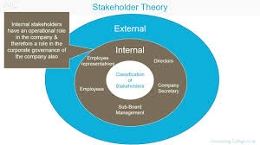
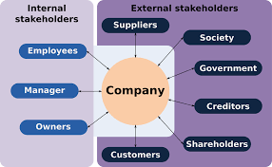
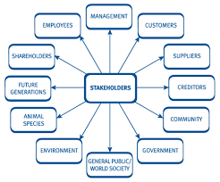
What does it look like?

Slide 6
Market Research
Types of market research – YouTube
What is Market Research?
“Market research can mean several things. It can be the process by which we gain insight into how markets work, a function in an organisation, or it can refer to the outcomes of research, such as a database of customer purchases or a report including recommendations”. (Sarstedt & Mooi, 2014).
Activity: Using the Business you have chosen for your assignment, consider what type of market research you would find most useful when designing your marketing campaign.

Slide 7

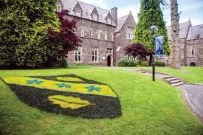
Part 2
Part 2
This Photo by Unknown Author is licensed under CC BY-ND

Slide 8
Background Info
Discussion
What was the role of marketing within the COVID Crisis?
How did the Government spread the message?
How effective was it?

