Slide 1

Module Code & Tile: (BMSW6102) Developing Innovation and Creativity for Business Advantage
Student id & name: 2121306 Alexandra Felicia Merauta
Assignment 2 : Presentation

Slide 2
Table of Contents
Introduction
Processes Followed to complete the assignment
Main Challenges Faced and how they were overcome
Practical Learning outcomes
Future Benefits
Conclusion
References
Appendix

Slide 3
Introduction
This presentation examines the difficulties that the Arcadia Group, a formerly powerful player in the UK retail sector faced and creative solutions to deal with its demise (Arcadia Group Brands Ltd - Company profile and news).
The demise of companies like Arcadia Group serves as an alarming reminder of the necessity of strategic innovation and adaptation in an era characterised by quickening technical breakthroughs, shifting customer preferences, and fierce market rivalry.
It also examines the details of Arcadia Group's collapse, looking at what went wrong and what might have been done differently in terms of innovation to change the company's course.
I hope to get practical insights that can guide strategic decision-making and promote sustainable growth in the dynamic retail sector by closely examining Arcadia Group's example through the perspective of the SCAMPER model.
Notes:
Analysis of the difficulties experienced by the once-dominant Arcadia Group in the UK retail sector, as well as creative solutions to its demise, are covered in this presentation. The tragic end of companies such as Arcadia Group serves as an alarming reminder of the necessity of strategic innovation and adaptation at a time of rapid technical improvement, shifting customer tastes, and fierce market rivalry. Examined the details of Arcadia Group's failure in this presentation, looking at the elements that went into its collapse as well as the chances for innovation that might have changed its course. Through a rigorous examination of Arcadia Group's case via the SCAMPER model, I want to extract useful information that can guide strategic choices and promote long-term success in the dynamic retail sector.

Slide 4
Processes Followed to complete the assignment
Conducted an extensive research procedure using primary and secondary sources to finish the project.
Started by carefully reviewing the provided list of companies that had gone bankrupt or faced financial difficulties and decided to concentrate on Arcadia Group.
Using business reports, news releases, and trade journals, primary research included a thorough examination of Arcadia Group's background, line of products, and competitive positioning (Handling numeric data, 2022).
Secondary research is also carried out, investigating pertinent ideas and theories, such as innovation models and retail business trends (Handling numeric data, 2022).
It required in-depth research on the elements affecting Arcadia Group's demise using scholarly literature, lecture notes, and reliable internet sources.
Notes:
I conducted a thorough investigation using primary and secondary sources in order to finish the project. I chose Arcadia Group as the main focus after carefully going over the given list of companies that had gone bankrupt or suffered financial difficulties. With the use of corporate reports, news releases, and trade journals, primary research comprised a thorough examination of Arcadia Group's background, line of business, and competitive positioning (Handling numeric data, 2022). I also carried out secondary research to investigate relevant ideas and theories, like innovation models and retail sector trends (Handling numeric data, 2022). This required reading scholarly publications, lecture notes, and reliable internet sources to develop a comprehensive grasp of the elements contributing to Arcadia Group's downfall.

Slide 5
Main Challenges Faced and how they were overcome
Handling the complexities of Arcadia Group's demise in the ever-changing retail environment proved to be quite difficult.
To solve this problem, I have conducted in-depth research and applied critical analysis to pinpoint the main causes of the company's failure.
Using innovation and strategic thinking, the SCAMPER model was applied to the unique issues faced by Arcadia Group (Fatima, 2023).
I overcome this difficulty by coming up with many uses for the model and customising each component to fit the particular needs of the business.
Careful organisation and clarity were necessary in order to integrate various study findings into a cohesive story.
I improved my arguments and made sure that my analysis was accurate and coherent by going through an iterative drafting process and review by other scholars.
Notes:
Navigating the intricacy of Arcadia Group's downfall within the larger context of the retail business was one of the assignment's primary obstacles. In order to overcome this hurdle, I carried out a thorough investigation to gain a greater understanding of the related issues. One major obstacle was interpreting the SCAMPER model in light of the unique circumstances faced by Arcadia Group (Fatima, 2023). In order to overcome this obstacle, I thought of numerous ways to use the SCAMPER model, taking into account how each component could be customised to fit the particular needs of the business. The process of combining the study findings into a well-organized and cohesive background needed some thought and planning. I improved my arguments and made sure my written offerings were logical and clear through continuous drafting and reviewing sessions.

Slide 6
Practical Learning outcomes
Developed a stronger comprehension of strategic management ideas, such as organisational resilience, innovation, and adaptation,
Gained insight into how strategic choices affect business results and the value of proactive management in overcoming obstacles by dissecting Arcadia Group's case study.
The research process sharpened my analytical abilities, enabling me to analyse intricate business scenarios critically, pinpoint important problems, and create novel solutions. having an analytical mindset is crucial for guiding strategic efforts and making well-informed judgements.
Developed the capacity to convey findings to others successfully and learned how to use varied perspectives through constructive criticism.
Notes:
As a result of the assignment, I now have a better understanding of the principles of organisational resilience, innovation, and adaptability in strategic management. I gained insight into how strategic choices affect business results and the value of proactive management in overcoming obstacles by dissecting Arcadia Group's case study. Through the research process, I improved my analytical abilities, which now enable me to analyse intricate business situations critically, pinpoint important problems, and create novel solutions. In the workplace, having an analytical mindset is crucial for guiding strategic efforts and making well-informed judgements. Developed the capacity to convey findings to others successfully and learned how to use varied perspectives through constructive criticism.

Slide 7
Future Benefits
The research and analytical abilities that I have developed via this assignment are highly transferable to different roles and sectors.
With these abilities, I will be able to take on difficult tasks, stimulate creativity, and succeed in my future professions.
The basis for further professional growth will be laid by the useful insights obtained from evaluating the Arcadia Group case and putting strategic management theories into practice.
I may use this experience as aspiring professional to lead strategic initiatives, succeed in changing business settings, and foster organisational success.
Notes:
Transferable Skills: Research and analysis are among the transferable skills that this assignment has taught me. These abilities can be used in a wide range of fields and positions. My ability to handle difficult problems, stimulate creativity, and produce outcomes will be a valuable asset in my future professions.
Professional Growth: The case study analysis of Arcadia Group and the application of strategic management principles will provide the practical understanding that will form the basis of future professional growth. In the future, I will be able to lead strategic projects, succeed in organisations, and navigate changing business environments due to this knowledge.

Slide 8
Conclusion
Improved the understanding of strategic management ideas and given useful skills that will help in future employment.
Obtained important insights into the complexities of corporate strategy and innovation by thorough study, critical analysis, and cooperative teamwork
Established the groundwork for future learning and professional development.
Notes:
A thorough process of investigation and analysis was required to complete the task, and the results produced insightful knowledge and useful learning objectives. I was better equipped to tackle future possibilities and difficulties in the professional world by using strategic management ideas and gaining a greater understanding of the intricacies of company strategy and innovation through the examination of Arcadia Group's case study.

Slide 9
References
Arcadia Group Brands Ltd - Company profile and news (no date) Bloomberg.com. Available at: https://www.bloomberg.com/profile/company/1085610Z:LN (Accessed: 17 February 2024).
Fatima, S.S. (2023) Scamper as a design thinking tool, First Loop. Available at: https://www.thefirstloop.com/post/scamper-as-a-design-thinking-tool (Accessed: 16 February 2024).
Handling numeric data (2022) Handling Numeric Data | Padhai Time. Available at: https://padhaitime.com/%5Bslug%5D/Handling-Numeric-Data (Accessed: 17 February 2024).

Slide 10
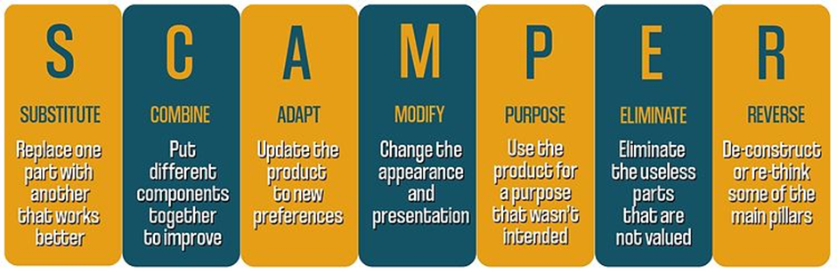
Appendix 1: SCAMPER Model
Source: (Fatima, 2023)

Slide 11
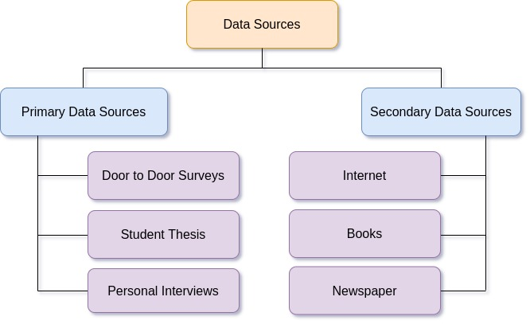
Appendix 2: Data Source
Source: (Handling numeric data, 2022)

