Slide 1
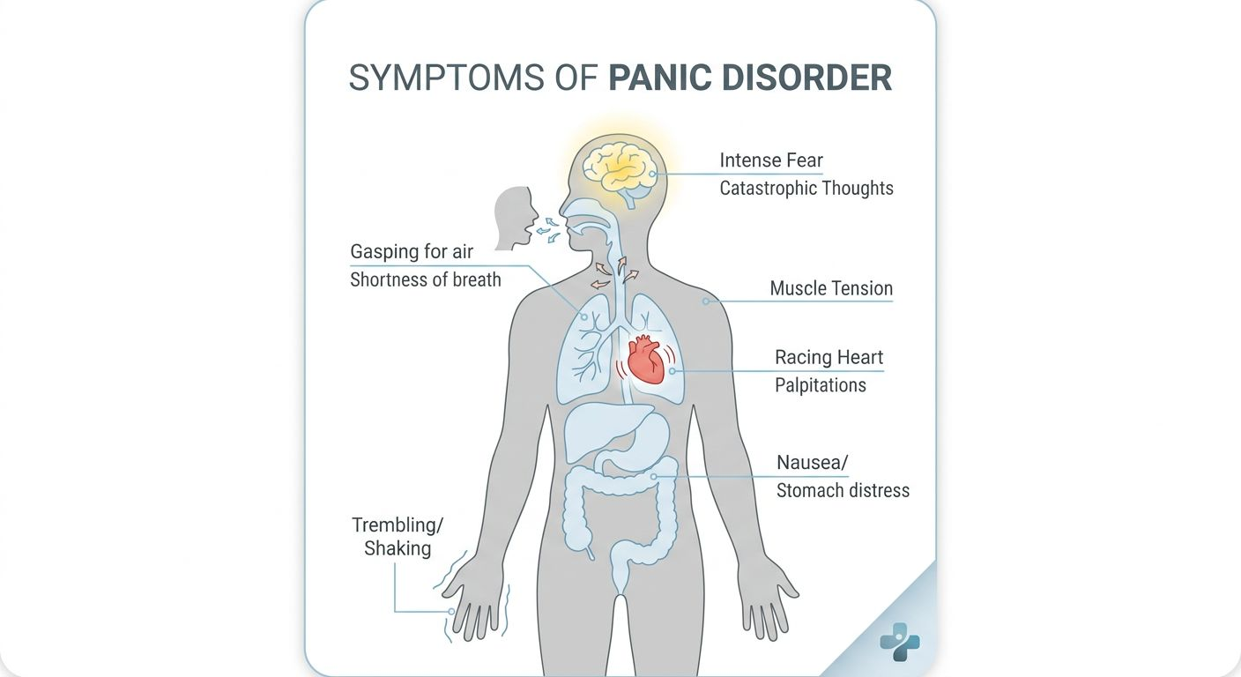

A CRITICAL ANALYSIS OF PANIC DISORDER
(ICD‑11 6B01)
Introduction
Panic Disorder is a specific Anxiety and Fear-Related Disorder defined by recurrent, unexpected "panic attacks." These are sudden waves of intense apprehension that are not tied to a specific situation.
Prevalence: It affects roughly 2-3% of adults annually. It is twice as common in females as in males and typically begins in the early 20s. (WHO, 2022)
It is a physiological "misfire" where the body’s "fight-or-flight" system activates during normal activities (like watching TV or shopping).
Figure 1
Image credit: firefly.adobe.com
In figure, according to the ICD-11, Panic Disorder is twice as common in females as in males. This 2:1 ratio is a significant clinical feature that often emerges during puberty. This presentation, we explore how social and biological factors contribute to this inequality, ensuring that we look at the person behind the diagnosis, not just the statistics.
Causes, Symptoms and Diagnosis
Symptoms: Rapid heartbeat (palpitations), sweating, trembling, chest pain, and a terrifying sense of "impending doom" or "going mad.“
The Cause: A "Biopsychosocial" mix. Genetics (family history), brain chemistry (amygdala overactivity), and life stressors (environmental triggers).
Diagnosis (ICD-11 6B01): Requires a pattern of attacks followed by at least one month of persistent concern about them recurring or significant changes in behavior to avoid them (e.g., stopping work or travel).
Figure 2
Image credit:
firefly.adobe.com
The visual map of the physical reality of a panic attack. It’s important to understand that these symptoms are often misinterpreted as a medical emergency, such as a heart attack. The infographic highlights the 'Body’s False Alarm': the racing heart (palpitations), gasping for air, and stomach distress. Crucially, it shows the cognitive element the 'Intense Fear' and 'Catastrophic Thoughts' which are the primary drivers that turn a single panic attack into a chronic Panic Disorder.

Slide 2
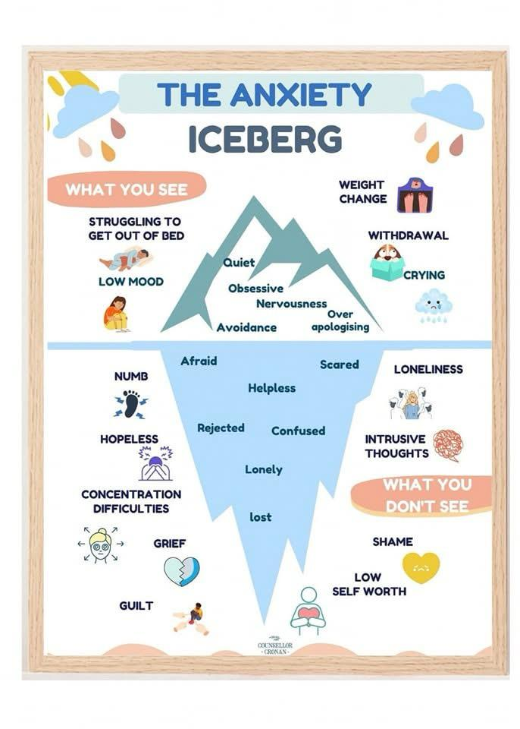
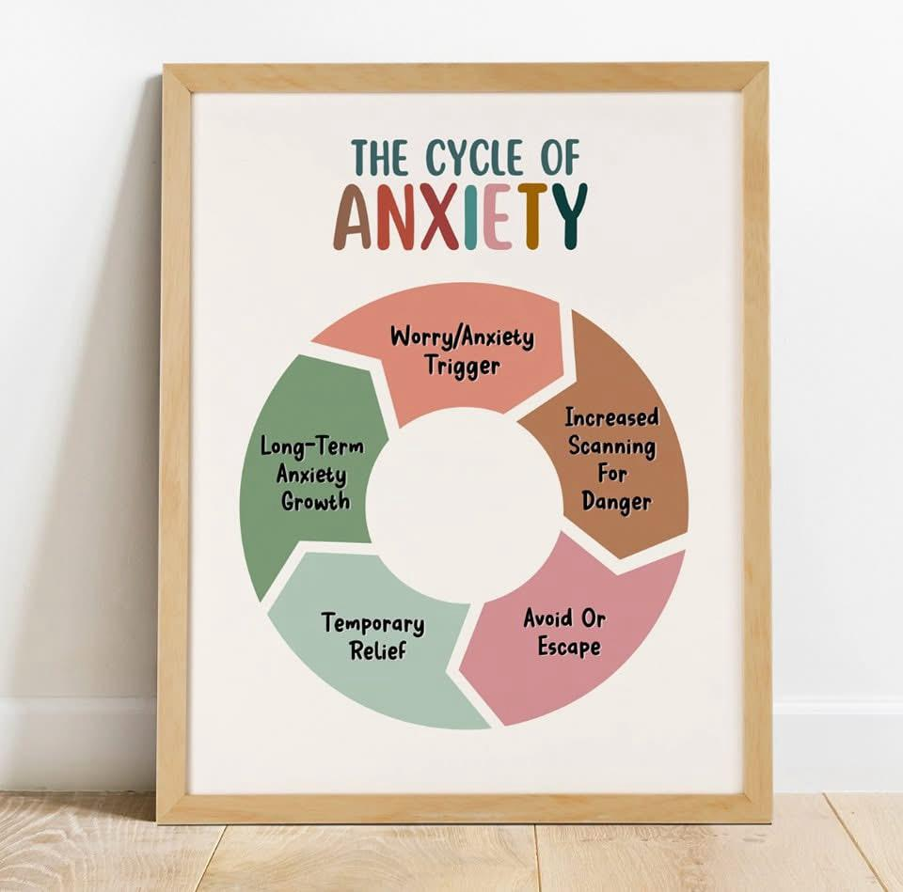
Historical Perspectives & Changing Views
The "Hysteria" Era: In the 19th century, panic symptoms were often dismissed as "vapors" or "female hysteria," focusing on "weak nerves" rather than a medical condition.
The Medical Shift: By the mid-20th century, it was viewed as "Anxiety Neurosis." Medical professionals began to recognize the biological reality of the "adrenaline surge.“
Modern View: We now move away from stigma, viewing it as a treatable neurological and psychological loop rather than a character flaw.
Image credit: firefly.adobe.com Image credit: firefly.adobe.com
References
American Psychiatric Association (2022). Diagnostic and Statistical Manual of Mental Disorders (5th ed., text rev.). Washington, DC: Author. (Essential for comparing with ICD-11).
Bandelow, B., et al. (2017). 'Guidelines for the pharmacological treatment of anxiety, obsessive-compulsive and post-traumatic stress disorders'. World Journal of Biological Psychiatry, 18(3), pp. 162-214.
Clark, D. M. (1986). 'A cognitive approach to panic'. Behaviour Research and Therapy, 24(4), pp. 461-470. (The seminal/important work for CBT).
Hofmann, S. G., et al. (2012). 'The Efficacy of Cognitive Behavioural Therapy: A Review of Meta-analyses'. Cognitive Therapy and Research, 36(5), pp. 427-440.
Kessler, R. C., et al. (2006). 'The epidemiology of panic attacks, panic disorder, and agoraphobia in the National Comorbidity Survey Replication'. Archives of General Psychiatry, 63(4), pp. 415-424.
NICE (National Institute for Health and Care Excellence) (2011). Generalized anxiety disorder and panic disorder in adults: management. Clinical guideline [CG113]. London: NICE.
Otto, M. W. and Pollack, M. H. (2009). Stopping Panic Attacks: A CBT Guide. New York: Oxford University Press.
Stein, M. B. and Sareen, J. (2015). 'Clinical Practice: Panic Disorder'. New England Journal of Medicine, 372(24), pp. 2320-2328.
World Health Organization (2022). ICD-11 for Mortality and Morbidity Statistics: 6B01 Panic Disorder. Available at: https://icd.who.int/browse11/l-m/en#/http%3a%2f%2fid.who.int%2ficd%2fentity%2f1334659223 (Accessed: 3 March 2026).
Zbozinek, T. D., et al. (2012). 'Diagnostic overlap of generalized anxiety disorder and panic disorder'. Journal of Anxiety Disorders, 26(2), pp. 257-265.
Current Services & Treatments
CBT (Cognitive Behavioral Therapy): The primary treatment. It teaches patients that physical sensations (like a racing heart) are uncomfortable but not dangerous, breaking the "fear of fear" cycle.
Pharmacology: SSRIs and SNRIs are the frontline medications used to stabilize the nervous system’s baseline.
Cultural Context: Modern care recognizes cultural "idioms of distress" (e.g., Khyâl cap in Cambodian culture or Ataque de nervios in Latin cultures), ensuring treatment fits the patient’s background (WHO, 2022).
Recommendations & Conclusion
Integrated care in A&E departments. Many patients present at emergency rooms thinking they have a heart attack; early mental health screening there can prevent years of undiagnosed suffering.
Greater focus on "Physical Literacy" in schools to help young people understand their body’s stress responses before they turn into a disorder.
Conclusion: Panic Disorder is highly impairing but also highly treatable. Success lies in moving from "avoidance" to "understanding."

