Slide 1
Design of Experiments
By
Andrew Thorn

Slide 2
Introduction
In order to properly define a designed experiment, we must have a good understanding of the term PROCESS
A process is an activity based upon some combination of inputs (factors), such as people, material, equipment, policies, procedures, methods, and environment, which are used to generate outputs (responses)

Slide 3
A process
Inputs (Factors) Outputs (Responses)
People
Material Finished product
Equipment
Policies
Procedures
Methods
Process

Slide 4
Design of Experiments
In conducting a designed experiment changes are purposefully made to the inputs (factors) in order to observe corresponding changes in the outputs (or responses)
The information gained from properly designed experiments can be used to:
- Improve performance characteristics
- Reduce costs
- Reduce time with product development
- Design and production

Slide 5
Design of Experiments
Designed experiments can be used to build mathematical models which approximate the true relationship between the output(s) and input(s)
These mathematical models will contain information on how to optimise the process, how to use sensitivity analysis which can be used for tolerance evaluations; (2) How to reduce variation

Slide 6
Design of Experiments
A process has four categories of variables all of, which have been documented on a cause and effect diagram
The categories are: (1) Response (output) variables; (2) Controlled variables; (3) Uncontrolled (noise) variables and; (4) key process variables

Slide 7
Categories of Variables
Response (output) variables: - those variables which are measured to evaluate process and/or product performance
Controlled variables: - which have been designated to be held constant during any experimentation. Typically (SOP) are used to ensure consistency of these variables

Slide 8
Categories of Variables
Uncontrolled (noise) Variables – those variables that cannot be held constant during the experiment and/or later on during production or product usage. These are variables to which we would like to make the process and/or product robust (insensitive)
Key Process Variables – which we intend to vary during an experiment

Slide 9
Principles of Design of Experiments
DOE refers to the process of planning, designing and analysing the experiment so that valid and objective conclusions can be drawn effectively and efficiently
In order to draw statistically sound conclusions from the experiment, it is necessary to integrate simple and powerful statistical methods into the experimental design methodology

Slide 10
Principles of Design of Experiments
The success of any industrially designed experiment depends on sound planning, appropriate choice of design, and statistical analysis of data and teamwork skills
In manufacturing one may come across two types of process variables of factors: qualitative and quantitative factors

Slide 11
Principles of Design of Experiments
For quantitative factors, one must decide on the range of settings how they are to be measured and controlled during the experiment
The three principles of experimental design such as randomisation, replication, and blocking can be utilised in industrial experiments to improve the efficiency of experimentation
These principles of experimental design, are applied to reduce or even remove experimental bias

Slide 12
Randomisation
We all live in a world in which noise factors never stay still
The parts of the machine are not fixed entities: they are wearing out over a period of time and their accuracy is not constant over a period of time
If you believe your system or process is stable you do not then need to randomise the experimental trials

Slide 13
Randomisation
Factors such as; power surges, operator errors, fluctuations in ambient temperature and humidity, raw material variations, etc., which may influence the process output performed
Such factors can adversely affect the experimental results and therefore must be either minimised or removed from the experiment
Randomisation is one of the methods experiments relied on to reduce the effect of experimental bias

Slide 14
Randomisation
By randomising the experiment, we assist in averaging out the effects of noise factors that may be present in the process
In other words, randomisation can ensure that all levels of a factor have an equal chance of being affected by noise factors

Slide 15
Apply Randomisation Strategy
What is the cost associated with the change of factor levels?
Have we incorporated any noise factors in the experimental layout
What is the set up time between trials?
How many factors in the experiment are expensive or difficult to control?
Where do we assign factors whose levels are difficult to change from one to another level

Slide 16
Replication
Replication is the process of running the experimental trials in a random sequence
Replication means repetitions of an entire experiment or a portion of it, under more than one condition
Replication has two important properties: (1) It allows the experimenter to obtain an estimate of the experimental error; (2) It permits the experimenter to obtain a more precise estimate of the factor/Interaction effect

Slide 17
Replication
The factor or interaction effect could be significant due to the result of experimental error
On the other hand, if we have sufficient number of replicates, we would be safely making satisfactory inferences about the effect of factors/interactions

Slide 18
Blocking
Blocking is a method of eliminating the effects of extraneous variation due to noise factors
The main objective is to eliminate unwanted sources of variability such as batch-to-batch, day-to-day, shift-to-shift
The idea is to arrange similar experimental runs into blocks

Slide 19
Blocking
The idea is to arrange similar experimental runs into blocks (or groups)
Generally, a block is a set of relatively homogenous experimental conditions
The blocks can be batches of raw materials, different operators, different vendors

Slide 20
Degrees of Freedom
The term ‘degrees of freedom’ is the number of independent and fair comparisons that can be made in a set of data
If the height of John is H_{J} and that of Kevin is H_{K} then we can make only one fair comparison (H_{J} - H_{K})
The number of degrees of freedom for the entire experiment is equal to one less than the total number of data points or observations

Slide 21
Confounding
Refers to the combining influences of two or more factor effects and their interaction effects independently
Effects which are confounded are called aliases

Slide 22
Design resolution
The degree to which the main effects are aliased with the interaction effects (two factors or higher) is represented by the resolution of the corresponding design
Obviously we don’t prefer the main effects to be aliased with other main effects
For designed experiments, designs of resolution III, IV and V are particularly important

Slide 23
Design resolution
Design resolution identifies for a specific design, the order of confounding of the main effects and their interactions
It is a key tool for determining what fractional factorial design will be the best choice for a given problem

Slide 24
Measurement System
Quality Characteristics will have to be measured either by direct or indirect methods
These measurement methods produce variation in the response
Measurement is a process and varies, just as all processes vary
Identifying, separating and removing the measurement variation lead to improvements to the actual measured values

Slide 25
Measurement System
The following characteristics need to be considered for a measurement system:
Accuracy: - Refers to the degree of closeness between the measured value and the true value or reference value
Precision: - It is a measure of the scatter of results of several observations and is not related to the true value. It is a comparative measure of the observations and is only a measure of the random errors

Slide 26
Measurement System
Stability: - A measurement is said to be stable if the measurements do not change overtime
Capability: - A measurement system is capable if the measurements are free from bias (accurate) and sensitive
A capable measurement system requires sensitivity (the variation around the average should be small compared to the specification limits or process spread and accuracy

Slide 27
Measurement System Capability
The goal of measurement system capability study is to understand and quantify the sources of variability present in the measurement system
Repeatability and reproducibility (R & R) studies analyse the variation of measurements of a guage and the variation of measurements by operators respectively

Slide 28
Measurement System Capability
Repeatability refers to the variation in measurements obtained when an operator uses the same gauge several times for measuring the identical characteristics on the same part
Reproducibility, on the other hand, refers to the variation in measurements when several operators use the same gauge for measuring the identical characteristic on the same part

Slide 29
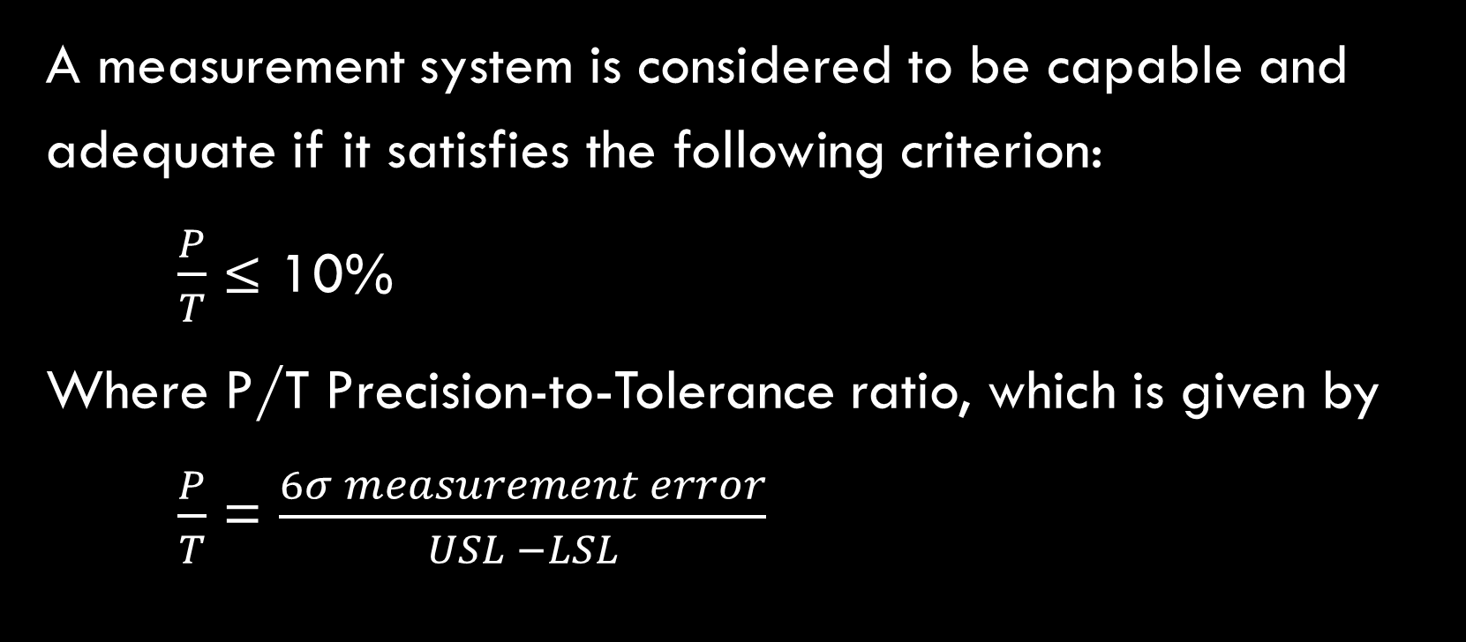
Measurement system capability
A measurement system is considered to be capable and adequate if it satisfies the following criterion:
$\frac{P}{T}$ ≤ 10%
Where P/T Precision-to-Tolerance ratio, which is given by
$\frac{P}{T}$ = $\frac{6σ measurement error}{USL −LSL}$

Slide 30
Measurement system capability
Moreover,
σ² Measurement error = σ² repeatability + σ² reproducibility
There are obvious dangers in relying too much on the P/T ratio
For example, the P/T ratio may be made arbitrary small by increasing the width of the specification of tolerance band
The gauge must be able to have sufficient capability to detect meaningful variation in product

Slide 31
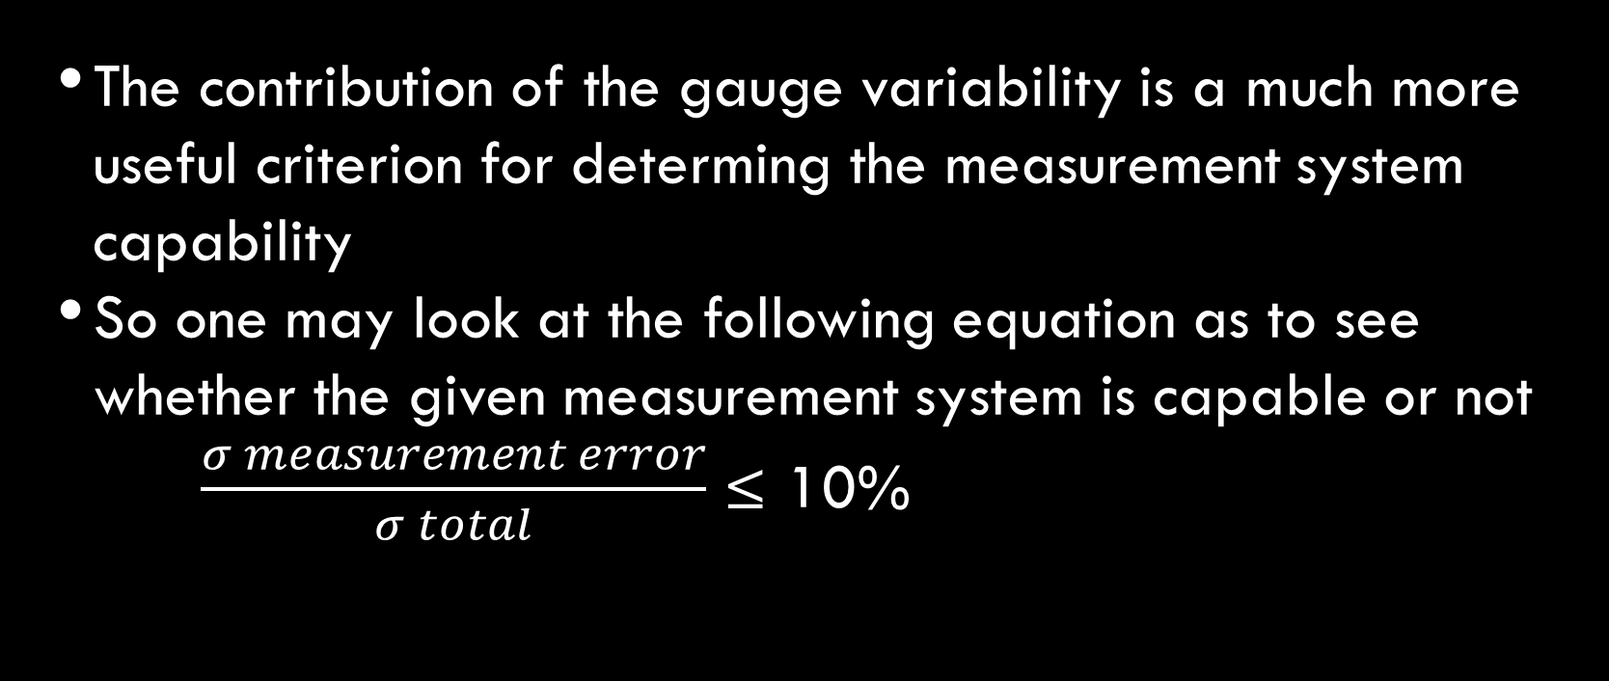
Measurement System Capability
The contribution of the gauge variability is a much more useful criterion for determing the measurement system capability
So one may look at the following equation as to see whether the given measurement system is capable or not
$\frac{σ measurement error}{σ total}$ ≤ 10%

Slide 32
Development of a measurement system
Select the process you want to measure
Define the characteristics that needs to be measured with the process
Perform a quality

Slide 33
Development of a measurement system
Select the process you want to measure: - This involves process definition and determination of recipients of the information on measurements, and how it will be used

Slide 34
Development of a measurement system
Define the characteristics that needs to be measured within the process: - This involves identification and definition of suitable characteristics that reflect customer needs and expectations

Slide 35
Development of a Measurement System
Perform a quality check
- How accurately can we measure the product
characteristics
- What is the error in our measurement system? Is it
acceptable
- Is our measurement system stable and capable
- What is the contribution of our measurement system
variability to the total variation?

Slide 36
Selection of Quality Characteristics
to identify a good quality characteristic, it is suggested to start with the engineering or economic goal
Having determined this goal, identify the fundamental mechanism and physical laws affecting this goal
Finally, choose the quality characteristics to increase the understanding of these mechanisms and physical laws

Slide 37
Selection of Quality Characteristics
Try to use quality characteristics which are easy to measure
Quality characteristics should be continuous variables as far as possible
Use quality characteristics, which can be measured precisely, accurately and with stability
For complex processes, it is best to select quality characteristics at the sub-system level and perform experiments at this level prior to attempting overall process optimisation

Slide 38
Selection of Quality Characteristics
Consider a certain painting process which results in various problems such as orange peel, poor appearance, voids etc.
Too often, experiments measure these characteristics as data and try to optimise the quality characteristic
It is not the function of the coating process to produce an orange peel
The problem could be due to excess variability of the coating process due to noise factors such as; variability in viscosity, ambient temperature, etc.

Slide 39
Stages in Taguchi Experiment
Define problem – list factors
Identify parameter
Select experimental design
Prepare for experiment
Experiment- data collection
Analysis of data
Determine optimum process parameter settings
Predict outcome for process set at optimum conditions
Conduct confirmation run
Not confirmed

Slide 40
Identify Parameters
Team selection
Brainstorming
Cause and effect diagram
Select factors
Decide levels

Slide 41
Taguchi’s Quality Characteristics
Smaller-the-better
Larger-the-better
Nominal-is-the-best
Classified attributes
Dynamic characteristics

Slide 42
Taguchi’s Quality Characteristics
Smaller-the-better: - used to measure characteristics such as tool wear, surface finish, porosity, shrinkage and other defects
Larger-the-better: - this measures characteristics such as efficiency, hardness and strength
Nominal-is-the-best: - is used to measure characteristics such as length, thickness, diameter, width, force and viscosity

Slide 43
Taguchi’s Quality Characteristics
Classified attribute: - is the selected experiment when the data is classified into good and bad or by grades
Dynamic characteristics: - are used when the strength of a particular parameter called a signal factor, has a direct effect on the output quality characteristics

Slide 44
Orthogonal Arrays
Experimental number | Factors and Settings |  |  |  |  |  |  | Results
 | A | B | C | D | E | F | G
1 | 1 | 1 | 1 | 1 | 1 | 1 | 1
2 | 1 | 1 | 1 | 2 | 2 | 2 | 2
3 | 1 | 2 | 2 | 1 | 1 | 2 | 2
4 | 1 | 2 | 2 | 2 | 2 | 1 | 1
5 | 2 | 1 | 2 | 1 | 2 | 1 | 2
6 | 2 | 1 | 2 | 2 | 1 | 2 | 1
7 | 2 | 2 | 1 | 1 | 2 | 2 | 1
8 | 2 | 2 | 1 | 2 | 1 | 1 | 2

Slide 45
Features of Orthogonal Arrays
Efficient
Systematic-balanced
Small number of tests
Large amount of information
Simple analysis
Produces representative and reproducible results
High level of confidence

Slide 46
Design of Experiment Example
Factors | Levels
 | 1 | 2
A. Packaging density | 3 | 1
B. Furnace temperature | 870°C | 840°C
C. Furnace time | 8 hours | 6 hours
D. Load size | 100kg | 350kg
E. Agitation of oil | fast | Slow
F. Boost/diffuse ratio | 60% | 50%
G. Oil temperature | 150°C | 80°C

Slide 47
Orthogonal Arrays
Experimental number | Factors and Settings |  |  |  |  |  |  | Results
 | A | B | C | D | E | F | G
1 | 1 | 1 | 1 | 1 | 1 | 1 | 1 | 42
2 | 1 | 1 | 1 | 2 | 2 | 2 | 2 | 72
3 | 1 | 2 | 2 | 1 | 1 | 2 | 2 | 28
4 | 1 | 2 | 2 | 2 | 2 | 1 | 1 | 41
5 | 2 | 1 | 2 | 1 | 2 | 1 | 2 | 84
6 | 2 | 1 | 2 | 2 | 1 | 2 | 1 | 63
7 | 2 | 2 | 1 | 1 | 2 | 2 | 1 | 35
8 | 2 | 2 | 1 | 2 | 1 | 1 | 2 | 59

Slide 48
Design of Experiment Example
∑T = 428
T = 428 / 8 = 53
A₁ = (42 + 72 + 28 + 41) /4 = 45.75
A₂ = (84 + 63 + 35 + 59) /4 = 60.25
Now calculate the values for B, C, D, E, F and G and complete the response table

Slide 49
Response Table
Levels | A | B | C | D | E | F | G
1 | 45.75 | 65.25 | 52 | 47.25 | 48 | 56.5 | 45.25
2 | 60.25 | 40.75 | 54 | 58.75 | 58 | 49.5 | 60.75
Diff | 14.5 | 24.5 | 2 | 11.5 | 10 | 7 | 15.5
Rank | 3 | 1 | 7 | 4 | 5 | 6 | 2
The lowest value is the best for each factor. Best combination of factors is
A₁ B₂ C₁ D₁ E₁ F₂ G₁

Slide 50
Interactions
An interaction exists between factors, when the effect of one factor depends on the level of another factor
To find out if an interaction exists between two factors we can produce an interaction plot graph
No interaction exists if the plotted response lines are parallel
An interaction exists if the plotted response lines are not parallel

Slide 51
Interactions
The strength of the interaction is indicated by the degree of non-parallelism in the interaction plot lines
High High
No interaction Small
Interaction
Low High Low High

Slide 52
Interactions
Dramatic Small
Interaction Interaction

Slide 53
Interactions
Interaction
Resin Hardener
Resin Quantity Hardener Quantity Bond Quality
Low Low Good
Low High Poor
High Low Poor
High High Good

Slide 54
Interaction
High High
Bond Quality Hardener
Low Low
Low Resin High

