Slide 1
LCBB4009
Understanding Organisational Structure and Culture (UOS)
Week 5: Session 2
Organisational culture – part 2

Slide 2
What we did the last time
What did you learn last class?
What were the key terms?
Do you have any questions?
Notes:
The lecturer can ask students to take turn writing key words on the board, read their notes, give examples, show their homework, or do case studies.
Can link the student’s answer to the content of this week – what organisational structure would best fit this company?

Slide 3
Lesson Aims
By the end of this session, students should be aware of important aspects of organisational culture, including:
Current challenges
Organisational culture and organisational performance

Slide 4
Current challenges
1. Creating an innovative culture
Challenge and involvement—Are employees involved in, motivated by, and committed to the long-term goals and success of the organization?
Freedom—Can employees independently define their work, exercise discretion, and take initiative in their day-to-day activities?
Trust and openness—Are employees supportive and respectful of each other?
Idea time—Do individuals have time to elaborate on new ideas before taking action?

Slide 5
Current challenges
1. Creating an innovative culture
Playfulness/humor—Is the workplace spontaneous and fun?
Conflict resolution—Do individuals make decisions and resolve issues based on the good of the organization versus personal interest?
Debates—Are employees allowed to express opinions and put forth ideas for consideration and review?
Risk taking—Do managers tolerate uncertainty and ambiguity, and are employees rewarded for taking risks

Slide 6
To build an innovative culture
Activity
Group work. 30 minutes.
Make a plan to develop an innovative culture to a newly established organisation.
Prepare to present your answer to the class.
Notes:
Remind students to use the knowledge learned from this module to answer this question. For example, here they should make use of the “Stories, rituals, material artifacts and symbols, and language” to develop the culture.

Slide 7
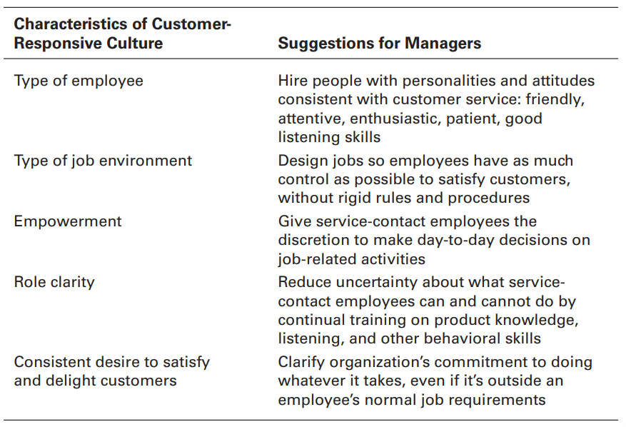
Current challenges
2. Creating a Customer-responsive Culture
Source: Robbins and Coulter (2021, p. 120)

Slide 8
Current challenges
3. Spirituality and organisational culture
Strong sense of purpose.
Focus on individual development.
Trust and openness
Employee empowerment
Tolerance of employee expression
Notes:
Robbins and Coulter, 2021, p. 121
Strong sense of purpose. Spiritual organizations build their cultures around
a meaningful purpose. While profits are important, they’re not the primary
values of the organization. For instance, Timberland’s slogan is “Boots, Brand,
Belief,” which embodies the company’s intent to use its “resources, energy,
and profits as a publicly traded footwear-and-apparel company to combat
social ills, help the environment, and improve conditions for laborers around
the globe . . . and to create a more productive, efficient, loyal, and committed
employee base.”57
2. Focus on individual development. Spiritual organizations recognize the worth and
value of individuals. They aren’t just providing jobs; they seek to create cultures
in which employees can continually grow and learn.
3. Trust and openness. Spiritual organizations are characterized by mutual trust,
honesty, and openness. Managers aren’t afraid to admit mistakes. And they tend
to be extremely up-front with employees, customers, and suppliers.
4. Employee empowerment. Managers trust employees to make thoughtful and
conscientious decisions. For instance, at Southwest Airlines, employees—
including flight attendants, baggage handlers, gate agents, and customer service
representatives—are encouraged to take whatever action they deem necessary
to meet customer needs or help fellow workers, even if it means going against
company policies.
5. Tolerance of employee expression. The final characteristic that differentiates
spiritually based organizations is that they don’t stifle employee emotions. They
allow people to be themselves—to express their moods and feelings without guilt
or fear of reprimand

Slide 9
Current challenges
Creating organizational cultures based on values and performance | Ann Rhoades | TEDxABQ
https://www.youtube.com/watch?v=BlhM7vALtUM
10:58
Discussion question:
What do you learn from the video?
Do you agree or disagree with the video? Why or why not?
Notes:
How to create a high performance culture | Andrew Sillitoe | TEDxRoyalTunbridgeWells
https://www.youtube.com/watch?v=BAdeFHlhKi4
13:08

Slide 10
Organisational culture and organisational performance
There is a strong link between organisations’ performance and their performance.
A strong and healthy culture reduce the likelihood of a flawed business model
Culture influences people’s attitudes and behaviour at work
Notes:
Mullins and McLean (2019, pp. 574-575)

Slide 11
Organisational culture and organisational performance
A happy and engaged workforce outperform negative one.
The biggest reason for two thirds of M&A failure is cultural incompatibility of the businesses.
Cultures affect performance indicators
Culture happens
Notes:
Mullins and McLean (2019, pp. 574-575)

Slide 12
Organisational culture and organisational performance
Business Speaker Erin Meyer: How Cultural Differences Affect Business
https://www.youtube.com/watch?v=zQvqDv4vbEg
4:09
Notes:
Business Speaker Erin Meyer: How Cultural Differences Affect Business
https://www.youtube.com/watch?v=zQvqDv4vbEg
4:09

Slide 13

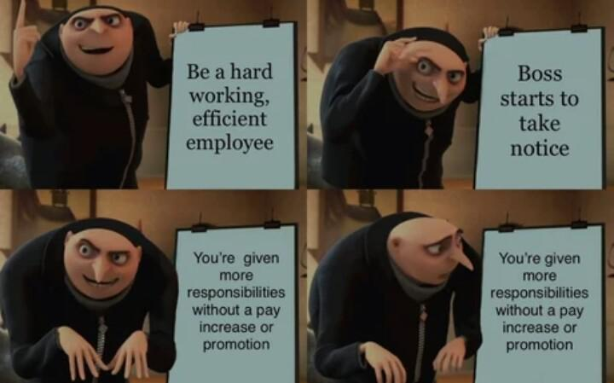
Homework
Review the key terms. Be prepared to explain them in the next class.
Assuming you are to create a new retailer start-up. What might be its organisational culture? Why? Email your answer as an MS Word file to the lecturer before the next class. Your email should have the subject as: Your full name_Your student ID_IMW_Week 2_structure.
Notes:
Note: use the contingency factor to answer the last question.

Slide 14
References
Mullins, L. J. and McLean, J.E. (2019) Organisational behaviour in the workplace. 12th edn. Harlow: Pearson Education Limited.
Huczynski, A. and Buchanan, D.A. (2019) Organizational behaviour. 10th edn. Harlow: Pearson
Robbins, S. and Coulter, M. (2021) Management, Global Edition. 15th edn. Pearson.
Cole, G. A. and Kelly, P. (2020) Management theory and practice. 9th edn. Hampshire: Cengage Learning EMEA.

Slide 15

I have a question…

