Slide 1

HPFY3001: Academic Skills
Critical Thinking
Dr Rhian Elinor Keyse
Lecturer in Global Historical Studies

Slide 2
Assignment 3: Academic Reading
450 words
Due 18 January 2026, 23:59 PM
22.5% of portfolio
Choose one journal article on the topic of your choice – it can be from your list of scholarly literature produced in Block 1, or an additional item. Read it, and produce a 450 word summary, reflecting on why you selected the item, what it tells you about your topic of interest, and how useful it was for your understanding.

Slide 3
Assignment 3: Academic Reading
Questions you will want to consider:
Who is the author? When are they writing? What kind of work is it?
What is the text about? What are the author’s main arguments?
Does the author have a particular theoretical perspective?
What sources is the text based upon?
When was it written? In what historical and social context?
What are the strengths and weaknesses of the argument and approach?
How does it relate to other things you have read on the topic – does it contradict or support them?
How is it useful for your research?
This should be properly referenced and include a bibliography.

Slide 4
In this session:
Critical thinking – what does it mean and how do we do it?
Giving you things to think about, tips, and tools, to build your confidence

Slide 5

What do we mean by ‘critical thinking’?

Slide 6

What do we mean by ‘critical thinking’? Some definitions
“the objective analysis and evaluation of an issue in order to form a judgment”
Oxford English Dictionary

Slide 7

What do we mean by ‘critical thinking’? Some definitions
“Active, persistent, and careful consideration of any belief or supposed form of knowledge in the light of the grounds that support it, and the further conclusions to which it tends, constitutes reflective thought.”
- John Dewey, US philosopher and educationalist (1859—1952) in How We Think (1910)

Slide 8
What do we mean by ‘critical thinking’? Some definitions
“The essence of critical thinking is suspended judgment; and the essence of this suspense is inquiry to determine the nature of the problem before proceeding to attempts at its solution. This, more than any other thing, transforms mere inference into tested inference, suggested conclusions into proof.”
- John Dewey, US philosopher and educationalist (1859—1952) in How We Think (1910)

Slide 9
Dewey’s Process of Inquiry
An intellectualization of the difficulty or perplexity into a problem to be solved, a question for which the answer must be sought
Suggestions: in which the mind leaps forward to a possible solution
The use of one suggestion after another as a leading idea, or hypothesis, to initiate and guide observation and other operations in collection of factual material
The mental elaboration of the idea or supposition as an idea or supposition (reasoning)
Testing the hypothesis
Criticise the results
Accept the results, or continue the study

Slide 10
Dewey’s Process of Inquiry
Youtube Video on Moodle

Slide 11
Critical versus uncritical thinking
“If the suggestion that occurs is at once accepted, we have uncritical thinking, the minimum of reflection. To turn the thing over in mind, to reflect, means to hunt for additional evidence, for new data, that will develop the suggestion, and will either, as we say, bear it out or else make obvious its absurdity and irrelevance.”
- John Dewey, US philosopher and educationalist (1859—1952) in How We Think (1910)

Slide 12
Put more simply…
Critical thinking is:
Clear, reasonable, and reflective
Focus on deciding what to believe or do
Asks questions like “How do we know?” or “is this true in every case?”
Is sceptical and challenges our assumptions
Probes new areas, looking for new knowledge, clarification, and solutions
Is evaluative
Distinguishes between facts and opinions

Slide 13
Features of critical thinking
Curiosity
Examining our own beliefs and acknowledging where we don’t know or understand
Being open to changing our mind with new evidence
Thinking about biases – our own and other people’s
Not simply memorising or accepting what we’re told

Slide 14
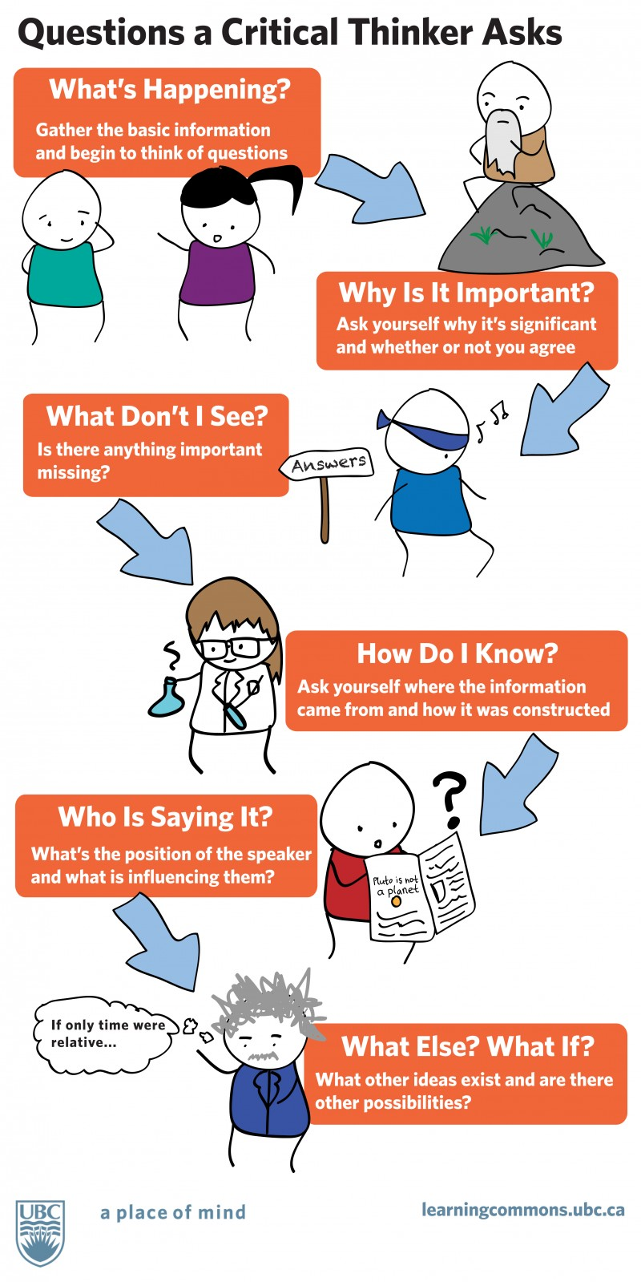

Slide 15
Other questions to think about
What is the main point of this paper/ article/ paragraph/ report/ blog?
Why was it written?
When was it written?
Has the context changed since it was written?
Is the evidence presented robust?
How did the authors come to their conclusions?
Do you agree with the conclusions?
What does this add to our knowledge?

Slide 16
Why?
Using and applying your knowledge
Evaluating and critiquing evidence
Assess evidence and make justifiable assessments – assessing strengths, weaknesses, and reliability

Slide 17
Critical thinking: Analysis
Analysis – breaking things up into parts, investigating the parts, examining relationships between them.
How was the research conducted?
Why are these theories discussed?
What are the alternative methods and theories?
What are the contributing factors to the problem?
How might one factor influence another?
What if one factor is removed or changed?

Slide 18
Critical thinking: Evaluation
Evaluation – looking beyond face value, assessing strengths, weaknesses, advantages and limitations
What do I think about this?
How is this relevant to the problem?
How does this compare to other work I’ve read?

Slide 19
Critical thinking: Synthesis
Synthesis – solving problems, bringing ideas together, taking what you’ve read and comparing it to other material in order to make an evidence-based assessment of the topic
You already do all these things! Product reviews – comments and numerical ratings (triangulation of qualitative and quantitative data.

Slide 20

Over to you: any questions?

