Slide 1
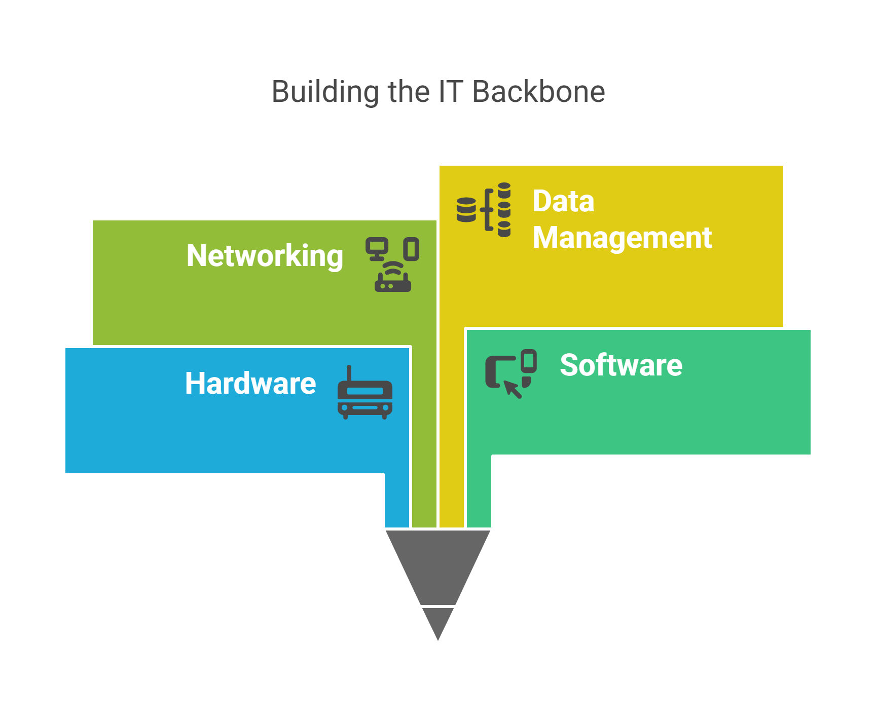

Modernising Information
Systems
A Consultancy Approach
LCLM 5004 Managing Business Information
Component 1: Group Presentation
Tutor Name: Chinomso Nwagboso
Group Members: Sabine Pindou-Bouanga (2335155)
Elijah Grant(2247866)
Notes:
Good morning / afternoon everyone. Welcome to our presentation about “Modernising Information Systems: A Consultancy Approach”. This one is for our Managing Business Information module , LCLM 5004. So today, our consultancy team will be sharing a sort of deep analysis of various information systems and the way they can reshape business operations, you know, in practice.
[Pause , for the introduction of the group members]
We are going to look at how a relatively small hairdressing salon can gain from putting Transaction Processing Systems in place, then Management Information Systems too, and also Customer Relationship Management systems. Alright lets begin.

Slide 2
content
What are Information Systems?
Types of Business Information Systems
Case study:
  Challenges
  Proposed Solutions:TPS, MIS and CRM
  Comparative Analysis of the proposed solutions
Ethical Consideration in IS
Real world case studies: NHS and Siemens
Conclusion

Slide 3




Types of Business Information Systems
TPS
MIS
CRM
Transaction Processing System
Management Information System
Customer Relationship Management
Processes daily transactions and routine operations
Generates reports and summaries for managers
Manages customer interactions and relationships
Generates operational-level data for day-to-day business
Supports tactical-level decisions and planning
Provides strategic-level insights for growth
Example: Point-of-Sale systems, inventory tracking
Example: Sales analytics, financial dashboards
Example: Customer databases, loyalty programs
Operational Level
Tactical Level
Strategic Level
Notes:
Now, lets take a look at the three main kinds of business information systems we’ll be covering today. First comes Transaction Processing Systems, often called TPS. Basically these handle the daily transactions and the usual operations. They work at the operational level inside the organization. Things like point of sale systems, and also inventory tracking, fall right into this category. TPS are important because they grab the day-to-day data that makes a business keep moving. Second, there are Management Information Systems, or MIS. These are the report makers, they compile summaries for managers and they generally sit at the tactical level. They support middle management during planning and day-to-day style decision making, even when the questions are a bit tricky. For example, sales analytics dashboards and financial reporting systems. MIS take the raw data coming from TPS, and they turn it into information that managers can actually use. Third, Customer Relationship Management systems, or CRM. These handle customer interactions and ongoing relationships, operating at the strategic level. They’re meant to give insights that help with longer term business growth. You’ll see examples like customer databases and loyalty program management systems, which help keep track of people in a more organized way. Each of these systems has its own role, sure, but as we’ll see later they work a lot better when they’re integrated together.

Slide 4
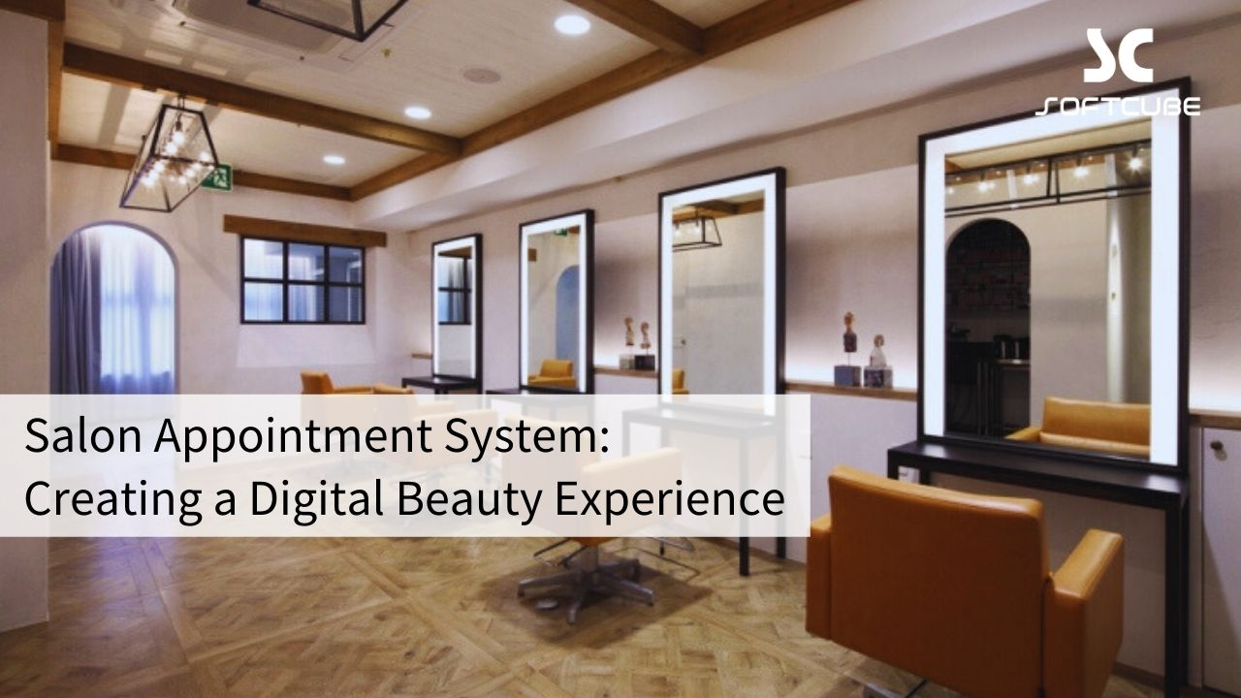





Case Study: Glamour Cuts Hair Salon
Consulting Brief
Our Client
Growing Salon in Bristol
5 staff members • Established 3 years
200+ Monthly Customers
Steady growth trajectory
The Challenge
Outdated manual systems limiting growth and customer experience
Notes:
Let me introduce our case study, um… Glamour Cuts is a modest, growing hairdressing salon, based in Bristol. They currently have 5 staff members and serve over 200 customers every month, roughly. The salon has been operating successfully for three years, and there’s been steady growth. Still, they’ve reached this point where their outdated manual systems are sort of, restricting what they can do next, and it’s also hurting the overall customer experience. The salon owner has contacted our consulting team because she’s heard there are different types of information systems, but she’s not fully sure which one will fit her business best. She wants to modernize so she can improve efficiency, make decision-making more solid, and also provide a nicer experience for customers. Honestly, this happens a lot with small to medium sized businesses. As Pearlson et al. (2019) mention, many organisations end up at a stage where manual processes turn into a bottleneck, and then technology becomes necessary for continued growth.

Slide 5






What are Information Systems?
Technical Perspective
Role in Business
Hardware & Software
Data & Procedures
Operational Efficiency
People & Networks
Integrated Systems
Automating routine tasks
Strategic Decision-Making
Business Perspective
Data-driven insights
Tools that enable competitive advantage, enhance operational efficiency, and support strategic decision-making
Competitive Advantage
Market differentiation
Customer Experience
Personalized services
Notes:
First, lets kind of set the stage for what we mean by information systems. In a technical view, an information system is basically made up of five core parts: hardware , software , data , procedures, and people . These pieces then work together to grab, process , keep, and send information along . From a business angle, information systems are important practical instruments. They help organizations get a competitive edge, improve day to day efficiency, and back strategic decision making in a more solid way. The role of information systems in business is really many sided, like not just one thing. They boost operational efficiency because they automate everyday chores and routine procedures. They help with strategic choices by handing managers data based insights. They build competitive advantage too, by making customer service smoother and enabling faster reactions when the market shifts. And in the end, they also make the customer experience better through more personalized and efficient ways of delivering service. As Laudon and Laudon (2020) point out, information systems aren’t only technical tools, they are more like the underlying way modern organisations function , and how they end up competing.

Slide 6





Current Challenges at Glamour Cuts
Manual Appointment Booking
No Customer History
No record of customer preferences or allergies
Paper diaries prone to double bookings
No online booking capability for customers
Repeat service data completely lost
Unable to personalize services
Difficult to manage staff schedules
Limited Data Insights
Inventory Issues
No sales analytics or trend data
Manual stock tracking leads to stockouts
Cash-only records create reporting difficulties
High product wastage and over-ordering
No automated reordering system
Unable to make data-driven decisions
Notes:
Right now, Glamour Cuts seems to be dealing with a few big problems because they still rely on manual processes, kind of old style. For starters their appointment scheduling is done completely by hand, they use paper diaries. That causes double bookings, customers can’t book online , and it can be hard to line up staff schedules properly too, like timing just gets messy. Second, there’s no real customer history kept. So there’s no way to remember customer preferences or allergy details, plus repeat visits and service patterns get lost. Without that, they can’t really tailor, their services don’t feel as personal as they could. Third, inventory management is also rough. Since stock is tracked manually they end up with frequent stockouts, more product wastage than you’d want, and there’s no automatic reordering system in place. Sometimes they end up running out of the popular items while oddly ordering too much of other products. Lastly, they have pretty limited data insights. Because the records are cash-only, and there’s no sales analytics, it’s really hard to create useful reports, notice performance trends, or make decisions based on actual numbers instead of guesses. And honestly, these kinds of problems aren’t only for Glamour Cuts. O’Brien and Marakas (2021) explain that lots of small businesses run into similar trouble when they don’t have the right information systems infrastructure in place.

Slide 7





Our Proposed Solution: Integrated Information Systems
A comprehensive approach to modernising Glamour Cuts through three integrated systems working together to improve efficiency, decision-making, and customer experience.
Key Benefits
TPS
Transaction Processing
Streamlined Operations
Automated daily processes
Data-Driven Insights
Strategic decision support
MIS
CRM
Enhanced Customer Experience
Management Information
Customer Relationship
Personalized services
Notes:
Our proposed solution is kind of to implement an integrated information systems approach for Glamour Cuts. Instead of just rolling out one system, we recommend a more comprehensive route that blends three complementary systems, TPS MIS and CRM. These systems should work together, as a whole, so they can deal with the salon’s challenges and also help push the business toward success. The key benefits here are three things, not only one. First, Streamlined Operations through automated processes, second Data-Driven Insights which supports better decision-making, and third Enhanced Customer Experience through more tailored service delivery. With this approach, the information can move smoothly between the systems, which helps unlock maximum value and efficiency. And like Chaffey and White (2022) point out, integration is basically the key that helps maximize the benefits from any information systems investment, not just the initial setup.

Slide 8








TPS Implementation for Glamour Cuts
Core Functions
Operational Excellence
Automated Scheduling
Real-time Inventory
Online booking system
Stock level tracking
Digital Payments
Daily Sales Recording
Card & mobile payments
Automatic transaction logs
Key Benefits
Eliminates double bookings
Reduces stockouts by 85%
40%
92%
Faster transactions
Accurate daily reports
Time Saved
Accuracy
Notes:
Let’s look at how a Transaction Processing System would work for Glamour Cuts. I mean, basically, the core functions of the TPS would involve automated appointment scheduling with an online booking system, real time inventory tracking that watches stock levels automatically, digital payment processing to manage both card and mobile payments, and daily sales recording that logs every transaction as it happens. For Glamour Cuts the benefits would be pretty noticeable. The TPS would remove double bookings entirely, cut stockouts by as much as 85% thanks to automated inventory management, make checkout faster, and give you precise daily reports that are generated automatically. So for a salon like Glamour Cuts, the TPS is sort of the operational base line. It collects the key information about each transaction, appointment, and sale. Then that information becomes the input for the Management Information System, which we’ll talk about next. In terms of rollout, implementing a TPS typically takes 1-2 months and usually needs a moderate investment, but the return on investment is typically reached within 6-12 months, because efficiency improves and errors drop.

Slide 9



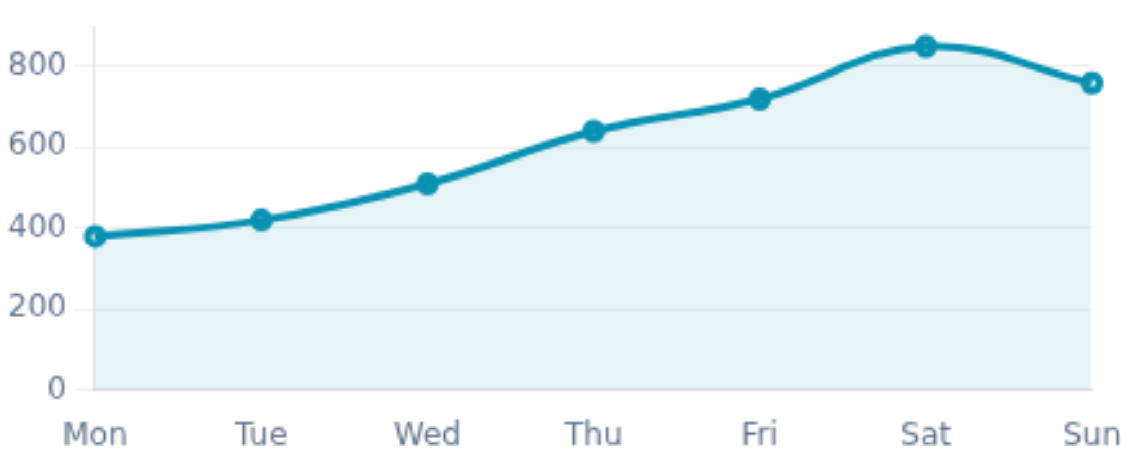




MIS Implementation for Glamour Cuts
Performance Dashboard
Management Reports
Last 7 Days
Weekly sales summaries
Staff performance metrics
Peak hour analysis
Strategic Support
Trend identification
Revenue forecasting
Resource allocation
247
£4,280
89%
Appointments
Revenue
Satisfaction
Top Services
Key Benefits
Haircut & Styling
42%
Informed decisions
Performance tracking
Cost optimization
Colour Treatment
31%
Blow Dry
27%
Notes:
Building on the TPS, a Management Information System would give Glamour Cuts some powerful management reporting and analytical features, even if the setup still feels a bit “in the weeds” at first. Basically, the MIS would produce weekly sales summaries that show revenue patterns and how popular each service is. It would also track staff performance metrics so the owner can see who is most productive, and, which services bring in the most revenue. On top of that, there’s peak hour analysis, so staffing plans and resource allocation can be adjusted instead of being, kind of, random. For strategic support, the MIS would surface trends in customer behavior and shifts in service demand. It would support revenue forecasting for business planning and budgeting, and it would assist with resource allocation too, so the correct staff and products are available at the right times, not too early, not too late. The main benefits for Glamour Cuts would be better decision-making based on actual data, rather than guesswork, plus broader performance tracking and cost optimization through improved resource management. In other words, fewer wasted materials, and fewer scheduling headaches. Implementation of an MIS usually takes about 2-4 months, and it strongly depends on having quality data input coming from the TPS. As Bocij et al. (2022) mention, the real effectiveness of the MIS relies completely on the quality and completeness of the underlying data.

Slide 10






CRM Implementation for Glamour Cuts
Enhancing Customer Relationships
Customer Database
Appointment Reminders
Loyalty Programs
Store client preferences and style history
Automated SMS/email notifications
Reward points system for regular visits
Complete service records for each visit
Reduce no-shows by 60%
Special offers and exclusive discounts
Secure contact details and communication preferences
Improve attendance and scheduling efficiency
Improve customer retention by 45%
Allergies and special requirements tracking
Follow-up messages post-visit
Referral program integration
Personalised Service Delivery
Enhanced Communication
Customer Retention Strategy
Notes:
The third piece is a Customer Relationship Management system, which sort of zeroes in on building , and keeping strong customer relationships, even when things get a bit messy on the ground. The CRM would produce a broad customer database where it records things like client preferences, the full service history for every visit, plus contact details and communication preferences. It would also note any allergies, special needs or other niche requirements that might pop up later. Appointment reminders would be handled automatically via SMS and email notifications, which sounds simple but works well in practice. This particular function alone can cut no-shows by as much as 60%, that then meaningfully boosts scheduling efficiency, and lowers the amount of revenue that basically slips away. On top of that the CRM would make room for a loyalty program , using a reward points approach for regular visits, special offers, and exclusive discounts for customers who keep coming back. It could also connect referral program mechanics, so new customers are pulled in through the existing ones, kind of like a loop that keeps running. Overall, the benefits land in three main areas: better customer relationships from more personalized service, improved retention , and a higher customer lifetime value. Of course, CRM implementation usually takes 3-6 months, plus it needs ongoing maintenance, but as Davenport and Harris (2024) stress, organizations that stay customer-centric and actually invest in CRM tend to see much higher satisfaction and loyalty.

Slide 11









Comparative Analysis: TPS vs MIS vs CRM
TPS
MIS
CRM
Primary Focus
Primary Focus
Primary Focus
Operational Level
Tactical Level
Strategic Level
Key Benefits
Key Benefits
Key Benefits
• Process automation
• Management reports
• Customer insights
• Real-time data capture
• Trend analysis
• Personalisation
• Error reduction
• Decision support
• Loyalty building
Limitations
Limitations
Limitations
• Basic reporting only
• Requires quality data
• High maintenance
• Limited analytics
• Staff training needed
• Data privacy concerns
Cost
Timeline
Cost
Timeline
Cost
Timeline
££
1-2 mo
£££
2-4 mo
£££
3-6 mo
Notes:
This slide gives a nice comparison between the three systems that we discussed.
The main goal between the three is TPS at the operational level and is concerned with daily transactions. MIS is at the tactical level and is concerned with decision making of management. Lastly, CRM is at the strategic level, dealing with customer relations over the long term.
Each system has their main advantage with the systems mentioned above. TPS offers automation and capture of information at the right time. MIS allows for management reporting and trend analysis. Lastly CRM helps with customer data and personalized messages.
Each system also has their limits. The limit of TPS is basic reporting and limited analysis. The limits of MIS are to receive accurate input and adequate employee training. The limits of CRM have greater maintenance and data privacy is an issue.
Implementation cost and implementation time for each system are different. TPS are cheap to implement and also have a very short implementation time frame of 1-2 months. MIS systems require a large amount of capital and have a implementation time frame of 2-4 months. CRM systems are the most costly and take the longest time for implementation at 3-6 months.
Recommendation for Glamour Cuts is to have an implementation strategy to start with TPS, implement MIS, and lastly implement CRM as the business grows.

Slide 12








Ethical Considerations in Information Systems
Key Concerns
Data Privacy & Security
GDPR Compliance
Legal Compliance
Employee Monitoring
AI Decision-Making Bias
Organizations must comply with GDPR, Data Protection Act, and industry-specific regulations
Mitigation Strategies
Data Encryption
Regular Security Audits
Best Practices
Transparent Policies
Comprehensive Staff Training
Implement privacy by design
Regular impact assessments
Clear consent mechanisms
Ethical IS implementation requires balance between business needs and stakeholder rights (Laudon & Laudon, 2020)
Notes:
Besides, introduction of information system has to take the ethical problems in consideration.
Key issues which are related to the usage of an IS: data privacy and security (an information system stores sensitive customer personal data so we have a responsibility to ensure this data is protected, so the organisation must comply with data protection requirements (GDPR)), transparency about monitoring employees by using the information system, and the bias in the AI-based decision making. This issue is really important for automated systems like automated scheduling systems, or automated customer service.
To face these issues we suggest to implement: data encryption for sensitive data and regular security audits, transparent policies for all users, and a training for all staff about data protection and about a responsible use of an information system.
" Ethical implementation of information systems: Information Commissioner's Office 2025 says that you must consider the balance between business goals and the rights of stakeholders involved. Organisations need a privacy by design framework”

Slide 13
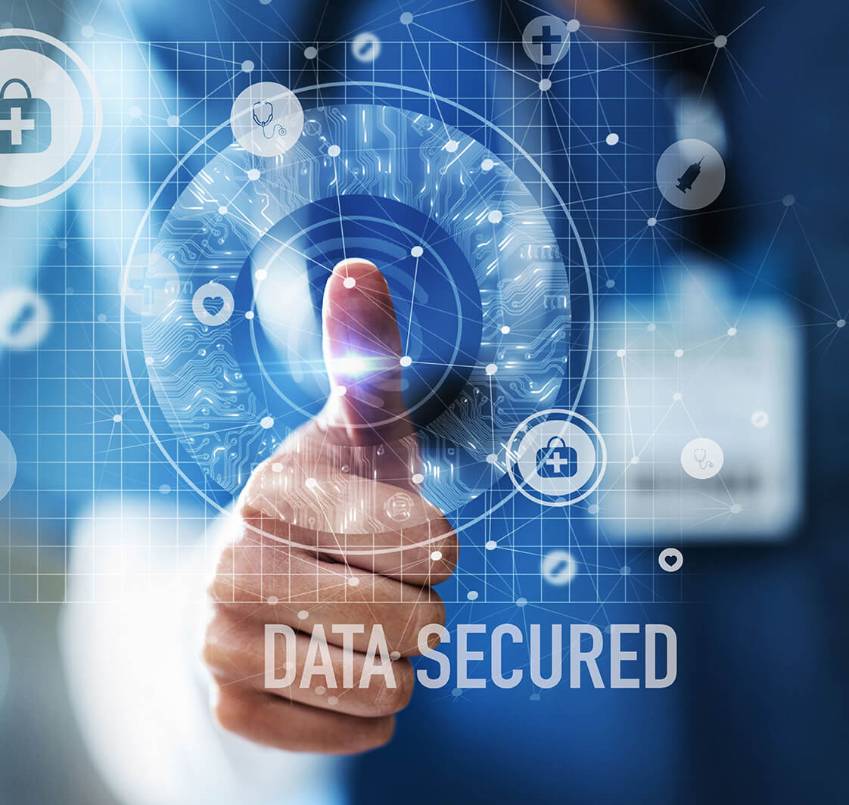











Real-World Case Study 1: NHS Digital Transformation
Implementation
NHS App (2018)
Electronic Health Records
NHS Spine Integration
Healthcare Sector
The NHS demonstrates how integrated information systems can transform public service delivery at scale
Challenges
Legacy systems
Data security concerns
Staff resistance
£2.3bn budget constraints
Successfully modernized patient data management
Improved interoperability across healthcare providers
Outcomes
30M+
70%
24/7
Enhanced patient engagement through digital services
App Users
Less Paperwork
Patient Access
Notes:
Let's now look at a relevant case study within healthcare - the NHS Digital Transformation.
Key systems implemented were the NHS App in 2018 allowing patients to view and access records and services, the introduction of Electronic Health Records as a replacement for paper-based system and the implementation of the NHS Spine as an interconnector of all services across health providers.
Challenges in implementing these were many. Previous legacy systems presented a difficult problem for integrating the new systems, Data security concerns arose from the sensitive nature of health data, the implementation of new technology caused some staff resistance to change and required the huge budget of 2.3billion pounds.
Despite these obstacles the impact has been great. There are now over 30 million users of the NHS App, a 70% drop in paperwork is freeing up staff time for patient care and patients can now access information and services 24/7.
The NHS case proves that large organisations with significant constraints can and have successfully implemented IS to revolutionise service provision. Although as Carr (2023) highlights this needs to be carefully considered at all levels of implementation.

Slide 14















Real-World Case Study 2: Siemens Digital Enterprise
Implementation
MindSphere IoT Platform
Digital Twin Technology
Cloud-Based Analytics
Manufacturing Sector
Challenges
Siemens showcases Industry 4.0 transformation through IoT and digital twin technologies
Integration complexity
Workforce upskilling
Cybersecurity threats
High initial investment
Connected factories with real-time monitoring
Outcomes
AI-driven predictive maintenance systems
20% efficiency gains
Predictive maintenance
Data-driven operational excellence
£1.2bn cost savings
Competitive advantage
Notes:
Our second case study comes from the manufacturing sector; Siemens Digital Enterprise.
Siemens introduced various cutting-edge technologies: The MindSphere IoT platform helps to connect different machines and devices enabling collection of data in real-time. Digital twin is used to generate a replica of the physical asset and its functioning, for use in simulations and for further analysis. Cloud-based analytics helped them in processing vast amount of generated data.
Challenges faced were: System integration complexity as Siemens has to integrate and connect different machines and devices; need of workforce upskilling to utilize the new technologies; concerns about cybersecurity for all systems being manufactured as they represent a core business activity; and the high initial investment for implementing such advanced technologies.
Resulting from this project Siemens reported 20% efficiency improvements throughout the operations and their overall costs were lowered. Savings of 1.2 billion reported by the company. Maintenance of equipment reduced its cost through implementation of predictive maintenance and the company got a significant competitive advantage in the market.
The case of Siemens demonstrates the way how IS is utilized for the growth and efficiency in manufacturing. Chaffey and White (2022) said that Industry 4.0 technologies such as IoT and digital twins are revolutionizing ways companies function and perform.

Slide 15



Key Takeaways & Recommendations
Key Takeaways
Recommendations for Glamour Cuts
Information systems are essential for modern business operations
1
Start with TPS implementation for immediate efficiency gains
TPS, MIS, and CRM serve different but complementary purposes
2
Gradually implement MIS once TPS is operational
Integration of systems maximizes business benefits
3
Plan CRM implementation for long-term customer growth
Ethical considerations are critical throughout implementation
4
Invest in comprehensive staff training programs
5
Prioritize data security and GDPR compliance
Successful IS implementation requires strategic planning, stakeholder engagement, and continuous improvement
Notes:
So, let me summarize the main points that were raised in the analysis, and our proposed recommendations for Glamour Cuts.
To recap the main points from the analysis: Information systems are an integral part of the operations of all modern day businesses. The TPS, MIS and CRM all perform vital, but disparate, functions which need to integrate. Integration provides businesses with the most significant benefits.Ethical issues need to be an imperative in the design and implementation process.
Our proposed recommendations for Glamour Cuts are the following:
Firstly, Implement the TPS stage with immediate effect in order to gain immediate operational efficiencies and address the more critical issues in business operations and lay a base for all subsequent systems.
Secondly, The MIS system will then be implemented after a considerable duration where the staff are accustomed to the TPS.
Thirdly, the CRM stage needs to be considered with a long-term customer retention perspective, and implementation will not need to be carried out straightaway.
Fourthly, The need for a rigorous training program for the employees is paramount for the successful adoption of the systems.
Fifthly, It is crucial that the systems maintain data security at the highest level possible and that Glamour Cuts must comply with the regulations posed by GDPR to prevent any adverse effects, both legal and reputational.
Finally, it is our firm belief that a successful implementation of information systems in business needs a strategic approach, active participation from stakeholders, and constant monitoring and improvement of the system. It is not just the technological system which matters, it's the transformation of the business operation.

Slide 16
References
1.
Laudon, K.C. and Laudon, J.P. (2020) Management Information Systems: Managing the Digital Firm. 16th edn. Harlow: Pearson Education.
6.
Chaffey, D. and White, G. (2022) Business Information Management: Improving Performance Using Information Systems. 4th edn. Harlow: Pearson Education.
2.
Pearlson, K.E., Saunders, C.S. and Galletta, D.F. (2019) Managing and Using Information Systems: A Strategic Approach. 7th edn. Hoboken: John Wiley & Sons.
7.
Bocij, P., Greasley, A. and Hickie, S. (2022) Business Information Systems: Technology, Development and Management. 7th edn. Harlow: Pearson Education.
O'Brien, J.A. and Marakas, G.M. (2021) Management Information Systems. 10th edn. New York: McGraw-Hill Education.
Information Commissioner's Office (2025) Guide to the General Data Protection Regulation (GDPR). Wilmslow: ICO. Available at: https://ico.org.uk (Accessed: 10 June 2026).
3.
8.
4.
NHS Digital (2024) NHS App Performance Report 2024. London: NHS England. Available at: https://www.nhsdigital.nhs.uk (Accessed: 10 June 2026).
9.
Carr, N.G. (2023) 'The future of information systems in business', Harvard Business Review, 101(2), pp. 45-53.
5.
Siemens AG (2023) Digital Enterprise Solutions: Annual Report 2023. Munich: Siemens AG. Available at: https://www.siemens.com (Accessed: 10 June 2026).
10.
Davenport, T.H. and Harris, J.G. (2024) 'AI and information systems: Ethical considerations and best practices', Journal of Business Ethics, 185(1), pp. 15-28.
Notes:
Today's data is supported by literature and real sources. Our referencing style is UWTSD Harvard referencing; our resources comprise, most recent publications and case studies, literature from top information system authors, with reference to the latest and newest sources including the use of NHS Digital and Siemens AG material, We would like to thank you for listening and are willing to respond to any questions.

