Slide 1


Finding and Using Information
CIPD3 - Carmarthen
Connie Davage
February 2025

Slide 2

Aim of the Session.
An introduction to the library resources and services
A demonstration how to use the library catalogue
Help and support from the library

Slide 3

Services and Support.
A dedicated librarian for research support.
Help available via chat, email or Teams.
Online resource lists linking to course reading.
Support for referencing and accessibility.

Slide 4
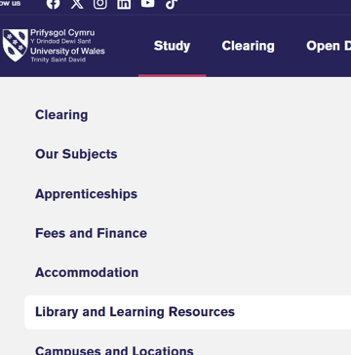
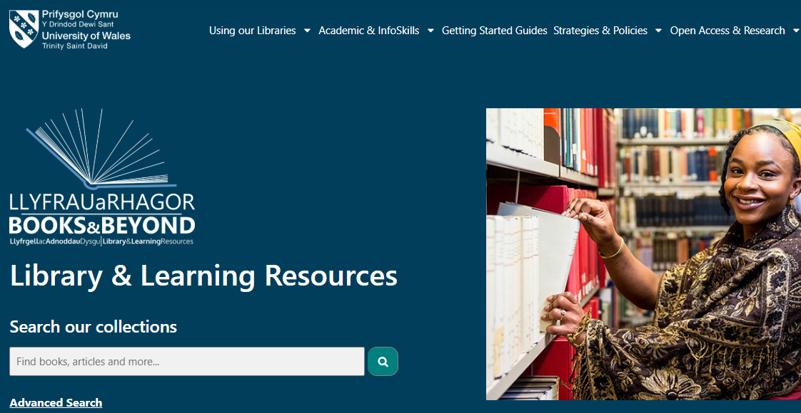
Library Webpage
To locate the library webpage, Go to https://digitalservices.uwtsd.ac.uk/library/
or
From UWTSD homepage, select ‘Study’ then ‘Library and learning resources’
Note You may need to login using your university login and password.
Remember to bookmark the location!

Slide 5
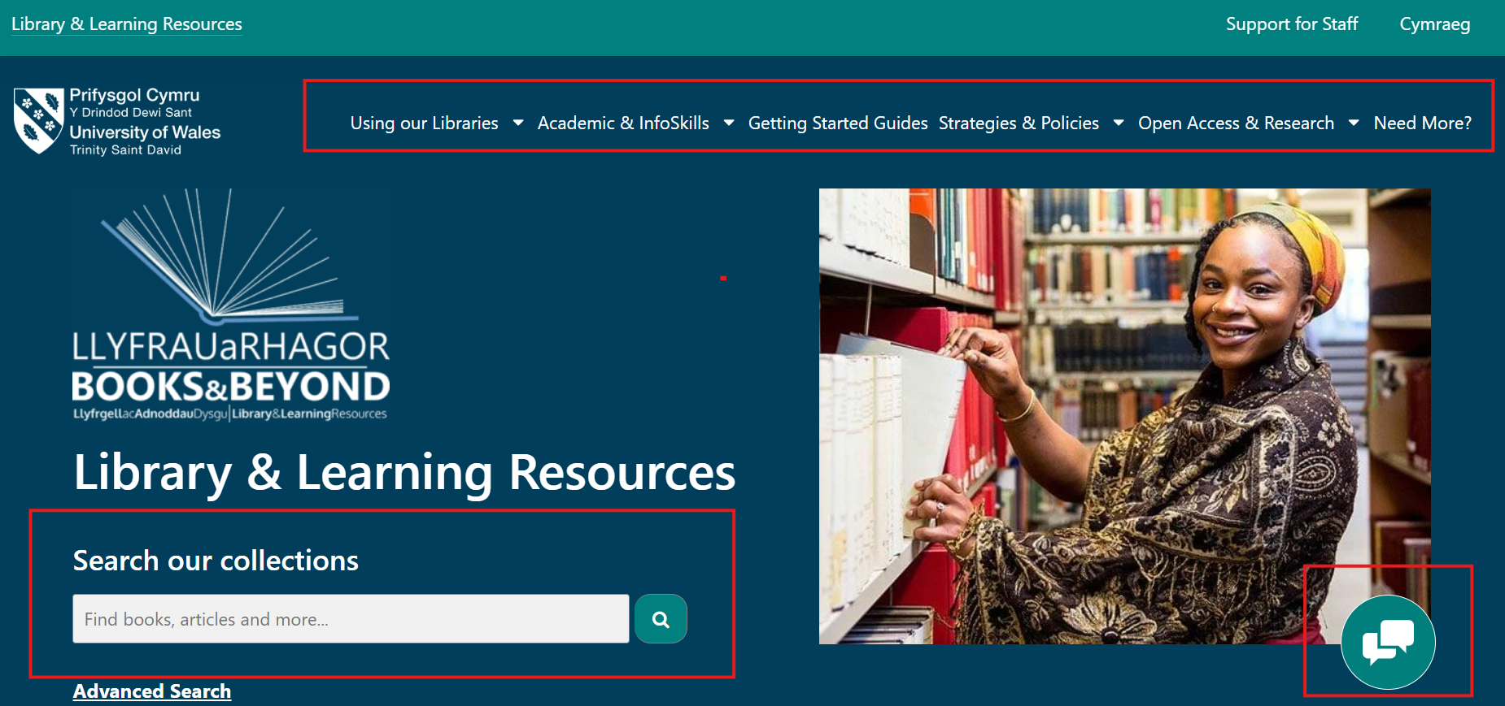
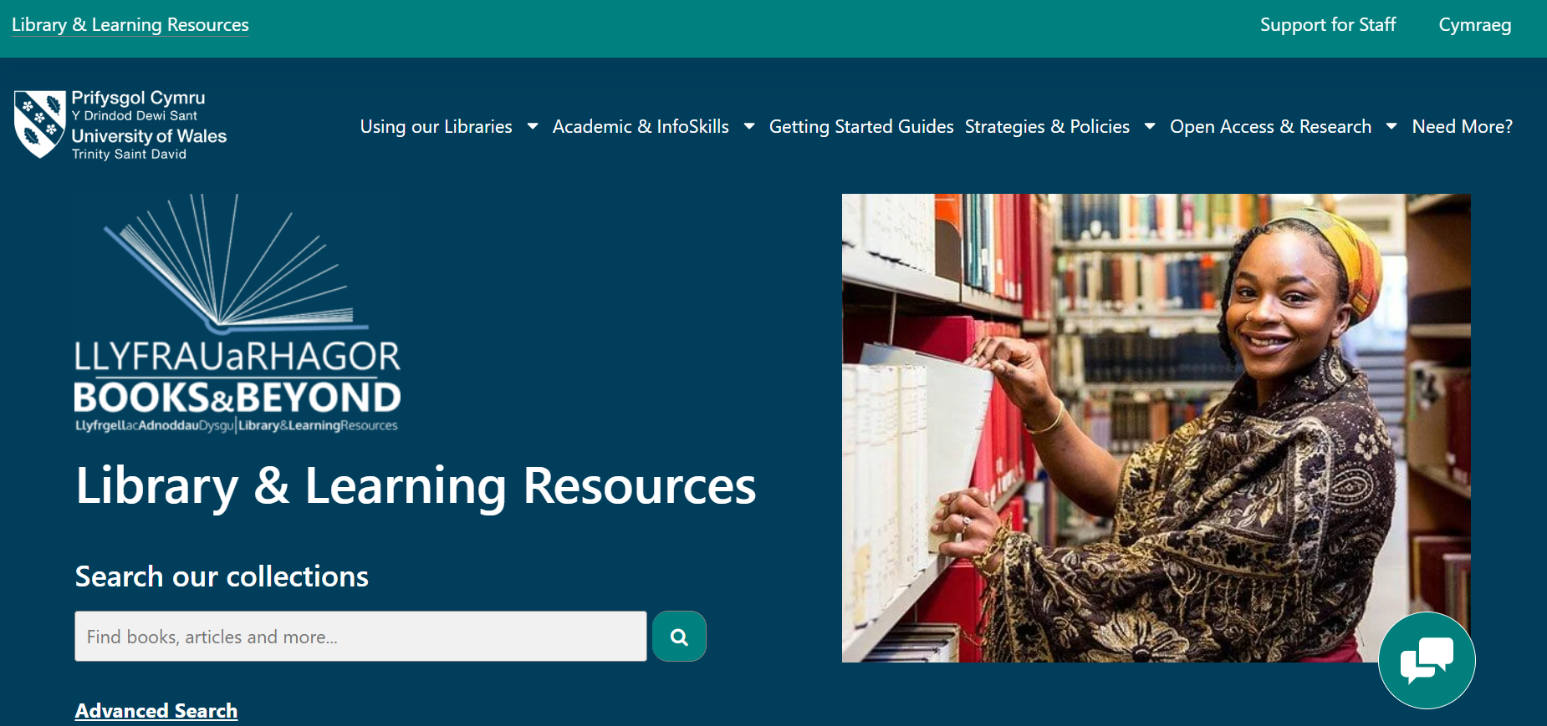
Library Webpage
UWTSD homepage

Slide 6
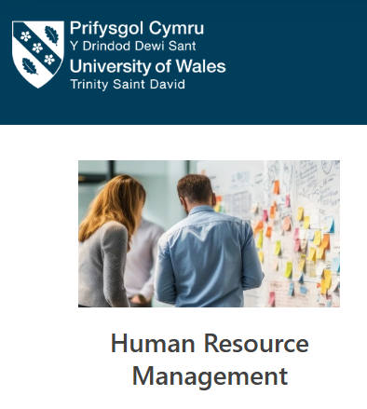
Get Started…
On the library website, you will find all the services and support available to help you.
To get started, click on ‘Getting Started Guides’ to explore subject-specific guides that show you where to find useful information and support for your course.
Getting Started Guides

Slide 7
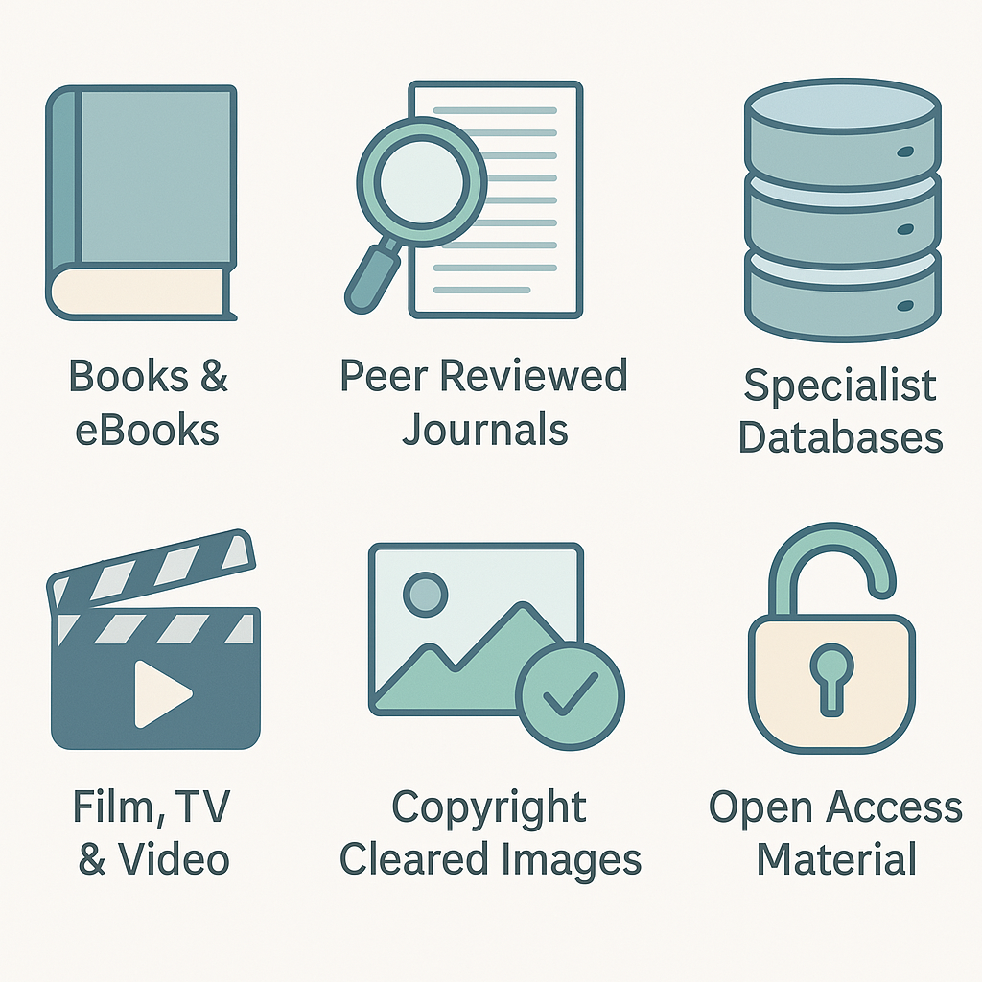
Explore your library resources.

Slide 8
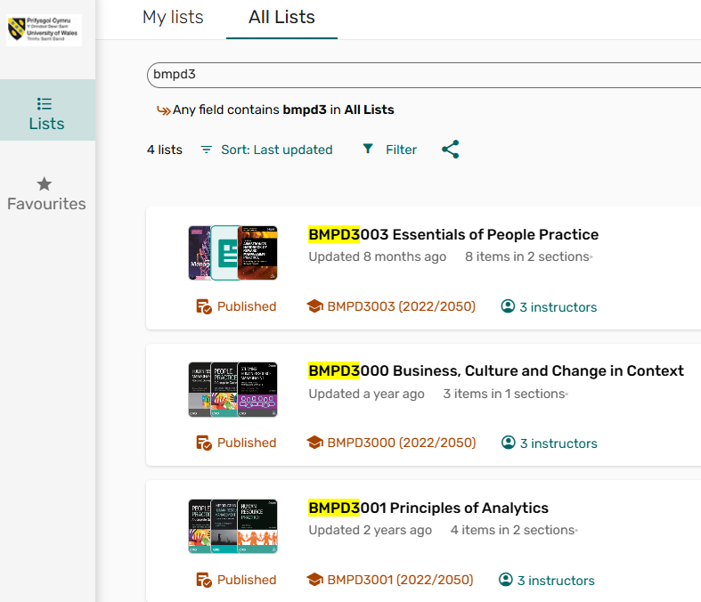
What are your online resource lists?
Your lecturers have already picked out the key books, articles, and materials you’ll need—
and they’re all in one place:
🧭 Where to Find Them:
On your Moodle course pages.
Or through the Library website.
✅ All managed by the library to make your life easier!
Online resource lists

Slide 9
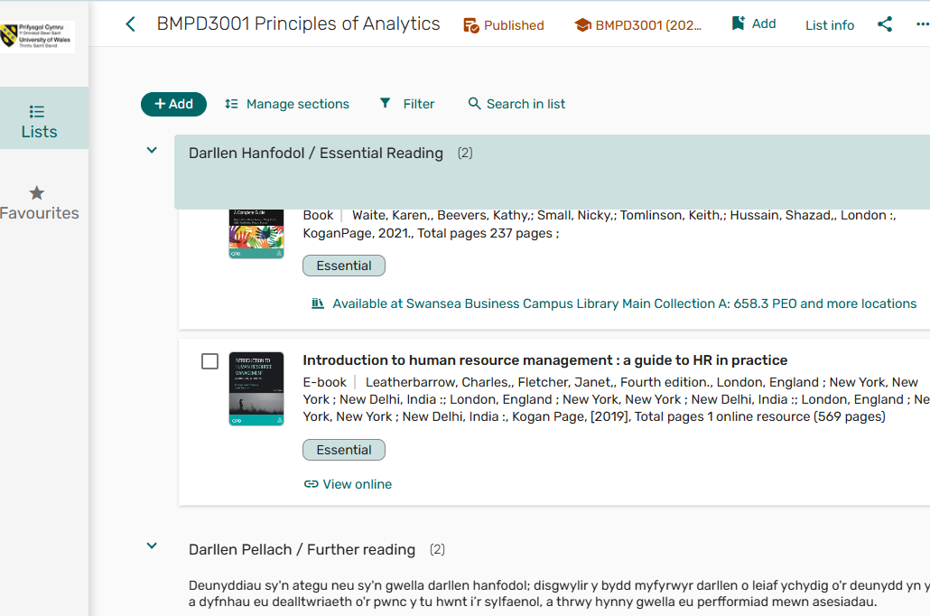
Why use them?
🎯 Focused Reading: Your lecturers have picked out the most important resources—clearly marked as Essential or Further Reading.
🔗 Easy Access: Click straight through to online content or check availability for printed items.
⭐ Stay Organised: Save your favourite resources, build your own list, and keep track of everything you’ll need for your assignments and reference lists.

Slide 10
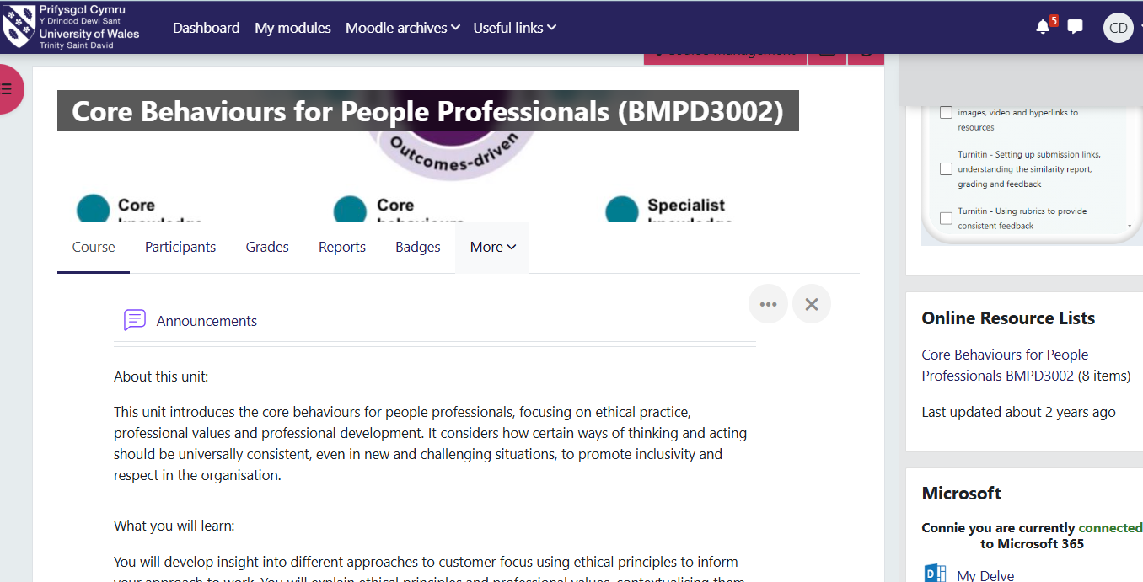
Find Online Resource list in Moodle
BMPD3002 Home

Slide 11
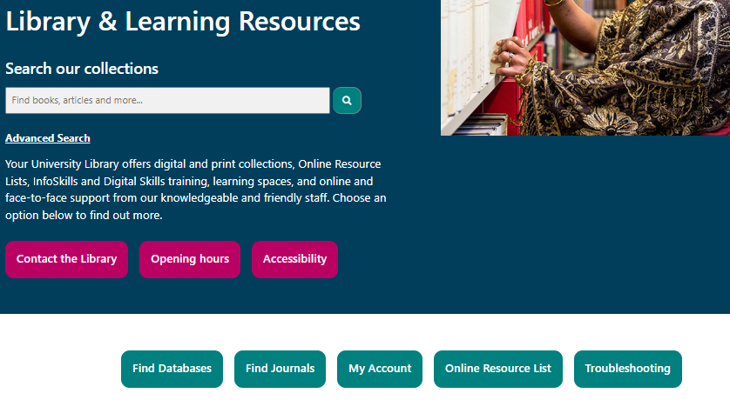
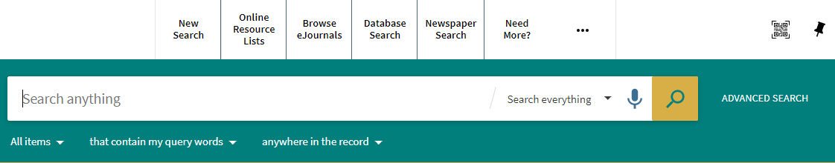
Also Find Them..
… in the Library Webpage &
Library Catalogue

Slide 12
Where to begin searching for academic information.
Online Resource Lists.
Find on Moodle or library web pages. Resources recommended by your lecturers, made available by the library. Accessible by direct link. Start here. Online Infoskills section Online Resource lists.
Library catalogue / databases.
Good print resources, but most information now available online, 24/7. Subscribed, up-to-date, academically credible content, in your subject area. Explore and build here. Online Infoskills course Finding and Using Information.
Moodle / Teams.
Useful additional resources and communications may be uploaded. Be aware of what is happening here.
Google and the internet.
Evaluate - little quality control. Limited ability to refine. Restricted subscribed content. Understand what you are looking at … and what you are not looking at! Be wary here. (Online Infoskills unit Advanced Searching.)
Notes:
The ORL can guide your searches in the library catalogue. Your lecturers may also post useful additional resources and communications in Microsoft Teams. Of course, you can also search for sources on the open web, such as Google Scholar. Be aware of using internet, you will evaluate the contents critically.
We suggested the ORL is the best place to start with your research because it will easily take you our online library.
This will lead us to the next question: why use library?

Slide 13
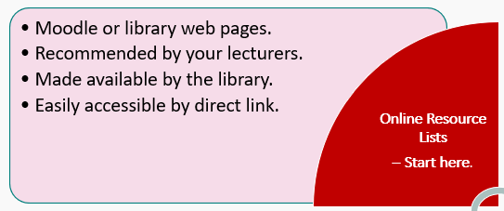
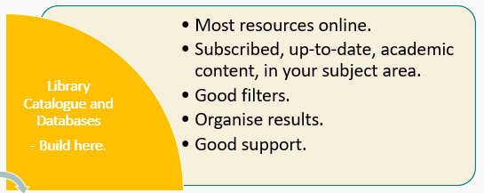
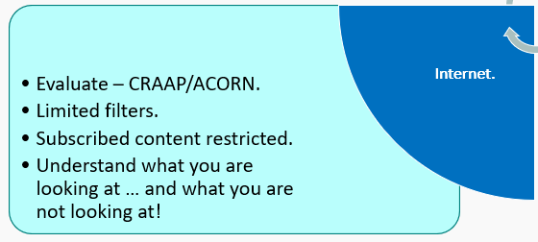
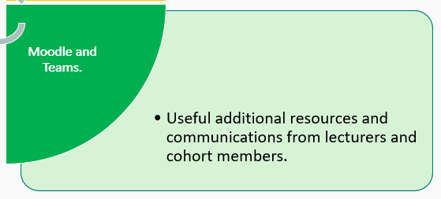
Where to begin searching for academic information.

Slide 14
Using the Library
Search all resources at once.
Sign in to use all the tools and features.
Use the filters to set the best results.
Save your favourite articles, books or journals in your pinned resources.
Email books and articles to yourself.

Slide 15
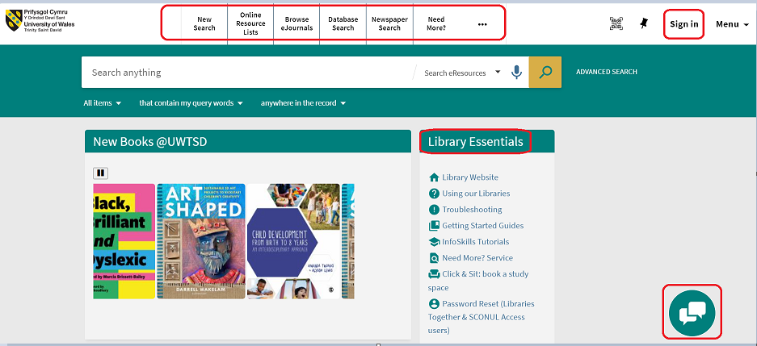
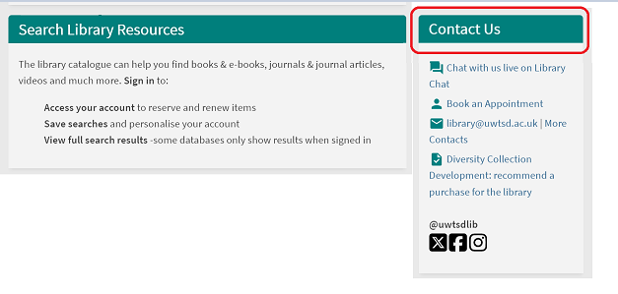
Library catalogue – your library account.
Sign in with your university username and password.
Links to Online Resource List; Databases search and more…
Links to library essential services and ways of contact us.
Library catalogue

Slide 16
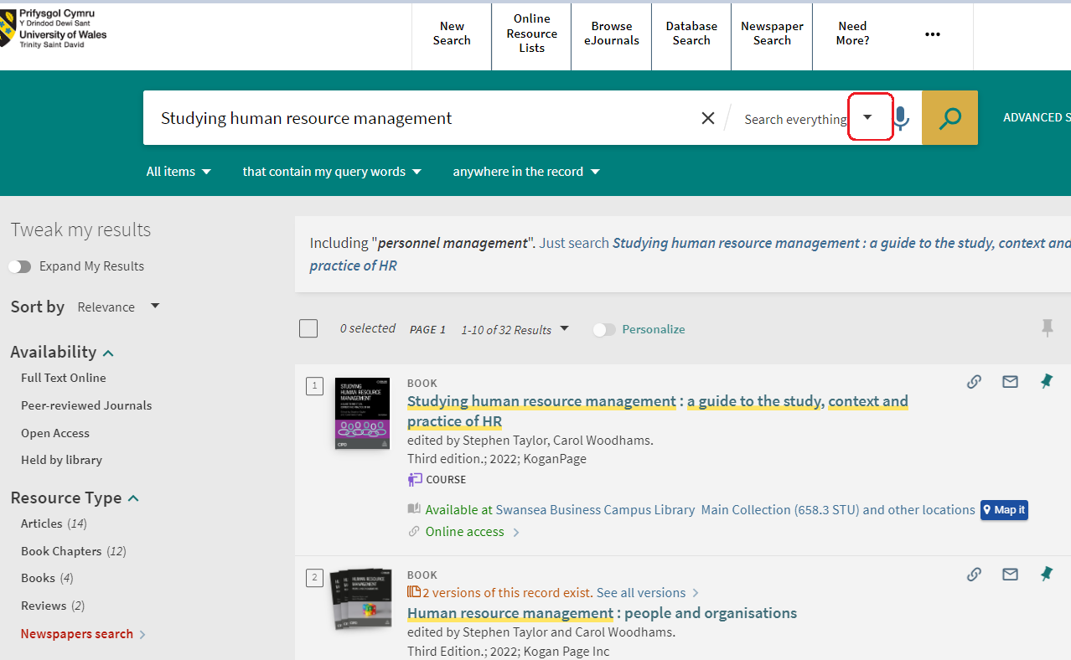
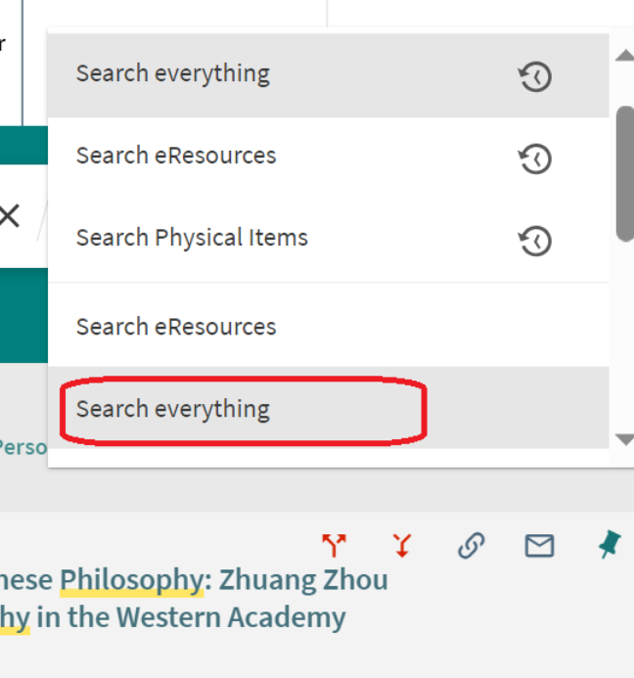
Search Resources
Use the search parameter to search for “everything” held in the library.

Slide 17
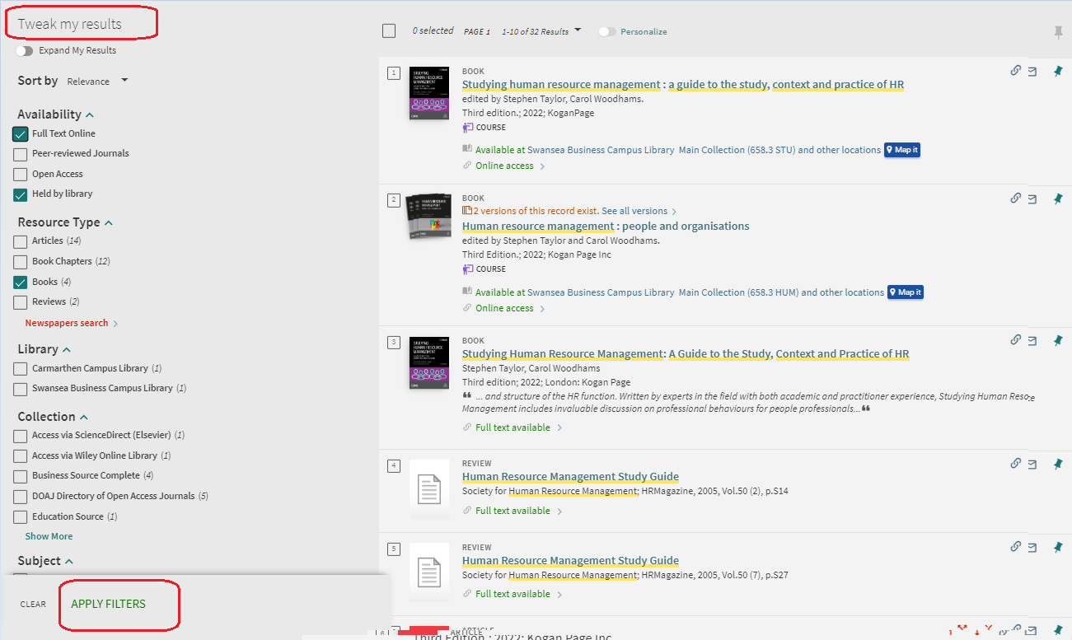
Use Filter to Narrow Your Results
Use the filter on the left-hand side.
You could limit further by date, subjects and other filters listed.

Slide 18
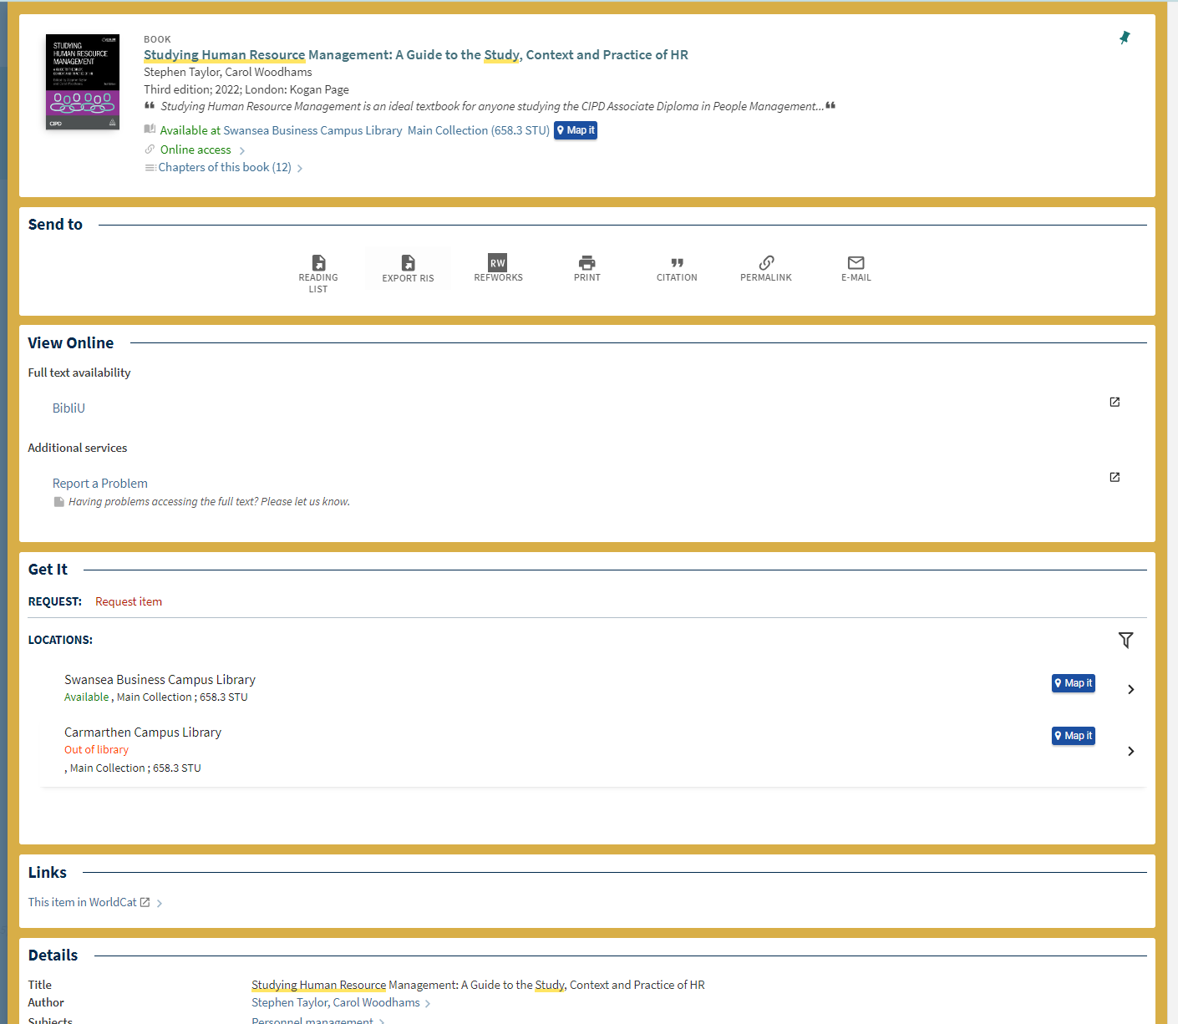
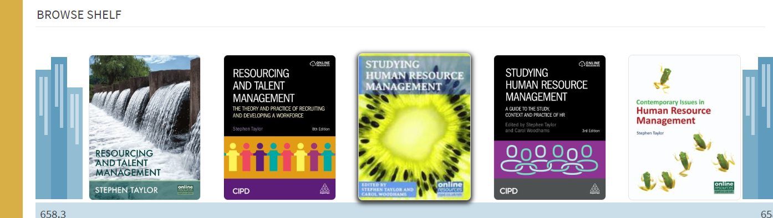
What the Item Records Include.
Where the book is held if it’s in print.
Link to ebook or journal article if it’s electronic.
How to request it if it’s on loan.
Related reading.
Option to search just within one journal.
Virtual browse of other similar books.
Books on the same Online Resource list.
Option to save in your personal reading list.
Book Records

Slide 19
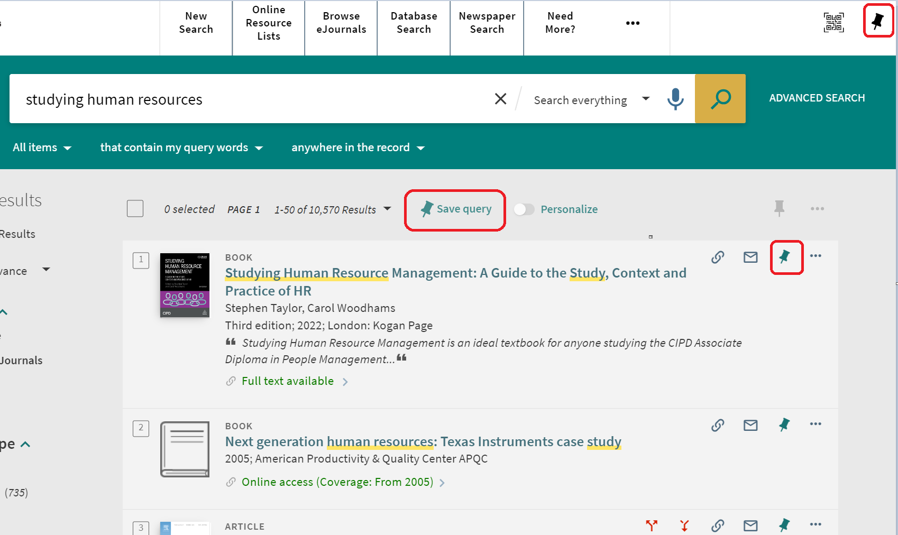
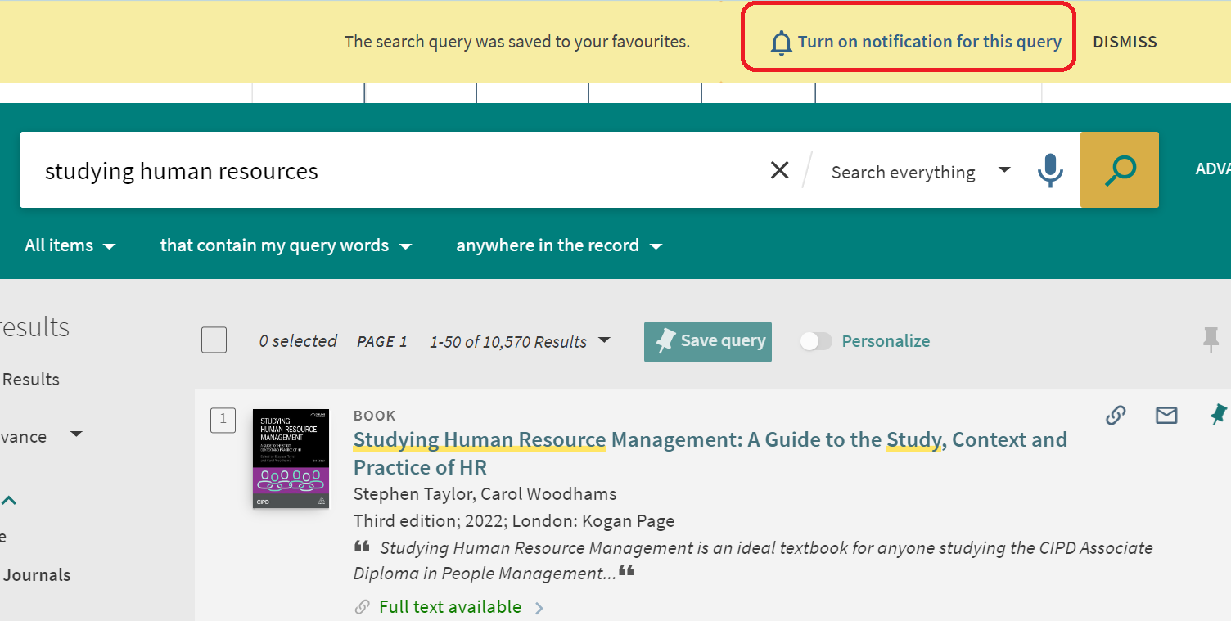
Saving favourites and set alerts.
Save your favourite resources in the pinned section of your account.

Slide 20
Task: Library search
Complete a search on the library catalogue on a topic of your choice. Explore a few of the detailed records found.
Take note of any additional keywords to describe your topic.
Refine your search to full-text e-books written in English since 2019.
Save and label at least 3 items to retrieve later.

Slide 21

The CRAAP Test
Currency Is it up-to-date?
Relevance Who is the intended audience?
Authority What are the author’s credentials?
Accuracy Can the information be verified?
Purpose Is the information objective?
Remember: always evaluate the information you find!

Slide 22
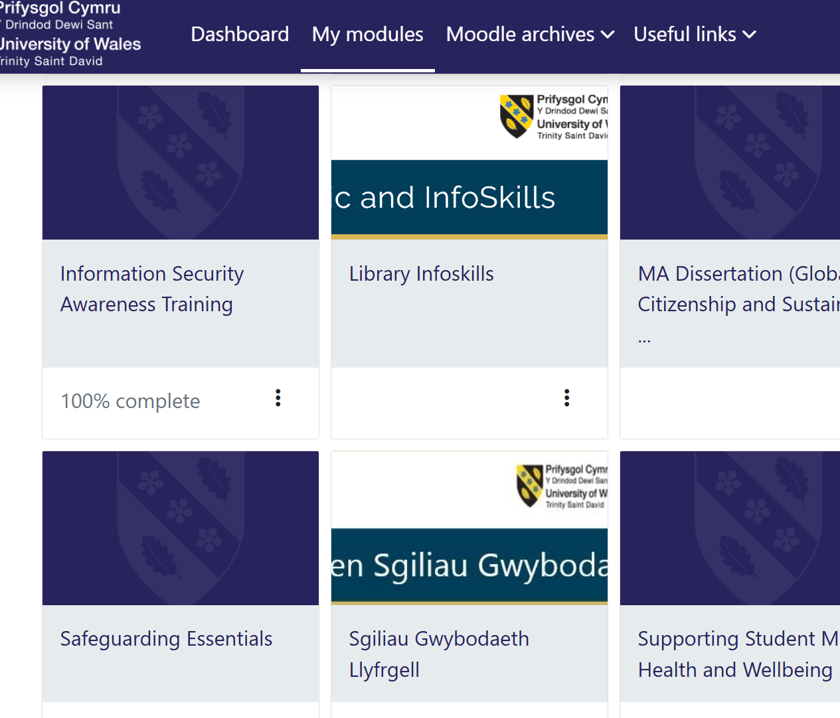
Academic Infoskills.
The Skills programme is designed to help you develop transferable academic and information skills.
It enhances both your academic performance and employability.
It includes a variety of topics, such as finding and using library resources, acknowledgement of Artificial Intelligence (AI).
It emphasises the importance of correct referencing in academic work and provides access to handbook that detail proper referencing formats.
and much more…

Slide 23
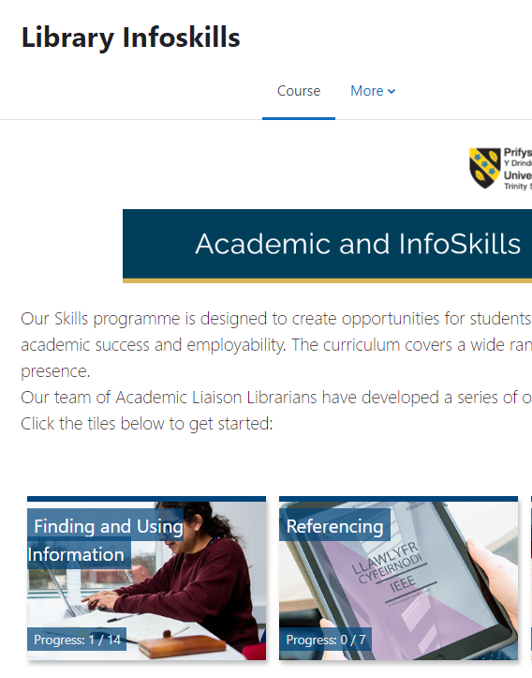
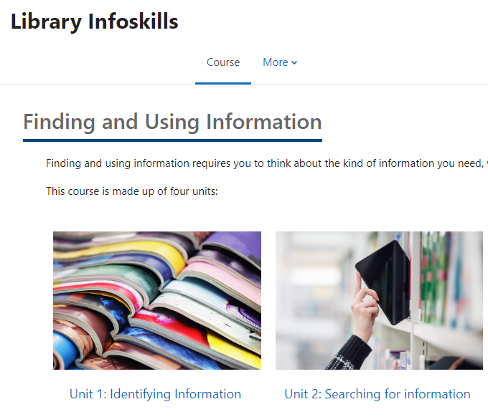
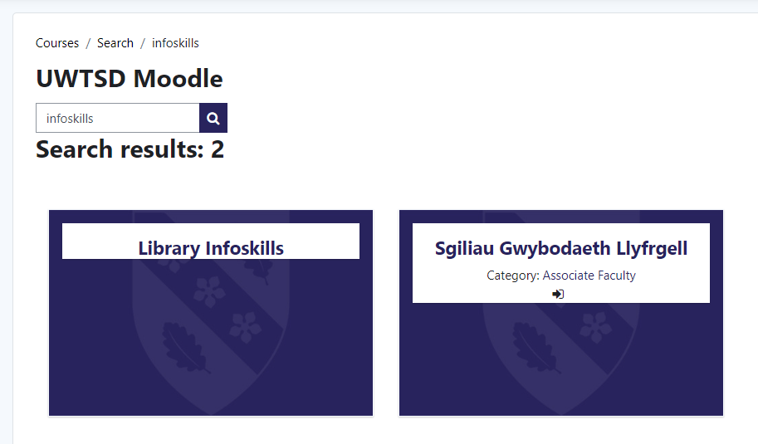
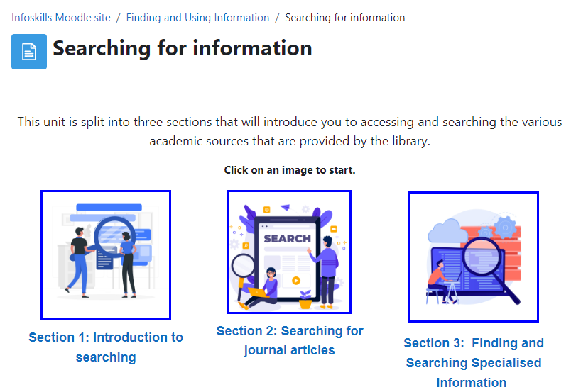
Academic Infoskills.
Our Academic and Infoskills programme is designed to help you develop your academic and information skills. The online curriculum covers a wide range of topics, from finding library resources and referencing, to critical evaluation and misinformation. You can access it either via either Moodle or the library web pages. Remember that you may need to login first!
1. Moodle:

Slide 24
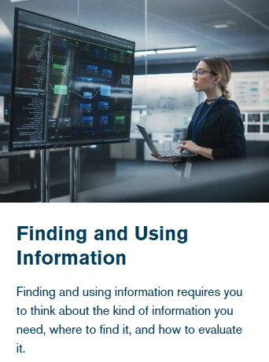
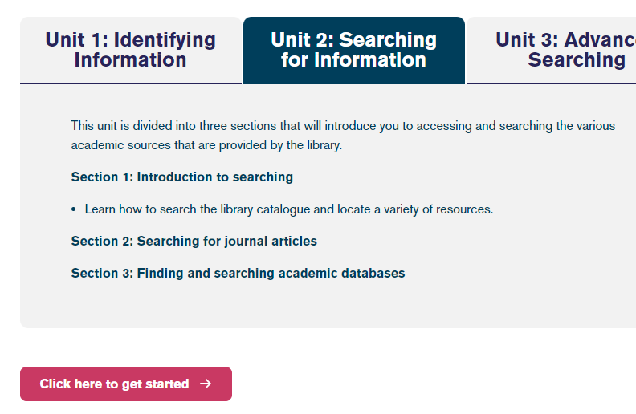
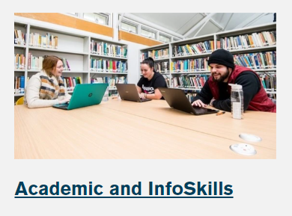
Academic Infoskills.
2. Library web pages:

Slide 25
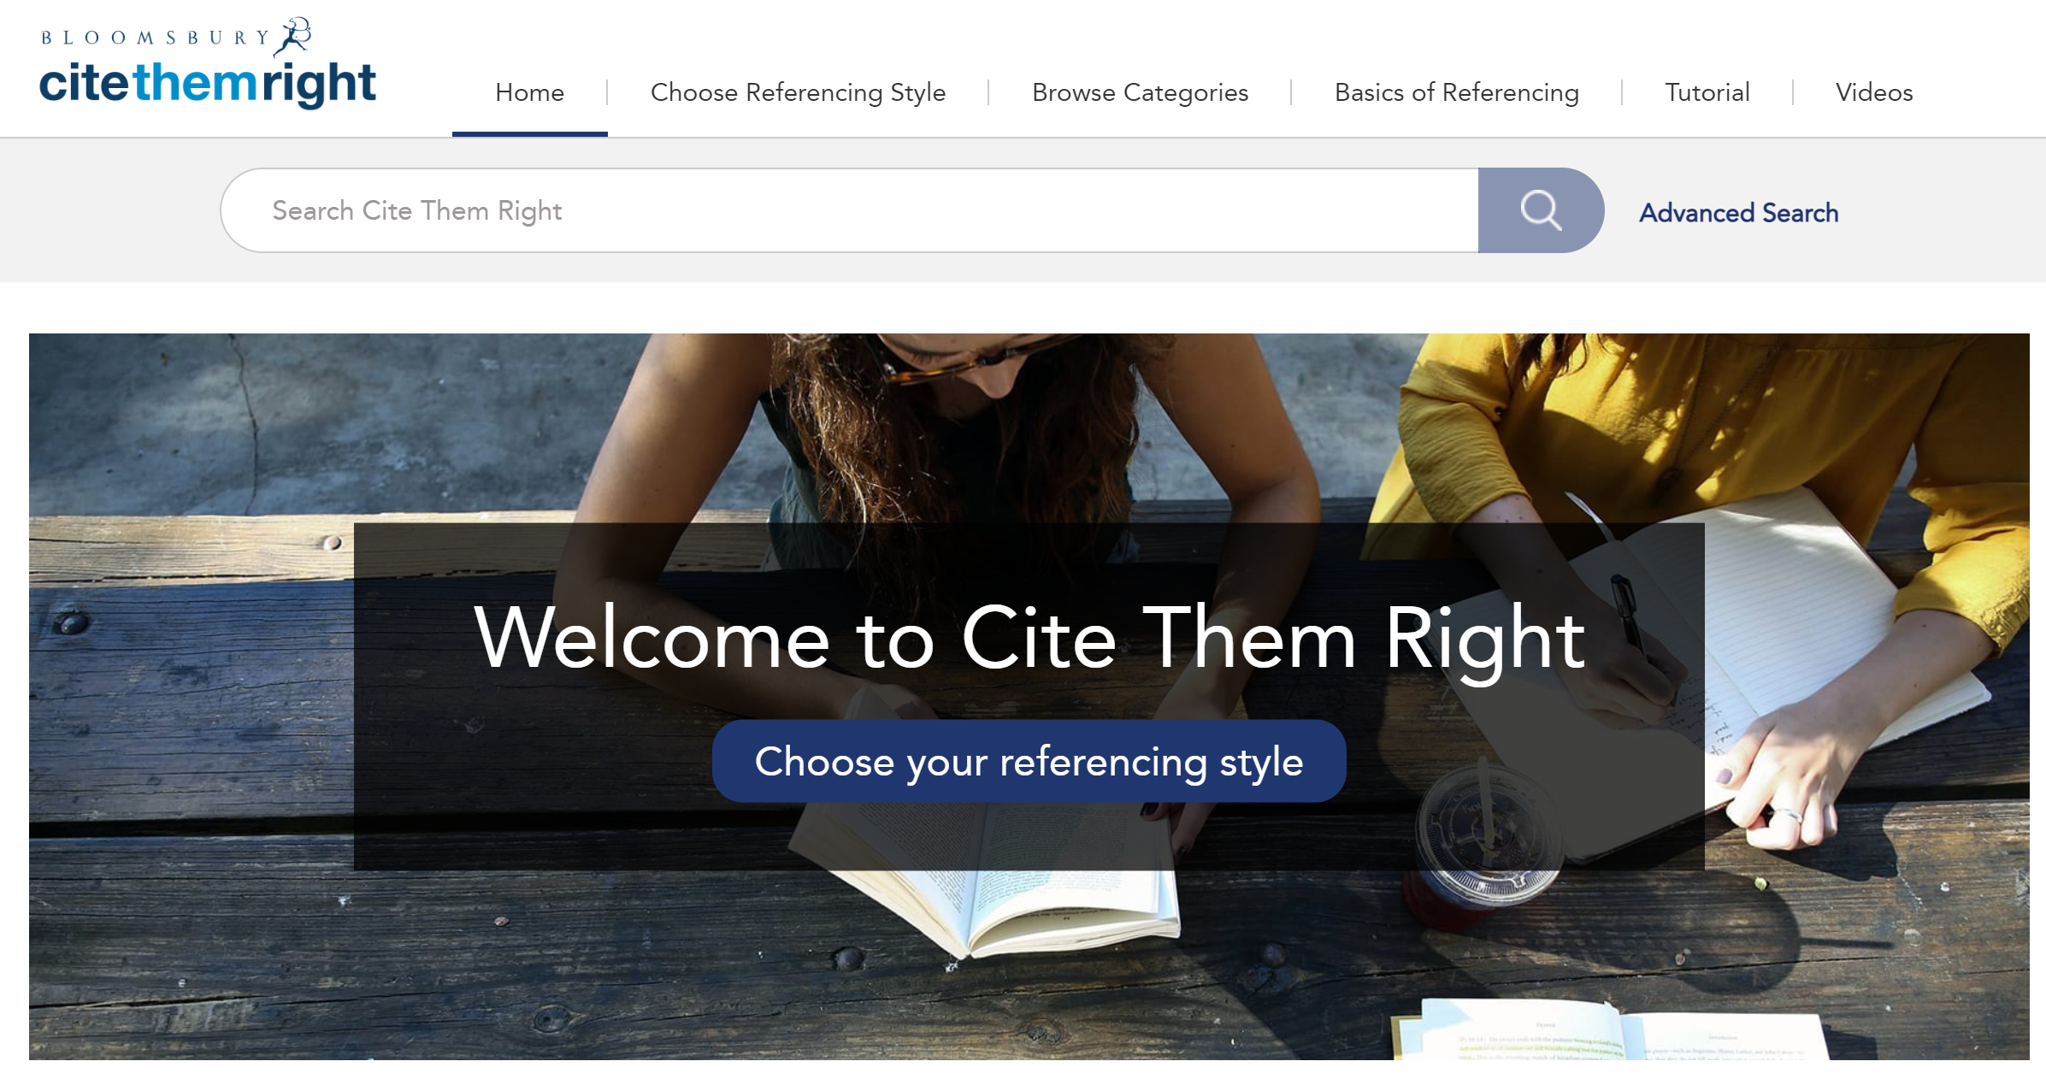
Cite Them Right Online
How to reference
Plagiarism
Study skills
Cite them right online

Slide 26

We also provide digital support.
The DigiCentre is a one-stop shop for all the digital skills needs of both staff and students.
Explore to find:
A collection of tools and resources to help you develop your digital skills.
Each institute has a Digital Skills Advisor. The IMH advisor is Jessica Hill.

Slide 27
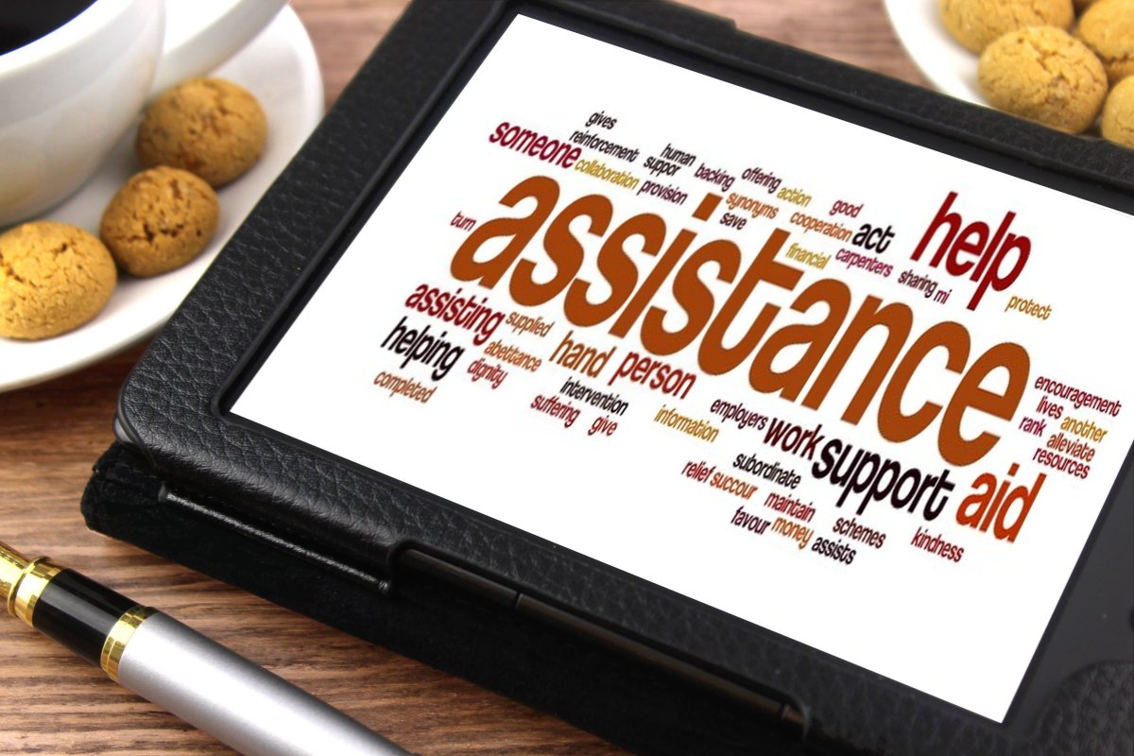
Help is Always Available.
For help with research and referencing queries or for help with digital skills advice
Connie Davage Academic Liaison Librarian
c.davage@uwtsd.ac.uk
Jessica Hill Digital Skills Advisor
j.hill@uwtsd.ac.uk
For 1-2-1 support:
Book an appointment
General queries and help with loans:
library@uwtsd.ac.uk
This Photo by Unknown Author is licensed under CC BY-SA

