Slide 1
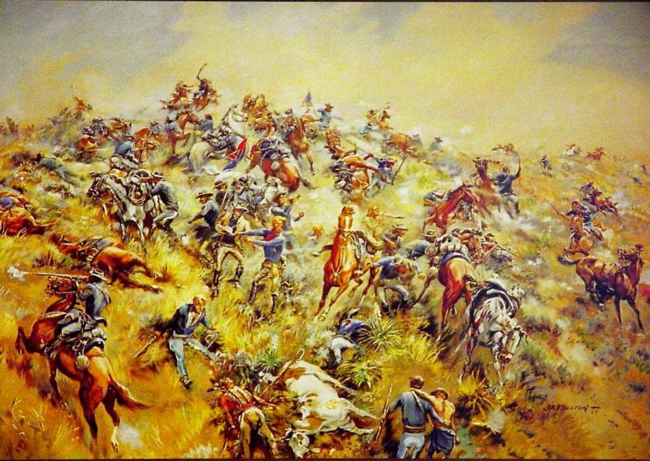
Custer, Sitting Bull and the Little Bighorn
Call of the Bugle by J K Ralston

Slide 2
The Battle of the Little Bighorn has come to symbolize the clash of two vastly dissimilar cultures:
the buffalo/horse culture of the northern plains tribes, and
the highly industrial/agricultural based culture of the U.S.
This difference today remains visible in the way in which we portray the events of that fateful day in June 1876 and even
the name we use for the engagement – Battle of the Little Big
Horn or the Battle of the Greasy Grass.

Slide 3
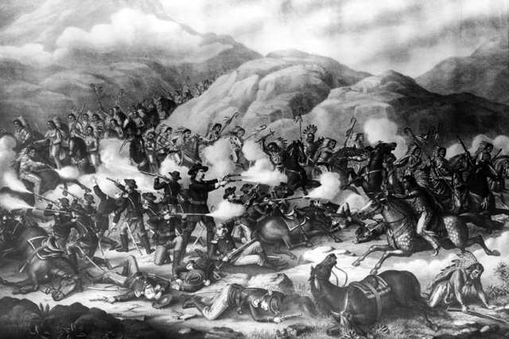

Slide 4
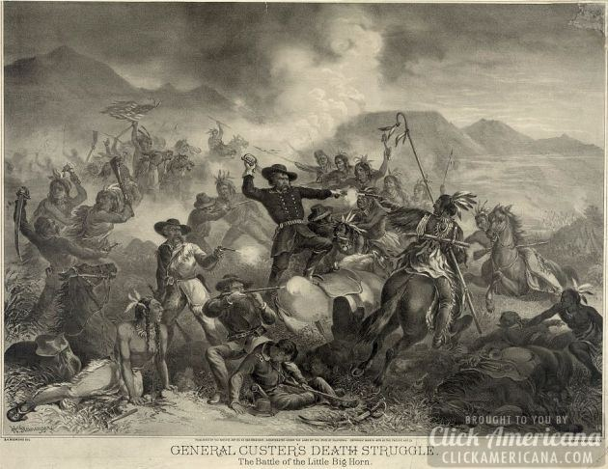

Slide 5
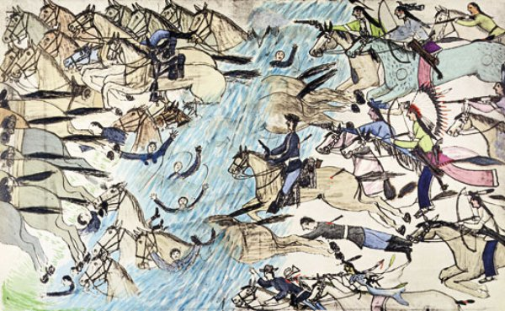
Amos Bad Heart Bull

Slide 6
Things to consider:
Background
The 1876 Campaign
Evidence from the Battlefield
Alternative views of the battle

Slide 7
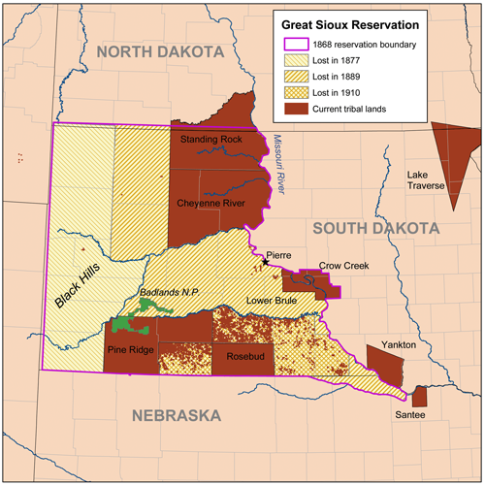
Background

Slide 8
Before 1860 the Crow had lands from the Black Hills of South Dakota to the Big Horn Mountains of Montana.
Due to westward movement of the Lakota the Crow were pushed westwards from their tribal lands in the middle 19th century

Slide 9
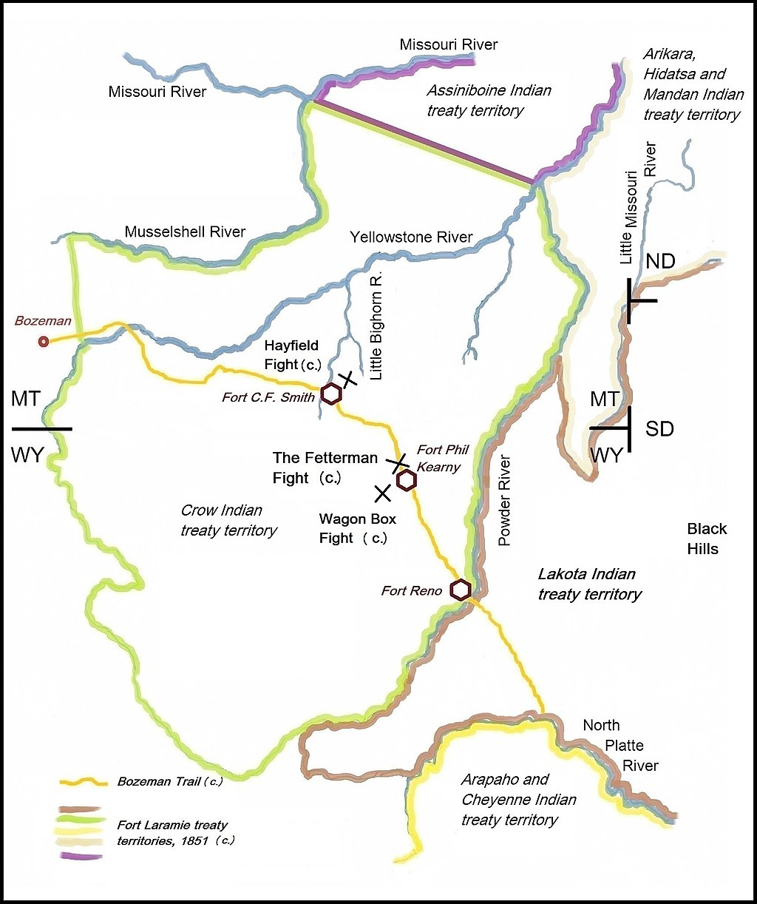
First treaty of Fort Laramie in 1851
Gold discovered in the West
Construction of the Union Pacific
Railroad
Red Cloud War of 1866

Slide 10
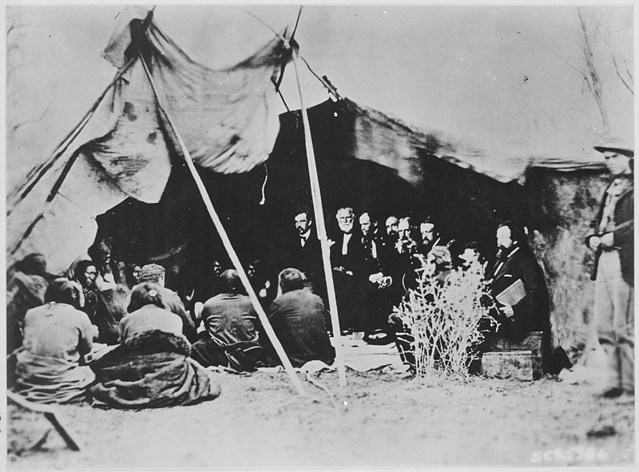
The Laramie Treaty of 1868 was an agreement between the United States and the Oglala, Miniconjou, and Brule bands of Lakota people, Yanktonai Dakota and Arapaho Nation in 1868. It guaranteed ownership of the Black Hills to the Lakota.

Slide 11
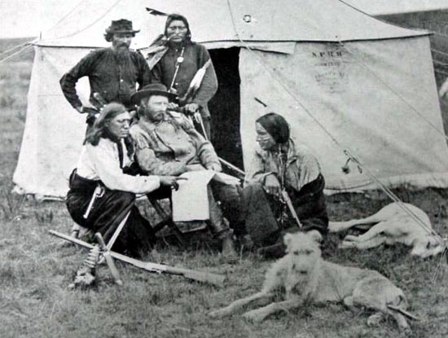
Gold was discovered in the Black Hills following the Custer expedition of 1874
This resulted in a gold rush and huge numbers of white miners violating the treaty
and entering the Black Hills

Slide 12
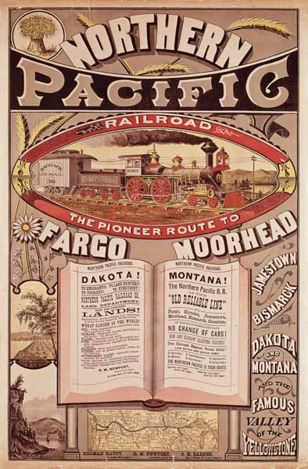
Other issues such as the building of the
Northern Pacific Railroad and the
need to obtain timber for construction
also contributed to the problem
The result was that tribes began to drift
from the reservations and back into the
old tribal lands

Slide 13
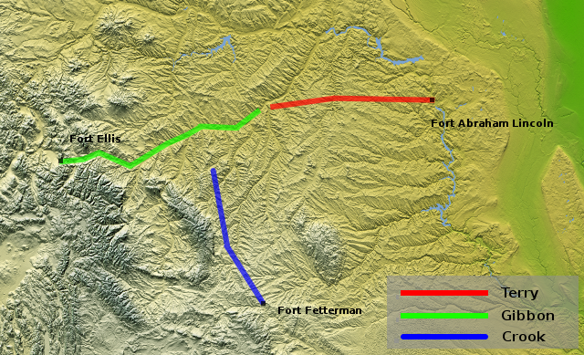
The 1876 Campaign

Slide 14
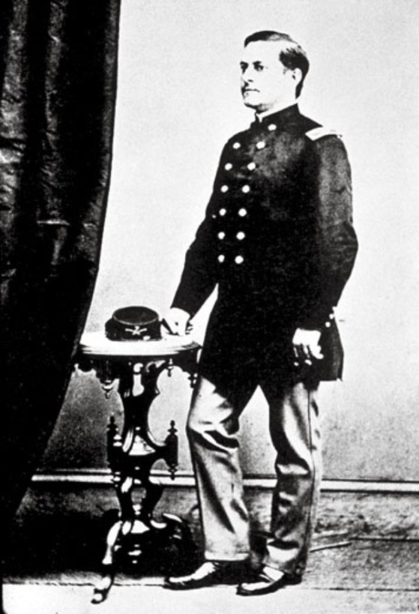
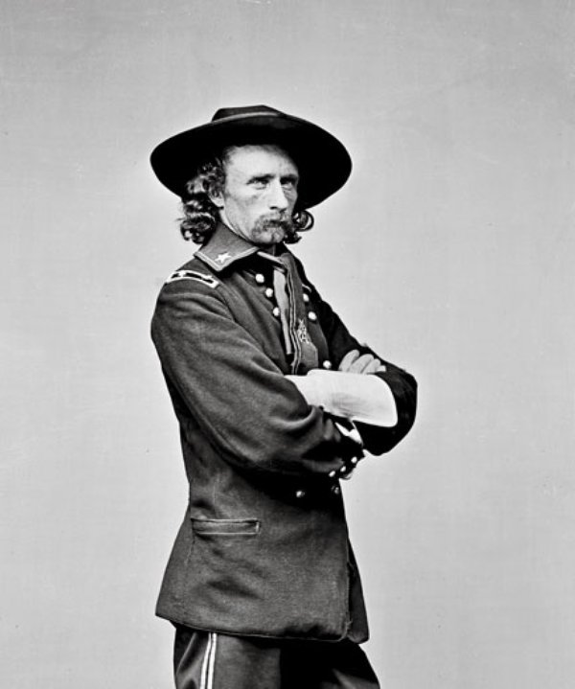
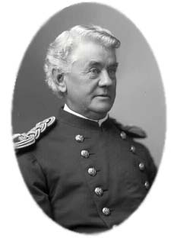
George Armstrong Custer
Marcus
Reno
Frederick
Benteen

Slide 15
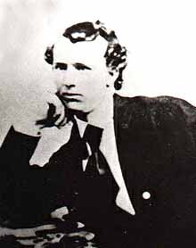
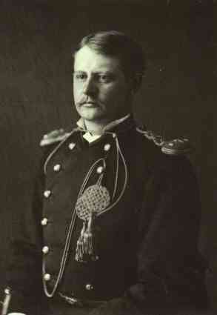
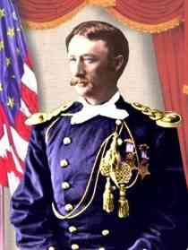
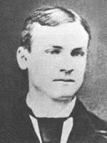
Other family members killed at the Little Big Horn
Boston Custer,
youngest brother
James Calhoun,
Brother-in-law
Tom Custer,
younger brother
Autie Reed, newphew

Slide 16
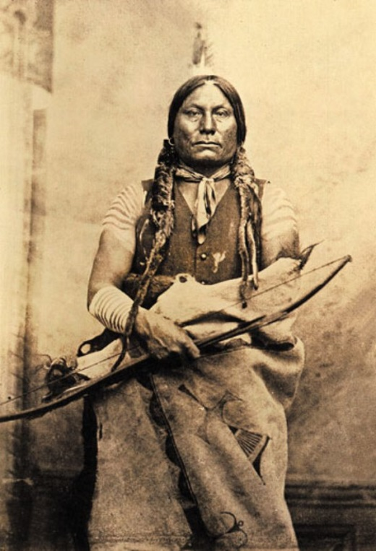
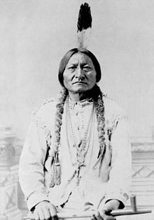
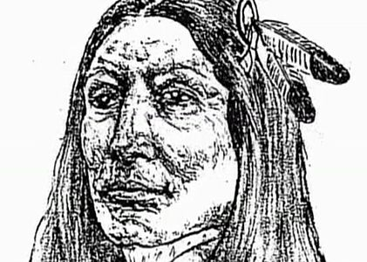
Gall
Sitting Bull (Tȟatȟáŋka Íyotake)
Crazy Horse

Slide 17
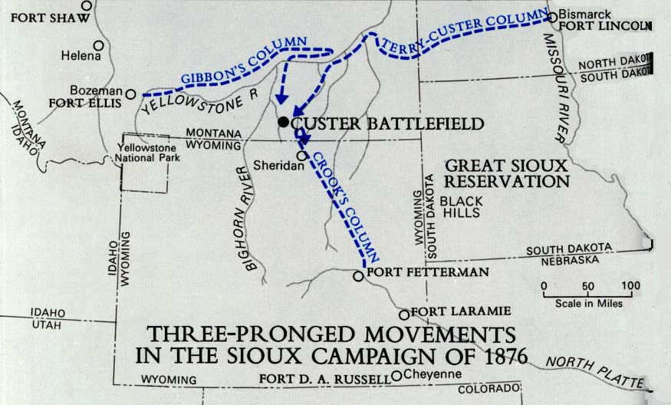
Eight days before the Little Bighorn battle Crook had encountered the Sioux on
the Rosebud and the Indians won a tactical victory forcing Crook to retreat
and consolidate

Slide 18
Did Custer ignore orders?
It is often cited that Custer ignored Terrys orders however Terry’s written
instructions to Custer indicated that it was
“impossible to give … any definite instructions in regards to this movement”
because he had “too much faith and confidence “ in his (Custer’s) “zeal, energy
and ability”
Furthermore Lieutenant James Bradley wrote after the event “with reference to
the combined movement between the two columns …. It is understood that if
Custer arrives first , he is at liberty to attach at once if he deems prudent”.

Slide 19
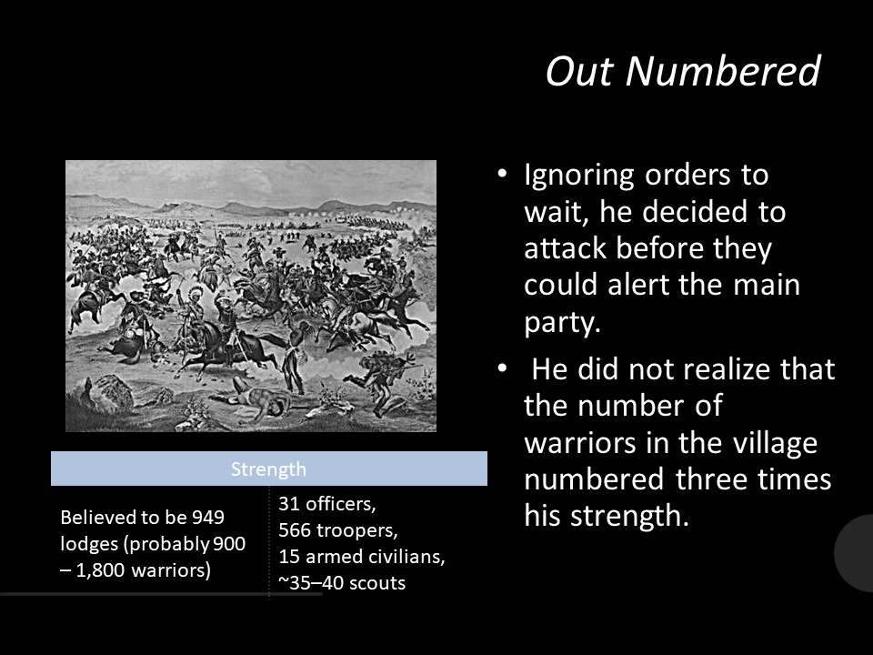

Slide 20
June 25, 1876
00:30: The main column left the Busby camp on a night march under Custer.
03:15: The main column rests.
03:40: Scouts saw the Sioux village at the Little Bighorn for the first time.
05:40: The Scouts saw two Sioux west of the Divide.
08:00: Custer visits Crow’s Nest and are spotted by two Sioux, Custer studied the valley and discussed the findings.
10:50: At officer’s call, Custer decided they will attack.

Slide 21
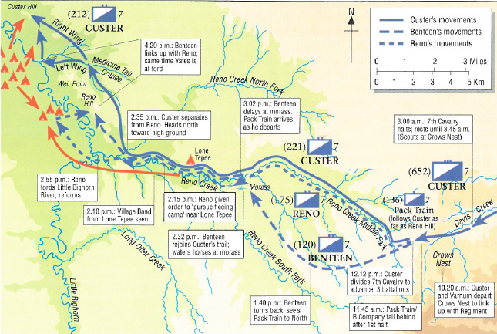
25th June 1876

Slide 22
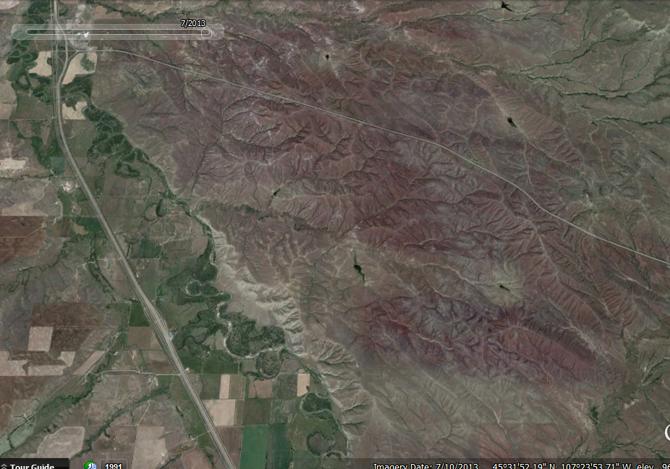
Custer Hill
Calhoun Hill
Nye-Cartwright
Ridge
Medicine Tail Coulee
Weir
Point
Reno-
Benteen
Field
Reno’s
Valley
Fight

Slide 23
12:12: Custer-Reno battalions left to descend to Reno Creek. Benteen’s battalion left the divide halt on an off-trail scout to the left.
14:15: Custer-Reno battalions passed the lone tepee.
14:43: The scouts reported the Sioux were alarming the village. Reno was ordered to charge
15:03: Reno’s battalion started its charge down the left bank of the Little Bighorn River.
15:13: Reno’s battalion saw Custer’s battalion at Reno Hill. Custer’s battalion saw Reno charge and the village.

Slide 24
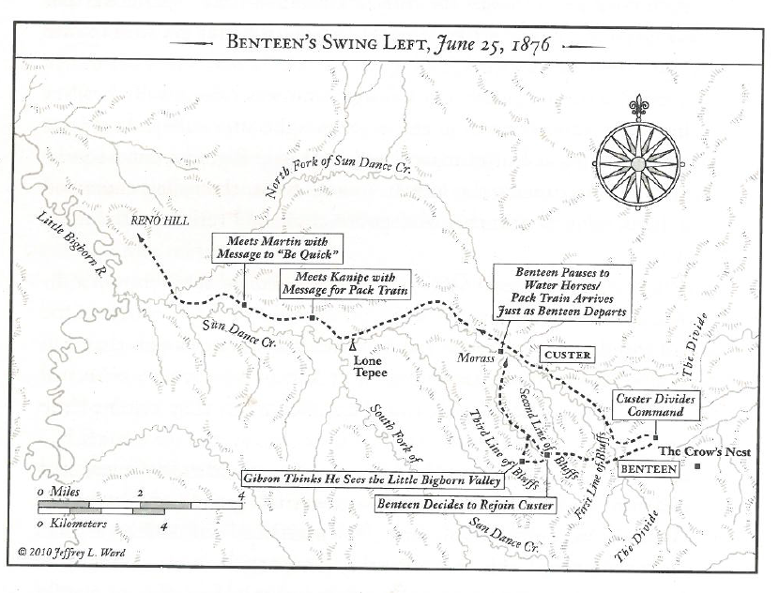

Slide 25
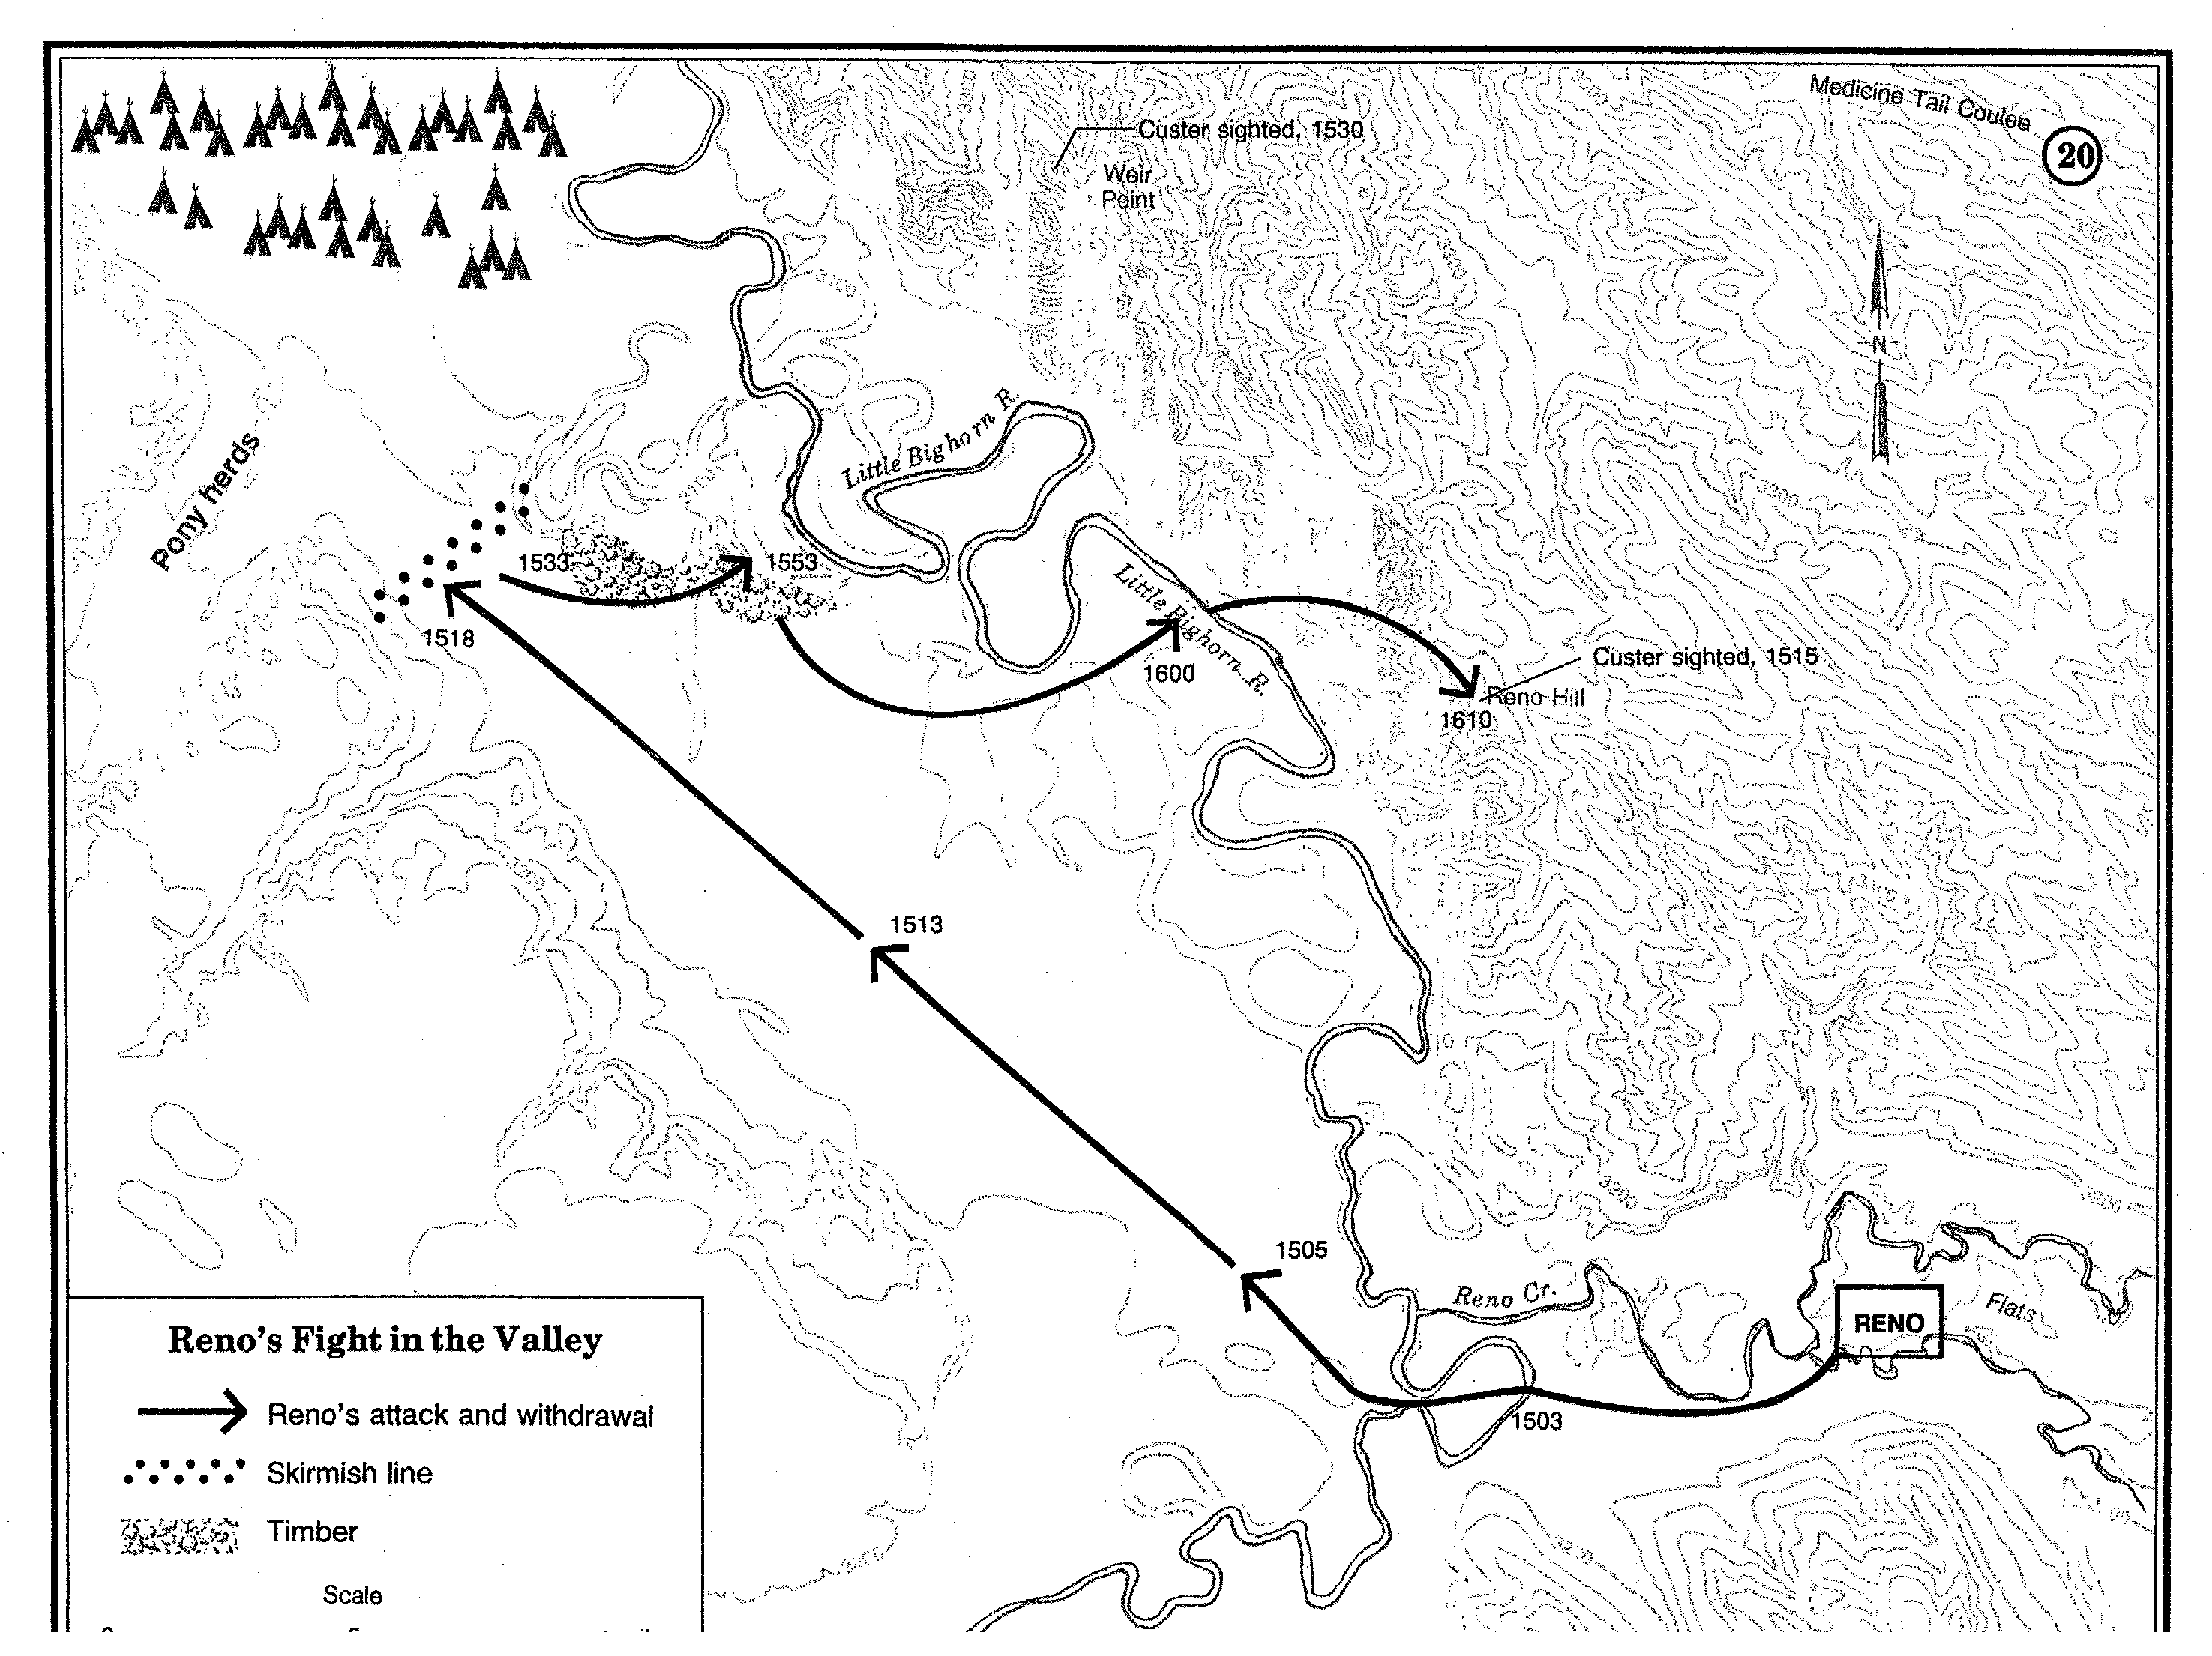

Slide 26
15:33: Reno withdrew the battalion into the timber.
15:34: Trumpeter John Martin left Custer’s battalion at the bend of Cedar Coulee for Benteen.
15:53: Reno ‘s battalion began its retreat upstream.
15:56: Custer’s battalion started down Medicine Tail Coulee.
16:06: Benteen’s battalion saw Reno’s retreat at the knoll and halted.

Slide 27
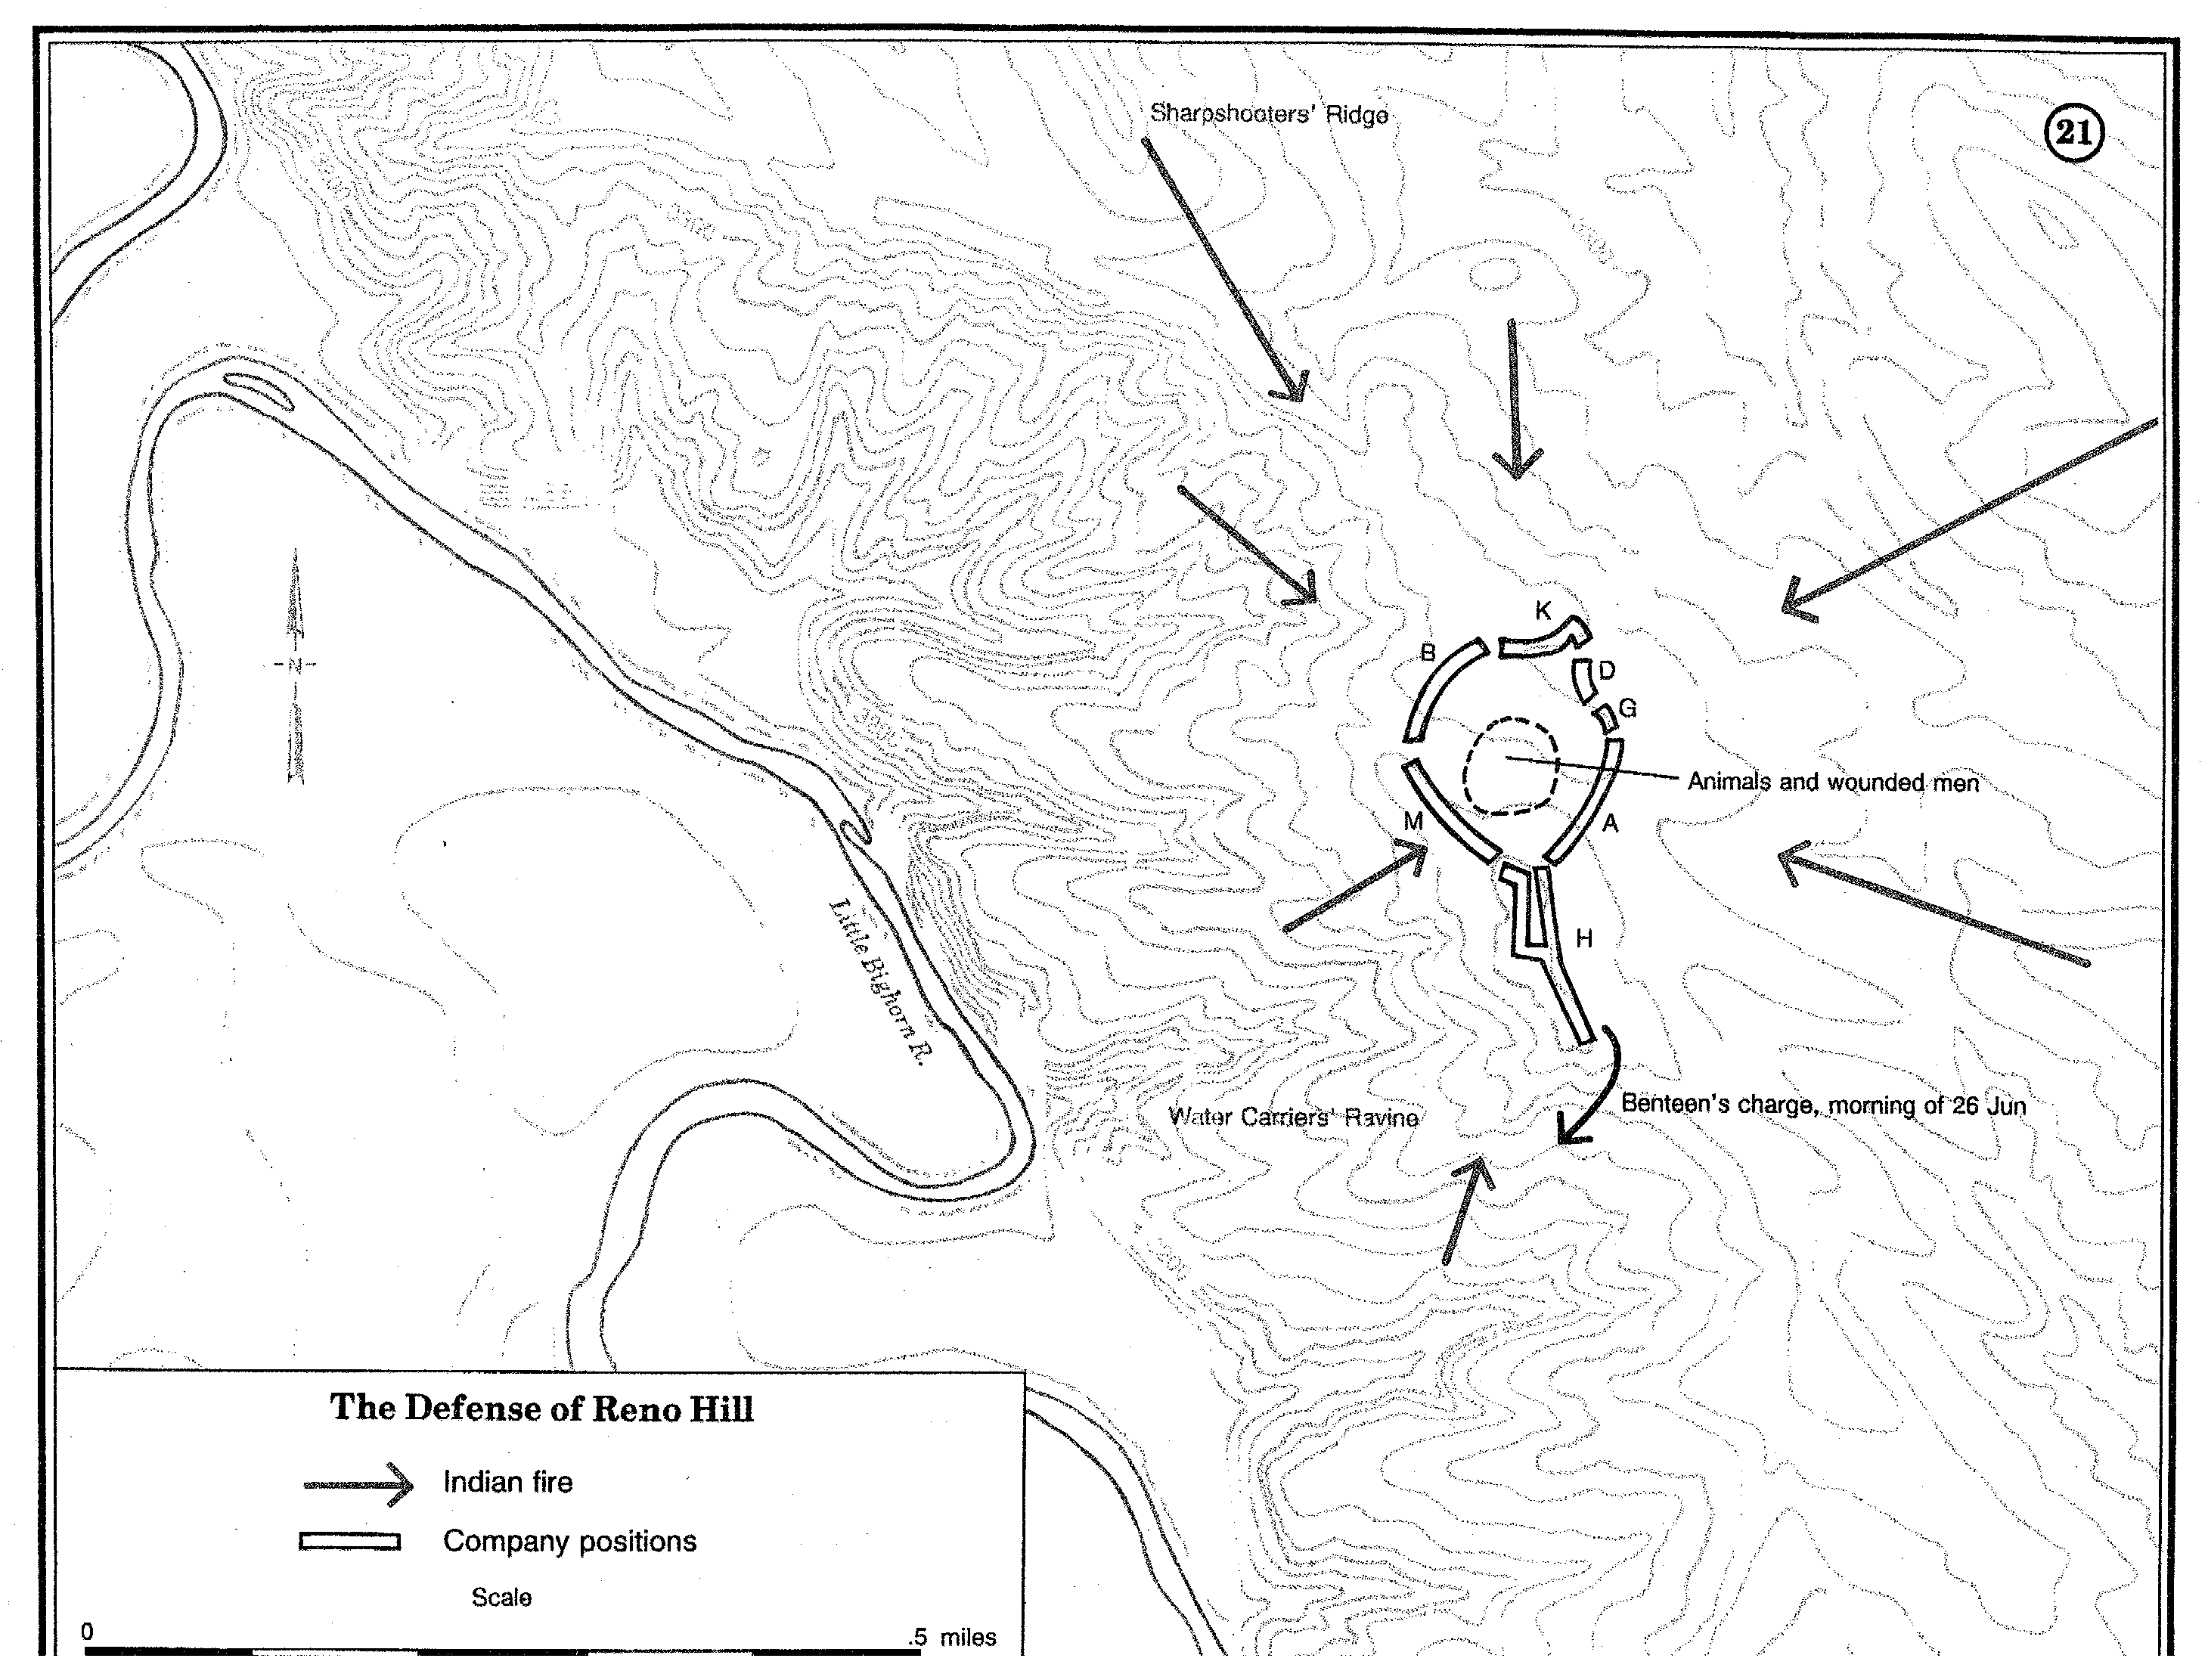

Slide 28
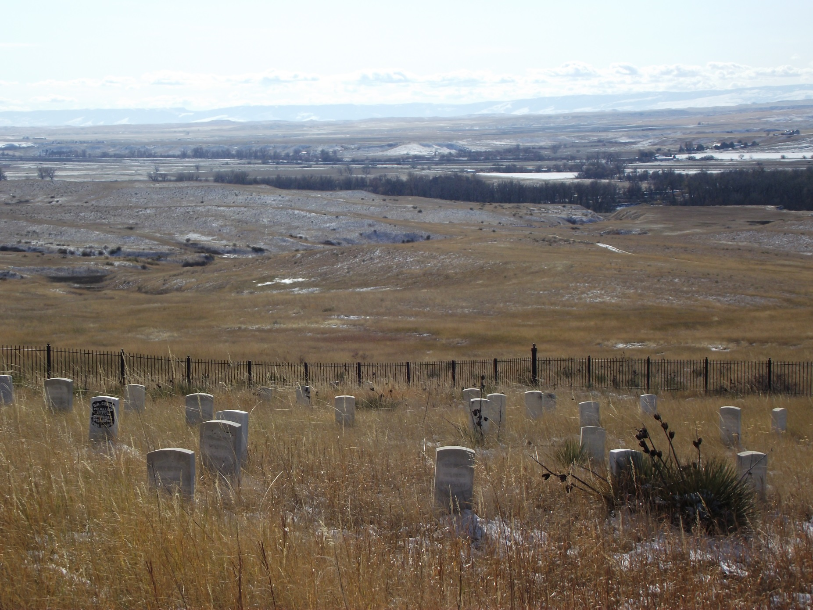
To the north

Slide 29
16:08: Yates’ battalion (Companies F and E, off-trail) left the separation halt down Medicine Tail Coulee. Custer’s battalion (Companies C, I, and L) left the separation halt north out of Medicine Tail Coulee.
16:20: Benteen’s battalion reached Reno Hill and joined Reno’s battalion.
16:25: Custer’s battalion pinned down the Sioux with heaving firing.
17.10-12: Custer’s last heavy firing was heard on Reno Hill.

Slide 30
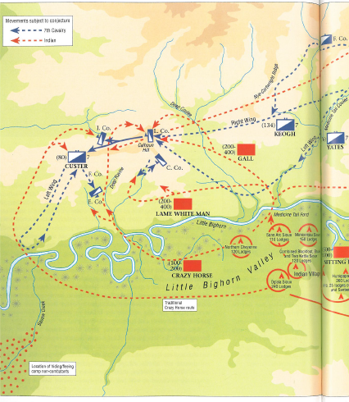
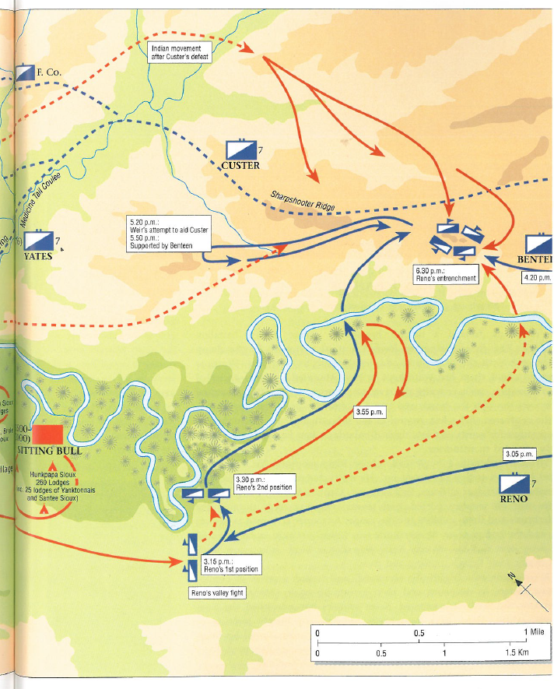

Slide 31
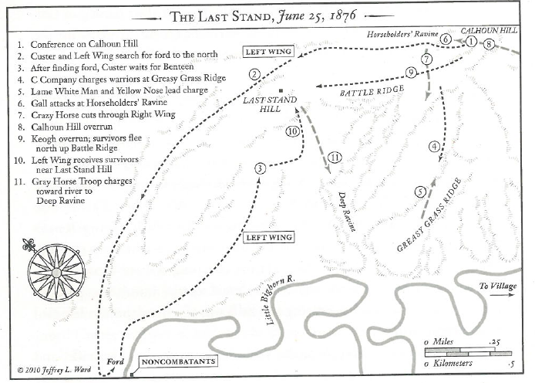

Slide 32
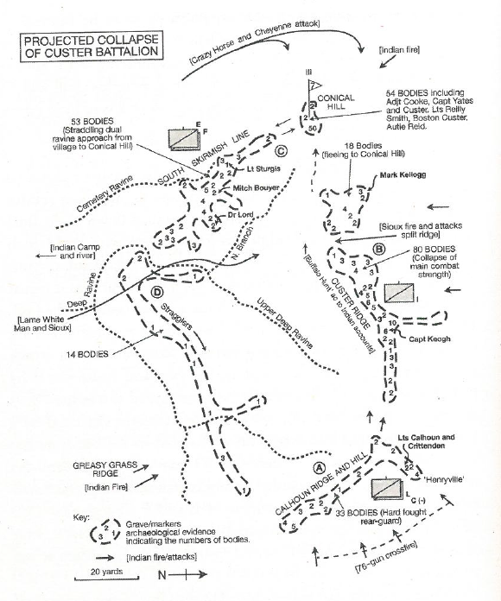

Slide 33
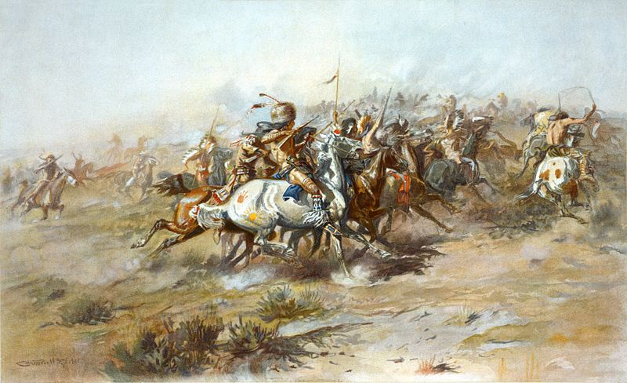
Charles Marion Russell - The Custer Fight (1903)

Slide 34
Evidence from the Battlefield
Archaeological investigations have used physical evidence, artefacts, to interpret specific elements of the battle. In turn, the archaeological studies spurred historians and other researches to re-evaluate the documentary record, Native American oral tradition, and ethnohistorical accounts.

Slide 35
The archaeological evidence from the spread of bullets suggests the ‘Last Stand’
was more like a running fight rather than a pitched battle at a series of discrete
locations.
Indian accounts are typically personal statements of what individuals did in
the battle, by contrast the white perspective treats the battle as a whole. The
consequence is that the narratives rarely match

Slide 36
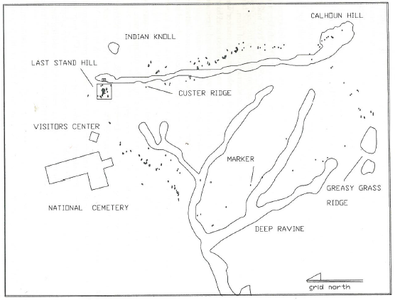
Location of markers as they appear today
Mitch
Boyer

Slide 37
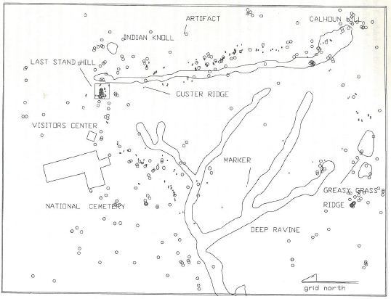
Distribution of army related artefacts

Slide 38
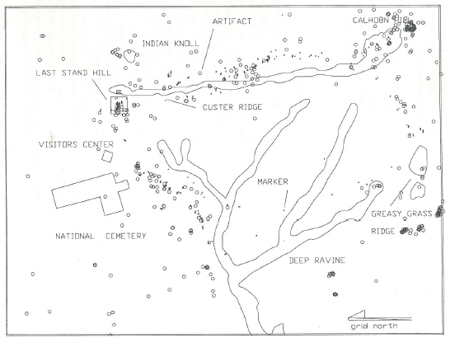
Distribution of Indian related artefacts

Slide 39
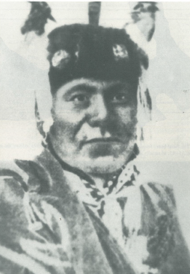
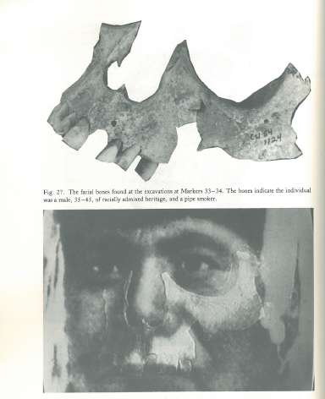
Mitch Boyer (markers 33/34)
Excavation in 1983 revealed a rubber button and a
mother-of-pearl type button – non-regulation issue.
Bones were of a 35-35 yr old, teeth show pipe smoker.
Facial bones indicate mixed race

Slide 40
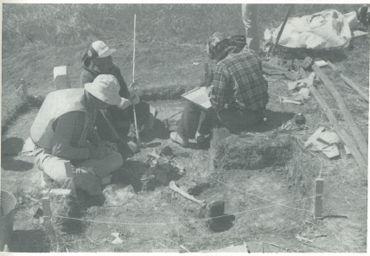
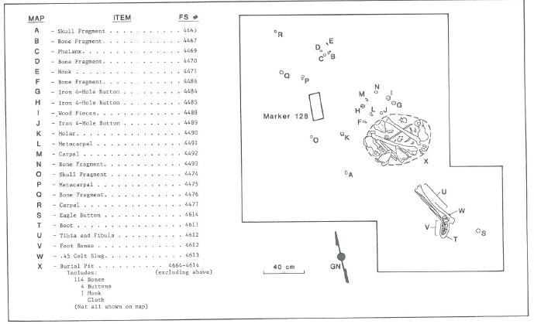
Excavation at marker 128

Slide 41
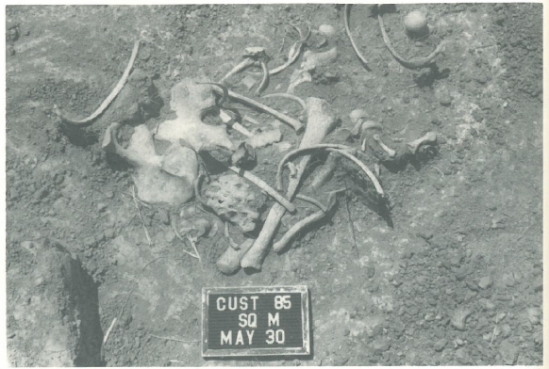
Jumbled bones at marker 128, early complete skeleton minus skull

Slide 42
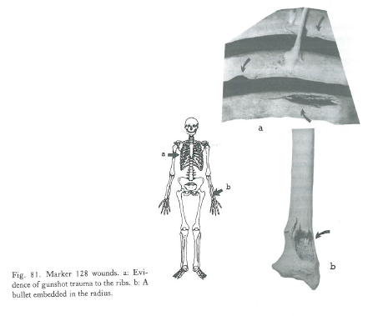
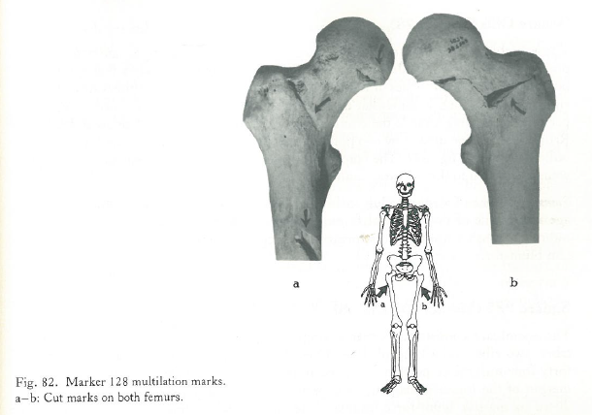
The bones show 19-22 yr old
Two gunshot wounds to ribs
One leg was still in position, other bones were
jumbled therefore body reburied
Body buried in uniform as buttons present,
plus boot on foot
Both femora have cut marks
Cut mark on clavicle
Skull fragments show forceful blow to
head
This body has been mutilated

Slide 43
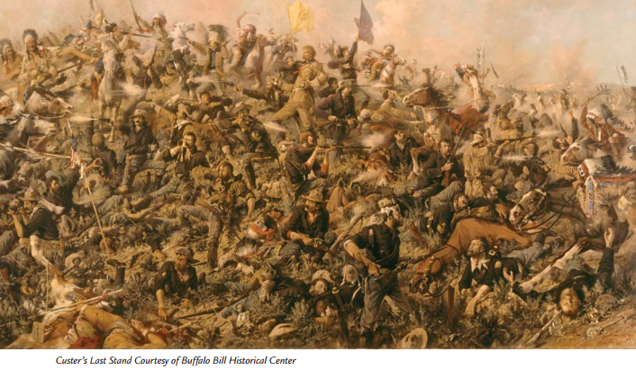
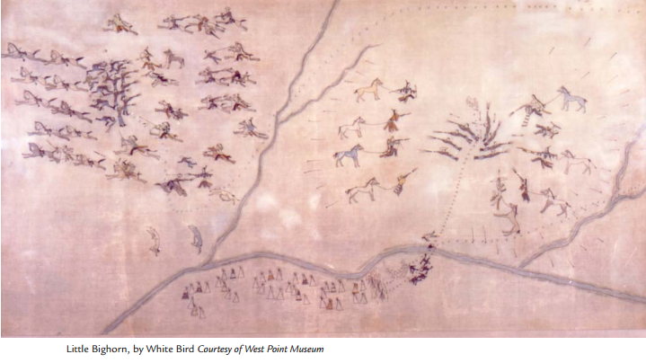
Alternative views of the battle

Slide 44
A survey of the disastrous battle-ground disclosed a dreadful slaughter. Two hundred and seven men were buried in one place, and the total number of killed is estimated at three hundred and fifteen, including seventeen commissioned officers. The bodies of the dead were terribly mutilated. The Indians are supposed to have numbered from 2500 to 4000, and all the courage and skill displayed by our troops was of no avail against such overwhelming odds…
From Harper’s Weekly, July 22, 1876, 598
The fate of the brave and gallant Custer has deeply touched the public heart, which sees only a
fearless soldier leading a charge against an ambushed foe, and falling at the head of his men and in the thick of the fray. A monument is proposed, and subscriptions have been made. But a truer monument, more enduring than brass or marble, would be an Indian policy intelligent, moral, and efficient. Custer would not have fallen in vain if such a policy should be the result of his death. It is a permanent accusation of our humanity and ability that over the Canadian line the relations between Indians and whites are so tranquil, while upon our side they are summed up in perpetual treachery, waste, and war…
From Harper’s Weekly, August 5, 1876, 630

Slide 45
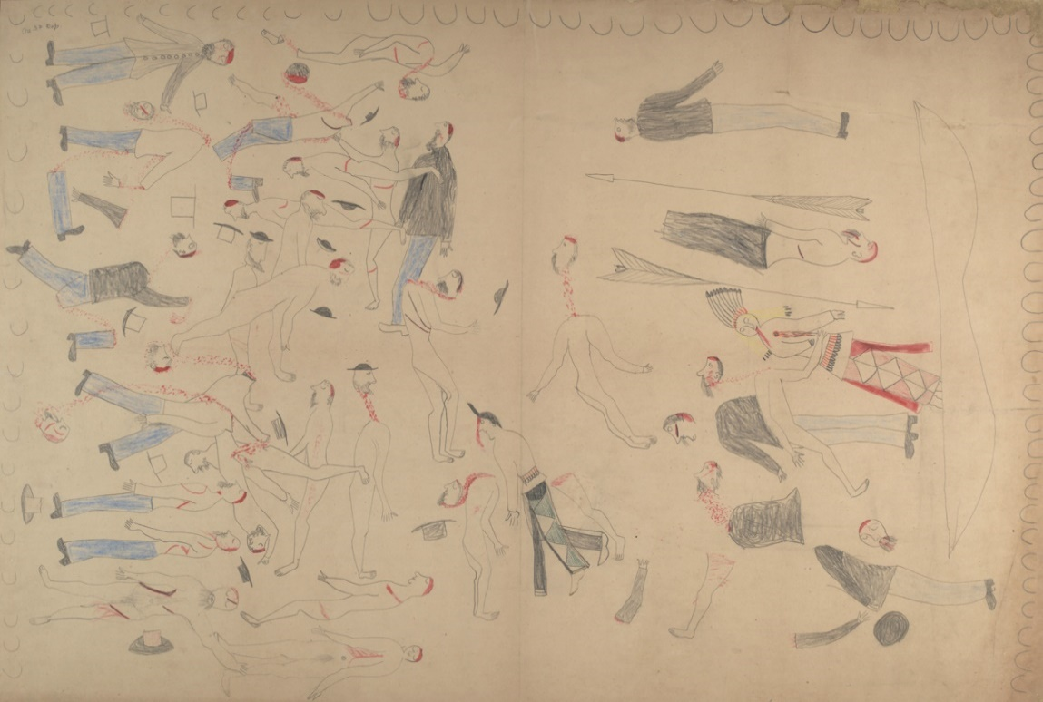
NATIVE AMERICAN SOURCES Lakota Account.
“The soldiers charged the Sioux camp about noon. The soldiers were divided, one party charging right into the camp. After driving these soldiers across the river, the Sioux charged the different soldiers [i.e., Custer's] below, and drive them in confusion; these soldiers became foolish, many throwing away their guns and raising their hands, saying, "Sioux, pity us; take us prisoners." The Sioux did not take a single soldier prisoner, but killed all of them; none were left alive for even a few minutes

Slide 46
The Indians made such short work of killing them that no man could give any
correct account of it. The first charge the Indians made never slacked up or stopped.
They made a finish of it. The Indians and the whites were so mixed up you could
hardly tell anything about it
Hump, 1881
The defeat of Custer was not a massacre. The Indians were being pursued by skilled
fighters with orders to kill. For centuries they had been hounded from the Atlantic to
the Pacific and back again. They had their wives and little ones to protect and
they were fighting for their existence
William Cody, 1885

Slide 47
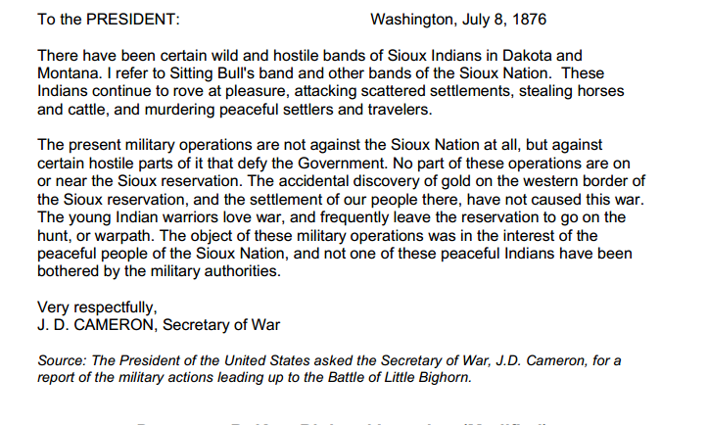

Slide 48
https://www.youtube.com/watch?v=60yLVrhksWk
https://www.youtube.com/watch?v=TEGC0MvVukc&feature=youtu.be

Slide 49
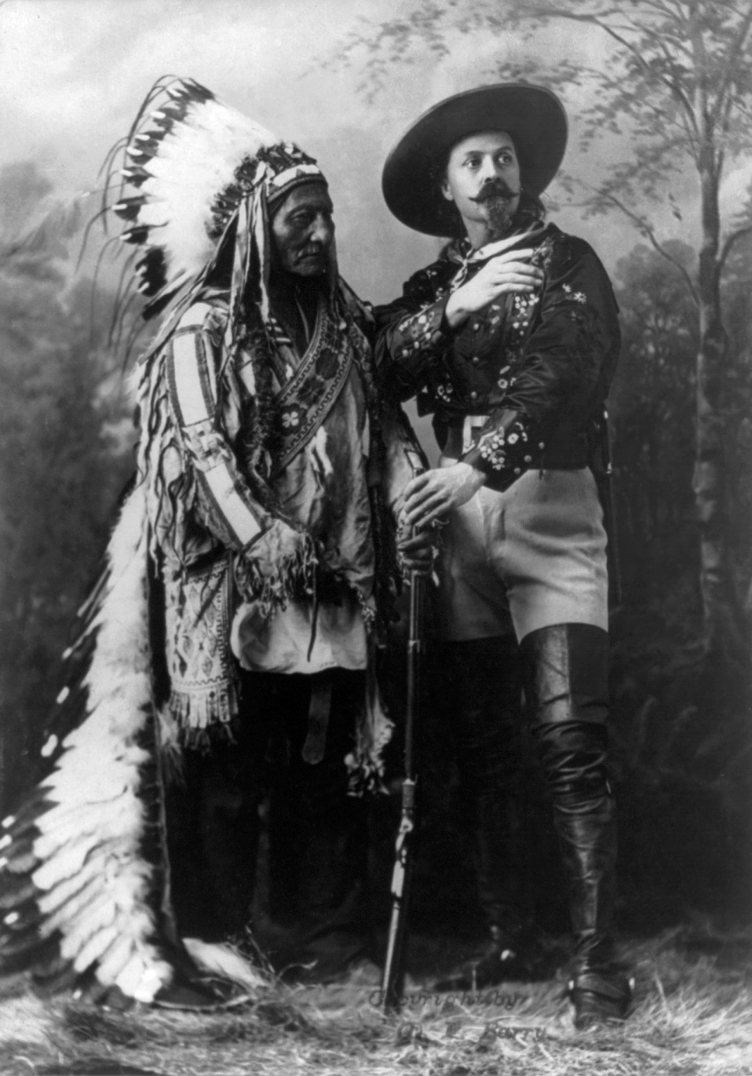
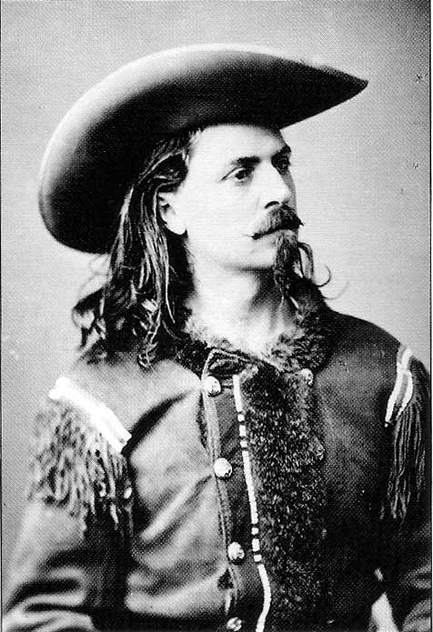

Slide 50
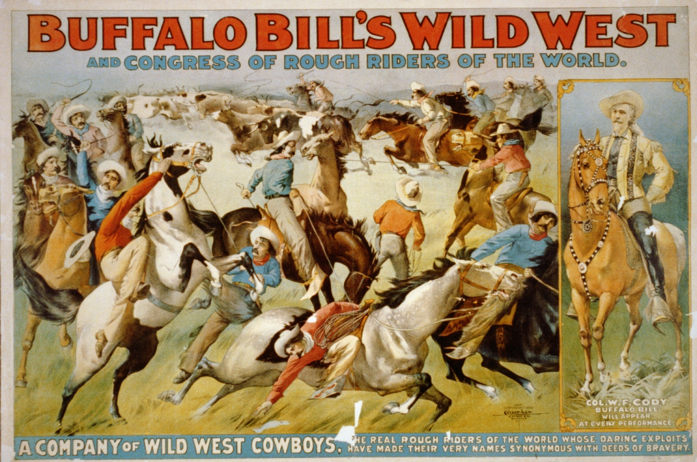

Slide 51

The U.S. government seized the Black Hills land in 1877.
More than a century later, the Sioux nation won a victory in court. On June 30, 1980,
in United States v. Sioux Nation of Indians the United States Supreme Court upheld an
award of $15.5 million for the market value of the land in 1877, along with 103 years
worth of interest at 5 percent, for an additional $105 million.

Slide 52

Today the ramifications of the Plains Indian wars continue
This is an overview of who NoDAPL are and why they exist:
http://www.euronews.com/2016/11/22/what-is-the-dakota-access-pipeline-and-who-are-nodapl
This is NoDAPL:
https://nodaplsolidarity.org/
This is DAPL (Dakota Access Pipeline):
http://www.daplpipelinefacts.com/
They are commonly known as Standing Rock:
http://standingrock.org/history/
Standing Rock and Little Bighorn:
http://www.npr.org/sections/codeswitch/2016/11/22/502068751/the-standing-rock-resistance-is-unprecedented-it-s-also-centuries-old
Example of news coverage:
https://www.theguardian.com/us-news/2016/nov/29/standing-rock-protest-north-dakota-shutdown-evacuation
http://www.nytimes.com/2016/11/26/us/dakota-pipeline-protest.html
Social media:
#NoDAPL #Waterislife

Slide 53
Panzeri, P. 1995 Little Bighorn 1876. Custer’s last stand. Campaign Series 39. Osprey
Publishing: Oxford.
Scott, D.D., Fox, R.A., Connor, M.A. and Harmon, D. 1989 Archaeological perspectives
on the Battle of the Little Bighorn. University of Oklahoma Press: Norman.
Scott, D.D. Willey, P and Connor, M.A. 1998 They died with Custer. Soldiers’ Bones
from the Battle of the Little Bighorn. Univeristy of Oklahoma Press: Norman.
https://www.youtube.com/watch?v=kPRB990wcR8
https://www.youtube.com/watch?v=60yLVrhksWk
https://www.youtube.com/watch?v=TEGC0MvVukc&feature=youtu.be
Custer’s Last Stand Selig Polyscope Company 1909 B&W (Lost Film)
They Died with Their Boots On Warner 1941 B&W
Custer of the West. 1967 movie with Robert Shaw
Son of the Morning Star Republic Pictures 1991

