Slide 1
Sins & Virtues
Film & Television Production 1 & 2
Semester 2 | Block 4

Slide 2
Film & Television Production1
(MX401799)
Assignment Task 1 [40%] (Learning outcomes 1,2 and 3 that contributes 40% of the module’s final grade)
The production portfolio must include a selection of;
filmed exercises
scripted scenes
internal location filming
external location filming
Cinematic techniques
Development of work through comparison of earlier filmed exercises and/or scenes.
Emulation
of Good Practice
Assignment Task2 [60%] (Learning outcome 3 that contributes 60% of the module’s final grade)
The written component to this assignment requires a Vlog (plus a script) detailing the work undertaken throughout the module. In your written responses, please answer the following questions;
To what extent how you followed the rules of film practice?
Describe your use of the following elements of production
  Art direction
  Cinematic space
  Cinematic Time
  Psychology of the shot
Module at a Glance

Slide 3
Film & Television Production2
(MX501800)
Assignment Task 1 (Practical) 50% - 5 Minute Production Portfolio
For the production component of your assignment you are required to produce a 5 minute portfolio of short production studies that demonstrate your understanding of each of the following production conventions in relation to your chosen genre.
Plot/ Narrative
Cinematography – Framing and Composition/ Camera Movement/ Lighting
Editing Techniques
Mise en Scene
Directing Acting and Performance
Experimentation
with the form
Assignment Task 2 (Written) 50% - 5 Minute Visual Essay
The presentation component of this assignment requires a five minute individual visual essay that defends and articulate aesthetic choices you made in your portfolio of ‘genre studies’ and overall filmmaking process.
Module at a Glance

Slide 4
Block 4
Schedule Overview
Week 1 – Research & Development
(Feb 3rd – Feb 10th)
Week 2 - Testing and Production
Feb 10th- Feb 17th)
Week 3 – Post and Portfolios
Feb 17th - Feb 21st
Submission Deadline
Friday 21st February 2020

Slide 5
Block 4
Schedule Overview
Monday – Lectures/Study Groups
Tuesday – Level 4 Workshops
Thursday – Level 5 Workshops
Friday – Lectures/Location Studies
Submission Deadline
Friday 21st February 2020

Slide 6
Block 4
Schedule Overview
Day One – Aims and Objectives
Morning -
Overview of Modules/Assignment Briefs
Genre Codes and Conventions (Nordic Noir)
Sins & Virtues (Character)
Story – Myths & Fairy Tales (Story Archetypes)
Afternoon –
Workshop – Story/Character Development
Sins & Virtues
Film & Television Production 1 & 2

Slide 7

Nordic Noir
Genre Focus
Establishing Codes and Conventions
For Aesthetics and Narrative Form

Slide 8


Slide 9
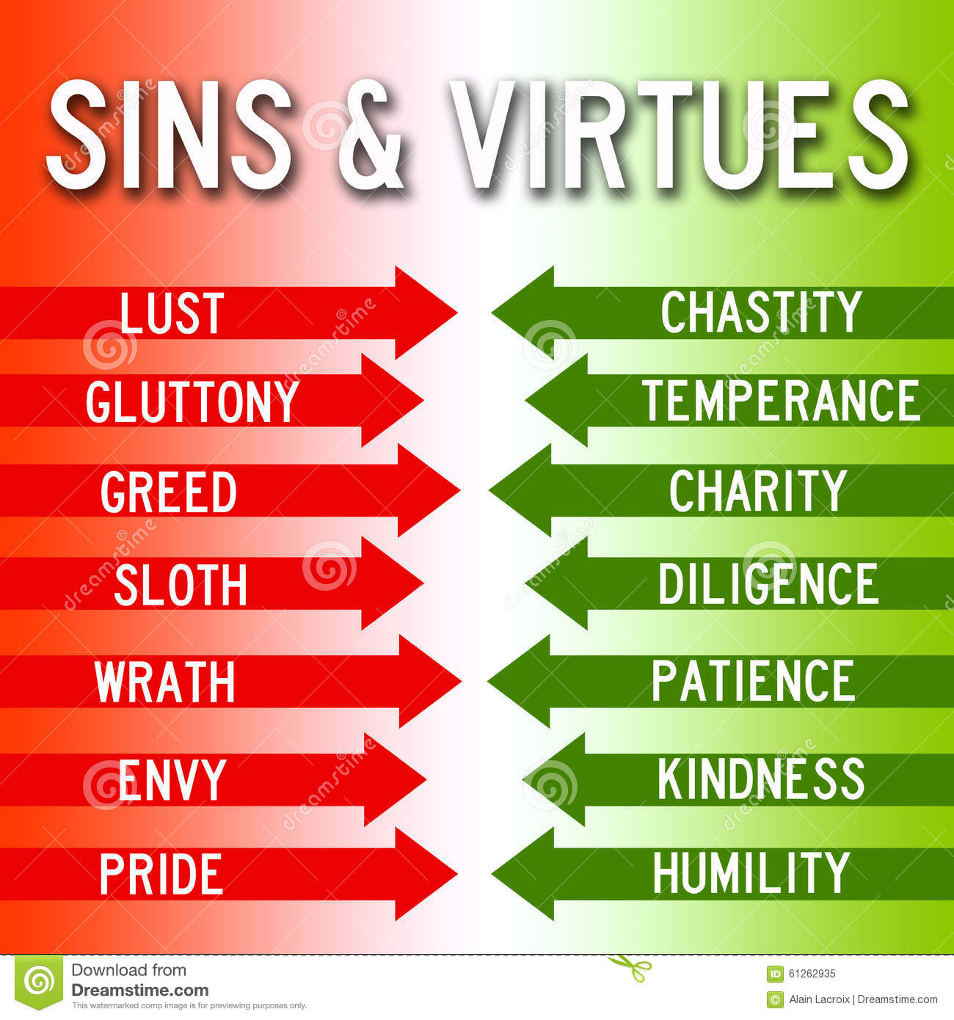
Sins &Virtues

