Slide 1

The Deepening Mental Health Crisis in the Hospitality Industry
Student Name :Iulia Ferent
Student ID: 2225255
BMIH6001
Lecturer: Natalie Brailsford

Slide 2
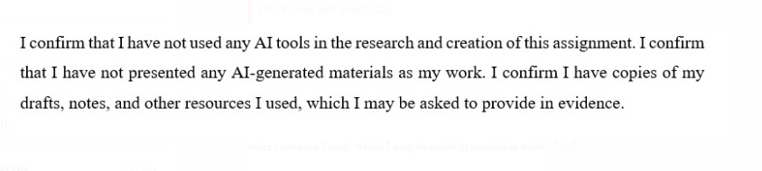
Declaration

Slide 3

Introduction
Mental health is a significant crises in the UK hospitality sector (Zientara et al., 2024).
The where employees are provided with long working hours.
There is a higher stress and an emotional labour management system (Ford & Sturman, 2020).
The hospitality industry in the UK offers a wider part to develop the UK economy (Wong et al., 2025).
There are limitations of employees for the support from the industry.
Notes:
Mental health is one of the rising crises emerging in the UK hospitality sector, where employees are provided with long working hours, higher stress, and an emotional labour management system. The hospitality industry in the UK offers a wider part to develop the UK economy, which remains characterised by the implication of intense pressures and definite challenges. There are some options for growing awareness, related stigma and the silent vision for mental health persistence, and limitations of employees while seeking much-needed support from the industry.

Slide 4

Overview
The presentation defines mental health conditions of employees in the UK.
There are highly relevant actions in the hospitality industry (Ueno et al., 2025).
It appears that applying relevant features to the workforce management.
The sector faces staff burnout and higher rates of turnover.
The understanding offers awareness of the urgency for hospitality leaders.
The systemic industry stressors as an effective reform.
Notes:
The presentation identified the changes in the mental health of employees in the UK, which seems highly relevant to the services in the hospitality industry. It appears that applying relevant features to the workforce management and data is. The sector is associated with hotels, restaurants, bars, and pubs, while facing staff burnout and higher rates of turnover. The understanding offers awareness of the urgency for hospitality leaders to maintain mental health within the sector. It seems that reflecting on the systemic industry stressors is considered an effective reform.

Slide 5

The Concept of Mental Health
The mental health is based on workplace stress, emotional labour, burnout, and stigma.
There are higher emotional demands for maintaining efficiency in customer satisfaction.
The Job Demand-Control model is practical in determining the imbalances in demand (Zientara et al., 2024).
It is also applied to learn about the control management.
There is increases mental health strain in the workforce due to inefficient management (Akerstrom et al., 2021).
Notes:
The practical mental health concepts which seem to influence the hospitality sector are associated with workplace stress, increasing value of emotional labour, efficiency in burnout, and an increase in stigma. There are higher emotional demands for maintaining efficiency in customer satisfaction while contributing to exhaustion. It seems that stigma is associated with the prevention of open discussion. The application of theories, such as the Job Demand-Control model, is practical in determining the imbalances in demand. It is also applied to learn about the control management, which increases mental health strain in the workforce.

Slide 6

Workplace Social Support Theory
The Workplace social support theory defines development of the supportive working environments (Jolly et al., 2020).
It mitigates the risks and challenges that emerged in the mental health conditions of the employees.
There are some irregular shifts in the hospitality industry.
There is lower job security and differences in customer abuse that leads towards stress (Giousmpasoglou, 2024).
Some workplace faces anxiety, depression, and fatigue.
Notes:
The application of the workplace social support theory is associated with the underscore development of the importance of supportive working environments. It seems that in mitigating the risks and challenges that emerged in the mental health conditions of the employees working in the hotels. Therefore, there are some irregular shifts in the hospitality industry, lower job security, and differences in customer abuse towards increases in stress. Some workplace factors contribute towards the increases in anxiety, rates of depression, and fatigue among hospitality employees in the UK.

Slide 7

Mental Health Issues in the UK
There is a significant prevalence of mental health issues in the UK.
The year 2024 estimated almost 75% of hospitality workers with mental health in the UK (Reuschke et al., 2024).
There is a dual impact of COVID-19 with effective cost-of-living crises.
There are some intensified challenges to address the ongoing vulnerability
Notes:
There is a significant prevalence of mental health issues in the UK, which is faced by a larger number of employees working in the hotel industry. It is estimated that in the year 2024, almost 75% of hospitality workers have reported difficulties and issues regarding mental health, which indicates a need for definite psychological support. There is a dual impact of COVID-19 with effective cost-of-living crises. There are some intensified challenges to address the ongoing vulnerability within the workforce performance.

Slide 8
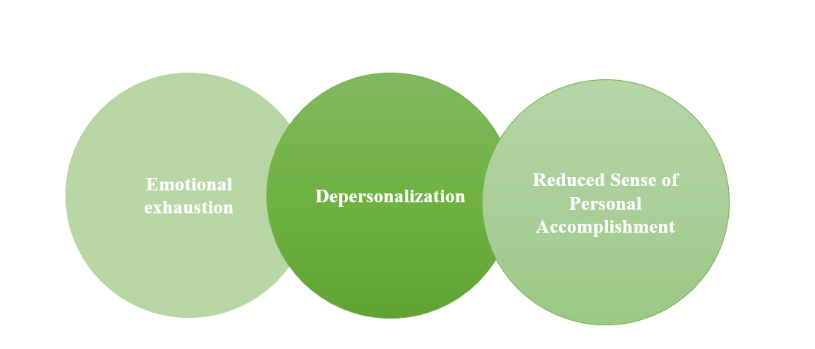
The Burnout Theory
Burnout theory explains the emotional, physical, and mental exhaustion caused by prolonged stress in the workplace (Batabyal & Das, 2019).
Emotional exhaustion, depersonalization, and a reduced sense of personal accomplishment are key components (Baquero et al., 2025.
It is particularly relevant to hospitality due to high stress, long hours, and emotional labor.
Addressing burnout involves reducing workplace stressors and fostering better work-life balance.
Notes:
The burnout theory concerns the long-term implications of occupational stress, especially in service-based sectors such as hospitality (Batabyal & Das, 2019). The symptoms of the uninterrupted stress without reprieve are emotional tiredness, depersonalisation, and low self-achievement. The burnout problem is quite common in the hospitality business as the working hours are frequently taxing, the customers are frequently pressing, and emotional labour is also causing the turnover rate to be high (Baquero et al., 2025). These issues need to be addressed by modifying the system level, such as reducing the stressors and enhancing the work-life balance of the employees. The theory focuses on support systems in organisations to reduce burnout and maximise employee welfare in the hospitality industry.

Slide 9

The Challenges in the UK Hospitality Sector
High levels of stress and emotional labor are common in the UK hospitality industry.
Staff turnover rates are high, leading to operational challenges (Kotera et al., 2020).
The COVID-19 pandemic has exacerbated existing mental health issues.
Mental health support structures are often inadequate in the sector (Cooper & Hall, 2019).
There is a growing stigma around mental health, preventing open discussions.
Notes:
The hospitality industry in UK is faced with problems especially in the area of mental health. The stress level and emotional nature of work in the industry are typical and lead to burnout and high turnover rates. COVID-19 has contributed to mental health issues and is the factor that has left a number of employees without hope and support (Kotera et al., 2020). Unfortunately, the mental health facilities in the industry are substandard in the majority of instances and majority of the workers are powerless enough to seek help due to the stigma attached to the discussion of mental health. To solve these problems, the industry should offer more support networks and de-stigmatise the employees who cannot find help and support (Cooper & Hall, 2019).

Slide 10

The Challenges in the UK Hospitality Sector (continued)
Hospitality workers are often exposed to physical and emotional exhaustion (Tribe, 2009).
Long working hours and irregular shifts affect mental well-being.
Job insecurity and low wages add additional stress to employees (Amissah et al., 2021).
Customer abuse and demanding behavior contribute to staff burnout.
Notes:
Employee physical and emotional exhaustion is still a problem within the hospitality sector. The abnormal rotations, extended working hours and job insecurity cause stress and mental health issues (Tribe, 2009). In addition, customer abuse, which may include verbal aggressiveness and unreasonable demands, is another factor that leads to burnout among hospitality employees. Poor wages are some of the financial stressors that lead to a cycle of dissatisfaction, which influences the welfare of the employees (Amissah et al., 2021). Although mental health problems are slowly coming to light, most of the workers have not been supported or provided with sufficient resources to counter these problems, creating a massive gap in care in the sector.

Slide 11

Political and Economic Factors
Government policies on labor rights and workplace mental health need to be enforced more rigorously.
Economic pressures, such as inflation and the cost-of-living crisis, add stress to workers (Arjona-Fuentes et al., 2022).
A lack of financial support for mental health services in the hospitality sector.
Rising operational costs put additional pressure on employers, limiting their ability to offer support.
Notes:
Political and economic factors are playing a central role in the worsening of the mental health crisis in the hospitality industry. Labour rights and mental policy are there, but are not usually put into practice to the extent required. The economic pressures on employees, including the cost-of-living crisis and inflation, add to their mental health problems (Arjona-Fuentes et al., 2022). Although the issue of mental health is increasingly being recognised, the mental health services lack massive funding in the sector. Employees are also unable to access union representation, particularly on matters that concern mental health, and thus are left without the necessary support, which makes they prone to exploitation and stress.

Slide 12

Social and Technological Factors
Social factors, such as workplace culture, can either support or hinder mental health (Filep et al., 2023).
Technological advancements can either alleviate or worsen stress in the hospitality industry.
Social media pressure adds stress to hospitality employees, especially in the public eye (Costa & Costa, 2022).
Digital tools can help with workload management but can also lead to burnout.
Notes:
The social and technological aspects are influential in creating mental health in the hospitality industry. The type of culture at the workplace, be it favourable or unhealthy, directly influences the mental state of employees. On the one hand, technology is useful in reducing workload using digital tools. Still, on the other hand, it may also cause burnout when employees are supposed to be always connected (Filep et al., 2023). The emergence of social media puts an added strain, especially on those in the front line, as hospitality workers are usually criticised and scrutinised on social media (Costa & Costa, 2022). The workplace is a social environment that contributes to mental health and alleviates the adverse effects of stress through a healthy social environment.

Slide 13

Legal and Environmental Factors
Labor laws need to prioritize mental health support for hospitality workers (King et al., 2024).
There is an increasing need for legal regulations on working hours and breaks.
Environmental factors like workspace conditions also contribute to employee stress.
The rise in sustainability practices could indirectly impact mental health if overburdened.
Notes:
Legal and environmental factors highly influence mental health in the hospitality industry. Although labour legislation offers some legal safeguards in the UK, more legal provisions should be established to directly address mental health assistance. Employees are prone to working odd hours and do not have enough rest time, hence the high degree of stress (King et al., 2024). The environment and work conditions also play a role, and a poorly designed space increases stress. The increased pressure on employees could cause their stress levels to increase as sustainability becomes an even greater concern in the industry. There is a need for more robust legal provisions so that employers can be held accountable for offering quality mental health programs to their employees.

Slide 14

Industry Responses
Several hospitality organizations have started to implement mental health programs (Sharma et al., 2024).
Employee assistance programs (EAPs) are being introduced to offer support (Langlieb et al., 2022).
Training for managers is being rolled out to recognize mental health issues in staff.
Some companies are offering flexible working hours to reduce stress.
Mental health-first aid training is being introduced to enhance workplace awareness.
Notes:
Due to the increasing mental health crisis, some hospitality organisations have started to initiate mental health support programs (Sharma et al., 2024). Government offices are also introducing Employee Assistance Programs (EAPs), which offer confidential support to the staff facing stress and anxiety, among other mental conditions. In addition, it is possible to find numerous training programs in which managers can be trained to identify mental health problems in employees and provide assistance (Langlieb et al., 2022). Flexible work hours and shifts are also being provided to minimise stress levels, and mental health first aid training also contributes to creating awareness of mental health in the workplace. All those efforts are in the right direction, but there should be a change at the industry level.

Slide 15
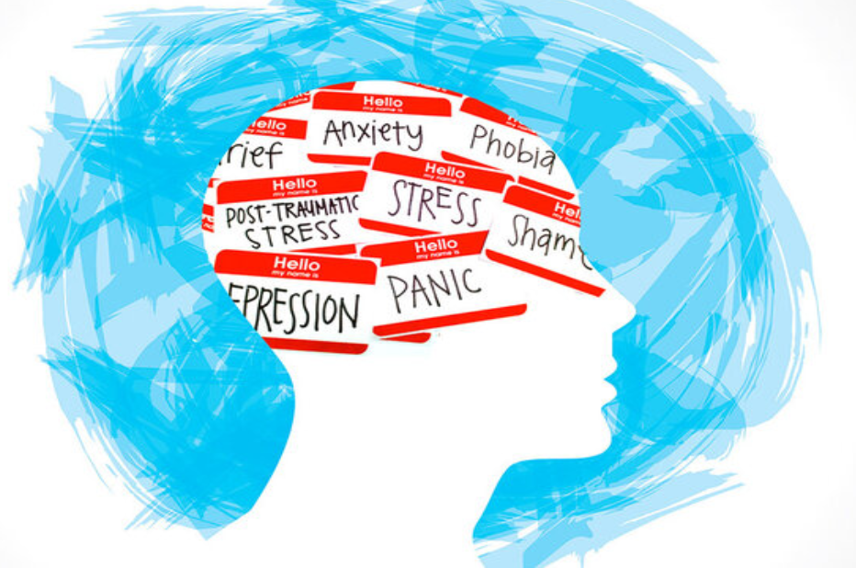
Critical Reflection
Mental health challenges in the UK hospitality industry have been underappreciated for too long.
Despite growing awareness, stigma remains a significant barrier to accessing support.
Many organizations have started addressing mental health but lack comprehensive long-term strategies.
There is a need for industry-wide cultural change to support mental well-being.
Mental health awareness must be integrated into both training and operational frameworks.
Notes:
Critical reflection of the current scenario in the mental health field within the UK hospitality industry implies that the issue, notwithstanding the burst of awareness, has not been taken seriously. Stigma remains one of the biggest impediments to encouraging most workers to seek assistance. In cases where some companies have achieved the task of ensuring the consideration of mental health, in most cases, they have failed to introduce long-term, sustainable strategies. The long-term orientation cannot be accomplished easily because the short-term orientation on action is a fast approach rather than a long-term orientation. It must be possible to change the cultural approach in the industry, as it would completely enable the accommodation of mental health in the industry. Employee education, business models and organisational cultures should be altered to create a healthy and sustainable working environment among all employees.

Slide 16

Conclusion
Mental health remains a critical issue in the UK hospitality sector.
The industry has recognized the problem but has not yet fully addressed it.
Employee mental health impacts not only staff but also operational efficiency.
A holistic approach involving employers, government, and employees is essential.
Ongoing efforts to reduce stigma and improve support systems must be prioritized.
Notes:
In conclusion, mental health is a highly critical issue concerning the UK hospitality industry that continues to bother it. Even though the problem is gradually finding implementation, the industry is not addressing it on a large scale. The psychological health of workers directly affects the productivity of operations, employee retention, and service quality. Thus, a comprehensive strategy must be adopted where a partnership between the employers, the government, and the employees is involved. The reduction of stigma, offer of multi-dimensional mental health services, and development of a supportive and sustainable workplace environment should be focused on long-term enhancement of the industry.

Slide 17

Recommendations
Hospitality organizations should implement mandatory mental health training for all staff.
Employers should establish clear mental health policies and integrate them into workplace culture (Ford, 2020).
Mental health-first aid training should be made available to all employees.
Flexible working hours should be considered as a standard policy to alleviate stress.
Government regulations should enforce better mental health support for hospitality workers.
Notes:
In ensuring that the mental health of workers in the hospitality industry is enhanced, a few recommendations are possible. All employees should be made aware of stress and mental health problems by enacting mandatory mental health training, to provide employees with the tools to cope with such problems. Employers must create and blend clear mental health policies within the workplace culture, and mental health must be a priority. It will also be possible to provide the environment for mental health-first-aid training (Ford, 2020). Flexibility of working hours will also ease the stressor since employees will have more time to balance work and personal lives. Lastly, the government policies should promote improved mental health services to protect workers and hold responsible players in the sector.

Slide 18
References
Amissah, E.F., Blankson-Stiles-Ocran, S. and Mensah, I. (2021). Emotional labour, emotional exhaustion and job satisfaction in the hospitality industry. Journal of Hospitality and Tourism Insights, 5(5).
Arjona-Fuentes, J.M., Radic, A., Ariza-Montes, A., Han, H. and Law, R. (2022). Fear and poor mental health among workers during the global cruise tourism crisis: Impact of low employability and family support. International Journal of Hospitality Management, 106, p.103276.
Baquero, A., Khairy, H.A. and Al-Romeedy, B.S. (2025). Workplace Stressors and the Intention to Quit: The Role of Psychological Distress and Psychological Flexibility Among Hospitality Employees. Tourism and Hospitality, 6(2), p.72.
Batabyal, D. & Das, D.K. (eds.), 2019. Global trends, practices, and challenges in contemporary tourism and hospitality management. Hershey, Pennsylvania: Business Science Reference, an imprint of IGI Global.
Cooper, C. & Hall, M., 2019. Contemporary Tourism: An International Approach (4th edn). Goodfellows, Oxford.
Costa, V. & Costa, C. (eds.), 2022. Sustainability and competitiveness in the hospitality industry. Hershey, Pennsylvania: Business Science Reference.
Filep, S., Kondja, A., Wong, C.C., Weber, K., Moyle, B.D. and Liubov Skavronskaya (2023). The role of technology in users’ wellbeing: Conceptualizing digital wellbeing in hospitality and future research directions. Journal of Hospitality Marketing & Management, pp.1–19.
Ford, R.C. & Sturman, M.C., 2020. Managing Hospitality Organizations (2nd edn). Sage, London.
Giousmpasoglou, C., (2024). Working conditions in the hospitality industry: the case for a fair and decent work agenda. Sustainability, 16(19), p.8428.
King, A., Kim, S., Gamor, E., Mehmet Ali Köseoğlu and Yao, Y. (2024). EXPRESS: Advancing employees’ mental health and psychological wellbeing research in hospitality and tourism: Systematic review, critical reflections, and future prospects. Journal of Hospitality & Tourism Research.

Slide 19
References
Kotera, Y., Adhikari, P. and Sheffield, D. (2020). Mental health of UK hospitality workers: shame, self-criticism and self-reassurance. The Service Industries Journal, 41(15-16), pp.1–21.
Langlieb, A.M., Langlieb, M.E. and Xiong, W. (2022). EAP 2.0: reimagining the role of the employee assistance program in the new workplace. International Review of Psychiatry, 33(8), pp.1–12.
Reuschke, D., Houston, D. and Sissons, P., (2024). Impacts of Long COVID on workers: A longitudinal study of employment exit, work hours and mental health in the UK. Plos one, 19(6), p.e0306122.
Sharma, M., Singh, A.K. & Tyagi, P., 2024. Proceedings of the International Conference on Innovation and Regenerative Trends in Tourism and Hospitality Industry (IRTTHI 2024). (1st edn). Dordrecht: Atlantis Press Zeger Karssen.
Tribe, J., 2009. Philosophical issues in Tourism (Aspects of Tourism). Channel View.
Ueno, A., Yu, C., Curtis, L. and Dennis, C., (2025). Job demands-resources theory extended: stress, loneliness, and care responsibilities impacting UK doctoral students’ and academics’ mental health. Studies in Higher Education, 50(4), pp.808-823.
Wong, A.K.F., Kim, S., Gamor, E., Koseoglu, M.A. and Liu, Y., (2025). Advancing employees’ mental health and psychological well-being research in hospitality and tourism: Systematic review, critical reflections, and future prospects. Journal of Hospitality & Tourism Research, 49(5), pp.1014-1031.
Zientara, P., Adamska-Mieruszewska, J. and Bąk, M., (2024). Factors affecting hospitality workers’ intention to leave the industry during the coronavirus pandemic. Evidence from the UK. Journal of Quality Assurance in Hospitality & Tourism, 25(4), pp.874-907.
Akerstrom, M., Corin, L., Severin, J., Jonsdottir, I.H. and Björk, L. (2021). Can Working Conditions and Employees’ Mental Health Be Improved via Job Stress Interventions Designed and Implemented by Line Managers and Human Resources on an Operational Level? International Journal of Environmental Research and Public Health, 18(4), p.1916.
Jolly, P.M., Kong, D.T. and Kim, K.Y. (2020). Social support at work: An integrative review. Journal of Organizational Behavior, 42(2), pp.229–251.

