Slide 1

BMSW4004
Problem Solving and Decision Making
PESTEL ANALYSIS

Slide 2
History of PEST
So where did the term PEST or PESTLE originate?
The term PESTLE has been used regularly in the last 20+ years.
The earliest known reference to the tools and techniques for ‘Scanning the Business Environment’ appears to be by Francis J. Aguilar (1967) who discusses ‘ETPS’ – a prompt for the four sectors of his taxonomy of the environment: Economic, Technical, Political, and Social.

Slide 3
PESTEL Analysis
PESTEL is an acronym - political (P), economic (E), socio-cultural / social (S), technological (T), environmental (E) and legal (L).
The framework is useful for identifying factors that affect an organisation from the outside.
Without such a structure, it would be difficult to know where to start because all organisations are affected by multiple external factors.
It is a used by strategists at a corporate level.

Slide 4
PESTEL Analysis
The technique is used to help identify factors involved in change rather than solutions to any of the factors.
PESTLE analysis is a useful tool for understanding the “big picture” of the environment in which you are operating, and the opportunities and threats that lie within it.
Specifically the PEST or PESTLE analysis is a useful tool for understanding risks associated with market growth or decline, and as such the position, potential and direction for a business or organisation.

Slide 5
PESTEL Analysis
There are several variations on PESTLE Analysis:
PEST: Political, Economic, Sociological, Technological
PESTLIED: Political, economic, sociological, technological, environmental, legal, international, environmental, demographic
STEEPLE: Sociological, technological, environmental, economic, political, legal, ethical

Slide 6
PESTEL Analysis
An important element to the technique is considering all the areas of the technique rather than carefully classifying a factor.
When considering each factor you need to identify what the factor is and what the impact will be on the business/organisation.
PESTLE analysis is often used alongside SWOT analysis to help identify opportunities and threats. See the PESTLE analysis example in the module page

Slide 7
PESTEL Analysis
At the outset, it is important to establish the general nature of the organisational environment.
Is it simple, certain and static?
Or is it complex, uncertain and dynamic?
What about the NHS?

Slide 8
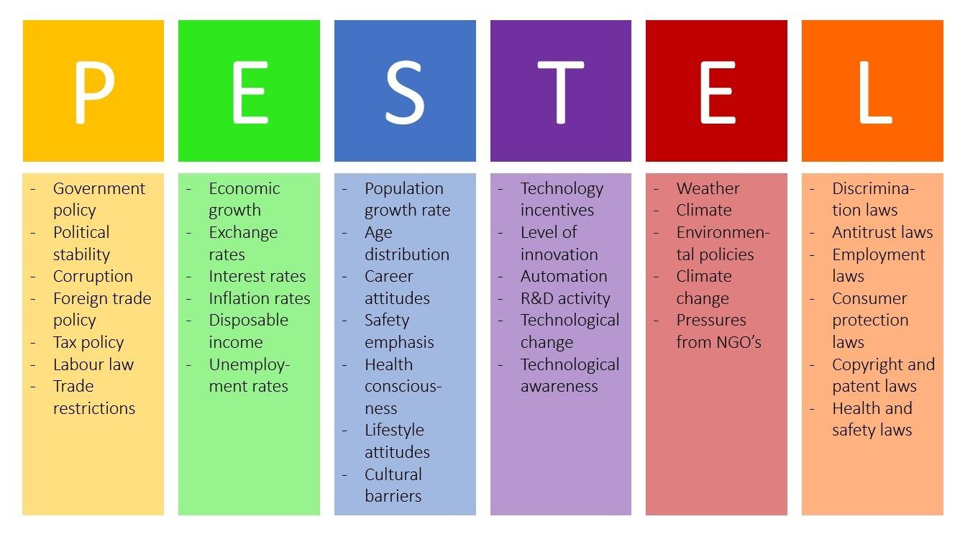

Slide 9
Political
This factor represents the way and extent to which the government influences the economy, and certain businesses.
This could be at the federal, state or local level. Current considerations in the market that may impact planning include factors, e.g. a potential change of government, unstable government due to the balance of power, tax law, changing superannuation policies, labour laws, and trade restrictions.

Slide 10
Economic
This factor refers to the areas unique to the economy and directly influence it. Factors that may influence your business plan include inflation rates, interest rates, economic growth, exchange rates, and property prices.
Economic factors differ for each town or city and must be analysed for their impact on your business.

Slide 11
Sociological
This factor refers to demographic factors, including population growth rates, cultural aspects, age distribution of population, and changing social behaviours; e.g. people using social media applications to discuss products and services.
Many of these factors may impact the way you do business with your clients and the methods of interaction you may have.

Slide 12
Technological
This refers to the rate of technological changes and Research and Development (R & D) activities, automation, and incentives. These factors influence outsourcing decisions, quality, and efficiency considerations.
Some examples include mobile internet, smart phones, Skype appointments, location based searching, emergence of Artificial Intelligence etc.
Over the last 10 years, changes in technology have massively impacted every industry and the degree and speed that this will occur in the future is only going to increase.

Slide 13
Legal
This factor refers to all the laws directly connected to a business or company and its area of activity. E.G. Health and Safety, Consumer Law, Privacy and Discrimination Law, Data Protection.
Legal issues often begin with examining any legislative issues in the home country and expanded to other countries depending on the business' international offerings.

Slide 14
Environmental
This refers to all the factors directly related to, influenced, or determined by the surrounding environment. This could include weather and natural disasters, geographical position, climate changes, and sustainability.
Think about the apparent increased frequency of natural disasters (floods, drought etc.) and their impact on the business and future planning of many affected businesses.
Environmental factors look at the world around the organisation and any factors which may have an impact on the environment. Examples include the use of plastic bags for goods, using vehicles for transporting goods and the pollution impact of these.

Slide 15
MS Teams group activity
Conduct a PESTEL analysis of the organisation your tutor would assign to you.
Be prepared to present your analysis to the class upon completion.

