Slide 1
Network Security: Control Mechanisms .
Delivered by: Lee Cobley

Slide 2
Preventing Network Attacks.
3 types of attack that could impact the network; Disruption, Destruction & Disaster.
The key principle towards prevention; is Redundancy.
Redundant Hardware & Specific configurations can automatically recognise failure
and automatically intervene to replace the failed component.
Typical example of redundant hardware device is a UPS (Uninterruptible power supply)
UPS provides additional source of power to network server; if power failure occurs UPS
can enable server to continue to operate for a few minutes (or hours), until UPS battery
becomes low.
In some UPS configurations; the server will receive notification when battery supply is low.
This prevents a cold shutdown occurring (which in some cases results in loss of data or
corrupted OS/Systems files.

Slide 3
Preventing Network Attacks
Another means of implementing redundancy is installing a Fault Tolerant Server.
Usually manifested in some form of RAID (Redundant Array of Independent Disks)
Common forms of RAID include RAID 5, RAID 0 and RAID 1, all different configurations
of disk redundancy. This can involve acquiring certain hardware (extra disk drives,
RAID controller cards and additional memory) depending on the implementation.
Can also extend this strategy to include disk controllers, in some cases more than one
disk is attached to a single disk controller.
Additional strategies include network components (Routers, Switches) and good
network design.
Finally considerations need be given to key personnel, equipment in the control centre
and important documentation and reports.

Slide 4
Preventing Natural Disasters & Theft.
Decentralising Network Resources – Don’t leave put all your eggs in one basket!
Common sense steps, Decentralise network resources; keep servers at separate offices, this reduces chance that a single disaster will destroy all data/resources.
Think logically to address specific types – Floods - don’t place Network Servers in basement rooms, particularly in organisations/offices near rivers/seafront.
Fire – Halon Fire Suppression Systems within server environments that house
network control centres.
Terrorist Attacks – Keep location of critical resources strictly secret, protect access with Security Guards.
Theft is often overlooked – Industry sources estimate a $1 billion loss through stolen computers and equipment. Security policy should include cabling to secure devices, use of security guards and other controls.

Slide 5
Preventing Virus Threats.
In most cases threats via virus that involve disruption/destruction of data are local and
as a result only a small number of components/systems are affected.
In these cases Anti-Virus software scans remove threats, or components are replaced.
Many viruses attach themselves to files/programs on the disk and are launched when
these items are accessed.
Macroviruses are one popular variant; they exist in documents or speadsheet files.
These files can spread to other parts of the disk, simply by opening the infected file.
Macroviruses account for 75% of all virus problems.
An effective strategy to enforce is to make users aware of suspect internet sites, since
the source of viruses are files (copied or downloaded) from an unknown origin.
Disks and files (e.g. received via email ) should be scanned for viruses before using
them, you can ensure this setting is configured via your Network Anti-Virus software
agent.

Slide 6
Preventing Virus Threats.
Maintain Updates – Industry sources estimate that six new viruses are developed per
day. It is therefore very important to frequently update Virus information definition files
used by Anti-Virus software. These files enable the software to identify the variant and
download appropriate patches to destroy/quarantine the threat.
WORM is another kind of Virus program – it can propagate itself and install on other
systems, often via emails or via security holes/vulnerabilities in server software.
Good policies that address email usage and appropriate means of Vulnerability Support
in Network Operating Systems are effective controls.

Slide 7
Preventing Denial of Service Attacks.
Difficult to block a specific source IP address since these are oftentimes ‘spoofed’.
Distributed DoS attacks is far greater form of disruption. Agents instructed by DDoS
handler to simultaneously send messages to target. Target is deluged with messages from many different source IP addresses.
The nature of these attacks makes it inherently difficult to defend against them.
Strategies of defence include distributed servers/systems and Intrusion Detection Systems that monitor the network for DoS attacks.
One possibility that is under review is the requirement of ISPs to verify that all incoming messages they receive from their customers are from Valid IP addresses.
This action would have major significance on restricting DoS/DDoS attacks. A major movement by ISPs has seen their policy impose strict requirements on their SME customers. This is because these SMEs are often unwittingly the accomplices in such attacks. The requirements impose the use of firewalls and other measures to address poor security.

Slide 8
Intrusion Detection Systems.
We’ve focused on prevention, although one hopes that these techniques are successful, we still have to plan for the possibility of a break-in/intrusion occurring.
Generally three types of IDS, most network security managers will choose to install all three.
Network Based IDS places IDS Sensors on network circuits. The IDS sensor is simply a device running a special operating system. The sensor monitors all packets that travel across the circuit and report intrusions to IDS management consoles.
Host Based IDS is a software based package installed on a host or server. Host based IDS monitors activity on the Server/Host and the incoming circuits and then reports any intrusions to the IDS Management Console.
Application Based IDS – Special form of host based IDS that monitors a specific application/service on the host (e.g. The Web Server).

Slide 9
Intrusion Detection Systems.
How do we actually determine an intrusion is in progress? – Two common techniques used by all of the three implementations of IDS, most use both:
  Misuse Detection – Compares the activities being monitored against signatures of known attacks/breaches. Once attack signature is recognised, IDS issues an alert to the IDS Management Console and discards the packets under suspicion.
  Obviously the mainstay here is ensuring that the database of “Attack Definitions & Signatures” is kept to the minute to reflect new attacks being invented.
  Anomaly Detection – Compares monitored activities against the ‘Baseline’ or snap-snot of what the network should look like when operating under normal conditions.
  If a major deviation is detected (e.g. a flood of ICMP packets OR an unusual number of failed logins to the Network Managers account), the IDS issues an alert and discards the suspicious packets.
  Again a problem here is when ‘false alarms’ arise; such as the production of significant yet valid network traffic that is above the ‘norm’, e.g. Etrade receives a large amount of traffic on the HTTP service, so Application based IDS drops packets).

Slide 10
Intrusion Detection Systems.
IDSs often used in conjunction with other security mechanisms (e.g. Firewalls), some Firewalls now include IDS Functions.
A major problem is that the IDS, the Sensors it provides, and its Management Console are themselves a target for hackers. Thus, the IDS should be secure against attack.
One strategy is to deploy redundant IDS, e.g. a Network-based IDS from one vendor and a Host Based IDS from another). This decreases the chance that the IDS is going to be hacked.

Slide 11
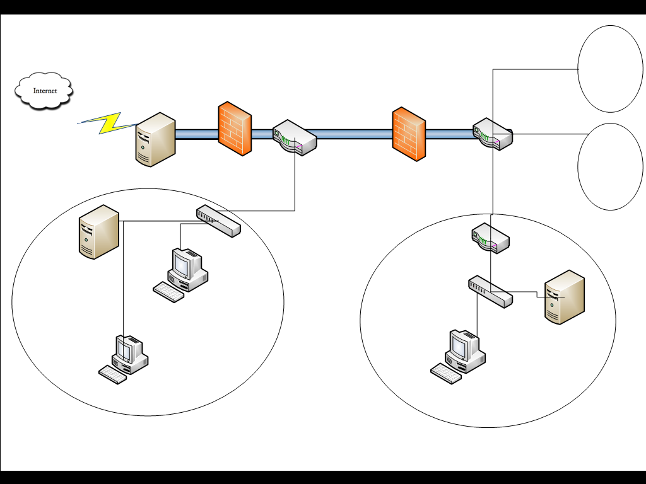
Intrusion Detection Systems.
NAT Proxy Server with Network Based IDS
Network based IDS Sensor
Internal Subnet
Firewall
Router
Router
Internal Subnet
Switch
Router
Web Server with Host Based IDS & Application Based IDS
DNS Server with Host based IDS
Switch
Network Based IDS Sensor
Mail Server with Host based IDS
IDS Management Console
DMZ
INTERNAL SUBNET

Slide 12
Intrusion Detection Systems.
WORMS are responsible for costly virus attacks – e.g. code RED spread through exploiting vulnerability in IIS Web Server, sends HTTP Request too large for the servers incoming HTTP message buffer, the Server can in turn be tricked into running operating systems commands contained in the HTTP Request Object.
LaBrea is a freely available IDS that has a method of trapping WORMS helping to prevent their spread. The tool traps the ‘connection requests’ that many WORMS use when they spread. LaBrea attempts (after detection) disable the intrusion.
If a worm has infected a company with an IP Address range of 128.196.x.x it will attempt to send HTTP requests containing the WORM to all IP addresses within that range e.g. 128.196.1.1, 128.196.1.2 etc, etc.
When the worm sends an HTTP Request, the TCP software on the infected machine sends a TCP ‘Open Connection Request to the selected IP address, before the HTTP Request is sent.

Slide 13
Intrusion Detection Systems.
When the gateway that serves this requested IP gets this request, it checks its memory to see if it has an Ethernet address that matches this IP.
If it doesn’t the Router broadcasts an ARP requesting that the computer with this IP address sends its Ethernet Address to the Router.
Of course no computer will respond that has this IP address so the Router will continue to send ARP requests until eventually giving up and returning the message back to the sender as ‘undeliverable’.
LaBrea, after hearing these ARP requests for the same IP address, go unanswered issues a response to the Router. As a result all messages targeted at the phantom IP address are delivered to LaBrea.
The trial and error process is foiled here; LaBrea accepts the TCP Open Connection Request that precedes the HTTP request. It will accept the connection, but does not send a TCP ACK packet in the usual way.

Slide 14
Intrusion Detection Systems.
TCP (like ARP) is a determined protocol, the infected machine will keep trying to send data, but will never succeed because LaBrea never responds properly.
LaBrea also tricks the sending machine into accepting a persistent connection which means it can only be closed when the LaBrea software chooses to close it, which of course it never will.
By holding the connection open; LaBrea software prevents the WORM process from moving onto the next IP address. Even if the process eventually continues, the next false IP address that the WORM uses, will again be met by LaBrea software.
Works very much on principles of probability of successes/failures.

Slide 15
Detecting Disruption, Destruction & Disaster
Major faults need prompt diagnosis – Network Management software needs to alert managers to problems.
Lots of different applications – Need to establish a snapshot of ‘baseline performance’. Intelligent Network Servers can send alerts to Managers to make them aware of problems (e.g. performance alerts on remote logins, alarms to pagers).
Type of problems vary – Cable damage/unplugged causes intermittent network performance. Network Drive could become corrupted CRC, likewise files could also be affected.
Requires ongoing monitoring, should be procedures in place to allow users to report their own problems/experiences.
Network should maintain logs to record information about faults. This enables managers to recognise minor service problems before they become major problems.

Slide 16
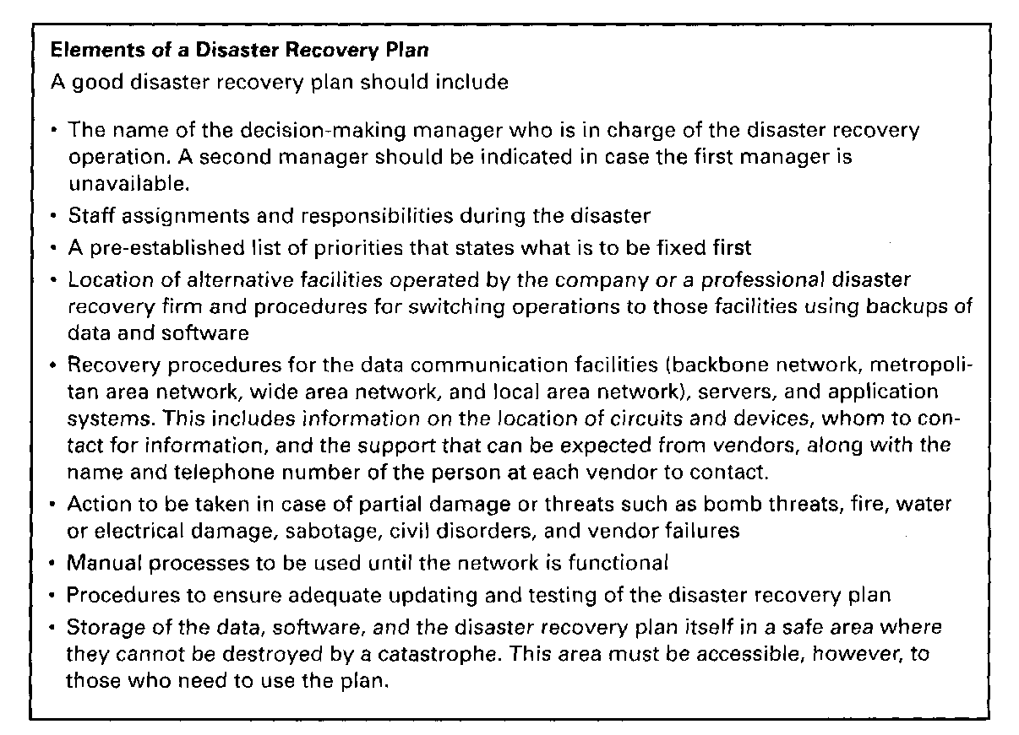
Corrective Controls for Disruption, Destruction & Disaster Attacks
Disaster Recovery Plan – Addresses various levels of ‘Response’ to any number of possible disasters, so should be a comprehensive document.
Should provide for partial or complete recovery of all data, application software, network components and physical assets. Fig A below shows a summary of elements that should be integral to any Disaster Recovery Plan.
Fig A: Elements of a Disaster Recovery Plan

Slide 17
Corrective Controls for Disruption, Destruction & Disaster Attacks
Backups and Recovery controls are the most critical elements of an effective Disaster Recovery Plan. These allow for recovery of data and the restart of critical applications, should a segment of the network become unavailable.
There are various approaches available for backup policies and we will investigate some of these practices during the course of this module.
Backups ensure the important data is safe, however it does not guarantee that this information is instantly usable in the live environment, which is oftentimes a critical requirement, time is money!
As a result disaster recovery documents should detail the recovery process, going from the backups to an operating application software system. Again we will investigate examples of these practices during the module.
Plan should detail specific goals for specific types of disasters (e.g. The centralised database server becomes unavailable, what do we do next?)
The plan should also be tested to assure its effectiveness, Disaster Recovery Drill is a similar strategy to a Fire Drill, it tests the effectiveness of the procedures we have in place and identifies any shortfalls. Similarly the possibility of Disaster Recovery Outsourcing should never be overlooked; disaster recovery firms can have data network back online within hours. Not cheap in terms of service costs, but compared with losses that could occur these systems quickly pay for themselves.

Slide 18
Controlling Unauthorised Access.
Essentially putting in place controls to address the threat of Hackers (whether these be internal or external to the organisation)
Preventive Controls – Being proactive towards threats is the key. You need to test your systems before someone else does! (see BABank case study).
3 Access Points into most Organisations networks:
1. Internet.
2. Dial Up access through a modem
3. Internal LANs inside the organisation.
8 general security areas related to preventing unauthorised access; Security Policy, User Profiles, Physical Security, Dial in Security, Firewalls, Network Address Translation, Security Holes and Encryption.

Slide 19
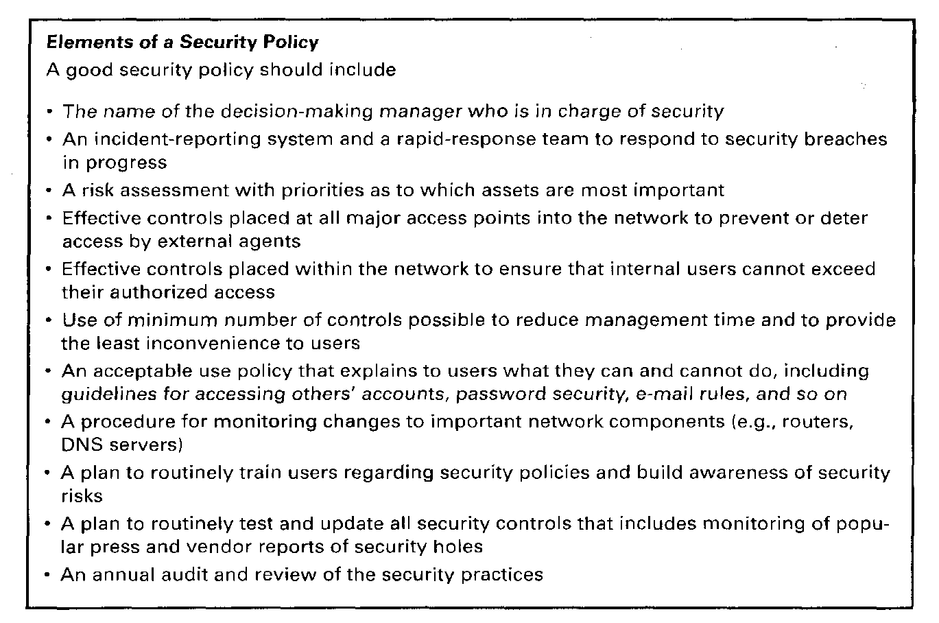
1. Security Policy: Overview of Good Practices.
Similarly whereas the Disaster Recovery Plan should control risks due to disruption, destruction and disaster; the security policy controls risks/threats posed by unauthorised access.
The document should define the assets to be safeguarded and should contain a dedicated section detailing employee practices (what they should and should not do).
Fig B shows a
summary of
security policy
practices.

Slide 20
2. User Profiles
User profile associated with each user, forms the basis of how the network access is obtained, this is assigned by the Network Manager.
Hackers target account access based on three principles; what you know, who you are and what you know. The most common approach is what you know. Users need passwords to gain access and poor passwords result in hackers guessing them and gaining access.
High security applications use parameters for access based on who you are, Biometric controls (e.g. Retina scans, fingerprint verification, voice recognition) ensure that it is only you who is able to access your network account.
User profiles can impose restrictions on allowable login days and times, physical locations. Using and Monitoring these is straightforward.
However one major loophole for security access is non-deletion disabling of inactive accounts. Recent findings showed that 30% of user accounts at University of Georgia were inactive. This opens opportunities for ex-staff members to exploit vulnerabilities for personal gains.
It is vital to establish user clearance levels to determine what applications/services on the network the user should be/should not be able to access.

Slide 21
3. Physical Security.
Both main and remote facilities should be well secured; proper access controls that restrict only authorised personnel can enter closed areas where network equipment is located.
Network Components themselves should be secured; locking on power switches, passwords that disable screen and keyboard (when WS is not attended). Two areas prone to unauthorised access attacks Network Cabling and Network Devices.
Network cables are target for eavesdroppers; oftentimes run over long distances and are not checked for tampering. It is 100 times easier to tap local cable than it is to tap an inter-exchange channel. Cables should be secured behind walls, above ceilings whilst switching rooms should be behind locked doors with strict access codes.
Certain cables are harder to tap (e.g. Fiber) which is why they are used for internetwork communications.
Network devices (hubs, controllers, switches) should be well secured. It is relatively simple to install a sniffer program onto a desktop, which could then be plugged into an unsecured hub/switch to eavesdrop on all message traffic. Secure hubs make this type of attack more difficult to execute, by requiring authorisation codes before computers can be added to it.

Slide 22
4. Dial-In Security.
If the organisation permits its staff members to access its network via dial in modems, it opens itself to a broader scope of intrusion.
One strategy to employ, if dial-in is a requirement, is to change modem telephone numbers periodically, keeping telephone numbers confidential and requiring the use of computers that have an electronic identification chip for all dial up ports.
Another effective control is to use a call-back modem. Here the user dials the organisations modem telephone number and logs into his/her account. When the correct password is entered the modem hangs up and dials the user’s modem telephone number. Unauthorised intruders cannot access others accounts because the host server will permit connections only from pre-specified numbers.
The applications for Dial-In Modems are these-days commonly replaced by VPN (Virtual Private Networks) with appropriate designated configurations.

Slide 23
5. Firewalls
One common secure configuration is to disconnect unneeded applications (e.g. Remove email server service from a Web server) to reduce the number of entry points available to a hacker.
Firewalls examine packets flowing into and out of the network. Network should be designed so that a firewall is placed on every network connection between the organisation and the internet. Two common types of firewalls Packet Level and Application Level Firewalls.
Packet Level – Examines source and destination address of every network packet that passes through it. In general the addresses are examined at Transport Layer (TCP Port IDNO) and Network Layer (IP Address) so the firewall has no knowledge of what the user is attempting to do. It simply chooses to permit entry/exit based on the contents of the packet.
Packet level firewall is simplest and least secure because it does not monitor the content of packets or why they are being transmitted, furthermore the firewall does not log the packets for later analysis.

Slide 24
5. Firewalls
Prone to spoofing, sending packets to a target computer requesting certain privileges. This attack is made possible by changing the source address on incoming packets from their real IP address into a an IP address inside the organisations network. This is to a large extent a weakness that has been revisited in Packet Level Firewalls; some firewalls automatically delete any packets arriving from the Internet that have internal source addresses.
Application Level Firewall acts as an intermediate host computer between the internet and the rest of the organisations networks.
More complicated to configure and install than a Packet level firewall.
Anyone who requires access to organisational networks from the Internet, must log into this Firewall and can only access the information authorised within the Firewall account he/she possesses.

Slide 25
5. Firewalls
Works on different fundamental principle than Packet Level firewall, in PL firewall anyone who has not been explicitly prohibited is authorised, whereas Application Layer firewalls strictly prohibit access in the first instance; unless access is authorised explicitly in another rule.
Can be over-secure, in some cases special programming code must be written in order to allow application software specific to the organisation to be run through the firewall.
Many application firewall programs prohibit external users from uploading executable files, the only way software can be modified is by obtaining physical access to the firewall.
Can refuse changes/modifications to their software, unless made by the vendor.
Some products also actively monitor their own software and automatically disable outside connections if they detect any changes.

Slide 26
6. Network Address Translation (NAT).
NAT is the process of translating between one set of private IP addresses (inside a network) and a set of public addresses for use outside the network.
No other computer other than NAT Proxy Server/Firewall is aware of the process, that exists mainly for security reasons.
NAT Proxy Server uses an ‘address table’ to interpret private IP addresses used inside the organisation into proxy IP addresses used on the Internet.
When computers send messages to computers situated on the Internet, the Proxy will transform critical parameters that ensure the security of the host inside our internal network (the process is shown in Fig C).

Slide 27
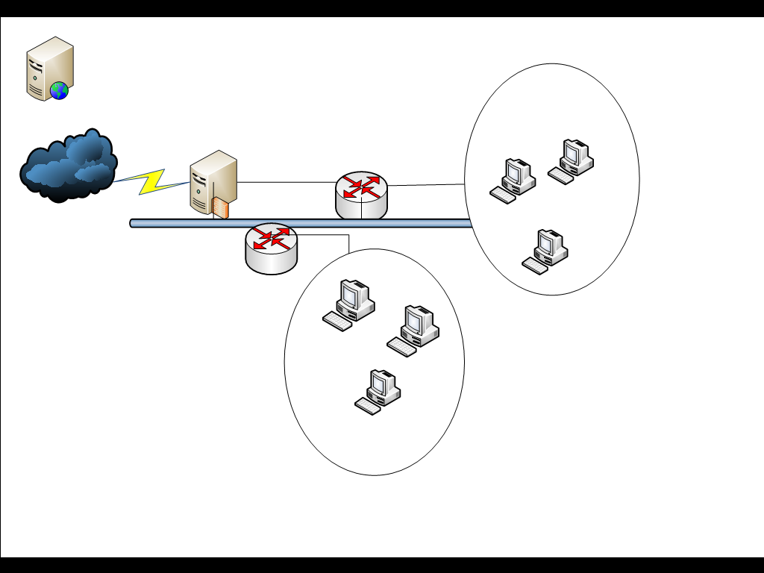
Step 4: Send web page to 193.62.89.2
Internal LAN
Step 6: Web page arrives at client
Proxy IP address: 193.62.89.2
Step 1. Find http://www.techtips.com
NAT Proxy/Firewall
IP address: 192.168.89.18
Step 3: Request comes from source address, 193.62.89.2
Step 2:
Translate Source address of internal private IP into proxy IP address.
Set source port in TCP packet to unique number, which is reference to IP address of actual sending machine stored in ‘address table’.
Step 5: Receive packet, check it should be allowed.
Check PortID against address table.
Change destination IP back to internal destination.
Also change TCP Port ID to correct PortID for the service requested (keep a note of this in first instance)
Internal LAN

Slide 28
6. Network Address Translation (NAT).
One strategy is to use illegal IP addresses; company has a domain registered IP for the NAT/Proxy/Firewall (e.g. 193.62.89.x), but uses addresses in the 10.x.x.x domain (these addresses are reserved for special purposes they are never assigned to organisations.
This way even if intruders discover actual IP addresses, these addresses could not be used to reach another network.
NAT Proxy Servers are replacing traditional firewalls, they do however slow transfer times between internet and internal networks. Furthermore you need two DNS servers, one for external users on the Internet and one for use by Internal Networks.

Slide 29
7. Security Holes.
Security Hole is a bug that permits unauthorised access to network resources.
Many commonly used Operating Systems have major security vulnerabilities that can be exploited by potential intruders. Some of these have been documented and in most cases patches are available from vendors to fix the weaknesses.
The problem is that network managers may be unaware of such holes/flaws or they may simply forget to regularly update the patches.
Different examples – e.g. sending messages to overflow network buffer, allowing all sorts of malicious activities to be executed).
When the security hole has been discovered the race begins to patch or exploit the vulnerability.
Security Holes can also be interpreted another way; bad system configurations (e.g. some of the Linux configuration files mentioned previously e.g. TCP Wrappers, RSH). It is therefore you have mechanisms for addressing such weak configurations well documented.

Slide 30
8. Encryption Systems.
Encryption – An effective means of disguising information based on mathematical rules known as Algorithms, more commonly referred to as Cryptography.
Information in encrypted form is cipher-text, non-readable, information in decrypted, readable form is plain-text
Primarily two forms of encryption available; Asymmetrical and Symmetrical; An asymmetrical algorithm is one where the key used to decrypt the cipher-text is different from the one used to encrypt it. Whereas Symmetrical algorithm involves using the same key to encrypt and decrypt a message.
In effective encryption systems the success does not depend on keeping the algorithm secret, only the key needs to be kept secret, without these the formula is useless.
The key is a small numeric value (in terms of bits), the larger the key the more secure the encryption is against brute force attacks.
We will see more details on how encryption models work as well as the different methods of encryption available during the course of this module.

