Slide 1


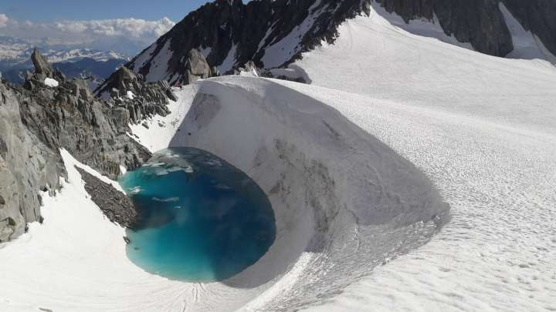
The impact of environmental change
tourism in Alpine villages, focussing on the area of the Espace Killy
By Richard beecher

Slide 2
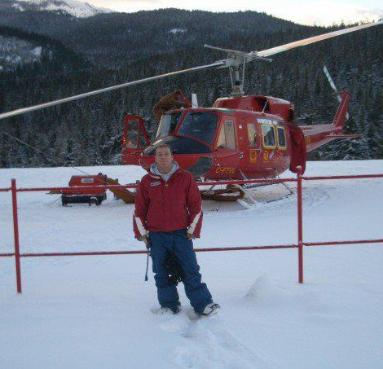
Who am I?
Richard Beecher - I have been skiing since 1989 when I competed in downhill competitions for in the Junior Leaders Regiment. I later took part in the adult inter-service ski championships. After leaving the army, I worked in the Alps, in Chamonix, during ski seasons, before going to North America as a property and hotel manager and then back to Val D'Isere, where I was resort manager.

Slide 3
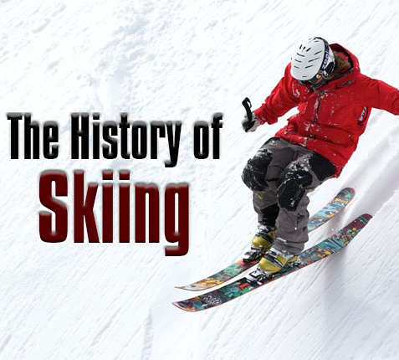
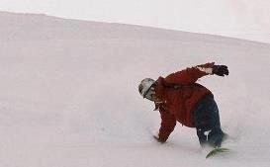
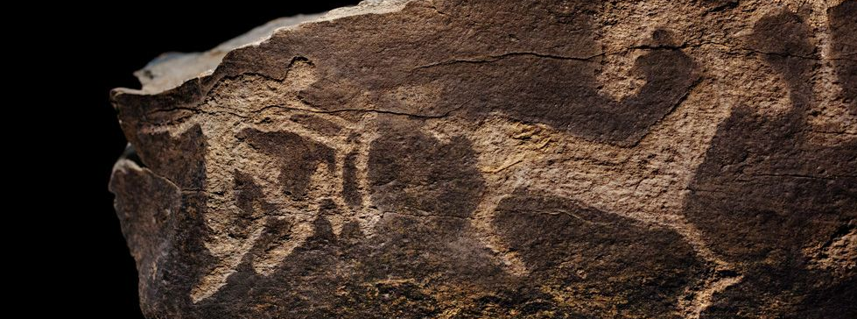
Notes:
Alpine tourism offers a prime example of how a destination can be damaged by becoming too popular. Initial success can feed into a process of over-development, which can, in turn, damage the desirability of the destination. In the ski resorts these problems are being exacerbated by the effects of climate change on the amount and quality of the snow, itself, arguably, accelerated by excessive travel.
There is evidence from 6000 BC cave markings that ice age people used some sort of ski to manoeuvre around hills and iced lakes (Soad, 2010). Fragments of ski-like objects, dated from 6000 BC have been discovered in northern Russia in the 1960s by Grigoriy Burov (Soad, 2010). More recently, skiing was associated with the Norwegian military. In the 1760s, the Norwegian army held competitions involving skiing down slopes; they would ski between the trees as slalom. These races formed the beginning of the winter Olympics. 1924 saw the first winter Olympic games in Chamonix and by the middle of the 20th century, skiing had begun to develop as a pastime.
Skiing is now one of the most popular holiday activities in Europe.

Slide 4
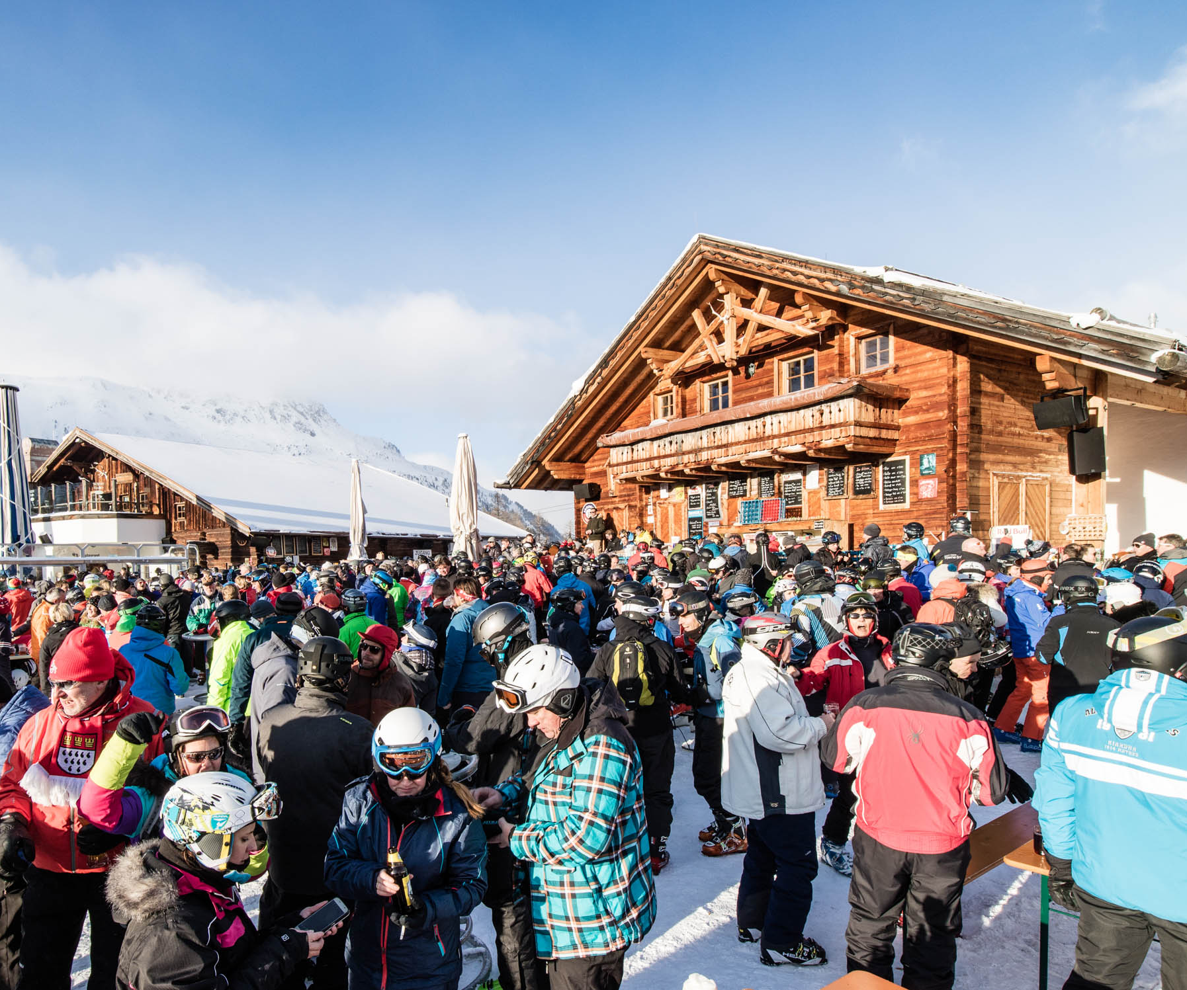
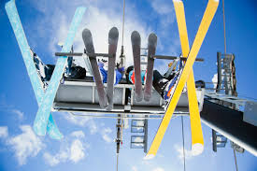
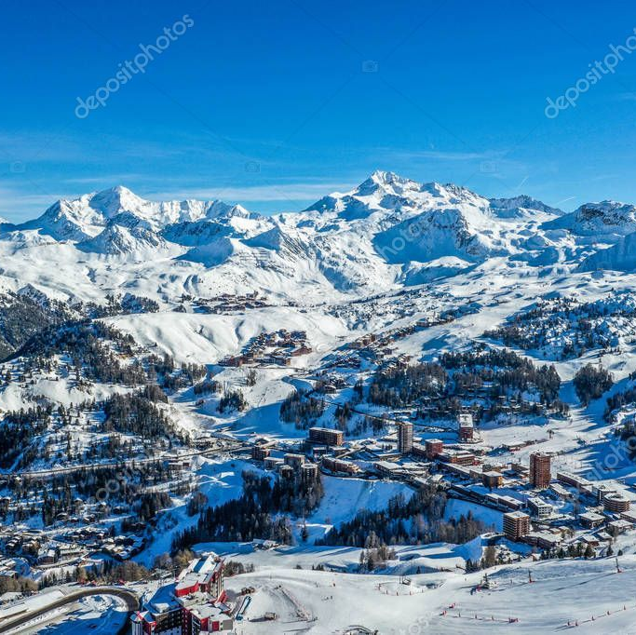
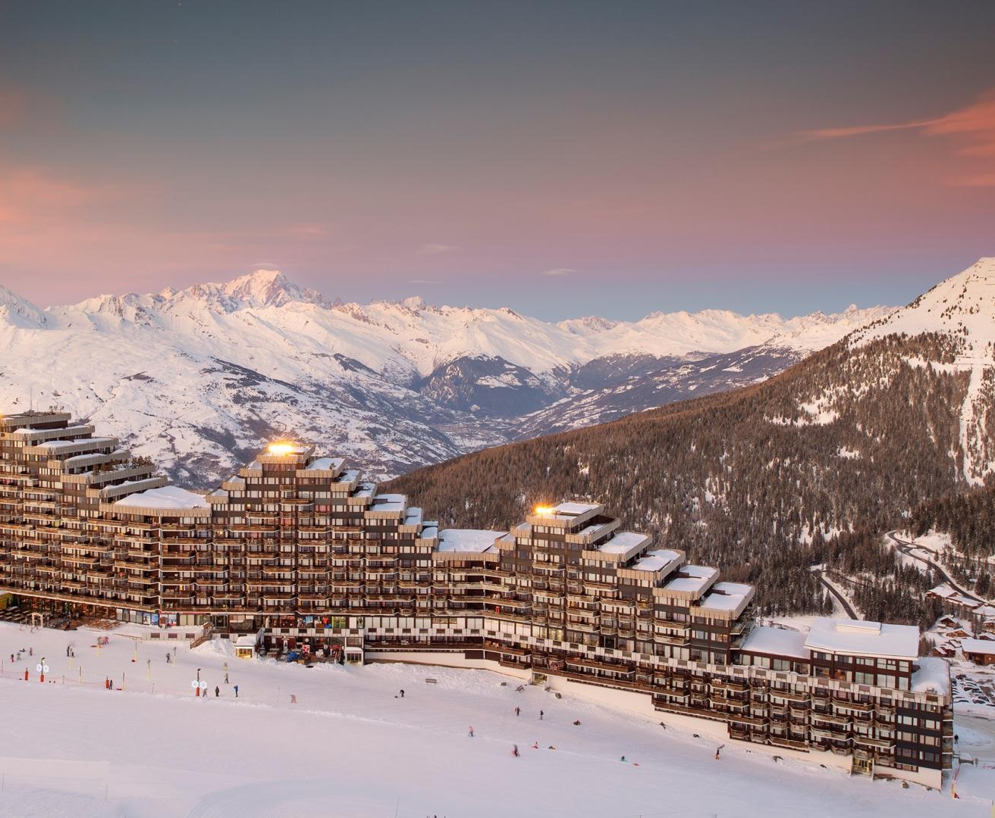
Over-tourism
Notes:
Around 60 – 80 million tourists visits the Alps each year. This contributes around 50 billion euros to the economy, and provides around 10 -12% jobs (Anon, 2020). There are over 600 ski resorts and 10,000 ski lifts in the Alps. France, Switzerland, Italy and Austria provide over 85% of Europe’s skiing area. France has the highest winter season turnover out of these four countries.
In Val d’Isere there are over 2000 guests travelling in and out of the resort each week, more during half term, the majority travelling by plane and bus transfer. While avalanches are not new to Alpine areas, the high number of visitors, and associated development, increases the risk to life when avalanches do occur. In 1999 Chamonix faced a severe crisis following adverse weather conditions over France. It was necessary to evacuate, but 'There were over 100 known avalanche paths in the valley. Years of development under pressure from the tourist industry meant that nearly every community had some chalets at risk.'(Weir, 2002)
Many resorts also have summer activities including, mountain biking, ice climbing, climbing and walking.
Demand from tourists has led to many examples of over-development, driven by profit rather than sustainability. This over-development leads to yet more tourism with consequent pollution. There is air pollution from traffic and littering, not just in the villages but also on the slopes. In consequence, the local environment is being damaged, which could well adversely impact future tourism. Further, activities around alpine tourism could well be a factor in global climate change.

Slide 5
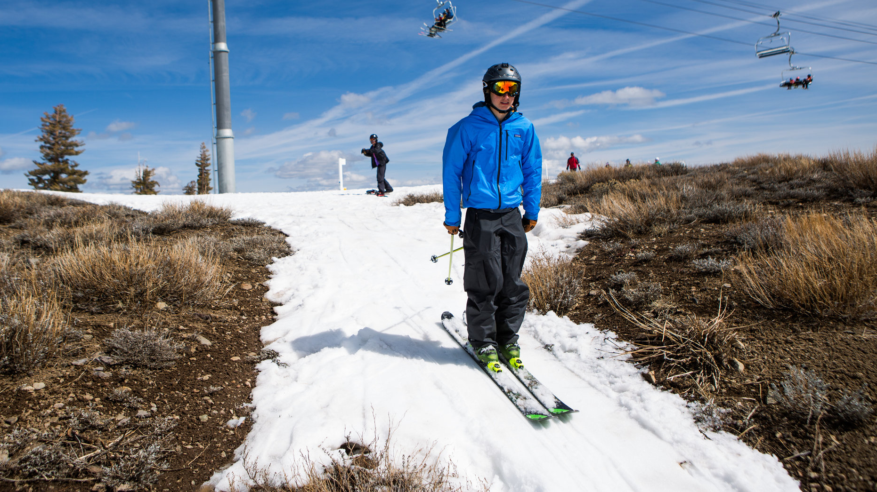
What is the difference between Global Warming and Climate Change?
Climate change is a long-term change in the average weather patterns
Notes:
‘Climate change is a long-term change in the average weather patterns that have come to define Earth’s local, regional and global climates. These changes have a broad range of observed effects that are synonymous with the term. The term is frequently understood, incorrectly, to be interchangeable with the term global warming. Technically, it refers to both human and naturally produced warming, as opposed to the warming solely caused by human activity. It is most commonly measured as the average increase in Earth’s global surface temperature’. (Shaftel, 2020)

Slide 6
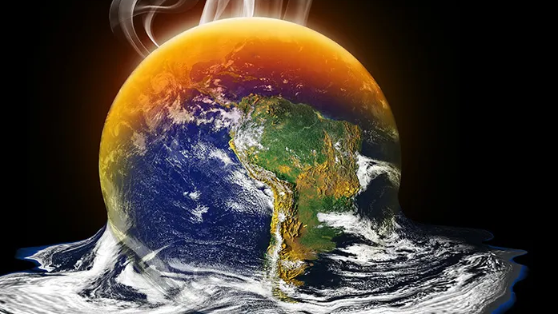
What is the difference between Global Warming and Climate Change?
Global warming is the long-term heating of the Earth’s climate system
Notes:
‘Global warming is the long-term heating of the Earth’s climate system observed as a consequence of the industrialisation that has occurred from the late 19th century. It is believed that this is due to human activities, primarily fossil fuel burning, which increases heat-trapping greenhouse gas levels in Earth’s atmosphere’. (Shaftel, 2020)

Slide 7
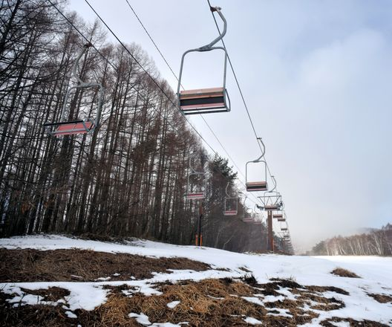
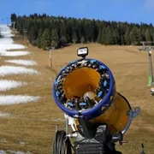
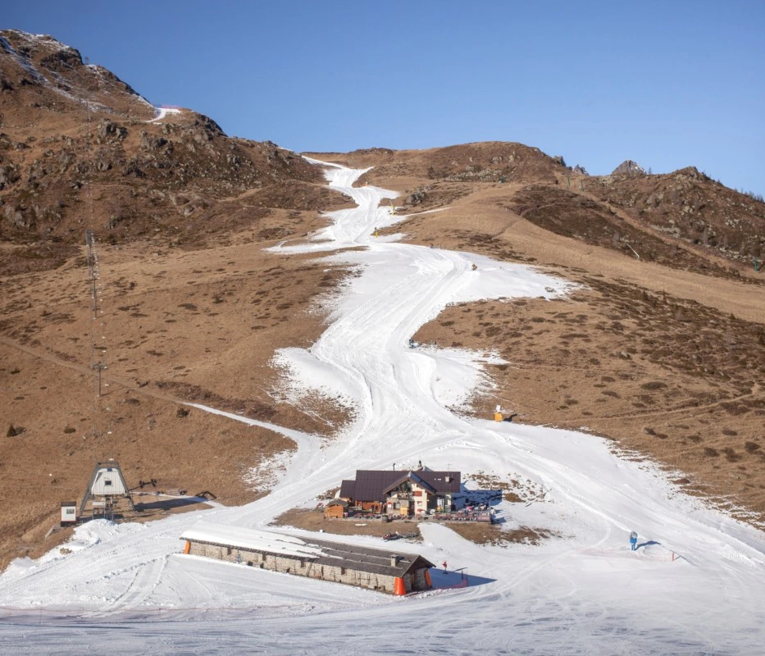
Effects of Climate Change on the Alps
1980’s first time alarm bells rang
The combination of a cycle of rapid warming and quick cooling
Snow canons
Notes:
It was in the early part of the 1980s that people first began to be concerned about the diminishing amount of snow at the end of the skiing season. (Anon 2020) More recently, there is strong evidence of receding glaciers and higher snow lines in resorts. (Anon 2020) Climate change is being seen as a major reason for these developments. (Anon 2020)
The combination of a cycle of rapid warming and quick cooling, brought about by climate change is affecting tree growth, with lower level trees being infected with disease. (Shaftel, 2020) The loss of trees is affecting carbon uptake - the higher the tree line the less protection the trees are offering from carbon. The natural balance is being upset, contributing further to an increasingly unsustainable skiing industry. Further, since the trees offer protection from avalanches, more villages will become vulnerable as the tree line ascends.
Indeed, there is a growing risk of avalanches and glacier splits in the Alps, enlarging the areas of danger as well as ringing an alarm bell that the impact of climate change is greater than is superficially visible.
'Solutions' to lower snowfall, such as snow cannons, exacerbate ecological problems. According to research conducted by the WWF:
‘The construction of ski runs causes irreparable damage to the landscape. The increasing use of snow cannons sets off additional problems by their use of water, energy, and chemical and biological additives’(Anon, 2020).
198

Slide 8
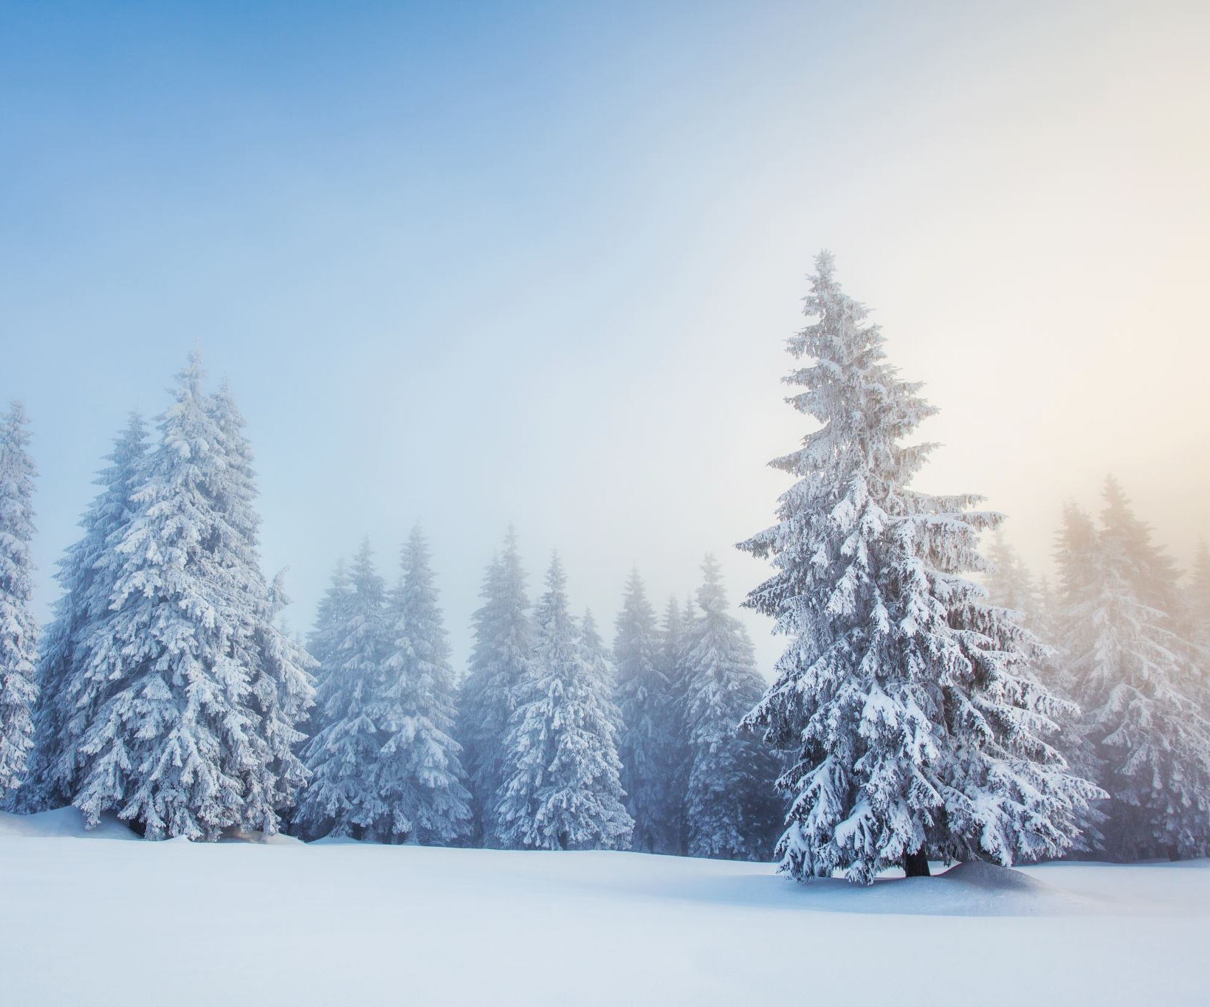
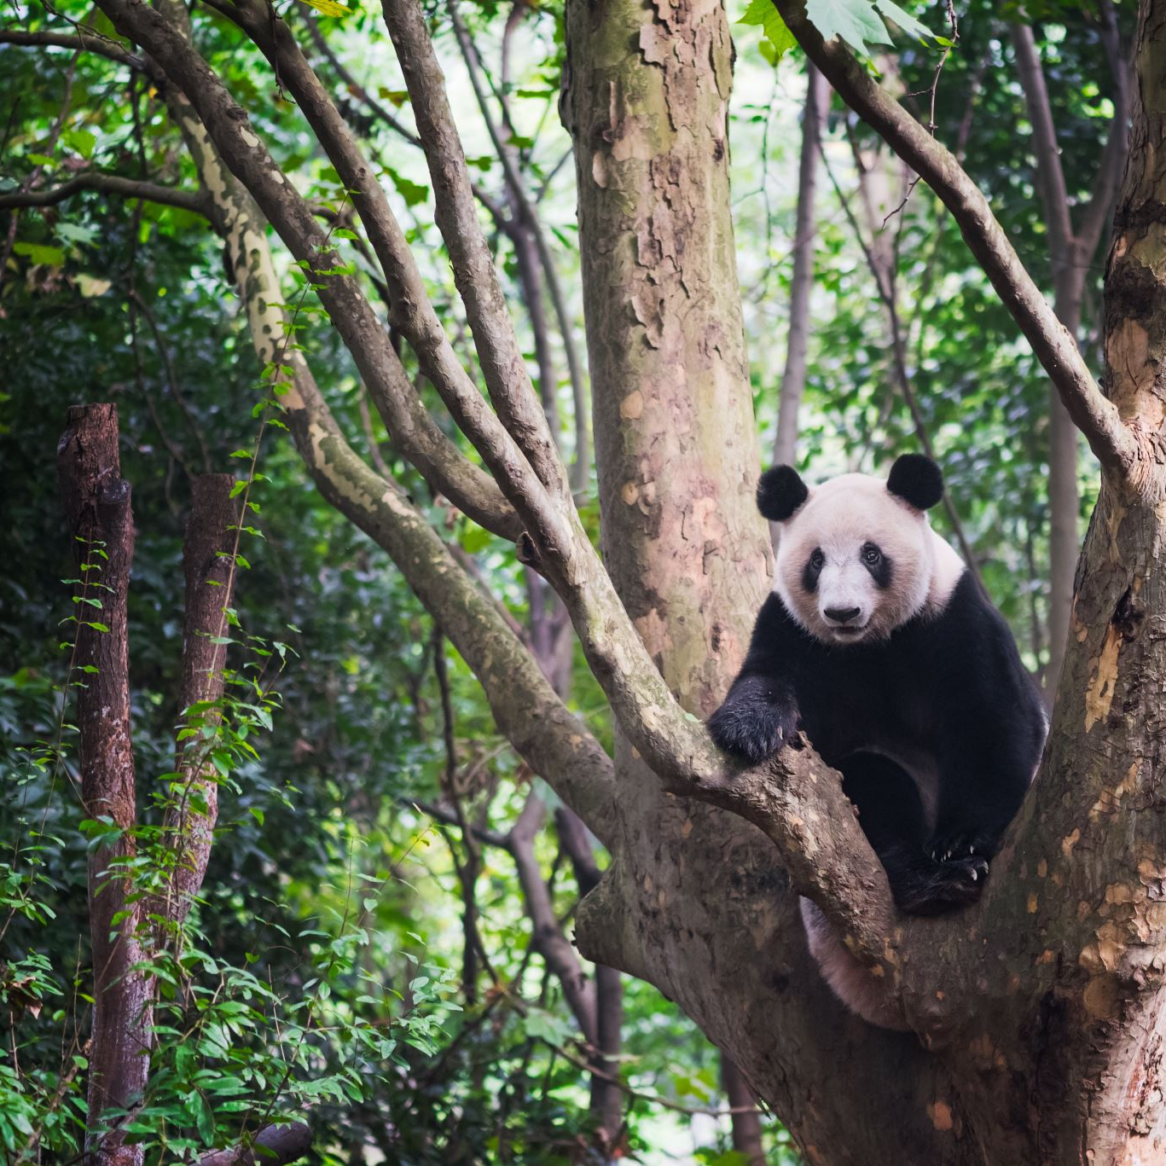
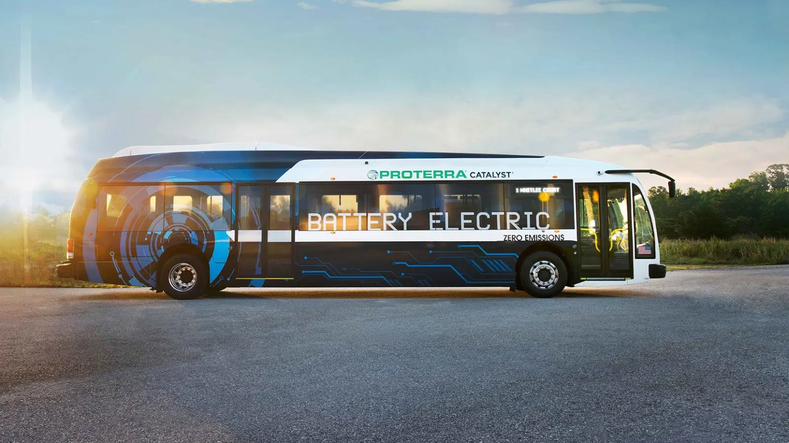
Solutions and Suggestions
Carbon offsetting
Electric buses
Notes:
Solutions and Suggestions
carbon offsetting
There are several schemes for carbon offsetting within the tourism industry, leading within this area is Sustainable Travel International. On their website, they promote credits, for each credit bought they will invest in a carbon-free project. They also have a very handy calculator tool (Sustainable travel, 2020): https://sustainabletravel.org/our-work/carbon-offsets/
electric buses
The concept of electric transport has been with us for some time and in recent years they have become to an economically viable alternative to fossil fuels. There are resorts within the alpine region that do not allow any petrol or diesel engines to enter the resort, for example Zermatt, Flaine and Saas Fee, which has been car free since 1950 (Anon, 2020)
The Global Sustainable Tourist Committee (GSTC) sets baseline standards for sustainable tourism. They provide international accreditation for tourism bodies who satisfy their criteria. These fall into two headings, industry criteria and destination criteria. For example, in terms of industry criteria, the GSTC expects that 'the organization has implemented a long-term sustainability management system that is suitable to its size and scope (Anon, 2020), addresses environmental, social, cultural, economic, quality, human rights, health, safety, risk and crisis management issues and drives continuous improvement.' Thus, the GSTC offers a sustainable way of combatting over-tourism and limiting environmental and social harm.

Slide 9
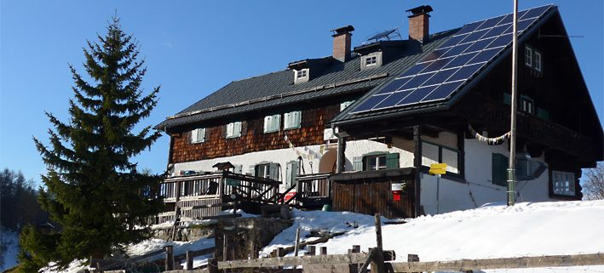

A blue print for sustainable tourism in Espace Killy
Notes:
In this section I am going to cover travel to and within the resort, sustainable building

Slide 10
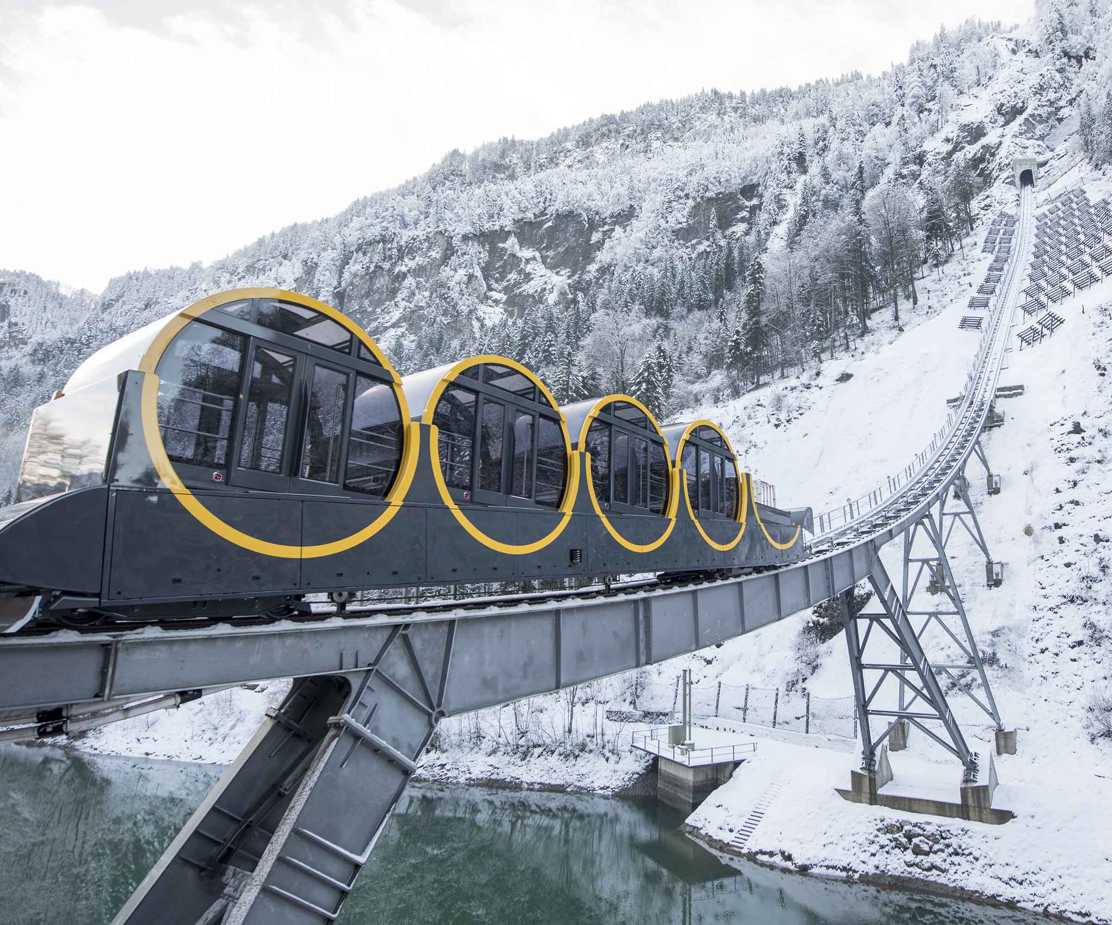
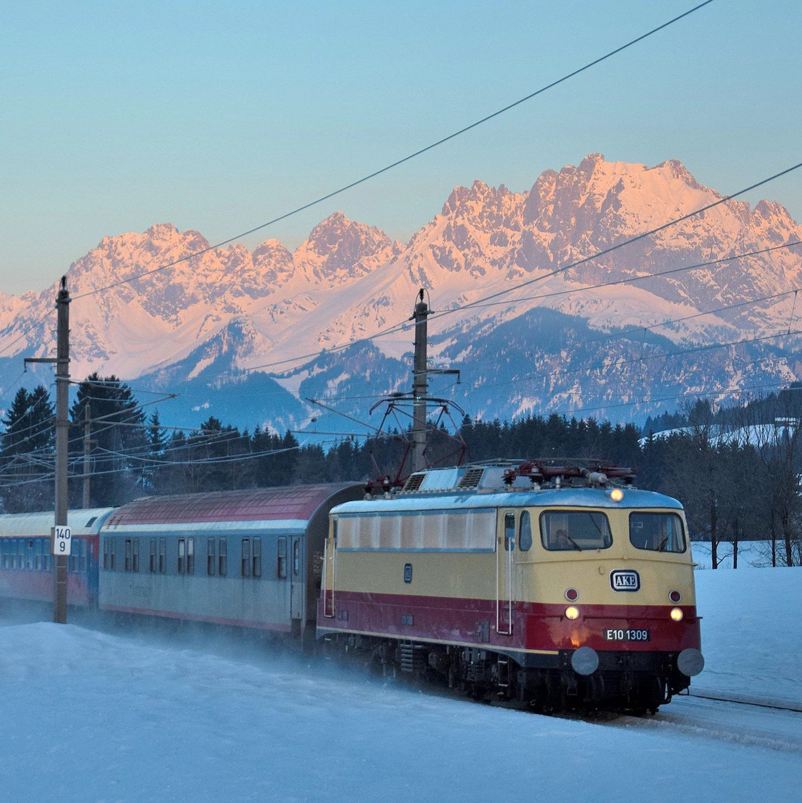
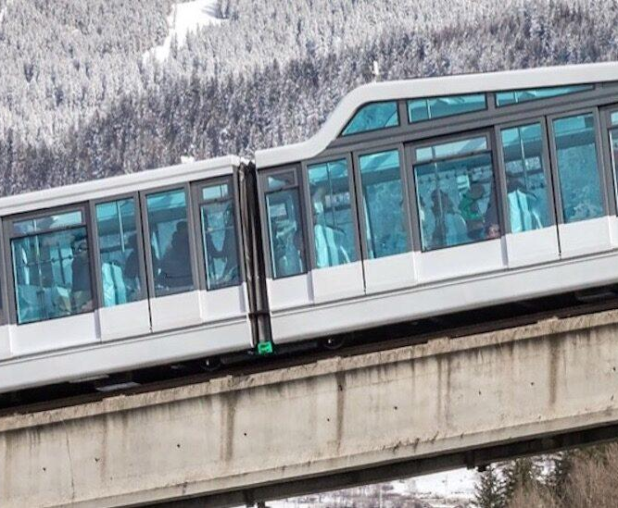
Travel into and within the resort
Notes:
1. One possibility would be the introduction of electric buses from the central points of arrival, such as the airports of Lyon, Grenoble, Chambery and Geneva. Onward travel is to Bourg Saint Maurice, which is the central hub for travel to the resorts.
An electric bus transfer could replace the current diesel buses to and onward from Bourg Saint Maurice. However, a more sustainable option would be
an electric funicular running up the valley to the resort. Within the resort, all fossil fuel traffic should be stopped; public transport should be electric, accommodation bookings should be contingent on the use of electric transport, ski lifts should use electricity from renewable sources, and all employment should be limited to people using public electric transport or their own electric cars.

Slide 11

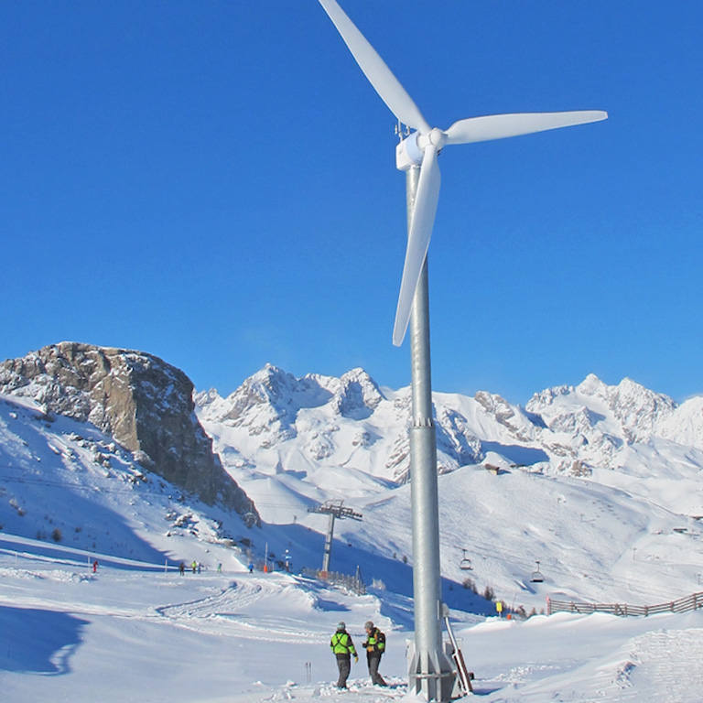
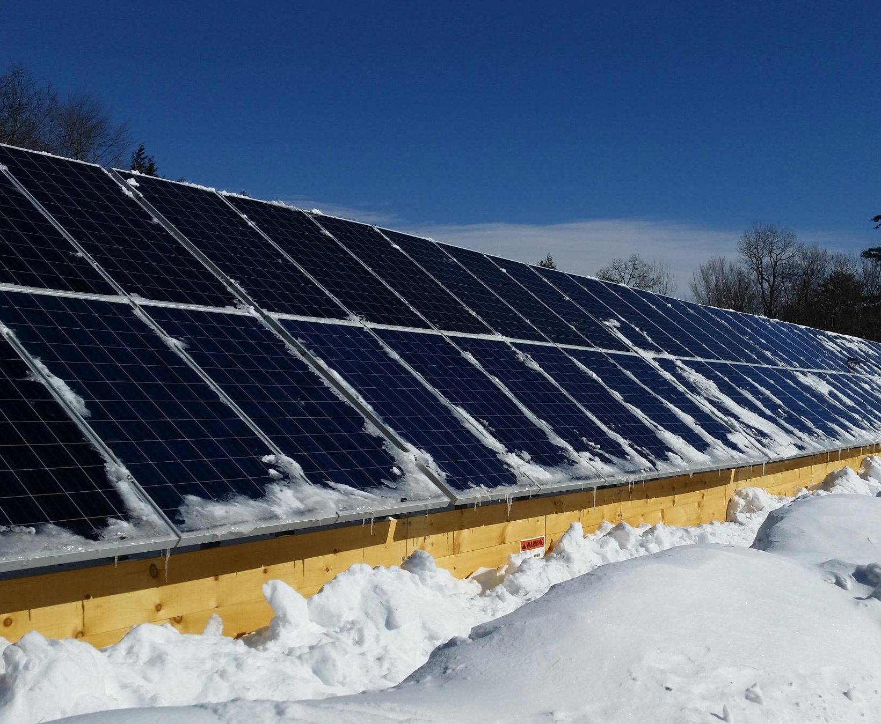
Within the resort
Within the resort
No non-recyclable rubbish.
All restaurants
Notes:
2. Within the resort all commercial buildings, lifts, street lighting, piste grooming, street cleaning should be run using electricity from renewable sources.
3. Emergency services will be exempt in the short term, but should be working towards using sustainable fuel sources.
4. No non-recyclable rubbish.
All products sold in resort, and used by local tradespeople should be recyclable. Waste collection vehicles should use renewable energy sources. Marketing material should all stress the need for visitors to recycle, and a proportion of the deposit will be allocated for any extra work involving recycling. If this is not done (particularly a problem in self catering accommodation) part of the deposit will be retained. Although we accept the need for individual responsibility, the ultimate responsibility will lie with those profiting from the tourists. Cigarette butts are a particular problem, since they are hidden by the snow, but once the snow melts they are clearly visible and are slow to degrade. In Val Thorens, 30,000 butts were found under a single chair lift (Leiritz, ( ), cited in Sage, 2004) Resorts have experimented with various strategies, such as portable ashtrays (Leiritz, ( ), cited in Sage, 2004) I would recommend ashtrays fitted on the lifts themselves, since skiiers are more likely to use receptacles that are easily accessible. Mountain restaurants have a key role to play in protecting the slopes from litter and failing to do this should lead to fines.
5. All restaurants, hotels and shops within the resort, as well as the council, should commit to the GSTC guidelines as a prerequisite to getting their licence.

Slide 12
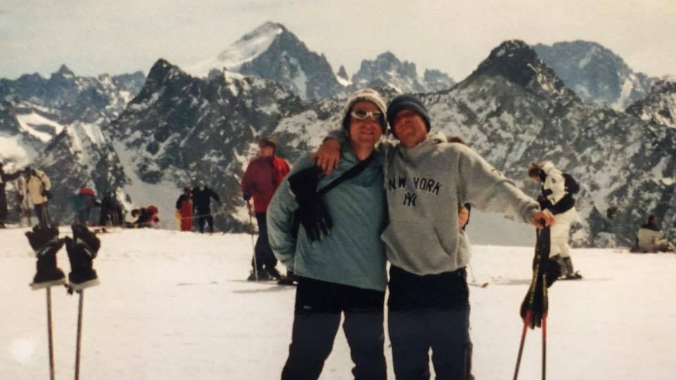
Any questions

Slide 13
Reference
Anon. (8/11/2020). Tourism in France. Available: https://www.climatechangepost.com/france/tourism/. Last accessed 8/11/2020.
Anon. (2020). Over Tourism. Available: https://wwf.panda.org/knowledge_hub/where_we_work/alps/problems/tourism/. Last accessed 8/11/2020.
Anon. (2020). unkonwn. Available: https://www.gstcouncil.org/. Last accessed 12/11/2020.
anon. (2020). eco friendly ski resorts. Available: https://www.sno.co.uk/ski-resort/green-eco-ski-resorts/. Last accessed 14/11/2020.
GSTC Council. (16/12/2016). Performance Indicators for Tour Operators. GSTC Industry Criteria. 3 (2), 3.
Holly Shaftel. (4/11/2020). Weather vs. Climate. Available: https://climate.nasa.gov/resources/global-warming-vs-climate-change/. Last accessed 8/11/2020.
Peter Weir. (2002). The Montroc Article. Available: http://pistehors.com/backcountry/wiki/Articles/Montroc-Avalanche. Last accessed 14/11/2020.
Suemedha Sood. (2010). where did skiing come from?. Available: http://www.bbc.com/travel/story/20101221-travelwise-where-did-skiing-come-from. Last accessed 8/11/2020.
Sustainable travel. (2020). Carbon offset. Available: https://sustainabletravel.org/our-work/carbon-offsets/. Last accessed 15/11/2020.
Notes:
Reference

