Slide 1
Reflection on feedback
By Casey Smith BMHP4017

Slide 2
Contents page
Introduction
Summary of the Assignment
Feedback received
Identifying my strengths
Identifying my weaknesses
What I learned from the feedback
What I would differently next time
Conclusion
References

Slide 3
Introduction
It is important to reflect on the feedback I receive as it offers me with advice on how to improve my work by changing external observation into internal learning. Feedback allows for an unbiased opinion on my strengths and weaknesses so that I can continue learning and improving (McEwen, 2020). In this presentation, I will reflect on the feedback I received for a recent assignment. I will provide a summary of the work I am focusing on, discuss the key point of feedback, explain what I learned from it, and outline what I would do differently in the future.

Slide 4
Summary of the Assignment
My assignment was titled E-portfolio where I had to complete the following tasks
  Referencing Quiz.
  Academic Writing Quiz.
  Using AI Ethically in Academic Studies Quiz and Forum.
  Organisation and Time Management Planner.
  Critical Thinking Skills Quiz.
  Networking: Student Integration Evidence.
  Resilient and Healthy Learner Check List.
This assignment was to show that I have development the essential study skills to ensure that I am a resilient, healthy and independent learner.

Slide 5
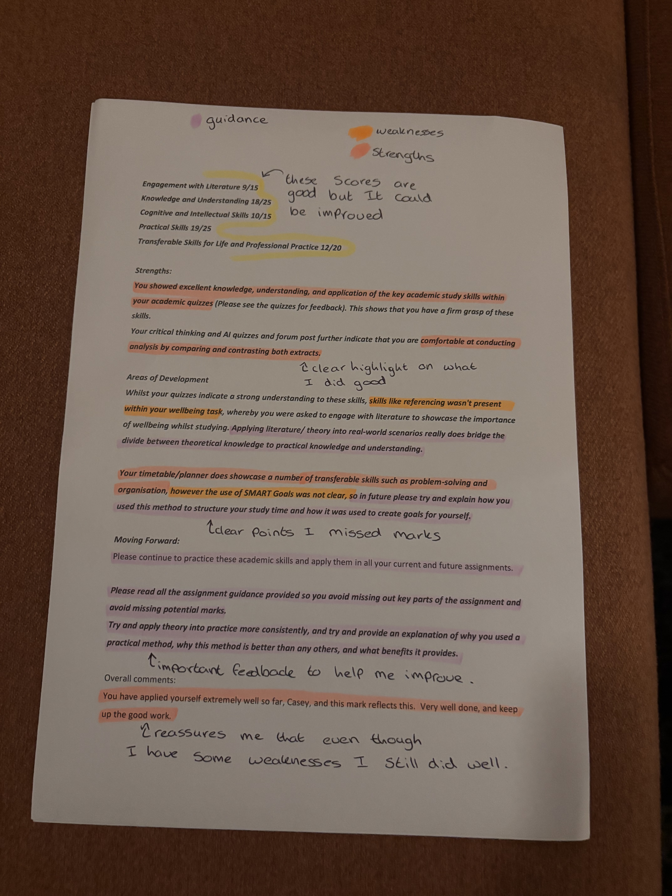
Feedback received
Here is a photo of the feedback I received from my assignment. In this photo I have annotated my strengths and weakness. I also made notes throughout it to highlight importance and to write down my thoughts.

Slide 6
Identifying my strengths
I was able to show
  Excellent knowledge
  Understanding
  Application of the key academic study within my academic quizzes
  Critical thinking skills
  Comfortability at conducting analysis by comparing and contrasting both extracts.

Slide 7
Identifying my weaknesses
During my assignment my weakness was
  Adding more referencing
  More clarity of the SMART goals
  I missed marks due to not reading the guidelines
  My literature to showcase the importance within my wellbeing task.

Slide 8
What I learned from the feedback
As a result, I learned
  The importance of adding more references
  To better my literature to be able to express myself better
  Read the guidelines
  To be more clear

Slide 9
Action plan
Improve my references
  Dedicated time in each assignment to check and add relevant reference
  Use references guides and or tools
Better my explanation through literature
  Select stronger and more relevant academic sources to be able to support my points
  Summarise and link literature to demonstrate understanding
Following assignment guidelines carefully
  Read the market criteria
  Create a simple checklist
Improve clarity and structure
  Plan each section
Apply SMART goals
  Revisit SMART goals

Slide 10
Conclusion
In conclusion, reflecting on my assignment and the feedback I received has allowed me to clearly identify both my strengths and the areas where I need to improve. This feedback has helped me understand what I need to focus on going forward. This assignment has made me became more self-aware as I was able to see my key strengths and weakness which will allow me to work on what I struggles with.

Slide 11
References
McEwen, J. (2020). Reflecting on Feedback. [online] Social Work England. Available at: https://www.socialworkengland.org.uk/news/reflecting-on-feedback/ [Accessed 8 Dec. 2025].

Slide 12
The end.
by Casey

