Slide 1

Master of business administration lcmb7000
Task 2 – Presentation
Mohammed Amir Rashid
Student number: - 1714326

Slide 2
CONTENTS
1) Introduction
2) Porter’s Five Forces Framework
3) Articles on how HRM can support competitive advantage
4) Advertised Job description
5) Person Specification and benefits
6) Interview Questions
7) Conclusion
8) References

Slide 3
introduction
In the current situation that we are in the cost of living is very high due to inflation which impact all businesses and due to the economic situation the businesses are forced to reduced costs by all means in order to keep a competitive advantage according to (Porter's Five Forces - The Framework Explained - A Guide to Analysing Competitiveness Using Michael Porter's Strategic Model. 2022)
Porter’s argument suggests that the framework he introduced is a strategic way of helping businesses recognise the importance of their competitors and strategic ways of staying competitive amongst them. In his framework he mentions it is very important to identify which entities are holding the power as well as displaying opportunities to expand the business so its important to understand the corporate risk in order to estimate the competition in the industry which helps to make corporate strategy and vision ('Porter's Five Forces: Advantages and Disadvantages', 2022).

Slide 4

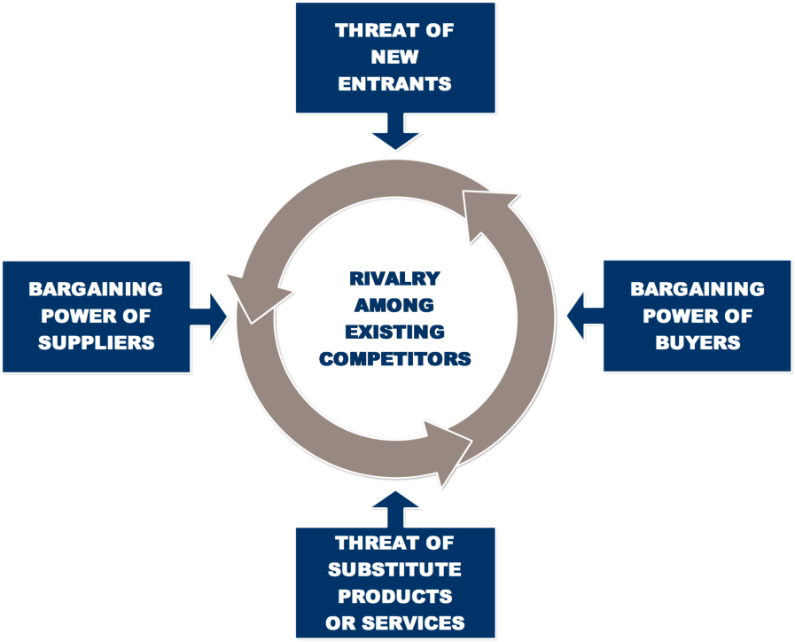
Porter’s five forces framework
The importance of the Five Forces Framework by Michael Porter suggest that they represent the bargaining power of the suppliers, competitors, buyers, threat of new entry, industry rivalry and threat of substitute products.
The reason why the Porter’s Five Forces model is important is because it determines a business competitive environment which has the ability to affect profitability.
(The Importance of Porter’s Diamond & Porter’s Five Forces in Business. 2021).

Slide 5

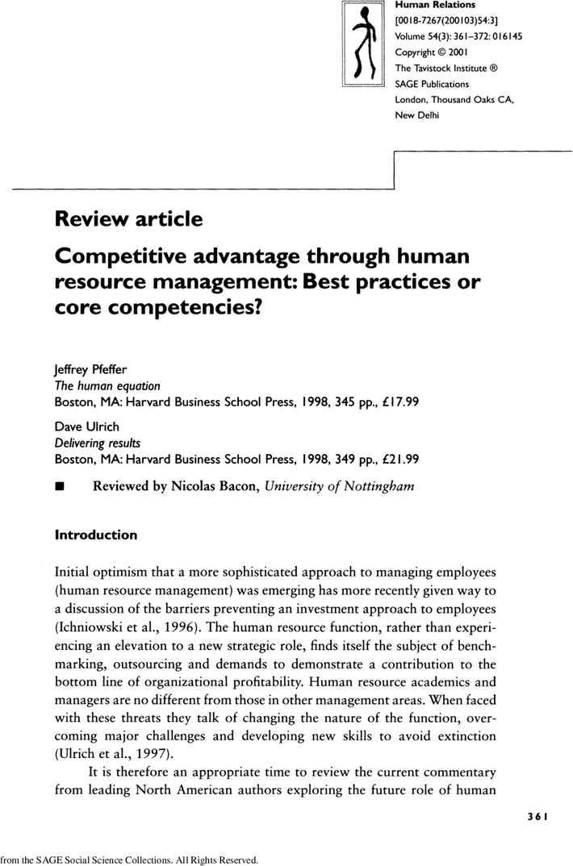
Articles on how HRM can support competitive advantage
As for human resource management is concerned it helps to retain highly skilled employees so in order for this to be implemented successfully there must be strategies such as providing employee incentives to keep a healthy motivated working environment for employees which helps to gain a strong competitive advantage amongst major competitors such as high pay rise after managing performances as well as a career progression from customer service to team leader for example and cheaper healthcare, major brand retail vouchers, bonuses, an appraisal and even more yearly holidays entitlement which creates a stronger and sustained workforce as a competitive advantage to major competitors.

Slide 6
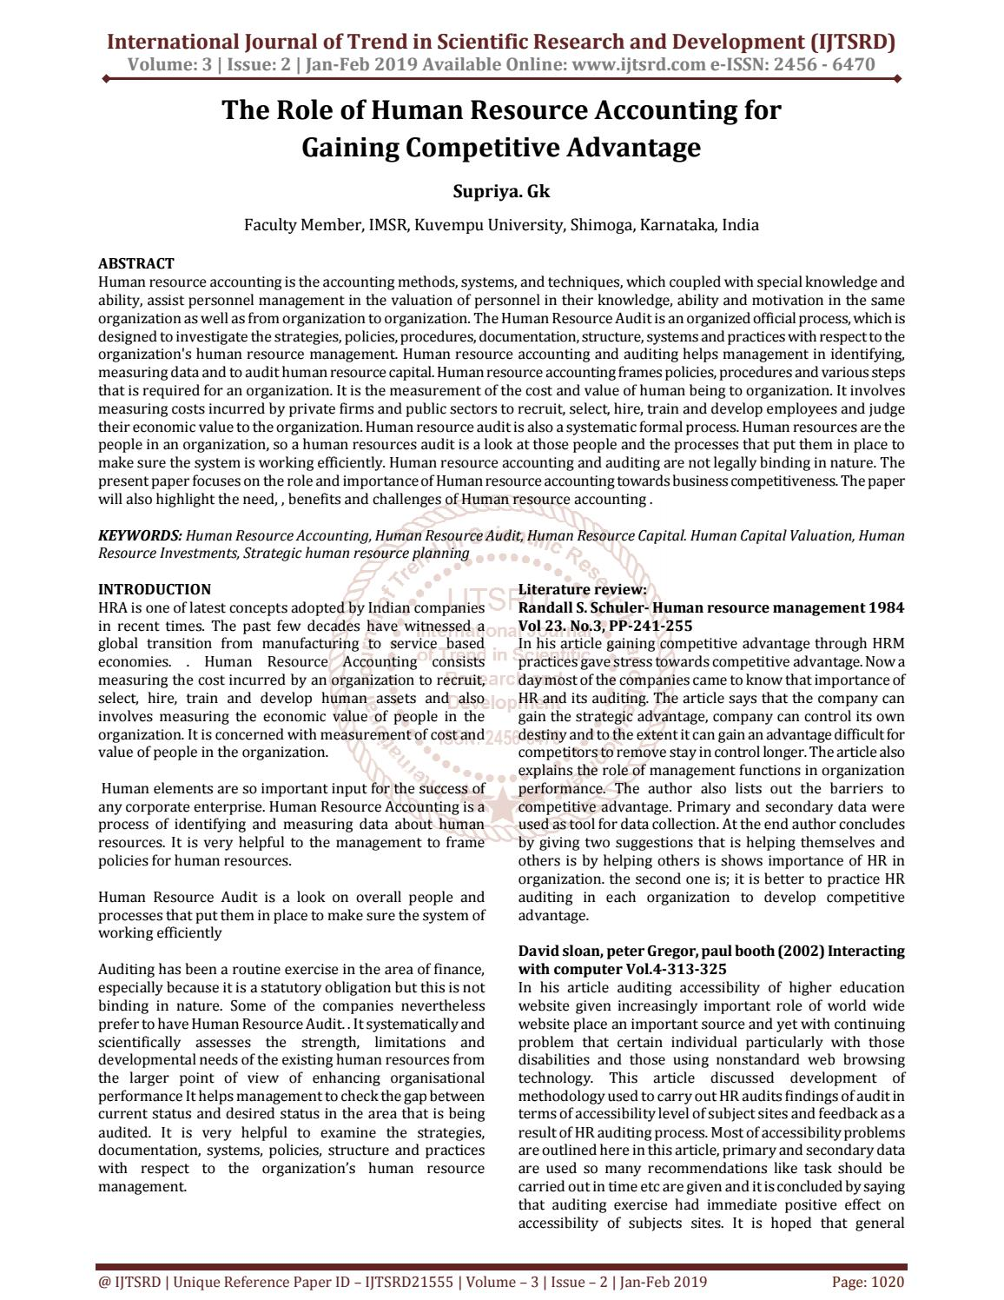
Gaining a competitive advantage using HRM have many important factors associated to gain such competitive advantages such as targets that would involve successful execution of strategies and suppliers as well as customers and competitors.
There are enhanced strategic drivers which play a huge part in sustainable HRM which are innovation, differentiation, growth and costs associated to the business.

Slide 7
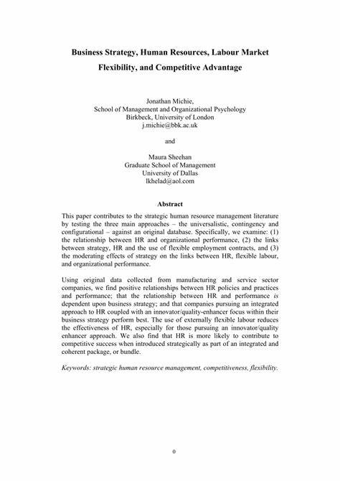
As a department, HR can advance environmental efforts through creating company policies and guidelines. Consolidating greener changes within business procedures and guidelines is a way that HR teams can make positive, climate-friendly changes.
What is the role of HRM in changing environment?
It takes planning and skilled project management. HR has a role to play in ensuring that people in the organization are part of the changes. With training and better communication, employees are empowered to grow with the company, creating long-lasting change.

Slide 8
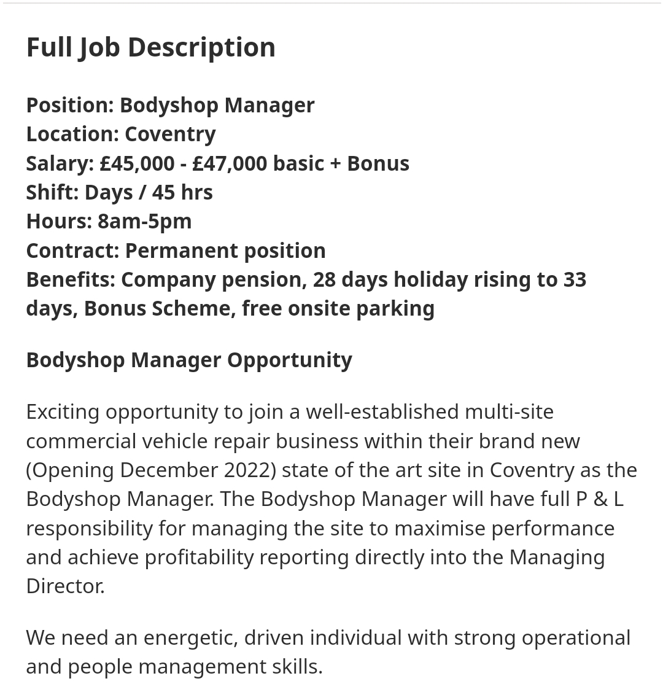
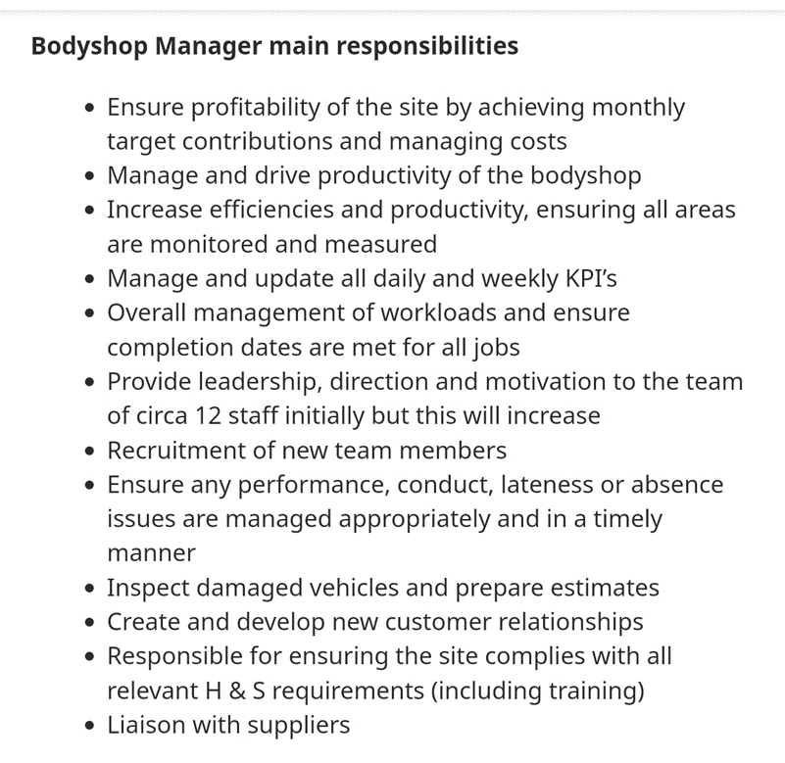
Job description and key responsibilities

Slide 9
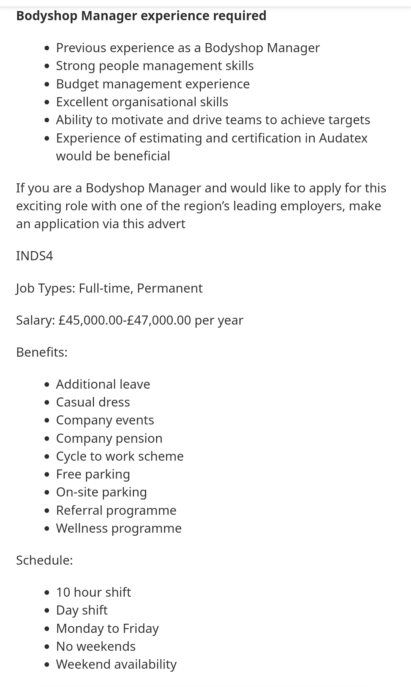

Person specification and benefits

Slide 10

1). Why did you decide to apply to this role?
2). What experience do you have that would be relevant to this role?
3). What are your strengths and weaknesses?
4). Where would you see yourself in 3 years?
5). What skills do you have which you believe are relevant to the required role and why?
6). As an example, from your previous work experience what can you bring to us which will help us as an organisation to reduce the cost effectiveness of the business?
7). Please tell us about a situation which was critical in the working environment which was stressful and how you overcame the situation?
8) What motivates you as an individual?

Slide 11

Using HRM in the modern-day working environment it has been proven to be a creative and sustainable competitive advantage using materials involving quality enhancement, innovation and cost reduction.
It also enhances competitive advantage using a selective employee recruitment strategy, improving HR processes, allowing collaboration, motivated workforce, replacing the paper file systems and have more feasibility.

Slide 12
Please feel free to ask any questions thank you !

Slide 13
References
Jago, L. and Deery, M. (2002), "The role of human resource practices in achieving quality enhancement and cost reduction: an investigation of volunteer use in tourism organisations", International Journal of Contemporary Hospitality Management, Vol. 14 No. 5, pp. 229-236. https://doi.org/10.1108/09596110210433754
7 Reasons Why HR is So Important for Business Success', (2023) Human Resources Degrees, . Available at: https://www.humanresourcesmba.net/lists/5-reasons-hr-is-so-important-for-business-success/ (Accessed: Mar 4, 2023).
Porter's Five Forces - The Framework Explained - A Guide to Analyzing Competitiveness Using Michael Porter's Strategic Model. (2022) Available at: https://www.mindtools.com/at7k8my/porter-s-five-forces (Accessed: Mar 4, 2023).
'Porter's Five Forces: Advantages and Disadvantages', (2022) Learn Business Concepts, -01-02T12:13:47+00:00. Available at: https://learnbusinessconcepts.com/advantages-and-disadvantages-of-porters-five-forces/ (Accessed: Mar 4, 2023).
The Importance of Porter's Diamond & Porter's Five Forces in Business. (2021) Available at: https://smallbusiness.chron.com/importance-porters-diamond-porters-five-forces-business-33891.html (Accessed: Mar 4, 2023).
Sands, L. (2022) Why is human resources (HR) important? Available at: https://www.breathehr.com/en-gb/blog/topic/business-process/why-is-human-resources-important (Accessed: Mar 4, 2023).

