Slide 1
Effective Low Costs Energy For Your Home And Business
Paul Roseway
No: 2127271
Certificate of Higher Education in Skills for Electronics (Level4)
Integrating Project (ACHA4008)
University of Wales Trinity Saint David.

Slide 2
The goal of the project
  The cost of energy is high and it will continue to rise in the future, there are effective low cost energy solutions that can help to reduce Carbon footprint, this is better for the environment, it helps save money, you can also benefit financially from it in the future.
  Governments are looking for ways of reducing energy consumption and cost.

Slide 3
Project Objectives
Energy consumption plays a crucial part in our everyday life
The cost of energy is a financial burden for businesses and households
There are ways you can reduce your energy consumption by
Checking your bills to see where you can save on energy

Slide 4
Objectives of the project
Using appliances more efficiently
Replace old appliances
Invest in some LED lights they use up less energy
Insulate your home and business properly it can cut energy costs
Use a programmable thermostat to check your energy system

Slide 5
Renewable energy is the way to go
Ways you can generate your own electricity
Benefits you get from renewable energy
Storage for excess energy

Slide 6
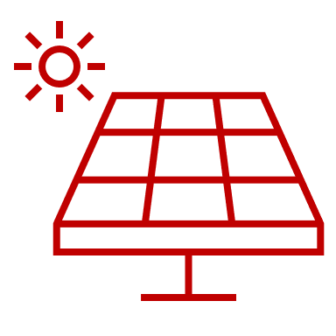
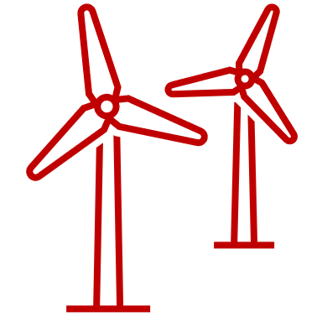



What is Renewable Energy
Solar energy
Wind energy
Renewable energy is environmentally friendly
Renewable energy comes from a natural source
Renewable energy is better than fossil fuels
Biomass energy
Hybrid energy

Slide 7
Types of Renewable energy
Solar power using solar panels
Wind Hybrid system
Micro hydropower system
Bioenergy
Geothermal energy

Slide 8
Installing renewable energy on your property
First you should consider licences, regulations and planning permission
Consider your budget and upfront capital spending
Check if your house or property is suitable for the type of system you are interested to install
Consider a suitable structure for your solar panels or wind turbines to Stand on
Also consider the weather patterns in your area

Slide 9
Before start project
You should consider a qualified person with knowledge, understanding and licences to do the job
Get a quote for the items you need for your installation, so you can be prepared

Slide 10
Solar power
solar power is affordable and it is most used and abundant sources for alternative energy
Solar panels are used to capture the energy from the sunlight and convert that energy into electric energy, even on a cloudy day
Solar panels come in different sizes, big or small it depends on the amount of energy you need they work the same
You will need a battery bank to store the excess energy for when you need it

Slide 11
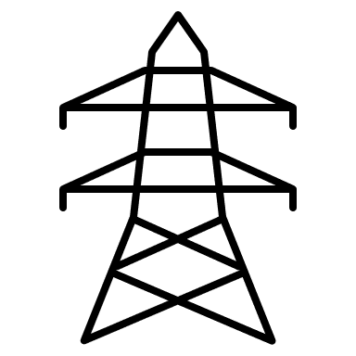

Solar Panels
PV CELL
Solar power chart
Utility grid
Solar panel
Chaarge controller
Inverter
Wire
Utility meter
House
Battery Storage
Battery bank

Slide 12
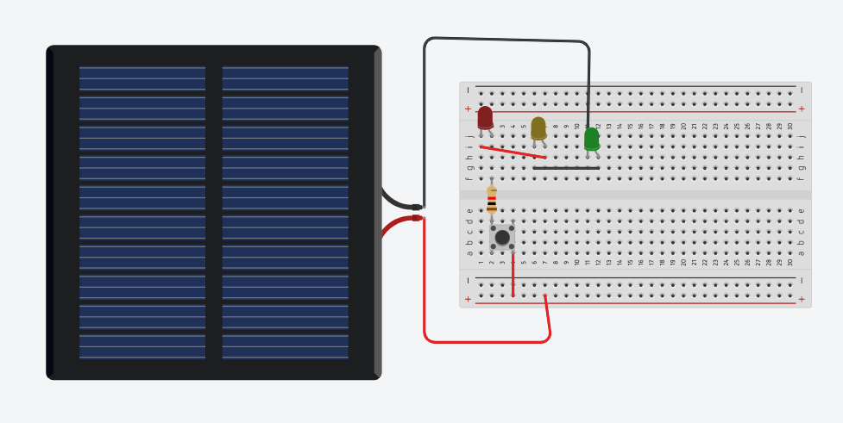
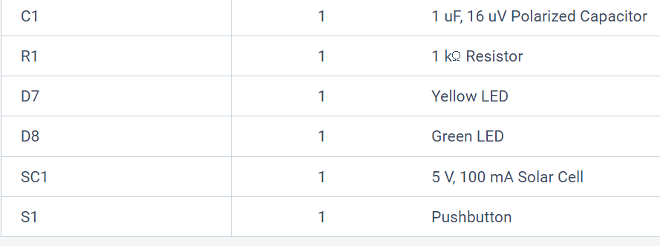
End product

Slide 13
Wind Hybrid system
Wind turbines are another source of generating electricity
It is zero emission and contributes strongly in energy consumption
Wind is free and is every where, its depending on the lift of the wind
This can go around your home depending on Laws, regulations and your land space

Slide 14
Wind Hybrid system
This works when the wind lift is strong, it rotates the blades of the turbine
as the blades rotate the mechanism inside the motor rotate the generator which converts DC to AC electricity energy
It can also work with solar power to have as a backup source of incoming energy from the wind

Slide 15
Wind Turbine Flow chart
Wind Turbine
PV Solar Panel
Generator
Wire connects
Regulator
Inverter
Battery-powered
Switch
on or off
House

Slide 16
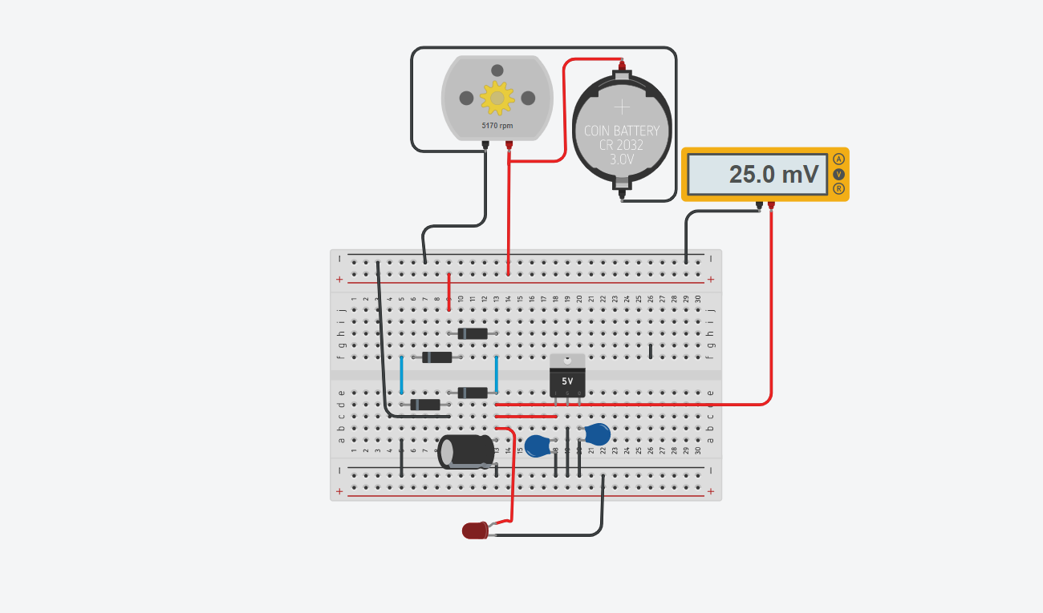
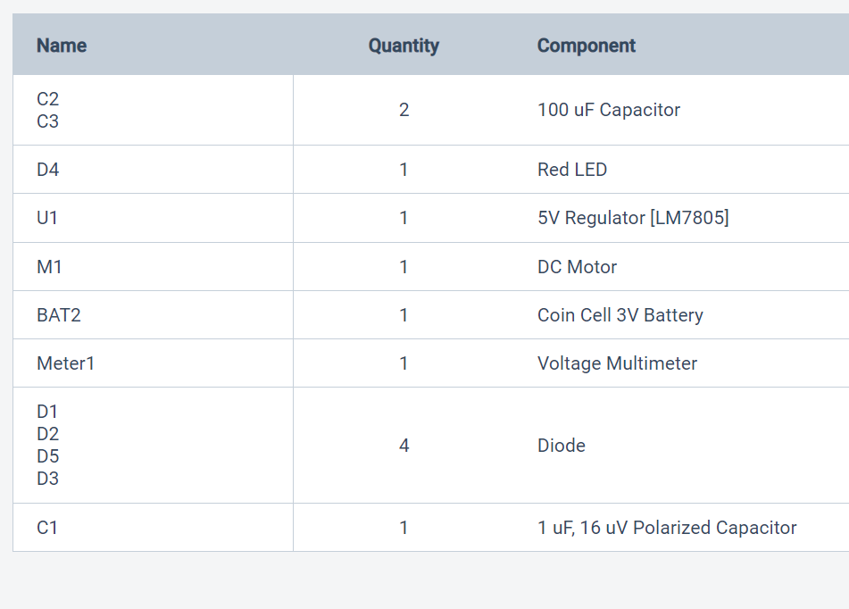
Wind System

Slide 17
Micro hydro systems
Micro hydro systems works in the similar way as the hydropower
Both used kinetic energy from the water movement while it flows
the movement of the water flowing through the turbine turns the generator which generates electricity
.

Slide 18
Micro hydro system
Water Divert
Divert
Home
wires
Battery-powered bank
Water
Electrical Generator
Wheel Turbine
RUNNING STREEM
Outlet
stream

Slide 19
Biomass Energy
Biomass is considered a source of energy,
Biomass is any organic matter that can be brunt, can be used to produce energy.
This works when you burn organic waste, wood pellets in a furnace or biomass boiler it produces hot water, that gives off heat that spins the generator which creates electricity.

Slide 20
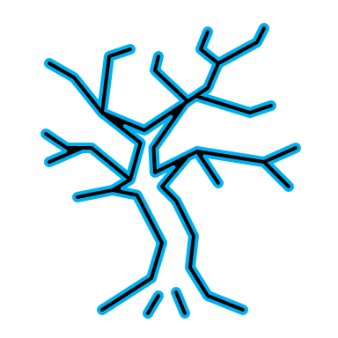







Biomass Energy
Biomass energy comes from organic things such as,
animals waste,
plants, such as cane, soy, corn, grassy , wood.
Some industrial waste, and also human waste

Slide 21
Geothermal Energy
Geothermal energy is a source renewable energy that gives off less greenhouse gas emissions and is considered sustainable to use.
Geothermal energy comes from underground, it is a form of energy conversion that captures heat energy from the earth, and it can be use for several things such as generate electricity.

Slide 22
Geothermal Energy system works
This works when the earth crust and mantle generates heat through the decay of radioactive elements and the friction produced along their movements.
To harness this source of energy involves drilling underground wells to access reservoirs of water and steam, which are subsequently employed to power turbines and produce electricity.

Slide 23
Geothermal system
Turbine
Generator
Cooling cylinder
Heat exchanger
Hot water
Injection well
Magma

Slide 24
Conclusion
By investing in renewable sources energy can lower your energy bills and reduce greenhouse gas emissions. Renewable energy sources, such as wind, solar, bioenergy, hydropower, and geothermal. These sources are considered a sustainable alternative renewable energy and its environmentally friendly. There are Government tax incentives on renewable energy.

