Slide 1
Learning Intentions for Reading

Slide 2
These are to help you as you plan
These statements to come from old curriculum documentation, but they are still valid learning intentions.
Statements from the LNF are show at the end.

Slide 3
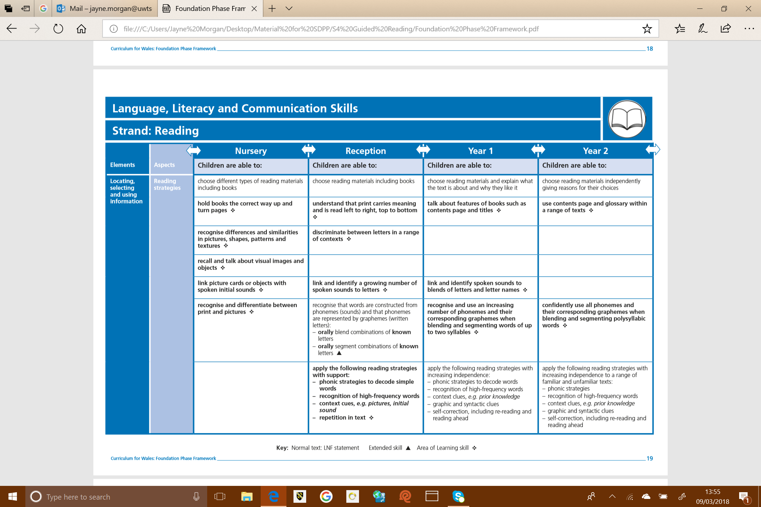

Slide 4
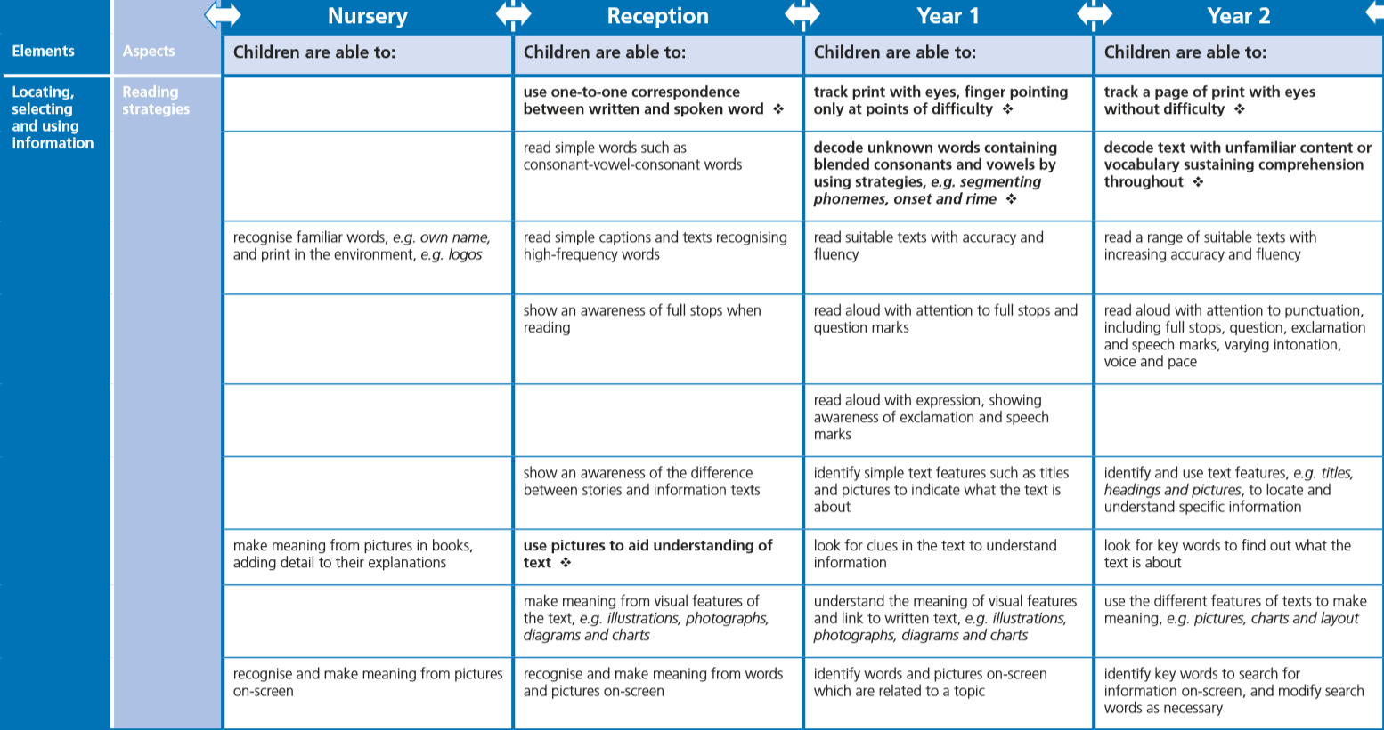

Slide 5
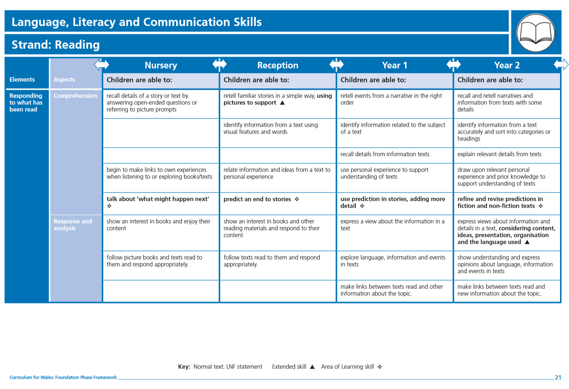

Slide 6
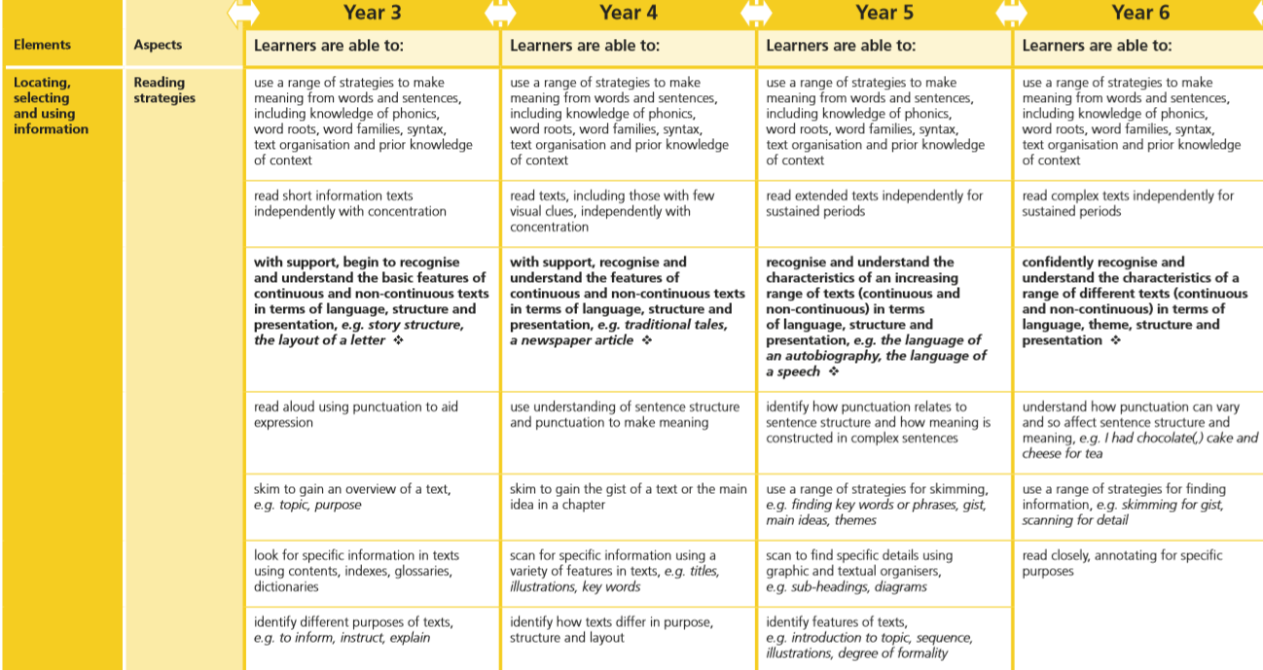

Slide 7
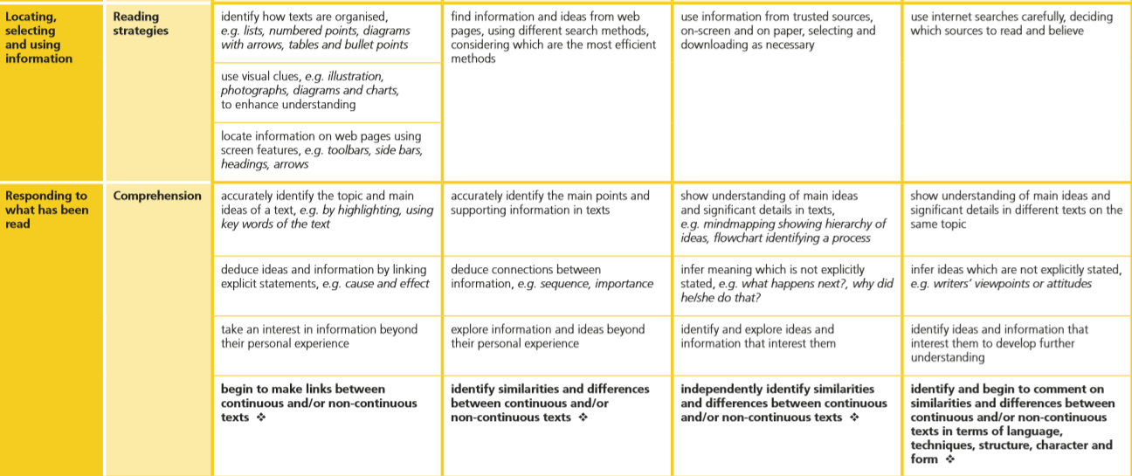

Slide 8
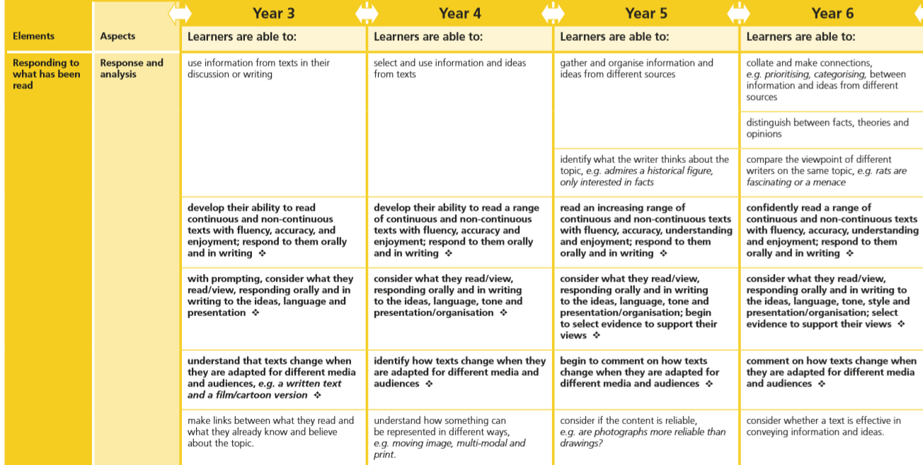

Slide 9
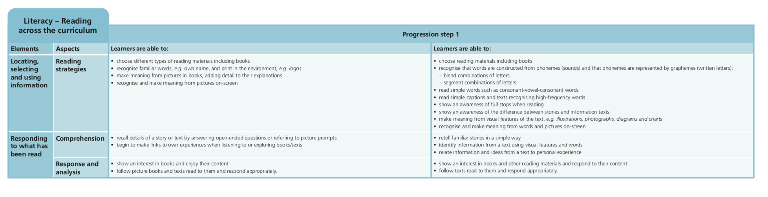

Slide 10
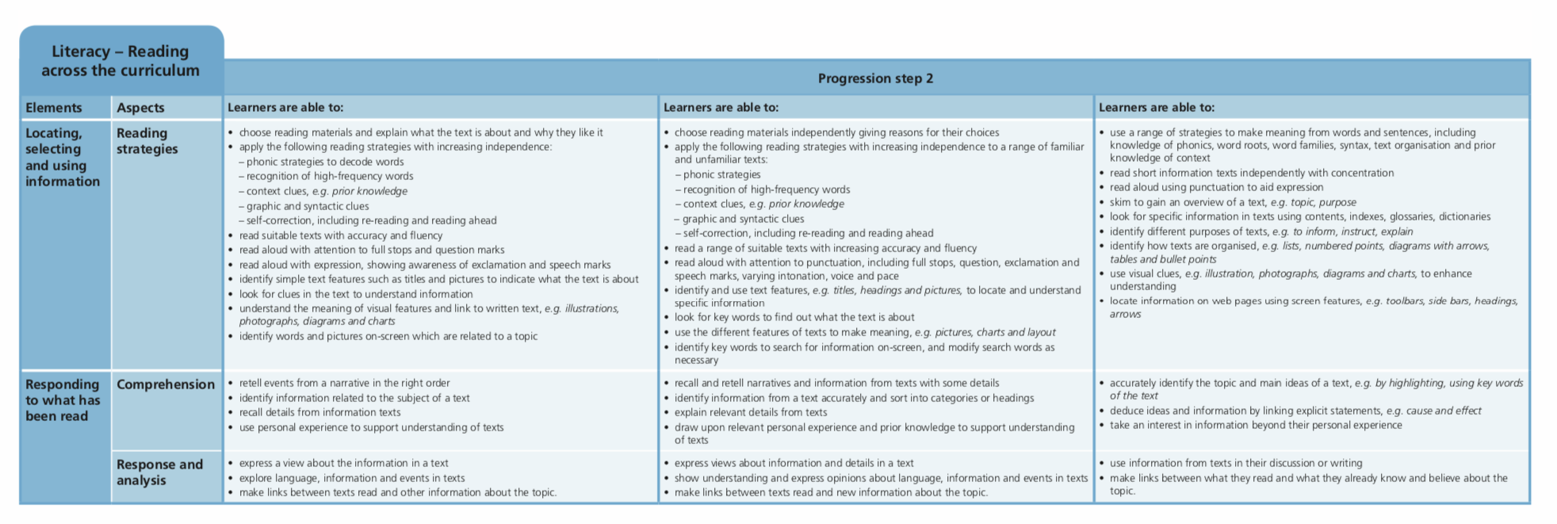

Slide 11
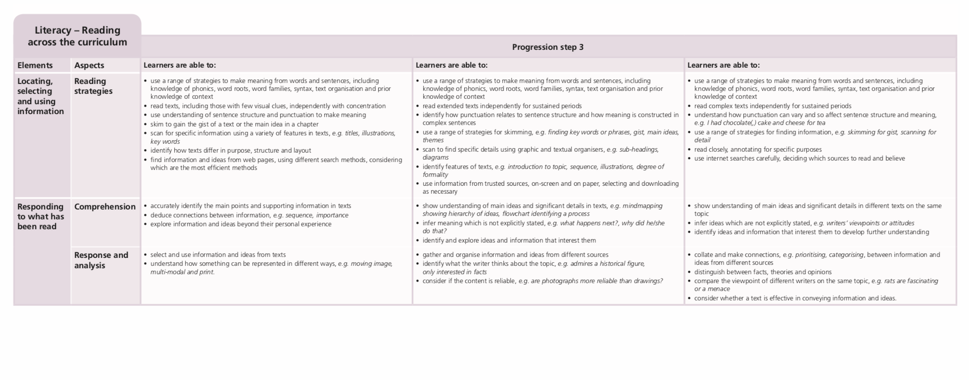

Slide 12
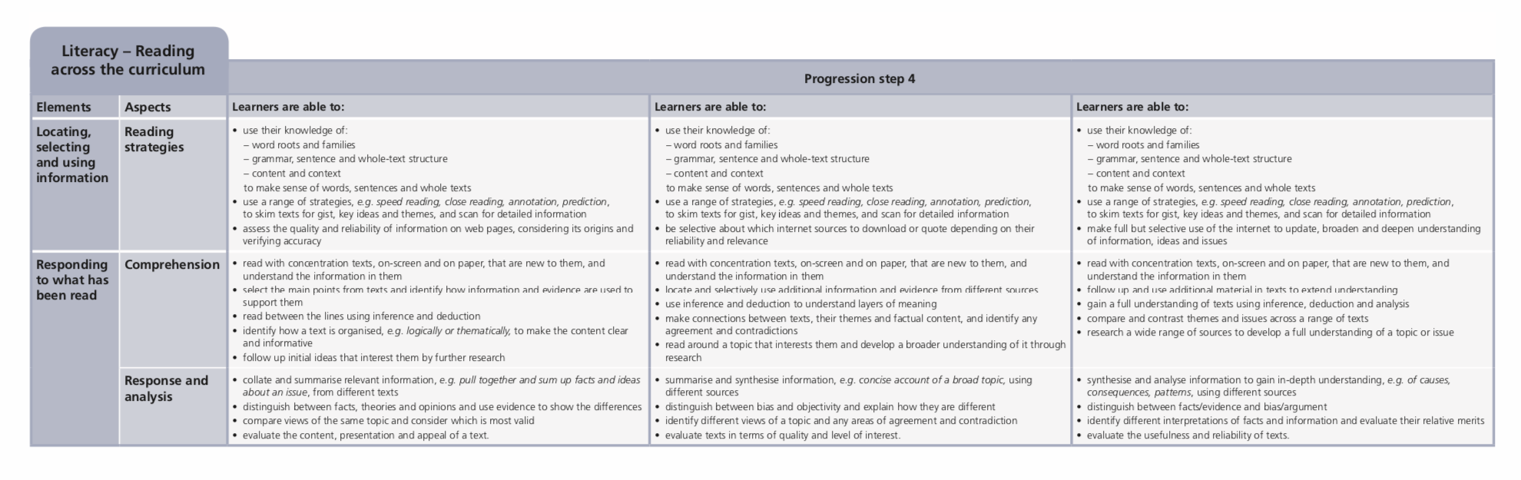

Slide 13


