Slide 1
Certificate of Higher Education
Business Skills for the Workplace
Academic Skills
(LCLM 4001)
Session 3 – Reading Strategies and Note-taking

Slide 2
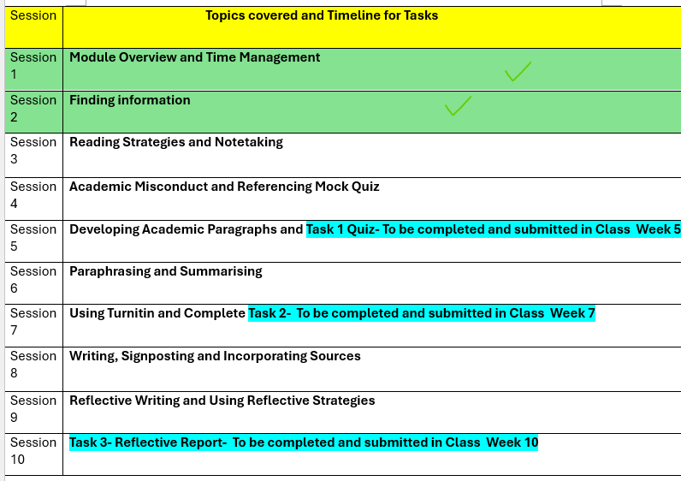

Slide 3

Last week’s recap
We did the following:
Finding information
Using the CRAAP Method
Scholarly, and non-scholarly sources
Explored the Infoskills Module/programme
Click here to attempt Recap Quiz

Slide 4
Remember Assessment weeks and deadlines (For more details, read the assessment specification document found in the purple tile on Moodle and watch the video LCLM4001-Academic Skills Assessment Tasks Explained
Academic skills Quiz – 45 minutes (In class)
Task 2
In week 7
Academic Skills Practice – 850 words
Task 3
In week 10
Essay writing (Reflective writing) –Max1200 Words
Task1
In week 5
This task has 3 questions on the following topics: Note-taking, Paraphrasing, Academic Writing and structuring paragraphs.
(Task to be completed in class)
(Task completed in Class)

Slide 5

Today’s session
The session will be divided into 2 parts:
Reading and Reading Strategies
Explore Note-taking Strategies

Slide 6
Part 1 – Reading

Slide 7

Reading
Reading involves thinking, learning, and expanding a reader’s knowledge and horizons. It has to do with building on past knowledge, mastering new information, and connecting with the minds of others. A process that demonstrates comprehension.
(Zimmerman, S. and Hutchins, C. (2003))
It entails
Locating, selecting, and using information, which covers reading strategies
Responding to what has been read, which includes comprehension.
Curriculum for Wales: Foundation Phase Framework (Revised 2015).

Slide 8
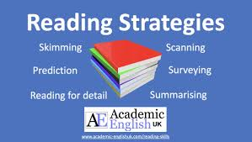
Reading Strategies
Prediction Guessing what the text is about
Surveying Surveying a text means focusing on the general aspects of a text rather than details, with the aim of deciding if the source is worth a closer read
Scanning Search for specific information (statistics, dates, facts, key/specific words, phrases, author or theory).
Skimming Focuses on identifying the main ideas rather than trying to read the details. Here, you identify which parts you need to read in depth.
Reading for detail To Understand exactly what a section is saying. The deepest form of reading.

Slide 9
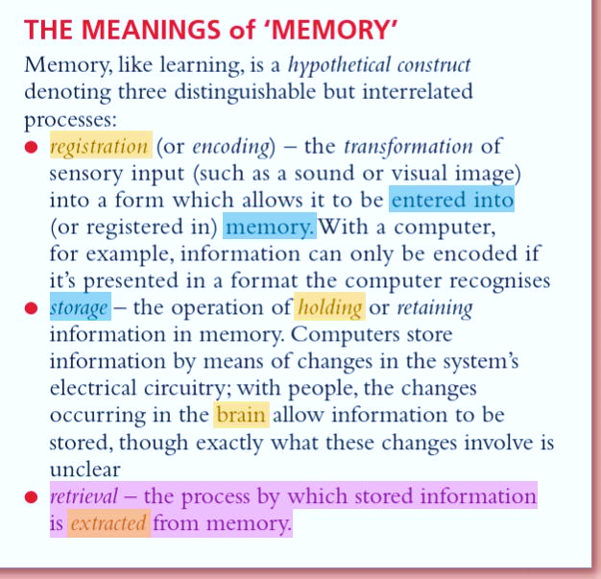
Highlighting
Highlighting refers to emphasising/selecting key words, phrases or data by means of underlining or circling, or using a coloured highlighter pen.
Many of the books available on the reading lists have a highlighter and note making tool.
How to highlight a PDF Source - Video
Notes:
Lecturer, please guide the students to search online, find a reliable source, and let them try to highlight information. They can use the library online reading list.

Slide 10

When do you stop reading?
Information starts to repeat itself
You have covered the core material
You have answered the research questions
You are coming across information not relevant to the research question
The information does not offer anything new
or
You have lost your concentration.
Notes:
Using reading strategies should help you to read more effectively, and to engage with the texts to question them and extract relevant ideas. You won’t have time to read everything on a topic as you will need to balance it with other academic work commitments.

Slide 11

Activity 1
Following the prompts on slide 13,
Select any of the texts of your choice (from the online reading list from slide 13-14)
Practice any of the reading strategies we have just learned.
Notes:
Use this opportunity to gauge students’ knowledge and understanding and manage expectations too.

Slide 12
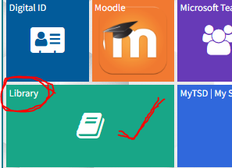
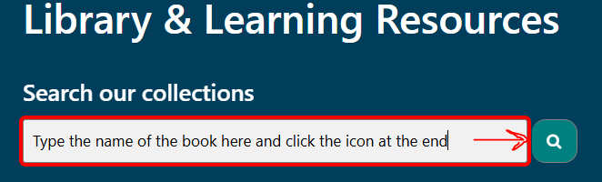


Locating Resources
If the online reading list is inaccessible or shows “Redesign” in the tab. Kindly follow these steps:
-Return to the Hwb page (Home page)
Click on the library Icon
Type in the title of the book of your choice
Open and complete the task.
Notes:
To use Lucid Chart, you need to create a free account with your student email address.

Slide 13
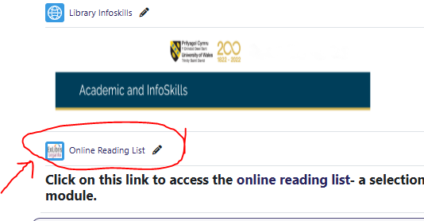
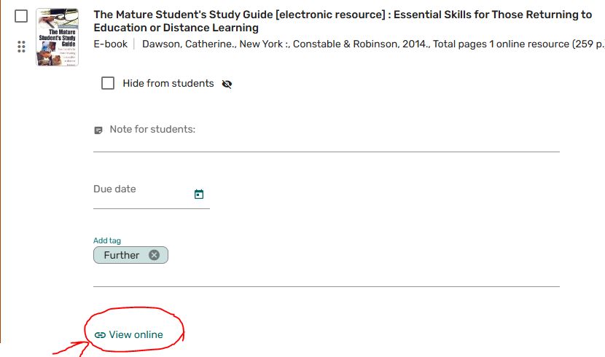
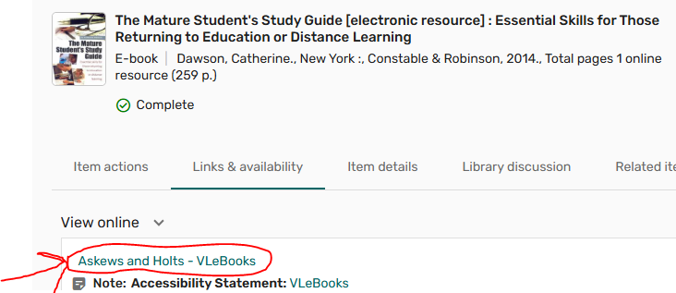


Go to the Moodle page, find the reading list, and follow these steps:
1 –Click the online reading list
2- Scroll to any book of your choice
click ‘view online.’
3- Click the first line/link under
‘View online’ to access the book.
4- Proceed to click ‘Read/Read online’
to access the book content.
Notes:
Note: You may be required to sign into the online library to access some of these books. If this happens for you, simply use your student email and DOB password to access the library.

Slide 14
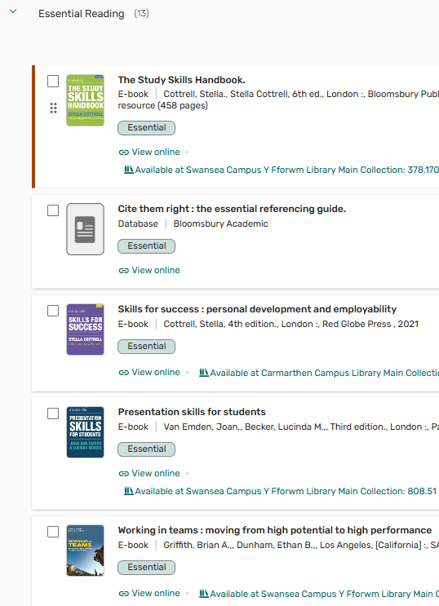
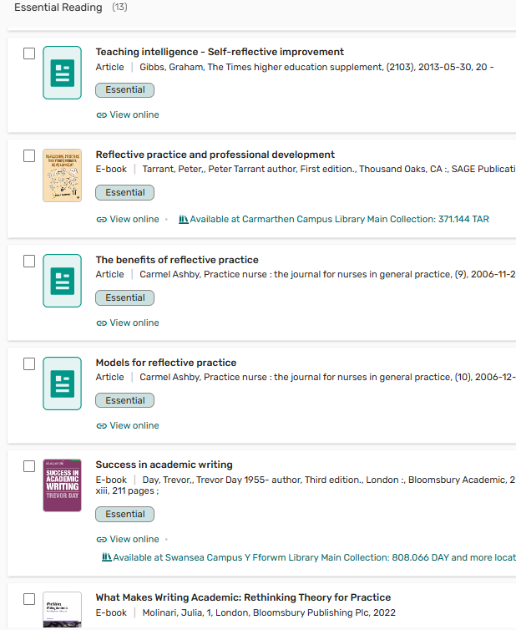
Notes:
Use this opportunity to gauge students’ knowledge and understanding and manage expectations too.

Slide 15
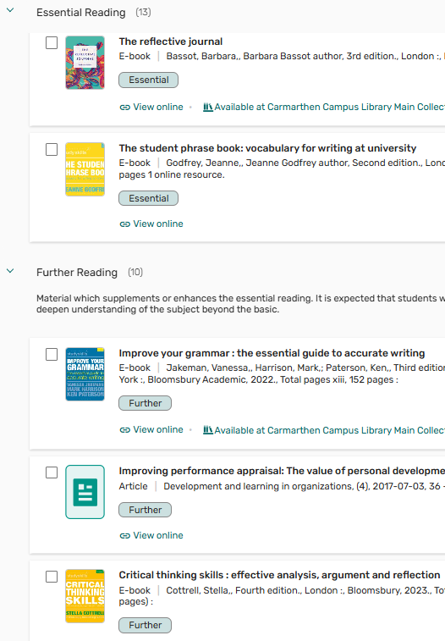
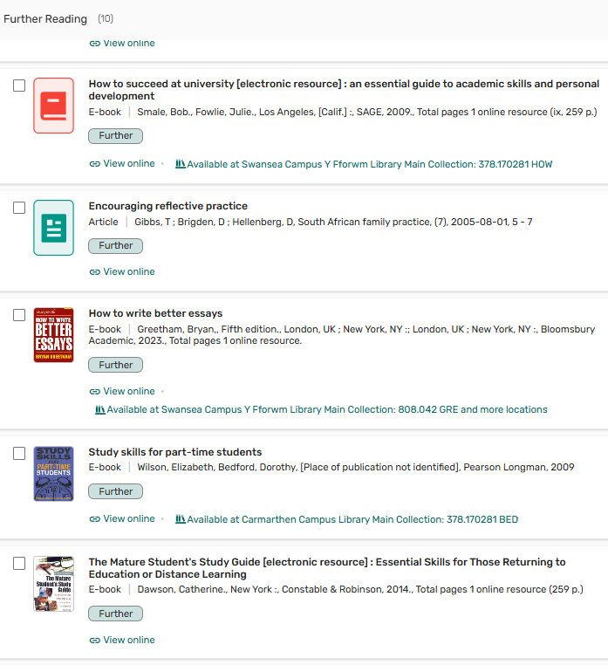
Notes:
Use this opportunity to gauge students’ knowledge and understanding and manage expectations too.

Slide 16
BREAK

Slide 17
Part 2
Note-taking

Slide 18

What is notetaking?
Notetaking is a process of writing, reviewing, connecting, and synthesising ideas from your lectures or reading.
(University of Leeds,2025)
(Click on this link to learn more Tips on Note taking)
(To view the tips, place the pointer on the hyperlink in blue, press and hold down the Ctrl Key when a finger appears, then click. The resource will open in a new tab.)
Notes:
Lecturer is encouraged to share tips on note taking:
Write phrases not full sentences
Take notes in your own words
Structure your notes with headings, subheadings and numbered lists
Code your notes - Use colour to highlight major sections, main points and diagrams.
Underline, circle, star, etc. to identify key information.
Use abbreviations - etc. (etcetera) = and the rest, e.g. = for example, info = information, i.e. = that is, n.b. =note well, important, p = page (pp = pages), para = paragraph, ch. = chapter, no. = number, diff = different, C19 = nineteenth century

Slide 19


Notetaking: How do you take notes?
I will write down everything the Lecturer says. Having comprehensive notes are very important.
I will not write anything. Listening is more important

Slide 20
Importance of note taking
To improve your understanding of concepts by converting difficult ideas into your own words.
Prepare for writing fuller and developing better-connected arguments in your essays
Be more focused and enables you to efficiently manage time when revising.
Assess your own progress as you study.
(Click on this link to learn more Tips on Note taking)
Notes:
Lecturer is encouraged to share tips on note taking:
Write phrases not full sentences
Take notes in your own words
Structure your notes with headings, subheadings and numbered lists
Code your notes - Use colour to highlight major sections, main points and diagrams.
Underline, circle, star, etc. to identify key information.
Use abbreviations - etc. (etcetera) = and the rest, e.g. = for example, info = information, i.e. = that is, n.b. =note well, important, p = page (pp = pages), para = paragraph, ch. = chapter, no. = number, diff = different, C19 = nineteenth century

Slide 21

Challenges of note-taking
Factors that may impact Note-taking
The density/complexity of the information.
How fast the information is presented – a slower pace gives time to reflect on/review notes.
How well the information is organised by the presenter.
How skilled you are at taking notes (do you capture the important points?)

Slide 22
BREAK

Slide 23

Note taking strategies
- Mind Maps/diagrammatic notes
Tabular notes
- Cornell method
Linear method
(see resources on Moodle for further learning)
Notes:
Let the students know that we shall be dwelling more on the first 3 strategies in detail. You can simply brush through the last two.

Slide 24
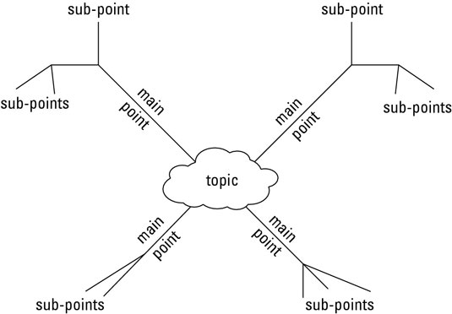
Diagram/ diagrammatic notes
How to make a mind map- Video 1
Mind map explained- Video 2
Image source: https://www.dummies.com/education/college/how-to-study-with-linear-and-non-linear-notes/
Notes:
(To play video, place the pointer on the hyperlink in blue, press and hold down the Ctrl Key when a finger appears, then click. The resource will open in a new tab.)

Slide 25
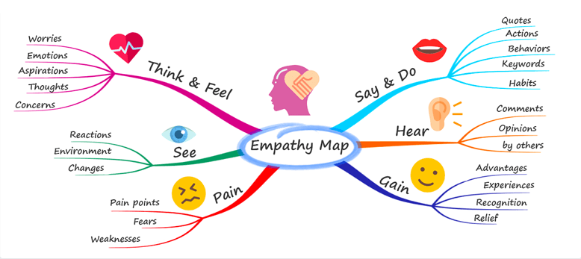
Mind map
Image source: https://www.mindmapping.com/

Slide 26
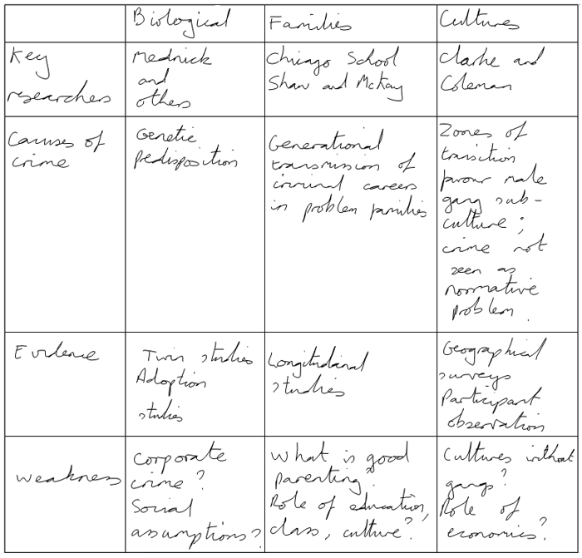
Tabular note taking
Using tables, or 'tabular notetaking', is a good technique if you need to summarise information that you want to compare, such as a debate with differing viewpoints.
Summarising the points in a table helps you to evaluate them, improving your understanding of a topic and helping you prepare for an essay or exam.

Slide 27
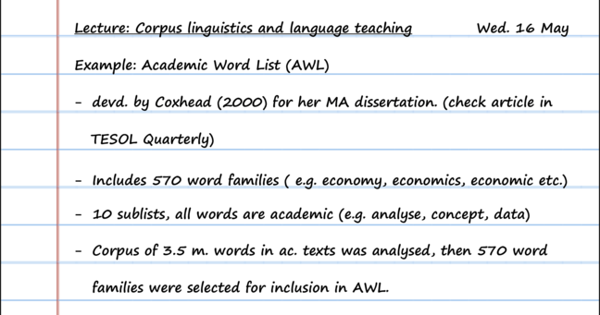
Linear Notes
Image source: https://www.futurelearn.com/courses/prepare-to-study-uk/0/steps/48554

Slide 28
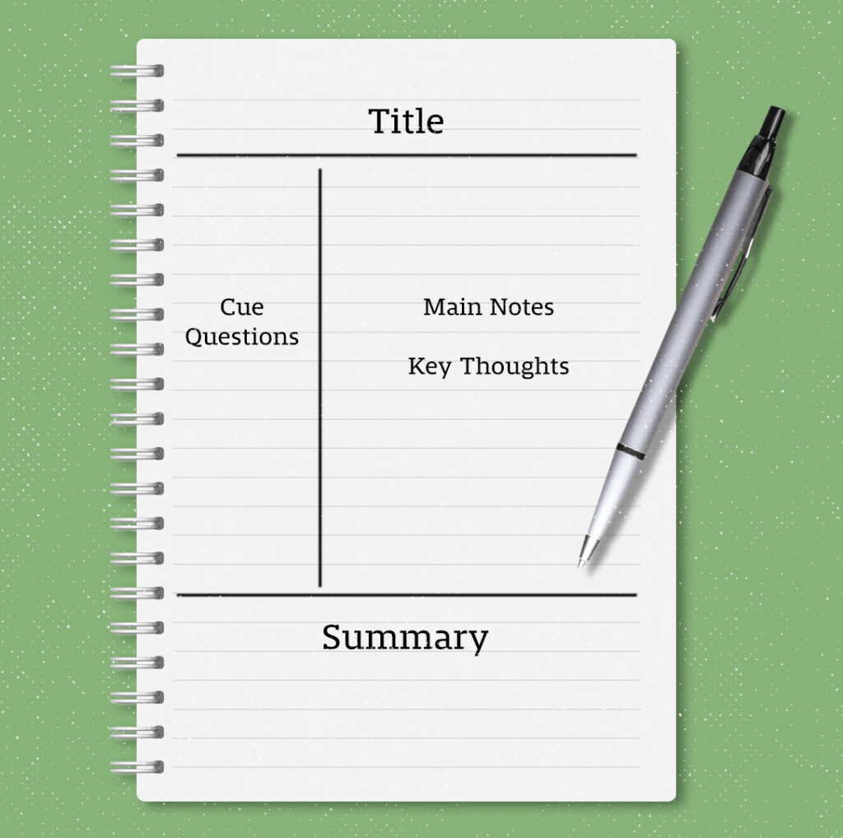
Cornell Notes
Let’s watch a video about this
https://www.youtube.com/watch?v=nX-xshA_0m8
(4 mins)
Image source: CornellNotes-Notepad2d-1024x1018.jpg (1024×1018)
Notes:
(To play video, place the pointer on the hyperlink in blue, press and hold down the Ctrl Key when a finger appears, then click. The resource will open in a new tab.)

Slide 29
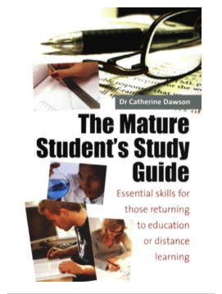
Activity 2
Return to the Reading list and select this book
‘The Mature Student’s Study Guide: Essential for those returning to Education and Distant Learning.’
1- Scroll to Chapter 17
2. Read the section on building a
relationship with your tutor
3- Take notes in diagrammatic format
(Use shapes in a Word document)
Video explaining how to use Lucid Chart App in taking Diagrammatic Notes
Notes:
To use Lucid Chart, you need to create a free account with your student email address.: (you can use shapes or any mindmap apps, e.g Lucidchart | Diagramming Powered By Intelligence your lecturer will support you)
Note: To use Lucid Chart, you need to create a free account with your student email address.

Slide 30


Locating Resources
If the online reading list is inaccessible or shows “Redesign” in the tab. Kindly follow these steps:
-Return to the Hwb page /Home page (see image 1)
Click on the library Icon (see image 1)
Type in the title of the book and search (see image 2)
Open the book, navigate to the required section
and complete the task.
Notes:
To use Lucid Chart, you need to create a free account with your student email address.

Slide 31
BREAK

Slide 32
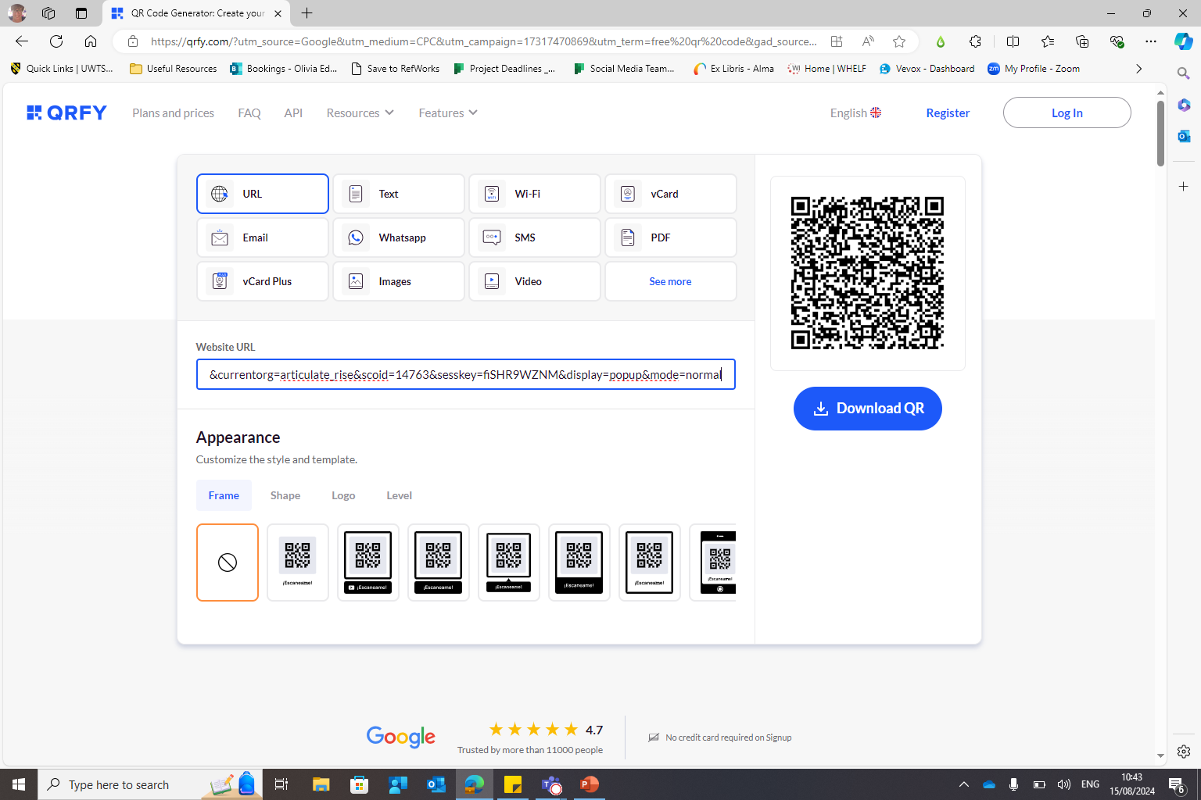
Online Infoskills Programme
If you were unable to sign into the Info Skills Module last week, please enrol using the link below and complete the sessions.
Go to Finding and Using Information Unit 1 Section 2: Stages of Information (includes Evaluating Sources)
moodle.uwtsd.ac.uk/mod/scorm/player.php?a=6864&currentorg=articulate_rise&scoid=14763&sesskey=fiSHR9WZNM&display=popup&mode=normal

Slide 33

Summary
Today we have explored:
Reading and Reading Strategies
Note-taking and Strategies
Online reading list
Importance of Note-taking
Factors that affect note-taking

Slide 34
Reference
Blakeslee, S. (2004) "The CRAAP Test," LOEX Quarterly: Vol. 31 : No. 3 , Article 4. Available at: https://commons.emich.edu/loexquarterly/vol31/iss3/4
Zimmerman, S. and Hutchins, C. (2003) Seven keys to comprehension: How to help your kids read it and get it! New York: Three Rivers Press.
Curriculum for Wales: Foundation Phase Framework (Revised 2015). P21 Available at: https://hwb.gov.wales/curriculum-for-wales-2008/foundation-phase/foundation-phase-framework/
The Open University. (2024) Note taking. Available at https://help.open.ac.uk/notetaking-techniques/tables Accessed 04/07/24
University of Leeds. (2024) Reading. Available at https://library.leeds.ac.uk/info/1401/academic-skills/207/reading/2 Accessed 04/07/24
Waldinger, R. (2017) What makes a good life? Lessons from the longest study on happiness | TED. Available at https://www.youtube.com/watch?v=8KkKuTCFvzI Accessed 05/07/24
UNSW Sydney. (2022) Techniques and Tips for Listening and Note Taking. Available at: https://www.student.unsw.edu.au/notetaking-tips
Accessed 05/07/24

