Slide 1
Essential Skills
Working with Others

Slide 2
During this session we will…
evaluate behaviours that influence team effectiveness,
explain the difference between individual contribution and effective collaboration
evaluate when to support, challenge, intervene, seek advice or escalate;
use professional communication to influence team situations appropriately;

Slide 3
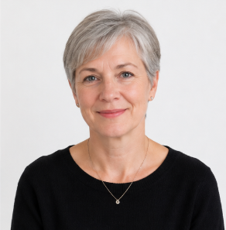




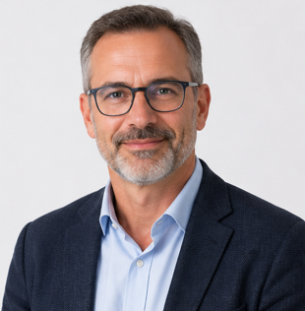
Who Would You Want on Your Team?
Remember our candidates from week 1?
Alex, Morgan, Sam, Taylor, Jordan and Casey have now been working together for several months.
Jordan has recently been appointed Team Coordinator.
Alex — The Expert
Highly capable, high standards, prefers working independently.
Morgan — The Enthusiast
Energetic, volunteers for tasks, Morgan's energy can quickly move the group towards action.
Sam — The Quiet Professional
Reliable and thoughtful, but when Sam raises a concern, colleagues usually listen because previous concerns have proved important.
Taylor — The Independent Worker
Works efficiently alone, but is reluctant to ask for help, has strong relationships with experienced colleagues outside the immediate team
Who has the most influence in this team?
Jordan — The Team Player
Supportive and encouraging, but may avoid disagreement.
Casey — The Learner
Less experienced, asks questions and responds well to feedback

Slide 4
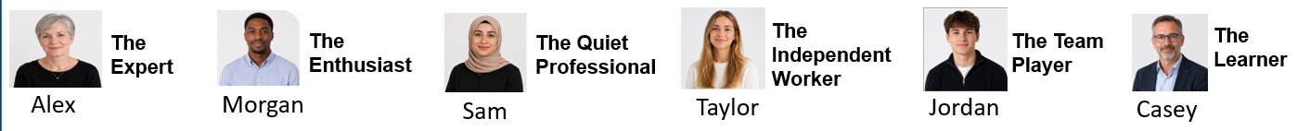
Influence
Your team has been asked to develop a New Starter Welcome Pack and first-week experience that will make joining the organisation easier.
Your team will need to:
find out what new employees need;
review the information currently given to new starters;
identify problems and possible improvements;
generate ideas;
decide what should be included in the welcome pack;
create a simple first-week plan;
produce the new resource;
present your recommendations to a manager.
Who has the most influence in this team?
Does Jordan automatically have the most influence because Jordan has the formal role?
Does expertise create influence?
Does confidence create influence?
Can asking a good question influence a decision?
Can someone influence a team without speaking very much?
Can influence be positive or negative?

Slide 5

From Contribution to Collaboration
In a professional team, completing your own work is important, but it is not always enough. Your work may provide information that someone else needs, your decisions may affect another person's task, or a delay may prevent the whole team from moving forward.
You may not be the manager or have formal authority, but you can still influence what happens through the questions you ask, the evidence you share, the way you challenge, the support you offer and how you respond to others.
  You might contribute an idea, complete a task, ask a useful question,
  solve a problem or support a colleague.
Contribution
  Collaboration means recognising that our individual contributions need
  to connect. We may need to share information, coordinate our work,
  respond to changes and consider what other people need from us.
Collaboration

Slide 6
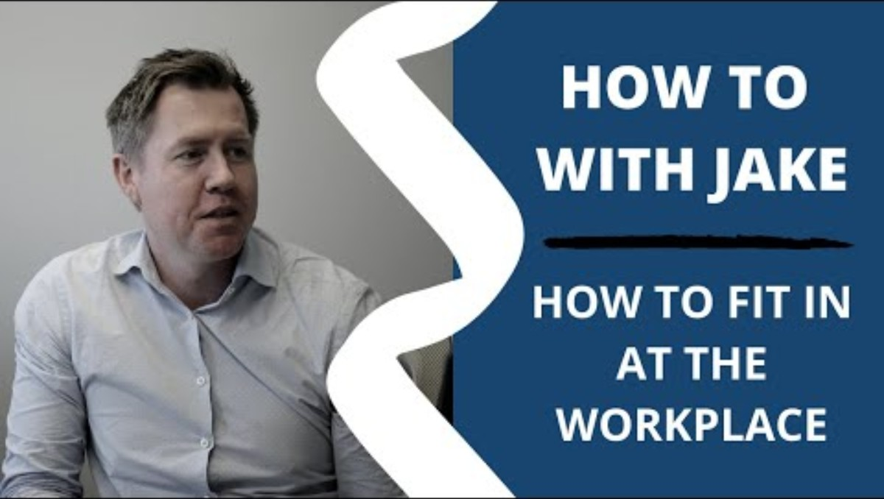
How To Fit in at The Workplace
Notes:
https://www.youtube.com/watch?v=K7GDb8u_AEI

Slide 7

Scenario discussion
Scenario 1
Alex has worked in the organisation for 12 years and recommends using the same approach used successfully on several previous projects.
Casey has been with the organisation for six months but has found recent information suggesting that circumstances have changed.
Alex says:
“We've done this many times before. I know what works.”
What might collaboration look like?
What assertive response could Casey make?

Slide 8

Scenario discussion
Scenario 2
One highly capable team member repeatedly works additional hours to correct other people's mistakes. Deadlines are being met, so the manager believes the team is performing well.
Is the team performing well?
What could the long-term impact of this type of behaviour be?
How could team contributions be monitored or managed differently?

Slide 9
Mini-sort activity : Does This Help Collaboration?
Read the behaviours listed below: sort these into the relevant categories of fitting in.
HELPS COLLABORATION
HINDERS COLLABORATION
I complete another person's work because it is quicker
I share unfinished work for feedback
I offer to take over an unfinished task
I change an agreed approach
I finish my own task early
I challenge the group's decision
I ask another colleague for help
I refuse additional work
I tell the team they cannot meet an agreed deadline

Slide 10
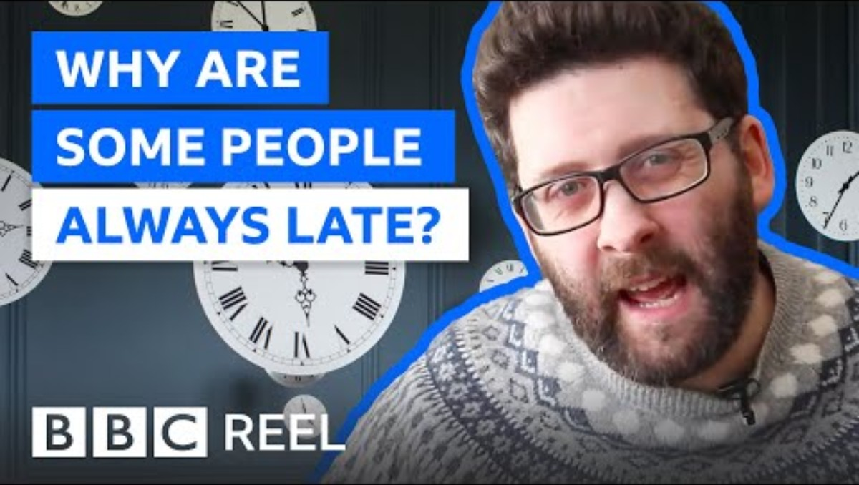
The impacts of your behaviours
Example behaviour – Being Late for work.
Poor time keeping can become a major drain for team morale. So why do people do it?

Slide 11
Reflect
How do you approach time keeping?
How do you feel if a colleague is late?
How can poor time keeping affect collaboration?
What reasons might someone have for being late frequently?

Slide 12
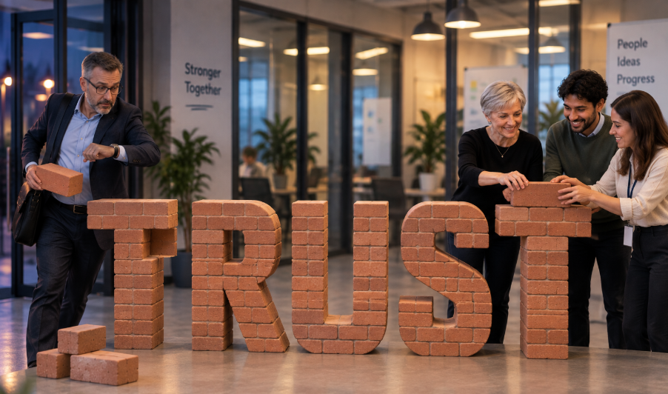
The Team Trust Account
Trust in a team is built through what people repeatedly do, not simply what they say.
Imagine that every working relationship has a Team Trust Account. Our everyday behaviour can either add to it (deposit) or take away from it (withdraw).
Not every deposit or withdrawal is the same size.
Being five minutes late once is different from repeatedly missing deadlines. Making an honest mistake is different from discovering a mistake and hiding it.
Deposits are behaviours that build trust
Withdrawals are behaviours that reduce trust.

Slide 13

The impacts of your behaviours
Admitting mistakes at work is important and helps you develop trust from your team.

Slide 14
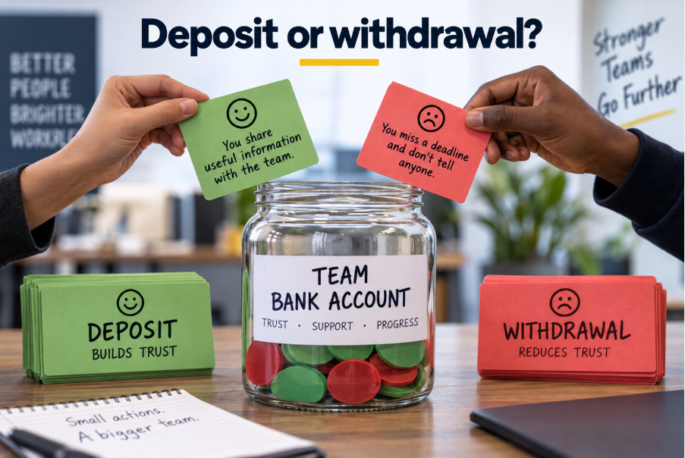
Deposit or withdrawal?
For each of the behaviours listed below, decide if they are a deposit or withdrawal from the team trust account. Think about how significant the impact on trust will be.
1. You agree to help a colleague but then complete the whole task for them without discussing it.
2. You realise you will miss a deadline and tell the team early.
3. You regularly arrive late and expect the team to wait for you
4. You take credit for an idea that originally came from a colleague.
5. You change an agreed plan without checking with the rest of the team
6. You complete your work by the agreed deadline.
7. You give someone credit for their idea.
8. You interrupt the same colleague repeatedly during meetings.

Slide 15
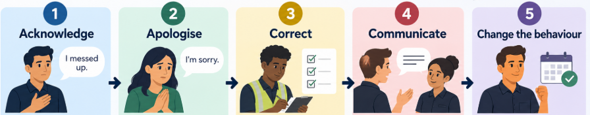
The impacts of your behaviours
If you make a withdrawal, can you put something back?
Being professional does not mean never getting things wrong. What matters is what you do next. When your behaviour has affected another person or the team, use this sequence:
.

Slide 16
Acknowledge:
  Be clear about what happened. Take responsibility rather than ignoring it or making excuses.
Apologise:
  Recognise the impact your behaviour had on someone else. A meaningful apology is more than simply saying “sorry.”
Correct:
  Ask what you can do now to put the situation right. Focus on practical action.
Communicate:
  Make sure the people affected know what is happening next. Don't leave them guessing.
Change the behaviour:
  Show what you will do differently in future. This is where trust really starts to be rebuilt

Slide 17

Discussion Scenario
Scenario: Casey makes a withdrawal
Casey is working on a shared team document. While checking some information, Casey notices that they have entered an important figure incorrectly.
The document has already been sent to another colleague who is using the information to complete their part of the work.
Casey feels embarrassed about the mistake and hopes it will not make much difference, so does not tell anyone. Later, the colleague discovers the error and realises that some of their own work will now need to be corrected.
.
What has Casey done that may have made a withdrawal from the Team Trust Account?

Slide 18
Discussion
Evaluate what could Casey say or do at each stage to start rebuilding trust?
Discuss as a group and develop a response.
Stage | Question for Casey
Acknowledge | What should Casey take responsibility for?
Apologise | What impact should Casey recognise?
Correct | What practical action could Casey take now?
Communicate | Who needs to know, and what do they need to know?
Change | What should Casey do differently if this happens again?

Slide 19

What Can I Control?
I can control…
my preparation;
my effort;
how I communicate;
whether I listen;
whether I ask questions;
whether I ask for help;
whether I keep commitments;
whether I include people;
whether I admit a mistake;
how I respond to difficulties.
I can influence but not control…
whether everybody likes me;
other people's effort;
whether someone agrees with me;
another person's behaviour;
every team decision;
the entire workplace culture.

Slide 20
My Professional Influence Profile
Take time to reflect and consider how you behave when working in a team. Try to complete the following sentences.
When I disagree with a team, I tend to…
A perspective I sometimes overlook is…
One way I can make it easier for other people to contribute is…
A situation where I should challenge rather than simply agree is…
A situation where I should seek advice rather than trying to solve everything myself is…
In my next professional role, I will positively influence a team by…

