Slide 1


Student Name: Syeda Anisa Afzaal
Student Number: 2310939
BMHP6029_BIRM – Component 1 – Poster Presentation
Title of Poster: Pregnancy, Childbirth, and the Puerperium

Slide 2
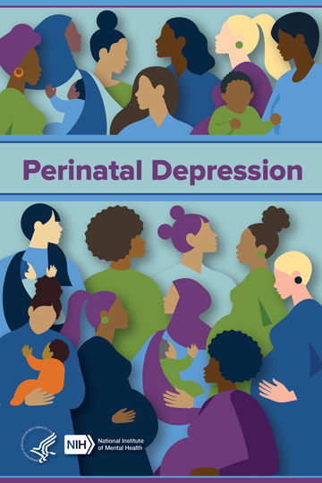
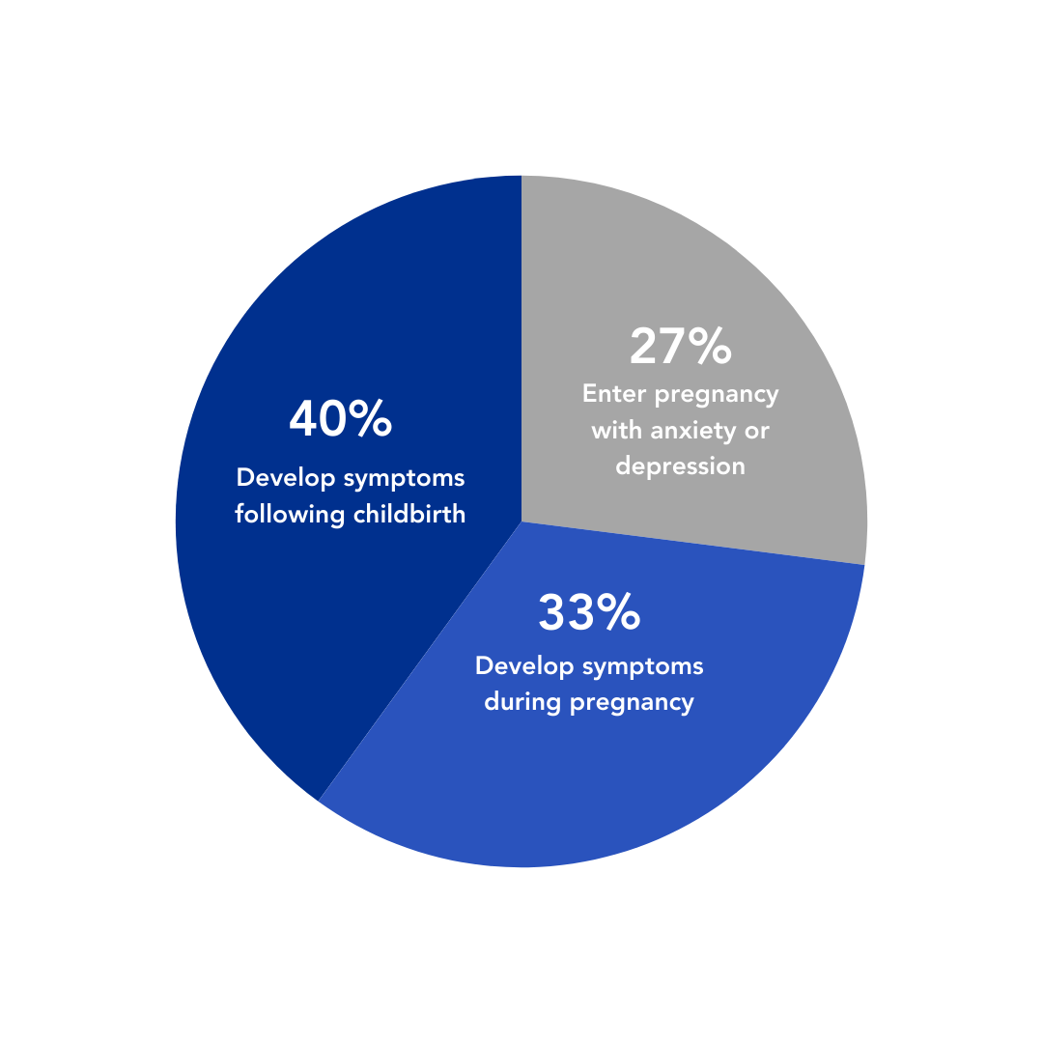
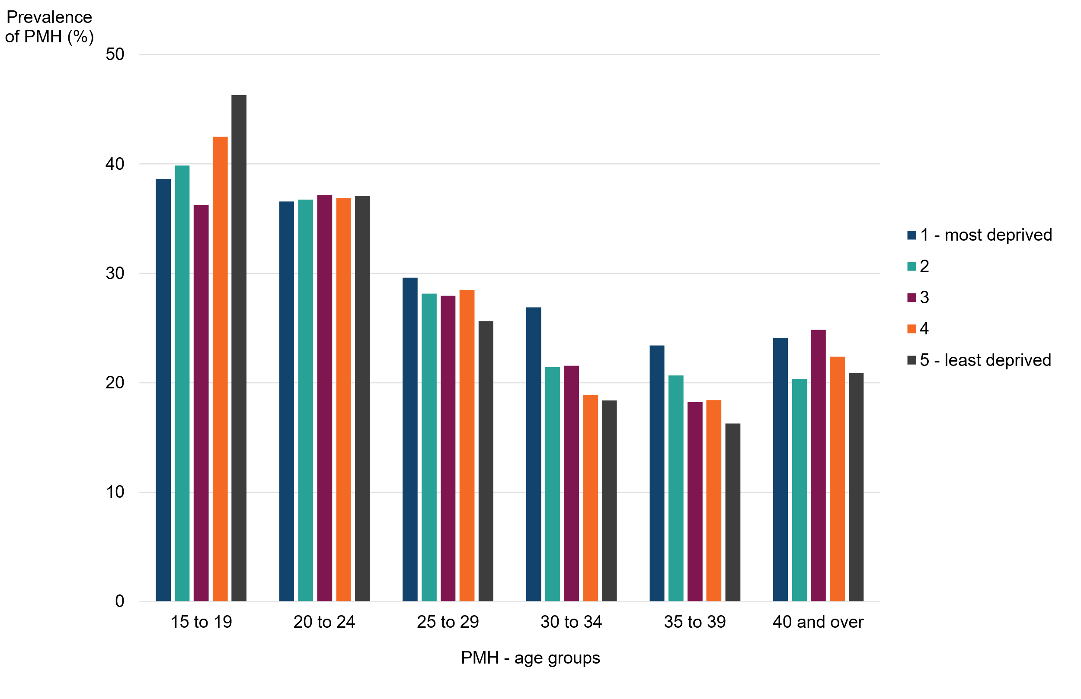
Pregnancy, Childbirth, and the Puerperium
Introduction
Covers conditions during pregnancy, delivery, and postpartum (WHO, 2023).
Includes physical complications and maternal mental health.
Historically under-addressed in policy and practice.
Types of Postpartum Disorders
Postpartum Depression (PPD)
  A mood disorder occurring shortly after childbirth.
  Symptoms: extreme sadness, anxiety, exhaustion, difficulty caring for self or baby.
  Onset: typically, within the first 4 weeks postpartum; sometimes begins in late pregnancy (ADAA, 2023).
Postpartum Obsessive-Compulsive Disorder
(OCD)
  One of the most misunderstood perinatal disorders.
  Involves intrusive thoughts and compulsive behaviours.
  Often triggered or worsened during pregnancy or postpartum (WHO, 2023).
Postpartum Post-Traumatic Stress Disorder
(PTSD)
  PTSD linked to traumatic childbirth experiences.
  Affects approximately 9% of women after giving birth.
  Symptoms include flashbacks, avoidance, and hyperarousal (WHO, 2019)
Postpartum Bipolar Disorder (Peripartum Bipolar Disorder)
  Characterized by mood episodes: mania, hypomania, or depression.
  Can begin during pregnancy or shortly after childbirth (NIH, 2021).
  High risk of postpartum depression if undiagnosed.
Inequality and Policy
Black women in UK are 4x more likely to die in childbirth than white women (Knight, 2022)
Cultural stigma and language barriers limit access (Public Health England, 2021; NHS England 2023)
Policy responses: Women’s Health Strategy, MBRRACE-UK, NHS equity initiatives
https://www.nimh.nih.gov/health/publications/perinatal-depression
Historical Context
19th–20th century: Shift from home births to hospitalisation (Oakley, 1984).
Early care focused on physical outcomes; mental health neglected.
Feminist movements advocated for informed consent and emotional wellbeing (Hammarberg, K., 2008).
https://www.mmhla.org/articles/maternal-mental-health-conditions-and-statistics
Contemporary Care
NHS offers antenatal, intrapartum, and postnatal care (NICE, 2021a, 2021b).
Mental health screening integrated into perinatal pathways (McCarthy, 2021).
NHS App supports appointment tracking and health records (DHSC, 2021).
Recommendations
Expand culturally competent maternity services (RCOG, 2021)
Strengthen perinatal mental health access (NICE, 2021)
Address racial disparities through audits and accountability (Knight, 2022)
Promote digital inclusion and multilingual support (DHSC, 2021)
https://www.gov.uk/government/publications/perinatal-mental-health-condition-prevalence/estimated-prevalence-of-perinatal-mental-health-conditions-in-england-2016-to-2019

Slide 3
References:
Anxiety and Depression Association of America (ADAA), (2023). Postpartum Depression & Anxiety Infographic. Available at: https://adaa.org/find-help-for/women/postpartum-disorders#Types%20of%20Postpartum%20Disorders (Accessed: 29th Oct 2025).
Department of Health and Social Care (2021). The Women’s Health Strategy for England. Available at: https://www.gov.uk/government/publications/womens-health-strategy-for-england (Accessed: 29th Oct 2025).
Hammarberg, K., et al (2008). Psychological and social aspects of pregnancy, childbirth and early parenting after assisted conception: a systematic review. Human Reproduction Update, 14(5), pp.395–414. Available at: https://academic.oup.com/humupd/article/14/5/395/820380 (Accessed: 30th Oct 2025).
Knight, M., et al (2022). Saving Lives, Improving Mothers’ Care – Lessons learned to inform maternity care from the UK and Ireland Confidential Enquiries into Maternal Deaths and Morbidity 2018–20. Oxford: National Perinatal Epidemiology Unit. Available at: https://www.npeu.ox.ac.uk/mbrrace-uk/reports (Accessed: 29th Oct 2025).
McCarthy, M., et al (2021). Women’s experiences and perceptions of anxiety and stress during the perinatal period: a systematic review. BMC Pregnancy and Childbirth, 21(811). Available at: https://bmcpregnancychildbirth.biomedcentral.com/articles/10.1186/s12884-021-04271-w (Accessed: 25th Oct 2025).
National Institute for Health and Care Excellence (NICE), (2021a). Antenatal care. Available at: https://www.nice.org.uk/guidance/ng201 (Accessed: 25th Oct 2025).
National Institute for Health and Care Excellence (NICE), (2021b). Postnatal care. Available at: https://www.nice.org.uk/guidance/ng194 (Accessed:25th Oct. 2025).
National Institutes of Health (NIH), (2021). Effects of an evidence-based nursing intervention on prevention of postpartum depression. PubMed. Available at: https://pubmed.ncbi.nlm.nih.gov/34633141/ (Accessed: 31st Oct 2025).

Slide 4
References:
NHS England (2023). Maternity Transformation Programme. Available at: https://www.england.nhs.uk/mat-transformation/ (Accessed: 25th Oct 2025).
Oakley, A. (1984). The Captured Womb: A History of the Medical Care of Pregnant Women. Oxford: Blackwell.
Public Health England (2021). Health inequalities: place-based approaches to reduce inequalities. Available at: https://www.gov.uk/government/publications/health-inequalities-place-based-approaches-to-reduce-inequalities (Accessed: 30th Oct 2025).
Royal College of Obstetricians and Gynaecologists (RCOG), (2021). Better for Women: Improving the health and wellbeing of girls and women. Available at: https://www.rcog.org.uk/better-for-women/ (Accessed: 25th Oct 2025).
World Health Organization (WHO), (2019). Perinatal Depression. [pdf]. Available at: https://applications.emro.who.int/docs/EMRPUB_leaflet_2019_mnh_222_en.pdf (Accessed: 31st Oct 2025).
World Health Organization (WHO), (2023a). ICD-11 for Mortality and Morbidity Statistics: Pregnancy, childbirth or the puerperium. Available at: https://icd.who.int/browse/2025-01/mms/en#714000734 (Accessed: 29th Oct 2025).
World Health Organization (WHO), (2023b). Maternal Mental Health – Promotion and Prevention. Available at: https://www.who.int/teams/mental-health-and-substance-use/promotion-prevention/maternal-mental-health (Accessed: 31st Oct 2025).

