Slide 1


Elderly Care and Carers in the UK

Slide 2
Types of Elderly Care Setting
How many elderly care settings can you think of?

Slide 3
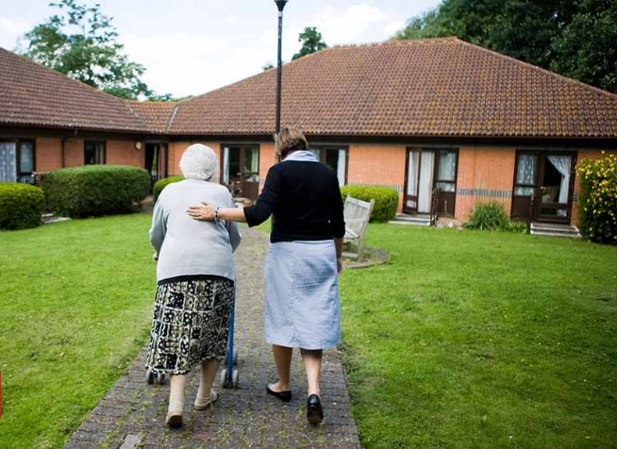


Elderly Care Settings
Residential Care
Residential Nursing Care
Hospital Care
Domiciliary Care
Assisted or supported living

Slide 4
Compassion Fatigue
Before we look at ‘carers’ I want you to consider ‘compassion fatigue’ and how it may affect those in a caring role.

Slide 5
Compassion Fatigue
(Secondary Traumatic Stress)
Fatigue, emotional distress, or apathy resulting from the constant demands of caring for others or from constant appeals from charities
Used to be largely confined to health care workers etc.
Now a more common occurrence
In a world where tragedy is ‘everyday’ have we become numb?
What do you think about this?

Slide 6
How do you think Compassion Fatigue is affecting carers in today’s society?
How are all the other issues discussed affecting carers both paid and unpaid?
Ultimately, how does all this impact on older people who need care?
Think about this as we go through and be prepared to feedback at the end of the session

Slide 7
Some Statistics…
There are around 3million paid care workers in the UK
More than 1.6 million of these work in frontline social care
Almost 80% of these are women
The social care workforce is relatively unskilled
Most of these workers receive minimum wage or just above
In 2012/13 shop workers and cleaners were paid less than care workers but in 2018/19 they were paid more

Slide 8
Paid Care Workers
Residential and Nursing Homes (RCW’s)
There are around 16,000 residential and nursing care homes in the UK
673 of these are in Wales
The majority of staff who work there are care workers
Predominantly female (4 in 5)
Average age is 43
Relatively poorly educated
Many are paid national minimum wage
    (CQC, 2023;JRF, 2015)

Slide 9
Paid Care Workers
Domiciliary Care (DCW’s)
426 Domiciliary Care Agencies registered in Wales employing around 20,000
9,000 in England employing over 500,000
Most are female (over 80%)
A fifth of these are over 55
Nearly half are on involuntary Zero Hours Contracts (ZHC’s)
(CSSIW, 2017; Skills for Care, 2019)

Slide 10
Issues Faced by Individuals Working in
Health and Social Care
Pressures of home life
Financial issues
Work conditions
Unsuitability for care work
Negative workplace culture
Pressures of home life
Lack of job satisfaction / self esteem
Lack of status in society
COVID 19 and Lockdown

Slide 11
Pressures of Home Life
Many women may have child care issues
Others may be taking care of grandchildren
Some may be carers for elderly relatives
SANDWICH GENERATION

Slide 12
Financial Issues
Minimum or low wage
A lot of ‘empty time’ between calls (DCW’s)
Zero Hours Contracts could mean ineligibility for credit or mortgage
No work means no pay!
Often only SSP is paid when a person is sick (£116.75 pw)

Slide 13
Work Conditions
Opportunity/ pressure to work very long hours
Pressure to cover sickness/ absence / staff leaving
Lack of training and pressure to complete tasks without training
Very high staff turnover
Time restraints (travel time/ 15 minute calls/ unrealistic expectations)

Slide 14
Unsuitability for Care Work
A lot of women enter the care sector without previous experience
Many do this because of financial necessity and ease of finding work
Evidence suggests that care providers, on the whole will employ almost anyone regardless of experience and qualifications

Slide 15
Negative Workplace Culture
Bullying by other staff members or management
Pressure to conform to or accept bad practice in order to ‘fit in’
Fear of reprisals or lack of action if incidents or concerns are reported

Slide 16
Lack of Status in Society
Care workers are often regarded as having low status
An issue that is widespread in the care sector (especially in elderly care)
Negative views of care workers in society influenced by media
Lack of positive reports of compassionate well delivered care
Lack of Job Satisfaction / Self Esteem
(JRF, 2014; Happer and Philo, 2013; Ames, 2012))

Slide 17
Responses of Paid Care Workers When Asked How They Felt They Were Seen by Society
“Others see us as arse wipers and we are definitely at the bottom of the pile” (CD2).
“I think that unfortunately carers are looked on as glorified house cleaners. Unfortunately the term arse-wipers has been used and I’ve always felt quite strongly about that” (CM2).
“People think when you’re a carer… it’s the only job you are capable of doing. They think you are thick and the only thing you can do is look after old people Some people have asked me what I’m doing and when I tell them they ask me couldn’t I find anything else!” (CD1).
(Davies, 2016)

Slide 18
Attitudes of other H&SC Professionals Towards Care Workers
“the doctors don’t very often listen to us when it comes to clients and the district nurses treat us as lowly skivvies!”(CD2).
“They don’t even stoop so low as to change an inco [incontinence] pad some of them, they just leave it to the carers. I’m sorry, I thought we were all on the same side but obviously not!”(CM1).
“the district nurses and some of the doctors used to talk down to us”(CD1).
(Davies, 2016)

Slide 19
An increasing number of care workers live in poverty…
What would be the advantages of paying all carers the national LW? (look at the following)
https://www.health.org.uk/sites/default/files/pdf/2022-10/2022%20-%20The%20cost%20of%20caring.pdf
https://www.jrf.org.uk/the-costs-and-benefits-of-paying-all-the-lowest-paid-care-home-workers-in-the-uk-the-living-wage

Slide 20
Gap Between Need and Availability of Social Care for the Elderly in the UK
As we know, the demand for social care is on the increase.
Funding is insufficient and although the government has pledged to spend up to £4.7 billion in 2024/2025 this is still insufficient, and LA spending has been cut in many areas (LGA, 2023)
Staffing is an issue and there were 52,000 vacancies on any given day in 2022/23) and 390,000 people leave their posts each year.

Slide 21
Gap Between Need and Availability of Social Care for the Elderly in the UK
Around 1.6 million older people have unmet needs for care and support.
The number of vacant adult social care sector posts increased by 52% from 110,000 in 2020/21 to 165,000 in 2021/22 (1 in 10 posts were vacant).
Although vacancy rates slightly reduced in 2022/2023, from 10.6% to 9.9%, there were still 152,000 vacant posts a day and 390,000 people left their roles last year - with around a third of them leaving social care completely
(Age UK, 2023)

Slide 22
Possible Solutions…
Being paid more than the minimum wage
Not being on a zero-hours contract
Being able to work full time
Being able to access training
Having a relevant qualification. (Skills for Care, 2023)
Can you think of others?

Slide 23
Cost of Social Care…
The cost of residential care varies depending on area and need but can vary from just over £800 to nearly £1500.
Domiciliary care can cost between £15 and £30 per hour.
Unlike health care, social care is means tested
Some older people are forced to sell their homes to pay for their care.

Slide 24
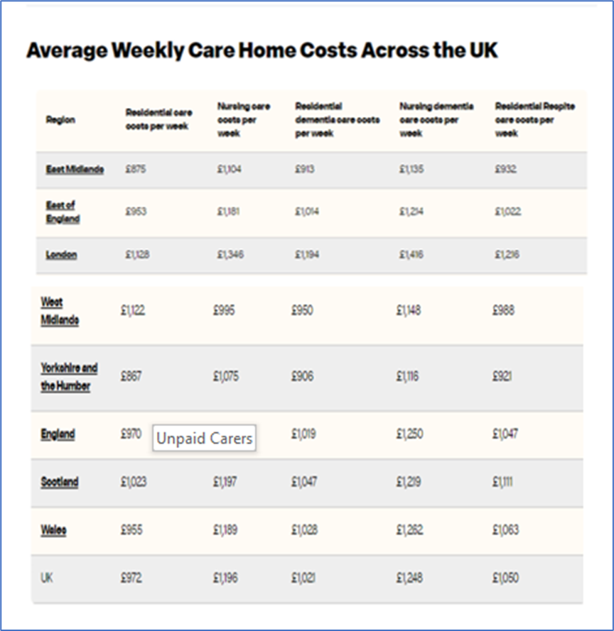
(Karim, 2024)

Slide 25
Cost of Social Care…
If an older person has over £23,250 in England or Northern Ireland they must pay full fees (Wales, £50,000; Scotland, £32,500)
The individual must be left a Personal Expenses Allowance (PEA). The PEA must be at least £30.15 per week. The council has discretion to increase this amount, depending on circumstances.
A lifetime care cost cap of £86,000 has been agreed but is divisive and is not in place yet.
(Age UK, 2024; BBC, 2022)

Slide 26
Unpaid Carers
Every year unpaid carers save the economy over £132 billion
5 million people in England and Wales are juggling caring responsibilities with work - that's 1 in 7 of the workforce.
However, the significant demands of caring mean that 600 people give up work every day to care for an older or disabled relative.
Carer's Allowance is the main carer's benefit and is £81.90 for a minimum of 35 hours, the lowest benefit of its kind (you can earn a maximum of £150 after tax).
(CarersUK, 2024)

Slide 27
Unpaid Carers
Every day another 6,000 people take on a caring responsibility – that equals over 2 million people each year.
59% of carers are women and 42% are men.
1.3 million people provide over 50 hours of care per week.
Over 1 million people care for more than one person
As of 2020, Carers UK estimates there are around 13.6 million people caring through the pandemic
(Carers UK 2020)

Slide 28
Unpaid Carers
People providing high levels of care are twice as likely to be permanently sick or disabled
72% of carers responding to Carers UK's State of Caring 2018 Survey said they had suffered mental ill health as a result of caring.
61% said they had suffered physical ill health as a result of caring.
8 in 10 people caring for loved ones say they have felt lonely or socially isolated.
(CarersUK, 2020)

Slide 29
Some Key UK Findings
-Unpaid Carers
6 in 10 carers have been pushed to breaking point
25% of these required medical treatment as a result
46% said they had fallen ill but had to continue caring
1 in 5 were forced to give up jobs because they were in crisis
63% had suffered from depression as a result of caring
(CarersUK, 2019)

Slide 30
Experiences of Compassion Fatigue
The cumulative demands of experiencing and helping others through suffering have been considered to contribute to the potential of compassion fatigue.
Carers suffering from compassion fatigue experience physical and emotional symptoms that leave them disconnected from those they care for
May focus on the technical rather than the compassionate components of their role. This disconnect can also affect personal relationships outside of work
(Joanna Briggs Institute, 2019)

Slide 31
Is Compassion Fatigue to Blame for Elder Abuse by Carers?
Think about this question and feed back to the group…

Slide 32
What Next?
Studies have been conducted and areas of concern have been highlighted
Government responses??
What do you think?

Slide 33
Social Care 360
Independent research…
Follow the link below and look at the latest report on ‘the state of caring’ compiled by the King’s Fund.
Do you think things are improving…or not?
We will discuss this at the beginning of next week’s session.
Social Care 360 | The King's Fund (kingsfund.org.uk)

Slide 34
References
BBC (2022) Social care: What is happening to the cap on care costs? Available at: Social care: What is happening to the cap on care costs? - BBC News (Accessed: 7 May 2024).
Carers UK (2024) Carers Allowance Available at Carer's Allowance | Carers UK (Accessed: 7 May 2024).
CarersUK, (2020) Facts and Figures Available at:https://www.carersuk.org/news-and-campaigns/press-releases/facts-and-figures (Accessed: 20 November 2020).
CarersUK. (2019) Carers at Breaking Point Available at: carers-at-breaking-point-making-the-case-for-carers-039-breaks.pdf (carersuk.org) (Accessed: 7 May 2024).
Care Quality Commission (2023). The State of Care 2023. Available at: www.cqc.org.uk/publications/major-report/state-care (Accessed: 7 May 2024).
CSSIW. (2017) Chief Inspector’s Annual Report 2016–2017 Available at: State of Care 2022/23 - Care Quality Commission (cqc.org.uk) (Accessed: 7 May 2024).
JRF, (2015) The costs and benefits of paying all the lowest-paid care home workers in the UK the Living Wage Available at: https://www.jrf.org.uk/report/costs-and-benefits-paying-all-lowest-paid-care-home-workers-uk-living-wage (Accessed: 11 November 2019).
Joanna Briggs Institute, (2019) JBI Database of Systematic Reviews and Implementation Reports: May 2019 - Volume 17 - Issue 5 - p 682–753 doi: 10.11124/JBISRIR-2017-003818
Skills for Care. (2019) The State of the Adult Social Care Workforce in England. Available at: https://www.skillsforcare.org.uk/adult-social-care-workforce-data/Workforce-intelligence/publications/The-state-of-the-adult-social-care-sector-and-workforce-in-England.aspx (Accessed: 21 November 2020).
Karim, H. (2024) Care Home Costs UK Average May 2024 | How Much You’ll Pay Available at: Care Home Costs UK Average May 2024 | How Much You’ll Pay | Lottie (Accessed: 7 May 2024).
LGA (2023) Exploring adult social care funding and delayed discharge Available at: https://www.local.gov.uk/publications/exploring-adult-social-care-funding-and-delayed-discharge (Accessed: 8 May 2024).
NCF (2024) Adult social care workforce strategy update from Skills for Care February 2024 Available at: https://www.nationalcareforum.org.uk/care-sector-news/adult-social-care-workforce-strategy-update-from-skills-for-care-february-2024/ (Accessed: 8 May 2024).
The Kings Fund. (2019a) The Health Care Workforce in England: Make or Break Available at: https://www.kingsfund.org.uk/publications/health-care-workforce-england (Accessed: 20 November 2019).
The Kings Fund. (2019b) Why you’re Better off Being a Cleaner than a Care Worker Available at: https://www.kingsfund.org.uk/blog/2019/10/cleaners-paid-more-than-care-workers (Accessed: 20 November 2020).

