Slide 1

How Does the Concept of ESDGC (Education for Sustainable Development and Global Citizenship) Contribute to Reducing Global Inequalities?

Slide 2
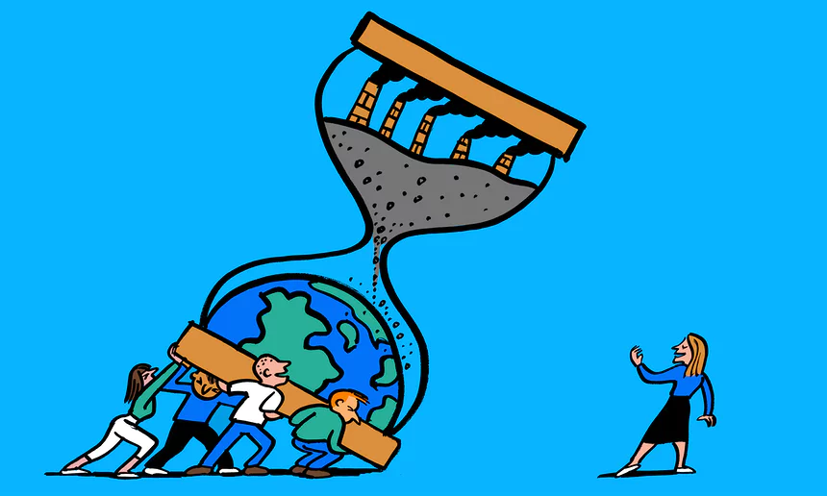
(Image 1)
Introduction
Learning to live together in peace through Global Citizenship Education (short Video)
UN Sustainable Development Goals: 17 Goals to Transform our World
Social Connectedness Theory
ESDGC development in Wales
Pedagogical approaches to ESDGC in Wales
7 Key Themes of ESDGC
Primary Education for Global Learning And Sustainability: The Borne Report
Conclusion

Slide 3
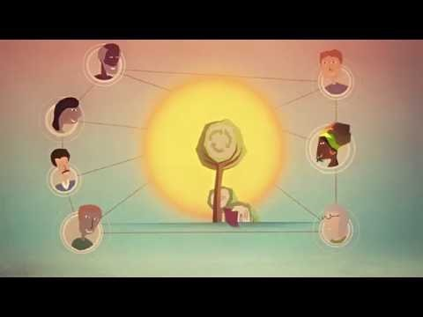
Learning to live together in peace through Global Citizenship Education
The United Nations Educational, Scientific and Cultural Organisation (2016)

Slide 4

Social Connectedness Theory
A sense of belonging and relatedness between human populations
Connectedness occurs when a person is actively involved with another person, object, group or environment
Communication through telephone, text messaging, email, instant messaging, and online communities has increased our communication horizon considerably
maintaining relatedness to others, objects, environments, society and self
Impacts on mental health (many studies have shown that wide ranging mental health conditions improve when individuals socially connect with others) (Rossi, Stratta and Capanna, 2012)
Human growth and development occur within the context of relatedness
Global citizenship
Hagerty, et al (1993)
VAN BEL, et al (2009)

Slide 5
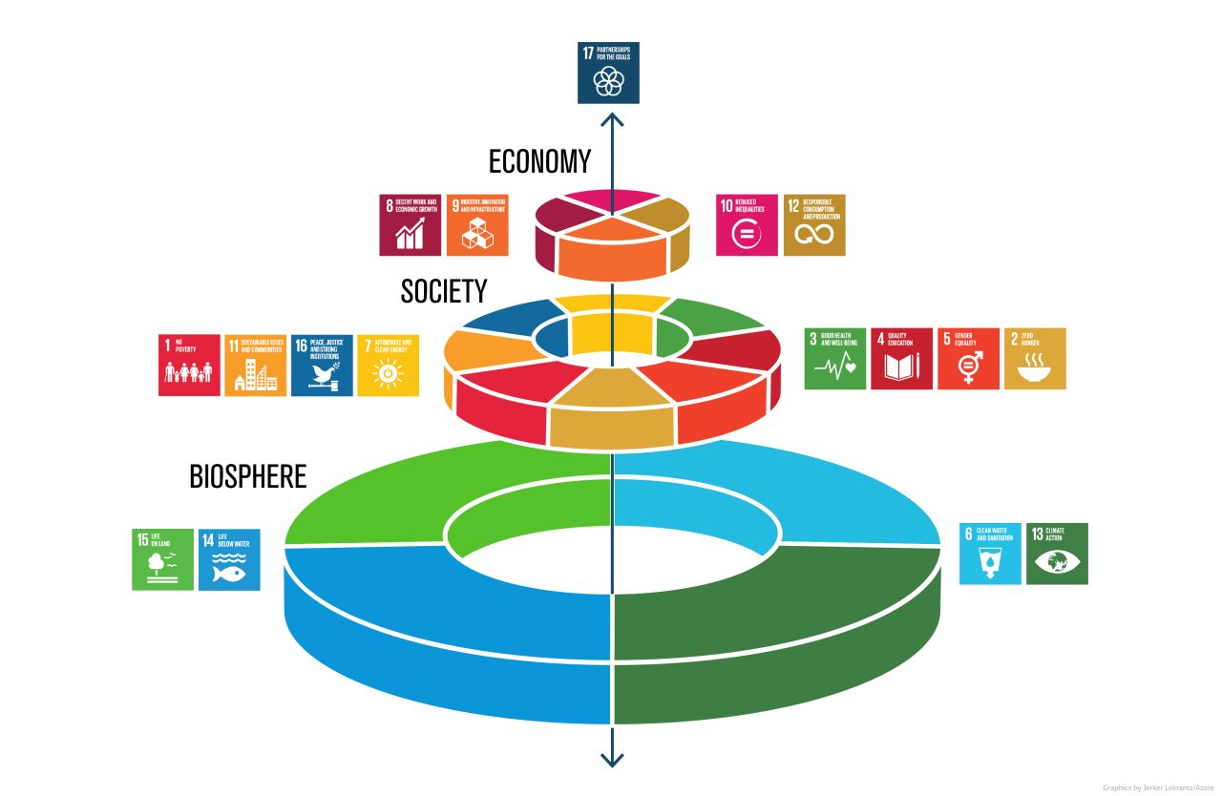
(Image 2)
17 Goals to Transform Our World
No Poverty
Zero Hunger
Good Health and Wellbeing
Quality Education
Gender Equality
Clean Water and Sanitation
Affordable clean Energy
Decent Work and Economic Growth
Industry, Innovation and Infrastructure
Reduced Inequalities
Sustainable Cities and communities
Responsible Consumption and Production
Climate Action
Life Below Water
Life on Land
Peace Justice and Strong Institutions
Partnerships for the Goals
United Nations (2015)
Sustainable Development Goals: working together to reduce inequalities and environmental devastation

Slide 6
ESDGC development in Wales
In 1999 - the Welsh Assembly Government (WAG) made a commitment to consider sustainable development in all its activities
In 2000 - Environmental Education Council for Wales, the network of Welsh Development Education Centres, Oxfam, and others formed an initiative called ‘ Education for the Future’ This group pushed the Welsh Assembly Government for even greater inclusion of subjects associated with education for sustainable development and global citizenship in the curriculum
In 2004 - Sustainable Development Education and Global Citizenship Education merged to form the ESDGC Panel – the group was made of people whose aims and objectives focused on different fields of practice, including those concerned with : global injustice, Education and care and respect for the environment
Wellbeing of Future Generations (Wales) Act 2015
The Welsh Government aims to ensure sustainable development as a fundamental organising principle for organisations (Glover and Peters, 2013)
Norcliffe and Bennell (2010)

Slide 7
Pedagogical approaches to ESDGC in Wales
Global issues and sustainable development in schools, embedded in the framework for Personal and Social Education (ACCAC, 2000)
Education for Global Citizenship and Sustainable Development. Cardiff: Qualifications, Curriculum and Assessment Authority for Wales (ACCAC, 2002)
Education for Sustainable Development and Global Citizenship; Why,What, How (ACCAC, 2002)
Personal and Social Education (PSE) framework in Wales. Cardiff: Qualifications, Curriculum and Assessment Authority for Wales.
Education for Sustainable Development and Global Citizenship: A Strategy for Action (DELLS, 2006)
Education for Sustainable Development and Global Citizenship: A Common Understanding for Schools (DCELLS, 2008b) - ESDGC has impacted on, and been affected by, the revised national curriculum, and also affected the ways in which schools work from day to day.
2017 Education for Sustainable Development and Global Citizenship (ESDGC) seeks to give learners, at all stages of education, an understanding of the impact of their choices on other people, the economy and the environment.
International Journal of Development Education and Global Learning (2010)

Slide 8
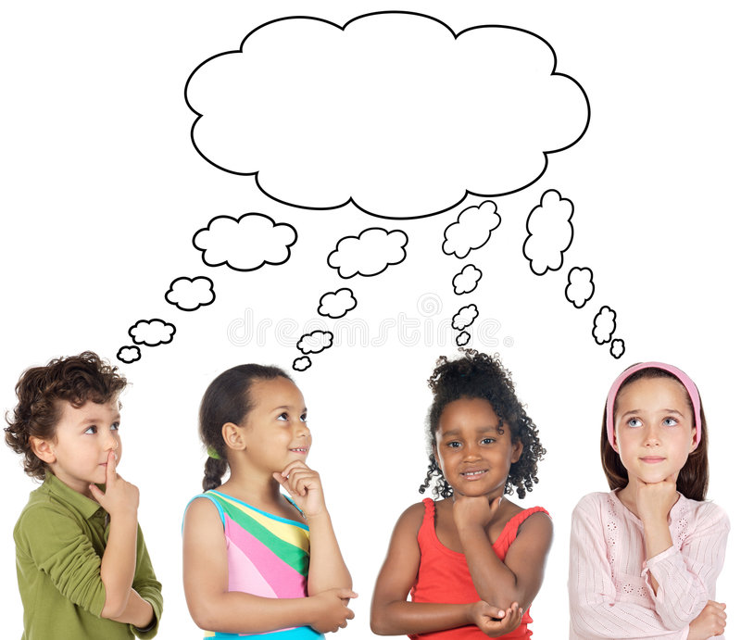
Image 3
7 Key Themes of ESDGC
I can make a difference
We can make a difference
What can I do to make a difference
We are all in this together
Climate Change
Recognise the importance of saving energy
Choices and Decisions
Appreciate that your personal
actions have consequences
Consumption and Waste
Dispose of used resources responsibly
Identity and Culture
Recognise that discrimination and exclusion is wrong
Health
Recognise the importance of eating
properly and exercise
Natural World
Act to protect biodiversity and local
and global environments
Wealth and Poverty
Develop opinions about exploitation & poverty
Rights Respect and Responsibility
Education for sustainable Development and Global Citizenship
Welsh Assembly Government (2008)

Slide 9
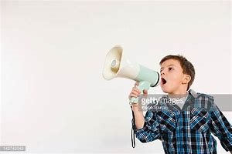
Primary Education for Global Learning And Sustainability: The Bourn Report
Sustainability and global citizenship to be embedded into educational policy and practice, linking to the UN agenda for global education after 2015.
Some of the Key concepts for promoting global and sustainability themes in education include:
Human rights
Environmental understanding
Global citizenship
Global social and environmental justice
Image 4
We need to stop and think about what we are doing to each other and our world.
No more war
No more poverty
Equality/equity for all
Social justice for all
We need to live Sustainably
We must stop polluting our air, our food and our water.
We need to work together for a better future and we need to act NOW….
Rights Respect and Responsibility
Bourn et al (2016)

Slide 10
Global education has been seen to have a positive influence on children’s understandings of poverty, global development and poverty reduction initiatives (Hunt and Cara, 2012)
Evidence suggests global learning and sustainability impacts positively on children’s values based on mutual respect and responsibility towards themselves and others. For example, all citizens working together to support a common humanity based on mutual respect and responsibility towards others
children have a better understanding of rights and responsibilities through campaigns such as ‘Keep Britain Tidy’ in 2013. This led to a greater awareness of their environment and an understanding and importance of becoming more sustainable in their own lives (Covell and Howe, 2008, OFSTED, 2009, Sebba and Robinson, 2010)
Evidence suggests that global learning and sustainability initiatives in children’s education has helped to develop their awareness of empathy, sense of fairness, self-esteem and diversity (Covell and Howe, 2001; Hirst et al, 2014)
Impact of global learning and sustainability on children

Slide 11
Conclusion
This presentation has demonstrated that ESDGC may contribute to reducing global inequalities by supporting children to become more conscious of the impacts their actions may have on others and the world around them (Covell and Howe, 2001; Hirst et al, 2014)
In 2018 children are being raised in a world where the threat of environmental catastrophe due to human behaviour is becoming an increasingly dominate agenda.
Early education is key in developing children’s understanding of the importance of working together as an interconnected and interdependent humanity in maintaining health and wellbeing, but also for the survival of the planet in which we all depend on.
Children need to be actively involved and included in decision making which may impact on environmental issues. This may encourage and empower children in taking positive action and responsibility towards sustainability and the importance of global citizenship. This needs to be supported by policy makers in the UK who must recognise that ESDGC should be part of the everyday learning of all primary school children and support schools effectively with relevant teacher training and resources to do so.
Rights Respect and Responsibility
Bourn et al (2016)

Slide 12
References
Awdurdod Cymwysterau, Cwricwlwm ac Asesu Cymru / Qualifications, Curriculum and Assessment Authority For Wales (ACCAC) (2000) Annual Report and Accounts. Available at. http://www.assembly.wales/committee%20documents/pre%2016%2015-00(p.5)%20accac%20annual%20rport-25102000-35928/39ef091400072a850000029600000000-english.pdf (Accessed on 11 May 2018).
ACCAC (2002) Education for Sustainable Development and Global Citizenship. Cardiff: Qualifications, Curriculum and Assessment Authority for Wales.
Armour, R. (2017) MPs must consider children during Brexit talks, Image 1. Available at: http://thirdforcenews.org.uk/tfn-news/mps-must-consider-children-during-brexit-talks#IduZVvlXGd4kllgZ.99 (Accessed on 14 May 2018).
Bourn, D et al (2016) Research Reports: Primary Education for Global Learning and Sustainability. Available at: http://cprtrust.org.uk/wp-content/uploads/2016/02/Bourn-report-160217-final.pdf (Accessed on 14 May 2018).
Covell, K. and R. B. Howe (2001) ‘Moral Education through the 3 Rs: Rights, respect and
responsibility’. Journal of Moral Education, vol. 30, (1), pp. 29-41.
Covell, K. and Howe, R.B. (2008) Rights, Respect and Responsibility: Final Report on the County of
Hampshire Rights Education Initiative. Hampshire: Hampshire LA.
Diaz, J. (2018) Multi ethnic group of children thinking, Image 3. Available at. https://www.dreamstime.com/royalty-free-stock-photo-multiethnic-group-children-thinking-image6063755 (Accessed on 12 May 2018).
.

Slide 13
References
Glovers, A. Peters, C. (2013) ‘A Whole Sector Approach: Education for Sustainable Development and Global Citizenship in Wales’ Sustainability Assessment Tools in Higher Education Institutions, pp. 205- 222. Available at. https://link.springer.com/chapter/10.1007/978-3-319-02375-5_12Q (Accessed on 12 May 2018).
Getty Images (2018) Boy Shouting through a mega phone, Image 4. Available at: https://www.gettyimages.com.au/photos/the-studio-volume-9?sort=mostpopular&mediatype=photography&phrase=the%20studio%20volume%209 (Accessed on 15 May 2018).
Hirst, B. and Associates (2014) Connecting Classrooms: UK Evaluation and Audit 2013/14.
London: British Council.
Hunt, F. (2012) Global Learning in Primary Schools in England: Practices and Impacts. DERC
Research Paper no. 9. London: UCL Institute of Education.
Lokrantz, J. (no date) UN Sustainable Development Goals – SDGs, image 2. Available at: https://www.ecohz.com/facts/un-sustainable-development-goals-sdgs/ (Accessed on 15 May 2018).

Slide 14
Reference
Norcliffe, D. Bennell, S. (2010) ‘Analysis of Views on the Development of Education for Sustainable Development and Global Citizenship Policy in Wales’. International Journal of Development Education and Global Learning, 3(1) pp. 39-58.
OFSTED (2009) Education for Sustainable Development: improving schools improving lives. London:
OFSTED.
Rossi, A. Stratta, P. Capanna, C. (2012) ‘Social connectedness and psychopathology’ Journal of Psychopathology, 18, pp. 305-308.
Sebba, J. and Robinson, C. (2010) Evaluation of UNICEF UK's Rights Respecting Schools Award.
London: UNICEF UK.
The United Nations Educational, Scientific and Cultural Organisation (2016) Learning to live together in peace through Global Citizenship Education. Available at: https://www.youtube.com/watch?v=KuKzq9EDt-0 (Accessed on 11 May 2018).
United Nations (2015) Sustainable Development Goals: 17 Goals to Transform our World. Available at. https://www.un.org/sustainabledevelopment/sustainable-development-goals/ (Accessed on 12 May 2018).

Slide 15
Reference
Van Bel, DT. et al (2014) ‘Social connectedness: concept and measurement’ (Proceedings of the 5th International Conference on Intelligent Environments - Barcelona, Spain 2009 ). Available at: https://www.researchgate.net/publication/220992602_Social_connectedness_Concept_and_measurement (Accessed on 12 May 2018).
Welsh Government (2015) Wellbeing and Future Generations (Wales) Act 2015. Available at. https://gov.wales/topics/people-and-communities/people/future-generations-act/future-generations-act-video/?skip=1&lang=en (Accessed on 11 May 2018).
Welsh Assembly Government (2006) DELLS Information Document: ‘Education for Sustainable Development
and Global Citizenship – A Strategy for Action’. Available at. https://www.aber.ac.uk/en/media/departmental/healthsafetyenvironment/environmentalhub/esdgc_g192e.pdf (Accessed on 12 May 2018).
Welsh Assembly Government (2008) Education for Sustainable Development and Global Citizenship
Information for teacher trainees and new teachers in Wales. Available at: http://learning.gov.wales/docs/learningwales/publications/081204infoteachertraineesen.pdf (Accessed on 14 May 2018).
Hagerty, B. et al (1993) ‘An Emerging Theory of Human Relatedness’ Journal of Nursing Scholarship, 25(4), pp. 291-296

