Slide 1
HPHI4002
Week 4 Lecture
REFERENCING
What, Why, How?

Slide 2
REFERENCING
FOOTNOTES
Why?

Slide 3

Tools of the trade …
“[The footnote] identifies [a] work of history as the creation of a professional. Like the high whine of the dentist’s drill, the low rumble of a footnote on the historian’s page reassures: the tedium it inflicts, like the pain inflicted by the drill, is not random but directed, part of the cost that the benefits of modern science and technology exact.”
Anthony Grafton, The Footnote: A Curious History (Cambridge, Massachusetts: Harvard University Press, 1997), p. 5.

Slide 4
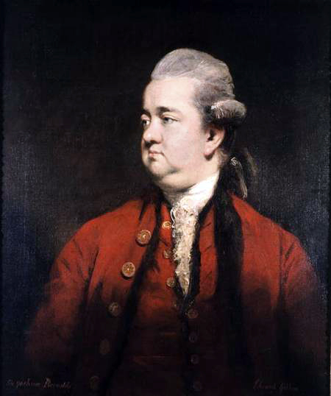
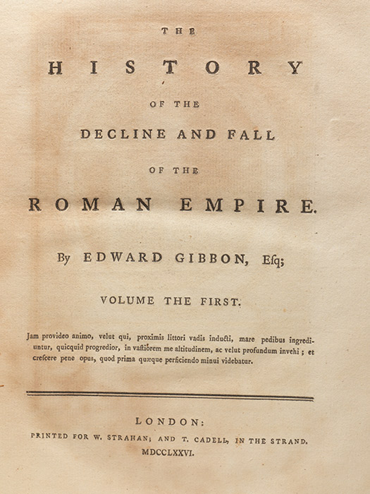
Our debt to Gibbon …
!
Edward Gibbon, The History of the Decline and Fall of the Roman Empire (6 vols., 1776–1789)
Used methods and practices which became recognisable features of history in the Western academy:
  Insistence on making connections between events
  Attempt to explain causes as well as telling a narrative
  Analysis of human actions and circumstances
  Extensive use of notes as guide to sources consulted: proto-footnotes

Slide 5
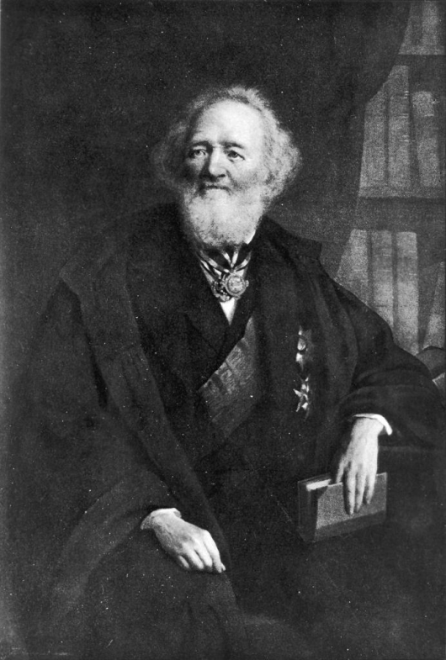
Our debt to Ranke …
Moves towards professionalization of history – and the systemization of historians’ methods – take root in Germany in 1820s and 1830s. A leading influence was Leopold von Ranke
Ranke’s 1824 book History of the Latin and Teutonic Peoples from 1494 to 1514 used a wide variety of primary sources including “memoirs, diaries, personal and formal missives, government documents, diplomatic dispatches and first-hand accounts of eye-witnesses”
Leopold von Ranke (1795–1886)

Slide 6
Our debt to Ranke …
RESEARCH and TEACHING
Ranke practised what is today a familiar three-step process: archival research of primary sources, followed by critical interpretation of these sources, and then publication of findings in a narrative text
At the University of Berlin, Ranke organised ‘exercises’ in which small groups of students met to converse with professors.
The researching and teaching of history along these lines became institutionalised within the German academy; emulated in France, Britain, the United States and other nations in the last few decades of the 19th century
Leopold von Ranke (1795–1886)

Slide 7
Our debt to Ranke …
“You will remember the handwritten notebook in which I entered all my notes about the historians whom I read. I could not avoid offering some justification for my treatment of these historians in my history.”
Ranke writing to his brother in 1824, cited by Grafton, The Footnote, p. 46.

Slide 8
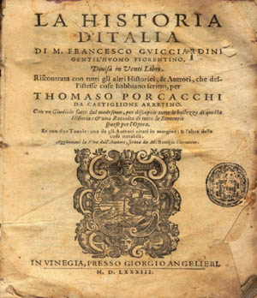
Our debt to Ranke …
Ranke on The History of Italy by Francesco Guicciardini (1483–1540)
“Let us acknowledge, once and for all, that this book does not deserve the unconditional respect it has enjoyed up to now. It should not be described as a source, but only as a reworking of sources, and a faulty one at that, if we accomplish that, we will have reached our goal [and historians] will have to stop citing Guicciardini at the bottom of every page, and always the same Guicciardini. They will know he does not provide any proof.”
Ranke writing in 1824, cited by Grafton, The Footnote, p. 44.

Slide 9
Our debt to Ranke …
“‘[Ranke] illuminates the works of historians who have previously been considered the chief sources of history for the period of history in question as well as the personalities of their authors … with uncompromising, strict criticism. Pitilessly, he deprives both of the aura in which they previously glowed: or, at least, he determines precisely the extent to which they really deserve and do not deserve belief, and in general how far they should be considered true sources.’”
“‘[His] contributions to the criticism of modern historians [were] the best part of Mister Ranke’s work; at least they reveal that he has compared the different extracts in many ways.’”
Reviews of Ranke’s History of the Latin and Teutonic Peoples from 1494 to 1514 (1824), cited by Grafton, The Footnote, pp. 47–48.

Slide 10
Our debt to Ranke …
“I can see the time approach when we will no longer have to base modern history on reports, even those of contemporary historians to say nothing of derivative reworkings of sources. Rather we must construct it from the accounts of eyewitnesses and the most genuine and direct sources.”
Ranke, cited by Grafton, The Footnote, p. 51.

Slide 11
Our debt to Ranke …
Ranke saw his empiricist history – a reliance on documentary sources – as the most reliable means to learn about the past:
“It is striking how history, when resting on the memory of men, always touches the bounds of mythology.”
“You have reckoned that history ought to judge the past and to instruct the contemporary world as to the future. The present attempt does not yield to that high office. It will merely tell how it really was.”

Slide 12
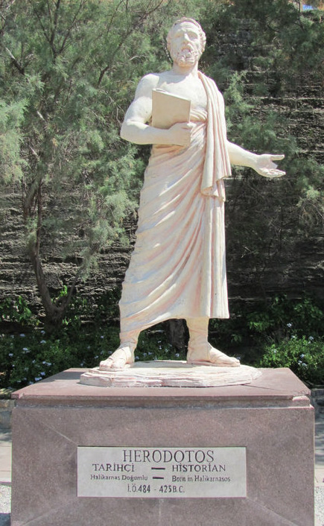
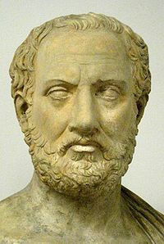
Ranke’s debt to Thucydides …
“To hear this history rehearsed, for that there be inserted in it no fables, shall be perhaps not delightful. But he that desires to look into the truth of things done, and which may be done again, or at least their like, shall find enough herein to make him think it profitable.”
From Thucydides (bottom), History of the Peloponnesian War (430sBC) – veiled critique of Herodotus (top), The Histories (450sBC)

Slide 13
Why to reference …
“References should document the information offered, to allow the reader to check the source of a quotation or the evidence on which an argument is based. A reference must therefore enable the reader to find the source referred to as quickly and easily as possible.”
Modern Humanities Research Association [MHRA], MHRA Style Guide a Handbook for Authors and Editors (London: Modern Humanities Research Association, 2013), p.

Slide 14
Why footnote …
“Notes are an interruption to the reader and should be kept down to what is strictly necessary. They are intended primarily for documentation and for the citation of sources relevant to the text.”
MHRA, Style Guide, p. 56.

Slide 15
When to footnote …
“The number of notes can often be kept down by grouping together, in one note, references to several sources mentioned close together in the same paragraph. In particular, adjacent references to several pages of the same publication should be cited together in a single note.”
MHRA, Style Guide, p. 56.

Slide 16
Where to footnote …
“Wherever possible, a note reference number should be placed at the end of a sentence. Notes should be marked in the typescript by superior (superscript) numbers, with no punctuation (full stops, parentheses, etc.), in sequence throughout an article or chapter. A note reference number should follow any punctuation (including a parenthesis) except a dash, which it should precede.”
MHRA, Style Guide, p. 57.

Slide 17
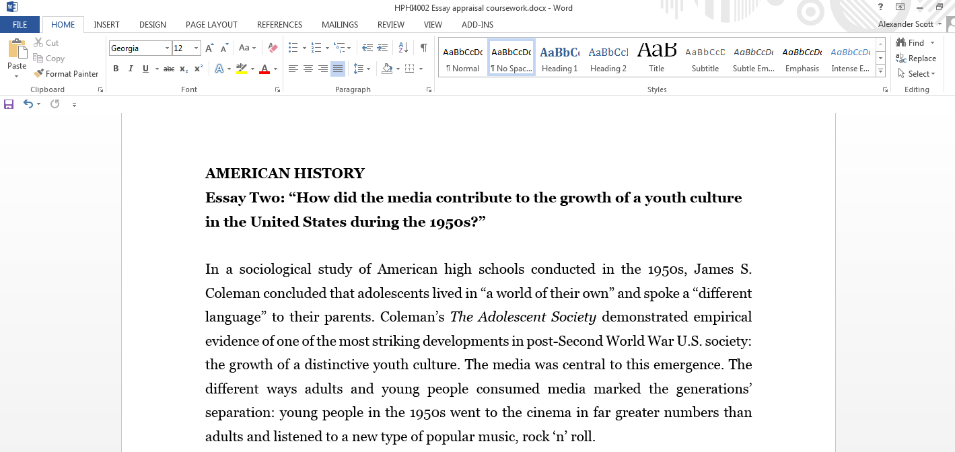
How to footnote using Microsoft Word …

Slide 18
How to footnote using Microsoft Word …

Slide 19
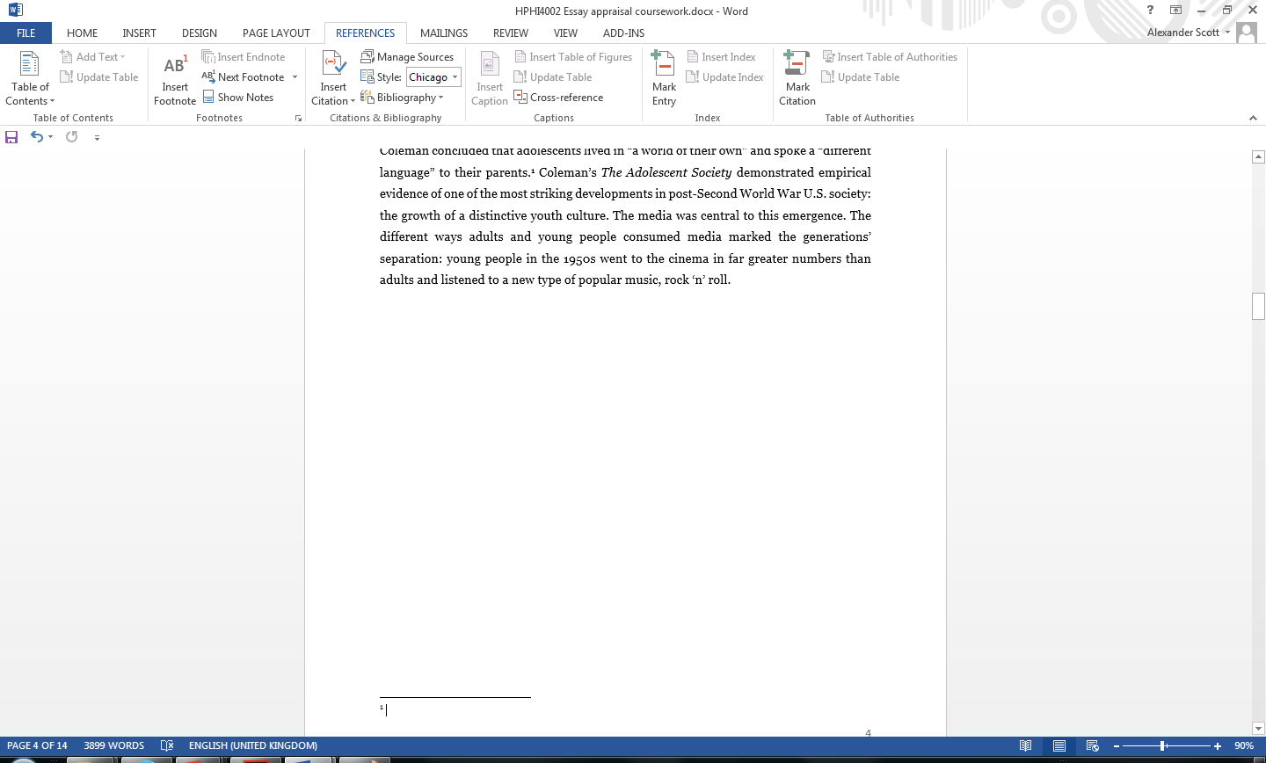
How to footnote using Microsoft Word …

Slide 20
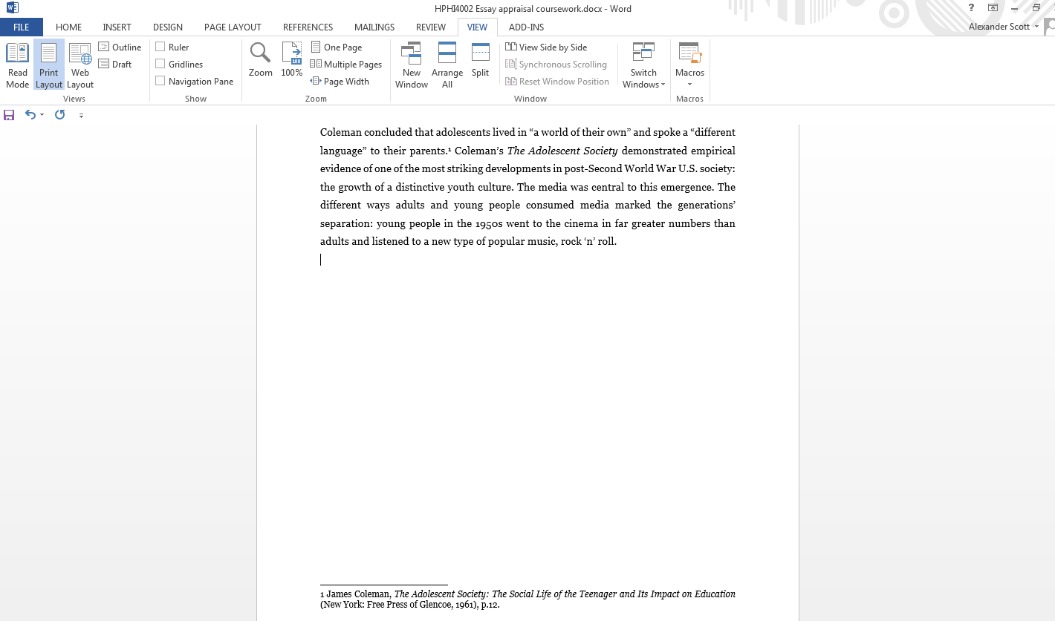
How to footnote using Microsoft Word …

Slide 21
How to footnote …
“The [relevant bibliographic] The information should be given in the following order:
  Author: The author’s name should normally be given as it appears on the title page; forenames should precede surnames and should not be reduced to initials. The names of up to three authors should be given in full …”
MHRA, Style Guide, p. 60.

Slide 22
How to footnote …
“The [relevant bibliographic] The information should be given in the following order:
  2. Title: The title should be given as it appears on the title page (although very long titles may be suitably abbreviated) and italicized. A colon [:] should always be used to separate title and subtitle … For books in English and German, capitalize the initial letter of the first word after the colon and of all principal words throughout … for titles in other languages, follow the capitalization rules for the language in question.”
    e.g. Tom McArthur, Worlds of Reference: Lexicography, Learning and Language from the Clay Tablet to the Computer (Cambridge: Cambridge University Press, 1986), p. 59.
MHRA, Style Guide, pp. 59, 61.

Slide 23
How to footnote …
“The [relevant bibliographic] The information should be given in the following order:
  3. Editor, Translator, etc.: The names of editors etc. should be treated in the same way as those of authors (as set out above) with regard to forenames and number to be given; they should be preceded by the accepted abbreviated forms ‘ed. by’, ‘trans. by’, ‘rev. by.”
  e.g. Jean Starobinski, Montaigne in Motion, trans. by Arthur Goldhammer (Chicago: University of Chicago Press, 1986), p. 174.
MHRA, Style Guide, pp. 59, 61.

Slide 24
How to footnote …
“The [relevant bibliographic] The information should be given in the following order:
  4. Series
  5. Edition
  6. Number of volumes
  7. Details of publication
  The place of publication, the name of the publisher, and the date of publication should be enclosed in parentheses; a colon separates the place from the publisher, a comma separates the publisher from the date.”
  e.g. Tom McArthur, Worlds of Reference: Lexicography, Learning and Language from the Clay Tablet to the Computer (Cambridge: Cambridge University Press, 1986), p. 59.
MHRA, Style Guide, pp. 59, 61–62.
ONE USEFUL ADDITION – if the book you are referring to has been published in earlier editions – especially when being used as a primary source – include the original publication date [in square brackets] as well.
e.g. Frederick Douglass, Narrative of the Life of Frederick Douglass, An American Slave, ed. By Houston A. Baker jr. (Harmondsworth: Penguin, 1982 [1845]), p. 120.

Slide 25
How to footnote …
Then, last but not least, include page numbers.
When referencing a single page, prefix the page number with a single “p.”
  e.g. Tom McArthur, Worlds of Reference: Lexicography, Learning and Language from the Clay Tablet to the Computer (Cambridge: Cambridge University Press, 1986), p. 59.
When referencing more than one page, prefix the page numbers with “pp.”
e.g. Frederick Douglass, Narrative of the Life of Frederick Douglass, An American Slave, ed. By Houston A. Baker jr. (Harmondsworth: Penguin, 1982 [1845]), pp. 120–125.
Douglass, Narrative, pp. 56, 78, 92.
AND FINALLY … A FULL STOP.

Slide 26
How to footnote …
Chapters, Essays or Articles in Books
The same general principles apply:
The information should be given in the following order:
Author’s name, exactly as it appears in the book
Title of chapter or article in single quotation marks
The word ‘in’ (preceded by a comma) followed by title, editor’s name, and full publication details of book
Page numbers.
Full stop.
e.g. Fanni Bogdanow, ‘The Suite du Merlin and the Post-Vulgate Roman du Graal’, in Arthurian Literature in the Middle Ages: A Collaborative History, ed. by Roger Sherman Loomis (Oxford: Clarendon Press, 1959), pp. 325–35.

Slide 27
How to footnote …
Articles in Journals
The same general principles apply:
The information should be given in the following order:
Author’s name, exactly as it appears in the article
Title of article, in single quotation marks
Title of journal, italicized
Information about volume and number of the edition of the journal cited
Year(s) of publication, in parentheses
Page number(s).
Full stop.
e.g. Leo Ou-fan Lee, ‘Shanghai Modern: Reflections on Urban Culture in China in the 1930s,’ Public Culture: Bulletin of the Project for Transnational Cultural Studies, Vol. 11, No. 1 (January 1999), pp. 76–107.
    OR
Leo Ou-fan Lee, ‘Shanghai Modern: Reflections on Urban Culture in China in the 1930s,’ Public Culture: Bulletin of the Project for Transnational Cultural Studies, 11:1 (January 1999), pp. 76–107.

Slide 28
How to footnote …
Articles in Newspapers and Magazines
References to articles in newspapers or magazines (periodical publications other than scholarly journals) require only the date of issue (day, month, and year), the section where relevant (e.g. ‘Reviews section’, ‘section G2’), and the page number(s):
Michael Schmidt, ‘Tragedy of Three Star-Crossed Lovers’, Daily Telegraph, 1 February 1990, p. 14.
Jonathan Friedland, ‘Across the Divide’, Guardian, 15 January 2002,section G2, pp. 10–11.
Jacques-Pierre Amette, ‘Thé et désespoir’, Le Point, 8 October 1989, p. 18.
Carlos Bousoño, ‘La ebriedad de un poeta puro’, El País, 21 May 1989, p. 17.

Slide 29
How to footnote …
Websites and online materials
“Material published online, whether at news websites, as part of electronic journals, or found only on personal web pages, should be cited as carefully as material published in print form. Similarly, authors should exercise the same discretion in considering the quality and value of material published on the internet as they would for material published by more traditional means.”
- MHRA, Style Guide, p. 71.

Slide 30
How to footnote …
Websites and online materials
Referencing online sources is less formalised than with printed materials. However, as far as possible, references to online materials should include the same information as in citations of printed publications:
Author’s name
Title of item (essay, story, etc.)
Title of complete work/resource (i.e. website)
Date
References to online sources should include the important additions of the WEB ADDRESS and the DATE ACCESSED
Full address (Universal Resource Locator [URL])
Date at which the resource was consulted
e.g. Jack Sommers, ‘Mental Health Report Reveals 300,000 People with Long-Term Problems Lose Their Jobs Every Year,’ Huffington Post, 26 October 2017 <http://www.huffingtonpost.co.uk/entry/mental-health-report-theresa-may_uk_59f17a98e4b07d838d321994?utm_hp_ref=uk-homepage>[accessed 27 October 2017]

Slide 31
Footnoting the same source on multiple occasions
When citing the same source on multiple occasions, footnotes can be abbreviated to include
Author’s surname only (except when your essay includes authors with same surname)
An abbreviated, yet clearly intelligible, shortened title
e.g.
MHRA, Style Guide, p. 71.
Lee, ‘Shanghai Modern,’ p. 100.
Douglass, Narrative, pp. 56, 78, 92.
Sommers, ‘Mental Health Report.’
NOTE: PUBLICATION DETAILS (PUBLISHER, PLACE OF PUBLICATION, DATE CAN GENERALLY BE OMITTED). THIS MAKES FOR A TIDIER, MORE EASILY LEGIBLE SET OF FOOTNOTES.

Slide 32
Footnotes can distinguish one’s work from others’ work
“In the modern world, historians perform two complementary tasks. They must examine sources relevant to the solution of a problem and construct a new narrative or argument from them. The footnote proves both tasks have been carried out. It identifies both the primary evidence that guarantees the novelty [of the historian’s work] and the secondary sources that do not undermine its novelty in form and thesis.”
Grafton, The Footnote, p. 5.

