Slide 1
Project Management
defining the problem; setting the goals
and objectives, milestones and monitoring, evaluation)

Slide 2
Contents Page
Problem Solving and Decision Making
Problem Solving tools
Goal setting and its importance
Project Management approaches

Slide 3
Aim and Objectives
Aim:
To provide students an insight to problem solving, goal setting and project management.
Objectives:
Students should be able to understand the nature of problem solving
Students should able to demonstrate how to problem solve
Students should be to explain how problem solving and goal setting are linked with project management.

Slide 4
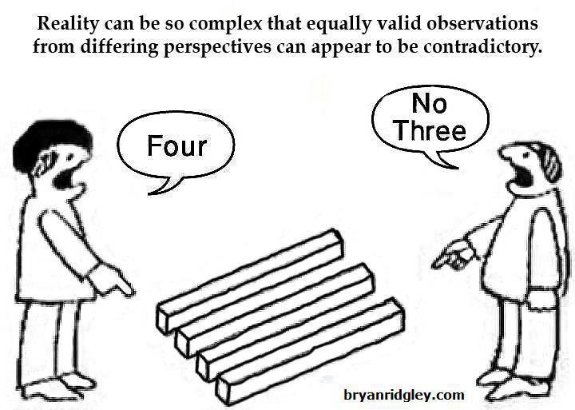
At First Glance
Reality can be so complex that equally valid observations from differing perspectives can appear to be contradictory.

Slide 5
Exercise 1 - Dots
• | • | •
• | • | •
• | • | •
Join all the dots using four lines without taking your pen off the paper
Individual - 3 mins

Slide 6
Mental Agility
Pairs – 3 minutes
Exercise 2:
Add one line so that:
5 + 5 + 5 = 550

Slide 7
What is a Problem???
A perceived gap between the existing state and a desired state, or a deviation from a norm, standard, or status quo. (Business dictionary, 2020)
A matter or situation regarded as unwelcome or harmful and needing to be dealt with and overcome.
(Oxford dictionaries, 2020)
A problem can be defined as a circumstance where there is a gap between the situation as you perceive it and what you believe the situation should be.

Slide 8

Definition of decision making?
Decision Making is the act of choosing between two or more courses of action.

Slide 9
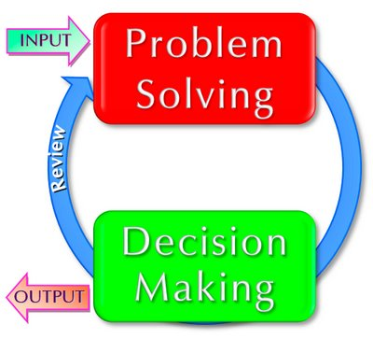
Problem solving & decision making
Problem Solving is the process of taking corrective action to meet objectives.
Decision making is the process of selecting a course of action that will solve the problem.
Decisions must be made when you face a problem.
Notes:
A problem exists whenever objectives are not being met. In other words you have a problem whenever there is a difference between what is actually happening and what you want to happen. If the objective is to produce 1,500 units per day but the department produces 1,490, a problem exists. Problem Solving is the process of taking corrective action to meet objectives. Decision making is the process of selecting a course of action that will solve the problem. Decisions must be made when you face a problem. When something isn’t working, fix it. McDonalds had a problem with decreasing sales and made in year 2015 made a decision to offer all-day breakfast and fresh baked foods.
Problem solving and decision-making are important skills for business and life. Problem-solving often involves decision-making, and decision-making is especially important for management and leadership. There are processes and techniques to improve decision-making and the quality of decisions. Decision-making is more natural to certain personalities, so these people should focus more on improving the quality of their decisions. People that are less natural decision-makers are often able to make quality assessments, but then need to be more decisive in acting upon the assessments made.
Problem-solving and decision-making are closely linked, and each requires creativity in identifying and developing options, for which the brainstorming technique is particularly useful. Good decision-making requires a mixture of skills: creative development and identification of options, clarity of judgement, firmness of decision, and effective implementation. For group problem-solving and decision-making, or when a consensus is required, workshops help, within which you can incorporate these tools and process as appropriate. Here are some useful methods for effective decision-making and problem-solving: First a simple step-by-step process for effective decision-making and problem-solving.

Slide 10

Types of Problems
Simple Problem
Complicated Problem
Complex Problem
Wicked Problems

Slide 11
Problem solving & decision making
Problem solving and decision-making are important skills for business and life. Problem-solving often involves decision-making, and decision-making is especially important for management and leadership.
There are processes and techniques to improve decision-making and the quality of decisions.
Decision-making is more natural to certain personalities, so these people should focus more on improving the quality of their decisions.
People that are less natural decision-makers are often able to make quality assessments, but then need to be more decisive in acting upon the assessments made.
Notes:
Much of what people do is solve problems and make decisions. Often, they are "under the gun", stressed and very short for time. Consequently, when they encounter a new problem or decision they must make, they react with a decision that seemed to work before. It's easy with this approach to get stuck in a circle of solving the same problem over and over again.
Definition of Problem Solving
2
A working definition of problem solving can help clarify what constitutes a problem. Perhaps an obvious place to start is to recognise that a problem must be “problematic”, if a solution is clear then you don’t have a problem to solve, you have a decision to make!
It’s useful to think of four factors which help to build a definition of problem solving.
Problem solving is:
a systematic process which
defines a problematic situation (where there is a gap between actual and expected or the situation is vague, or there is something that is unsatisfactory) and identifies the problem as an opportunity
for which a resolution or solution is needed to beimplemented by an individual or group.
and which finally, and crucially should beworthwhile solving.
What may have surprised you in the words we used to help define problem solving is the idea of regarding problems as opportunities. The very word “problem” tends to have a negative sense, implying that there is a difficulty or issue to be resolved, and sometimes that is the case. However, often what are problems can and should be seen as opportunities. Opportunities to make something better or do something better, or perhaps help someone to become better.
For example, common problems can be found in all areas of our work like:
Conflict between teams or team members
Customer issues with the service or product produced
Processes that don’t work properly and you don’t know why
Making cost savings
Finding new customers
Launching a new service
All of which can be seen as opportunities. Perhaps just as important as the words we use in our definition of problem solving, is our attitude towards problem solving. Seeing problems as opportunities starts to change how we define a problem.
A Problem or a Decision?
As a final thought it is worth contrasting problem solving with a definition of decision making. They both have similarities, and of course you must have decision making as part of a problem solving process. Decisions however tend to be a choice about alternatives and take you forward to action. Whereas problem solving tends to start by looking back at what has happened or is happening in order to understand how you might solve the problem you have.
The words we use to create a definition of problem solving matter when they help us to recognise that problems are really opportunities to do things better.
Decision making, problem solving, and creative thinking have in common the fact that they are all forms of effective thinking. But there are some distinctions between them. You can, for example, think creatively, in the sense of having an original idea, without either making a decision or solving a problem. In this chapter the main focus is upon problem solving.
How problems differ from decisions
What is a problem? A ‘problem’ is literally ‘something thrown in front of you’. Another of those Greek words by origin, it is related to ‘ballistics’. Originally what was thrown or put in front of one by the Greek teachers was the sort of puzzle or question that you encountered in the first chapter: ‘The nine dots’, ‘The six matchsticks’ and ‘Who owns the zebra?’ (Incidentally, has your Depth Mind come up with solutions – or extra solutions – to the first two yet?)
You will notice that in problems like these, all the elements of the solution are already there. All that you have to do is arrange or rearrange what has been given. In that sense, a problem is a solution in disguise.
As a result of solving such problems your life is not going to be different. By contrast, a decision usually does mean that life will be different. It opens the way to changes of some kind or other. Some of these changes are planned, wanted, expected or at least foreseen (the manifest consequences), whereas others are not. But solving or not solving a crossword puzzle is not going to change your life in any way.
In this respect such problems are similar to games – in fact, games are sets of problems. Why do we invent them? Because there is nothing that humans enjoy more than solving problems. The skills of a problem solver in this limited sense, however, differ from those of a decision maker. As a problem solver you have to be clever, with analytical skills well honed on manyother problems in that particular field. By contrast, a decision-maker needs a much wider range of skills and characteristics.
Moving away from puzzles and games, the problems we encounter in real life are mostly obstacles placed in front of us. If you decide to climb Mount Everest, for example, you may find that all goes well until – a day before your final ascent – a heavy storm suddenly develops on the South Col, the ridge leading to the summit. You have a problem! Notice that you would not have that particular problem – or any problems – on Everest unless you had made a decision to climb to the summit. It is not a problem for anyone else. And it would cease to be a problem for you if you changed your mind and decided to go off and climb some other mountain in the Himalayas.
Therefore problems as obstacles or difficulties in the path ahead of us are always secondary to the results of decision making. Decisions create problems. One way of solving them – or rather the problem state in your mind – is to alter your decision, or at least your plan. Did you have a contingency plan – a Plan B – for your route up the mountain if the weather deteriorated or avalanches (unexpected at this time of year) occurred?
If you stick with your decision, then, in consultation with your team, you have to find a way of overcoming the problem. Because the mental framework you must use is so similar to the decision-making process, a single model covering them both is possible.

Slide 12
Diagnosing Problems
The first stage in the problem-solving process is recognising a problem exists:
Many day-to-day problems can easily be resolved by taking decisive actions
Problems that are more complex often require lengthy deliberation.
Notes:
Define the problem
Diagnose the situation so that your focus is on the problem, not just its symptoms. Helpful techniques at this stage include using flowcharts to identify the expected steps of a process and cause-and-effect diagrams to define and analyze root causes.
The chart below identifies key steps for defining problems. These steps support the involvement of interested parties, the use of factual information, comparison of expectations to reality and a focus on root causes of a problem. What’s needed is to:
Review and document how processes currently work (who does what, with what information, using what tools, communicating with what organizations and individuals, in what time frame, using what format, etc).
Evaluate the possible impact of new tools and revised policies in the development of a model of “what should be.”

Slide 13
Problems can be diagnosed through
Continuously monitoring performance
Listening to subordinates
Observing subordinates’ behaviour
Establishing the cause of the problem
Notes:
1. Define the problem
This is often where people struggle. They react to what they think the problem is. Instead, seek to understand more about why you think there's a problem.
Define the problem: (with input from yourself and others). Ask yourself and others, the following questions:
What can you see that causes you to think there's a problem?
Where is it happening?
How is it happening?
When is it happening?
With whom is it happening? (HINT: Don't jump to "Who is causing the problem?" When we're stressed, blaming is often one of our first reactions. To be an effective manager, you need to address issues more than people.)
Why is it happening?
Write down a five-sentence description of the problem in terms of "The following should be happening, but isn't ..." or "The following is happening and should be: ..." As much as possible, be specific in your description, including what is happening, where, how, with whom and why. (It may be helpful at this point to use a variety of research methods.
Defining complex problems:
If the problem still seems overwhelming, break it down by repeating steps 1-7 until you have descriptions of several related problems.
Verifying your understanding of the problems:
It helps a great deal to verify your problem analysis for conferring with a peer or someone else.
Prioritize the problems:
If you discover that you are looking at several related problems, then prioritize which ones you should address first.
Note the difference between "important" and "urgent" problems. Often, what we consider to be important problems to consider are really just urgent problems. Important problems deserve more attention. For example, if you're continually answering "urgent" phone calls, then you've probably got a more "important" problem and that's to design a system that screens and prioritizes your phone calls.
Understand your role in the problem:
Your role in the problem can greatly influence how you perceive the role of others. For example, if you're very stressed out, it'll probably look like others are, too, or, you may resort too quickly to blaming and reprimanding others. Or, you are feel very guilty about your role in the problem, you may ignore the accountabilities of others.
2. Look at potential causes for the problem
It's amazing how much you don't know about what you don't know. Therefore, in this phase, it's critical to get input from other people who notice the problem and who are effected by it.
It's often useful to collect input from other individuals one at a time (at least at first). Otherwise, people tend to be inhibited about offering their impressions of the real causes of problems.
Write down what your opinions and what you've heard from others.
Regarding what you think might be performance problems associated with an employee, it's often useful to seek advice from a peer or your supervisor in order to verify your impression of the problem.
Write down a description of the cause of the problem and in terms of what is happening, where, when, how, with whom and why.

Slide 14
Initial Analysis
Gather information
Define the scope
Define the Impact
Determine consequences
Notes:
Once a problem has been diagnosed the first thing to do is to carry out an initial analysis.

Slide 15
What next?
Decide to do nothing
Keep the problem under surveillance and review it (later date)
Contain the problem
Find a solution
Notes:
3. Identify alternatives for approaches to resolve the problem
At this point, it's useful to keep others involved (unless you're facing a personal and/or employee performance problem). Brainstorm for solutions to the problem. Very simply put, brainstorming is collecting as many ideas as possible, then screening them to find the best idea. It's critical when collecting the ideas to not pass any judgment on the ideas -- just write them down as you hear them. (A wonderful set of skills used to identify the underlying cause of issues is Systems Thinking.)
4. Select an approach to resolve the problem
When selecting the best approach, consider:
Which approach is the most likely to solve the problem for the long term?
Which approach is the most realistic to accomplish for now? Do you have the resources? Are they affordable? Do you have enough time to implement the approach?
What is the extent of risk associated with each alternative?
(The nature of this step, in particular, in the problem solving process is why problem solving and decision making are highly integrated.)

Slide 16
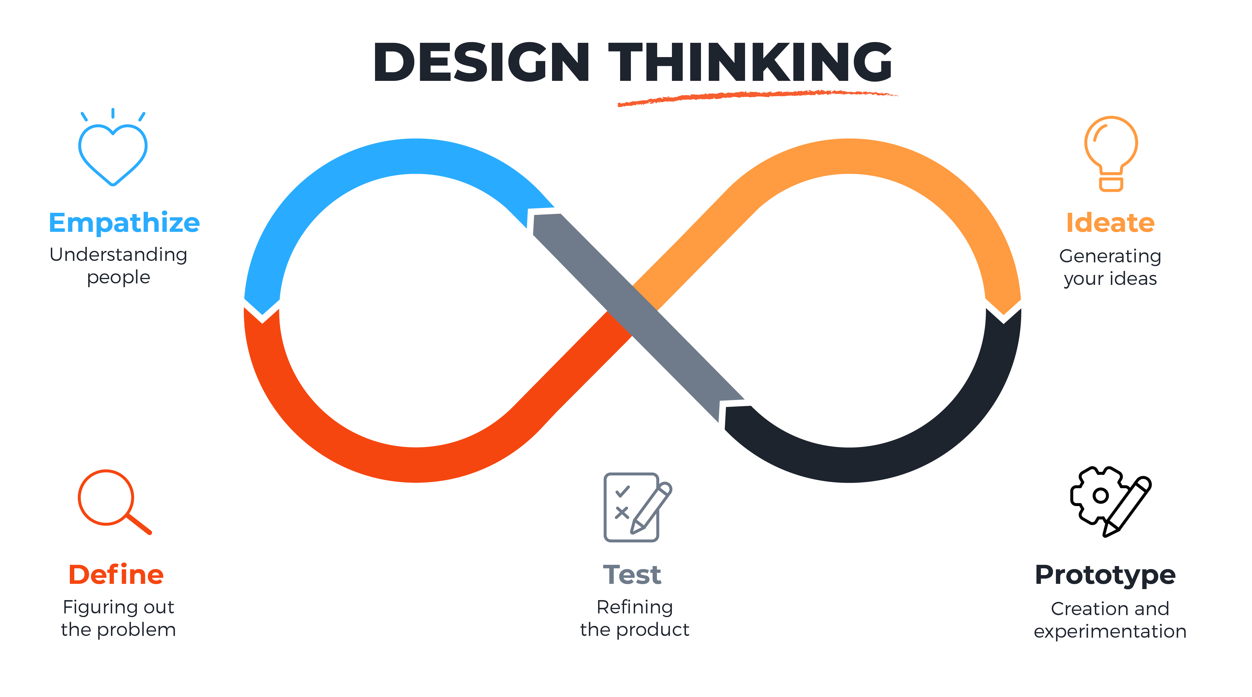
Problem Solving
Notes:
Define (the Problem)
During the Define stage, you put together the information you have created and gathered during the Empathise stage. This is where you will analyse your observations and synthesise them in order to define the core problems that you and your team have identified up to this point. You should seek to define the problem as a problem statement in a human-centred manner.
To illustrate, instead of defining the problem as your own wish or a need of the company such as, “We need to increase our food-product market share among young teenage girls by 5%,” a much better way to define the problem would be, “Teenage girls need to eat nutritious food in order to thrive, be healthy and grow.”
The Define stage will help the designers in your team gather great ideas to establish features, functions, and any other elements that will allow them to solve the problems or, at the very least, allow users to resolve issues themselves with the minimum of difficulty. In the Define stage you will start to progress to the third stage, Ideate, by asking questions which can help you look for ideas for solutions by asking: “How might we… encourage teenage girls to perform an action that benefits them and also involves your company’s food-product or service?”

Slide 17
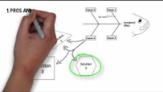
IDEA

Slide 18
Activity?
You are given an assignment brief, but no template has been provided.
The assignment brief contains information concerning the topic area: how would you go about tackling the assignment?

Slide 19
Break

Slide 20
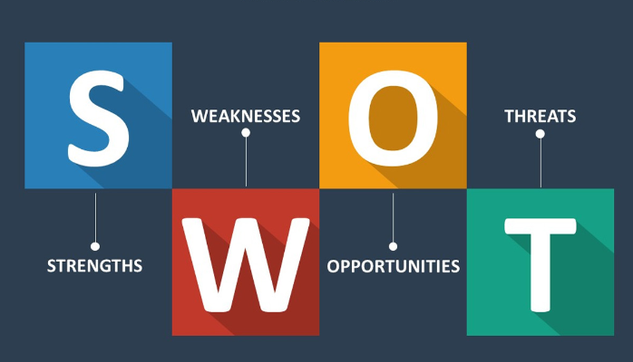

Slide 21
The importance of goal setting.
Many people feel as if the are adrift in the world. They work hard, but they do not seem to make any worthwhile progress.
A key reason that they feel this way is that they have not spent enough time thinking about what they want from life and have not set themselves formal goals.
After all, would you set out on a major journey with no real idea of your destination? Probably not!

Slide 22
The Importance of goal setting
Goal setting is a powerful process for thinking about your ideal future, and for motivating yourself to turn your vision of this future into reality
The process of setting goals helps you choose where you want to go in life.
By knowing precisely what you want to achieve, you know where you have to concentrate your efforts.
You will also quickly spot the distractions that can, so easily, lead you astray.

Slide 23
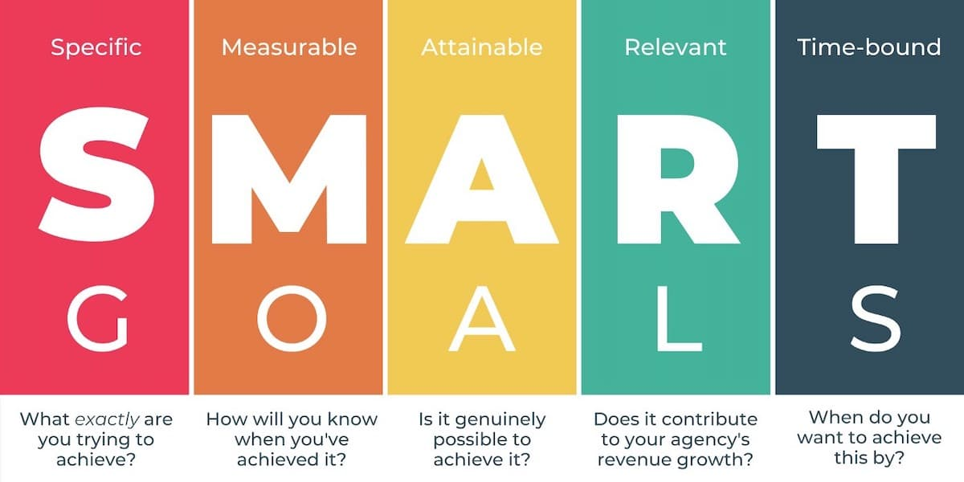

Slide 24
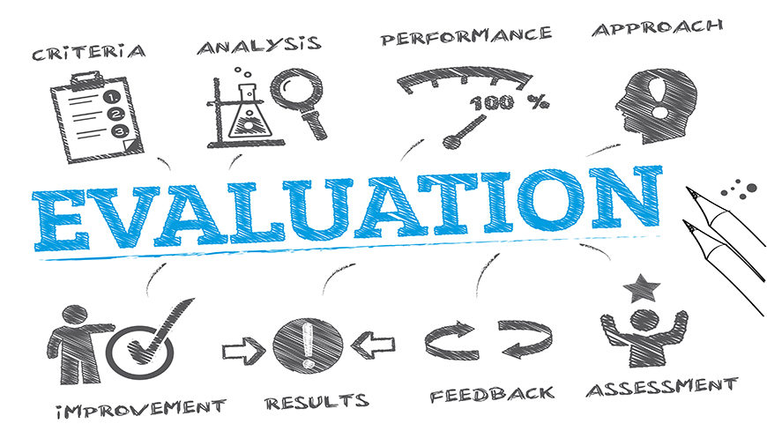
Evaluating Goals
A general objective of an evaluation process is to organize and analysed gathered information (Berriet-Solliec, Larbarthe and Laurent 2014).
Goal 1: To measure
Goal 2: To understand
Goal 3: To Learn
Notes:
Goal 1: To Assess to effects of a program or project. This can be viewed as ‘assessment impact’ (E.g. efficiency of delivery, value of product or services against production costs).
Goal 2: Analysis of mechanisms and assessment of outcomes
Goal 3: The evaluation is designed as a collective learning process (What can be taken away? What can be improved?
All goals need to produced empirical data as evidence.

Slide 25
Break

Slide 26

Project Management
Simon and Murray-Webster (2018) describes a project as “activities that are done to meet specific objectives for change.”
Project Management:
Organising and controlling the implementation of change.
Understanding requirements
Co-ordinating work loads of different people
Monitoring
Delivering successful results

Slide 27
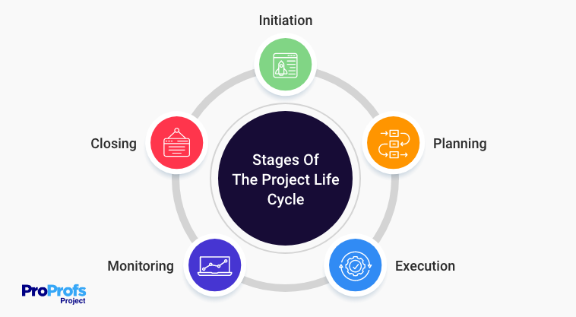

Slide 28

Initiation
This phase within the life cycle involves:
Defining projects intentions, objectives and feasibility
Identifying appropriate stakeholders
Creating a project charter
Producing a high-level project plan.

Slide 29
Planning
This phase within the cycle concentrates on:
Planning to define the projects activities, timelines and budget
Creating work breakdown structure (WBS)
Identifying potential risks and a communication plan
Generating risk management plan(s)

Slide 30

Execution
This phase within the cycle involves:
Implementation of project plans and activities
Coordinating resources
Managing tasks
Addressing issues and changes

Slide 31

Monitoring and control
In this phase, projects are monitored and assessed on performance against the designed and agreed project plan(s):
Tracking activities
Managing risks
Ensuring quality control
Producing progress reports

Slide 32
Closing
This the final phase of the project life cycle involves:
Formally closing the project and documenting final results
Conducting project review
Lessons learned (What went well?)
Stakeholders sign-off

Slide 33

Prince2 Framework
PRINCE2 is a generic method for Project Management. The framework can be applied:
1-to-2-day projects (TV shows)
Company Acquisition
Construction (Building a new football stadium)
Notes:
Link: https://pmstudent.com/wp-content/uploads/The-PRINCE2-Training-Manual.pdf.

Slide 34

PRINCE2 Framework
PRINCE2 separates management from work to create products that the project has to produce (specialist work).
Project Board
Project Manager
Project Teams
These separation layers can be applied to multiple and different projects.

Slide 35

PRINCE2 Principles
Like many models, PRINCE2 has 7 core principles ingrained. They are:
Continued business justification
• Learn from experience
• Defined roles and responsibilities
• Manage by stages
• Manage by exception
• Focus on products
• Tailor to suit the project environment

Slide 36

Lean Conceptualisation
“Lean production… is “lean” because it uses less of everything compared with mass production – half the human effort in the factory, half the manufacturing space, half the investment in tools, half the engineering working hours to develop a new product in half the time. Also, it requires keeping far less than half the inventory on site, results in fewer defects, and produces a greater quality of products” (Womack et al.,1990, p.256).

Slide 37
Lean Project Management
Lean thinking enables companies to:
Specify companies
Create processes and actions in efficient sequences
To perform effectively
The six principles:
Value,
Value stream
Flow,
Pull,
Perfection
Respect for people
(Oppenheim et al., 2011).

Slide 38

Lean project Management

Slide 39

Lean Health Management

Slide 40
Summary
There are numerous types of problems
Tools such as Design Thinking can be used to define an identified problem
Goal setting and evaluation are important to successful outcomes
Project management utilises theoretical frameworks to ensure successful outcomes.

Slide 41
Independent Activity
Students are required to search and identify a suitable job role within HSC sector and make note of the role’s criteria, paying particular focus towards the transferable skills.

Slide 42
Reference List
Berriet-Solliec, M., Larbathe, P. and Laurent, C. (2014) Goals of evaluations and types of evidence. Evaluation. 20 (2): pp. 195-193
Oppenheim, B. W., Murman, E. M., and Secor, D. A. (2011) ‘Lean enablers for systems engineering’. Systems Engineering, 14(1): pp. 29-55.
Simon, P. and Murray-Webster. R. (2018) Starting Out in Project Management, Association for Project Management, 2018. ProQuest Ebook Central,http://ebookcentral.proquest.com/lib/trinity/detail.action?docID=6348574.Created from trinity on 2023-07-14 12:35:33
Womack. J.P., Jones, D.T. and Roos, D. (1990) The Machine That Changed the World: The Story of Lean Production. New York: Rawson Associates.

