Slide 1
Student Name: Rebbeh Manneh
Student ID: 2026514
Module Code: BMHP5003_BIRM
Assignment Title: Individual Academic Poster presentation
Lecturer Name: Rachael Rivers

Slide 2
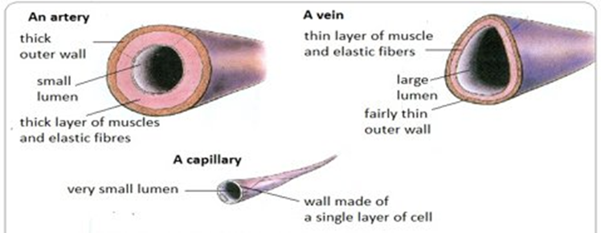
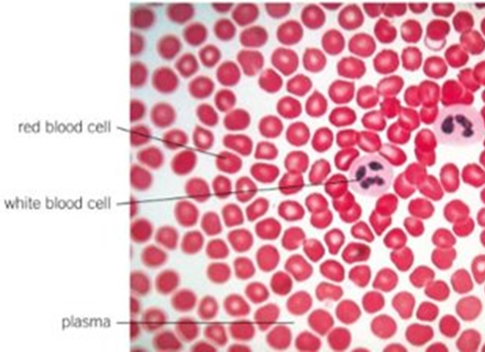
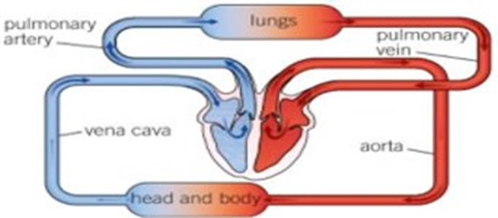
What is the circulatory system?
What are blood vessels?
What is in blood?
As blood travels away from and towards the heart, it passes through vessels that are part of the circulatory system. "Arteries carry blood away from the heart and veins carry blood back to the heart" (Hirsch, 2018).
Blood vessels and your heart make up your circulatory system. Substances are transported by blood to the cells where they are needed. This includes oxygen and glucose needed for respiration.The blood also removes waste products, such as carbon dioxide, from the body
The role of blood vessels is to distribute blood throughout the body. According to National Cancer Institute, "The vessels make up two closed systems of tubes that begin and end at the heart". There is one system (pulmonary Vessels) responsible for the transportation of blood between the right ventricle and the lungs and also between the left atrium and the lungs. Blood is also carried throughout the body by the systemic vessels, which return blood from the left ventricle to the right atrium.
There are 3 main types of blood vessel: arteries, veins, and capillaries.
Blood vessels are tubelike structures that transport blood around the body. The hollow cavity in the centre is called the lumen
Arteries : Blood is carried away from the heart by arteries under high pressure
Veins : Blood returns to the heart through veins
Capillaries : link arteries and veins in tissues and organs
Blood is composed of liquids and solids.
Human blood consists of 4 main components: red blood cells, white blood cells, plasma, and platelets.
Red blood Cells: small Biconcave, haemoglobin-containing cells with no nucleus. Their role is to carry oxygen
White blood cells: They contain a nucleus and are large cells. By making antibodies, they combat disease.
Plasma: Over 90% of plasma is water, which is the liquid in which blood cells float.
Platelets: Clotting of the blood is facilitated by platelets

Slide 3
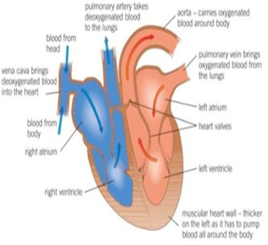
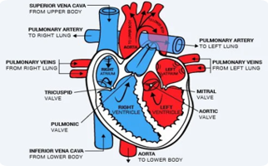
The heart and it’s order of blood flow:
What is inside your heart?
VENA CAVA​
RIGHT ATRIUM​
Tricuspid valve ​
RIGHT VENTRICLE​
Pulmonic valve ​
PULMONARY ARTERY​
LUNGS ​
PULMONARY VEINS​
LEFT ATRIUM ​
Bicuspid valve​
LEFT VENTRICLE ​
Aortic valve ​
AORTA ​
REST OF THE BODY
Your heart has four chambers. The two smaller upper chambers are atria (single – atrium) and the two larger lower chambers are ventricles. The blood is pumped from the body and lungs to the atria and then from the atria to the ventricles. Blood is pumped out of the heart through the ventricles to the lungs and other organs. There is an internal wall of tissue that divides the left and right sides of your heart. As National Heart, Lung and Blood Institute. (2022) states "This wall is called the septum".

Slide 4
Heart Conditions
Causes of a heart attack
Cardiovascular disease refers to multiple heart conditions and problems. Here are few:
Coronary heart disease
Angina
Heart attack
High blood pressure
Heart attack occurs when your heart muscle is completely deprived of blood supply. There is a common cause for this that has to do with a piece of fat breaking away and causing a blood clot to form within the coronary artery. It can damage the area of your heart muscle that the coronary artery served.
Symptoms of a heart attack
chest pain
shortness of breath
nausea
anxiety
coughing
vomiting
wheezing
The risk of heart disease can be increased by certain factors. These factors are known as risk factors and include:
High blood pressure
High cholesterol level
Diabetes
Smoking
Not getting enough exercise
Being overweight
Drinking too much alcohol
Unhealthy diet
Treating a heart attack
Treatment plans will differ depending on the type of heart attack you've suffered.
A heart attack must be treated immediately for two reasons:
to relieve pain and shock
ensure that blood flow is restored and damage to heart muscles is minimised
The best way to reduce your risk of having another heart attack is by changing your lifestyle and taking a combination of different medications for a long period of time.

Slide 5
British Heart Foundation. How your heart works. Available at: How your heart works – Heart and circulatory system – BritishHeart Foundation (bhf.org.uk). (Accessed: 16 October 2022)
Cleveland Clinic. (2022) Blood Vessels. Available at:Blood Vessels: Types, Anatomy, Function & Conditions (clevelandclinic.org). (Accessed: 14 October 2022).​
Hirch, L. (2018) Heart and Circulatory System. Available at: Heart and Circulatory System (for Teens) - Nemours KidsHealth. (Accessed: 14 October 2022).
​
Medline Plus. (2015) Blood. Available at:Blood | MedlinePlus (Accessed: 16 October 2022).
National Cancer Institute. Classification & Structure of Blood Vessels. Available at: Classification & Structure of Blood Vessels | SEER Training (cancer.gov). (Accessed: 19 October 2022).​
National Heart, Lung and Blood Institute. (2022) What the Heart Looks Like. Available at: https://www.nhlbi.nih.gov/health/heart/anatomy%20Nat (Accessed: 19 October 2022).
NHS inform. (2022) Common heart conditions. Available at:Common heart conditions - Illnesses & conditions | NHS inform Accessed : (19 October 2022)
Quizlet. Circulatory system TEST. Available at: Circulatory system TEST Flashcards | Quizlet (Accessed 20 October 2022)

