Slide 1
Excavation, methods, techniques.
Excavation: Introduction Strata Florida 2020
Excavation background information
Images from Google images

Slide 2
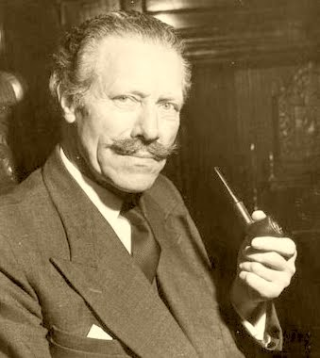
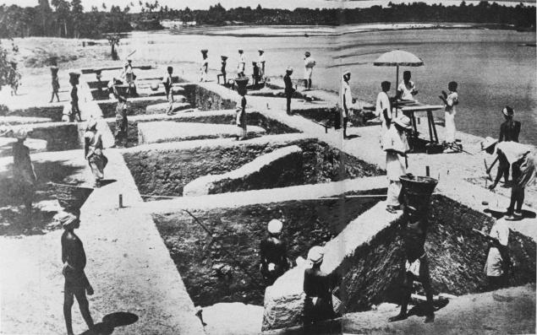
Excavation: Sir Mortimer Wheeler: Box Grid
The Arikamedu excavations – a lost Roman trading post in India

Slide 3
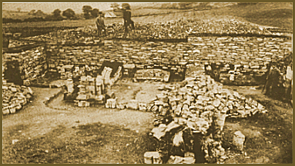
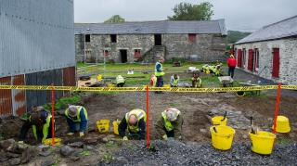
Excavation: Strata Flordia Open Area
Stephen Williams Excavation 188
http://history.powys.org.uk/history/rhaeadr/william3.html8
Excavation around the Abbey Farm Complex 2019

Slide 4
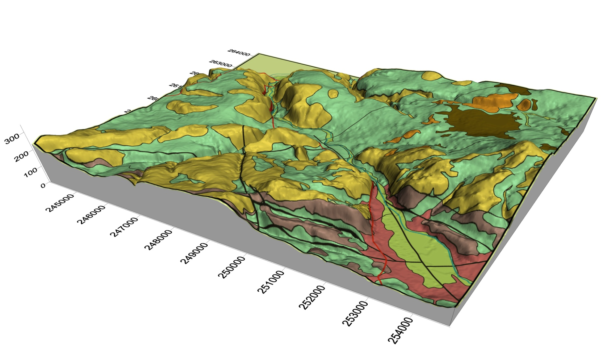
Excavation: Llanllyr 2017-19 Test pits
Test pitting and excavation of a mound-like feature
Recording sediments
Surveying
Augering
Why? To understand the buried archaeology
Site of Llanllyr
Slides of Llanllyr ourtesy of Martin Bates

Slide 5
Excavation: Before the excavation
Historical archives (county, national)
Estate maps, plans, archives (legal letters, notes, legal documents) etc. wills, transfer of deeds/landholdings.
Paintings, sketches, drawings.
Diaries, personal correspondence, family bible, memorabilia
Oral traditions, stories and histories
Antiquarian records, reports, collections, correspondence……
All are extensive and exhaustive before excavation

Slide 6
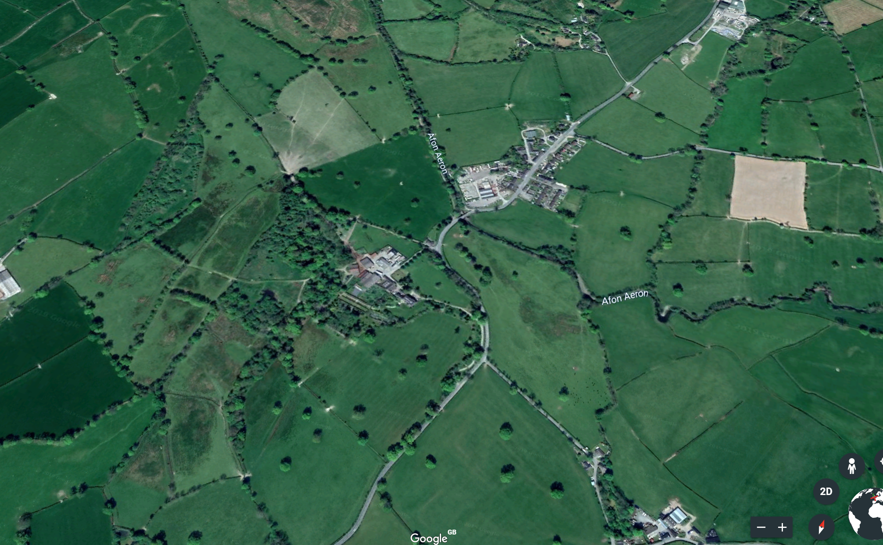
Excavation: Llanllyr Aerial photograph

Slide 7
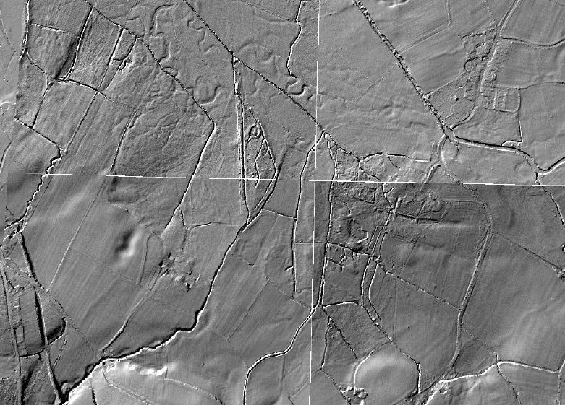
Excavation: Llanllyr
Old river channels: evidence of a buried landscape and archaeology, can’t open area excavate all of this. Hence, test pitting, auguring and boreholes as a strategy

Slide 8
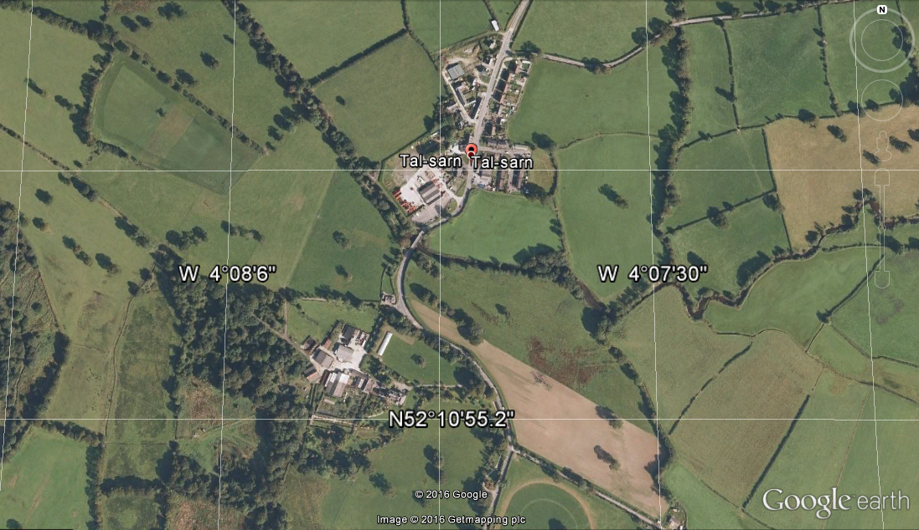
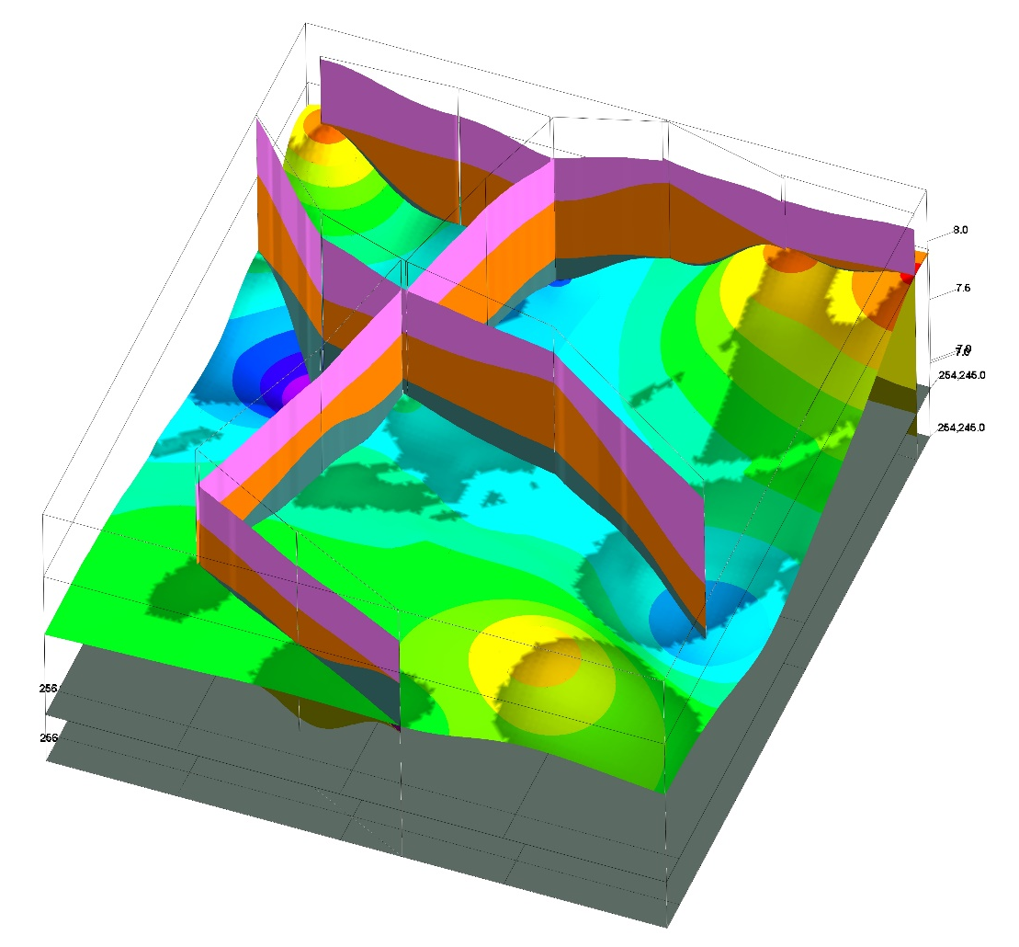
Excavation: Geophysical survey and boreholes

Slide 9
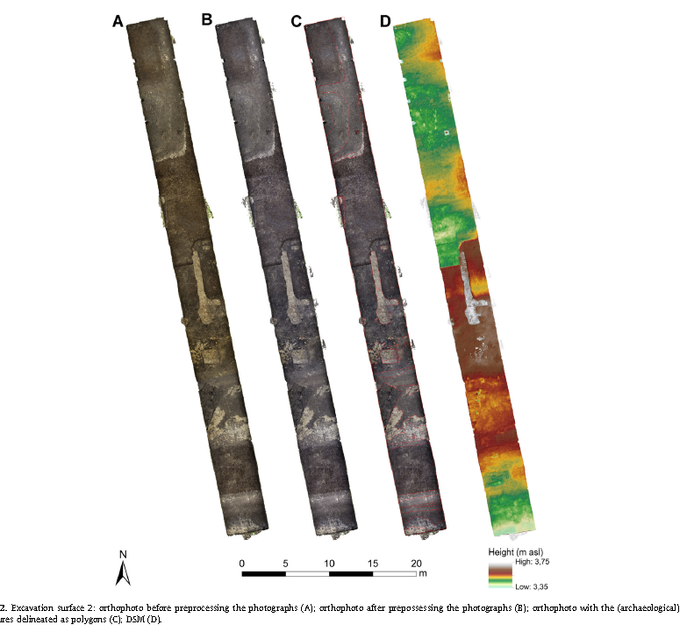
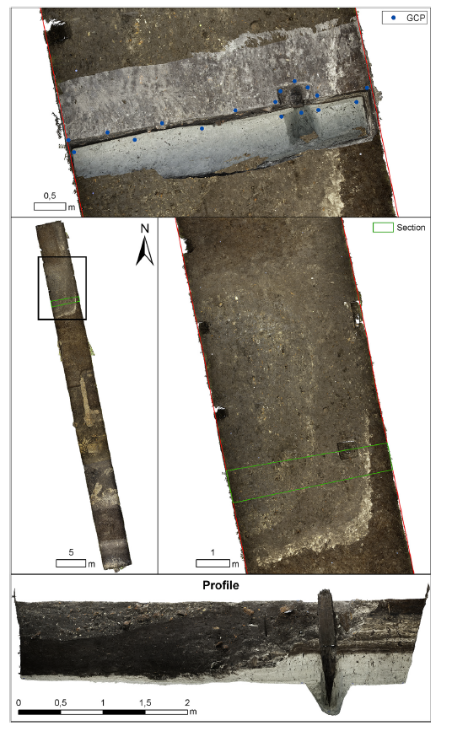
Excavation Recording: Digital Revolution

Slide 10
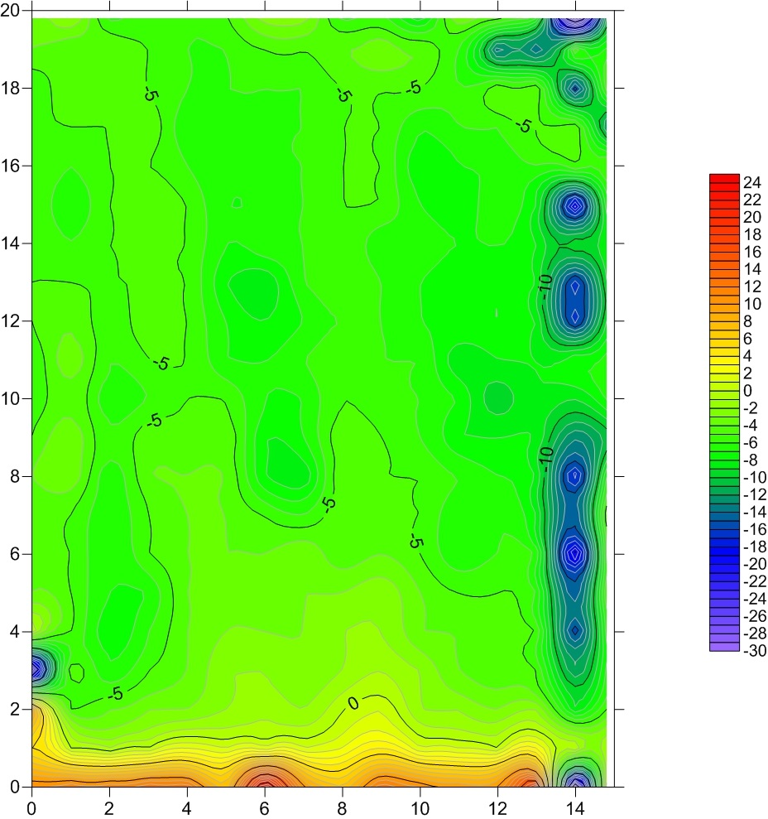
Excavation: Fieldwork and survey
Sub-surface: e.g. Magnetometers, Ground Penetrating Radar
Near ground surface, e.g. total stations to plot, map upstanding features
Aerial photography, cherry pickers, balloons, planes, etc.
These are all basically using a hand held methods
Geophys of College just outside the front of Old Building. OB is at the bottom in red. UWTSD Students 2016.

Slide 11
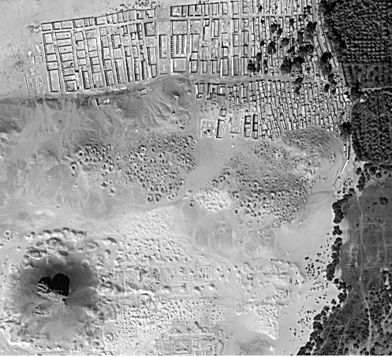
Excavation: Remote sensing survey
Drones, to space satellites and sensor remote sensing technologies
Geography of the air!
Dr Sarah Parcak use of NASA technology in Egypt

Slide 12
Excavation: Further Reading
Drewett, P., 2012. Field Archaeology: An Introduction, Hoboken: Taylor and Francis.
Grant, J., Fleming, N. & Gorin, S., 2008. The archaeology coursebook an introduction to themes, sites, methods, and skills 3rd ed., London: Routledge.
Greene, K. and Moore, T. 2010 Archaeology: An Introduction. London/New York: Routledge (Chapter 2 Discovery and Excavation is particularly useful).
Renfrew, P. and Bahn, P. 2016/19/20 Archeology: Theories Methods and Practice. Thames and Hudson. (Chapter 3 Where? Survey and excavation of sites and features is particularly useful).

