Slide 1
PR CRISIS CAMPAIGN
Yilin Wang
日期

Slide 2
Key issues
Due to some ingredients on our new product packaging are incompletely, we must recall a batch of chocolate bars.
Stakeholder crisis of trust. (investors, employees, customers)

Slide 3



What we should do?
First, we need to make an apology statement in the social media at the first time.
Tell the public that our food is safe.

Slide 4

What we should do?
Second, the key messages for recall.
Distinguish food packaging from the food itself.
Choose a person who is media trained to speak in front of the public to appease the public’s emotions.

Slide 5
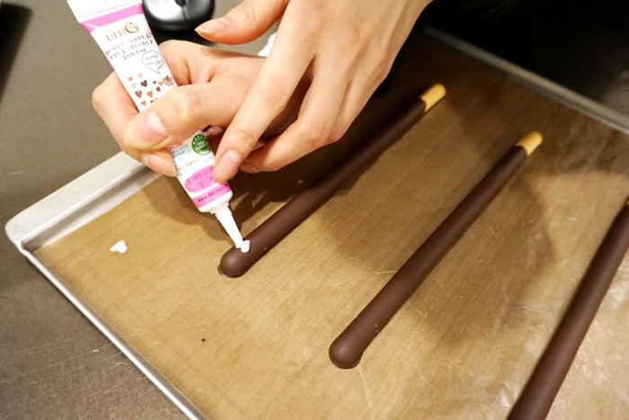
What should we do?
Third, form a monitoring team to follow up the recall process at any time.
Public food production process and selection of food raw materials.
Re-design the colour and style of the packaging or create a new product.

Slide 6
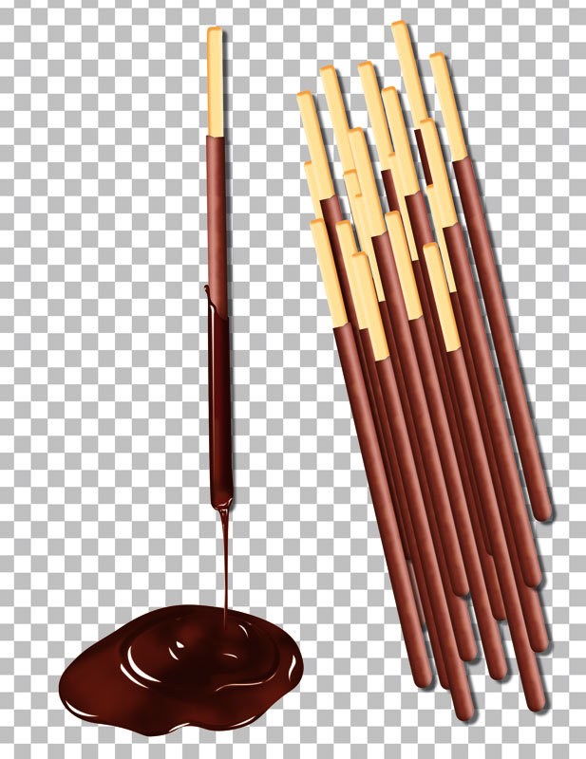
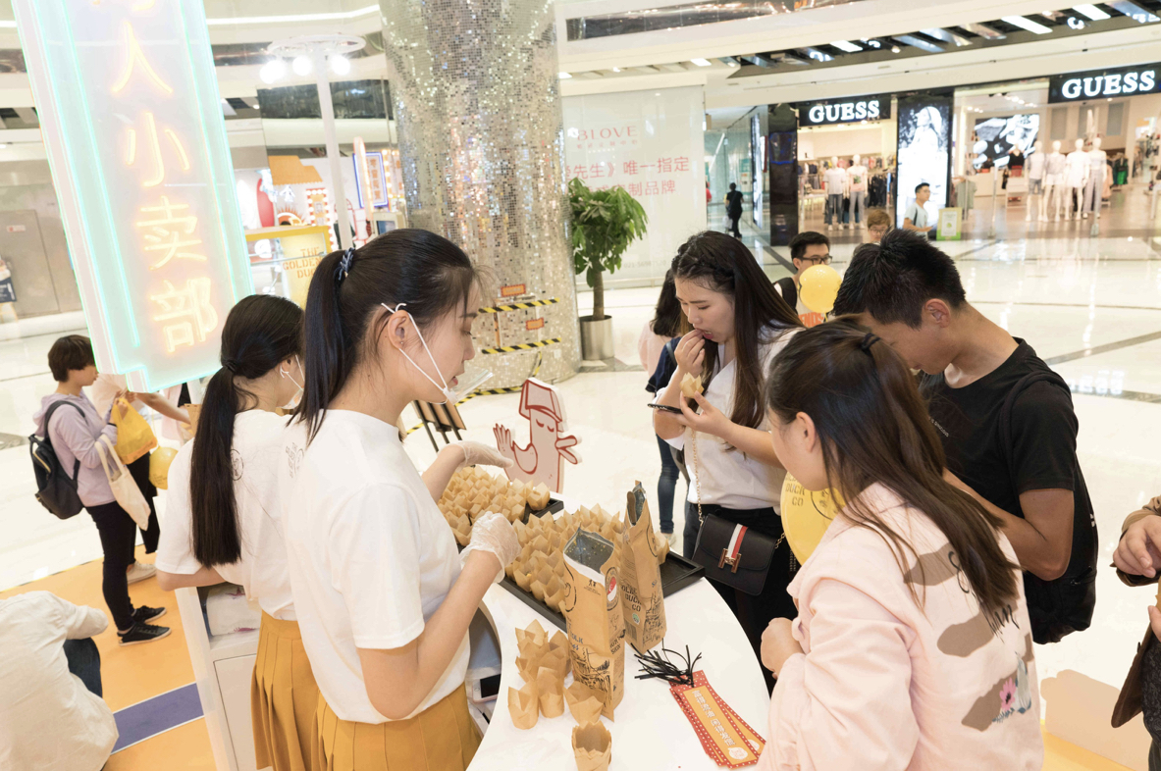
What we should do?
Last, emotional identity.
We need to humble ourselves and let customers feel “customer first” so that maybe they will forgive us.
Show our sincerity. (Launch store activities and interact with customers on social media.)

Slide 7
Thanks for watching

