Slide 1
React Next.js
Lecturer: Michael Dacey
E-mail: michael.dacey@uwtsd.ac.uk

Slide 2
React Server Components

Slide 3
Concepts
There are a few concepts we need to be familiar with:
  Client Side Rendering
  Server Side Rendering
  React Server Components
https://www.joshwcomeau.com/react/server-components/

Slide 4
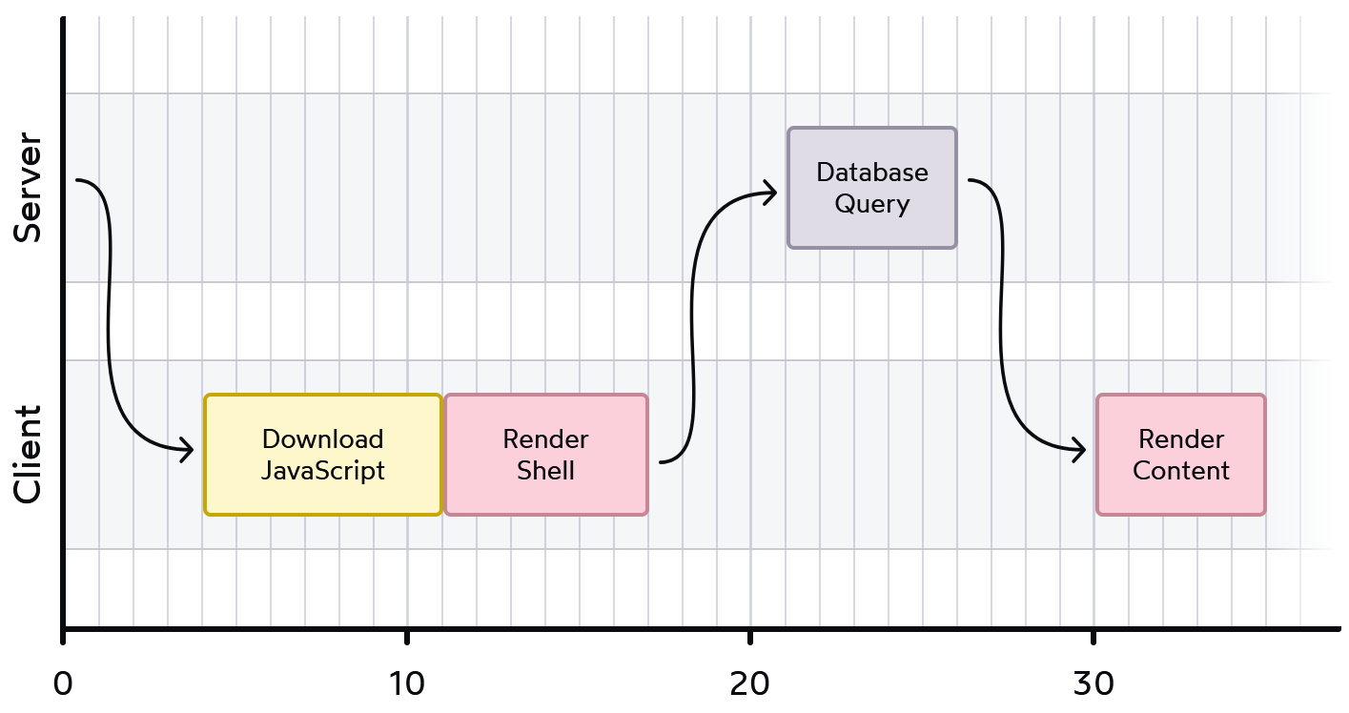
Client Side Rendering
In the client rendering approach, we load some basic HTML and a js file containing the JavaScript that uses React to update the contents of the page using the DOM
<!DOCTYPE html>
<html>
<body>
<div id="root"></div>
<script src="/static/js/bundle.js"></script>
</body>
</html>
The problem is the user gets to stare at a white screen while the js file is downloaded (can take some time for a big application) and then React renders all the components
This gets worse when we use a REST web service and have to read the data from the server before we render the page. We have to go back to the server again to get the data.
https://www.joshwcomeau.com/react/server-components/#bouncing-back-and-forth-2

Slide 5
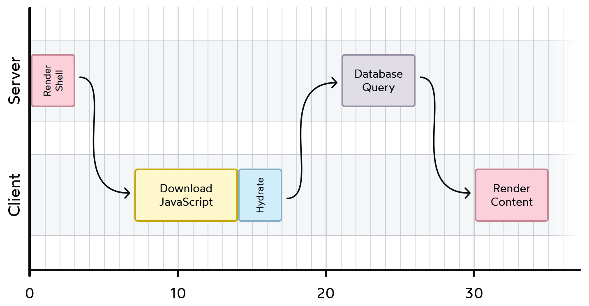
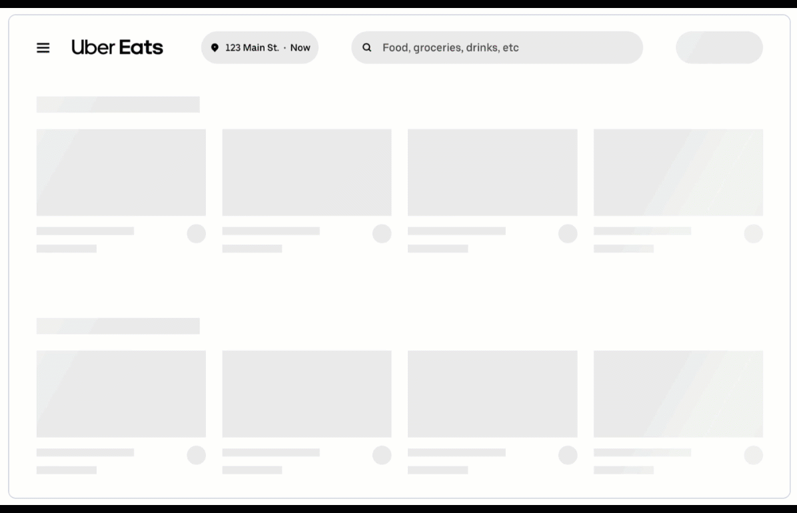
Server Side Rendering
Instead of sending an empty HTML page we render a HTML page at the server side and send this as the initial page content the user sees
This HTML will still include the <script> tag, since we still need React to run on the client and handle any interactivity.
React on the client now has to adopt the existing HTML that the server has sent to the browser. Known as hydration
“Hydration is like watering the “dry” HTML with the “water” of interactivity and event handlers.”
Dan Abramov
With this server side rendering approach, we still need to perform a round-trip to read the data and render parts of the page
A shell of a page is better than a blank page
Example: UberEats starts by rendering a shell while it fetches the data it needs to populate the actual restaurants

Slide 6
Static Site Generation
Kind of extreme server side rendering
Render all the components into HTML when we build the site
  “pre-rendered” all of the HTML for all of the different routes
  generate static (as in vanilla HTML and CSS) files
Next.js performs a version of this known as incremental static regeneration
  generate the “initial version” of the page statically during build time but are rebuild any page containing stale data after a user lands on it (i.e., the server request triggers the data check).
  That is, the server will serve new versions of that page statically in increments when needed
  However, it does not address the “stale content” symptom, where users may visit a page before it has finished being generated.

Slide 7
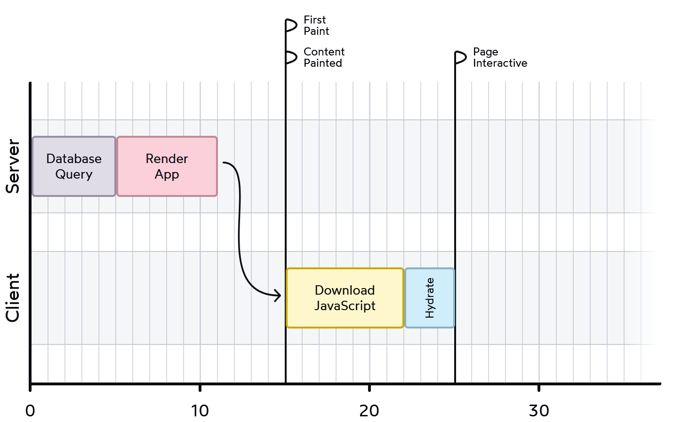
React Server Components
React Server Components allow us to execute database queries on the server side and populate the initial page with data before it is delivered to the browser avoiding the round trip back to the server to fetch this data.
Note: these components only really work when you use frameworks such as Next.js where server components are actually the default
The key thing to understand is this: Server Components never re-render.
They run once on the server to generate the initial page that is sent to the browser. As far as React running on the browser is concerned, this output is no longer changeable because the content was created on the server.
We cannot use state or effects because these component never run on the client

Slide 8
Client vs Server Components
React now allows us to render components at both the client and server side – server side components are not bundled and sent to the browser
Client Components are components in a render tree that are rendered on the client.
Server Components are components in a render tree that are rendered on the server.
Server components are the default.
With 'use client', you can determine when components are Client Components.
Note 1: Server Components are NOT denoted by "use server“ only server functions
Note 2: For server side rendering use the React Server API function renderToString but for the Server Components react creates an RSC Payload which is a special data format that the server generates as it renders the component tree to rendered HTML, placeholders where the Client Components should be rendered, references to the Client Components’ JavaScript files, instructions on which JavaScript files it should invoke and any props passed from a Server Component to a Client Component. Streaming allows react to progressively render the UI from the server. With RSCs, each component is capable of fetching its own data. Some components are fully static and ready to be sent immediately to the client, while others require more work before loading. Based on this, Next.js splits that work into multiple chunks and streams them to the browser as they become ready.
https://www.smashingmagazine.com/2024/05/forensics-react-server-components/

Slide 9
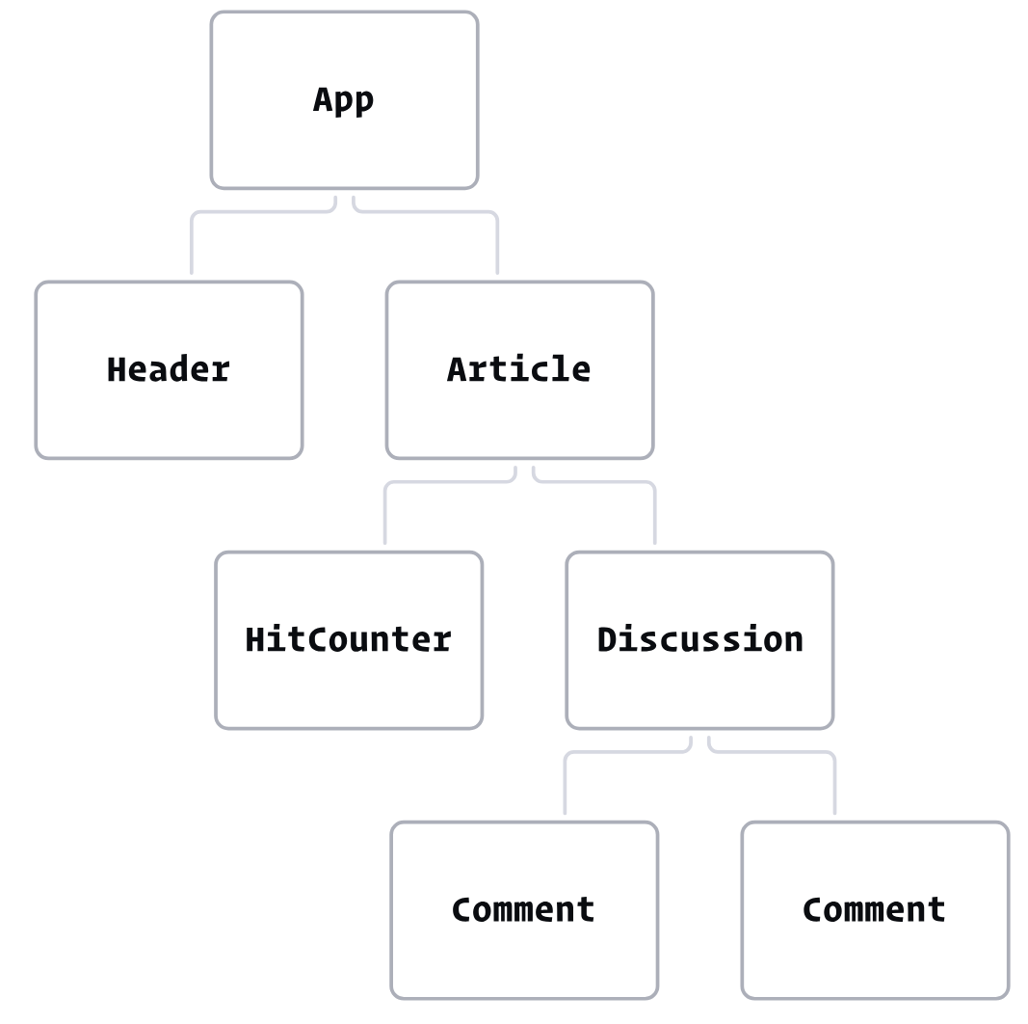
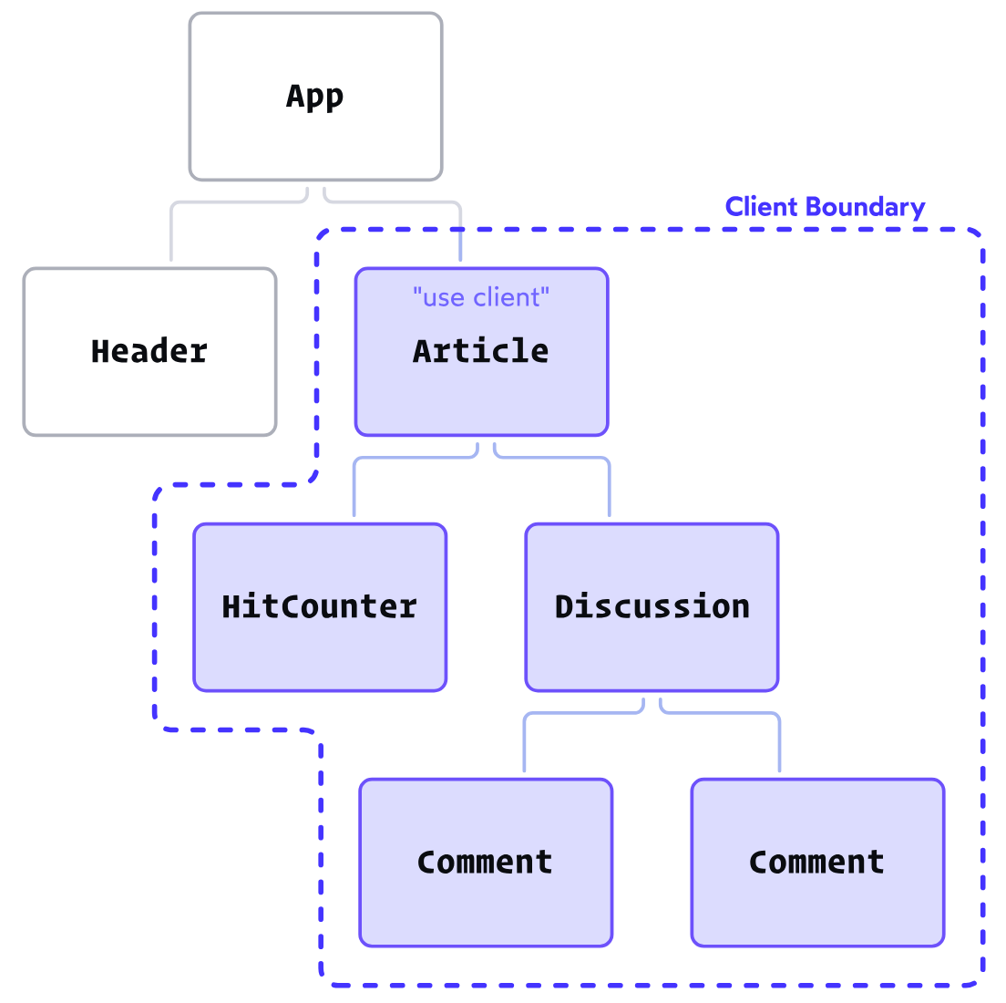
Client Components
When we add the 'use client' directive to the Article component, we create a “client boundary”.
All of the components within this boundary are implicitly converted to Client Components.
Even though components like HitCounter don't have the 'use client' directive, they'll still hydrate/render on the client in this particular situation.
This means we don't have to add 'use client' to every single file that needs to run on the client. In practice, we only need to add it when we're creating new client boundaries.

Slide 10
Next.JS Framework

Slide 11
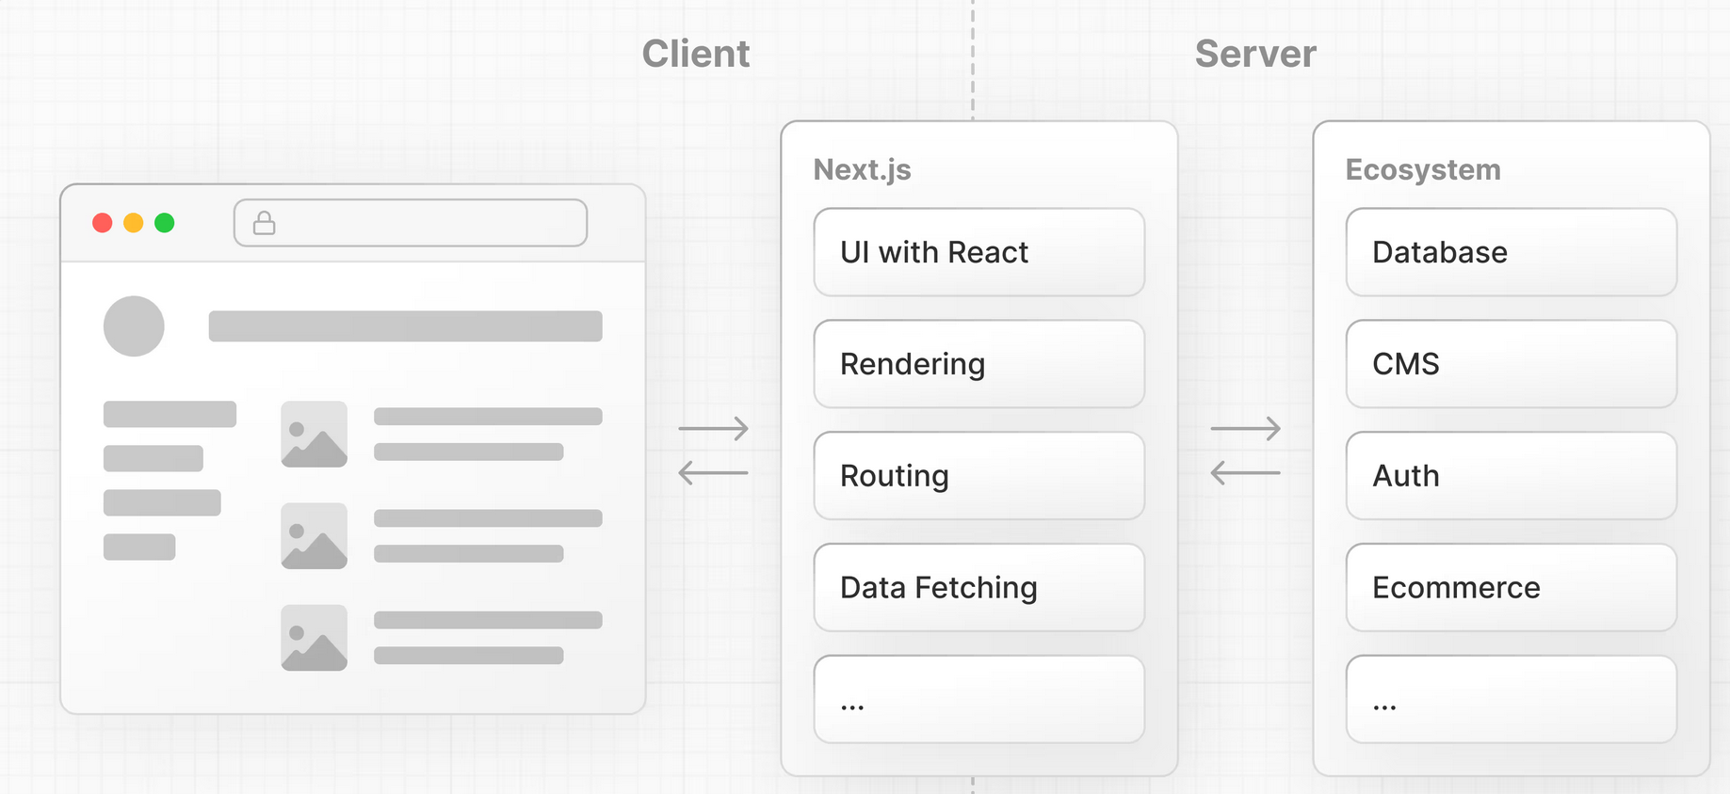
What is Next.js?
Next.js is a React framework that gives you building blocks to create web applications.
By framework, we mean Next.js handles the tooling and configuration needed for React, and provides additional structure, features, and optimizations for your application.
You can use React to build your UI, then incrementally adopt Next.js features to solve common application requirements such as routing, data fetching, and caching

Slide 12
Install Next.js
Create a new directory ReactNextJS
$ mkdir ReactNextJS
$ cd ReactNextJS
$ mkdir app
$ mkdir app/
$ mkdir app
$ mkdir public
Setup the node project
$ npm init --yes
Install react js and next.js
$ npm install react react-dom next
Create an page.tsx file in the app directory (see later page)
$ vi app/page.tsx
https://nextjs.org/learn/react-foundations/installation

Slide 13
Typescript
Next.js comes with built-in TypeScript support. To add TypeScript to your project, rename a file to .ts / .tsx then run next dev
  Next.js will automatically install the necessary dependencies and add a tsconfig.json file with the recommended config options.
Next.js comes with built-in ESLint, automatically installing the necessary packages (eslint and eslint-config-next) and creates a .eslintrc.json file (npm run lint)
https://nextjs.org/docs/app/getting-started/installation#set-up-typescript

Slide 14
Exercise
We will add some commands to the package.json file run the service
{
"name": "nodewebservice",
"version": "1.0.0",
"description": "Node.js web service example",
"main": "service.js",
"scripts": {
"test": "echo \"Error: no test specified\" && exit 1" ← Replace this line
},
"author": "Mike Dacey",
……
"scripts": {
"dev": "next dev",
"build": "next build",
"start": "next start",
"lint": "next lint"
},

Slide 15
Absolute Imports and Module Path Aliases
Next.js has in-built support for the "paths" and "baseUrl" options of tsconfig.json and jsconfig.json files.
These options allow you to alias project directories to absolute paths, making it easier to import modules.
  baseUrl: for absolute imports this defines the directory where the modules can be found
  paths: "alias" module paths.
tsconfig.json or jsconfig.json
Use alias
{
"compilerOptions": {
"baseUrl": "src/",
"paths": {
"@/styles/*": ["styles/*"],
"@/components/*": ["components/*"]
}
}
}
import { Button } from '@/components/button'
Each of the "paths" are relative to the baseUrl location.

Slide 16
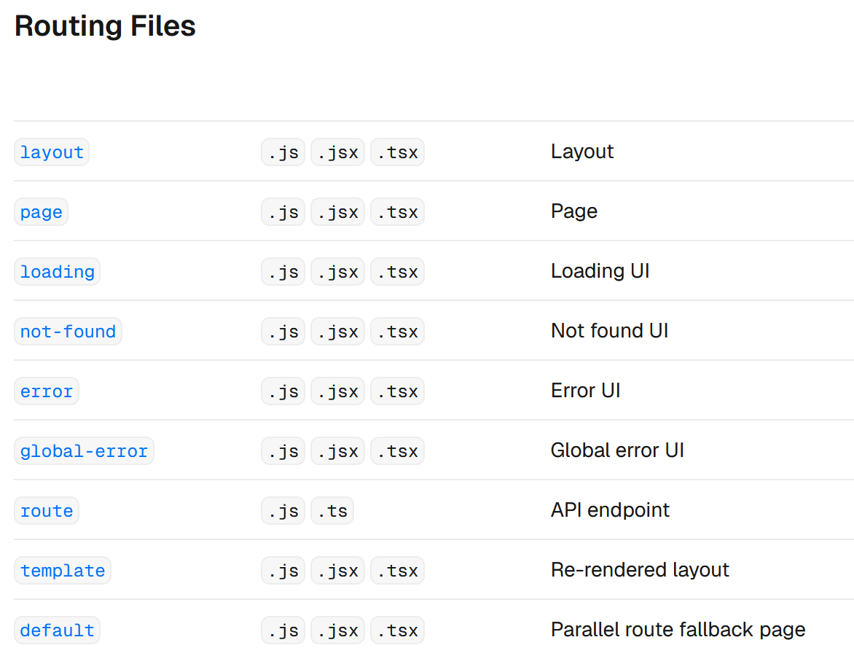
Add any of these to directory for a route

Slide 17
Exercise: layout.tsx
A new file called layout.tsx is automatically created inside the app folder to form the root layout for the app
We don’t need to change this, but this is where we define the html page where the react components are rendered.
app/layout.tsx
export const metadata = {
title: 'Next.js',
description: 'Generated by Next.js',
}
export default function RootLayout({ children }) {
return (
<html lang="en">
<body>
<p>Root Layout</p>
{children}
</body>
</html>
)
}

Slide 18
Exercise: app/page.tsx
https://nextjs.org/learn/react-foundations/installation
app/page.tsx
function Header({ title })
{
return <h1>{title ? title : 'Default title'}</h1>;
}
export default function HomePage()
{
const names = ['Ada Lovelace', 'Grace Hopper', 'Margaret Hamilton'];
return (
<div className={styles.shape}>
<Header title="Develop. Preview. Ship." />
<ul>
{names.map((name) => (
<li key={name}>{name}</li>
))}
</ul>
</div >
);
}
Create page.tsx:
This is a Server Side Component
$ npm run dev
Creates the tsconfig.json file for us

Slide 19
Exercise: tsconfig.json
Let’s update the file to point to setup aliases to the modules we are creating, etc.
/tsconfig.json
"compilerOptions": {
"baseUrl": "app/",
"paths": {
"@/components/*": ["components/*"],
"@/*": [“../public/*"]
},
"target": "ES2017",

Slide 20
Exercise: Add Client Side Component
Create a likebutton.tsx in the app/components directory
app/components/likebutton.tsx
'use client';
import { useState } from 'react';
export default function LikeButton() {
const [likes, setLikes] = useState(0);
function handleClick() {
setLikes(likes + 1);
}
return <button onClick={handleClick}>Like ({likes})</button>;
}

Slide 21
Exercise: Add Client Side Component
Add the LikeButton to the page.tsx file
app/page.tsx
import styles from './page.module.css';
import LikeButton from '@/components/likebutton’;
………
return (
<div className={styles.shape}>
<Header title="Develop. Preview. Ship." />
<ul>
{names.map((name) => (
<li key={name}>{name}</li>
))}
</ul>
<LikeButton />
</div >
);

Slide 22
Exercise: CSS
Add a page.module.css file to the app directory
Link it to the app/page.module.css must end in .module.css
app/page.tsx
app/page.module.css
import LikeButton from './likebutton';
import styles from ./page.module.css';
function Header({ title })
{
……..
return (
<div className={styles.shape}>
<Header title="Develop. Preview. Ship." />
<ul>
.shape {
background-color: lightblue;
}
public/global.css
app/layout.js
body {
background-color: lightpink;
}
import '@/global.css'
export const metadata = {
….

Slide 23
Image
The Next.js <Image> component extends the HTML <img> element to provide:
Size optimization: Automatically serving correctly sized images for each device, using modern image formats like WebP.
Visual stability: Preventing layout shift automatically when images are loading.
Faster page loads: Only loading images when they enter the viewport using native browser lazy loading, with optional blur-up placeholders.
Asset flexibility: Resizing images on-demand, even images stored on remote servers.
https://nextjs.org/docs/app/getting-started/images-and-fonts#optimizing-images

Slide 24
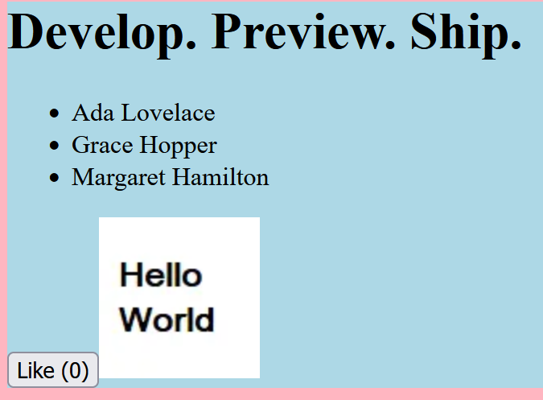
Exercise: Image
Add an Image component to page.jsx and an hello.png file to the public directory
app/page.tsx
import LikeButton from './likebutton';
import styles from './page.module.css';
import Image from 'next/image';
import helloPic from ‘@/hello.png'
…..
<LikeButton />
<Image src={helloPic} alt="hello" />
</div >
);
}

Slide 25
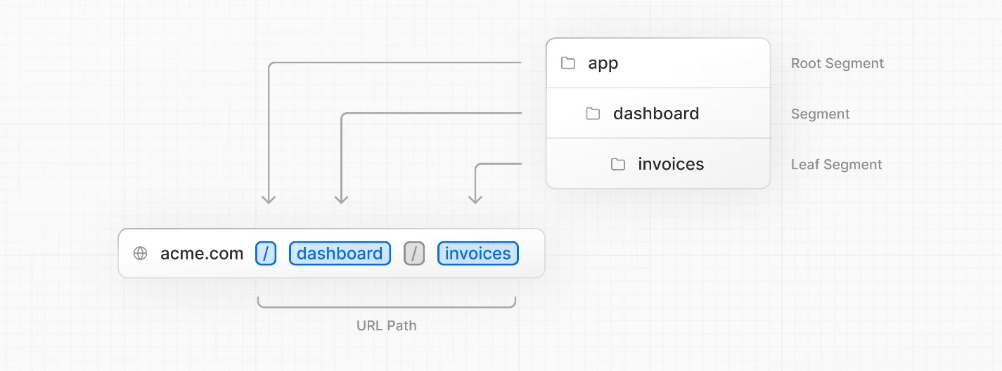
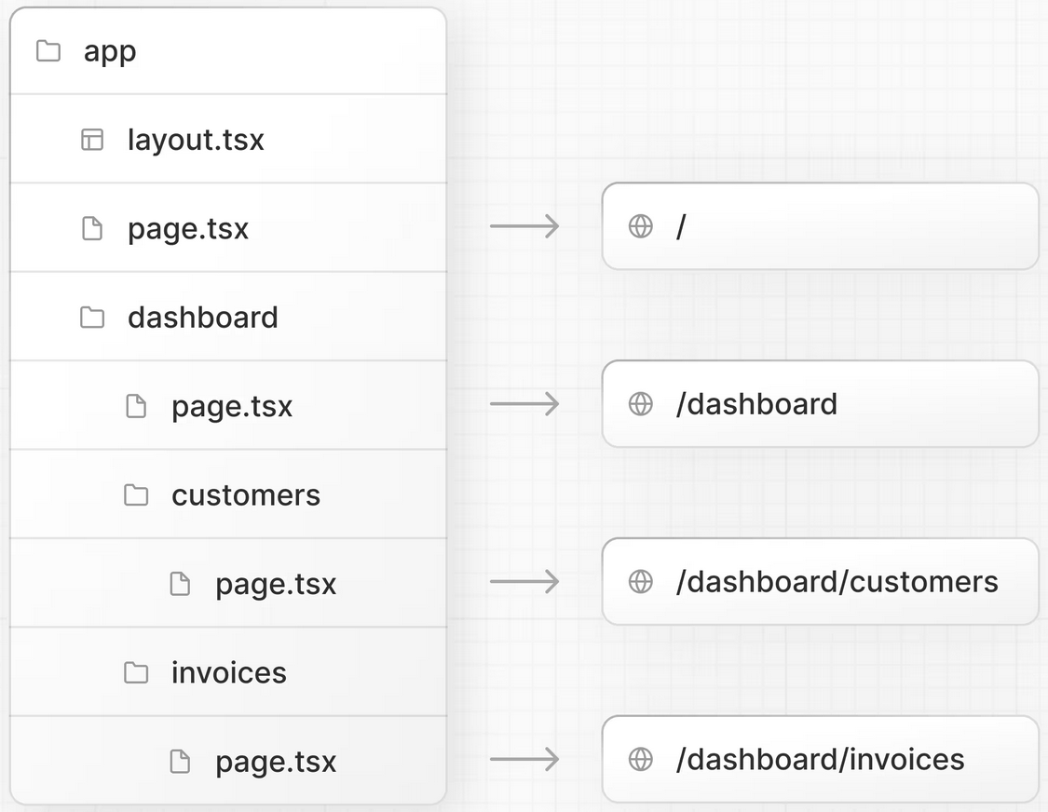
Nested Routing
Next.js uses file-system routing where folders are used to create nested routes. Each folder represents a route segment that maps to a URL segment.
You can create separate UIs for each route using layout.tsx and page.tsx files. /app/page.tsx is the home page associated with the route /
You can create separate UIs for each route using layout.tsx and page.tsx files.
/app/dashboard/page.tsx is associated with the /dashboard path.

Slide 26
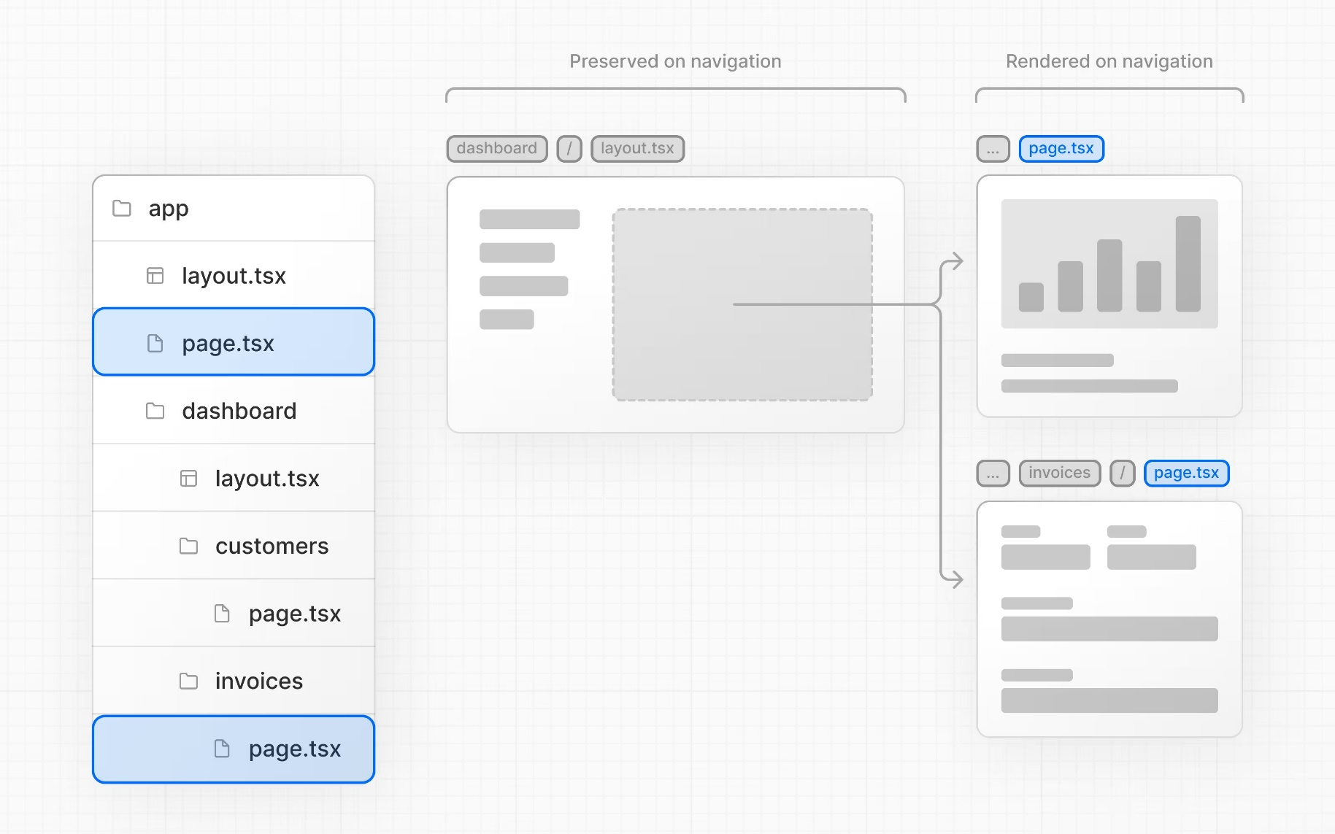
Layout
The <Layout /> component receives a children prop. This child can either be a page or another layout.
One benefit of using layouts in Next.js is that on navigation, only the page components update while the layout won't re-render.

Slide 27
Exercise: Add an “albums” Route
Create a new page.jsx and page.module.css file for an “albums” route
Making a new directory creates the route automatically
$ mkdir app/albums
Create an page.tsx file in the app/albums directory (see later page)
$ vi app/albums/page.tsx
← Automatically creates a route /albums
import styles from './page.module.css’;
import Link from 'next/link';
export default function AlbumsPage()
{
return (
<div className={styles.shape}>
<header>
<h1>Albums</h1>
</header>
<p>Albums</p>
</div >
);
}
app/albums/page.tsx
This is a server side component
app/albums/page.module.css
.shape {
background-color: lightcoral;
}

Slide 28
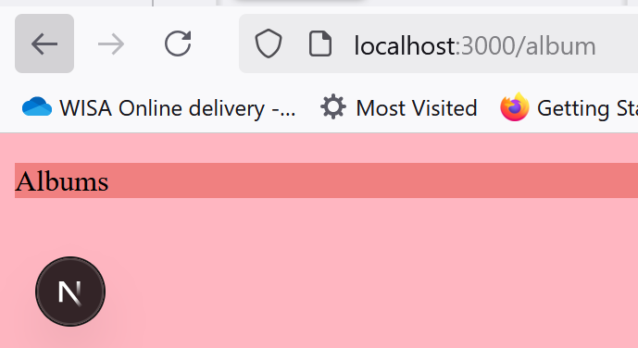
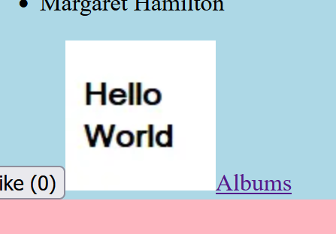
Exercise: Link (Cont)
Create a Link link to the root page.tsx file (equivalent to an anchor tag <a> in HTML) to route us to this albums page
app/page.tsx
import Image from 'next/image';
import helloPic from '@/hello.png'
import Link from 'next/link’
……
……
<LikeButton />
<Image src={helloPic} alt="hello" />
<Link href="/albums">Albums</Link>
</div >
);
}
Notice that the page content within the root layout has changed
Notice, this the route is the name of the directory
Root page
Albums page
Root layout
Root layout

Slide 29
Exercise: Using a Web Service
Using fetch we can read and display the data read from a web service
Remember this is a server side component
app/albums/page.tsx
……..
export default async function AlbumsPage()
{
const data = await fetch('https://jsonplaceholder.typicode.com/albums')
const albums = await data.json()
return (
<div className={styles.shape}>
………</header>
<ul>
{albums.map((album) => (
<li key={album.id}>{album.title} <Link href={`/photos/${album.id}`}>
Photos
</Link> </li>
))}
</ul>
</div >
);
}
This AJAX call is made from the server
JS template, use back ticks
I’ve sneaked in a Link here, we will get to this later
Replace the content after </header> tag

Slide 30
Exercise: Routing Parameters
Create a new “photos” route which requires a routing parameter “albumId” to select the album we are displaying
Add a page.tsx for this route
$ mkdir app/photos
$ mkdir app/photos/[albumId]
Create an page.tsx file in the app/photos directory (see later page)
$ vi app/photos/[albumId]/page.tsx
Yes, the directory name is [albumId]
Url: http://localhost:3000/photos/5
$ mkdir app/photos/[albumId]

Slide 31
Exercise: Reading Routing Parameter
app/photos/[albumId]/page.tsx
import styles from './page.module.css’;
interface IPhotosPromise {
params: Promise<{ albumId: number }>
}
export default function PhotosPage({ params } : IPhotosPromise)
{
const { albumId } = await params;
return (
<div className={styles.shape}>
<header>
<h1>Album Photos {albumId}</h1>
</header>
<p>Photos</p>
</div >
);
}
$ mkdir app/photos/[albumId]
Must match name of directory
app/photos/[albumId]/page.module.css
.shape {
background-color: lightgreen;
}

Slide 32
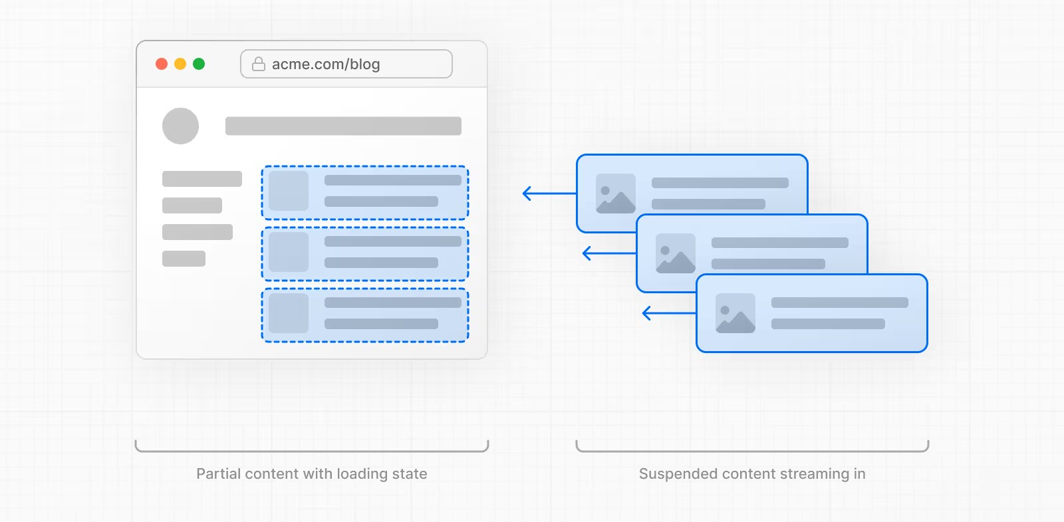
Streaming
To improve the initial load time and user experience, you can use streaming to break up the page's HTML into smaller chunks and progressively send those chunks from the server to the client.
When using async/await in Server Components, Next.js will opt into dynamic rendering.
There are two ways you can implement streaming in your application:
With the loading.tsx file
With React's <Suspense> component

Slide 33
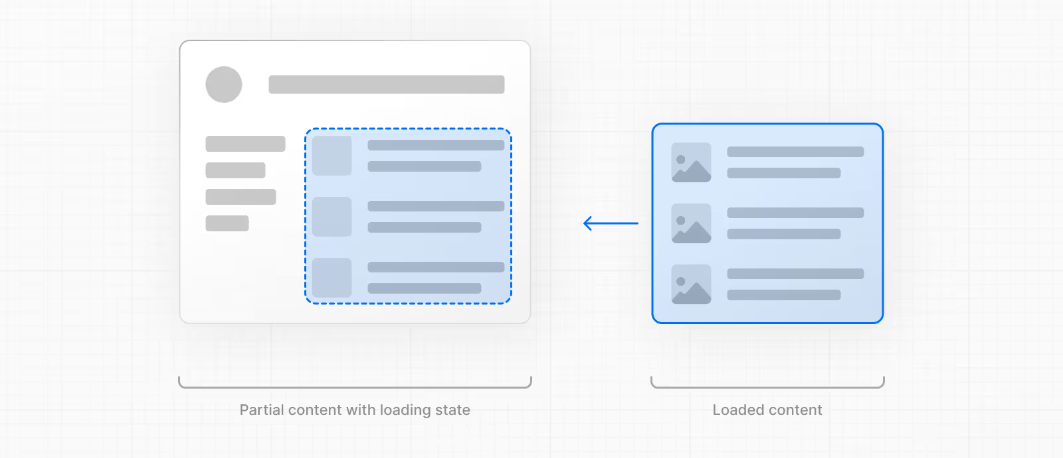
loading.tsx
Allows you to immediately display the layout and a “loading state”
The loading state can take the form of a page skeleton, spinner(s) or a small but meaningful part of future screens
The new content will then be automatically swapped in once rendering is complete.
export default function Loading()
{
// Define the Loading UI here
return <div>Loading photos...</div>
}
For example, we could pull in the first 10 photos and use spinners to suggest that the others are loading
https://nextjs.org/docs/app/getting-started/fetching-data#with-loadingjs

Slide 34
Exercise: <Suspense>
https://nextjs.org/docs/app/getting-started/fetching-data#with-suspense
<Suspense> allows you to be more granular about what parts of the page to stream.
For example, you can immediately show any page content that falls outside of the <Suspense> boundary, and stream in the list of photos inside the boundary.
app/photos/[albumId]/page.tsx
import styles from './page.module.css’;
import { Suspense } from 'react';
import PhotoList from '@/components/photolist';
import PhotoListSkeleton from '@/components/photolistskeleton’;
………
<div>
</header>
<main>
<Suspense fallback={<PhotoListSkeleton />}>
<PhotoList albumId={albumId} />
</Suspense>
</main>
</div >
This content goes to browser immediately
Replace the <div> content here!!!
This content is streamed to browser
We are using two new server component here, PhotoList and PhotoListSkeleton

Slide 35
Exercise: photolist.tsx
app/components/photolist.tsx
export default async function PhotoList(props) {
const data = await fetch(
`https://jsonplaceholder.typicode.com/photos?albumId=${props.albumId}`)
const photos = await data.json()
return (
<div>
<p>Photos downloaded for {props.albumId}</p>
<ul>
{photos.map((photo) => (
<li key={photo.title}>{photo.thumbnailUrl}</li>
))}
</ul>
</div >
);
}
This AJAX call is made from the server

Slide 36
Exercise: photolistskeleton.tsx
app/components/photolistskeleton.tsx
export default function PhotoListSkeleton(props) {
return (
<div>
<p>Images coming soon.....</p>
</div >
);
}
Essentially the same as loading.tsx

Slide 37
Exercise: Server Functions
Server functions allow us to perform CRUD operations using webservices
You can add them to separate files e.g. in a “actions” directory, or embed them directly in a component.
Note: these can be used by Client Components but only if they are imported from a file with the "use server" directive at the top of it.
Create a new app/lib and app/actions directories where we can create files for these functions
$ mkdir app/lib
Not all Server Functions are Server Actions, action prop or called from inside an action then it is a Server Action. We will Server Actions in an “actions” directory
$ mkdir app/actions
"paths": {
"@/components/*": ["components/*"],
"@/*": ["../public/*"],
"@/lib/*": ["lib/*"],
"@/actions/*": ["actions/*"]
},
Modify tsconfig.json to find these directories

Slide 38
Exercise: Add Album
Add a Link to the album page to create a new album
app/albums/page.tsx
import styles from './page.module.css';
import Link from 'next/link’;
……..
return (
<div className={styles.shape}>
<header>
<h1>Albums</h1>
<Link href="/albums/newalbum">Add Album</Link>
</header>}

Slide 39
Exercise: Add Album (Cont)
Add new newalbum directory to the albums directory
$ mkdir app/albums/newalbum
app/albums/newalbum/page.tsx
'use client';
import styles from './page.module.css';
import { useState, useActionState } from 'react';
import { createAlbumAction } from '@/actions/albums_actions';
export default function AlbumsPage() {
const [userId, setUserId] = useState(101);
const [albumId, setAlbumId] = useState(101);
const [title, setTitle] = useState('');
const [message, formAction, isPending] = useActionState(createAlbumAction, ‘’);
CONTINUE ON NEXT SLIDE…
We are using useActionState so we can display “loading” or any error that may occur
app/albums/newalbum/page.module.css
.shape {
background-color: lightskyblue;
}

Slide 40
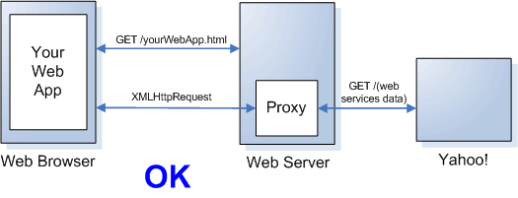
CROSS ORIGIN POST
Here the Server Action (Function) is acting as a server-side proxy
  The web server makes the web service request on behalf of the client
createAlbumAction
https://jsonplaceholder.typicode.com/albums

Slide 41
Exercise: Add Album (Cont)
app/albums/newalbum/page.tsx
….. CONTINUE
return (
<div className={styles.shape}>
<header>
<h1>New Album</h1>
</header>
<main>
<form action={formAction}>
…TO BE ADDED
</form>
</main>
</div>
);
}
Use the action state function
(The alternative is to pass the Server Action function directly but you will not get any status messages to display that way)

Slide 42
Exercise: Add Album (Cont)
app/albums/newalbum/page.tsx
<form action={formAction}>
<label htmlFor="userid-numberbox">User Id:</label>
<input id="userid-numberbox" name="userid-numberbox" type="number" min="1“
max="101“ value={userId} onChange={(e) => setUserId(Number(e.target.value))} />
<br />
<label htmlFor="id-numberbox">Album Id:</label>
<input id="id-numberbox" name="id-numberbox" type="number" min="1"
max="101“ value={albumId} onChange={(e) => setAlbumId(Number(e.target.value))} />
<br />
<label htmlFor="title-textbox">Album Title:</label>
<input id="title-textbox" name="title-textbox" type="text"
value={title} onChange={(e) => setTitle(e.target.value)} />
<br />
<input type="submit" value="Create Album" />
<br/>{isPending ? "Loading..." : message}
</form>
Display “loading…” or error message

Slide 43
Exercise: Server Function
Add Server Function to the lib directory
app/lib/albums_functions.tsx
'use server'
export interface IAlbumData {
userId: number,
id: number,
title: string
}
export default async function createAlbum(data: IAlbumData) {
try {
SEE NEXT SLIDE….
}
catch (error) {
throw new Error(error.message);
}
}
This is the data we need to add an Album

Slide 44
Exercise: Server Function (Cont)
app/lib/albums_functions.tsx
try {
const response = await fetch('https://jsonplaceholder.typicode.com/albums', {
method: 'POST',
headers: {
'Content-Type': 'application/json'
},
body: JSON.stringify(data)
});
if (!response.ok)
throw new Error(`Response status: ${response.status}`);
return response.json()
}

Slide 45
Exercise: Server Action
Add a Server Action (Function) to handle the form action (it is passed a FormData object)
We will add this to the actions directory to distinguish this from the Server Function but this is not strictly necessary
app/actions/albums_functions.tsx
'use server'
import createAlbum, { IAlbumData } from '@/lib/albums_functions';
import { redirect } from 'next/navigation'
// We add a state argument here so that we can use useActionState later
// and add a spinner or "loading.." message
export async function createAlbumAction(state: string, formData: FormData) {
CONTINUES ON NEXT SLIDE…
}
Because we are using useActionState, we are passed the current state argument. We will return strings.

Slide 46
Exercise: Server Action
app/actions/albums_functions.tsx
export async function createAlbumAction(state: string, formData: FormData) {
let data: IAlbumData = {
userId: parseInt(formData.get('userid-numberbox').toString()),
id: parseInt(formData.get('id-numberbox').toString()),
title: formData.get('title-textbox').toString()
};
try
{
await createAlbum(data);
return 'Added album';
}
catch (error)
{
return error.message;
}
}
The “state” messages to be displayed to the user. This is why we made the “state” a string argument.

Slide 47
Alternative…
If you don’t need to display a “loading…” message (or spinner) or error messages, then you don’t need to use useActionState and you can supply the Service Action function directly to the form like this…
app/albums/newalbum/page.tsx
'use client';
import styles from './page.module.css';
import { useState, useActionState } from 'react’; ← NOT REQUIRED
import { createAlbumAction } from '@/actions/albums_actions';
export default function AlbumsPage() {
const [userId, setUserId] = useState(101);
const [albumId, setAlbumId] = useState(101);
const [title, setTitle] = useState('');
const [message, formAction, isPending] = useActionState(createAlbumAction, ‘’);
CONTINUE ON NEXT SLIDE…
NOT REQUIRED

Slide 48
Alternative….(Cont)
app/albums/newalbum/page.tsx
….. CONTINUE
return (
<div className={styles.shape}>
<header>
<h1>New Album</h1>
</header>
<main>
<form action={createAlbumAction}>
…TO BE ADDED
</form>
</main>
</div>
);
}
Use Server Action directly not through useActionState

Slide 49
Alternative…(Cont)
Change the Service Action since we no longer pass in the previous state in the first argument and we cannot return any messages including errors so we need to redirect() to another route instead.
app/actions/albums_functions.tsx
'use server'
import createAlbum, { IAlbumData } from '@/lib/albums_functions';
import { redirect } from 'next/navigation'
export async function createAlbumAction(formData: FormData) {
let data: IAlbumData = {
userId: parseInt(formData.get('userid-numberbox').toString()),
id: parseInt(formData.get('id-numberbox').toString()),
title: formData.get('title-textbox').toString()
};
await createAlbum(data);
redirect('/albums’);
}
Only passed the form data
Redirect to display the albums again
Let error.tsx catch any errors

Slide 50
Server Side vs Client Side
Server Side Components are the recommended approach so use them as often as possible
  Of course, if we have event handlers in our component (such as a button) because the user interacts with it, then it will need to be a client side component
However, let’s say we want to call a webservice from the client directly
We have two options:
  Add our own AJAX calls
  Call a Server Function from the client
  Next.JS automatically realises the function has to be packed and transferred to the client
Note: for client-side components you cannot directly call async functions.
Instead, you will need to call them indirectly through hooks such as useActionState and useEffect

Slide 51
Client Component with Library
You can use a 3rd party community library to perform AJAX
For example, we can combine Axios and React Query leveraging React Query's caching and state management capabilities with Axios's flexible HTTP client
import { useQuery } from 'react-query';
import axios from 'axios';
const fetchDataWithAxios = async () => {
const { data } = await axios.get('https://api.example.com/data');
return data;
};
const MyComponent = () => {
const { data, error, isLoading } = useQuery('fetchData', fetchDataWithAxios);
if (isLoading) return Loading...;
if (error) return Error fetching data;
return Data: {JSON.stringify(data)};
};
https://codeparrot.ai/blogs/axios-vs-react-query-comparison

Slide 52
Example
'use client';
import { useState, useActionState } from 'react’;
……….
async function handleInsert(state: string, data: FormData) {
……….
}
export default function PhotoInsert(props) {
……….
const [message, formAction, isPending] = useActionState(handleInsert, ‘ ‘);
return (
<form action={formAction}>
Calls this function when the form is submitted
It gives us a function to supply to the form action

Slide 53
Example: AJAX
We can add our own async function that will be called when the form is submitted using an AJAX library of your choice or the built in fetch library
async function handleInsert(state: string, data: FormData) {
let json: IPhotoData = {
albumId: parseInt(data.get('albumIdSelect').toString()),
…. Read the form data that was submitted
};
try {
const response = await fetch('https://jsonplaceholder.typicode.com/photos', {
method: 'POST',
headers: {
'Content-Type': 'application/json'
},
body: JSON.stringify(json)
});
…….
return "Successfully added photo";
}
catch (error) {
return error.message;
}
}
Send the form data as JSON to the web service
The “state” is typically just a string that we can display, but in principal you can choose the type you need to represent thprincipleeet and new state

Slide 54
Example: Server Function
We can call a Server Function from the client-side. This can be useful since we can share code between Server-Side and Client-Side components
'use client’;
import {createPhoto} from '@/lib/photo_functions’;
async function handleInsertFunction(state: string, data: FormData) {
let json: IPhotoData = {
albumId: parseInt(data.get('albumIdSelect').toString()),
…. Read the form data that was submitted
};
try {
await createPhoto(json);
return "Successfully added photo";
}
catch (error) {
return error.message;
}
}
The server function can be used in this client side component
Send the form data as JSON to the web service
'use server’
export async function createPhoto(data: IPhotoData) {
try {
const response = await fetch(
'https://jsonplaceholder.typicode.com/photos', {
method: 'POST',
headers: {
'Content-Type': 'application/json'
},
body: JSON.stringify(data)
});
……
}
}
This AJAX call is made from the client

