Slide 1

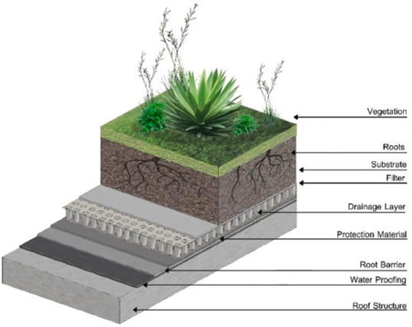



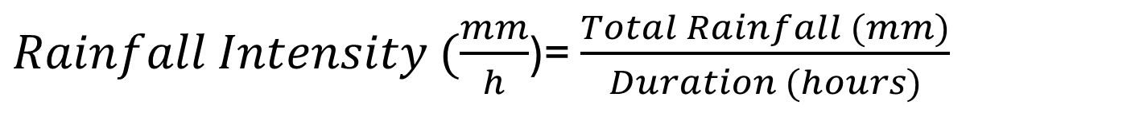
Comparing Green Roof and Traditional Roof Runoff
Introduction
Tomos Butterworth
Methodology
Urbanisation has increased impermeable surfaces, placing immense pressure on sewage systems. Sustainable Urban Drainage Systems (SuDS) aim to address this by replicating natural surfaces, allowing for ground infiltration (CIRIA, 2015).
Green roofs are described as a natural ecosystem, reducing runoff volume and improving water quality. With rainfall increasing, the dependence on natural alternatives has also increased.
This study evaluates how green roofs can effectively reduce pollutant concentrations compared with traditional roofing systems, with a particular focus on South Wales
This research will compare green roofs and traditional roofs and evaluate the pollutant concentrations between the two. By conducting a comparative analysis of runoff from both roof types, it allows for a more location- specific conclusion
When testing heavy metal concentrations, Atomic Absorption Spectroscopy (AAS) will be used due to efficiency in testing water quality (Thomas, 2025), and for nutrient testing, spectrophotometry (colourimetric test) will be undertaken due to its accuracy (Mettler Toledo, n.d.).
The research will be over the course of 14 weeks, allowing for ample time for sampling different rainfall intensities, laboratory testing, and data analysis, as shown in figure 2.
Aims & Objectives
Figure 1. The layers of a typical green roof (Mihalakakou et al, 2023)
Literature Review
Figure 2. The research timeline
Research Aim-
To evaluate the extent to which green roofs could reduce pollutant concentrations, including nitrates, phosphates, and heavy metals in urban water runoff compared with traditional roofing systems in South Wales.
Research Objectives-
To identify and characterise the heavy metals and contaminants, such as zinc, copper, nickel, nitrogen, and phosphorus, most frequently reported in urban roof runoff.
To analyse the influence of design on the filtration of rainwater and retention of impurities.
To conduct a comparative analysis of rainwater runoff quality between traditional and green roofs.
Runoff from traditional roofs contributes to water pollution, carrying nutrients (nitrogen, phosphorus) and heavy metals into waterways, causing eutrophication and damaging aquatic ecosystems.
Key Findings
Green roofs can reduce runoff volume, slowing water flow and helping limit pollutant transport. Research has shown reductions in nitrogen and heavy metals. However, results vary—green roofs may initially release nutrients before stabilising.
Conclusion
Green roofs have the potential to improve urban water quality naturally, while depending on their design, age, and the environmental conditions.
Expected Outcomes
The test results should indicate that green roofs reduce runoff volume and delay peak flow compared to traditional roofs. They may also lower pollutant and heavy metal concentrations. However, performance can vary, with green roofs acting as a source of nutrients and metals under certain conditions, particularly during early stages or during heavy rainfall. pH levels are expected to be comparable to traditional roofs, staying within acceptable limits.
References
CIRIA (2015) The SuDS manual (C753). London, CIRIA, p51.
Mettler Toledo (n.d.) UV/Vis Water Testing. Available at: https://www.mt.com/us/en/home/applications/Application_Browse_Laboratory_Analytics/uv-vis-spectroscopy/uv-vis-water-testing.html (Accessed: 7 April 2026).
Mihalakakou, G. Souliotis, M. Papadaki, M. Menounou, P. Dimopoulos, P. Kolokotsa, D. Paravantis, J. A. Tsangrassoulis, A. Panaras, G. Giannakopoulos, E. and Papaefthimiou, S. (2023) ‘Green roofs as a nature-based solution for improving urban sustainability: Progress and perspectives’, Renewable and Sustainable Energy Reviews, 180. Available at: https://www.sciencedirect.com/science/article/pii/S1364032123001624#abs0015 (Accessed: 3 May 2026).
Thomas, R. (2025) Atomic Absorption Spectrophotometry (AAS): Principles, Instrumentation, and Comparisons with Other AS Techniques. Available at: https://www.sepscience.com/atomic-absorption-spectrophotometry-aas-principles-instrumentation-and-comparisons-with-other-as-techniques-12134 (Accessed: 3 May 2026).
$Rainfall Intensity (\frac{mm}{h}$)= $\frac{Total Rainfall (mm)}{Duration (hours)}$

