Slide 1
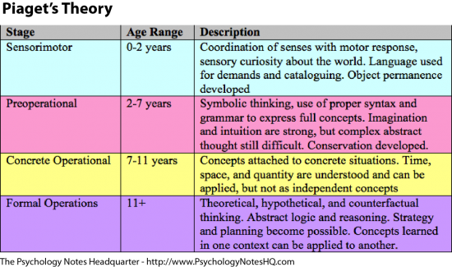
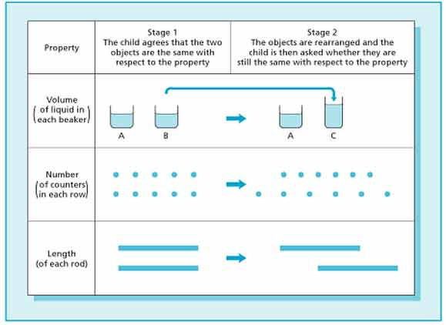
Jean Piaget – Cognitive Development
By Rebecca Crane
^{Who is Jean Piaget?}
The Four Stages
Experiment Example
Criticisms
Piaget was born in Switzerland in 1896, he was the eldest of his siblings. His father worked in a university as a professor for medieval literature, having a father in the education field may have helped Piaget to develop his own intelligence further from a young age. He would have likely had more emphasis put on and its importance. At age eleven whilst he was a pupil in school he wrote a short piece on an albino sparrow, many predicted from this paper that Piaget would one day have a great career in science. Their predications were right as Piaget is well known as a psychologist and epistemologist and also a pioneer of child development. He is best known for his work on cognitive development.
Piaget said that there were four stages to his cognitive theory, each stage split by age and showing how the children’s mental process develops. He was able to create these stages by observing children playing, Piaget was a constructivist and he believed that children, must learn by conducting their own understanding.
A well-known experiment that Piaget would carry out during observations is conservation of number, from doing the following experiments Piaget found that children seven and under lacked the ability to see that the quantity doesn’t change when the objects are moved around.
Wood (2008) stated, “Piaget underestimated children’s abilities”. It is said that some of the tasks set by Piaget were abstract and most children would be able to do a simpler task and show proof of using the same skills. So some of his tasks actually made children seem less able.
Piaget also makes it seem like children think in one way regardless of the task, he believed that whatever his stage said for that particular age group was a mirror of what the child should act and think like, and he didn’t see that children could develop at different paces without skipping a stage.
The reliability of Piaget’s work is questionable due to the fact he only used small groups (Mostly white Swedish children) for his observation, he also studied his own children which means he may have been bias and he didn’t really take in to account the fact that not all children are the same and they aren’t all brought up the same so they have different cultural backgrounds and social groups.
Having stages of development can be seen as unrealistic and theorists (Vygotsky and Bruner) who looked at Piaget’s work have not looked at stages at all because they have said that development is a continual process.
Mcleod (2012) said that “40-60% of college students fail at formal operation tasks. Only one third of adults reach the formal operational stage in life.” An example of a task could be “If Ben is taller than Alex and Alex is taller than Joe, who is tallest?”, Some people will always find tasks like this confusing and not everyone can give the correct answer. Piaget believed that twelve plus year olds in the formal operational stage should be able to do maths, creative thinking, be able to reason and work out outcomes of actions without ever experiencing it for themselves, some children may be twelve plus but still in the concrete operational stage and this is shown if the child needs to use objects or draw and write things down instead of being able to just use their head.
(PSYCHOLOGY NOTES HQ · JUNE 11, 2017)
(https://www.simplypsychology.org/concrete-operational.html)
^{What is Cognitive development?}
Schema
Looking at the second experiment children under seven would be able to count the counters and understand that there is the same number of counters but when one row is spread out they would get confused as when something is longer it is usually bigger so they would ignore the fact that they know there is the same number of counters and they would say that the spread-out line has more counters because it looks longer than the other row. This way process of thinking shows us how differently children think in comparison to adults. This experiment was a great one for Piaget because he was able to try it on children of all ages and compare the results to prove his four-stage theory right.
Cognitive development is how a child’s thought process allows them to see a “mental model of the world”, Piaget believed that intelligence was not a fixed trait and that cognitive development occurred “due to biological maturation and interaction with the environment”. (McLeod, 2015)
Piaget’s interest in cognitive development was peaked when he was working for Binet Institute, his job role required him to develop questions based on English intelligence tests and also to grade them. Piaget was curious about the reasons children provided for getting wrong answers to questions that required them to think logically.
Manichander (2016, P.89) states that Piaget was the first to methodically study cognitive development. Even studying his own children. He has contributed to observational studies on child cognition, helped with a series of inventive tests that have been able to show different cognitive abilities. “According to Piaget, children are born with a very basic mental structure (genetically inherited and evolved) on which all subsequent learning and knowledge is based.”
Piaget (1952) explains that a schema is "a cohesive, repeatable action sequence possessing component actions that are tightly interconnected and governed by a core meaning”.
According to McLeod (2015) Piaget also refers to schemas as the “basic building blocks of intelligent behaviour – a way of organising knowledge.”
The schema is just the beginning for what makes an object e.g. Four legs it must be a chair.
As the child matures they will learn to adjust their knowledge by using their original schema, assimilation is the word used to describe this. The child knows that a chair has four legs but this time this particular “chair” is very tall and the seat is much smaller, what the child is experiencing now is accommodation, if explained to that this new object is a stool because of its new characteristics e.g. the height, the child has now adapted their original schema and now understands the difference between a chair and a stool.
Equilibration allows children to keep understanding their schema after it has been accommodated and as they mature they are able to make schemas for new objects much easier through assimilation and will also find it easier to accommodate in the future.
Support
Piaget has faced a lot of criticism and a lot of it because his work was made many years ago and he was one of the first to actually look into cognitive development and have his work on it published. The methods Piaget used may have been dated but at the time this was all he knew. It has been proven that Piaget’s work changed the development of psychology and the way psychologists work today, he is heavily criticised for describing his theory and not explaining it but because of this he left unanswered questions that have influenced many others to find answers too. Piaget’s work is a start to the wonders of cognitive development and many theorists have developed on his work and actually changed and adapted it with new knowledge and improvements in technology allowing scientists to understand the brain and thought processes better.
Piaget’s work has also been used in schools, although it’s not concrete that children learn in age stages, schools have adapted his theory and made it possible for children to learn things that relate to their age and thinking process, milestones have been created and children are encouraged to learn through play which is something Piaget saw as important as having the appropriate stimuli and environment for each age is crucial to cognitive development.

