Slide 1
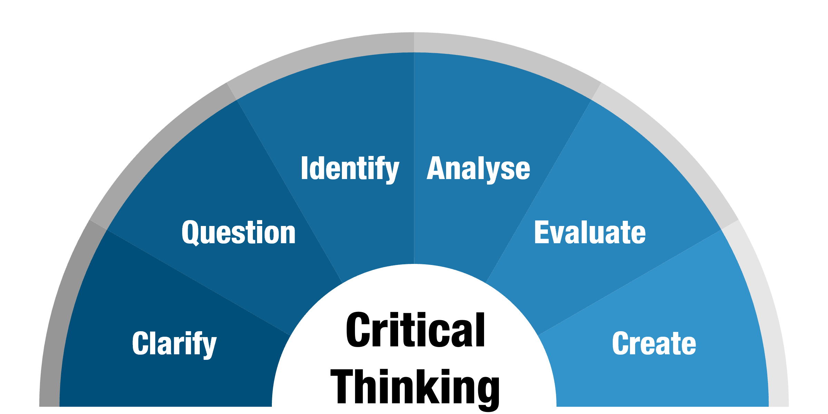
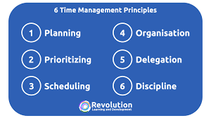

What is critical thinking?
When becoming a student at university you need to be able to complete deeper research into information you find. You must be able to show how you query information, ideas, and arguments that you collate for your studies and have an open mind when learning. (Leeds University 2022)
Eales-Reynolds. Et al. (2013) believes that critical thinking is a process where we must think about all eventualities before we conclude our thoughts.
Cottrell (2017) agrees with this and believes that “critical thinking is a complex process of deliberation which involves a wide range of skills and attributes”
Source: Monash
University (2022)
Google Search
Critical Thinking
Natalie Herdman 2213358 EGCE4005PJC
Note taking
It is often said that students in Higher Education will need to acquire several different skills to develop within their academic studies one of these is note taking.
Godfrey (2018) believes that for you to understand the information that you are reading a practical approach to note taking is essential. Godfrey (2018) suggests five tips for note taking which aids the readers understanding and note taking skills. These are making notes that are relevant to your research, referencing as you go along, making logs of when you copy words or use your own, making your notes useful and finally reviewing what notes you have and questioning the relevance.
In addition, Cottrell (2019) has examples of how to take effective notes during research such as leaving space in notes to allow for further information, using sticky notes with key points that you want to add into your work, keeping one set of notes and using abbreviations. All these examples will help students develop an understanding of the information that they have read and collated.
Time management
Mind Skills (2022) state that time management is a way in which you construct and plan how you are going to breakdown your time between different activities. If one manages to get the balance right, it could reduce stress and increase performance.
Forsyth, P. (2013) says that there are four categories that help with the organisation of time, they are, planning – this is imperative to time keeping, it enables you to have a clear view of what you need to achieve, so that you can then move on to the implementation of the tasks. Monitoring and control are also crucial to the process to ensure that you are on the right track with your work and lastly communication and dealing with people this is something which can be challenging as to complete certain tasks requires focus and interruptions can become disruptive, but people can also provide support to certain challenges, which could alleviate any time management issues.
Cottrell (2019) has a range of activities to support students who are struggling with time management. She states that students are in control of their time and finding the work life balance can be very difficult but stresses the importance of making time for all aspects of life not just work and studies.
Source: The
Revolution
Learning
(2022)
Google
Search
Researching and managing information
Becoming an academic student, you will need to be able to find information from credible sources to aid with your course. Researching is something we do in everyday life without even realising whether it is finding the cheapest electronic product or finding how to guides to fix things. However, as an academic student you need to show a deeper understanding of the need for credible sources.
Cottrell (2017) stresses the importance of ensuring that you check the sources that you are going to use in the work so that they stand up to scrutiny.
Cottrell (2019) also demonstrates ways to support these processes, such as using Google Scholar, using University reading lists and library for additional sources such as journals and articles. Cottrell (2019) also demonstrates ways in which you can condense the work you find to make it more manageable.
Source: Pbc Publications
(2022) Google search
Conclusion
To conclude to become a critical thinker you have to gain a variety of new skills to assist in your learning, The skills that have been discussed in this poster will enable students to understand the importance of finding reliable sources of information and to critically assess them for currency, relevancy, authority, accuracy and purpose. (Scribbr 2022). Students will also need to develop their note taking skills to ensure that they are noting relevant information which is needed for each assignment they undertake and lastly students will need to learn how to manage their time effectively, so that they are not rushing to complete work and ensuring that they have time for other areas of their lives too.

Slide 2
Reference List
Cottrell, S (2017) Critical Thinking Skills : Effective analysis, argument and reflection. 3rd edn. London: Palgrave.
Cottrell, S. (2019) The Study Skills Handbook. 5th edn. London: Red Glo be Press.
Eales-Reynolds, L.J.et al. (2013) Critical Thinking skills for education students. 2nd edn. London: SAGE Publications Ltd.
Forsyth, P. (2013) Successful time management. 3rd edn. London: Kogan Page Ltd.
Greedham, B. (2018) How to write better essays. 4th edn. London: Palgrave
Godfrey, J. (2018) How to use your reading in your essays. 3rd edn. London: Palgrave.
Levin, P. (2007) Skillful time management. 1st edn. Berkshire: Bell and Bain Ltd Glasgow.
MindSkills (2022) What is time management?. Available at: https://www.mindtools.com/pages/article/newHTE_00.htm (Accessed 19 September 2022)
Pbc publicconsulting media (no date) Publication formats and the information lifecycle. [Image]. Available at: https://www.publicconsulting.com/wordpress/choosingsources/chapter/publication-formats-and-the-information-cycle/ (Accessed 24 September 2022)
Scribbr (2022) Applying the CRAPP Test and Evaluating Sources. Available at: https://www.scribbr.com/working-with-sources/craap-test/#:~::text=The%20CRAPP%20%20test (Accessed 20 September 22)
The 6 principles of effective time management (2022) [Image]. www.revolutionlearning.co.uk/blog/the-6-principles-of-effective-time-management/ (Accessed 21 September 2022)
University of Leeds (2022) What is critical thinking?. Available at:- https://library.leeds.ac.uk/info/140/academic_skills/105/critical-thinking (Accessed 29 September 2022)
What is critical thinking? (2022) [Image]. https://monash.edu/learnhq/enhance-your-thinking/critical-thinking/what-is-critical-thinking (Accessed 19 September 2022)

